Slide 1
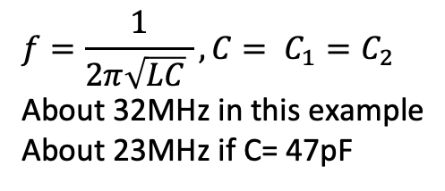
YD-1485
1N4001
2N6121
1K
2.7K
100uF
1000 uF
2N3904
10K
1N5247
Variable power supply
9v
Colpitts
C₁ (22 pF)
1K
.1 uF
L (1uH)
47K
C₂=C₁
.1uF
$$f=\frac{1}{2π\sqrt{LC} }, C= C_{1}=C_{2}$$
About 32MHz in this example
About 23MHz if C= 47pF
2.7K
100

