Slide 1
Cryptanalysis
Elliptic Curves and Lattices
John Manferdelli
JohnManferdelli@hotmail.com
© 2004-2020, John L. Manferdelli.
This material is provided without warranty of any kind including, without limitation, warranty of non-infringement or suitability for any purpose. This material is not guaranteed to be error free and is intended for instructional use only.

Slide 2
Elliptic Curves
Motivation:
Full employment act for mathematicians
Elliptic curves over finite fields have an arithmetic operation
Index calculus doesn’t work on elliptic curves.
Even for large elliptic curves, field size is relatively modest so arithmetic is faster
.
Use this operation to define a discrete log problem.
To do this we need to:
Define point addition and multiplication on an elliptic curve
Find an elliptic curve whose arithmetic gives rise to large finite groups with elements of high order
Figure out how to embed a message in a point multiplication.
Figure out how to pick “good” curves.

Slide 3
Rational Points
Bezout
Linear equations
x²+5y²=1
y²=x³-ax-b
Disconnected: y²= 4x³-4x +1
Connected: a= 7, b=-10
Troublesome: a=3, b=-2
Arithmetic
D= 4a³-27b²
Genus, rational point for g>1
Mordell
Z_{n[1]}xZ_{n[2]}, n[2]|n[1], n[2]|(p-1)

Slide 4
Equation solving in the rational numbers
Linear case: solve ax+by=c or, find the rational points on the curve C: f(x,y)= ax+by-c=0.
Clearing the fractions in x and y, this is equivalent to solving the equation in the integers. Suppose (a,b)=d, there are x, yÎZ: ax+by=d. If d|c, say c=d’d, a(d’x)+b(d’y)=d’d=c and we have a solution. If d does not divide c, there isn’t any. We can homogenize the equation to get ax+by=cz and extend this procedure, here, because of z, there is always a solution.
Quadratic (conic) case: solve x²+5y²=1 or find the rational points on the curve C: g(x,y)= x²+5y²-1=0.
(-1,0)ÎC. Let (x,y) be another rational point and join the two by a line: y= m(x+1). Note m is rational. Then x²+5(m(x+1))²=1 and (5m²+1) x²+2 (5m²)x+(5m²-1)= 0 → x²+2 [(5m²)/(5m²+1)] x + [(5m²-1)/(5m²+1)]= 0. Completing the square and simplifying we get (x+(5m²)/(5m²+1)) ²= [25m⁴ –(25m⁴ -1)]/(5m²+1)²= 1/(5m²+1)². So x= ±(1-5m²)/(5m²+1) and substituting in the linear equation, y= ±(2m)/(5m²+1). These are all the solutions.
Cubic case is more interesting!

Slide 5
Bezout’s Theorem
Let deg(f(x,y,z))=m and deg(g(x,y,z))=n be homogeneous polynomials over C, the complex numbers and C₁ and C₂ be the curves in CP², the projective plane, defined by:
C₁ = {(x,y,z): f(x,y,z)=0}; and,
C₂ = {(x,y,z): g(x,y,z)=0}.
If f and g have no common components and D=C₁∩C₂, then ∑_{x𝝴D} I(C₁ ∩ C₂,x)=mn.
I is the intersection multiplicity. This is a fancy way of saying that (multiple points aside), there are mn points of intersection between C₁ and C₂. There is a nice proof in Silverman and Tate, Rational Points on Elliptic Curves, pp 242-251. The entire book is a must read.
A consequence of this theorem is that two cubic curves intersect in nine points.

Slide 6
Elliptic Curve Preliminaries -1
Let K be a field. char(K) is the characteristic of K which is either 0 or p^{n} for some prime p, n>0.
F(x,y)= y²+axy+by+cx³+dx²+ex+f is a general cubic.
F(x,y) is non-singular if F_{x}(x,y) or F_{y}(x,y) ≠ 0.
If char(K)≠2,3, F(x,y)=0 is equivalent to y²= x³+ax+b which is denoted by E_{K}(a, b) and is called the Weierstrass equation.
Note that the intersection of a line (y=mx+d) and a cubic, E_{K}(a,b) is 1, 2 or 3 points.
Idea is: given 2 points, P,Q on a cubic, the line between P and Q generally identifies a third point on the cubic, R.
Two identical points on a cubic generally identify another point which is the intersection of the tangent line to the cubic at the given point with the cubic.
The last observation is the motivation for defining a binary operation (addition) on points of a cubic.

Slide 7
Elliptic Curve Preliminaries - 2
We are most interested in cubics with a finite number of points.
Cubics over finite fields have a finite number of points (duh).
E_{K}(a,b) is an elliptic equation over the “affine plane.”
It is often easier to work with elliptic equations over the “projective plane”. The projective plane consists of the points (a,b,c) (not all 0) and (a,b,c) and (ad,bd,cd) represent the same point.
The map (x,y,1)→(xz,yz,z) sets up a 1-1 correspondence between the affine plane (plus the “infinities”) and the projective plane.
E_{K}(a,b) is zy²= x³+axz²+bz³. Note these are homogeneous equations.
The points (x,y,0) are called the line at infinity.
The point at infinity, (0,1,0) is the natural “identity element” O and its introduction is less “ad hoc.”

Slide 8
Elliptic Curves
A non-singular Elliptic Curve is a curve, having no multiple roots, satisfying the equation: y²=x³+ax+b.
The points of interest on the
curve are those with rational coordinates which can be combined using the “addition” operation.
These are called “rational points.”
Graphic by Richard Spillman

Slide 9
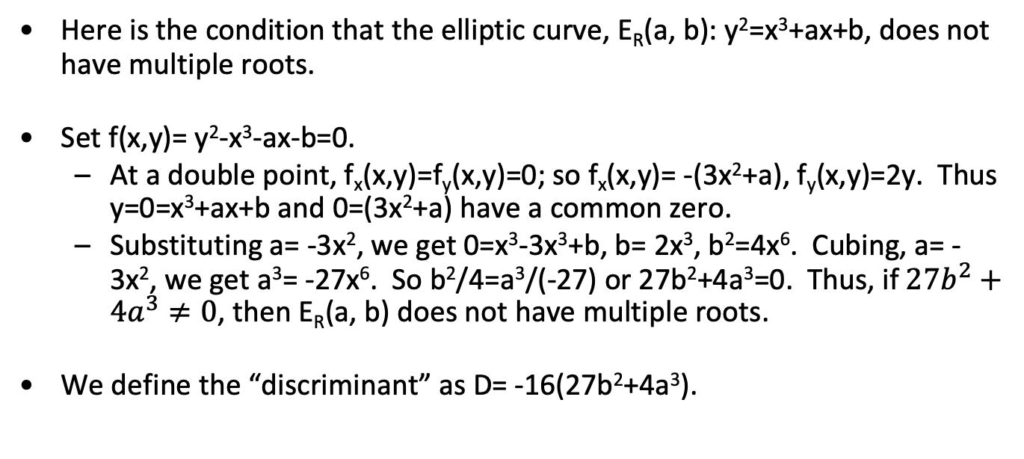
Multiple roots
Here is the condition that the elliptic curve, E_{R}(a, b): y²=x³+ax+b, does not have multiple roots.
Set f(x,y)= y²-x³-ax-b=0.
At a double point, f_{x}(x,y)=f_{y}(x,y)=0; so f_{x}(x,y)= -(3x²+a), f_{y}(x,y)=2y. Thus y=0=x³+ax+b and 0=(3x²+a) have a common zero.
Substituting a= -3x², we get 0=x³-3x³+b, b= 2x³, b²=4x⁶. Cubing, a= -3x², we get a³= -27x⁶. So b²/4=a³/(-27) or 27b²+4a³=0. Thus, if$27b^{2}+4a^{3}≠0$, then E_{R}(a, b) does not have multiple roots.
We define the “discriminant” as D= -16(27b²+4a³).

Slide 10
Elliptic curve addition
The addition operator on a non-singular elliptic curve maps two points, P and Q, into a third “P+Q”. Here’s how we construct “P+Q” when P≠Q .
Construct straight line through P and Q which hits E at R.
P+Q is the point which is the reflection of R across the x-axis.
R
Q
P
P+Q
Graphic by Richard Spillman

Slide 11
Addition for points P, Q in E_{R}(a, b) - 1
Suppose we want to add two distinct points P and Q lying on the curve E_{R}(a, b): y²=x³+ax+b, where P=(x₁, y₁) and Q=(x₂, y₂) with P≠Q, then P+Q=R=(x₃, y₃).
Suppose x₁≠x₂, here is the computation: Join P and Q by the line y=mx+u. m=(y₂-y₁)/(x₂-x₁). u= (mx₁-y₁)= (mx₂-y₂).
Substituting for y into E_{R}(a, b), we get (mx+u)²=x³+ax+b
0= x³-m²x+(a-2mu)x+b-u².
x₁, x₂, x₃ are the roots of this equations so m²= x₁+x₂+x₃.
x₃= m²-x₁-x₂. P*Q= (x₃, -y₃)
-y₃= -mx₃–u= -m(x₃) -(mx₁-y₁)= m(x₁–x₃)–y₁.
To summarize, if P≠Q (and x₁≠x₂):
x₃= m²–x₁–x₂
y₃= m(x₁–x₃)–y₁
m= (y₂-y₁)/(x₂-x₁)

Slide 12
Multiples in Elliptic Curves 1
P+P (or 2P) is defined in terms of the tangent to the cubic at P.
Construct tangent to P and reflect the point in y at which it intercepts the curve (R) to obtain 2P.
P can be added to itself
k times resulting in a point Q = kP.
P+P= 2P
P
R
Graphic by Richard Spillman

Slide 13
Addition for points P, Q in E_{R}(a, b) - 2
Suppose we want to add two distinct points P and Q lying on the curve E_{R}(a, b): y²=x³+ax+b, where P=(x₁, y₁) and Q=(x₂, y₂) and x₁=x₂.
Case 1, y₁≠y₂: In this case, y₁=-y₂ and the line between P and Q “meet at infinity,” this is the point we called O and we get P+Q=O. Note Q=-P so –(x,y)=(x,-y).
Case 2, y₁=y₂ so P=Q: The slope of the tangent line to E_{R}(a, b) at (x₁, y₁) is m. Differentiating y²=x³+ax+b, we get 2y y’= 3x₂+a, so m=(3x₁²+a)/(2y₁). The addition formulas on the previous page still hold.

Slide 14
Addition in E_{R}(a, b) - summary
Given two points P and Q lying on the curve E_{R}(a, b): y²=x³+ax+b, where P=(x₁, y₁) and Q=(x₂, y₂) with P≠Q, then P+Q=R=(x₃, y₃) where:
If x₁≠x₂, m=(y₂-y₁)/(x₂-x₁), and
x₃ =m² – x₁ – x₂
y₃ =m(x₁ –x₃) – y₁
If x₁=x₂ and y₁≠y₂, then y₁=-y₂ and P+Q=O, Q= -P
If x₁=x₂ and y₁=y₂, then P=Q, R=2P, m=(3x₁²+a)/(2y₁), and
x₃ =m² –x₁–x₂
y₃ =m(x₁ –x₃)–y₁

Slide 15
Point multiplication in E_{R}(a, b)
By using the doubling operation just defined, we can easily calculate P, 2P, 4P, 8P ,…, 2eP and by adding appropriate multiples calculate nP for any n.
If nP=O, and n is the smallest positive integer with this property, we say P has order n.
Example:
The order of P=(2,3) on E_{R}(0,1) is 6.
2P=(0,1), 4P= (0,-1), 6P=O.

Slide 16
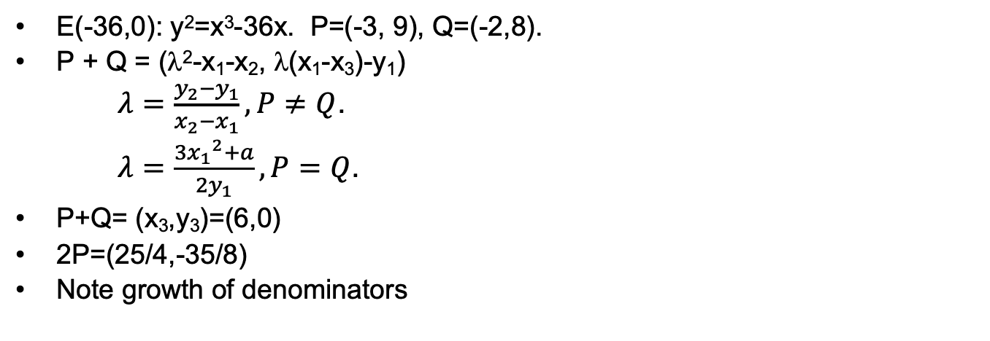
Example of Addition and Element Order
E(-36,0): y²=x³-36x. P=(-3, 9), Q=(-2,8).
P + Q = (λ²-x₁-x₂, λ(x₁-x₃)-y₁)
$λ=\frac{y_{2}−y_{1}}{x_{2}−x_{1}}, P≠Q$.
$λ=\frac{3{x_{1}}^{2}+a}{{2y}_{1}}, P=Q$.
P+Q= (x₃,y₃)=(6,0)
2P=(25/4,-35/8)
Note growth of denominators

Slide 17
Proof of group laws
From the formulas and definitions it is easy to see the operation “+” is commutative, O acts like an identity and if P= (x,y), -P= (x,-y) with P+(-P)= O.
Associativity is the only law that’s hard to verify. We could use the formulas to prove it but that’s pretty ugly.
There is a shorter poof that uses the following result: Let C, C₁, C₂ be three cubic curves. Suppose C goes through eight of the nine intersection points of C₁∩C₂, then C also goes through the ninth intersection point.

Slide 18
Associativity
If P and Q are points on an elliptic curve, E, let P*Q denote the third point of intersection of the line PQ and E.
Now let P, Q, R be points on an elliptic curve E. We want to prove (P+Q)+R=P+(Q+R). To get (P+Q), form P*Q and find the intersection point, between P*Q and E and the vertical line through P*Q; this latter operation is the same as finding the intersection of P*Q, O (the point at infinity) and E. To get (P+Q)+R, find (P+Q)*R and the vertical line, the other intersection point with E is (P+Q)+R. A similar calculation applies to P+(Q+R) and it suffices to show (P+Q)*R=P*(Q+R). O,P,Q,R, P*Q, P+Q, Q*R, Q+R and the intersection of the line between (P+Q), R and E lie on the two cubics:
C₁: Product of the lines [(P,Q), (R,P+Q), (Q+R, O)]
C₂: Product of the lines [(P,Q+R), (P+Q,O), (R,Q)]
The original curve E goes through eight of these points, so it must go through the ninth [ (P+Q)*R]. Thus the intersection of the two lines lies on E and (P+Q)*R= P*(Q+R).
This proof will seem more natural if you’ve taken projective geometry. You could just slog out the algebra though.

Slide 19
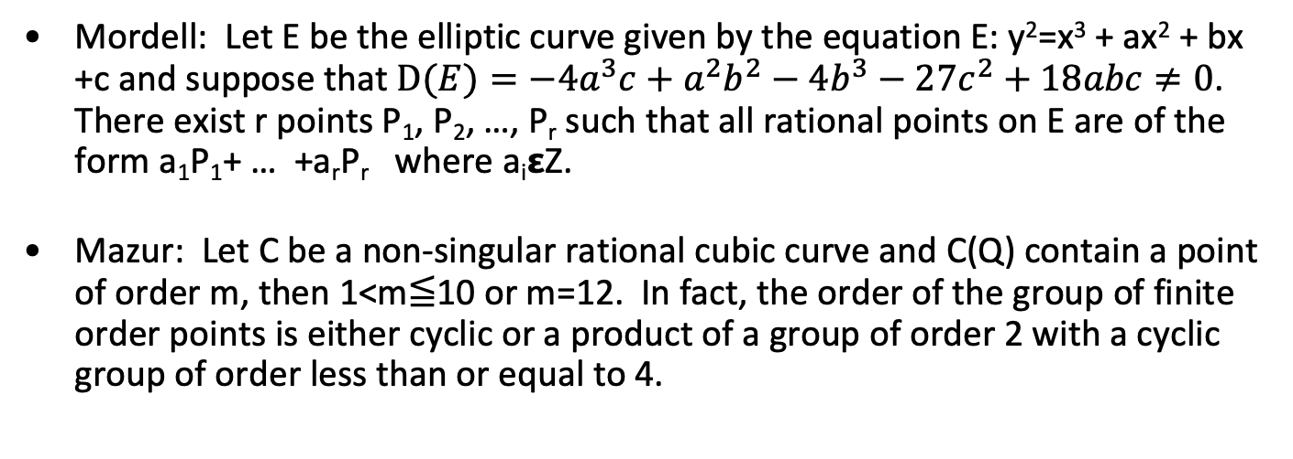
Mordell and Mazur
Mordell: Let E be the elliptic curve given by the equation E: y²=x³ + ax² + bx +c and suppose that $D(E)=−4a^{3}c+a^{2}b^{2}−4b^{3}−27c^{2}+18abc≠0$. There exist r points P₁, P₂, …, P_{r} such that all rational points on E are of the form a₁P₁+ … +a_{r}P_{r} where a_{i}𝝴Z.
Mazur: Let C be a non-singular rational cubic curve and C(Q) contain a point of order m, then 1<m≦10 or m=12. In fact, the order of the group of finite order points is either cyclic or a product of a group of order 2 with a cyclic group of order less than or equal to 4.

Slide 20
Fermat’s Last Theorem
x^{n}+y^{n} = z^{n} has no non-trivial solutions in Z for n>2.
It is sufficient to prove this for n=p, where p is an odd prime.
Proof (full version will be on HW):
Suppose A^{p}+B^{p}=C^{p}, (A,B,C)=1.
E_{AB}: y² = x(x+A^{p})(x+B^{p})
Wiles: E_{AB} is modular.
Ribet: E_{AB} is too weird to be modular.
Fermat was right.

Slide 21
Why elliptic curves might be valuable in crypto
Consider E: y²= x³+17. Let P_{n}=(A_{n}/B_{n}, C_{n}/D_{n}) be a rational point on E. Define ht(P_{n})= max(|A_{n}|, |B_{n}|).
Define P₁= (2,3), P₂= (-1,4) and P_{n+1}= P_{n} + P₁.
n | ht(P_{n})
1 | 2
2 | 1
3 | 4
4 | 2
5 | 4
6 | 106
7 | 2228
n | ht(P_{n})
8 | 76271
9 | 9776276
10 | 3497742218
20 | 8309471981636130322638066614339972215969861310
In fact, ht(P_{n})≅(1.574)^{ns}, ns=n².
Example from Silverman, A Friendly Introduction to Number Theory.

Slide 22
Points on elliptic curves over F_{q}
The number of points N on E_{q}(a,b) is the number of solutions of y²=x³+ax+b.
For each of q x’s there are up to 2 square roots plus O, giving a maximum of 2q+1. However, not every number in F_{q} has a square root. In fact, N= q+1+∑_{x}χ(x³+ax+b), where χ is the quadratic character of F_{q}.
Hasse’s Theorem: |N–(q+1)|≤2√q where N is the number of points
E_{q}(a,b) is supersingular if N= (q+1)-t, t= 0,q, 2q, 3q or 4q.
The abelian group formed by addition in E_{q}(a,b) does not need to be cyclic, although it often is; it can always be decomposed into cyclic groups. In fact, if G is the Elliptic group for E_{q}(a,b).
Theorem: G=Z_{p} x Z/Zpª x Z/Zq^{b} .
Example: E₇₁(-1,0). N= 72, G is of type (2,4,9).

Slide 23
E₇₁(-1, 0) – Spot the Group
There are 72 points on the curve. Can you spot (2, 4, 9). Points:
Order Point
[ 1] O
[ 2] ( 0, 0)
[ 2] ( 1, 0)
[ 9] ( 2, 19)
[ 9] ( 2, 52)
[ 18] ( 3, 38)
[ 18] ( 3, 33)
[ 9] ( 4, 42)
[ 9] ( 4, 29)
[ 18] ( 5, 7)
[ 18] ( 5, 64)
[ 6] ( 9, 62)
[ 6] ( 9, 9)
[ 36] (12, 56)
[ 36] (12, 15)
[ 4] (13, 14)
[ 4] (13, 57)
[ 18] (14, 23)
Order Point
[ 18] (14, 48)
[ 3] (19, 38)
[ 3] (19, 33)
[ 36] (21, 62)
[ 36] (21, 9)
[ 18] (23, 28)
[ 18] (23, 43)
[ 36] (27, 42)
[ 36] (27, 29)
[ 12] (32, 54)
[ 12] (32, 17)
[ 36] (33, 7)
[ 36] (33, 64)
[ 18] (35, 58)
[ 18] (35, 13)
[ 9] (37, 8)
[ 9] (37, 63)
[ 12] (40, 42)
Order Point
[ 12] (40, 29)
[ 36] (41, 62)
[ 36] (41, 9)
[ 18] (42, 8)
[ 18] (42, 63)
[ 36] (43, 21)
[ 36] (43, 50)
[ 36] (45, 49)
[ 36] (45, 22)
[ 36] (46, 37)
[ 36] (46, 34)
[ 18] (47, 51)
[ 18] (47, 20)
[ 18] (49, 38)
[ 18] (49, 33)
[ 12] (51, 16)
[ 12] (51, 55)
[ 18] (53, 47)
Order Point
[ 18] (53, 24)
[ 36] (54, 28)
[ 36] (54, 43)
[ 12] (55, 31)
[ 12] (55, 40)
[ 6] (56, 41)
[ 6] (56, 30)
[ 4] (60, 10)
[ 4] (60, 61)
[ 36] (61, 2)
[ 36] (61, 69)
[ 6] (63, 8)
[ 6] (63, 63)
[ 36] (64, 27)
[ 36] (64, 44)
[ 36] (65, 28)
[ 36] (65, 43)
[ 2] (70, 0)

Slide 24
Addition for points P, Q in E_{p}(a, b)
P+O=P
If P=(x, y), then P+(x, -y)=O. The point (x, -y) is the negative of P, denoted as –P.
If P=(x₁, y₁) and Q=(x₂, y₂) with P≠Q, then P+Q=(x₃, y₃) is determined by the following rules:
x₃ =λ²–x₁–x₂ (mod p)
y₃ =λ( x₁–x₃)–y₁ (mod p)
λ=(y₂-y₁)/(x₂-x₁) (mod p) if P≠Q
λ=(3(x₁)²+a)/(2y₁) (mod p) if P=Q
The order of P is the smallest positive number n: nP=O

Slide 25
Point multiplication in E_{p}(a, b)
E: y²= x³+17 (mod 101) or E₁₀₁(0,17)
x₃ =m² – x₁ – x₂ (mod p)
y₃ =m( x₁ – x₃) – y₁ (mod p)
m=(y₂-y₁)/(x₂-x₁) (mod p) if P≠Q
m=(3(x₁)²+a)/(2y₁) (mod p) if P=Q
(23,93)+(54,74)= (29, 41)
m= (74-93)/(54-23) = -19/31= 82 x 88 = 45
x₃ = 45²-23-54= 29 (101)
y₃ =45 x (23-29)-93)= 41
2 x (41, 37)= (35, 88)
m= (3 x 41² + 0)/(2 x 37)= 94/74=94 x 86 =4
x₃ = 4²- 82= 35
y₃ =4 x (41-35)-37= -13= 88 (101)
Note:
93²= 23³+17=64 (101)
74²= 54³+17=22 (101)
41²= 29³+17=65 (101)
37²= 41³+17=56 (101)
88²= 35³+17=64 (101)

Slide 26
Elliptic Curve (Characteristic = 2)
For K of characteristic 2, define j(E) = (a₁)^{1/2}/Δ
If j(E) ≠ 0:
-P = (x₁, y₁+x₁)
P+Q = (x₃, y₃)
P ≠ Q
x₃= ((y₁+y₂)/(x₁+x₂))²+(y₁+y₂)/(x₁+x₂)+x₁+x₂+a,
y₃ = ((y₁+y₂)/(x₁+x₂))(x₁+x₃) + x₃ + y₁
P = Q
x₃ = x₁²+b/x₁²,
y₃ = x₁²+(x₁+y₁/x₁)x₃+x₃
If j(E) = 0:
-P = (x₁, y₁+c)
P+Q = (x₃, y₃)
P ≠ Q
x₃= ((y₁+y₂)/(x₁+x₂))² +x₁+x₂
y₃ = ((y₁+y₂)/(x₁+x₂))(x₁+x₃)+c+ y₁
P = Q
x₃ = (x₁⁴+a²)/ c², P = Q
y₃ = ((x₁²+a)/c)(x₁+x₃)+c+y₁

Slide 27
Structure of the Elliptic Curve Group on E_{p}(a,b) - 1
E₁₁(1, 6)[ y²= x³ + 1 x + 6 (mod 11)]. D: -7, 2 is primitive (mod 11). D=4a³+27b² (mod p). 13 points on curve; G, cyclic.
Order Point
[ 1] O
[13] ( 2, 4)
[13] ( 2, 7)
[13] ( 3, 5)
[13] ( 3, 6)
[13] ( 5, 2)
[13] ( 5, 9)
[13] ( 7, 2)
[13] ( 7, 9)
[13] ( 8, 8)
[13] ( 8, 3)
[13] (10, 2)
[13] (10, 9)
Powers
( 1) ( 5, 2)
( 2) (10, -9)
( 3) ( 7, 9)
( 4) ( 3, 5)
( 5) ( 8, 8)
( 6) ( 2, 4)
( 7) ( 2, 7)
( 8) ( 8, 3)
( 9) ( 3, 6)
(10) ( 7, 2)
(11) (10, 9)
(12) ( 5, 9)
(13) O

Slide 28
Structure of the Elliptic Curve Group on E_{p}(a,b) - 2
E₃₁(1, 6). D: -23, 3 is primitive (31). 32 points on curve. Not cyclic!
Order Point Order Point
[ 1] O
[16] ( 1, 16)
[16] ( 1, 15)
[ 8] ( 2, 27)
[ 8] ( 2, 4)
[ 4] ( 3, 25)
[ 4] ( 3, 6)
[ 2] ( 9, 0)
[16] (12, 17)
[16] (12, 14)
[ 8] (14, 25)
[ 8] (14, 6)
[16] (17, 10)
[16] (17, 21)
[16] (18, 20)
[16] (18, 11)
[16] (19, 8)
[16] (19, 23)
[ 4] (20, 20)
[ 4] (20, 11)
[16] (21, 9)
[16] (21, 22)
[16] (24, 20)
[16] (24, 11)
[16] (25, 30)
[16] (25, 1)
[ 2] (26, 0)
[ 2] (27, 0)
[ 8] (28, 10)
[ 8] (28, 21)
[ 8] (30, 29)
[ 8] (30, 2)

Slide 29
Structure of the Elliptic Curve Group on E_{p}(a,b) - 3
E_{p}(a, b) y²= x³ + ax + b (mod p). D= 4a³+27b² (mod p).
Cyclic
E₂₉(0, 17). D: -3, <2> (29). 30 points. G: ( 2,24).
E₃₁(0, 17). D: -11. <3> (31). 43 points. G: ( 1, 24).
E₁₀₁(0, 17). D: -12. <2> (101). 102, points. G: ( 4, 9).
E₃₁₁(0, 17). D: -137. <17> (311). 312 points. G: (14, 133).
E₂₉(1, 6). D: -14. <2> (29). 38 points. G: ( 2, 4).
E₄₇(1, 6). D: -12. <5> (47). 52 points. G: ( 0, 10).
E₁₀₁(1, 6). D: -62. <2> (101). 112 points. G: ( 0, 39).
E₁₂₁₇(0, 17). D: -714. <3> (1217). 1218 points. G: ( 2, 5).
Not cyclic
E₃₁(1, 6). D: -23. <3>(31). 32 points. (1, 6) has order 16.

Slide 30
Group order and Hasse
#E_{q}(a,b)= q+1-t
j²- [t]j+q=0
|t|≦√2q
G(E_{p}(a,b)) = Z_{n} x Z_{m}, n|m, n|p-1. Used proving endomorphisms.
Let E be an elliptic curve over K and n a positive integer. If char(K) does not divided n or is 0, then E[n]= Z_{n} x Z_{n} .
Twist: m: a₂= m²a₁, b₂= m³b₁.
#E_{p}(a₁,b₁)+#E_{p}(a₂,b₂) = p+2

Slide 31
Point counting
Group order calculations are critical for curve selection and algorithm safety. The number of points on the curve is the size of the group so counting points is important. There are several methods:
Baby Step Giant Step: Explained in next slide.
Schoof: O(lg⁸(p)). Beyond the scope of this lecture.
Determines t (mod l) for l, prime and l£l_{max}, where P_{l} l >4√p.
SEA: Schoof-Elkies-Atkins. Further beyond the scope of this lecture.

Slide 32
Elliptic Curve Discrete Log Problem
Let C be an elliptic curve, E(a,b): y²=x³+ax+b, over a finite field K with elliptic group, G. Given P, Q in the group with P=nQ, find n.
Elliptic Curve crypto system is precisely analogous to discrete log systems using arithmetic over finite fields.
Discovered by Koblitz and Miller
Note in computing kP over E_{p}(a,b), we can write k as powers of 2 and multiply P by k in lg(k)lg(p)³ time. For example, 40P= (2⁵+2³)P

Slide 33
Baby step, giant step
Want to find m: O= [m]P. There is a general attack just like in DLP called the Baby Step – Giant Step Attack. It takes O(√n) where n is the order of the group.
The attack:
M=ceiling(√n). m=aM+b is the order of P.
To find a, b note (O-[b]P)=[a][M]P.
Compute R_{b}= O-[b]P, b=1,2,…,M. Store (b, O-[b]P) sorted by second element.
Giant step: S_{a}= [a][M]P, a= 1,2,…,M check table if
S_{a}=R_{b}, m=aM+b.

Slide 34
Special Attacks on discrete log in E_{q}(a,b)
MOV Attack (Menezes, Okamoto, Vanstone).
Idea: map the ECDLP to the DLP in an extension field.
In the case of MOV, if n is the order of a point (hence it divides the number of points on the curve) and n|q^{k}-1, the ECDLP can be mapped into the DLP in GF(q^{k}).
To avoid this attack, we need to make sure the DLP in GF(q^{l}) is as hard as the ECDLP in E_{q}(a,b). This is guaranteed to happen of l>k²/(lg(k)²), so we can avoid this attack if the smallest l: q^{l}=1 (mod n) satisfies l>k²/(lg(k)²).
Another attack: An anomalous curve satisfies #E_{q}(a,b)=q. This group is cyclic and allows an easy embedding in the DLP problem in the additive group of F_{q}. To avoid this, make sure the number of points on the elliptic curve is not q.

Slide 35
Diffie Hellman over ECC
Alice and Bob chose a finite field F_{q} and an elliptic curve E
The key will be taken from a random point P over the elliptic curve (e.g. - the x coordinate).
Alice and Bob choose a point B that does not need to be secret
B must have a very large order
Alice chooses a random a and compute aB∈E
Bob chooses a random b and compute bB∈E
Alice and Bob exchange the computed values
Alice, from bB and a can compute P= abB
Bob, from aB and b can compute P= abB

Slide 36
Elliptic curve El Gamal
There are several ways in which the ECDLP can be embedded in a cipher system.
One method begins by selecting an Elliptic Curve, E_{p}(a,b), a point G on the curve and a secret number k which will be the private key.
The public key is G and P_{A} where P_{A}= kG. Think of G as the generator in the discrete log problem.
A message is encrypted by converting the plaintext into a number m, selecting a random number r, and finding a point on the curve P_{m} corresponding to m. We explain how to do this in the next slide.
The ciphertext consists of two points on the curve {rG, P_{m}+r P_{A}}
To decipher, multiply the first point by k and subtract the result from the second point: P_{m}+rP_{A}–k(rG)= P_{m}+r(kG)–k(rG)= P_{m}.

Slide 37
Embedding m in E_{q}(a,b)
There is no deterministic way.
Assume q= p^{r} and we want to embed with a probability of failure not to exceed 2^{-k}.
Message is m and 0≤m<M. q>M𝜅.
For a^{r-1}p^{r-1}+…+a₁p+a₀=x_{a}= m𝜅+j.
For j= 0, try to solve y²=x_{a}³+ax_{a}+b by evaluating Legendre symbol. Can do this with probability ½. If this succeeds, use it. Otherwise try j=1 ,…
Given x_{a}, we can recover m by writing x_{a}=m𝜅 +j and discarding j.
P_{m}= (x_{a}, y).

Slide 38
Putting it all together: EC El Gamal
Curve: E₈₈₃₁(3,45)
G=(4,11),a=3, A=aG=(413,1808)
b=8, B=bG= (5415, 6321)
P= (5, 1743)
Bob sends Alice:
[B, P+ 8A]= [ (5415,6321), (6626,3576)]
Alice decrypts as:
3 (5415, 6321)= (673, 146)
P= (6626,3576)-(673,146)= (6626,3576)+(673,-146)= (5, 1743)

Slide 39
Putting it all together: ECDH
Curve: E₇₃₁₁(1,7206)
G=(3,5)
Alice picks a=12 sends aG= (1794,6375)
Bob picks b= 23, sends bG= (3861,1242)
Bob computes 23(1794, 6375)= (1472, 2098)
Alice computes 12 (3861,1242)= (1472, 2098)

Slide 40
Picking Curves
Curves are selected at random subject to resistance to known attacks like Hellman-Pohlig-Silver and Pollard rho.
#E(F_{q}) should be divisible by a large prime, n.
#E(F_{q}) should not be q
n should not divide q^{k}-1
Method of selecting curves
Select a,b at random with (4a³+27b²)≠0
Calculate N= #E(F_{q}).
Factor N and verify 1, 2, 3 above.
If the coefficients are selected at random, the order of the curves are uniformly distributed (Lenstra).

Slide 41
Curve selection
Given p and a parameter S, generate an acceptable E.
Generate random a,b𝝴F_{p}.
If 𝛥=0 go to 1.
Determine N= #E_{p}(a,b)
If E_{p}(a,b) is anomolous (p=N), go to 1.
If E_{p}(a,b) is subject to MOV attack, there is an l<lg(p)²/(lg(lg(p))²: p^{l}=1 (mod N), go to 1.
Factor N, if it takes too long, go to 1.
If N=sxr, s≦S return E_{p}(a,b)
Go to 1.

Slide 42
ECC Point Operation Costs and modular operations
Parameters
I= inverse cost in GF(p).
S= square cost GF(p).
M= multiply cost GF(p)
Op | Cost | Modular Op | Cost
2P | I+2S+2M | Add, Sub | O(lg(n))
P+Q | I + S+ 2M | Multiply | O(lg(n)²)
2P+Q | 2I + 2S + 2M | Invert | O(lg(n)²)
P+Q, P-Q | I+2S+4M | Exp | O(lg(n)³)

Slide 43
ECC vs RSA performance analysis
n= [lg(p)] (for EC), N= [lg(p)] for DLP.
The cost to break DLP with best known algorithm (IC) is c_{DLP}(N)= exp(c₀ N^{1/3} ln(N ln(2))^{2/3}).
The cost to break ECDLP with best known algorithm (IC) is c_{ECDLP}(n)= 2^{n/2}.
n= b(N^{1/3}) ln(N(ln(2))^{2/3}, b=2c₀/ln(2^{)2/3}~4.91
The number of key bits (for equivalent security) in the DLP case grows as the cube of the number of bits for the ECDLP case. This has a key size and performance implication.

Slide 44
Pollard Rho Method for ECC vs. Factoring by Number Field Sieve
Key size MIPS-Years
150 bits 3.8x10¹⁰
205 bits 7.1x10¹⁸
234 bits 1.6x10²⁸
Elliptic Curve Logarithms Using Pollard Rho Method
Key size MIPS-Years
512 bits 3x10⁴
768 bits 2x10⁸
1024 bits 3x10¹¹
1280 bits 3x10¹⁴
1536 bits 3x10¹⁶
2048 bits 3x10²⁰
Integer Factoring Using Number Field Sieve
This slide came from someone else

Slide 45
Observations on ECC
Asymmetry between encryption and decryption is reduced (4:1)
NIST recommendations for key size to provide “equivalent” security (bits in key).
ECC | RSA | AES
163 | 1024
256 | 3072 | 128
384 | 7680 | 192
521 | 15360 | 256

Slide 46
NIST Curves
Use prime fields F_{p} with p=2¹⁹²-2⁶⁴-1, p=2²²⁴-2⁹⁶+1, p=2²⁵⁶-2²²⁴+2¹⁹²+2⁹⁶-1, p= 2³⁸⁴-2¹²⁸- 2⁹⁶+2³²-1, p=2⁵²¹-1 or binary fields F_{q} with q= 2¹⁶³, 2²³³, 2²⁸³, 2⁴⁰⁹, 2⁵⁷¹.
#E_{p}(a,b)=q+1-t, |t|≦2√q and t is called the trace of E. E_{q}(a,b) has rank 1 or 2, that is: E_{q}(a,b) ~ Z_{n[1]}xZ_{n[2]} and n[2] | n[1], n[2] | (q-1).
If n[2] =1, E_{q}(a,b) ~ Z_{n1}= {kP: 0<k<n[1]} and P is a generator.
E_{q}(a₁, b₁) ~ E_{q} (a₂, b₂) if a₁= u⁴a₂ and b₁= u⁴b₂.
E_{q}, q= p^{n} is supersingular if p|t. Field represented as polynomial or normal basis.

Slide 47
El Gamal Signature
Bob has a private key x and a public key <g,X>: X= g^{x} in a group G. To sign m, given a map f: G → Z_{|G|}:
Bob generates a random a: 1≦a<|G|. A= gª.
Bob computes B𝝴Z_{|G|}: m=xf(A)+Ba (mod |G|).
Sig_{Bob}(m)= (A,B)
To verify check that the signature is right, verify that X^{f(A)}A^{B}=g^{m}.

Slide 48
EC El Gamal Signature
Bob has a private key x and a public key <g,X>: X= g^{x} in a group G. To sign m, given a map f: G → Z_{|G|}:
Bob generates a random a: 1≦a<|G|. A= gª.
Bob computes B𝝴Z_{|G|}: m=xf(A)+Ba (mod |G|).
Sig_{Bob}(m)= (A,B)
To verify check that the signature is right, verify that X^{f(A)}A^{B}=g^{m}.

Slide 49
Factoring using Elliptic Curves
Let E_{n}(a,b) be an elliptic curve with (4a³+27b², n)=1 and let P₁, P₂ be two rational points whose denominators are prime to n. Then O ≠ P₁+P₂𝝴E has denominators prime to n iff there is no prime p|n such that P₁+P₂ = O (mod p).
Lenstra’s Algorithm. Choose 2 bounds B, K.
(n,6)=1, n≠m^{r}
Choose random b, x₁, y₁ between 1 and n
c= y₁²+ x₁³-bx₁ (mod n)
(n,4b³+27c²)=1
k= LCM(1,2,…,K)
Compute kP=(a_{k}/d_{k}²,b_{k}/d_{k}³), if at any point can’t succeed, n is composite.
D=(d_{k},n). If D=1, go to 5 and bump K or go to 2 and select new curve.

Slide 50
Factoring using elliptic curves - example
Factor n=4453.
Use E: y² = x³+10x-2 (mod m).
Initial point: P₁= (1,3).
2P=(4332, 3230).
To calculate 3P:
m=(3230-3)/(4332-1)=3227/4331.
(4331, 4453)=61.
4453= 61x73.

Slide 51

Factoring using elliptic curves - example
Factor m=1938796243.
Use E: y² = x³–Ax+A (mod p). A= 1,2,…
Initial point: P₁= (1,1), P_{n+1}= (n+1)P_{n}.
For A=7, (w₁₆, m)= 37409. m= 37409 x 51827.
$a_{i}= a^{(r_{1} r_{2} … r_{i})}$, $g_{i}=(a_{n}−1,n)$

Slide 52
Divisors
D= ∑_{j} a_{j}[P_{j}], a_{j} 𝝴 Z
deg(D)= ∑_{j} a_{j}
sum(D)= ∑_{j} a_{j}P_{j}
sum: Div⁰(E) → E(K).
f= u_{P}^{r} g: ord_{P}(f)=r, div(f)= S_{P𝝴E(K)} ord_{P}(f) [P]
Div⁰(E)/(principal divisors) is isomorphic to E(K)
Let E be an elliptic curve and f a function on E that is ≠0 then
f has only finitely many poles and zeros
deg(div(f))=0
If f has no poles or zeros it is constant

Slide 53
Pairings
E[n]⊆E(K), e_{n}: E[n] x E[n] → 𝜇_{n}
T𝝴E[n], f: div(f)= n[T]-n[∞]
Choose T’𝝴E[n²]: nT’=T: div(g)= S_{R𝝴E[n]}([T’+R]-[R])
div(f°n)=div(g^{n})
Let S𝝴E[n], P𝝴E(K) then g(P+S)^{n}= f(n(P+S))=f(nP)=g(P)^{n}
Thus g(P+S)/g(P) 𝝴 𝜇_{n} and is independent of P.
Define e_{n}(S,T)= g(P+S)/g(P), then
e_{n}: E[n] x E[n] → 𝜇_{n}
e_{n} is binlinear, non-degenerate.
e_{n}(𝜎S, 𝜎T)= 𝜎e_{n}(S,T)
e_{n}(𝛼S, 𝛼T)= e_{n}(S,T)^{deg(𝛼)} if a is separable.

Slide 54
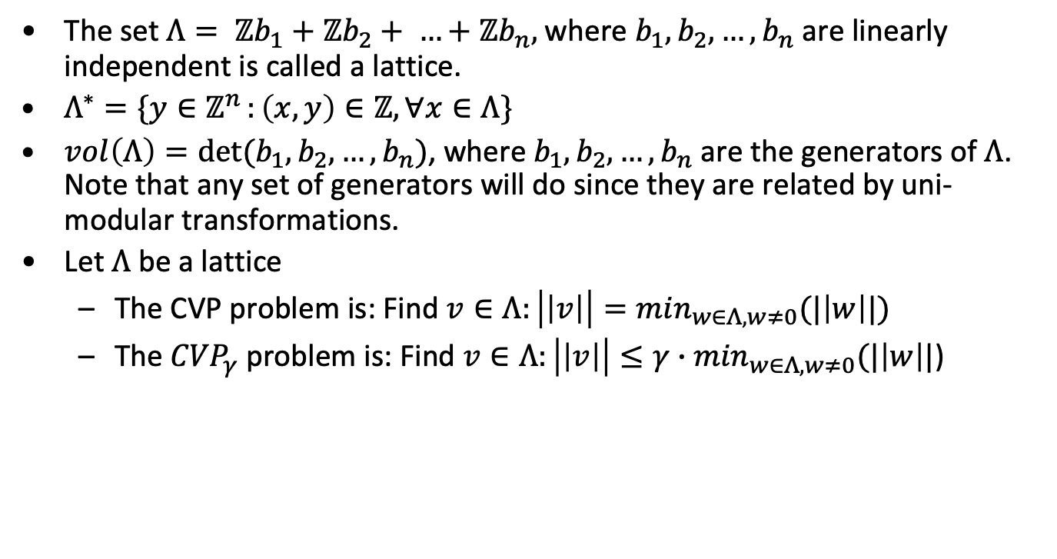
Lattices
The set $Λ= ℤb_{1}+ℤb_{2}+ …+ℤb_{n},$where $b_{1}, b_{2},…,b_{n}$ are linearly independent is called a lattice.
$Λ^{∗}=\{y∈ℤ^{n }:\left(x,y\right)∈ℤ, ∀x∈Λ\}$
$vol\left(Λ\right)=det⁡(b_{1},b_{2},…,b_{n})$, where $b_{1}, b_{2},…,b_{n}$ are the generators of $Λ$. Note that any set of generators will do since they are related by uni-modular transformations.
Let $Λ$ be a lattice
The CVP problem is: Find $v∈Λ:\left|\left|v\right|\right|=\min_{w∈Λ, w≠0}(|\left|w\right||)$
The ${CVP}_{γ}$ problem is: Find $v∈Λ:\left|\left|v\right|\right|≤{γ∙min}_{w∈Λ, w≠0}(|\left|w\right||$)

Slide 55

Definitions
Hermite Normal Form (HNF)
$$\left[\begin{matrix}>0 & 0 & 0 & ⋯ & 0 & 0 & … & 0 \\ ≥0 & >0 & 0 & 0 & 0 & 0 & … & 0 \\ ≥0 & ⋮ & >0 & ⋱ & ⋮ & 0 & … & 0 \\ ≥0 & ≥0 & ≥0 & … & 0 & 0 & … & 0 \\ ≥0 & ≥0 & ≥0 & ⋯ & >0 & 0 & … & 0\end{matrix}\right]$$

Slide 56
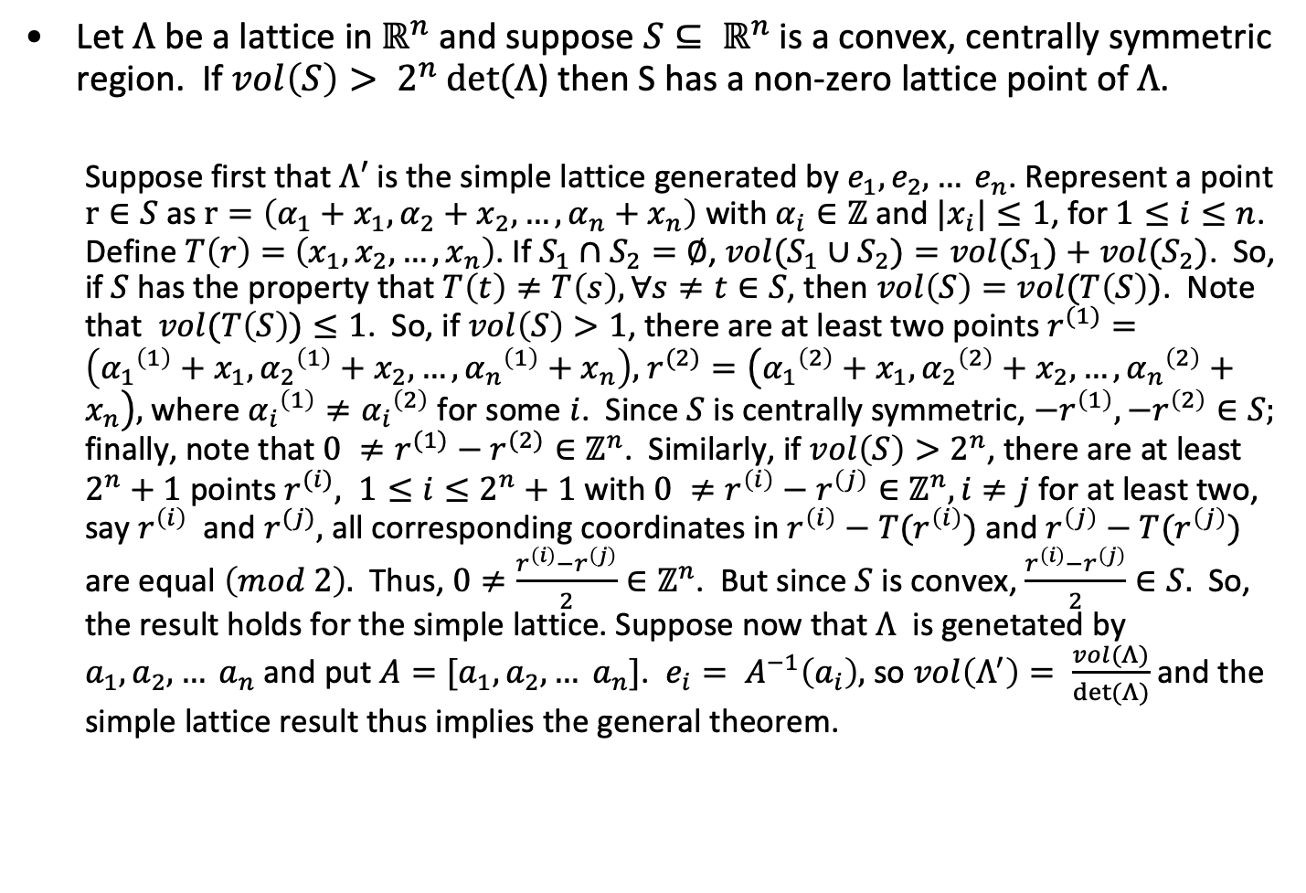
Minkowski’s Theorem
Let $Λ$ be a lattice in $ℝ^{n}$ and suppose $S⊆ ℝ^{n}$ is a convex, centrally symmetric region. If $vol\left(S\right)> 2^{n} det⁡(Λ$) then S has a non-zero lattice point of $Λ$.
Suppose first that $Λ′$ is the simple lattice generated by $e_{1},e_{2}, … e_{n}$. Represent a point $r∈S$ as$r=\left(α_{1}+x_{1},α_{2}+x_{2}, …,α_{n}+x_{n}\right)$ with $α_{i}∈ℤ$ and $|x_{i}|≤1$, for $1≤i≤n$. Define $T\left(r\right)=$ $\left(x_{1},x_{2}, …,x_{n}\right)$. If $S_{1}∩S_{2}=∅$, ${vol(S}_{1}∪S_{2})=vol(S_{1})+vol(S_{2})$. So, if $S$has the property that $T\left(t\right)≠T\left(s\right), ∀s≠t∈S$, then $vol\left(S\right)=vol(T\left(S\right))$. Note that $vol(T\left(S\right))≤1$. So, if $vol\left(S\right)>1$, there are at least two points $r^{(1)}=\left({α_{1}}^{\left(1\right)}+x_{1},{α_{2}}^{\left(1\right)}+x_{2}, …,{α_{n}}^{\left(1\right)}+x_{n}\right),$ $r^{(2)}=\left({α_{1}}^{\left(2\right)}+x_{1},{α_{2}}^{\left(2\right)}+x_{2}, …,{α_{n}}^{\left(2\right)}+x_{n}\right),$ where ${α_{i}}^{\left(1\right)}≠{α_{i}}^{\left(2\right)}$ for some $i$. Since $S$ is centrally symmetric, $−r^{\left(1\right)}, −r^{\left(2\right)}∈S;$ finally, note that $0 ≠r^{(1)}−r^{(2)}∈ℤ^{n}$. Similarly, if $vol\left(S\right)>2^{n}$, there are at least $2^{n}+1$ points $r^{(i)}, 1≤i≤2^{n}+1$ with $0 ≠r^{\left(i\right)}−r^{\left(j\right)}∈ℤ^{n}, i≠j$ for at least two, say $r^{\left(i\right)}$ and $r^{(j)},$ all corresponding coordinates in $r^{\left(i\right)}−T(r^{\left(i\right)})$ and $r^{\left(j\right)}−T(r^{\left(j\right)})$ are equal $\left(mod 2\right).$ Thus, $0≠\frac{r^{\left(i\right)}−r^{\left(j\right)}}{2}∈ℤ^{n}$. But since $S$ is convex, $\frac{r^{\left(i\right)}−r^{\left(j\right)}}{2}∈S.$ So, the result holds for the simple lattice. Suppose now that $Λ$ is genetated by $a_{1},a_{2}, … a_{n}$ and put $A=[a_{1},a_{2}, … a_{n}]$. $e_{i}= A^{−1}\left(a_{i}\right),$ so $vol\left(Λ^{′}\right)= \frac{vol(Λ)}{det⁡(Λ)}$ and the simple lattice result thus implies the general theorem.

Slide 57
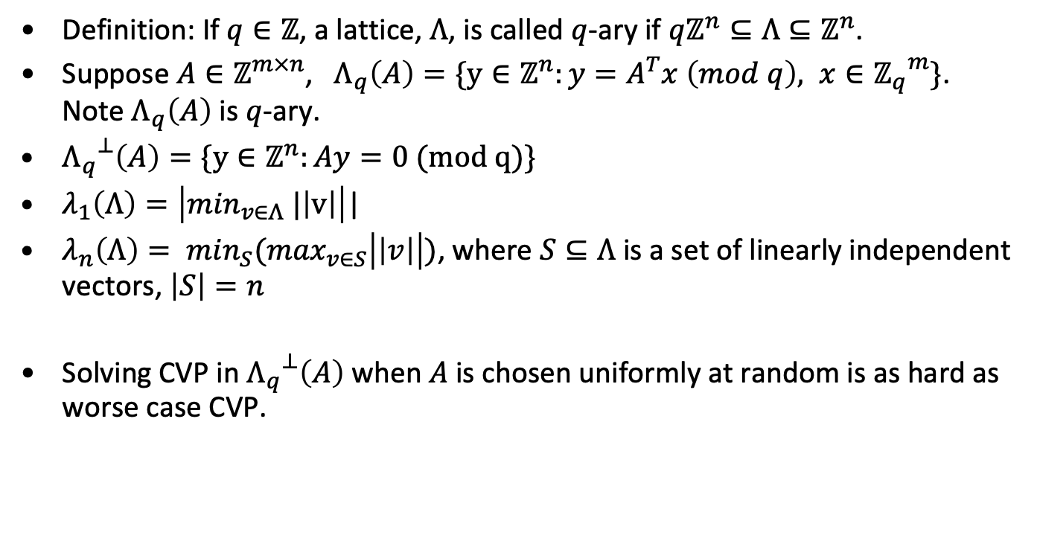
q-ary lattices and other definitions
Definition: If $q∈ℤ$, a lattice, $Λ$, is called $q$-ary if $qℤ^{n}⊆Λ⊆ℤ^{n}$.
Suppose $A∈ℤ^{m×n}$, $Λ_{q}\left(A\right)=\{y∈ℤ^{n}:y=A^{T}x \left(mod q\right), x∈{ℤ_{q}}^{m}\}$. Note $Λ_{q}\left(A\right)$ is $q$-ary.
${Λ_{q}}^{⊥}\left(A\right)=\{y∈ℤ^{n}:Ay=0 (mod q)\}$
$λ_{1}\left(Λ\right)=\left|\min_{v∈Λ} |\left|v\right|\right|$|
$λ_{n}\left(Λ\right)= \min_{S}(\max_{v∈S}\left|\left|v\right|\right|)$, where $S⊆Λ$ is a set of linearly independent vectors, $\left|S\right|=n$
Solving CVP in ${Λ_{q}}^{⊥}\left(A\right)$ when $A$ is chosen uniformly at random is as hard as worse case CVP.

Slide 58
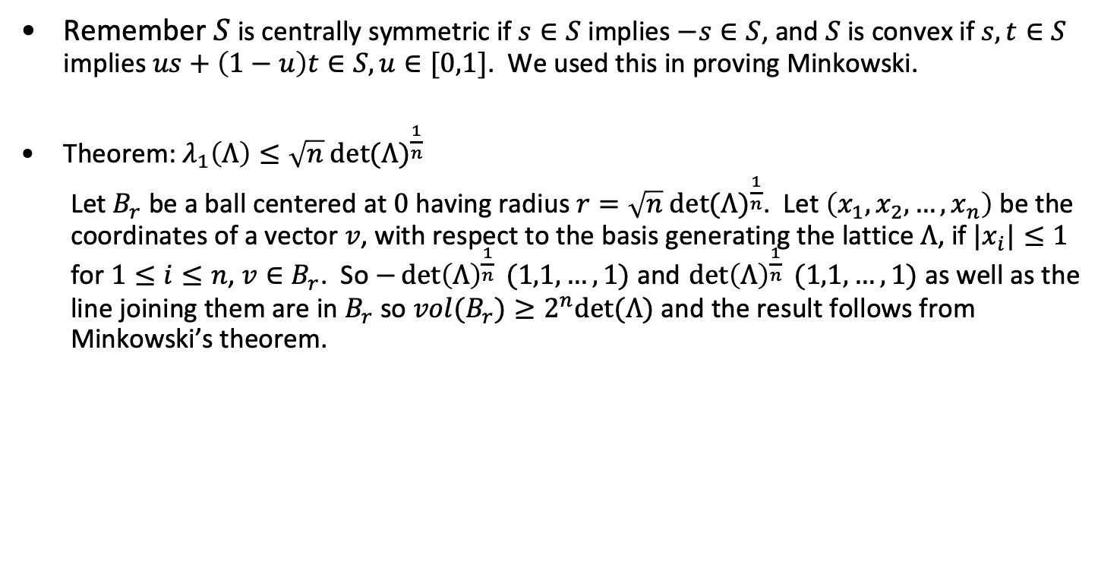
Some simple results
Remember $S$ is centrally symmetric if $s∈S$ implies $−s∈S$, and $S$ is convex if $s,t∈S$ implies $us+\left(1−u\right)t∈S, u∈[0,1]$. We used this in proving Minkowski.
Theorem: $λ_{1}\left(Λ\right)≤\sqrt{n} {det⁡(Λ)}^{\frac{1}{n}}$
Let $B_{r}$ be a ball centered at $0$ having radius $r=\sqrt{n} {det⁡(Λ)}^{\frac{1}{n}}$. Let $\left(x_{1},x_{2}, …,x_{n}\right)$ be the coordinates of a vector $v$, with respect to the basis generating the lattice $Λ$, if $|x_{i}|≤1$ for $1≤i≤n$, $v∈B_{r}$. So $−{\det\left(Λ\right)}^{\frac{1}{n}} (1,1,…,1)$ and ${\det\left(Λ\right)}^{\frac{1}{n}} (1,1,…,1)$ as well as the line joining them are in $B_{r}$ so $vol(B_{r})≥2^{n}det⁡(Λ)$ and the result follows from Minkowski’s theorem.

Slide 59
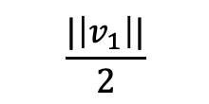
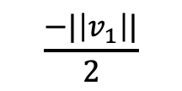
Reduced Basis
<v₁, v₂> is reduced if
||v₂||≦|v₁||; and,
-1/2||v₁||² ≦(v₁, v₂) ≦ 1/2||v₁||² .
v₂
v₂
v₁
v₁
$$\frac{−|\left|v_{1}\right||}{2}$$
$$\frac{|\left|v_{1}\right||}{2}$$
Reduced
Not

Slide 60
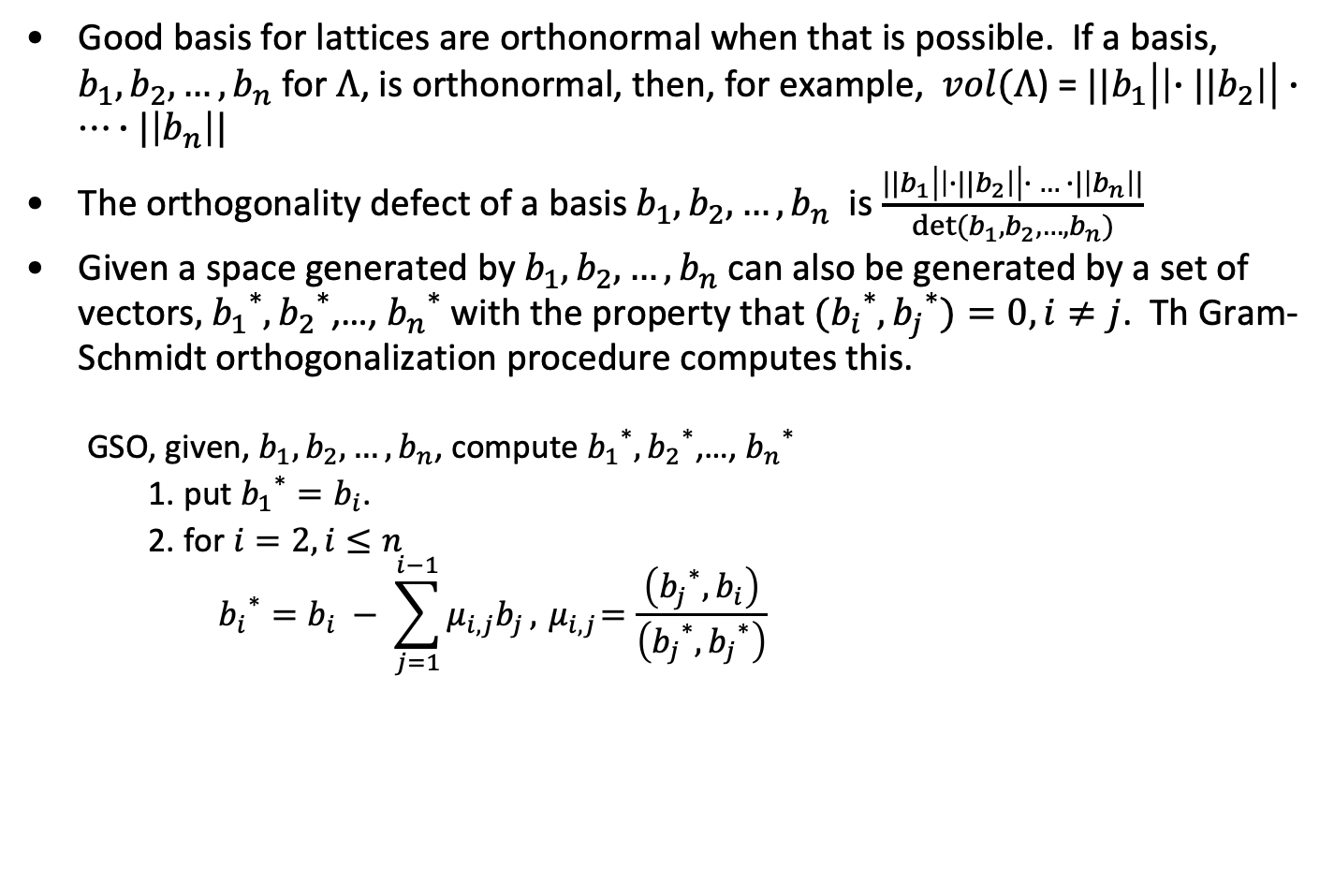
Good basis and Gram-Schmidt Orthogonalization
Good basis for lattices are orthonormal when that is possible. If a basis, $b_{1}, b_{2},…,b_{n}$ for $Λ$, is orthonormal, then, for example, $vol(Λ$) = ${||b}_{1}\left|\left|{∙||b}_{2}\right|\right|∙…∙|\left|b_{n}\right||$
The orthogonality defect of a basis $b_{1}, b_{2},…,b_{n}$ is $\frac{{||b}_{1}\left|\left|{∙||b}_{2}\right|\right|∙ … ∙|\left|b_{n}\right||}{det⁡(b_{1}, b_{2},…,b_{n})}$
Given a space generated by $b_{1}, b_{2},…,b_{n}$ can also be generated by a set of vectors$,$ ${b_{1}}^{∗},{b_{2}}^{∗}$,…, ${b_{n}}^{∗}$ with the property that ${{(b}_{i}}^{∗},{b_{j}}^{∗})=0, i≠j$. Th Gram-Schmidt orthogonalization procedure computes this.
GSO, given, $b_{1}, b_{2},…,b_{n}$, compute ${b_{1}}^{∗},{b_{2}}^{∗}$,…, ${b_{n}}^{∗}$
put ${b_{1}}^{∗}=b_{i}$.
for $i=2, i≤n$
$${b_{i}}^{∗}=b_{i} − \sum_{j=1}^{i−1}{μ_{i,j}b_{j}}, { μ}_{i,j}=\frac{\left({b_{j}}^{∗}, b_{i}\right)}{\left({b_{j}}^{∗},{b_{j}}^{∗}\right)}$$

Slide 61
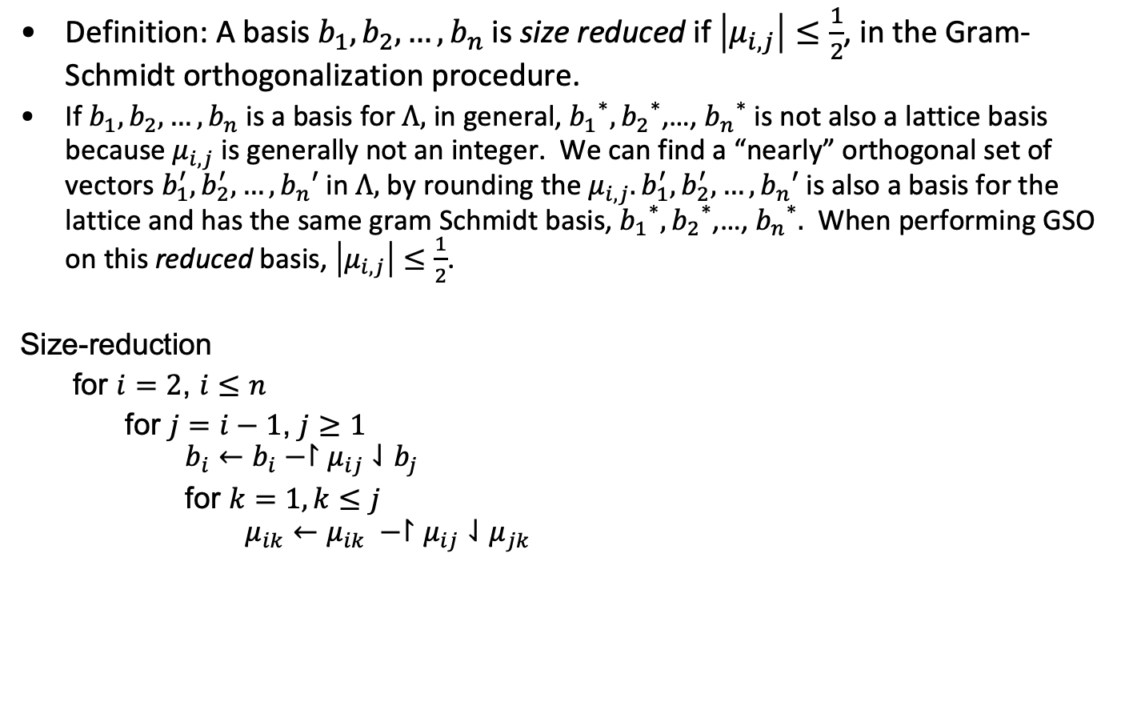
Size Reduction
Definition: A basis $b_{1}, b_{2},…,b_{n}$ is size reduced if $\left|μ_{i,j}\right|≤\frac{1}{2}$, in the Gram-Schmidt orthogonalization procedure.
If $b_{1}, b_{2},…,b_{n}$ is a basis for $Λ,$ in general, ${b_{1}}^{∗},{b_{2}}^{∗}$,…, ${b_{n}}^{∗}$ is not also a lattice basis because${ μ}_{i,j}$ is generally not an integer. We can find a “nearly” orthogonal set of vectors $b_{1}^{′}, b_{2}^{′}, …,b_{n}′$ in $Λ,$ by rounding the $μ_{i,j}. b_{1}^{′}, b_{2}^{′}, …,b_{n}′$is also a basis for the lattice and has the same gram Schmidt basis, ${b_{1}}^{∗},{b_{2}}^{∗}$,…, ${b_{n}}^{∗}.$ When performing GSO on this reduced basis, $\left|μ_{i,j}\right|≤\frac{1}{2}$.
Size-reduction
for $i=2$, $i≤n$
for $j=i−1$, $j≥1$
$$b_{i}←b_{i}−↾μ_{ij}⇃b_{j}$$
for $k=1, k≤j$
$$μ_{ik}←μ_{ik} −↾μ_{ij}⇃μ_{jk}$$

Slide 62
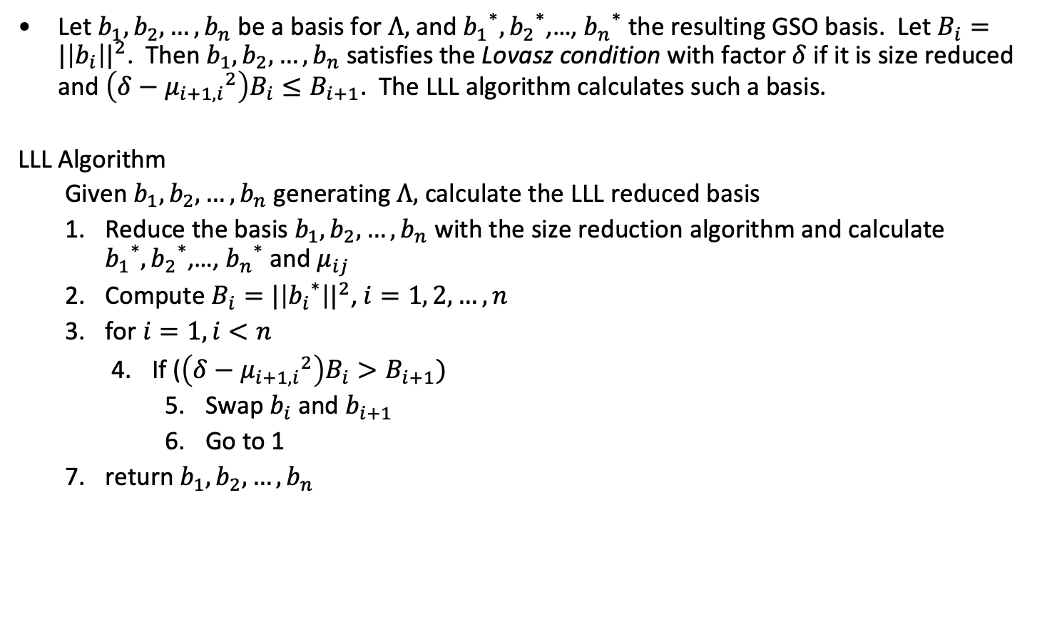
Size reduction and basis reordering
Let $b_{1}, b_{2},…,b_{n}$ be a basis for $Λ,$ and ${b_{1}}^{∗},{b_{2}}^{∗}$,…, ${b_{n}}^{∗}$ the resulting GSO basis. Let $B_{i}={|\left|b_{i}\right||}^{2}$. Then $b_{1}, b_{2},…,b_{n}$ satisfies the Lovasz condition with factor $δ$ if it is size reduced and $\left(δ−{μ_{i+1,i}}^{2}\right)B_{i}≤B_{i+1}$. The LLL algorithm calculates such a basis.
LLL Algorithm
Given $b_{1}, b_{2},…,b_{n}$ generating $Λ,$ calculate the LLL reduced basis
Reduce the basis $b_{1}, b_{2},…,b_{n}$ with the size reduction algorithm and calculate ${b_{1}}^{∗},{b_{2}}^{∗}$,…, ${b_{n}}^{∗}$ and $μ_{ij}$
Compute $B_{i}={|\left|{b_{i}}^{∗}\right||}^{2}$, $i=1, 2, …, n$
for $i=1, i<n$
If ($\left(δ−{μ_{i+1,i}}^{2}\right)B_{i}>B_{i+1})$
Swap $b_{i}$ and $b_{i+1}$
Go to 1
return $b_{1}, b_{2},…,b_{n}$

Slide 63
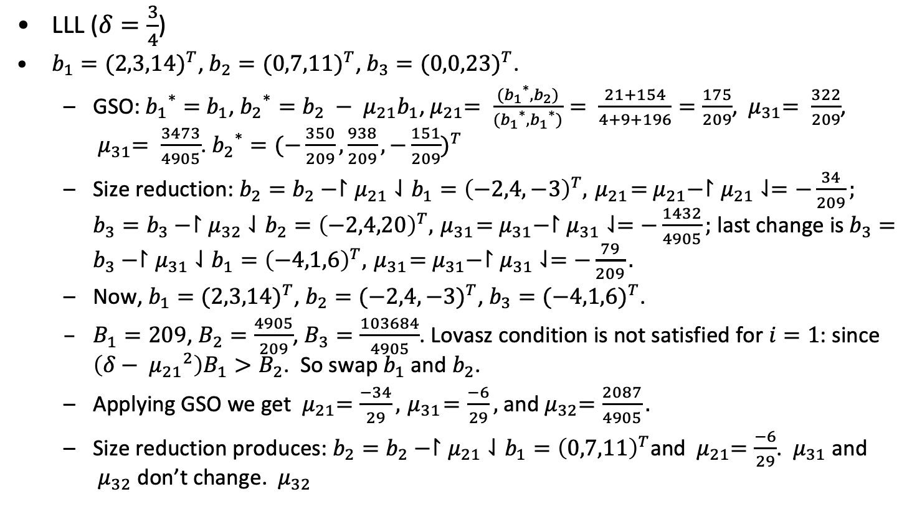
Example (LLL including GSO)
LLL ($δ=\frac{3}{4}$)
$b_{1}={(2,3,14)}^{T}$, $b_{2}={(0,7,11)}^{T}$, $b_{3}={(0,0,23)}^{T}$.
GSO: ${b_{1}}^{∗}=$ $b_{1}$, ${b_{2}}^{∗}=b_{2} − μ_{21}b_{1}$,${ μ}_{21}= \frac{({b_{1}}^{∗},b_{2})}{({b_{1}}^{∗},{b_{1}}^{∗})}= \frac{21+154}{4+9+196}=\frac{175}{209}$, ${ μ}_{31}= \frac{322}{209}$, ${ μ}_{31}= \frac{3473}{4905}$. ${b_{2}}^{∗}={(−\frac{350}{209}, \frac{938}{209}, −\frac{151}{209})}^{T}$
Size reduction: $b_{2}=b_{2}−↾μ_{21}⇃b_{1}={\left(−2,4,−3\right)}^{T},{ μ}_{21}={ μ}_{21}−↾μ_{21}⇃=−\frac{34}{209};$ $b_{3}=b_{3}−↾μ_{32}⇃b_{2}={\left(−2,4,20\right)}^{T},{ μ}_{31}={ μ}_{31}−↾μ_{31}⇃=−\frac{1432}{4905};$ last change is $b_{3}=b_{3}−↾μ_{31}⇃b_{1}={\left(−4,1,6\right)}^{T},{ μ}_{31}={ μ}_{31}−↾μ_{31}⇃=−\frac{79}{209}.$
Now, $b_{1}={(2,3,14)}^{T}$, $b_{2}={(−2,4,−3)}^{T}$, $b_{3}={(−4,1,6)}^{T}$.
$B_{1}=209$, $B_{2}=\frac{4905}{209}$, $B_{3}=\frac{103684}{4905}$. Lovasz condition is not satisfied for $i=1$: since $\left(δ−{{ μ}_{21}}^{2}\right)B_{1}>B_{2}$. So swap $b_{1}$ and $b_{2}$.
Applying GSO we get ${ μ}_{21}=\frac{−34}{29}, { μ}_{31}=\frac{−6}{29},$ and${ μ}_{32}=\frac{2087}{4905}.$
Size reduction produces: $b_{2}=b_{2}−↾μ_{21}⇃b_{1}={\left(0,7,11\right)}^{T}$and ${ μ}_{21}=\frac{−6}{29}$. ${ μ}_{31}$ and ${ μ}_{32}$ don’t change. ${ μ}_{32}$
From Heiko Knopse

Slide 64
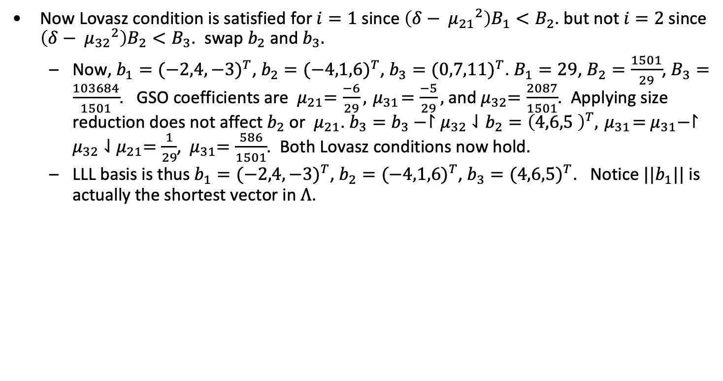
Example (LLL including GSO) - continued
Now Lovasz condition is satisfied for $i=1$ since $\left(δ−{{ μ}_{21}}^{2}\right)B_{1}<B_{2}$. but not $i=2$ since $\left(δ−{{ μ}_{32}}^{2}\right)B_{2}<B_{3}$. swap $b_{2}$ and $b_{3}.$
Now, $b_{1}={(−2,4,−3)}^{T}$, $b_{2}={(−4,1,6)}^{T}$, $b_{3}={(0,7,11)}^{T}$. $B_{1}=29$, $B_{2}=\frac{1501}{29}$, $B_{3}=\frac{103684}{1501}$. GSO coefficients are ${ μ}_{21}=\frac{−6}{29}, { μ}_{31}=\frac{−5}{29},$ and${ μ}_{32}=\frac{2087}{1501}$. Applying size reduction does not affect $b_{2}$ or ${ μ}_{21}$. $b_{3}=b_{3}−↾μ_{32}⇃b_{2}={\left(4,6,5 \right)}^{T},{ μ}_{31}={ μ}_{31}−↾μ_{32}⇃{ μ}_{21}=\frac{1}{29}$, ${ μ}_{31}=\frac{586}{1501}$. Both Lovasz conditions now hold.
LLL basis is thus $b_{1}={(−2,4,−3)}^{T}$, $b_{2}={(−4,1,6)}^{T}$, $b_{3}={(4,6,5)}^{T}$. Notice $||b_{1}||$ is actually the shortest vector in $Λ$.
From Heiko Knopse

Slide 65
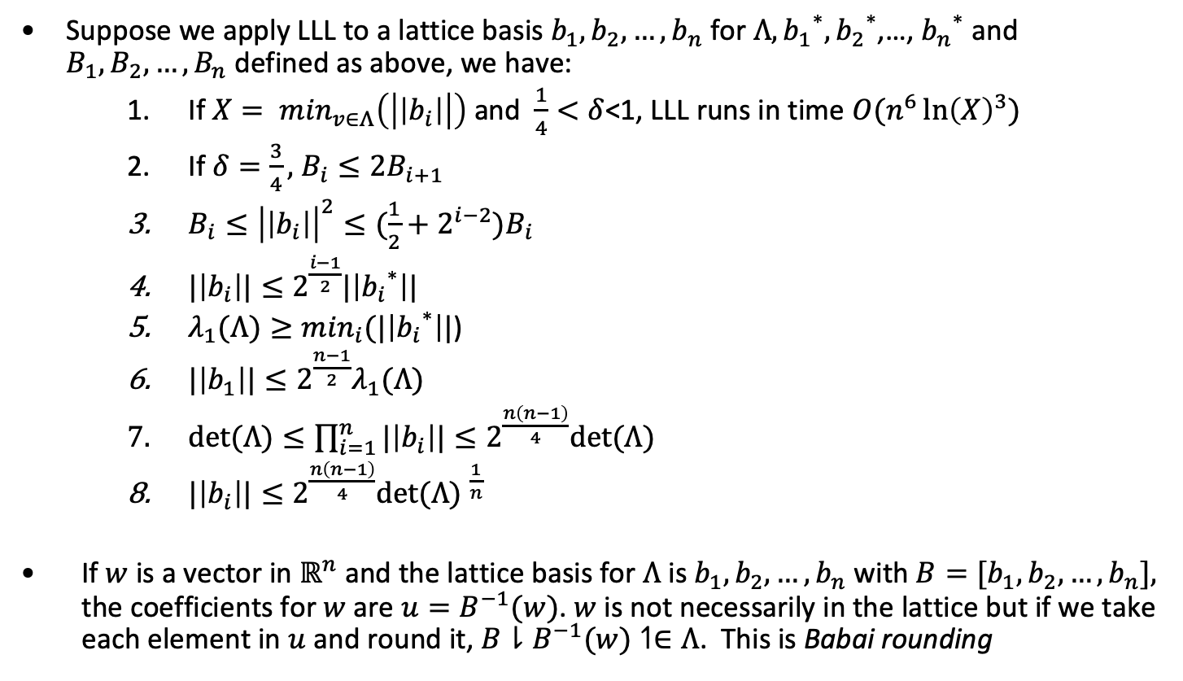

LLL Properties
Suppose we apply LLL to a lattice basis $b_{1}, b_{2},…,b_{n}$ for $Λ,{b_{1}}^{∗},{b_{2}}^{∗}\text{,…, }{b_{n}}^{∗}$ and $B_{1}, B_{2},…,B_{n}$ defined as above, we have:
If $X= \min_{v∈Λ}\left(\left|\left|b_{i}\right|\right|\right)$ and $\frac{1}{4}<δ$<1, LLL runs in time $O(n^{6}{\ln\left(X\right)}^{3})$
If $δ=\frac{3}{4},$ $B_{i}≤2B_{i+1}$
$B_{i}≤{\left|\left|b_{i}\right|\right|}^{2}≤(\frac{1}{2}+2^{i−2})B_{i}$
$|\left|b_{i}\right||≤2^{\frac{i−1}{2}}|\left|{b_{i}}^{∗}\right||$
$λ_{1}(Λ)≥\min_{i}(|\left|{b_{i}}^{∗}\right||$)
$|\left|b_{1}\right||≤2^{\frac{n−1}{2}}λ_{1}(Λ)$
$det⁡(Λ)≤\prod_{i=1}^{n}{|\left|b_{i}\right||}≤2^{\frac{n\left(n−1\right)}{4}}det⁡(Λ)$
$|\left|b_{i}\right||≤2^{\frac{n\left(n−1\right)}{4}}{det⁡(Λ) }^{\frac{1}{n}}$
If $w$ is a vector in $ℝ^{n}$ and the lattice basis for $Λ$ is $b_{1}, b_{2},…,b_{n}$ with $B={[b}_{1}, b_{2},…,b_{n}],$ the coefficients for $w$ are $u=B^{−1}(w)$. $w$ is not necessarily in the lattice but if we take each element in $u$ and round it, $B⇂B^{−1}(w)↿∈Λ$. This is Babai rounding

Slide 66
Attack on RSA using LLL
Attack applies to messages of the form "M xxx" where only "xxx" varies (e.g.- "The key is xxx") and xxx is small.
From now on, assume M(x)=B+x where B is fixed
|x|<Y.
Not that E(M(x))=c= (B+x)³ (mod n)
f(x)= (B+x)³-c= x³+a₂x²+a₁x+a₀ (mod n).
We want to find x: f(x)=0 (mod n), a solution to this, m, will be the corresponding plaintext.

Slide 67
Attack on RSA using LLL
To apply LLL, let:
v₁= (n, 0, 0, 0),
v₂= (0, Yn, 0, 0),
v₃= (0, 0, Y²n, 0),
v₄= (a₀ , a₁Y, a₂Y², a₃Y³)
When we apply LLL, we get a vector, b₁:
||b₁|| ≦ 2^{(3/4)} |det(v₁, v₂, v₃, v₄)| = 2^{(3/4)} n^{(3/4)} Y^{(3/2)} …. Equation 1.
Let b₁= c₁v₁ + …+ c₄v₄= (e₀, Ye₁, Y²e₂, Y³e₃). Then:
e₀ = c₁n+c₄a₀
e₁ = c₂n+c₄a₁
e₂= c₃n+c₄a₂
e₃ = c₄

Slide 68
Attack on RSA using LLL
Now set g(x)= e₃x³+e₂x²+e₁x+e₀.
From the definition of the e_{i}, c₄ f(x)= g(x) (mod n), so if m is a solution of f(x) (mod n), g(m)= c₄ f(m)= 0 (mod n).
The trick is to regard g as being defined over the real numbers, then the solution can be calculated using an iterative solver.
If Y<2^{(7/6)}n^{(1/6)}, |g(x)| ≦ 2||b₁||.
So, using the Cauchy-Schwartz inequality, ||b₁||≦2⁻¹n.
Thus |g(x)|<n and g(x)=0 yielding 3 candidates for x.
Coppersmith extended this to small solutions of polynomials of degree d using a d+1 dimensional lattice by examining the monic polynomial f(T)= 0 (mod n) of degree d when |x|≦n^{1/d}.

Slide 69
Example attack on RSA using LLL
p= 757285757575769, q= 2545724696579693.
n= 1927841055428697487157594258917.
B= 200805000114192305180009190000.
c= (B+m)³, 0<=m<100.
f(x)= (B+x)³-c= x³+a₂x²+a₁x+a₀ (mod n).
a₂= 602415000342576915540027570000
a₁= 1123549124004247469362171467964
a₀= 587324114445679876954457927616
v₁= (n,0,0,0)
v₂= (0,100n,0,0)
v₃= (0,0,10⁴n,0)
v₄= (a₀, a₁100, a₂10⁴,10⁶)

Slide 70
Example attack on RSA using LLL
Apply LLL, b₁=
308331465484476402v₁ + 589837092377839611v₂ +
316253828707108264v₃ + (-1012071602751202635)v₄ =
(246073430665887186108474, -577816087453534232385300,
405848565585194400880000, -1012071602751202635000000)
g(x)= (-1012071602751202635) t³ + 40584856558519440088 t² +
(-57781608745353442323853) t +246073430665887186108474.
Roots of g(x) are 42.0000000, (-.9496±76.0796i)
The answer is 42.

Slide 71
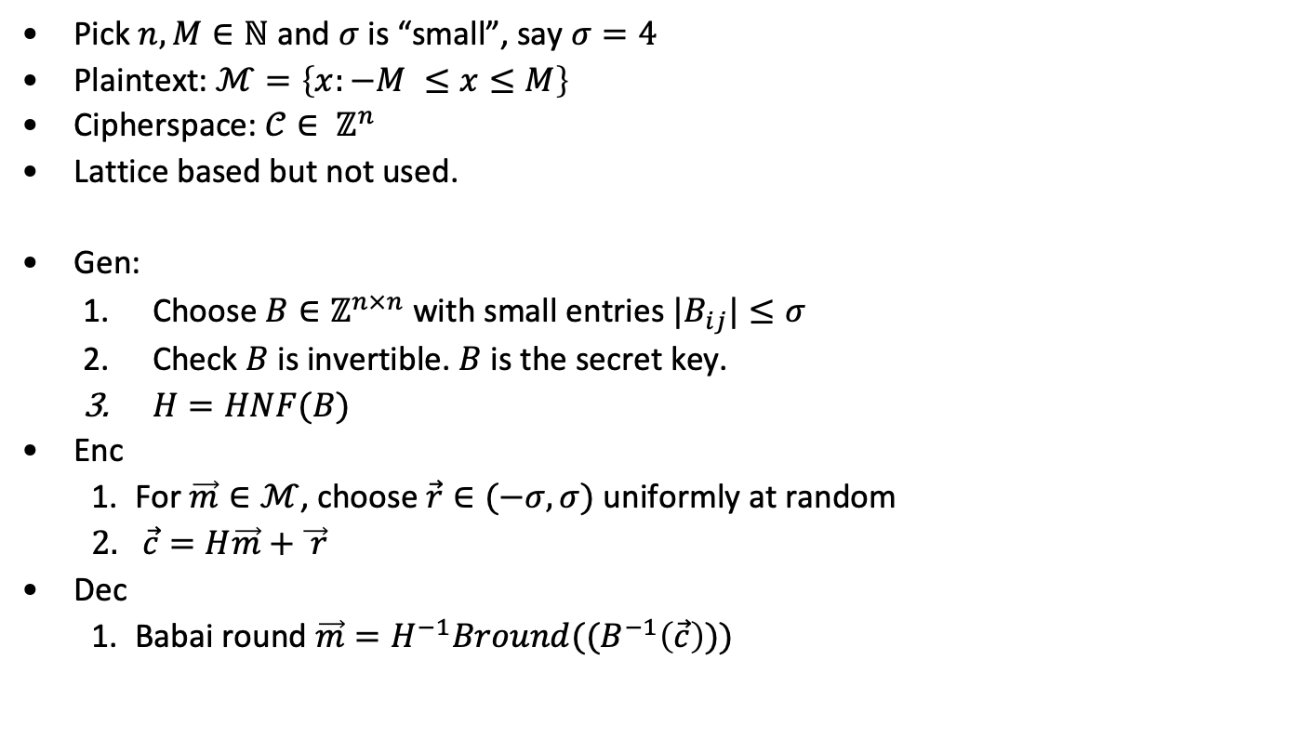
GGH Public Key System
Pick $n,M∈ℕ$ and $σ$ is “small”, say $σ=4$
Plaintext: $ℳ=\left\{x:−M ≤x≤M\right\}$
Cipherspace: $𝒞∈ ℤ^{n}$
Lattice based but not used.
Gen:
Choose $B∈ℤ^{n×n}$ with small entries $|B_{ij}|≤σ$
Check $B$ is invertible. $B$ is the secret key.
$H=HNF(B)$
Enc
For $\vec{m}∈ℳ$, choose $\vec{r}∈(−σ,σ)$ uniformly at random
$\vec{c}=H\vec{m}+\vec{ r}$
Dec
Babai round ${\vec{m}=H}^{−1}Bround((B^{−1}\left(\vec{c}\right)))$

Slide 72
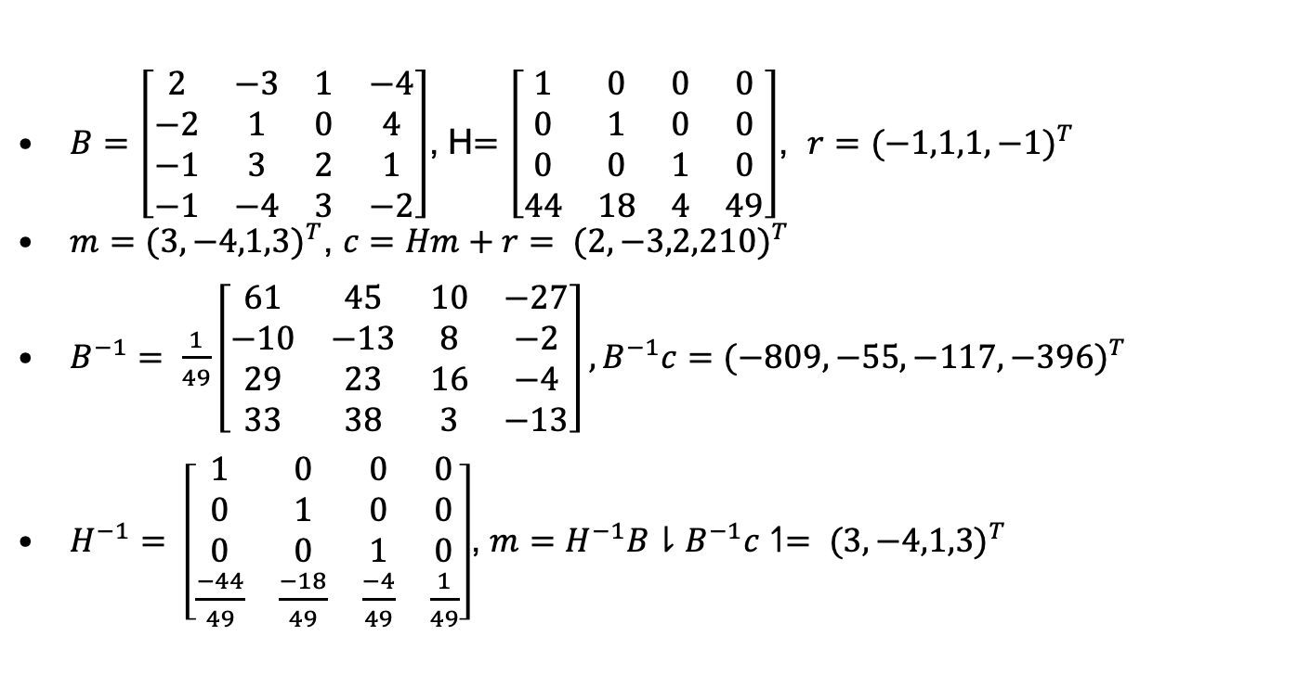
GGH Example
$B=\left[\begin{matrix}2 & −3 & 1 & −4 \\ −2 & 1 & 0 & 4 \\ −1 & 3 & 2 & 1 \\ −1 & −4 & 3 & −2\end{matrix}\right]$, H$=\left[\begin{matrix}1 & 0 & 0 & 0 \\ 0 & 1 & 0 & 0 \\ 0 & 0 & 1 & 0 \\ 44 & 18 & 4 & 49\end{matrix}\right]$, $r={(−1,1,1,−1)}^{T}$
$m={(3,−4,1,3)}^{T}$, $c=Hm+r= {(2,−3,2,210)}^{T}$
$B^{−1}= \frac{1}{49}\left[\begin{matrix}61 & 45 & 10 & −27 \\ −10 & −13 & 8 & −2 \\ 29 & 23 & 16 & −4 \\ 33 & 38 & 3 & −13\end{matrix}\right], B^{−1}c={(−809,−55,−117,−396)}^{T}$
$H^{−1}= \left[\begin{matrix}1 & 0 & 0 & 0 \\ 0 & 1 & 0 & 0 \\ 0 & 0 & 1 & 0 \\ \frac{−44}{49} & \frac{−18}{49} & \frac{−4}{49} & \frac{1}{49}\end{matrix}\right]$, $m=H^{−1}B⇂B^{−1}c↿= {(3,−4,1,3)}^{T}$
From Heiko Knopse

Slide 73
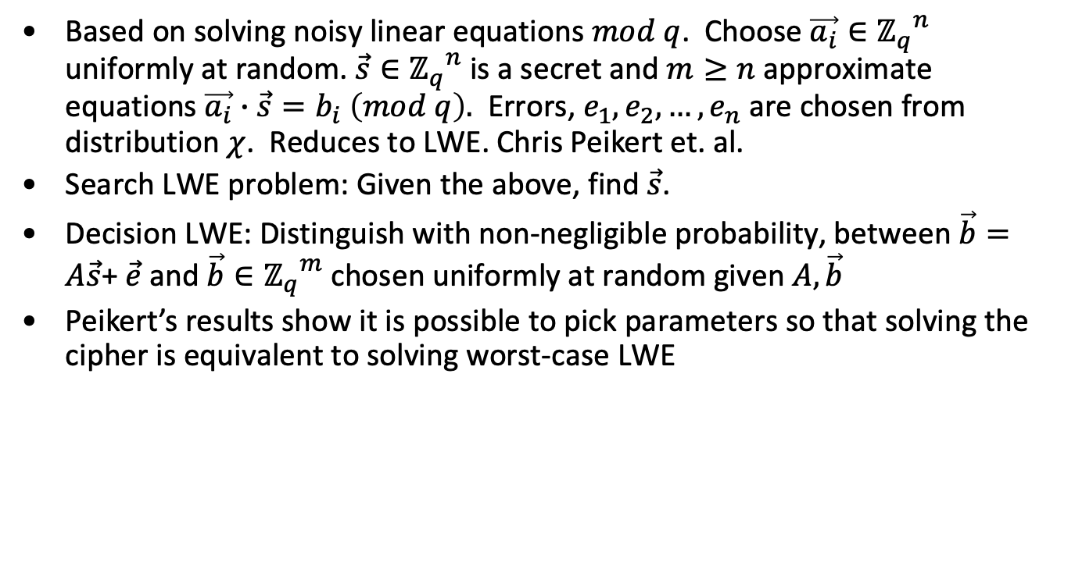
LWE
Based on solving noisy linear equations $mod q$. Choose $\vec{a_{i}}∈{ℤ_{q}}^{n}$ uniformly at random. $\vec{s}∈{ℤ_{q}}^{n}$ is a secret and $m≥n$ approximate equations $\vec{a_{i}}∙\vec{s}=b_{i} \left(mod q\right).$ Errors, $e_{1},e_{2},…,e_{n}$ are chosen from distribution $χ$. Reduces to LWE. Chris Peikert et. al.
Search LWE problem: Given the above, find $\vec{s}$.
Decision LWE: Distinguish with non-negligible probability, between $\vec{b}=A\vec{s}$+ $\vec{e}$ and $\vec{b}∈{ℤ_{q}}^{m}$ chosen uniformly at random given $A,\vec{b}$
Peikert’s results show it is possible to pick parameters so that solving the cipher is equivalent to solving worst-case LWE

Slide 74
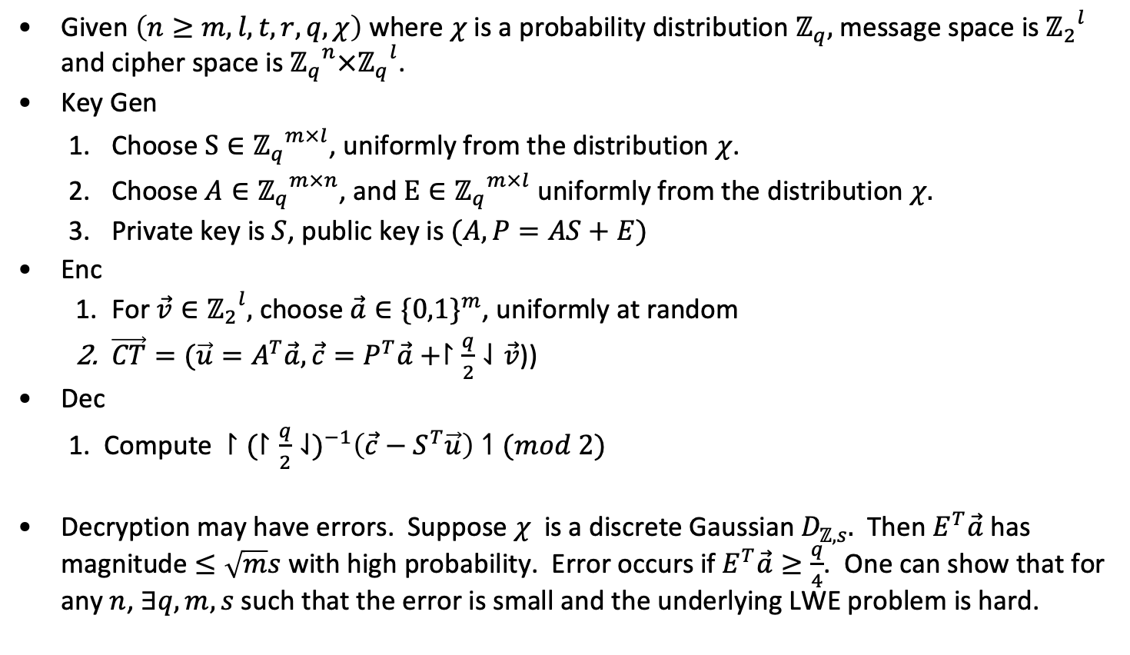
LWE cryptosystem
Given $\left(n≥m, l, t, r,q, χ\right)$ where $χ$ is a probability distribution $ℤ_{q},$message space is ${ℤ_{2}}^{l}$ and cipher space is ${ℤ_{q}}^{n}×{ℤ_{q}}^{l}$.
Key Gen
Choose $S∈{ℤ_{q}}^{m×l}$, uniformly from the distribution $χ$.
Choose $A∈{ℤ_{q}}^{m×n}$, and $E∈{ℤ_{q}}^{m×l}$ uniformly from the distribution $χ.$
Private key is $S$, public key is $(A, P=AS+E)$
Enc
For $\vec{v}∈{ℤ_{2}}^{l},$ choose $\vec{a}∈{\{0,1\}}^{m}$, uniformly at random
$\vec{CT}=(\vec{u}=A^{T}\vec{a}, \vec{c}=P^{T}\vec{a}+↾\frac{q}{2}⇃\vec{v}$))
Dec
Compute $↾{(↾\frac{q}{2}⇃)}^{−1}\left(\vec{c}−S^{T}\vec{u}\right)↿(mod 2)$
Decryption may have errors. Suppose $χ$ is a discrete Gaussian $D_{ℤ,s}.$ Then $E^{T}\vec{a}$ has magnitude $≤\sqrt{m}s$ with high probability. Error occurs if $E^{T}\vec{a}≥\frac{q}{4}$. One can show that for any $n$, $∃q,m,s$ such that the error is small and the underlying LWE problem is hard.

Slide 75
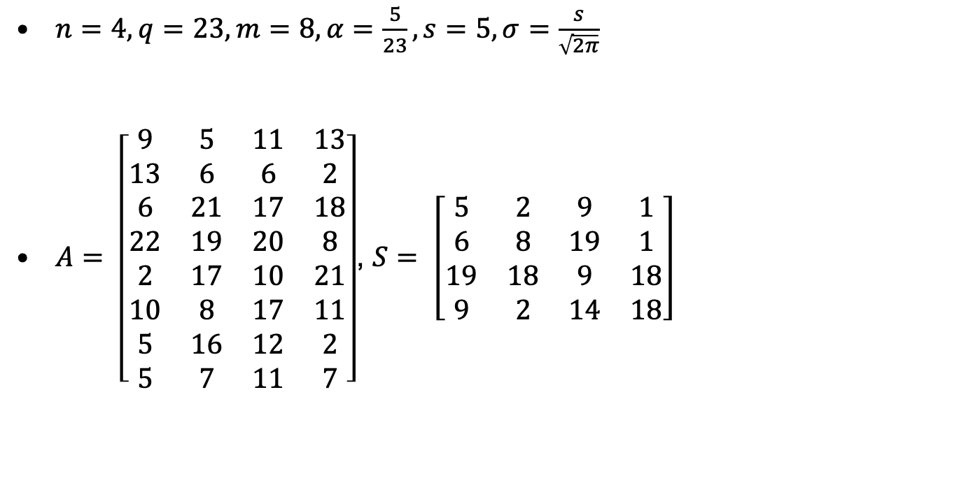
LWE example
$n=4, q=23,m=8, α=\frac{5}{23}, s=5, σ=\frac{s}{\sqrt{2π}}$
$A= \left[\begin{matrix}9 & 5 & 11 & 13 \\ 13 & 6 & 6 & 2 \\ 6 & 21 & 17 & 18 \\ 22 & 19 & 20 & 8 \\ 2 & 17 & 10 & 21 \\ 10 & 8 & 17 & 11 \\ 5 & 16 & 12 & 2 \\ 5 & 7 & 11 & 7\end{matrix}\right]$, $S= \left[\begin{matrix}5 & 2 & 9 & 1 \\ 6 & 8 & 19 & 1 \\ 19 & 18 & 9 & 18 \\ 9 & 2 & 14 & 18\end{matrix}\right]$
From Heiko Knopse

Slide 76
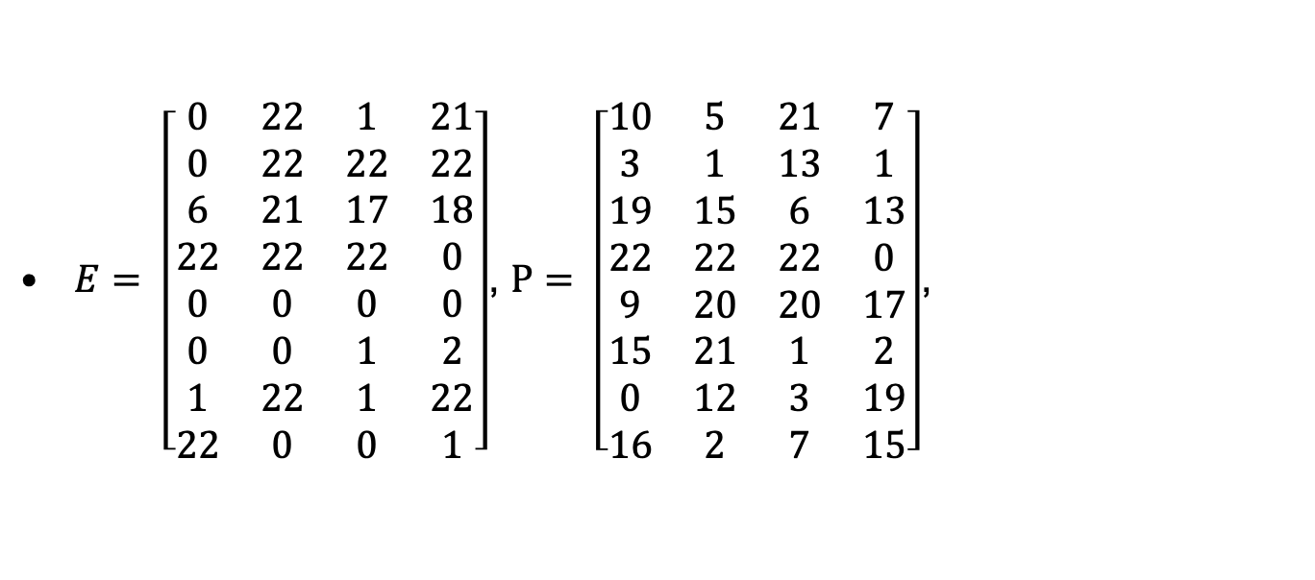
LWE example
$E= \left[\begin{matrix}0 & 22 & 1 & 21 \\ 0 & 22 & 22 & 22 \\ 6 & 21 & 17 & 18 \\ 22 & 22 & 22 & 0 \\ 0 & 0 & 0 & 0 \\ 0 & 0 & 1 & 2 \\ 1 & 22 & 1 & 22 \\ 22 & 0 & 0 & 1\end{matrix}\right]$, $P= \left[\begin{matrix}10 & 5 & 21 & 7 \\ 3 & 1 & 13 & 1 \\ 19 & 15 & 6 & 13 \\ 22 & 22 & 22 & 0 \\ 9 & 20 & 20 & 17 \\ 15 & 21 & 1 & 2 \\ 0 & 12 & 3 & 19 \\ 16 & 2 & 7 & 15\end{matrix}\right]$,
From Heiko Knopse

Slide 77
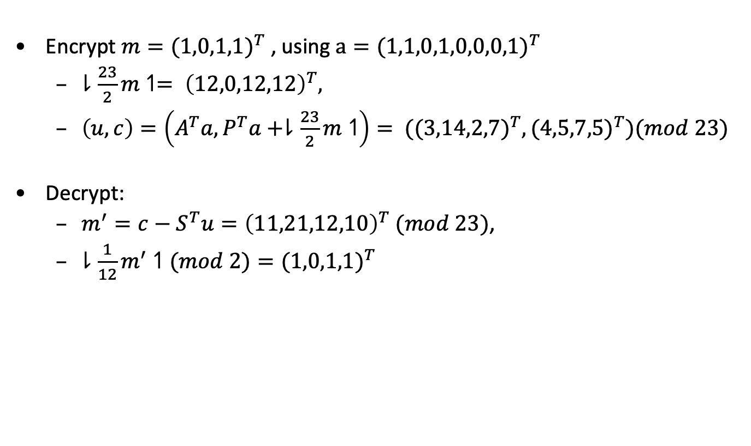
LWE example
Encrypt $m={(1,0,1,1)}^{T}$ , using $a={(1,1,0,1,0,0,0,1)}^{T}$
$⇂\frac{23}{2}m↿= {\left(12,0,12,12\right)}^{T},$
$\left(u,c\right)=\left(A^{T}a,P^{T}a+⇂\frac{23}{2}m↿\right)= {((3,14,2,7)}^{T},{(4,5,7,5)}^{T})(mod 23)$
Decrypt:
$m^{′}=c−S^{T}u={\left(11,21,12,10\right)}^{T} (mod 23)$,
$⇂\frac{1}{12}m^{′}↿(mod 2)={(1,0,1,1)}^{T}$
From Heiko Knopse

Slide 78
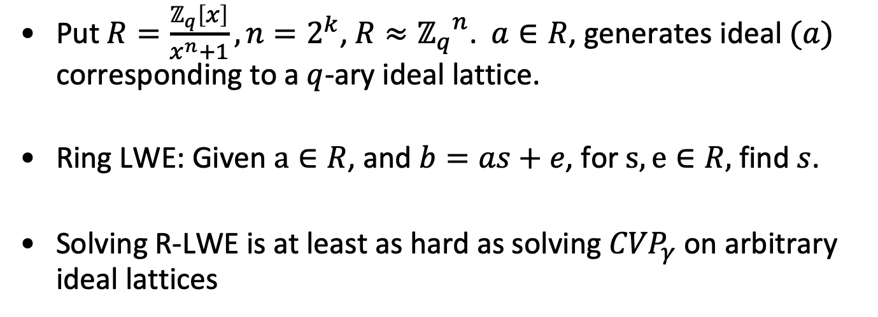
Ring-LWE
Put $R=\frac{ℤ_{q}\left[x\right]}{x^{n}+1}, n=2^{k}$, $R≈{ℤ_{q}}^{n}$. $a∈R$, generates ideal $(a)$ corresponding to a $q$-ary ideal lattice.
Ring LWE: Given $a∈R$, and $b=as+e$, for $s,e∈R,$ find $s$.
Solving R-LWE is at least as hard as solving ${CVP}_{γ}$ on arbitrary ideal lattices

Slide 79
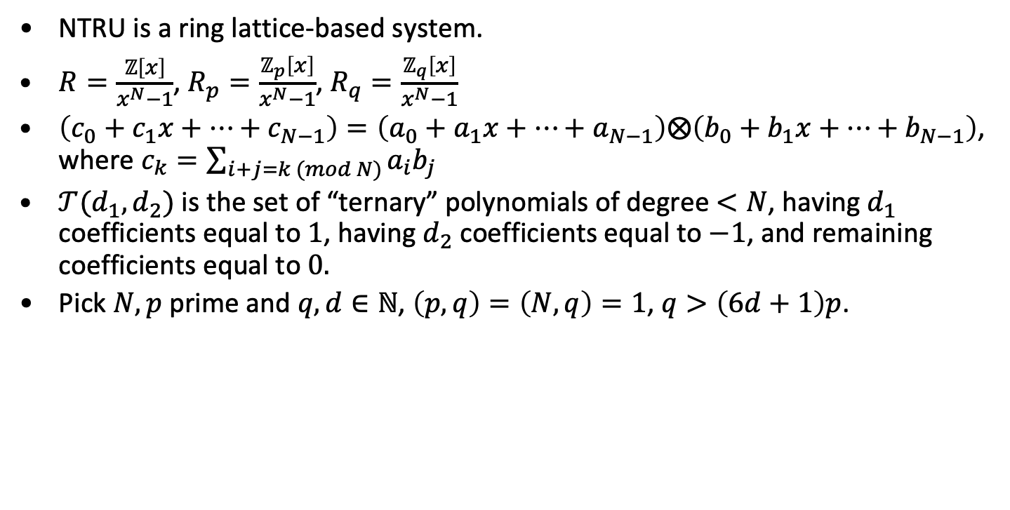
NTRU Public Key System
NTRU is a ring lattice-based system.
$R=\frac{ℤ\left[x\right]}{x^{N}−1}$, $R_{p}=\frac{ℤ_{p}\left[x\right]}{x^{N}−1}$, $R_{q}=\frac{ℤ_{q}\left[x\right]}{x^{N}−1}$
$\left(c_{0}+c_{1}x+…+c_{N−1}\right)=\left(a_{0}+a_{1}x+…+a_{N−1}\right)⨂\left(b_{0}+b_{1}x+…+b_{N−1}\right)$, where $c_{k}=\sum_{i+j=k (mod N)}{a_{i}b_{j}}$
$𝒯(d_{1},d_{2})$ is the set of “ternary” polynomials of degree $<N$, having $d_{1}$ coefficients equal to $1$, having $d_{2}$ coefficients equal to $−1$, and remaining coefficients equal to $0.$
Pick $N,p$ prime and $q,d∈ℕ$, $\left(p,q\right)=\left(N,q\right)=1$, $q>\left(6d+1\right)p$.

Slide 80
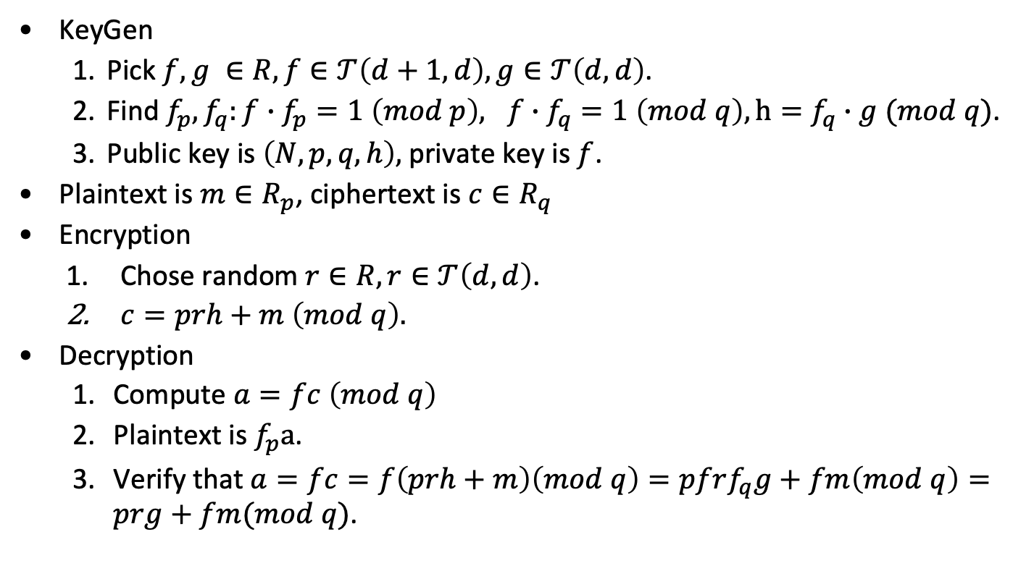
NTRU Public Key System
KeyGen
Pick $f,g ∈R, f∈𝒯\left(d+1,d\right),g∈𝒯\left(d,d\right)$.
Find $f_{p}, f_{q}:f∙f_{p}=1 \left(mod p\right), f∙f_{q}=1 \left(mod q\right), h=f_{q}∙g (mod q)$.
Public key is $\left(N,p,q,h\right),$ private key is $f$.
Plaintext is $m∈R_{p}$, ciphertext is $c∈R_{q}$
Encryption
Chose random $r∈R, r∈𝒯\left(d,d\right)$.
$c=prh+m \left(mod q\right).$
Decryption
Compute $a=fc \left(mod q\right)$
Plaintext is $f_{p}a$.
Verify that $a=fc=f\left(prh+m\right)\left(mod q\right)=pfrf_{q}g+fm\left(mod q\right)=prg+fm(mod q)$.

Slide 81
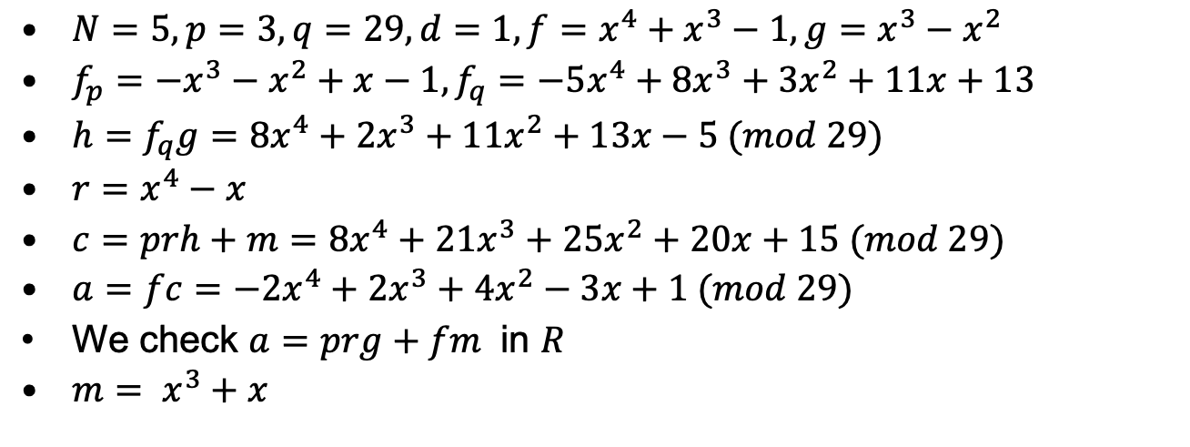
NTRU Example
$N=5, p=3, q=29,d=1, f=x^{4}+x^{3}−1,g=x^{3}−x^{2}$
$f_{p}={−x}^{3}−x^{2}+x−1,f_{q}={−5x}^{4}+{8x}^{3}+{3x}^{2}+11x+13$
$h=f_{q}g=8x^{4}+2x^{3}+{11x}^{2}+13x−5 (mod 29)$
$r=x^{4}−x$
$c=prh+m=8x^{4}+21x^{3}+{25x}^{2}+20x+15 (mod 29)$
$a=fc=−2x^{4}+2x^{3}+{4x}^{2}−3x+1 (mod 29)$
We check $a=prg+fm$ in $R$
$m= x^{3}+x$
From Heiko Knopse

Slide 82
Some NIST Round 2 post quantum
Here are some of the NIST round 2 candidates and their parameters:
New Hope uses ring-LWE with parameters q=12289, n=1024.
Frodo uses LWE on unstructured lattices, based on LWE, n=752, q=2¹⁵, error rate: 2⁻³⁶.
NTRU uses NTRU, n =1024, 𝑁=743, 𝑞=2048, d₁=11, d₂=11 for 256-bit security.
Classic McEliece: n=6960, k=5413, t=119 with Goppa code, key size 8MB (!).
There was a lot of work tweaking parameters for speed and lots of clever optimizations. Of course, the motivation was to avoid public key vulnerability to quantum computer-based attacks.
All these systems are slower and have larger key sizes than current public key systems.

Slide 83
Some NIST Round 3
Public-Key Encryption/KEMs
Classic McEliece
CRYSTALS-KYBER
NTRU
SABER
Digital Signatures
CRYSTALS-DILITHIUM
FALCON
Rainbow
Public-Key Encryption/KEMs (Alternates)
BIKE;
FrodoKEM
HQC
NTRU Prime
SIKE
Digital Signatures
GeMSS
Picnic
SPHINCS+

Slide 84
End

Slide 85
Endomorphisms
Endomorphisms are homomorphisms from E(K) → E(K) that can be represented by rational functions.
If a(x,y)=(r₁(x), r₂(x)y), r₁(x)= p(x)/q(x). deg(a)= max(deg(p), deg(q)).
The endomorphism, a, is separable, if r’(x)¹0.
If a is separable deg(a)= #ker(a).
If a is not separable deg(a)> #ker(a).
If f_{p} is the Frobenius map, it is an endomorphism of degree p and f_{p} is not separable.
ker(f_{p}-1)=#E_{p}. f_{p}-1 is a separable endomorphism.
Let E be an elliptic curve over F_{p}, a= q+1-#E_{p}= q+1- deg(ker(f_{p}-1)). f_{p}²-af_{p}+q=0.

Slide 86
Shanks and Menstre
Input: E_{q}(a,b), #E_{q}(a,b)=q+1-t, |t|≦4<q.
Output: Bound on t. O(q^{1/4}+e).
Pick random point P on E_{q}(a,b), |P|>4<q.
Q=[q+1]P
Q₁= Q+ floor[2q]P
t’= t+ floor[2q], note 0≦t’ ≦4q
m= ceiling(2q^{1/4})
Baby step: [j]P
Giant step: Q₁-[i][m]P
t’= im+j, i,j<m. This bounds #E_{q}(a,b).
Menstre: either a curve or its twist has a point with order >4q

Slide 87
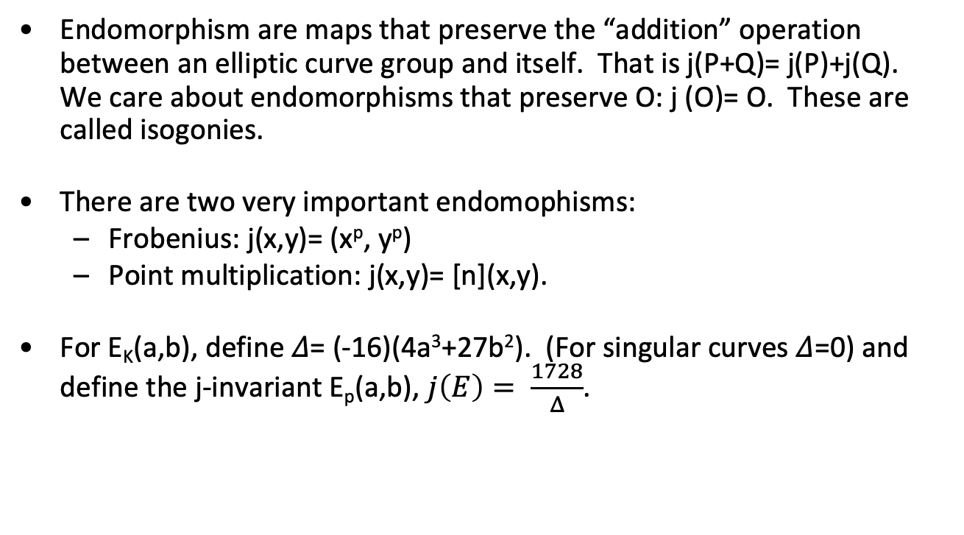
Endomorphisms continued
Endomorphism are maps that preserve the “addition” operation between an elliptic curve group and itself. That is j(P+Q)= j(P)+j(Q). We care about endomorphisms that preserve O: j (O)= O. These are called isogonies.
There are two very important endomophisms:
Frobenius: j(x,y)= (x^{p}, y^{p})
Point multiplication: j(x,y)= [n](x,y).
For E_{K}(a,b), define 𝛥= (-16)(4a³+27b²). (For singular curves 𝛥=0) and define the j-invariant E_{p}(a,b), $j\left(E\right)= \frac{1728}{Δ}$.

Slide 88
Isomorphic Curves and the j-invariant
Let K be a field and K* its algebraic closure. E_{K}(a,b) and E_{K}(a’,b’) are isomorphic if r,s,t 𝝴 K, u 𝝴 K*: the transformations (x,y) → (x’,y’) given by x=u²x’+r, y= u³y’+su²x’+t, take E_{K}(a,b) to E_{K}(a’,b’).
Recall D= (-16)(4a³+27b²). (For singular curves 𝛥=0) and define the j-invariant E_{p}(a,b), j(E)= 1728/𝛥.
Theorem: Let E₁=E_{K}(a,b) and E₂=E_{K}(a’,b’) be two ellliptic curves.
If E₁ and E₂ are isomorphic, they have the same j-invariant.
If j(E₁)=j(E₂), there is a m: a₂= 𝜇⁴a₁, b₂= 𝜇⁶b₁.
If two curves have the same j-invariant, they are isomorphic over the algebraic closure, K*.

Slide 89
The Division Polynomials
[m] (x,y)= (q_{m}(x,y)/y_{m}(x,y)², w_{m}(x,y)/y(x,y)³)
We can calculate these polynomials recursively:
y₀(x,y)= 0; y₁(x,y)= 0.
then y_{2m+1}(x,y)= y_{m+2}(x,y)y_{m}³+y_{m-1}(x,y)y_{m+1}³.
f_{m}=xy_{m}²-y_{m+1}y_{m-1}
w_{m}= 1/(4y)(y_{m+2}y_{m-1}²–y_{m-2}y_{m+1}²)
Let E be an elliptic curve, the endomorphism of E given by multiplication by n has degree n².
(x,y)=P 𝝴 E[m] is the subgroup of torsion points whose order divides m: [m]P=0.

Slide 90
Preliminary DSA
Bob has a private key x and a public key <g,X>: X= g^{x} in a group G. To sign m, given a map f: G → Z_{|G|}:
Bob generates a random a: 1≦a<|G|. A= gª.
Bob computes B𝝴Z_{|G|}: m= -xf(A)+Ba (mod |G|).
Sig_{Bob}(m)= (A,B)
To verify compute u= mB⁻¹ (mod |G|), v=f(A)B⁻¹ (mod |G|) and w=g^{u}X^{v}. Verify that w=A.

Slide 91
ECDSA
D=(q, a,b,P,n,h). nh= #E_{q}(a,b). Private key d, message m.
Signature (r,s)
Select k𝝴[1,n-1]
Compute kP=(x₁, y₁). Convert x₁ to integer x₁.
Compute r= x₁ (mod n). If r=0 goto 1.
Compute e=H(m).
s= k⁻¹(e+dr) (mod n). If s=0, goto 1.
Verify
Check r,s [1,n-1]. Compute e=H(m).
Compute w= s⁻¹ (mod n). u₁= ew (mod n). u₂= rw (mod n).
Compute X= u₁ P+ u₂ Q. If X= O, reject.
Convert x₁ of X to integer x₁. Compute v= x₁ (mod n).
If (v=r) accept signature.

Slide 92
ECIES
Input D=(q, a, b, P, n, h), public key Q, plaintext m.
ENC, MAC, DEC are standard “symmetric key” functions. KDF is key derivation function (also standard).
Pick k𝝴[1, n-1].
Compute R= kP, Z=hkQ. If Z=O, go to 1.
(k[1], k[2]) = KDF(x_{Z}, R).
c= ENC_{k1}(m), t= MAC_{k[2]}(c).
return (R, c, t)

Slide 93
LLL
Definition: B= {b₁, …, b_{n}}, L in R^{n}. m_{i,j}= (b_{i}, b_{j}*)/(b_{j}*, b_{j}*). b_{i}*= b_{i}- ∑_{j=1}^{i-1} m_{i,j} b_{j}*. B is reduced if
| m_{i,j} |≦1/2; 1≦j<i≦n
||b_{i}*||² (3/4-m_{i,i-1}²)||b_{i-1}*||² .
Note b₁*=b₁.

Slide 94
LLL algorithm
b₁*= b₁; k= 2;
for(i=2; i≦n; i++) {
b_{i}*= b_{i};
for(j=1; j<i; j++)
{ m_{i,j}= (b_{i ,} b_{j}*)/B_{j};
b_{i}*= b_{i}- m_{i,j}b_{j}*;B_{i}= (b_{i}*, b_{i}*);}
}
for(;;) {
RED(k, k-1);
if(B_{k}<(3/4 – m_{k,k-1}²)B_{k-1}) {
m= m_{k,k-1}; B= B_{k}+ m ²B_{k-1};m_{k,k-1} = m B_{k-1}/B;
B_{k}= B_{k-1}B_{k}/B; B_{k-1}= B; swap(b_{k}, b_{k-1});
if(k>2) swap(b_{k}, b_{k-1});
for(i=k+1; i £n;i++)
{ t= m_{i,k};; m_{i,k};= m_{i,k-1}- mt;
m_{i,k-1}=t+ m_{k,k-1} m_{i,k}; }
k= max(2, k-1);
if(k>n) return(b_{1, …,} b_{n});
}
RED(k, k-1)
if(|m_{k,l}|)> 1/2) {
r= d1/2+m_{k,l}t;
b_{k}= b_{k} -r b_{l};
for(j=1; j<l;j++) {
m_{k,j}= m_{k,j}-rm_{l,j};
m_{k,l} = m_{k,l}-r;
}
}

Slide 95
LLL Theorem
Let L be the n-dimensional lattice generated by <v₁, …, v_{n}> and l the length of the shortest vector in L. The LLL algorithm produces a reduced basis <b₁, …, b_{n}> of L.
||b₁|| ≦ 2^{(n-1)/4}D^{1/n}.
||b₁|| ≦ 2^{(n-1)/2}l.
||b₁|| ||b₂|| … ||b_{n}|| ≦ 2^{n(n-1)/4}D.
If ||b_{i}||²≤C algorithm takes O(n⁴ lg(C)) .

Slide 96
Gauss again
Let <v₁, v₂> be a basis for a two dimensional lattice L in R². The following algorithm produces a reduced basis.
for(;;) {
if(||v₁||>||v₂||)
swap v₁ and v₂;
t= [(v₁, v₂)/(v₁, v₁)]; // [] is the “closest integer” function
if(t==0)
return;
v₂ = v₂-tv₁;
}
<v₁, v₂> is now a reduced basis and v₁ is a shortest vector in the lattice.

