Slide 1
Electronics of Radio, Part 2 Notes on David Rutledge’s book
John Manferdelli
johnmanferdelli@hotmail.com
11062024 12:12

Slide 2
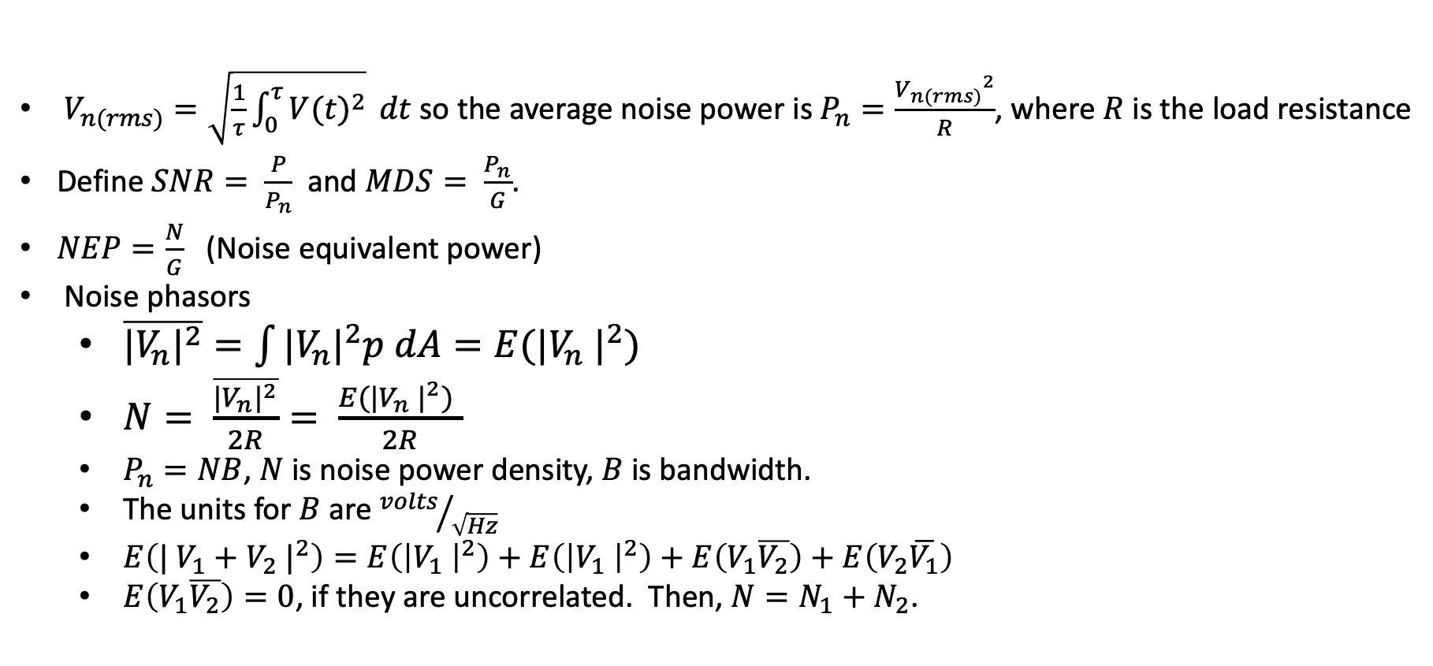
Noise
$V_{n(rms)}=\sqrt{\frac{1}{τ}\int_{0}^{τ}{{V(t)}^{2}}} dt$ so the average noise power is $P_{n}=\frac{{V_{n(rms)}}^{2}}{R}$, where $R$ is the load resistance
Define $SNR= \frac{P}{P_{n}}$and $MDS= \frac{P_{n}}{G}$.
$NEP=\frac{N}{G}$ (Noise equivalent power)
Noise phasors
$\overline{{|V_{n}|}^{2}}=\int{|{V_{n}|}^{2}p dA}=E({|V_{n} |}^{2})$
$N= \frac{\overline{{|V_{n}|}^{2}}}{2R}= \frac{E({|V_{n} |}^{2}) }{2R}$
$P_{n}=NB$, $N$ is noise power density, $B$ is bandwidth.
The units for $B$ are ${volts}/{\sqrt{Hz}}$
$E\left({| V_{1}+V_{2} |}^{2}\right)=E\left({\left|V_{1} \right|}^{2}\right)+E\left({\left|V_{1} \right|}^{2}\right)+E\left(V_{1}\overline{V_{2}}\right)+E\left(V_{2}\overline{V_{1}}\right)$
$E\left(V_{1}\overline{V_{2}}\right)=0$, if they are uncorrelated. Then, $N=N_{1}+N_{2}$.

Slide 3
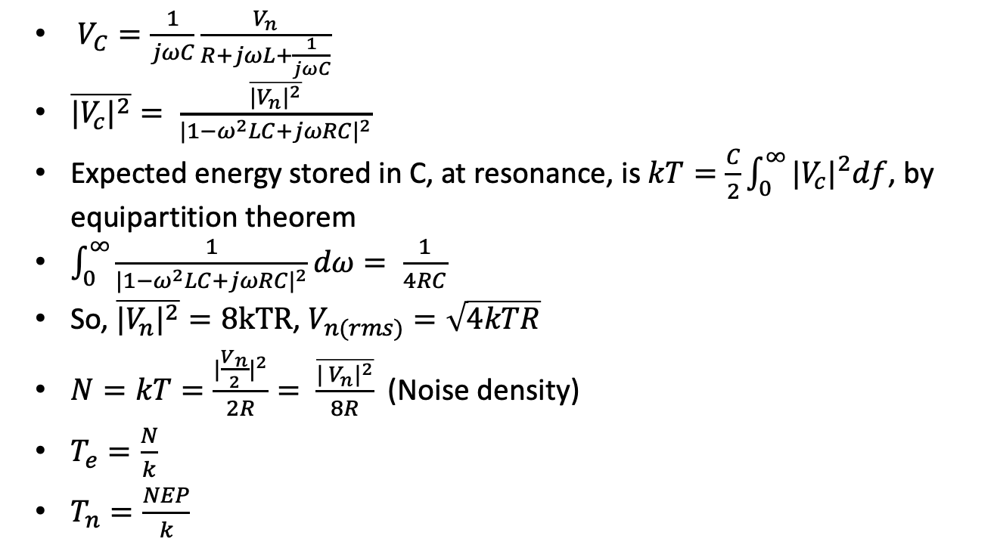
Nyquist
R
L
$V_{C}=\frac{1}{jωC}\frac{V_{n}}{R+jωL+\frac{1}{jωC}}$
$\overline{{|V_{c}|}^{2}}= \frac{\overline{{|V_{n}|}^{2}}}{{|1−ω^{2}LC+jωRC|}^{2}}$
Expected energy stored in C, at resonance, is $kT=\frac{C}{2}\int_{0}^{∞}{{|V_{c}|}^{2}df}$, by equipartition theorem
$\int_{0}^{∞}{\frac{1}{{|1−ω^{2}LC+jωRC|}^{2}}dω}= \frac{1}{4RC}$
So, $\overline{{|V_{n}|}^{2}}=8kTR$, $V_{n(rms)}=\sqrt{4kTR}$
$N=kT=\frac{{|\frac{V_{n}}{2}|}^{2}}{2R}= \frac{\overline{{| V_{n}|}^{2}}}{8R}$ (Noise density)
$T_{e}=\frac{N}{k}$
$T_{n}=\frac{NEP}{k}$
V_{n}
C
V_{C}
Noise model for Nyquist
R
R
V_{n}
Matched load
3

Slide 4
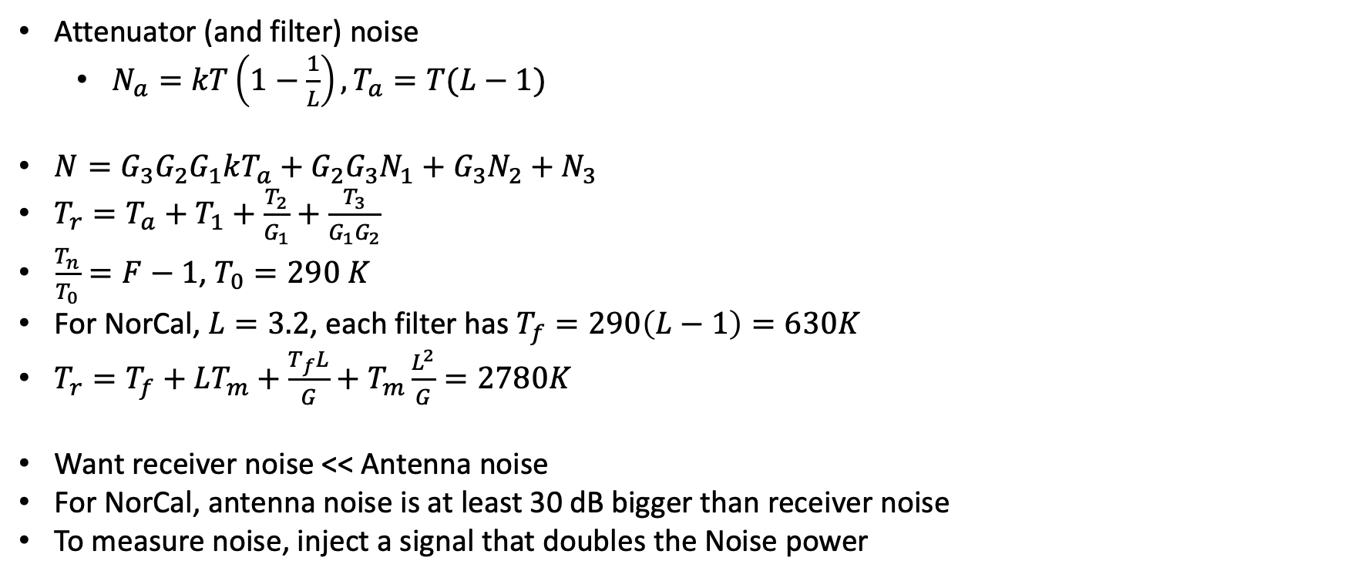
System noise
Attenuator (and filter) noise
$N_{a}=kT\left(1−\frac{1}{L}\right), T_{a}=T(L−1)$
$N=G_{3}G_{2}G_{1}kT_{a}+G_{2}G_{3}N_{1}+G_{3}N_{2}+N_{3}$
$T_{r}=T_{a}+T_{1}+\frac{T_{2}}{G_{1}}+\frac{T_{3}}{G_{1}G_{2}}$
$\frac{T_{n}}{T_{0}}=F−1$, $T_{0}=290 K$
For NorCal, $L=3.2$, each filter has $T_{f}=290\left(L−1\right)=630K$
$T_{r}=T_{f}+LT_{m}+\frac{T_{f}L}{G}+T_{m}\frac{L^{2}}{G}=2780K$
Want receiver noise << Antenna noise
For NorCal, antenna noise is at least 30 dB bigger than receiver noise
To measure noise, inject a signal that doubles the Noise power
T_{a}
N
G₁, N₁, T₁
G₂, N₂, T₂
G₃, N₃, T₃
Process Cascade

Slide 5
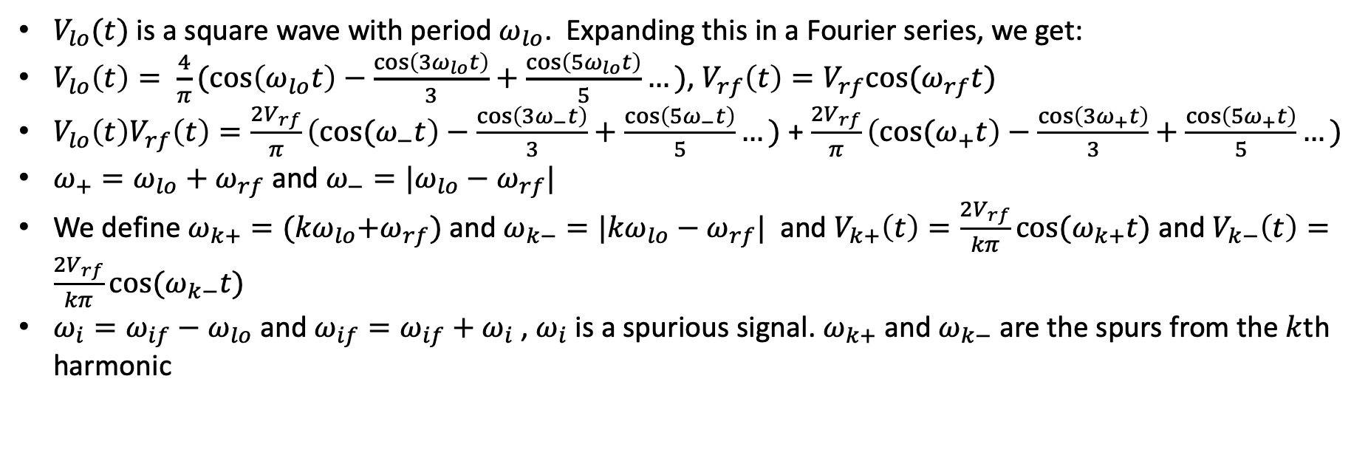


Mixers
$V_{lo}(t)$ is a square wave with period $ω_{lo}$. Expanding this in a Fourier series, we get:
$V_{lo}\left(t\right)= \frac{4}{π}(\cos\left(ω_{lo}t\right)−\frac{\cos\left(3ω_{lo}t\right)}{3}+\frac{\cos\left(5ω_{lo}t\right)}{5}…)$, $V_{rf}\left(t\right)=V_{rf}cos⁡(ω_{rf}t)$
$V_{lo}\left(t\right)V_{rf}\left(t\right)=\frac{2V_{rf}}{π}\left({cos⁡(ω}_{−}t\right)−\frac{\cos\left(3ω_{−}t\right)}{3}+\frac{\cos\left(5ω_{−}t\right)}{5}…)$ + $\frac{2V_{rf}}{π}\left({cos⁡(ω}_{+}t\right)−\frac{\cos\left(3ω_{+}t\right)}{3}+\frac{\cos\left(5ω_{+}t\right)}{5}…)$
$ω_{+}=ω_{lo}+ω_{rf}$ and $ω_{−}=|ω_{lo}−ω_{rf}|$
We define $ω_{k+}={(kω}_{lo}+ω_{rf})$ and $ω_{k−}=|{kω}_{lo}−ω_{rf}|$ and $V_{k+}\left(t\right)=\frac{2V_{rf}}{kπ}cos⁡(ω_{k+}t)$ and $V_{k−}\left(t\right)=\frac{2V_{rf}}{kπ}cos⁡(ω_{k−}t)$
$ω_{i}=ω_{if}−ω_{lo}$ and $ω_{if}=ω_{if}+ω_{i}$ , $ω_{i}$ is a spurious signal. $ω_{k+}$ and $ω_{k−}$ are the spurs from the $k$th harmonic
LO
Image
IF
RF
$$3↑$$
$$5↑$$

Slide 6

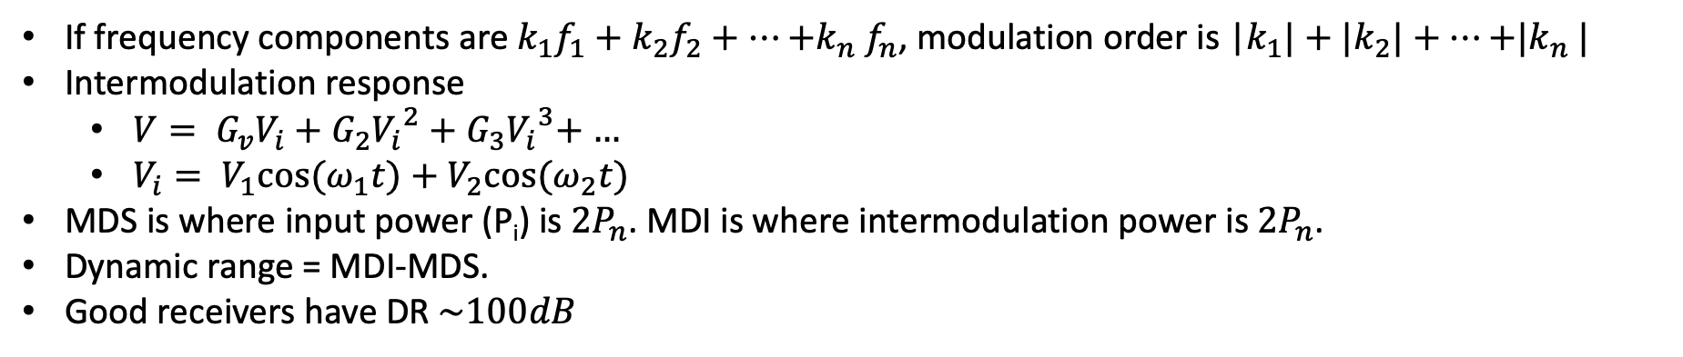





Intermodulation
If frequency components are $k_{1}f_{1}+k_{2}f_{2}+…{+k}_{n}f_{n}$, modulation order is |$k_{1}|+{|k}_{2}|+…{+|k}_{n}|$
Intermodulation response
$V= G_{v}V_{i}+G_{2}{V_{i}}^{2}+G_{3}{V_{i}}^{3}$+ …
$V_{i}= V_{1}cos⁡(ω_{1}t)+$ $V_{2}cos⁡(ω_{2}t)$
MDS is where input power (P_{i}) is $2P_{n}$. MDI is where intermodulation power is $2P_{n}$.
Dynamic range = MDI-MDS.
Good receivers have DR $\sim 100dB$
$$f_{\underline{5}}$$
$$f_{\underline{3}}$$
$$f_{1}$$
$$f_{2}$$
$$f_{\overline{3}}$$
$$f_{\overline{5}}$$
f
Intermodulation products

Slide 7
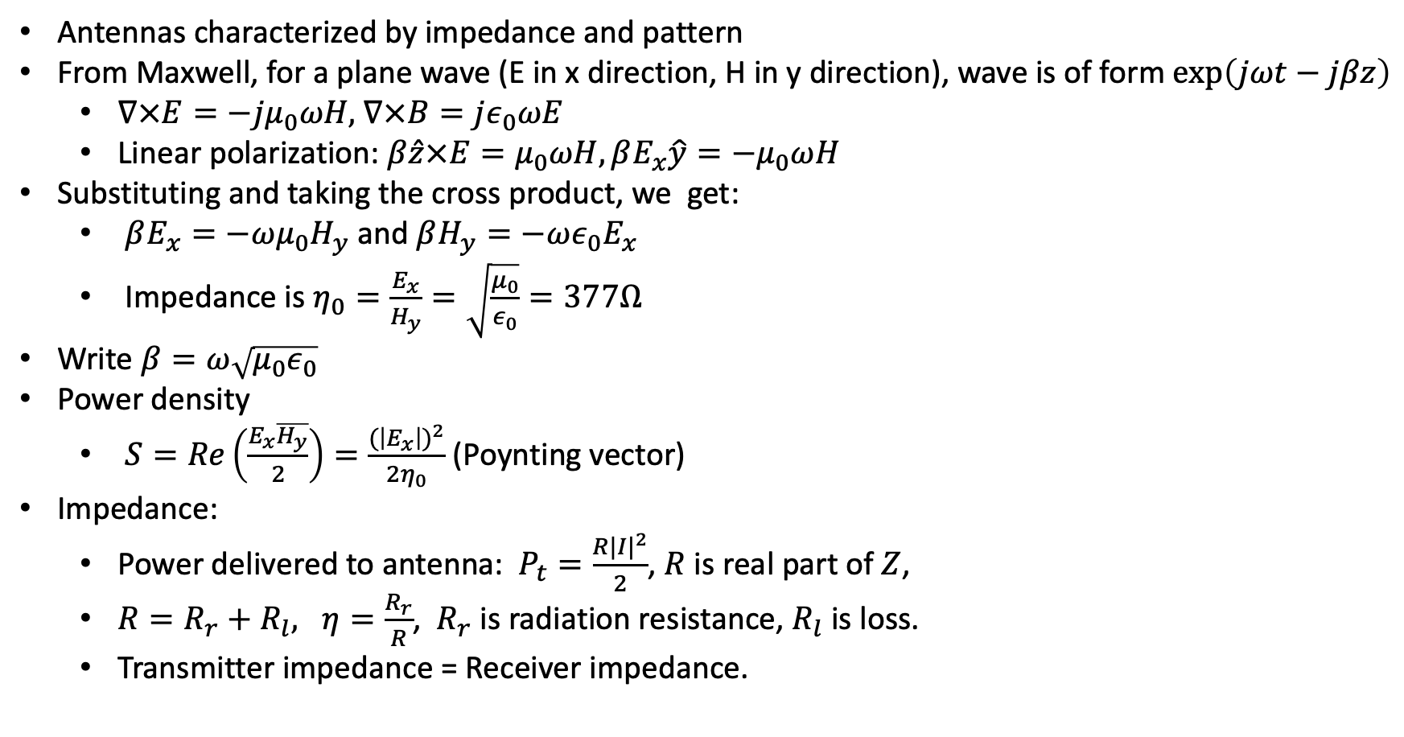
Antennas
Antennas characterized by impedance and pattern
From Maxwell, for a plane wave (E in x direction, H in y direction), wave is of form $\exp\left(jωt−jβz\right)$
$∇×E=−jμ_{0}ωH$, $∇×B=jε_{0}ωE$
Linear polarization: $β\hat{z}×E=μ_{0}ωH, βE_{x}\hat{y}=−μ_{0}ωH$
Substituting and taking the cross product, we get:
$βE_{x}=−ωμ_{0}H_{y}$ and $βH_{y}=−ωε_{0}E_{x}$
Impedance is $η_{0}=\frac{E_{x}}{H_{y}}=\sqrt{\frac{μ_{0}}{ε_{0}}}=377Ω$
Write $β=ω\sqrt{μ_{0}ε_{0}}$
Power density
$S=Re\left(\frac{E_{x}\overline{H_{y}}}{2}\right)=\frac{{(\left|E_{x}\right|)}^{2}}{2η_{0}}$ (Poynting vector)
Impedance:
Power delivered to antenna: $P_{t}=\frac{R{|I|}^{2}}{2}$, $R$ is real part of $Z$,
$R=R_{r}+R_{l}, η=\frac{R_{r}}{R}$, $R_{r}$ is radiation resistance, $R_{l}$ is loss.
Transmitter impedance = Receiver impedance.
I
Z
Transmitting Antenna
Z
V₀
Receiving Antenna

Slide 8
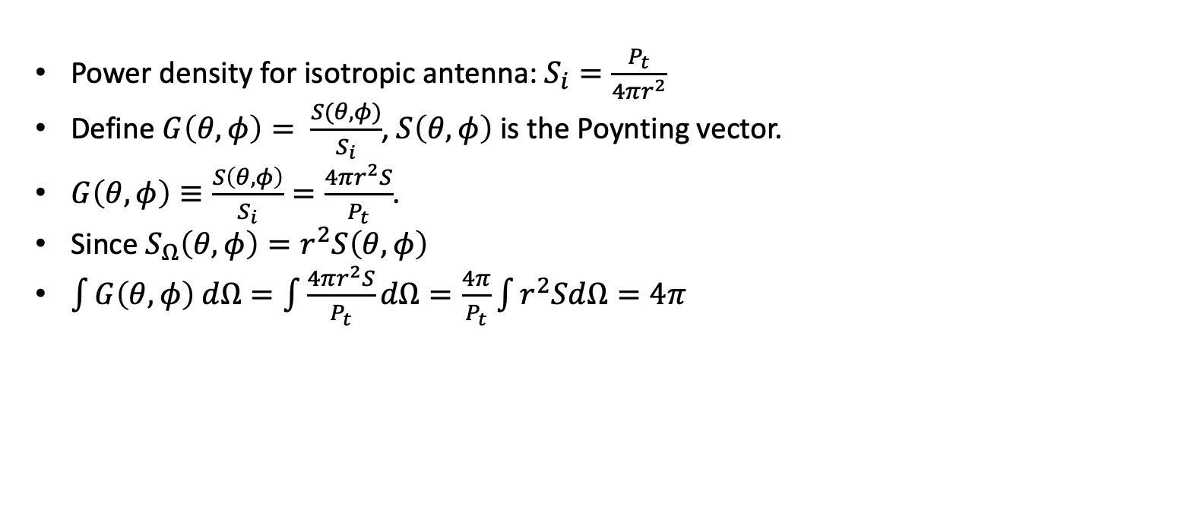
Transmitting Antennas
Power density for isotropic antenna: $S_{i}=\frac{P_{t}}{4πr^{2}}$
Define $G\left(θ,φ\right)= \frac{S(θ,φ)}{S_{i}}$, $S\left(θ,φ\right)$ is the Poynting vector.
$G\left(θ,φ\right)≡\frac{S\left(θ,φ\right)}{S_{i}}=\frac{4πr^{2}S}{P_{t}}$.
Since $S_{Ω}\left(θ,φ\right)=r^{2}S\left(θ,φ\right)$
$\int{G\left(θ,φ\right) dΩ}=\int{\frac{4πr^{2}S}{P_{t}}dΩ=\frac{4π}{P_{t}}\int{r^{2}SdΩ}}=4π$
I
Z
Transmitting Antenna

Slide 9

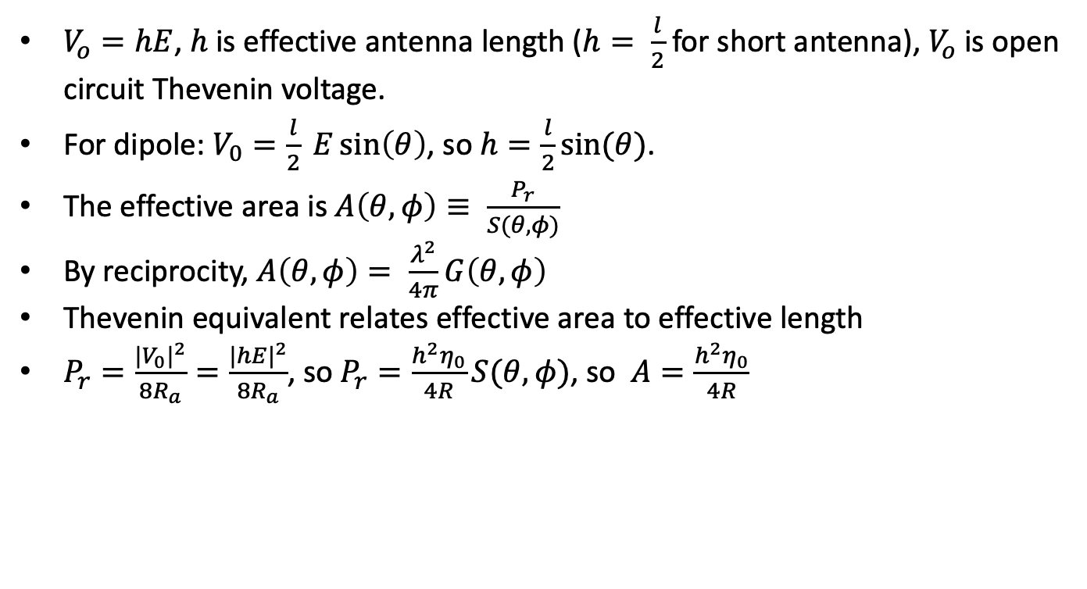



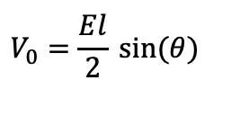
Receiving Antenna
$$E$$
$$θ$$
$$l$$
$$V_{0}$$
$V_{o}=hE$, $h$ is effective antenna length ($h= \frac{l}{2}$ for short antenna), $V_{o}$ is open circuit Thevenin voltage.
For dipole: $V_{0}=\frac{l}{2} E\sin\left(θ\right)$, so $h=\frac{l}{2}sin⁡(θ)$.
The effective area is $A\left(θ, φ\right)≡ \frac{P_{r}}{S(θ,φ)}$
By reciprocity, $A\left(θ, φ\right)= \frac{λ^{2}}{4π}G\left(θ, φ\right)$
Thevenin equivalent relates effective area to effective length
$P_{r}=\frac{{{|V}_{0}|}^{2}}{8R_{a}}=\frac{{|hE|}^{2}}{8R_{a}}$, so $P_{r}=\frac{h^{2}η_{0}}{4R}S(θ,φ)$, so $A=\frac{h^{2}η_{0}}{4R}$
Receiving dipole
C
R
$$V_{0}=\frac{El}{2} sin⁡(θ)$$
Dipole Thevenin equivalent circuit

Slide 10
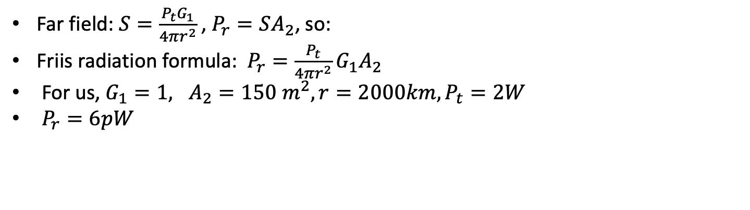
Friis formula
Far field: $S=\frac{P_{t}G_{1}}{4πr^{2}}$, $P_{r}=SA_{2}$, so:
Friis radiation formula: $P_{r}=\frac{P_{t}}{4πr^{2}}G_{1}A_{2}$
For us, $G_{1}=1, A_{2}=150 m^{2}, r=2000km, P_{t}=2W$
$P_{r}=6pW$
G₂, A₂, R₂
I
V
G₁, A₁, R₁

Slide 11
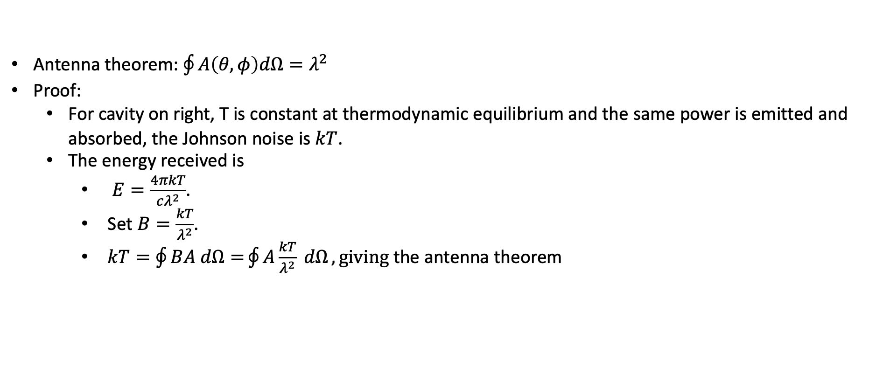
Antenna Theorem
Antenna theorem: $\oint{A\left(θ, φ\right)dΩ=λ^{2}}$
Proof:
For cavity on right, T is constant at thermodynamic equilibrium and the same power is emitted and absorbed, the Johnson noise is $kT$.
The energy received is
$E=\frac{4πkT}{cλ^{2}}$.
Set $B=\frac{kT}{λ^{2}}$.
$kT=\oint{BA dΩ=}\oint{A\frac{kT}{λ^{2}} dΩ}, giving$the antenna theorem
T
A
Insulated cavity

Slide 12

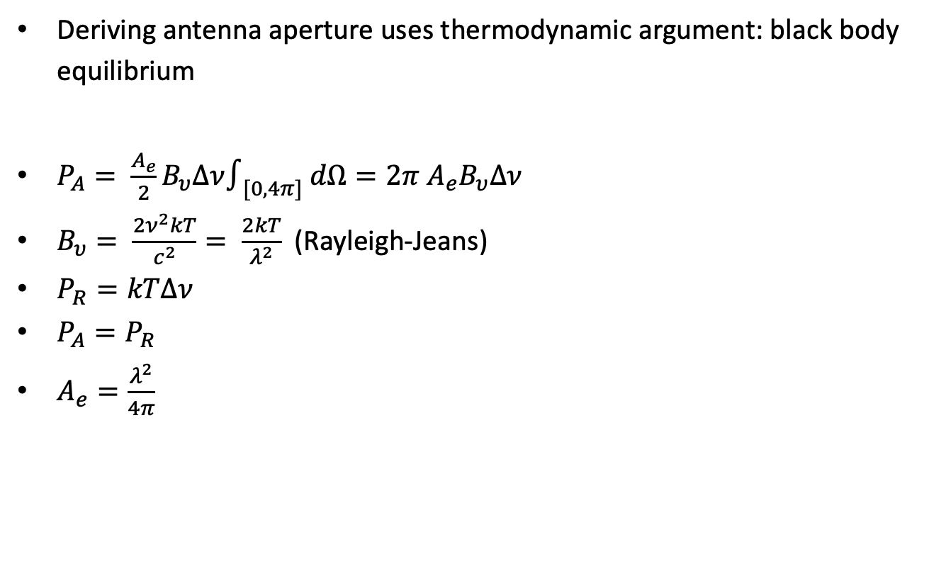
Antenna aperture
Deriving antenna aperture uses thermodynamic argument: black body equilibrium
$P_{A}= \frac{A_{e}}{2}B_{υ}Δν∫_{[0,4π]} dΩ=2π A_{e}B_{υ}Δν$
$B_{υ}= \frac{2ν^{2}kT}{c^{2}}= \frac{2kT}{λ^{2}}$ (Rayleigh-Jeans)
$P_{R}=kTΔν$
$P_{A}=P_{R}$
$A_{e}=\frac{λ^{2}}{4π}$
P_{A}
P_{R}
A
R
T
T
Filter[$ν,ν$+ $Δν]$

Slide 13

Radiation loss and antenna aperture
Spreading loss: $L_{s}=32+log\left(d\right)+20 log\left(f\right)$
d in kilometers
F in megahertz
$W= A_{e}P_{e}$, $A_{e}=\frac{λ^{2}}{4π}$

Slide 14
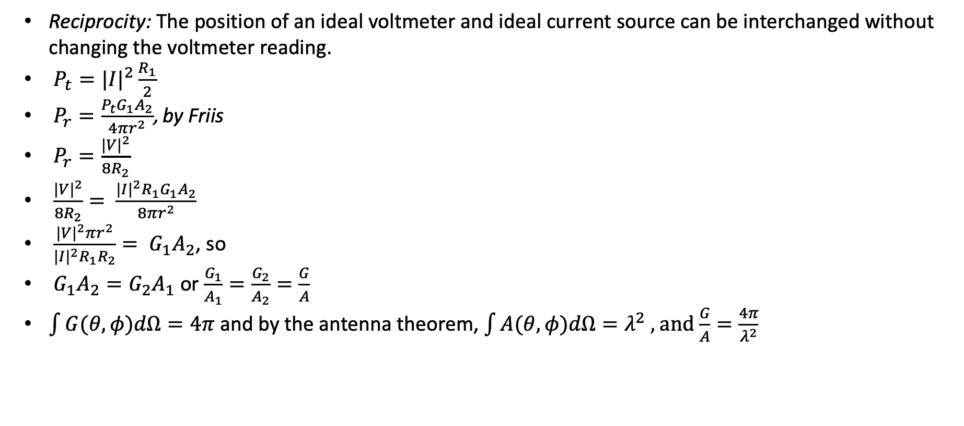
Reciprocity
Reciprocity: The position of an ideal voltmeter and ideal current source can be interchanged without changing the voltmeter reading.
$P_{t}={|I|}^{2}\frac{R_{1}}{2}$
$P_{r}=\frac{P_{t}G_{1}A_{2}}{4πr^{2}}$, by Friis
$P_{r}=\frac{{|V|}^{2}}{8R_{2}}$
$\frac{{|V|}^{2}}{8R_{2}}= \frac{{|I|}^{2}R_{1}G_{1}A_{2}}{8πr^{2}}$
$\frac{{|V|}^{2}πr^{2}}{{|I|}^{2}R_{1}R_{2}}= G_{1}A_{2}$, so
$G_{1}A_{2}=G_{2}A_{1}$ or $\frac{G_{1}}{A_{1}}=\frac{G_{2}}{A_{2}}=\frac{G}{A}$
$\int{G(θ,φ)dΩ}=4π$ and by the antenna theorem, $\int{A(θ,φ)dΩ}=λ^{2}$ , and $\frac{G}{A}=\frac{4π}{λ^{2}}$
G₂, A₂, R₂
I
V
G₁, A₁, R₁

Slide 15
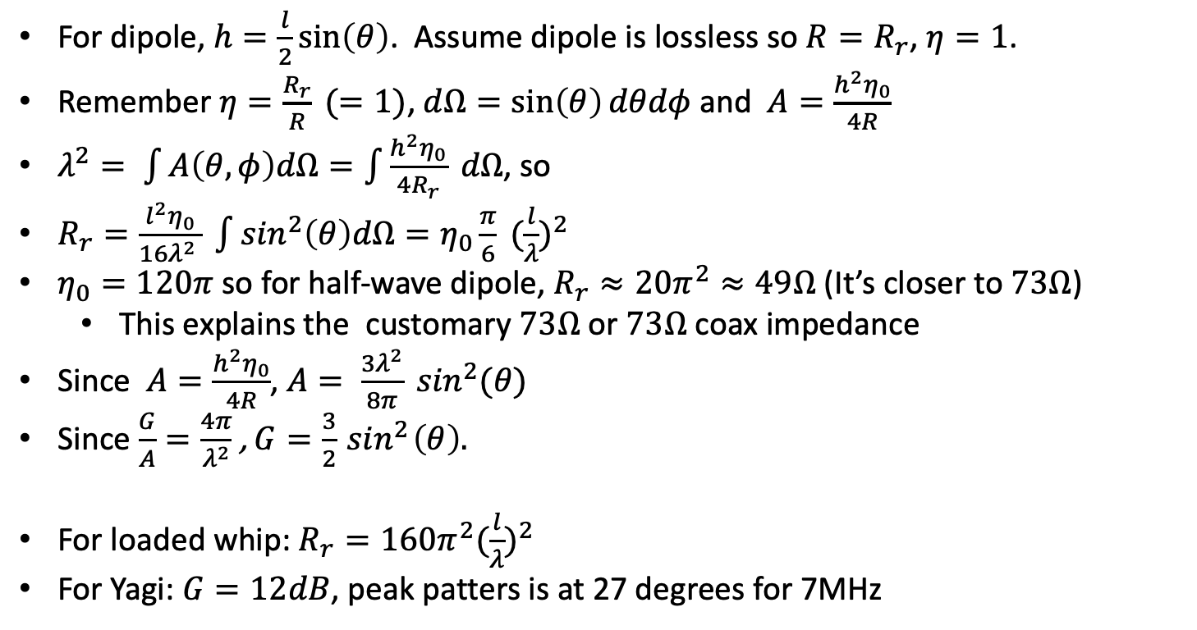

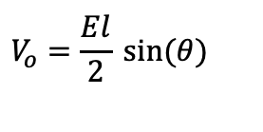
Dipoles
$$E$$
For dipole, $h=\frac{l}{2}\sin\left(θ\right)$. Assume dipole is lossless so $R=R_{r}$, $η=1$.
Remember $η=\frac{R_{r}}{R} (=1)$, $dΩ=\sin\left(θ\right)dθdφ$ and $A=\frac{h^{2}η_{0}}{4R}$
$λ^{2}= \int{A\left(θ, φ\right)dΩ=\int{\frac{h^{2}η_{0}}{4R_{r}} dΩ}}$, so
$R_{r}=\frac{l^{2}η_{0}}{16λ^{2} } \int{\sin^{2}\left(θ\right)dΩ=η_{0}\frac{π}{6}} {(\frac{l}{λ})}^{2}$
$η_{0}=120π$ so for half-wave dipole, $R_{r}≈20π^{2}≈49Ω$ (It’s closer to $73Ω$)
This explains the customary $73Ω$ or $73Ω$ coax impedance
Since $A=\frac{h^{2}η_{0}}{4R}$, $A= \frac{3λ^{2}}{8π} \sin^{2}(θ)$
Since $\frac{G}{A}=\frac{4π}{λ^{2}}$, $G=\frac{3}{2}\sin^{2}\left(θ\right).$
For loaded whip: $R_{r}=160π^{2}{(\frac{l}{λ})}^{2}$
For Yagi: $G=12dB$, peak patters is at 27 degrees for 7MHz
$$θ$$
$$l$$
$$V_{o}$$
Receiving dipole
C
R
$$V_{o}=\frac{El}{2} sin⁡(θ)$$
Dipole Thevenin equivalent circuit

Slide 16
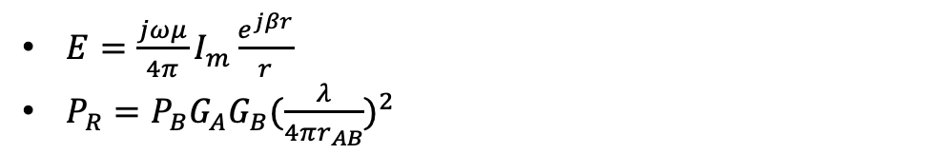
Another antenna model
$E=\frac{jωμ}{4π}I_{m}\frac{e^{jβr}}{r}$
$P_{R}=P_{B}G_{A}G_{B}{(\frac{λ}{4πr_{AB}})}^{2}$

Slide 17
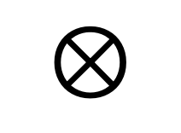
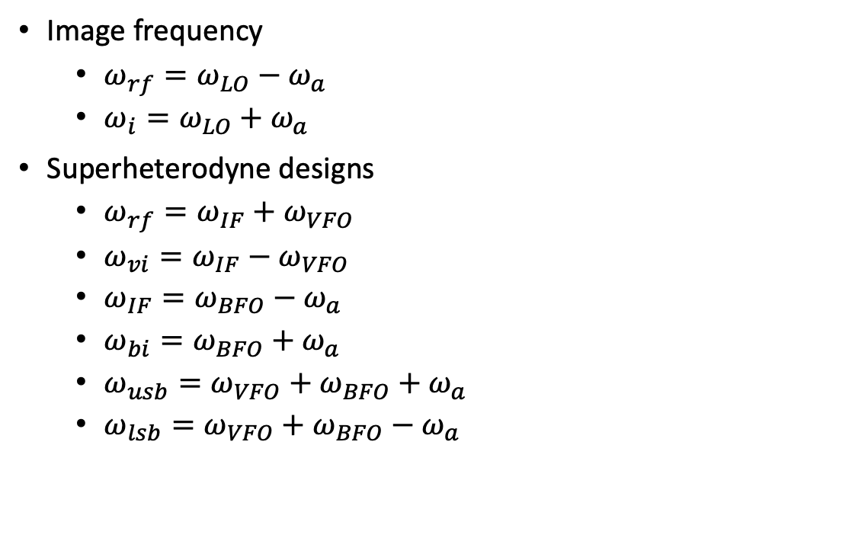
Direct conversion and superhet receivers
Image frequency
$ω_{rf}=ω_{LO}−ω_{a}$
$ω_{i}=ω_{LO}+ω_{a}$
Superheterodyne designs
$ω_{rf}=ω_{IF}+ω_{VFO}$
$ω_{vi}=ω_{IF}−ω_{VFO}$
$ω_{IF}=ω_{BFO}−ω_{a}$
$ω_{bi}=ω_{BFO}+ω_{a}$
$ω_{usb}=ω_{VFO}+ω_{BFO}+$ $ω_{a}$
$ω_{lsb}=ω_{VFO}+ω_{BFO}−$ $ω_{a}$
RF
Filter
$$⊗$$
RF Mixer
LO
Audio
Amp
Direct conversion

Slide 18
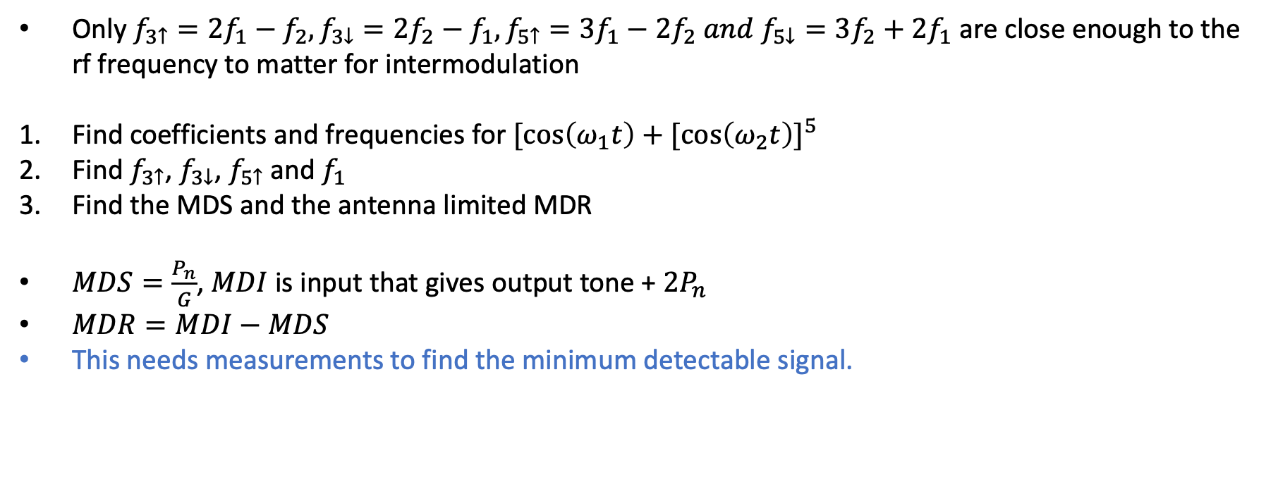
Exercise 35: Intermodulation
Only $f_{3↑}=2f_{1}−f_{2}, f_{3↓}=2f_{2}−f_{1},f_{5↑}=3f_{1}−2f_{2} and f_{5↓}=3f_{2}+2f_{1}$ are close enough to the rf frequency to matter for intermodulation
Find coefficients and frequencies for ${[\cos\left(ω_{1}t\right)+[\cos\left(ω_{2}t\right)]}^{5}$
Find $f_{3↑}$, $f_{3↓}$, $f_{5↑}$ and $f_{1}$
Find the MDS and the antenna limited MDR
$MDS=\frac{P_{n}}{G}$, $MDI$ is input that gives output tone + $2P_{n}$
$MDR=MDI−MDS$
This needs measurements to find the minimum detectable signal.

Slide 19
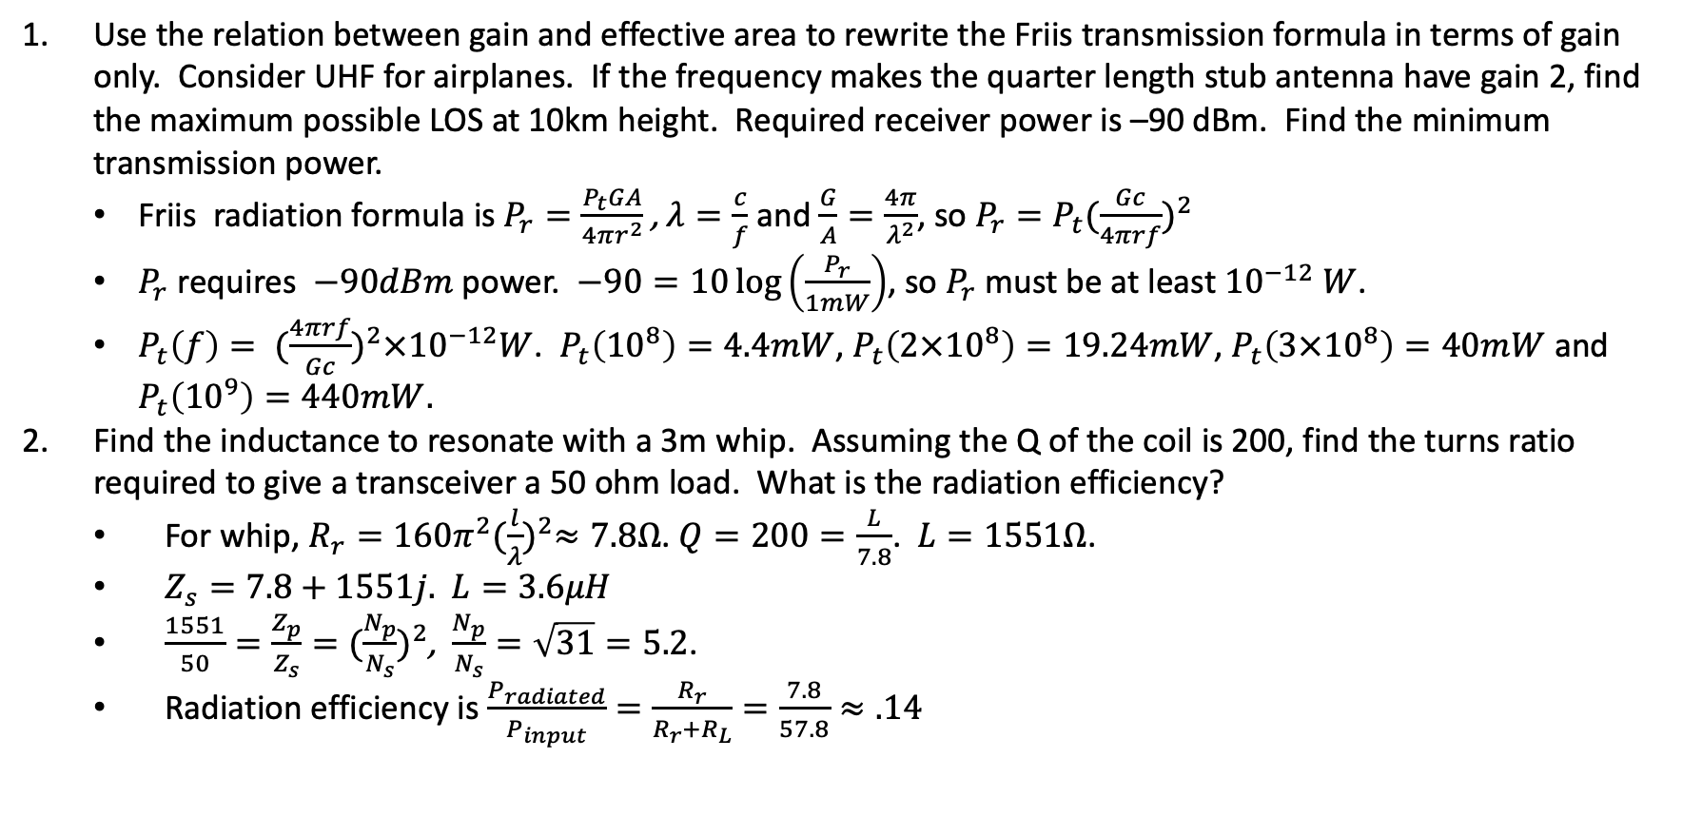
Exercise 37: Antennas
Use the relation between gain and effective area to rewrite the Friis transmission formula in terms of gain only. Consider UHF for airplanes. If the frequency makes the quarter length stub antenna have gain 2, find the maximum possible LOS at 10km height. Required receiver power is –90 dBm. Find the minimum transmission power.
Friis radiation formula is $P_{r}=\frac{P_{t}GA}{4πr^{2}}$, $λ=\frac{c}{f}$ and $\frac{G}{A}=\frac{4π}{λ^{2}}$, so $P_{r}=P_{t}{(\frac{Gc}{4πrf})}^{2}$
$P_{r}$ requires $−90dBm$ power. $−90=10\log\left(\frac{P_{r}}{1mW}\right)$, so $P_{r}$ must be at least ${10}^{−12} W$.
$P_{t}\left(f\right)= {(\frac{4πrf}{Gc})}^{2}×{10}^{−12}W$. $P_{t}\left({10}^{8}\right)=4.4mW$, $P_{t}\left({2×10}^{8}\right)=19.24mW$, $P_{t}\left(3×{10}^{8}\right)=40mW$ and $P_{t}\left({10}^{9}\right)=440mW.$
Find the inductance to resonate with a 3m whip. Assuming the Q of the coil is 200, find the turns ratio required to give a transceiver a 50 ohm load. What is the radiation efficiency?
For whip, $R_{r}=160π^{2}{(\frac{l}{λ})}^{2}≈7.8Ω$. $Q=200=\frac{L}{7.8}$. $L=1551Ω$.
$Z_{s}=7.8+1551j.$ $L=3.6μH$
$\frac{1551}{50}=\frac{Z_{p}}{Z_{s}}={(\frac{N_{p}}{N_{s}})}^{2}$, $\frac{N_{p}}{N_{s}}=\sqrt{31}=5.2$.
Radiation efficiency is $\frac{P_{radiated}}{P_{input}}=\frac{R_{r}}{R_{r}+R_{L}}=\frac{7.8}{57.8}≈.14$

Slide 20
Exercise 17: Tuned Speaker
Connect speaker to function generator 600Hz, 25mVrms.
Sound peaks at resonance. Find resonant frequency L_{p}.
Measure f_{l}, f_{u} by noting the 3dB loss. Calculate Q.
Use voltmeter to find resonance with speaker (nominally 8ohm) to calculate impedance
Calculate the resonant frequency from a transmission line equivalent circuit.

Slide 21
Norcal circuit diagram, 1

Slide 22
Norcal circuit diagram, 2

Slide 23
Norcal circuit diagram, 3

Slide 24
Norcal circuit diagram, 4

Slide 25
Norcal circuit diagram, 5

Slide 26
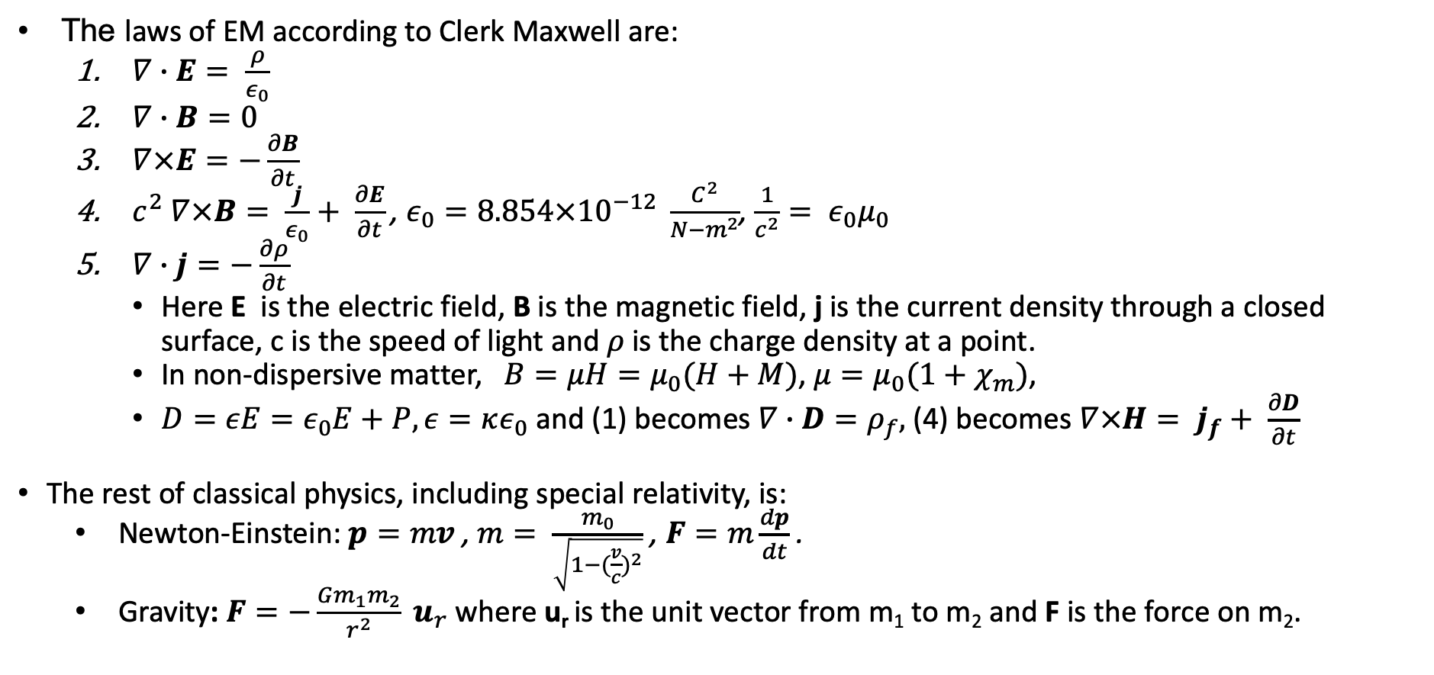
In the beginning…
The laws of EM according to Clerk Maxwell are:
$∇∙E= \frac{ρ}{ε_{0}}$
$∇∙B=0$
$∇×E=−\frac{∂B}{∂t}$
$c^{2} ∇×B= \frac{j}{ε_{0}}+ \frac{∂E}{∂t}$, $ε_{0}=8.854×{10}^{−12} \frac{C^{2}}{N−m^{2}}$, $\frac{1}{c^{2}}= ε_{0}μ_{0}$
$∇∙j=−\frac{∂ρ}{∂t}$
Here E is the electric field, B is the magnetic field, j is the current density through a closed surface, c is the speed of light and 𝜌 is the charge density at a point.
In non-dispersive matter, $B=μH=μ_{0}(H+M)$, $μ=μ_{0}(1+χ_{m})$,
$D=εE=ε_{0}E+P, ε=κε_{0}$ and (1) becomes $∇∙D=ρ_{f},$(4) becomes $∇×H= j_{f}+ \frac{∂D}{∂t}$
The rest of classical physics, including special relativity, is:
Newton-Einstein: $p=mv$, $m= \frac{m_{0}}{\sqrt{1−{(\frac{v}{c})}^{2}}}$ , $F=m\frac{dp}{dt}$ .
Gravity: $F=−\frac{Gm_{1}m_{2}}{r^{2}} u_{r}$ where u_{r} is the unit vector from m₁ to m₂ and F is the force on m₂.

Slide 27
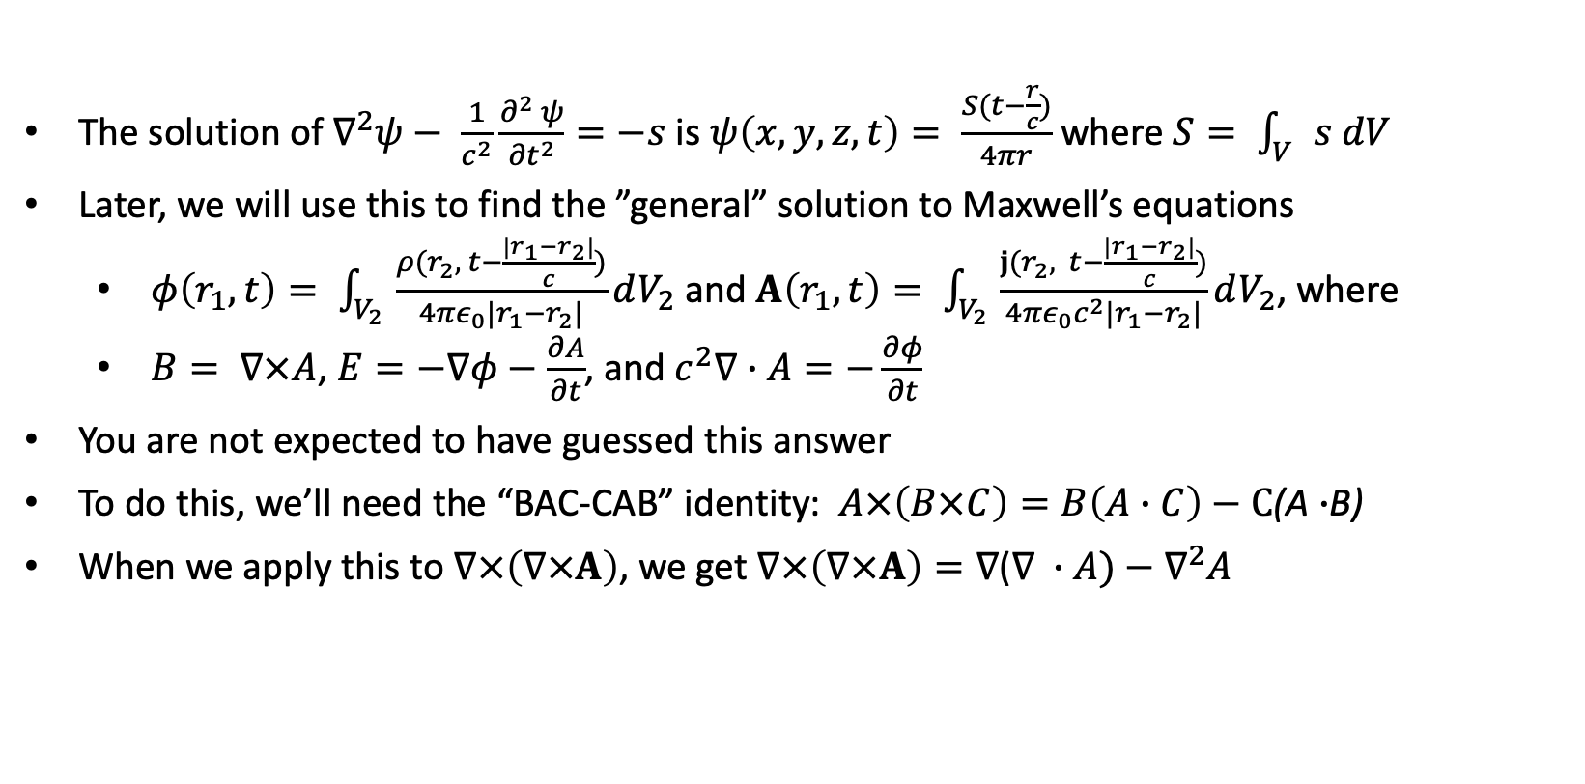
Solutions to the wave equation
The solution of $∇^{2}ψ− \frac{1}{c^{2}}\frac{∂^{2} ψ}{{∂t}^{2}}=−s$ is $ψ\left(x,y,z,t\right)= \frac{S(t−\frac{r}{c})}{4πr}$ where $S= \int_{V}{s dV}$
Later, we will use this to find the ”general” solution to Maxwell’s equations
$φ\left(r_{1}, t\right)= \int_{V_{2}}{\frac{ρ(r_{2}, t−\frac{|r_{1}−r_{2}|}{c})}{4πε_{0}|r_{1}−r_{2}|}dV_{2}}$ and $A\left(r_{1}, t\right)= \int_{V_{2}}{\frac{j(r_{2}, t−\frac{|r_{1}−r_{2}|}{c})}{4πε_{0}c^{2}|r_{1}−r_{2}|}dV_{2}}$, where
$B= ∇×A$, $E=−∇φ−\frac{∂A}{∂t}$, and $c^{2}∇∙A=−\frac{∂φ}{∂t}$
You are not expected to have guessed this answer
To do this, we’ll need the “BAC-CAB” identity: $A×\left(B×C\right)=B\left(A∙C\right)−C$(A $∙$B)
When we apply this to $∇×\left(∇×A\right)$, we get $∇×\left(∇×A\right)=∇$($∇ ∙A)−∇^{2}A$

Slide 28
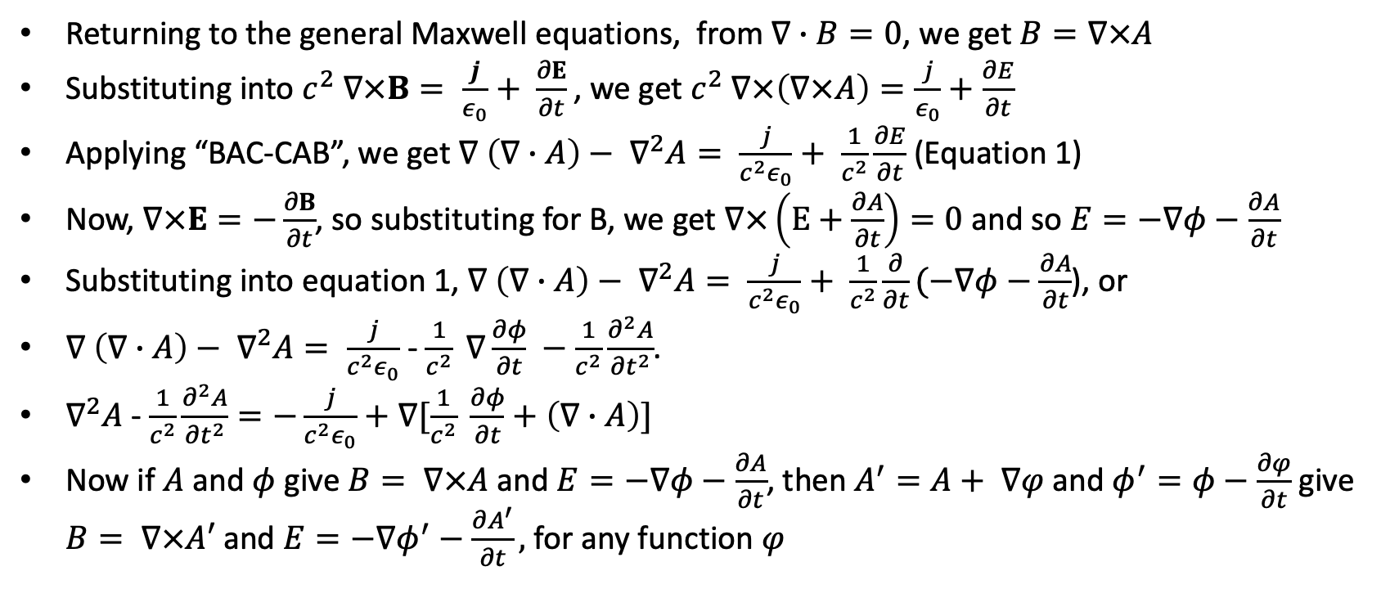
General solution to Maxwell’s equations
Returning to the general Maxwell equations, from $∇∙B=0$, we get $B=∇×A$
Substituting into $c^{2} ∇×B= \frac{j}{ε_{0}}+ \frac{∂E}{∂t}$, we get $c^{2} ∇×\left(∇×A\right)=\frac{j}{ε_{0}}+\frac{∂E}{∂t}$
Applying “BAC-CAB”, we get $∇ \left(∇∙A\right)− ∇^{2}A= \frac{j}{c^{2}ε_{0}}+ \frac{1}{c^{2}}\frac{∂E}{∂t}$ (Equation 1)
Now, $∇×E=−\frac{∂B}{∂t}$, so substituting for B, we get $∇×\left(E+\frac{∂A}{∂t}\right)=0$ and so $E=−∇φ−\frac{∂A}{∂t}$
Substituting into equation 1, $∇ \left(∇∙A\right)− ∇^{2}A= \frac{j}{c^{2}ε_{0}}+ \frac{1}{c^{2}}\frac{∂}{∂t}(−∇φ−\frac{∂A}{∂t}$), or
$∇ \left(∇∙A\right)− ∇^{2}A= \frac{j}{c^{2}ε_{0}}$ - $\frac{1}{c^{2}} ∇\frac{∂φ}{∂t} −\frac{1}{c^{2}}\frac{∂^{2}A}{{∂t}^{2}}$.
$∇^{2}A$ - $\frac{1}{c^{2}}\frac{∂^{2}A}{{∂t}^{2}}=−\frac{j}{c^{2}ε_{0}}+∇[\frac{1}{c^{2}} \frac{∂φ}{∂t}+\left(∇∙A\right)]$
Now if $A$ and $φ$ give $B= ∇×A$ and $E=−∇φ−\frac{∂A}{∂t}$, then $A^{′}=A+ ∇φ$ and $φ^{′}=φ−\frac{∂φ}{∂t}$ give $B= ∇×A′$ and $E=−∇φ^{′}−\frac{∂A^{′}}{∂t},$ for any function $φ$

Slide 29
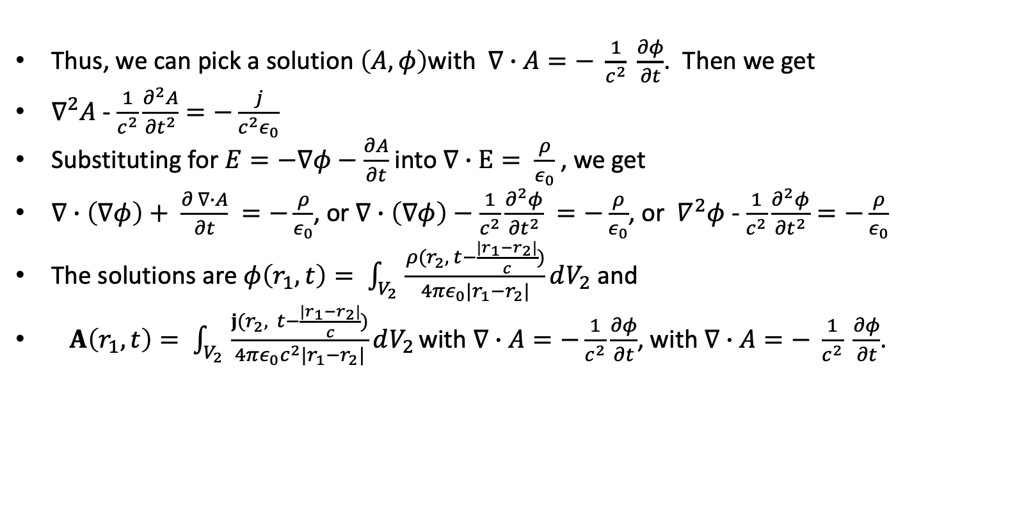
General solution to Maxwell’s equations
Thus, we can pick a solution $\left(A, φ\right)$with $∇∙A=− \frac{1}{c^{2}} \frac{∂φ}{∂t}$. Then we get
$∇^{2}A$ - $\frac{1}{c^{2}}\frac{∂^{2}A}{{∂t}^{2}}=−\frac{j}{c^{2}ε_{0}}$
Substituting for $E=−∇φ−\frac{∂A}{∂t}$ into $∇∙E= \frac{ρ}{ε_{0}}$, we get
$∇∙\left(∇φ\right)+ \frac{∂ ∇∙A}{∂t} =−\frac{ρ}{ε_{0}}$, or $∇∙\left(∇φ\right)−\frac{1}{c^{2}}\frac{∂^{2}φ}{{∂t}^{2}} =−\frac{ρ}{ε_{0}}$, or $∇^{2}φ$ - $\frac{1}{c^{2}}\frac{∂^{2}φ}{{∂t}^{2}}=−\frac{ρ}{ε_{0}}$
The solutions are $φ\left(r_{1}, t\right)= \int_{V_{2}}{\frac{ρ(r_{2}, t−\frac{|r_{1}−r_{2}|}{c})}{4πε_{0}|r_{1}−r_{2}|}dV_{2}}$ and
$A\left(r_{1}, t\right)= \int_{V_{2}}{\frac{j(r_{2}, t−\frac{|r_{1}−r_{2}|}{c})}{4πε_{0}c^{2}|r_{1}−r_{2}|}dV_{2}}$ with $∇∙A=−\frac{1}{c^{2}}\frac{∂φ}{∂t}$, with $∇∙A=− \frac{1}{c^{2}} \frac{∂φ}{∂t}$.

Slide 30
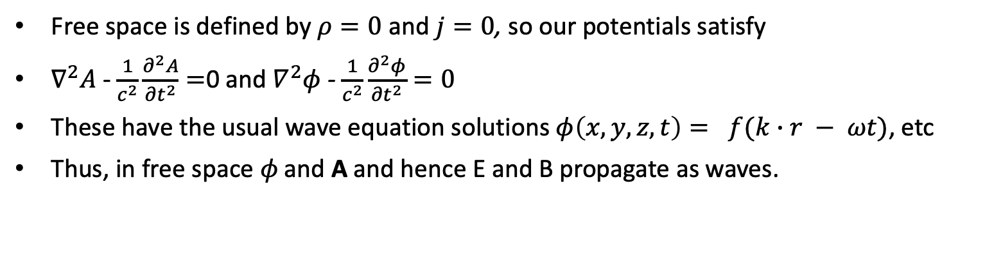
Solution to Maxwell’s equations in free space
Free space is defined by $ρ=0$ and $j=0$, so our potentials satisfy
$∇^{2}A$ - $\frac{1}{c^{2}}\frac{∂^{2}A}{{∂t}^{2}}=$0 and $∇^{2}φ$ - $\frac{1}{c^{2}}\frac{∂^{2}φ}{{∂t}^{2}}=0$
These have the usual wave equation solutions $φ\left(x,y,z,t\right)= f(k∙r − ωt)$, etc
Thus, in free space 𝜙 and A and hence E and B propagate as waves.

Slide 31
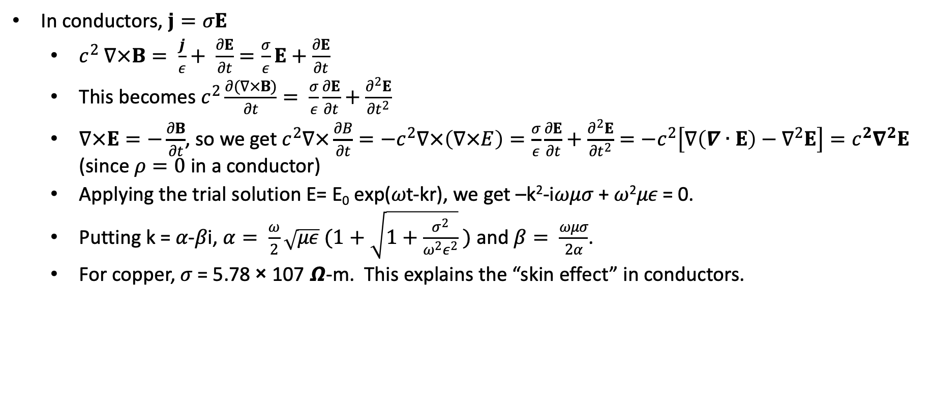
Solution to Maxwell’s equations in conductors
In conductors, $j=σE$
$c^{2} ∇×B= \frac{j}{ε}+ \frac{∂E}{∂t}=\frac{σ}{ε}E+\frac{∂E}{∂t}$
This becomes $c^{2}\frac{∂(∇×B)}{∂t}= \frac{σ}{ε}\frac{∂E}{∂t}+\frac{∂^{2}E}{{∂t}^{2}}$
$∇×E=−\frac{∂B}{∂t}$, so we get $c^{2}∇×\frac{∂B}{∂t}=−c^{2}∇×\left(∇×E\right)=\frac{σ}{ε}\frac{∂E}{∂t}+\frac{∂^{2}E}{{∂t}^{2}}=−c^{2}\left[∇\left(∇∙E\right)−∇^{2}E\right]=c^{2}∇^{2}E$ (since $ρ=0$ in a conductor)
Applying the trial solution E= E₀ exp(𝜔t-kr), we get –k²-i𝜔𝜇𝜎 + 𝜔²𝜇𝜖 = 0.
Putting k = 𝛼-𝛽i, $α= \frac{ω}{2}\sqrt{με} (1+\sqrt{1+\frac{σ^{2}}{ω^{2}ε^{2}}} )$ and $β= \frac{ωμσ}{2α}$.
For copper, 𝜎 = 5.78 × 107 𝞨-m. This explains the “skin effect” in conductors.

Slide 32
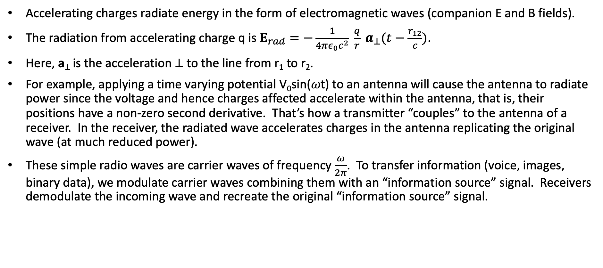
Radiation, antennas
Accelerating charges radiate energy in the form of electromagnetic waves (companion E and B fields).
The radiation from accelerating charge q is $E_{rad}=−\frac{1}{4πε_{0}c^{2}} \frac{q}{r} a_{⊥}(t−\frac{r_{12}}{c})$.
Here, a⊥ is the acceleration ⊥ to the line from r₁ to r₂.
For example, applying a time varying potential V₀sin(𝜔t) to an antenna will cause the antenna to radiate power since the voltage and hence charges affected accelerate within the antenna, that is, their positions have a non-zero second derivative. That’s how a transmitter “couples” to the antenna of a receiver. In the receiver, the radiated wave accelerates charges in the antenna replicating the original wave (at much reduced power).
These simple radio waves are carrier waves of frequency $\frac{ω}{2π}$. To transfer information (voice, images, binary data), we modulate carrier waves combining them with an “information source” signal. Receivers demodulate the incoming wave and recreate the original “information source” signal.

Slide 33

Maxwell’s equations in a non-dispersive media
$B=μH$, $D= ϵE$
$∇∙D=ρ$
$∇∙B=0$
$∇×E=−\frac{∂B}{∂t}$
$∇×H=j+\frac{∂E}{∂t}$
$∇∙j=−\frac{∂ρ}{∂t}$

Slide 34
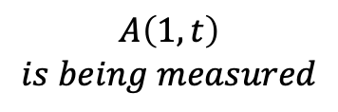



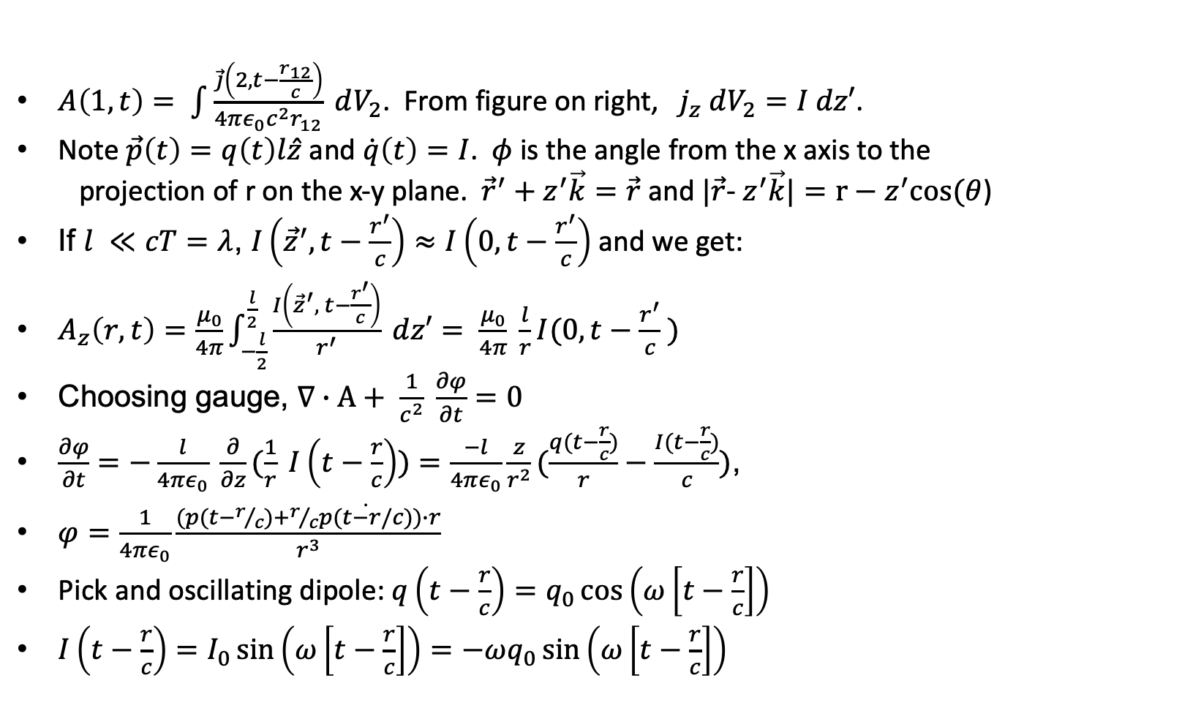






Radiation from a small dipole
$A\left(1,t\right)= \int{\frac{\vec{j}\left(2, t−\frac{r_{12}}{c}\right)}{4πε_{0}c^{2}r_{12}}} dV_{2}$. From figure on right, $j_{z} dV_{2}=I dz′$.
Note $\vec{p}\left(t\right)=q\left(t\right)l\hat{z}$ and $\dot{q}\left(t\right)=I$. $φ$ is the angle from the x axis to the
projection of r on the x-y plane. ${\vec{r}}^{′}+z^{′}\vec{k}=\vec{r}$ and $|\vec{r}$- $z^{′}\vec{k}|=r−z^{′}cos⁡(θ$)
If $l ≪cT=λ$, $I\left({\vec{z}}^{′}, t−\frac{r^{′}}{c}\right)≈I\left(0, t−\frac{r^{′}}{c}\right)$ and we get:
$A_{z}\left(r,t\right)=\frac{μ_{0}}{4π}\int_{−\frac{l}{2}}^{\frac{l}{2}}{\frac{I\left({\vec{z}}^{′}, t−\frac{r^{′}}{c}\right)}{r^{′}} dz′}= \frac{μ_{0}}{4π} \frac{l}{r}I(0, t−\frac{r^{′}}{c} )$
Choosing gauge, $∇∙A+ \frac{1}{c^{2}} \frac{∂φ}{∂t}=0$
$\frac{∂φ}{∂t}=−\frac{l}{4πε_{0}} \frac{∂}{∂z}(\frac{1}{r} I\left(t−\frac{r}{c}\right))=\frac{−l}{4πε_{0}}\frac{z}{r^{2}}(\frac{q(t−\frac{r}{c})}{r}−\frac{I(t−\frac{r}{c})}{c})$,
$φ=\frac{1}{4πε_{0}}\frac{(p(t−r/c)+r/c\dot{p(t−r/c)})∙r}{r^{3}}$
Pick and oscillating dipole: $q\left(t−\frac{r}{c}\right)=q_{0}\cos\left(ω\left[t−\frac{r}{c}\right]\right)$
$I\left(t−\frac{r}{c}\right)=I_{0}\sin\left(ω\left[t−\frac{r}{c}\right]\right)=−ωq_{0}\sin\left(ω\left[t−\frac{r}{c}\right]\right)$
$$q(t)$$
$$A\left(1,t\right)$$
$$is being measured$$
$$\vec{r}′$$
$$1$$
$$\frac{ℓ}{2}$$
$$\vec{r}$$
$$z′$$
$$θ$$
y
$$\frac{ℓ}{2}$$
z
$$−q(t)$$

Slide 35
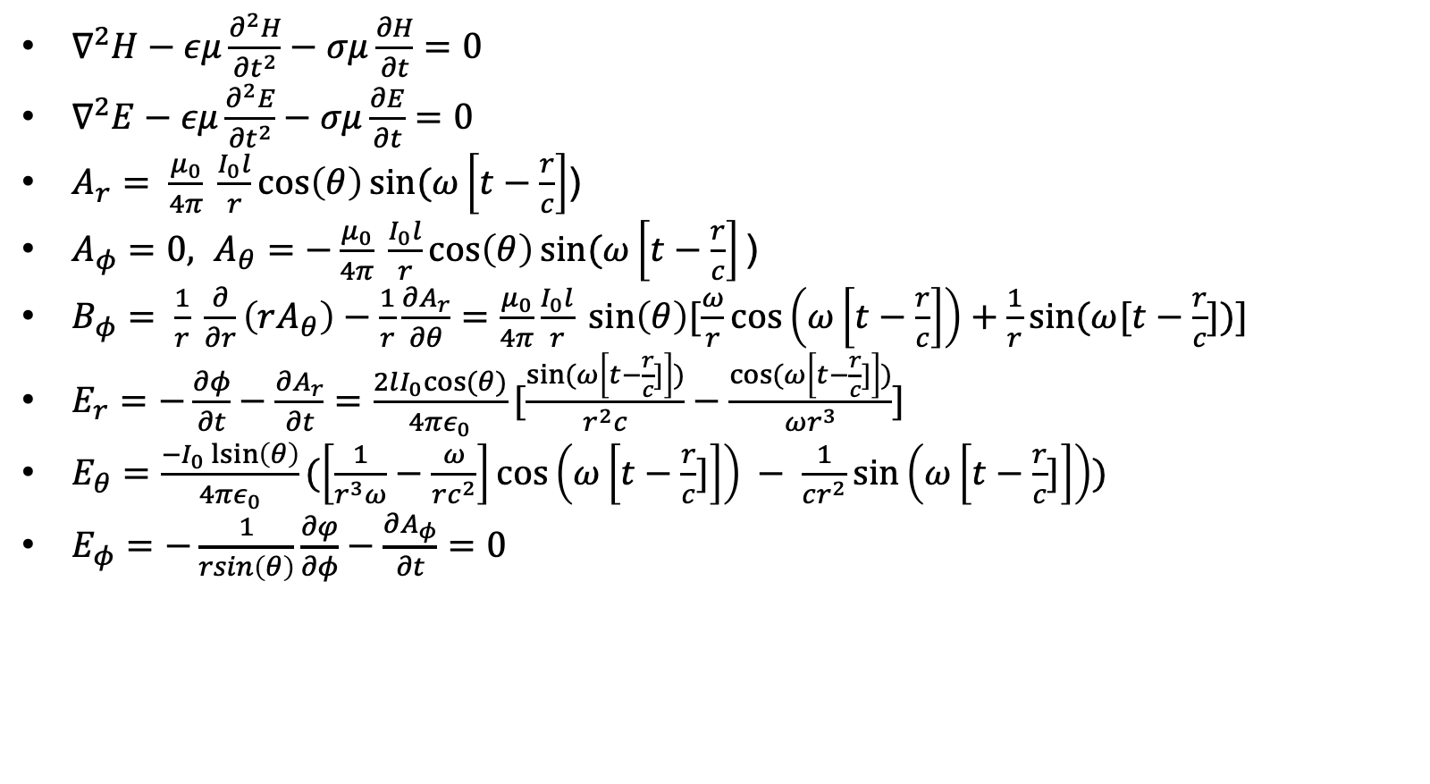
Radiation from a small dipole
$∇^{2}H−εμ\frac{∂^{2}H}{{∂t}^{2}}−σμ\frac{∂H}{∂t}=0$
$∇^{2}E−εμ\frac{∂^{2}E}{{∂t}^{2}}−σμ\frac{∂E}{∂t}=0$
$A_{r}= \frac{μ_{0}}{4π} \frac{I_{0}l}{r}\cos\left(θ\right)sin⁡(ω\left[t−\frac{r}{c}\right]$)
$A_{φ}=0, A_{θ}=−\frac{μ_{0}}{4π} \frac{I_{0}l}{r}\cos\left(θ\right)sin⁡(ω\left[t−\frac{r}{c}\right]\text{)}$
$B_{φ}= \frac{1}{r} \frac{∂}{∂r}\left(rA_{θ}\right)−\frac{1}{r}\frac{∂A_{r}}{∂θ}=\frac{μ_{0}}{4π}\frac{I_{0}l}{r} sin\left(θ\right)[\frac{ω}{r}\cos\left(ω\left[t−\frac{r}{c}\right]\right)+\frac{1}{r}sin⁡(ω[t−\frac{r}{c}])]$
$E_{r}=−\frac{∂φ}{∂t}−\frac{∂A_{r}}{∂t}=\frac{2lI_{0}cos⁡(θ)}{4πε_{0}}[\frac{sin⁡(ω\left[t−\frac{r}{c}]\right])}{r^{2}c}−\frac{cos⁡(ω\left[t−\frac{r}{c}]\right])}{ωr^{3}}]$
$E_{θ}=\frac{−I_{0}\operatorname{lsin}\left(θ\right)}{4πε_{0}}(\left[\frac{1}{r^{3}ω}−\frac{ω}{rc^{2}}\right]\cos\left(ω\left[t−\frac{r}{c}]\right]\right) − \frac{1}{cr^{2}}\sin\left(ω\left[t−\frac{r}{c}]\right]\right))$
$E_{φ}=−\frac{1}{rsin\left(θ\right)}\frac{∂φ}{∂φ}−\frac{∂A_{φ}}{∂t}=0$

Slide 36

Radiation from a small dipole
$B=μH$
$∇∙\left(E ×H\right)=−H\frac{∂B}{∂t}−E\frac{∂D}{∂t} −E∙j$
$S=E×H$, $∇∙S+ \frac{∂u}{∂t}=−E∙j$ (u is energy density)
$\int{S∙dA= \frac{{(l I_{0} ω)}^{2}}{6πε_{0}c^{3}}{{cos⁡(ω\left[t−\frac{r}{c}\right])}^{2}}}$
$P_{av}=\frac{{(lω)}^{2}}{6πε_{0}c^{3}}\frac{{I_{0}}^{2}}{2}{=} \frac{2π}{3} \sqrt{\frac{μ_{0}}{ε_{0}}} {(\frac{l}{λ})}^{2} \frac{{I_{0}}^{2}}{2}$
$R_{r}=\frac{2π}{3} \sqrt{\frac{μ_{0}}{ε_{0}}} {(\frac{l}{λ})}^{2}$

Slide 37
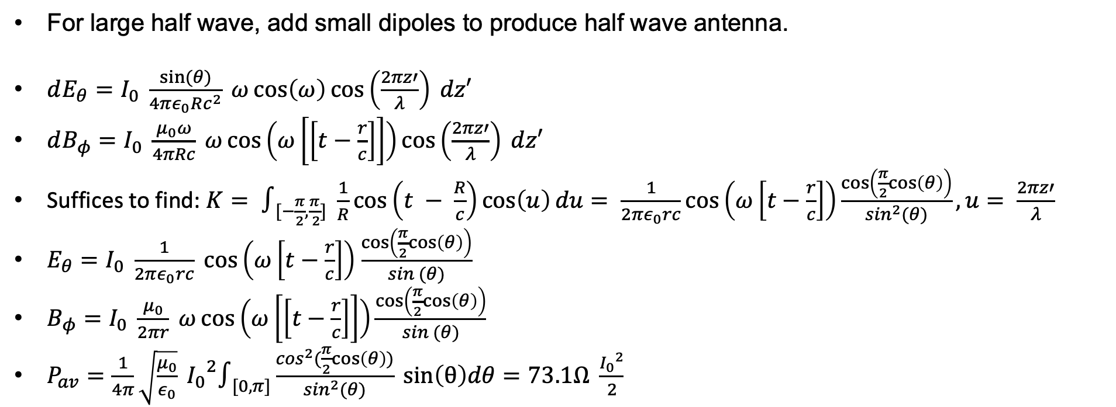
Large half wave dipole
For large half wave, add small dipoles to produce half wave antenna.
$dE_{θ}=I_{0} \frac{sin⁡(θ)}{4πε_{0}Rc^{2}} ω\cos\left(ω\right)\cos\left(\frac{2πz′}{λ}\right) dz′$
$dB_{φ}=I_{0} \frac{μ_{0}ω}{4πRc} ω\cos\left(ω\left[\left[t−\frac{r}{c}\right]\right]\right)\cos\left(\frac{2πz′}{λ}\right) dz′$
Suffices to find: $K= ∫_{[−\frac{π}{2},\frac{π}{ 2}]} \frac{1}{R}\cos\left(t − \frac{R}{c}\right)\cos\left(u\right)du= \frac{1}{2πε_{0}rc}\cos\left(ω\left[t−\frac{r}{c}\right]\right)\frac{\cos\left(\frac{π}{2}cos\left(θ\right)\right)}{\sin^{2}(θ)}, u= \frac{2πz′}{λ}$
$E_{θ}=I_{0} \frac{1}{2πε_{0}rc} \cos\left(ω\left[t−\frac{r}{c}\right]\right)$ $\frac{\cos\left(\frac{π}{2}cos\left(θ\right)\right)}{sin (θ)}$
$B_{φ}=I_{0} \frac{μ_{0}}{2πr} ω\cos\left(ω\left[\left[t−\frac{r}{c}\right]\right]\right)\frac{\cos\left(\frac{π}{2}cos\left(θ\right)\right)}{sin (θ)}$
$P_{av}=\frac{1}{4π}\sqrt{\frac{μ_{0}}{ε_{0}}} {I_{0}}^{2}∫_{[0, π]}\frac{\cos^{2}(\frac{π}{2}cos\left(θ\right))}{\sin^{2}(θ)} sin\left(θ\right)dθ=73.1Ω \frac{{I_{0}}^{2}}{2}$

Slide 38

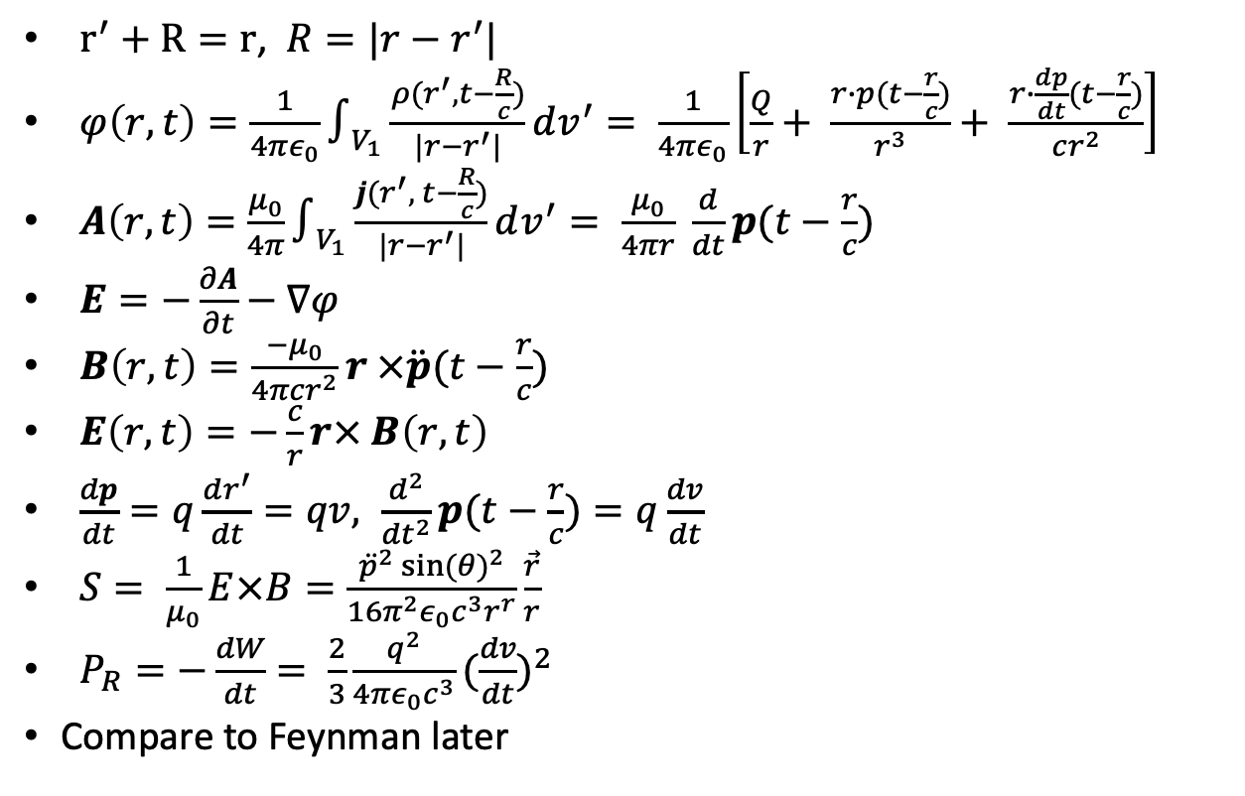



Radiation from charge distribution
$r^{′}+R=r$, $R=|r−r^{′}|$
$φ\left(r,t\right)=\frac{1}{4πε_{0}}∫_{V_{1}}\frac{ρ(r^{′}, t−\frac{R}{c})}{|r−r^{′}|}dv^{′}= \frac{1}{4πε_{0}}\left[\frac{Q}{r}+ \frac{r∙p(t−\frac{r}{c})}{r^{3}}+ \frac{r∙\frac{dp}{dt}(t−\frac{r}{c})}{cr^{2}}\right]$
$A\left(r,t\right)=$ $\frac{μ_{0}}{4π}∫_{V_{1}}\frac{j(r^{′}, t−\frac{R}{c})}{|r−r^{′}|}dv^{′}= \frac{μ_{0}}{4πr} \frac{d}{dt}p(t−\frac{r}{c})$
$E=−\frac{∂A}{∂t}−∇φ$
$B\left(r,t\right)=\frac{−μ_{0}}{4πcr^{2}}r ×\ddot{p}(t−\frac{r}{c})$
$E\left(r,t\right)=−\frac{c}{r}r× B\left(r,t\right)$
$\frac{dp}{dt}=q\frac{dr^{′}}{dt}=qv, \frac{d^{2}}{{dt}^{2}}p(t−\frac{r}{c})=q\frac{dv}{dt}$
$S= \frac{1}{μ_{0}}E×B=\frac{{\ddot{p}}^{2} {sin⁡(θ)}^{2}}{16π^{2}ε_{0}c^{3}r^{r}}\frac{\vec{r}}{r}$
$P_{R}=−\frac{dW}{dt}= \frac{2}{3}\frac{q^{2}}{4πε_{0}c^{3}}{(\frac{dv}{dt})}^{2}$
Compare to Feynman later
$$1$$
$$R$$
$$r$$
$$r^{′}$$
(0,0)

Slide 39

Radiation from a single accelerating charge
Near zone
$φ\left(r,t\right)=\frac{q}{4πε_{0}}\left[\frac{1}{R′(1+\frac{v∙n^{′}}{c})}\right]$
$R^{∗}=R^{′}−\frac{v}{c}(x_{0}−{x′}_{1})$
$E\left(r,t\right)=\frac{1}{4πε_{0}}\frac{1}{R^{∗3}}[\left(R^{′}− \frac{R^{′} v^{′}}{c}\right)\left(1− \frac{v^{2}}{c^{2}}\right)+ \frac{R′}{c^{2}}\left(R′ − \frac{R^{′}v^{′}}{c}\right)× \frac{dv^{′}}{dt}]$
$B= \frac{R^{′}×E}{R^{′}c}$
$S= \frac{q^{2}}{16π^{2}c^{3}ε_{0}} \frac{R^{′}{(R^{′}×v^{′})}^{2}}{{(R^{′})}^{5}}$

Slide 40
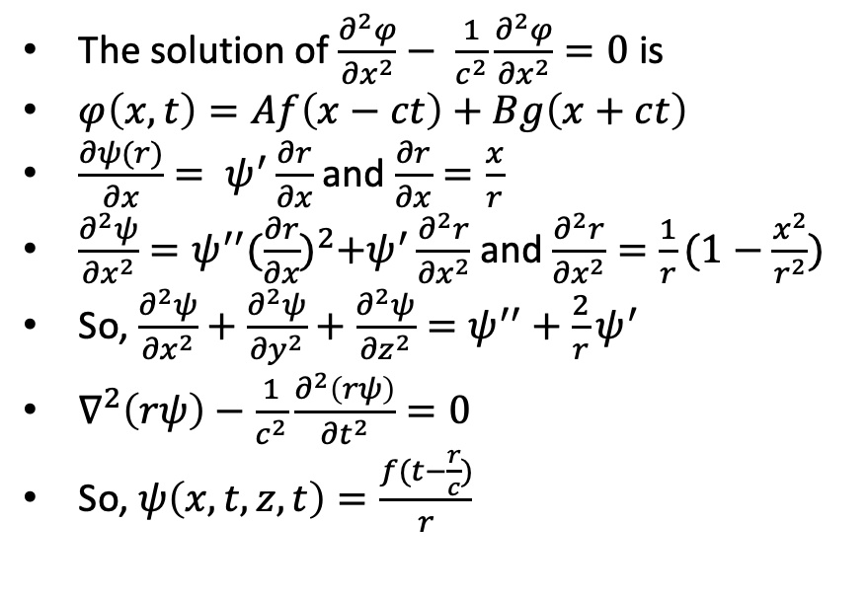
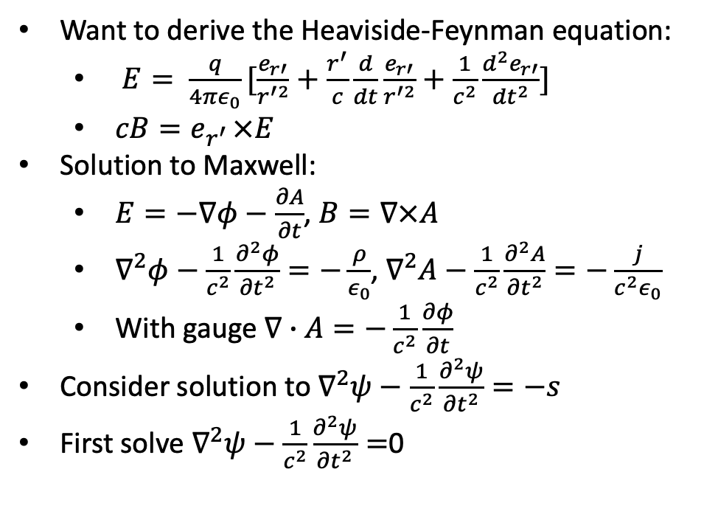
Feynman’s Treatment - 1
Want to derive the Heaviside-Feynman equation:
$E= \frac{q}{4πε_{0}}[\frac{e_{r′}}{r^{′2}}+\frac{r^{′}}{c}\frac{d}{dt}\frac{e_{r′}}{r^{′2}}+\frac{1}{c^{2}}\frac{d^{2}e_{r′}}{{dt}^{2}}]$
$cB=e_{r^{′ }}×E$
Solution to Maxwell:
$E=−∇φ−\frac{∂A}{∂t}$, $B=∇×A$
$∇^{2}φ−\frac{1}{c^{2}}\frac{∂^{2}φ}{{∂t}^{2}}=−\frac{ρ}{ε_{0}}$, $∇^{2}A−\frac{1}{c^{2}}\frac{∂^{2}A}{{∂t}^{2}}=−\frac{j}{c^{2}ε_{0}}$
With gauge $∇∙A=−\frac{1}{c^{2}}\frac{∂φ}{∂t}$
Consider solution to $∇^{2}ψ−\frac{1}{c^{2}}\frac{∂^{2}ψ}{{∂t}^{2}}=−s$
First solve $∇^{2}ψ−\frac{1}{c^{2}}\frac{∂^{2}ψ}{{∂t}^{2}}=$0
The solution of $\frac{∂^{2}φ}{{∂x}^{2}}− \frac{1}{c^{2}}\frac{∂^{2}φ}{{∂x}^{2}}=0$ is
$φ\left(x,t\right)=Af\left(x−ct\right)+Bg\left(x+ct\right)$
$\frac{∂ψ(r)}{∂x}= ψ^{′}\frac{∂r}{∂x}$ and $\frac{∂r}{∂x}=\frac{x}{r}$
$\frac{∂^{2}ψ}{{∂x}^{2}}=ψ^{′′}{(\frac{∂r}{∂x})}^{2}+ψ^{′}\frac{∂^{2}r}{{∂x}^{2}}$ and $\frac{∂^{2}r}{{∂x}^{2}}=\frac{1}{r}(1−\frac{x^{2}}{r^{2}})$
So, $\frac{∂^{2}ψ}{{∂x}^{2}}+\frac{∂^{2}ψ}{{∂y}^{2}}+\frac{∂^{2}ψ}{{∂z}^{2}}=ψ^{′′}+\frac{2}{r}ψ^{′}$
$∇^{2}\left(rψ\right)−\frac{1}{c^{2}}\frac{∂^{2}\left(rψ\right)}{{∂t}^{2}}=0$
So, $ψ\left(x,t,z,t\right)=\frac{f(t−\frac{r}{c})}{r}$

Slide 41
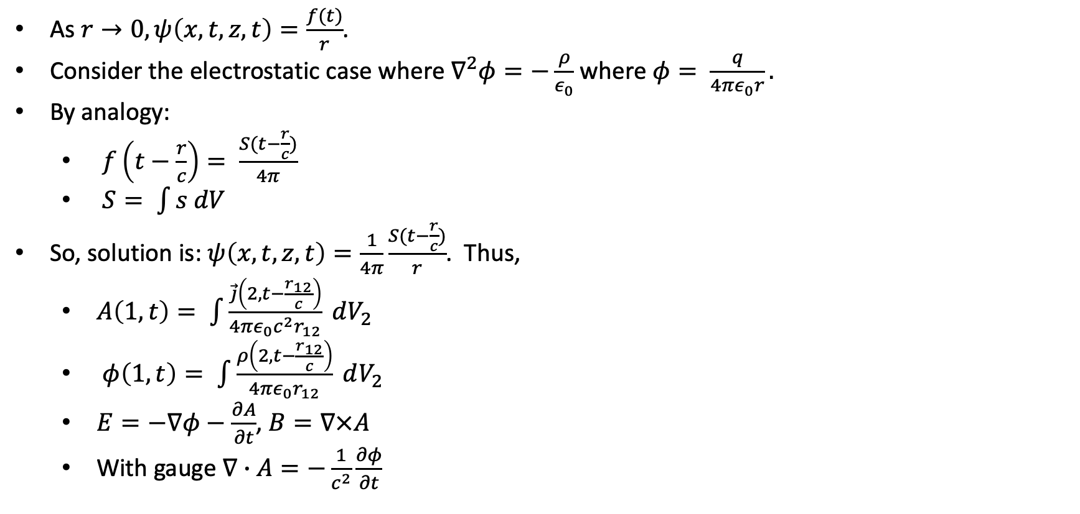
Feynman’s Treatment - 2
As $r→0,ψ\left(x,t,z,t\right)=\frac{f(t)}{r}$.
Consider the electrostatic case where $∇^{2}φ=−\frac{ρ}{ε_{0}}$ where $φ= \frac{q}{4πε_{0}r}.$
By analogy:
$f\left(t−\frac{r}{c}\right)= \frac{S(t−\frac{r}{c})}{4π}$
$S= \int{s dV}$
So, solution is: $ψ\left(x,t,z,t\right)=\frac{1}{4π}\frac{S(t−\frac{r}{c})}{r}$. Thus,
$A\left(1,t\right)= \int{\frac{\vec{j}\left(2, t−\frac{r_{12}}{c}\right)}{4πε_{0}c^{2}r_{12}}} dV_{2}$
$φ\left(1,t\right)= \int{\frac{ρ\left(2, t−\frac{r_{12}}{c}\right)}{4πε_{0}r_{12}}} dV_{2}$
$E=−∇φ−\frac{∂A}{∂t}$, $B=∇×A$
With gauge $∇∙A=−\frac{1}{c^{2}}\frac{∂φ}{∂t}$

Slide 42
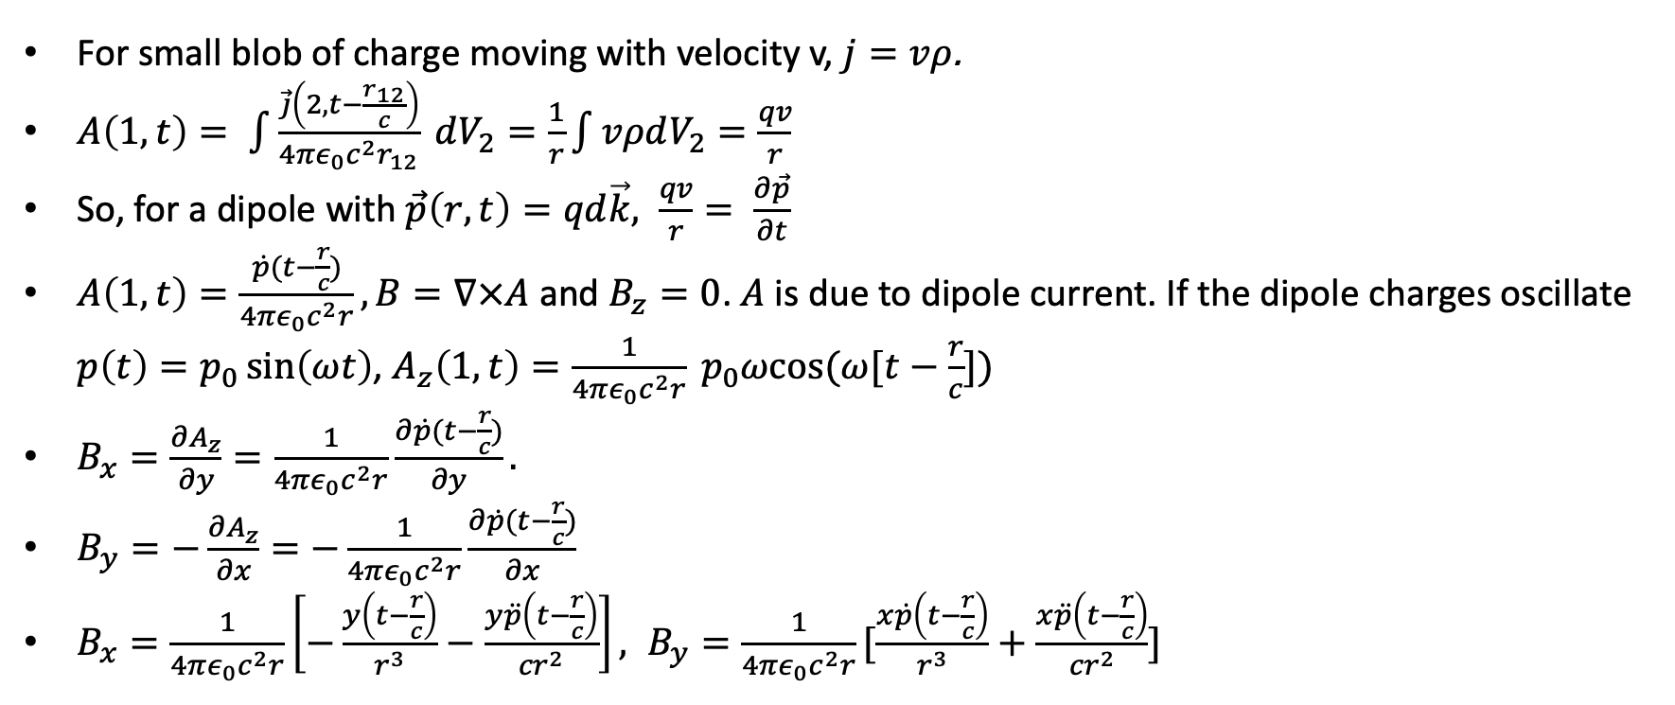
Feynman’s Treatment - 3
For small blob of charge moving with velocity v, $j=vρ$.
$A\left(1,t\right)= \int{\frac{\vec{j}\left(2, t−\frac{r_{12}}{c}\right)}{4πε_{0}c^{2}r_{12}}} dV_{2}=\frac{1}{r}\int{vρdV_{2}=\frac{qv}{r}}$
So, for a dipole with $\vec{p}\left(r,t\right)=qd\vec{k}, \frac{qv}{r}= \frac{∂\vec{p}}{∂t}$
$A\left(1,t\right)=\frac{\dot{p}(t−\frac{r}{c})}{4πε_{0}c^{2}r}, B=∇×A$ and $B_{z}=0$. $A$ is due to dipole current. If the dipole charges oscillate $p\left(t\right)=p_{0}\sin\left(ωt\right)$, $A_{z}\left(1, t\right)=\frac{1}{4πε_{0}c^{2}r} p_{0}ωcos⁡(ω[t−\frac{r}{c}])$
$B_{x}=\frac{∂A_{z}}{∂y}=\frac{1}{4πε_{0}c^{2}r}\frac{∂\dot{p}(t−\frac{r}{c})}{∂y}.$
$B_{y}=−\frac{∂A_{z}}{∂x}=−\frac{1}{4πε_{0}c^{2}r}\frac{∂\dot{p}(t−\frac{r}{c})}{∂x}$
$B_{x}=\frac{1}{4πε_{0}c^{2}r}\left[−\frac{y\left(t−\frac{r}{c}\right)}{r^{3}}−\frac{y\ddot{p}\left(t−\frac{r}{c}\right)}{{cr}^{2}}\right], B_{y}=\frac{1}{4πε_{0}c^{2}r}[\frac{x\dot{p}\left(t−\frac{r}{c}\right)}{r^{3}}+\frac{x\ddot{p}\left(t−\frac{r}{c}\right)}{{cr}^{2}}]$

Slide 43
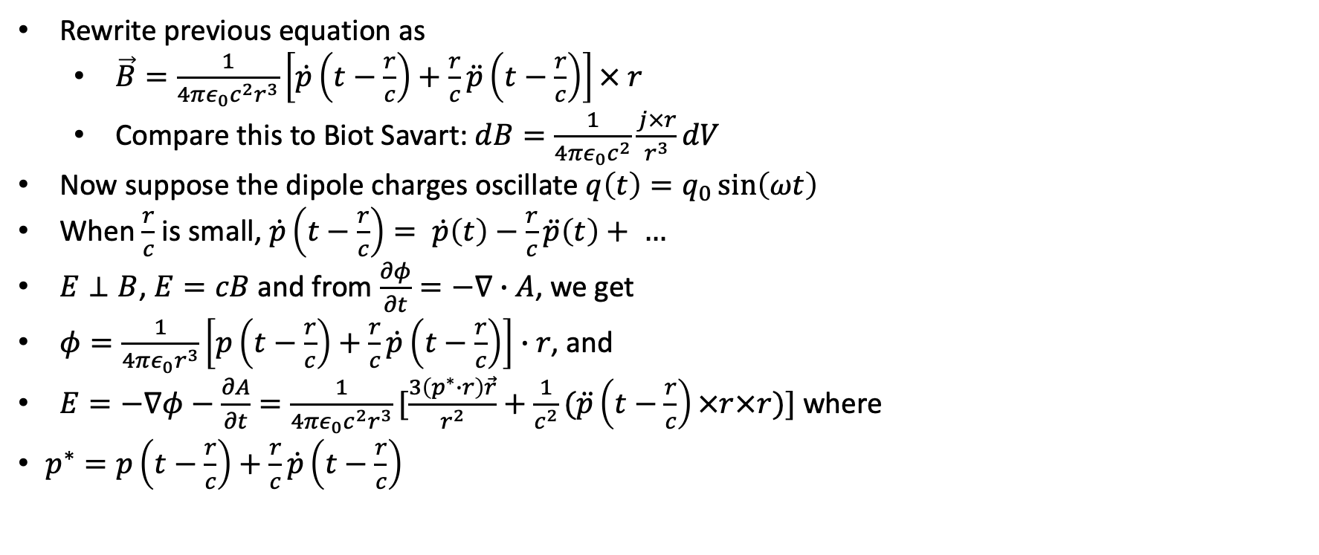
Feynman’s Treatment - 4
Rewrite previous equation as
$\vec{B}=\frac{1}{4πε_{0}c^{2}r^{3}}\left[\dot{p}\left(t−\frac{r}{c}\right)+\frac{r}{c}\ddot{p}\left(t−\frac{r}{c}\right)\right]× r$
Compare this to Biot Savart: $dB=\frac{1}{4πε_{0}c^{2}}\frac{j×r}{r^{3}}dV$
Now suppose the dipole charges oscillate $q\left(t\right)=q_{0}\sin\left(ωt\right)$
When $\frac{r}{c}$ is small, $\dot{p}\left(t−\frac{r}{c}\right)= \dot{p}\left(t\right)−\frac{r}{c}\ddot{p}\left(t\right)+ …$
$E⊥B$, $E=cB$ and from $\frac{∂φ}{∂t}=−∇∙A$, we get
$φ=\frac{1}{4πε_{0}r^{3}}\left[p\left(t−\frac{r}{c}\right)+\frac{r}{c}\dot{p}\left(t−\frac{r}{c}\right)\right]∙r$, and
$E=−∇φ−\frac{∂A}{∂t}=\frac{1}{4πε_{0}c^{2}r^{3}}[\frac{3\left(p^{∗}∙r\right)\vec{r}}{r^{2}}+\frac{1}{c^{2}}(\ddot{p}\left(t−\frac{r}{c}\right)×r×r)]$ where
$p^{∗}=p\left(t−\frac{r}{c}\right)+\frac{r}{c}\dot{p}\left(t−\frac{r}{c}\right)$

Slide 44
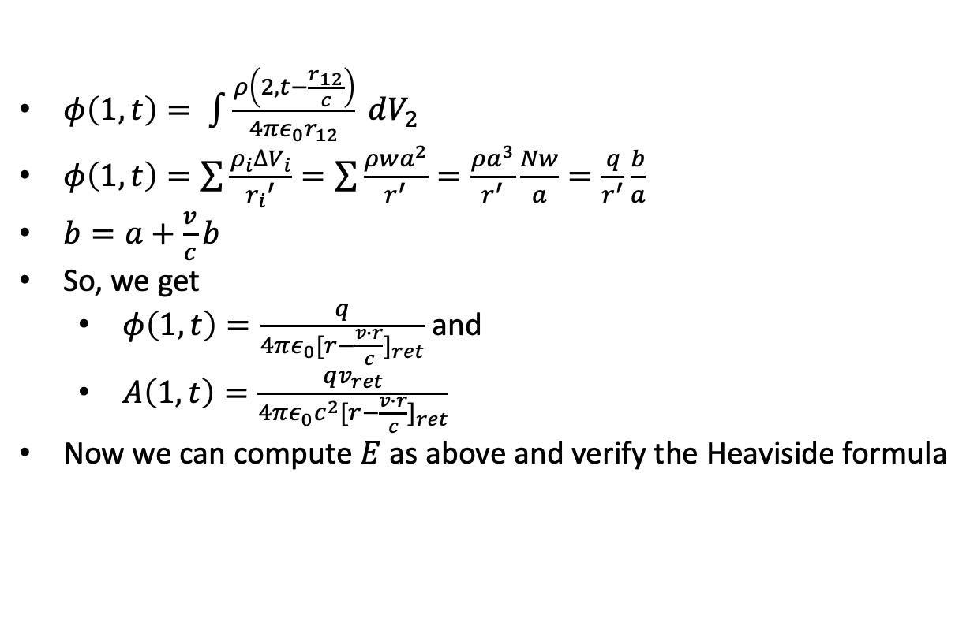
Lienard-Wierchert
$φ\left(1,t\right)= \int{\frac{ρ\left(2, t−\frac{r_{12}}{c}\right)}{4πε_{0}r_{12}}} dV_{2}$
$φ\left(1,t\right)=\sum{\frac{ρ_{i}∆V_{i}}{{r_{i}}^{′}}}=\sum{\frac{ρwa^{2}}{r^{′}}}=\frac{ρa^{3}}{r^{′}}\frac{Nw}{a}=\frac{q}{r^{′}}\frac{b}{a}$
$b=a+\frac{v}{c}b$
So, we get
$φ\left(1,t\right)=\frac{q}{4πε_{0}{[r−\frac{v∙r}{c}]}_{ret}}$ and
$A\left(1,t\right)=\frac{qv_{ret}}{4πε_{0}c^{2}{[r−\frac{v∙r}{c}]}_{ret}}$
Now we can compute $E$ as above and verify the Heaviside formula
a
1
r₁
…
1
2
N
v
a
…
1
2
N
r_{N}
b

Slide 45
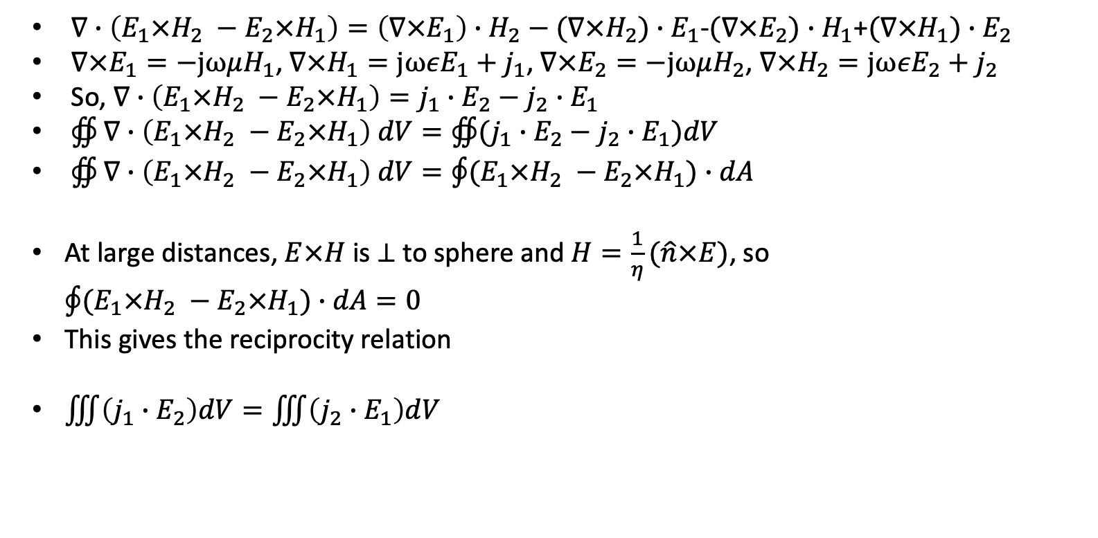
A proof of reciprocity for transmitters and receivers
$∇∙\left(E_{1}×H_{2} −E_{2}×H_{1}\right)=\left(∇×E_{1}\right)∙H_{2}−(∇×H_{2})∙E_{1}$-$(∇×E_{2})∙H_{1}$+$(∇×H_{1})∙E_{2}$
$∇×E_{1}=−jωμH_{1}$, $∇×H_{1}=jωεE_{1}+j_{1}$, $∇×E_{2}=−jωμH_{2}$, $∇×H_{2}=jωεE_{2}+j_{2}$
So, $∇∙\left(E_{1}×H_{2} −E_{2}×H_{1}\right)=j_{1}∙E_{2}−j_{2}∙E_{1}$
$∯{∇∙\left(E_{1}×H_{2} −E_{2}×H_{1}\right) dV}=∯{(j_{1}∙E_{2}−j_{2}∙E_{1})dV}$
$∯{∇∙\left(E_{1}×H_{2} −E_{2}×H_{1}\right) dV}=\oint{(E_{1}×H_{2} −E_{2}×H_{1})∙dA}$
At large distances, $E×H$ is $⊥$ to sphere and $H=\frac{1}{η}(\hat{n}×E)$, so $\oint{(E_{1}×H_{2} −E_{2}×H_{1})∙dA}=0$
This gives the reciprocity relation
$\iiint{\left(j_{1}∙E_{2}\right)dV}=\iiint{\left(j_{2}∙E_{1}\right)dV}$
j₁ E₁, H₁
j₂ E₂, H₂

Slide 46
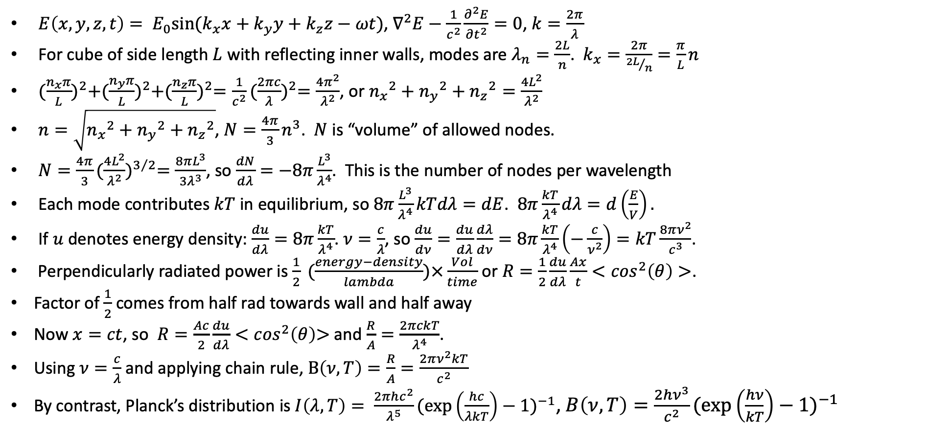
Rayleigh-Jeans
$E\left(x,y,z,t\right)= E_{0}sin⁡(k_{x}x+k_{y}y+k_{z}z−ωt)$, $∇^{2}E−\frac{1}{c^{2}}\frac{∂^{2}E}{{∂t}^{2}}=0$, $k=\frac{2π}{λ}$
For cube of side length $L$ with reflecting inner walls, modes are $λ_{n}=\frac{2L}{n}$. $k_{x}=\frac{2π}{{2L}/n}=\frac{π}{L}n$
${(\frac{n_{x}π}{L})}^{2}+{(\frac{n_{y}π}{L})}^{2}+{(\frac{n_{z}π}{L})}^{2}=\frac{1}{c^{2}}{(\frac{2πc}{λ})}^{2}=\frac{4π^{2}}{λ^{2}}$, or ${n_{x}}^{2}+{n_{y}}^{2}+{n_{z}}^{2}=\frac{4L^{2}}{λ^{2}}$
$n=\sqrt{{n_{x}}^{2}+{n_{y}}^{2}+{n_{z}}^{2}}$, $N=\frac{4π}{3}n^{3}$. $N$ is “volume” of allowed nodes.
$N=\frac{4π}{3}{(\frac{4L^{2}}{λ^{2}})}^{3/2}=\frac{8πL^{3}}{3λ^{3}}$, so $\frac{dN}{dλ}=−8π\frac{L^{3}}{λ^{4}}$. This is the number of nodes per wavelength
Each mode contributes $kT$ in equilibrium, so$8π\frac{L^{3}}{λ^{4}}kTdλ=dE$. $8π\frac{kT}{λ^{4}}dλ=d\left(\frac{E}{V}\right).$
If $u$ denotes energy density: $\frac{du}{dλ}=8π\frac{kT}{λ^{4}}$. $ν=\frac{c}{λ}$, so $\frac{du}{dν}=\frac{du}{dλ}\frac{dλ}{dν}=8π\frac{kT}{λ^{4}}\left(−\frac{c}{ν^{2}}\right)=kT\frac{8πν^{2}}{c^{3}}$.
Perpendicularly radiated power is $\frac{1}{2} (\frac{energy−density}{lambda})×\frac{Vol}{time}$ or $R=\frac{1}{2}\frac{du}{dλ}\frac{Ax}{t}<\cos^{2}\left(θ\right)>$.
Factor of $\frac{1}{2}$ comes from half rad towards wall and half away
Now $x=ct$, so $R=\frac{Ac}{2}\frac{du}{dλ}<\cos^{2}\left(θ\right)\text{>}$ and $\frac{R}{A}=\frac{2πckT}{λ^{4}}$.
Using $ν=\frac{c}{λ}$ and applying chain rule, $B\left(ν,T\right)=\frac{R}{A}=\frac{2πν^{2}kT}{c^{2}}$
By contrast, Planck’s distribution is $I\left(λ,T\right)= \frac{2πhc^{2}}{λ^{5}}{(\exp\left(\frac{hc}{λkT}\right)−1)}^{−1}$, $B\left(ν,T\right)=\frac{2hν^{3}}{c^{2}}{(\exp\left(\frac{hν}{kT}\right)−1)}^{−1}$

Slide 47



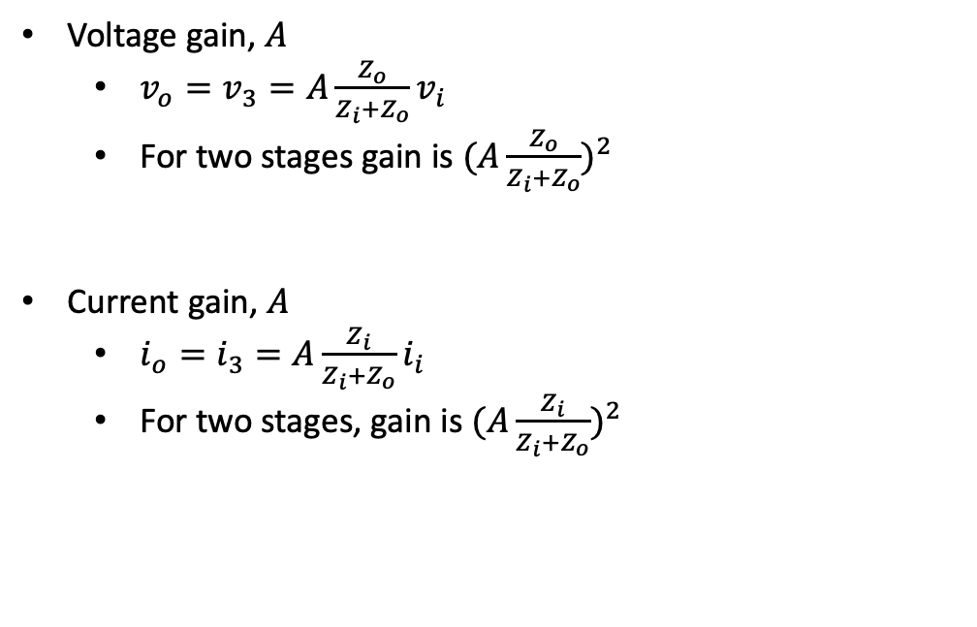












Coupling
Voltage gain, $A$
${v_{o}=v}_{3}=A\frac{Z_{o}}{Z_{i}+Z_{o}}v_{i}$
For two stages gain is ${(A\frac{Z_{o}}{Z_{i}+Z_{o}})}^{2}$
Current gain, $A$
$i_{o}=i_{3}=A\frac{Z_{i}}{Z_{i}+Z_{o}}i_{i}$
For two stages, gain is ${(A\frac{Z_{i}}{Z_{i}+Z_{o}})}^{2}$
$$Z_{1}(=Z_{o})$$
$$Z_{3}$$
$$v_{2}$$
$$v_{i}$$
$$Z_{2}(=Z_{i})$$
$$v_{3}$$
$$Z_{4}$$
$$i_{2}$$
$$i_{4}$$
$$i_{i}$$
$$Z_{i}$$
$$Z_{o}$$
$$i_{3}$$
$$Z_{i}$$
$$Z_{o}$$

Slide 48

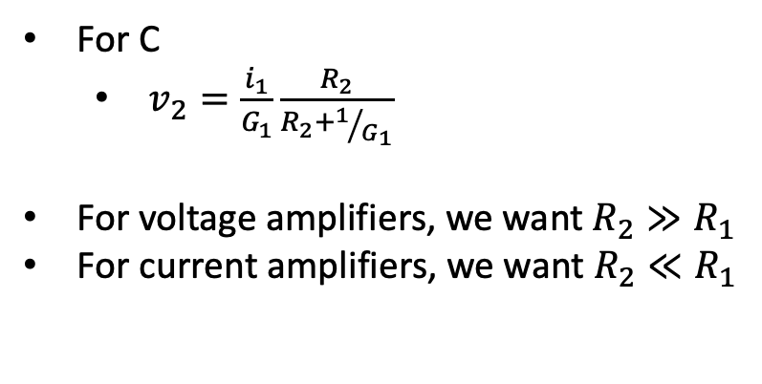
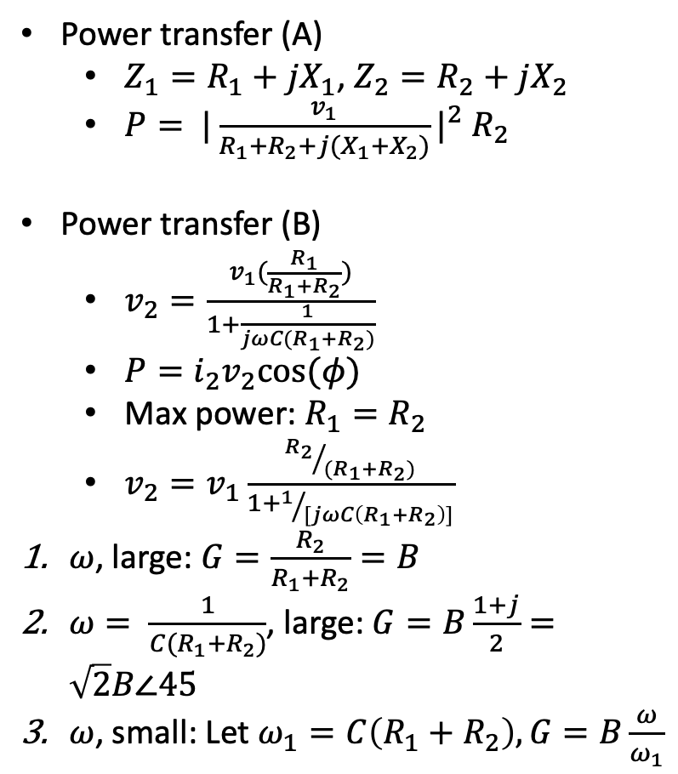











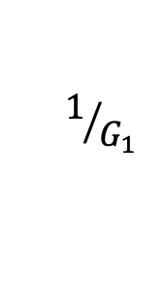
Power transfer
$$Z_{1}$$
$$v_{2}$$
Power transfer (A)
$Z_{1}=R_{1}+jX_{1}$, $Z_{2}=R_{2}+jX_{2}$
$P= {|\frac{v_{1}}{R_{1}+R_{2}+j(X_{1}+X_{2})}|}^{2} R_{2}$
Power transfer (B)
$v_{2}=\frac{v_{1}(\frac{R_{1}}{R_{1}+R_{2}})}{1+\frac{1}{jωC(R_{1}+R_{2})}}$
$P=i_{2}v_{2}cos⁡(φ)$
Max power: $R_{1}=R_{2}$
$v_{2}=v_{1}\frac{{R_{2}}/{(R_{1}+R_{2})}}{1+1/{[jωC\left(R_{1}+R_{2}\right)]}}$
$ω$, large: $G=\frac{R_{2}}{R_{1}+R_{2}}=B$
$ω= \frac{1}{C(R_{1}+R_{2})}$, large: $G=B\frac{1+j}{2}=\sqrt{2}B∠45$
$ω$, small: Let $ω_{1}=C\left(R_{1}+R_{2}\right),G=B\frac{ω}{ω_{1}}$
$$v_{1}$$
$$Z_{2}$$
A
For C
$v_{2}=\frac{i_{1}}{G_{1}}\frac{R_{2}}{R_{2}+1/{G_{1}}}$
For voltage amplifiers, we want $R_{2}≫R_{1}$
For current amplifiers, we want $R_{2}≪R_{1}$
$$R_{1}$$
$$C$$
$$v_{2}$$
$$v_{1}$$
$$R_{2}$$
B
$$v_{2}$$
$$1/{G_{1}}$$
$$C_{1}$$
$$R_{2}$$
C

Slide 49

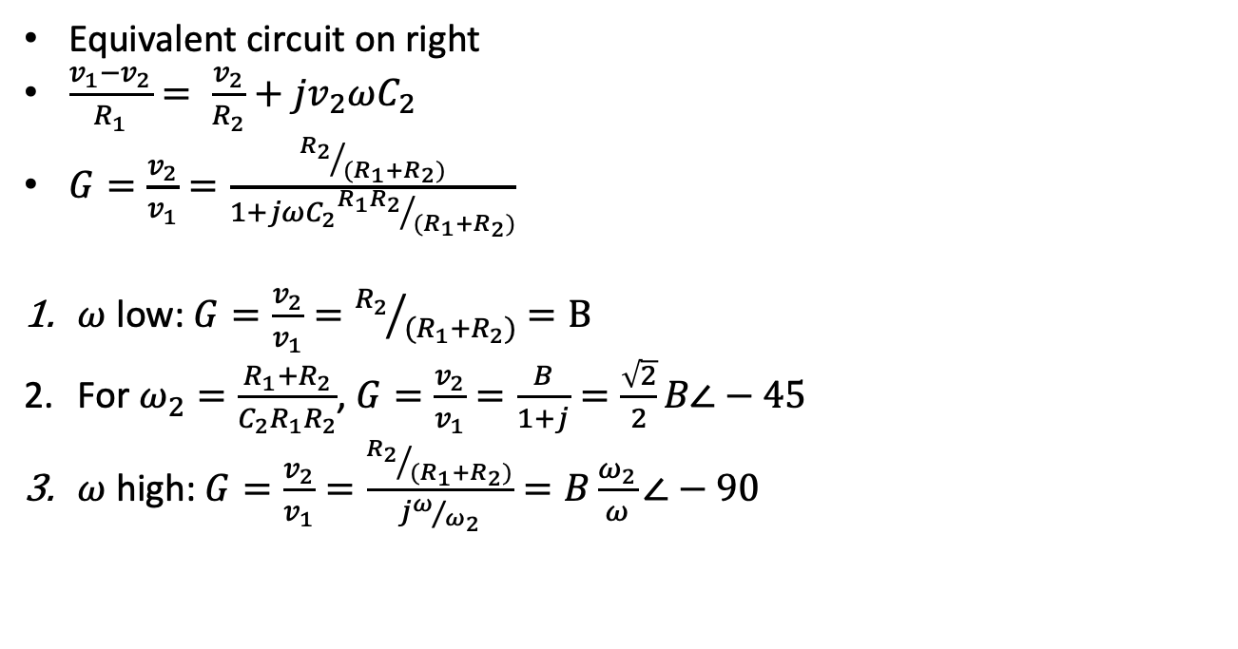




High frequency coupling
Equivalent circuit on right
$\frac{v_{1}−v_{2}}{R_{1}}= \frac{v_{2}}{R_{2}}+jv_{2}ωC_{2}$
$G=\frac{v_{2}}{v_{1}}=\frac{{R_{2}}/{(R_{1}+R_{2})}}{1+jωC_{2}{{R_{1}R}_{2}}/{(R_{1}+R_{2})}}$
$ω$ low: $G=\frac{v_{2}}{v_{1}}={R_{2}}/{(R_{1}+R_{2})}=B$
For $ω_{2}=\frac{R_{1}+R_{2}}{C_{2}R_{1}R_{2}}$, $G=\frac{v_{2}}{v_{1}}=\frac{B}{1+j}=\frac{\sqrt{2}}{2}B∠−45$
$ω$ high: $G=\frac{v_{2}}{v_{1}}=\frac{{R_{2}}/{(R_{1}+R_{2})}}{jω/{ω_{2}}}=B\frac{ω_{2}}{ω}∠−90$
$$R_{1}$$
$$v_{2}$$
$$v_{1}$$
$$R_{2}$$
$$C_{2}$$

Slide 50



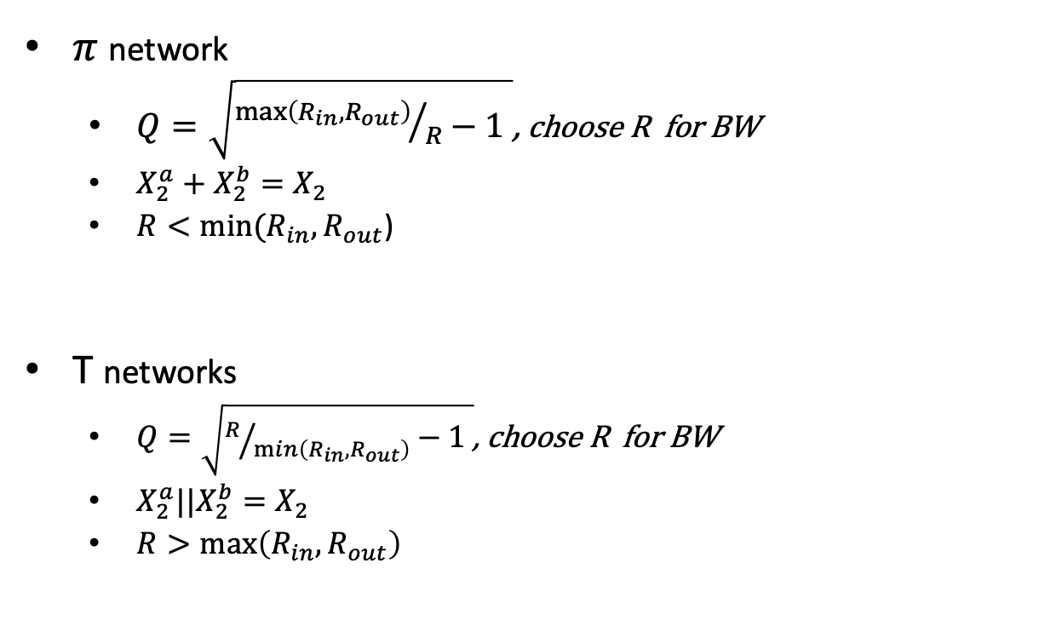
















Impedance matching
X₂
$$X_{2}^{a}$$
$$X_{2}^{b}$$
$π$network
$Q=\sqrt{{\max\left(R_{in},R_{out}\right)}/R−1 }$, choose R for BW
$X_{2}^{a}+X_{2}^{b}=X_{2}$
$R<min⁡(R_{in},R_{out}$)
T networks
$Q=\sqrt{R/{\min\left(R_{in},R_{out}\right)}−1 }$, choose R for BW
$X_{2}^{a}||X_{2}^{b}=X_{2}$
$R>\max\left(R_{in},R_{out}\right)$
X₁
X₃
$$R_{in}$$
X₁
$$R$$
$$R$$
X₃
$$R_{out}$$
$π$ network
$π$ equiv
$$X_{1}$$
$$X_{3}$$
$$X_{1}$$
X₃
$$R_{in}$$
$$X_{2}^{a}$$
$$R$$
$$R$$
$$X_{2}^{b}$$
$$X_{2}$$
$$R_{out}$$
T network
$T$ equiv

Slide 51

Negative feedback
$\frac{X_{2}}{A}=X_{1}−BX_{2}, \frac{X_{2}}{X_{1}}=\frac{A}{1+AB}≡K$
No feedback ($B=0$):
$K=A$
$AB<0, 1+AB<1$
$K≫A$
$AB=−1$
$K=∞$
$AB≫0$
$K≈\frac{1}{B}$
$\frac{dK}{dA}=\frac{1}{{(1+AB)}^{2}}$ measures stability
If forward gain is $\frac{A}{1+jωτ_{1}}$, $K_{feebback}= \frac{{(1+AB)K}_{no−feedback}}{1+jωτ_{1}}$
This increases frequency response
Effect on impedance
$Z_{1}→Z_{1}(1+AB)$, $Z_{2}→\frac{Z_{2}}{1+AB}$
X₁
X₂
+
A
B

Slide 52

Oscillators and feedback
v_{o}
A
$K=\frac{A}{1+AB}$
On upper right, oscillation conditions is $AB=1∠180$
For lower right, $AB=1∠0$
B
B
v_{o}
A

Slide 53




Some filter transfer functions
High pass
Low pass
Wein
C
R
C
R
C
R
$$G_{HP}=\frac{1}{1+\frac{ω_{0}}{jω}}$$
$$G_{LP}=\frac{1}{1+j\frac{ω}{ω_{0}}}$$
$\frac{v_{2}}{v_{1}}= \frac{1}{\begin{aligned}3+j(ωCR−\frac{1}{ωCR}) \\ \end{aligned}}$
Oscillation when $ωCR=1$
$\tan\left(φ\right)= \frac{−R_{1}R_{2}(ωCR−\frac{1}{ωCR})}{R_{1}+R_{2}}$
$\frac{dφ}{dω}=− \frac{2Q}{ω}$ so high Q improved stability
For CR ladder filter of length 3
$\frac{v_{2}}{v_{1}}= \frac{1}{1−5ω^{2}C^{2}R^{2}+j((6ωCR−ω^{3}C^{3}R^{3})}$
Phase shift is 0 when $6=ω^{2}C^{2}R^{2}$

Slide 54



Feedback networks for oscillators
R
R
R
$\frac{v_{2}}{v_{1}}=1/{\left(1−5ω^{2}C^{2}R^{2}\right)+j(6ωCR−ω^{3}C^{3}R^{3})}$
C
C
C
Phase Shift Ladder
$\frac{v_{2}}{v_{1}}=\frac{1}{3}$
C
R
C
R
Wein
$\frac{v_{2}}{v_{1}}=(\frac{M}{L})(1/{\left(R_{1}/R_{2}+1\right)+j\left(R_{1}ωC−{R_{1}}/{\left(ωL\right)}\right)})$
M
R₁
C
R₂
L
Tuned circuit

Slide 55







More on oscillation
v₁
A
For sine waves, $\left|v_{1}\right|=1, AB>1$
$v_{1}=ABv_{1}$
You can use the feedback networks on the previous slide for B
Want hi Q for stability
$v_{o}=\frac{A}{1−\frac{R_{i}A}{R_{i}+R+j(ωL−1/{ωC})}}v_{i}$
$Q=\frac{ω_{0}L}{R_{i}+R}$
B
$$R$$
$$L$$
$$C$$
$$v_{o}$$
$$R_{i}$$
$$v_{i}$$

Slide 56


Some oscillators
V_{cc}
B₂ feedback
Z₂
M
v₂
R₂
C
Z₁
L
-
D
v₃
out
A
G
v₁
+
S
R
R₁
C
C
R
B₁ feedback
$B=\frac{M}{L} (\frac{R_{2}}{R_{1}+R_{2}})$
$ω=\frac{1}{\sqrt{LC}}$
$v_{3}=A(v_{1}−v_{2})$
$K=\frac{1}{B_{1}}$

Slide 57


Op Amp models
X₁
$$⊕$$
A
X₂
$A\left(f\right)= \frac{A_{0}}{1+j(f/{f_{0}})}$
$A\left(X_{1}−BX_{2}\right)=X_{2}$ so $\frac{X_{2}}{X_{1}}=K=\frac{A}{1+AB}$
$\frac{dK}{dA}= \frac{1}{{(1+AB)}^{2}}$
$AB<0$, positive feedback
$AB>0$, negative feedback
For 741, $Z_{i}≈2×{10}^{6}Ω$, $Z_{o}≈150Ω$
B
Feedback
Z_{o}
Z_{i}
-Av_{i}
+

Slide 58

Op Amps
Ideal op amp
$Z_{in}=∞$
$A_{V}=\frac{V_{o}}{V_{i,+}−V_{i,−}}$, $A_{V}$ is an op amp parameter between ${10}^{4}$ and ${10}^{6}$.
$V_{−}=V_{+}$ for negative feedback
Output voltage increases when $v_{+}>v_{−}$, decreases when $v_{+}<v_{−}.$
Example 1: Inverting amp, we’ll show the gain is $\frac{R_{2}}{R_{1}}$
$i_{1}=\frac{V_{in}}{R_{1}}$, $i_{2}=\frac{V_{out}}{R_{2}}$ since the op amp has infinite input impedance
By Kirchhoff, $i_{1}=−i_{2}$, so $V_{out}=\frac{R_{2}}{R_{1}} V_{in}$
$Z_{in}=R_{1}$
$Z_{out}$ is same as non-inverting.
Example 2: Non-inverting amp
$V_{−}=V_{+}$, so $V_{out}=(1+\frac{R_{2}}{R_{1}}) V_{in}$
$Z_{in}>{10}^{6}Ω$
$Z_{out}=\frac{R_{o,Th}}{1+A_{V}β}$, $β= \frac{R_{2}}{R_{1}+R_{2}}$, $R_{o,Th}$ is the Thevenin resistance of the op amp
R₁
R₂
v_{in}
-
Inverting
+
v_{out}
R₁
R₂
-
Non-inverting
+
v_{out}
v_{in}

Slide 59






Miscellaneous op amps
Schmidt trigger
Smoothing
V_{in}
-
V_{out}
+
R₁
C
R
$RC=\frac{10}{f}$
R₂
$R_{1}>R_{2}$
$\left(V_{Th,+}−V_{Th,−}\right)=\frac{R_{2}}{R_{1}+R_{2}}(V_{sat,+}−V_{sat,−})$
Simple op amp model
$\frac{1}{g(f)}=\frac{1}{g_{DC}}+j\frac{f}{f_{BW}}$
LM324

Slide 60
358 op amp
Peak
.05uF
VCO
Square wave
.001uF
100K
V_{in}
-
V_{out}
100K
sawtooth
-
LM358
-
V_{out}
LM358
+
LM358
-
square
100K
V_{c}
51K
+
V_{ref}
+
LM358
100K
V_{c}/2
V_{in}
+
51K
51K
50K
100K
100K
10K

Slide 61
Op integrators and differentiators and differential amp
Integrator
V_{in}
R_{i}
R_{f}
Differentiator
R₁=10K
-
V_{out}
-
R_{i}
+
V_{in}
-
+
R_{f}
+
Differential amp

Slide 62


Real 358 based ops
R_{f}=100K
R₁=100K
1M=R₂
Inverting Amp
R₁=10K
.1uF
-
-
LM358
LM358
100K
Non-inverting Amp
+
+
6.2K
10K
6.2K
10K
V_{in}
V_{in}
100K
1M
$$A_{v}=1+\frac{R_{2}}{R_{1}}$$
10uF
100K
$$A_{v}=\frac{R_{f}}{R_{1}}$$
V_{c}
100K
10uF

Slide 63

Op amp feedback
Nyquist
Polar plot of AB
A
i₁
v₁
+
v₂
$v_{−}=v_{2}\frac{R_{2}}{R_{1}+R_{2}}$
$v_{2}=A\left(v_{1}−v_{2}\frac{R_{2}}{R_{1}+R_{2}}\right)$
$\frac{v_{2}}{v_{1}}=\frac{A}{1+A\frac{R_{2}}{R_{1}+R_{2}}}=\frac{A}{1+AB}$
$K=\frac{A}{1+AB}$
$\frac{dK}{dA}=\frac{1}{{(1+AB)}^{2}}$
-
R₁
R₂

Slide 64
Current to voltage
R₁
-
i₁
R₂
+
v₂

Slide 65


PLL
+12
2
$$⊗$$
3
LPF
7
.01
10K
4
5
VCO
.01
4.7K
1
Gnd
LM565
in
10
R
2
8
10
V_{cc}
8_{R}
9_{C}
3
4.7K
C
4.7K
565
9
For general PLL, if $v_{ref}\left(t\right)= V_{R}\cos\left(ω_{0}t+φ_{R}\left(t\right)\right)$ and $v_{VCO}\left(t\right)= V_{V}cos⁡(ω_{0}t+φ_{V}\left(t\right))$, $v_{D}=k_{D}$($v_{ref}\left(t\right)−v_{VCO}\left(t\right)$) where $v_{D}$ is the output of the phase detector.
$f_{0}=.3{(RC)}^{−1}$
With no input, VCO out is about 1360Hz
For input, set function generator to 1V_{pp}
4
.022uF
5
7
+
1
VCO out
10uF
.01
-12

Slide 66
PLL FM detector
V_{cc}
With no input, out is about 1360Hz
For input, set function generator to 1V_{pp} and connect to previous 565
10K
8
4
out
7
3
.1uF
565
1uF
10K
470
6
5
Function Gen
1 V_{pp}
2
1
.1

Slide 67












Miscellaneous
$$v_{i}$$
$C=Blg\left(1+SNR\right)$
$P_{n}=4kTB$
Diode: $i_{D}=i_{S}[\exp\left(\frac{V_{diode}}{nV_{T}}\right)−1]$, $V_{T}=\frac{kT}{q}$
Circuits on right
$Y=G+jB$
Capacitive Divider
$G_{in}=\frac{1}{R_{L}}{(\frac{C_{1}}{C_{1}+C_{2}})}^{2}$, $B_{in}=\frac{{ωC}_{1}C_{2}}{C_{1}+C_{2}}$
Resonant capacitive divider
${ω_{0}}^{2}= \frac{C_{1}+C_{2}}{LC_{1}C_{2}}$
$Q=\frac{R_{in}||R_{s}}{ω_{0}L}$
$$C_{1}$$
$$v_{o}$$
$$C_{2}$$
$$R_{L}$$
$$v_{i}$$
$$L$$
$$C_{1}$$
$$v_{o}$$
$$C_{2}$$
$$R_{L}$$

Slide 68
RF Amp
9V
68
68
12:3
out
.01
.01
22K
47
in
100
4.7K
270

Slide 69












BJT and FET mixers
AM: $v\left(t\right)=\left[1+ma\left(t\right)\right]cos⁡(ω_{c}t)$
Phase: $v\left(t\right)=Acos⁡(ω_{c}t+φ)$, $φ=ma(t)$
FM: $v\left(t\right)=Acos⁡(ω_{c}t+φ)$, $φ=\int{ma(t) dt}$
FET mixer
BJT mixer
$$v_{cc}$$
$$v_{cc}$$
$$v_{o}$$
D
$$v_{o}$$
$$RF$$
G
$$RF$$
$$C_{BL}$$
S
$$LO$$
$$LO$$
$$R_{2}$$
$$R_{S}$$

Slide 70


Some real oscillators
V_{cc}
B₂ feedback
Z₂
M
v₂
R₂
C
Z₁
L
-
D
v₃
out
A
G
v₁
+
S
R
R₁
C
C
R
B₁ feedback
$B=\frac{M}{L} (\frac{R_{2}}{R_{1}+R_{2}})$
$ω=\frac{1}{\sqrt{LC}}$
$v_{3}=A(v_{1}−v_{2})$
$K=\frac{1}{B_{1}}$

Slide 71


















Modulators and detectors
Phase modulator
Simple FM detector
$$v_{cc}$$
$$v_{o}$$
$$R_{S}$$
$$L$$
$$RFC$$
$$C$$
$$C_{L}$$
$$R_{L}$$
$$C_{BL}$$
$$C$$
$$RF$$
$$v_{M}$$
$$v_{i}$$
D
$$BB$$
G
$v_{o}=\frac{R}{\left(R+R_{s}\right)[1+\frac{4Q^{2}}{{ω_{0}}^{2}}{\left(ω−ω_{0}\right)}^{2}]}v_{i}$
$Q=\frac{R||R_{s}}{ω_{0}L}$
S
$$R_{2}$$
$$C_{BP}$$
$$R_{S}$$

Slide 72
More Oscillators
Norcal VFO
9 V
10K
4.7K
9 V
Hartley
2.7 pf
D
510
47nF
G
J309
47K
47pF
47pF
D
100pf
S
200pF
G
J309
1M
MVAM108
S
L
47K
2-25pF
1.2nF
1.8K
2uF
¼ from ground
1.2nF
1mH
10nF
L: 62 turns on T68-7
19uH
150pF

Slide 73
More Oscillators
9V
Clapp
Crystal Clapp
68
Colpitts
D
D
G
G
J309
.01
100
J309
10K
out
S
S
10K
390
7MHz
2.2K
390

Slide 74

GPS
Space Segment
31 operating satellites (Current generation: block IIIA – 2018)
12 hour MEO (21000km) orbits, 8-12 satellites in view
Transmitter power: 44.8* W, $G_{t}=12dBi$. Clocks accurate to better than 10ns (no leap seconds).
Control segment master at Schriever AFB (plus alternative master, 4 ground antennas and 6 ground stations). Ephemeris updates daily.
User segment
Two bands: L1 (1575.42 MHz [2.046MHz BW]) civilian and military, L2 (1227.6MHz)], military only
Two signals: C/A (civilian) and P(Y) (military). C/A signal is Direct Sequence Spread Spectrum
Satellite identified by PRN (1-32).
L1 signal: $s\left(t\right)= A_{c}C\left(t\right)D\left(t\right)\cos\left(ω_{c}t+θ_{1}\right)+A_{p}P\left(t\right)D\left(t\right)\sin\left(ω_{c}t+θ_{2}\right)$
$C\left(t\right)$ - coarse ranging code
$D\left(t\right)$ - navigation signal consists of (clock, ephemeris, almanac corrections) 37,500 bits. 50 bps transmission.
$P\left(t\right)$ - precision ranging (Y is encrypted)
* This is total transmitter power, 22 W devoted to ranging code. Newer satellites have higher power and can surge power

Slide 75

Some data and rough calculations
$N=kTB, k=1.38×{10}^{−23} J/K$. BW: $2.046MHz$
For comparison: laptop emission noise density is capped at ${10}^{−7}\frac{W}{MHz}$
Noise:$1.38×{10}^{−23}\frac{J}{K}×100×2×{10}^{6}=2.76 ×{10}^{−15}W,$ ($−145.6 dB$)
Free space loss (@100K): $P_{r}=\frac{P_{t}GA}{4πr^{2}}.$ $\int{AdΩ}=λ^{2}.$ $P_{r}=\frac{(44.7){10}^{1.24}}{4π{(21×{10}^{6})}^{2}}×\frac{3×{10}^{8}}{1.575×{10}^{9}}=4×{10}^{−15}W$($−144dB$)
Final SNR: $−144+145.6+43=44.6dB.$
Lower in practice since satellite not directly overhead, and there are shadowing and multipath losses. In addition, we have receiver loss (and receiver antenna gain) so $P_{r}$ could be as small as $−170dB$ and final SNR is approximately $−170+144+43=17dB$
Receiver modeled at $G_{r}=2dBi$

Slide 76

More refined calculations
Sat power: $13.4dBW \left(21.7W\right)$
Sat Antenna gain: $13.4 dBW$
EIRP: $26.8 dBW$
Polarization loss: $−3.4 dBW$
Space loss: $−184.4 dBW$
Atmo loss: $−2 dBW$
Receiver Antenna gain: $3 dBW$
Total signal power at antenna base: $−160 dBW$
Correlated signal strength is $−147dBW$
Thermal noise: $−174dBW$
Noise Figure: $F= \frac{{SNR}_{ideal}}{{SNR}_{out}}$ . Good LNA at GPS frequency has noise figure of $2.3dBW$
Compression point: when amp becomes non-linear.

Slide 77


Signal Structure

Slide 78

GPS spectrum neighborhood

Slide 79

Signal Summary

Slide 80

L1 Signal Structure
$s_{m}\left(t\right)=C\left(t\right)⊕D\left(t\right)$. $s\left(t\right)={A_{c}s}_{m}\left(t\right)cos⁡(ω_{c}t+θ_{1})$ [bspk]
D(t) - 50 bps transmission (20ms).
C(t) – 1 Mbps chipping rate. 300 meters, $1μs/chip$. Chipping code repeats 20 times for single navigation bit.
C/A code is generated from two Gold codes and the PRN identifier (5 bits).
$g_{1}\left(x\right)=1+ x^{3}+x^{10}$, $g_{2}\left(x\right)=1+x^{2}+x^{3}+x^{8}+x^{9}+x^{10}$
Phase selector takes PRN and uses it to select bits of the second Gold code.
Signal Characteristics
Received power: -130dBm, Noise power: -111dBm
Spread spectrum contributes 43 dB to processing. Want SNR greater than 14 dB
SNR for C/A: -20dB

Slide 81
Acquisition, tracking and navigation
Acquisition
Receiver generates known C/A code and attempts to correlate with signal.
To generate C/A code, receiver needs to know which satellite it’s attempting to acquire to determine code
Tracking via delay loop to maintain C/A code alignment
The Navigation Message includes the Ephemeris parameters, the Time parameters and Clock Corrections, the Service Parameters with satellite health information, Ionospheric parameters model, and the Almanacs, allowing the computation of the position of ”all satellites in the constellation”. The ephemeris and clocks parameters are usually updated every two hours, while the almanac is updated at least every six days.

Slide 82
Navigation Message
The navigation message contains 25 pages (’frames’) of 30 seconds each. Entire message takes 12.5 minutes to be transmitted. Every frame is subdivided into 5 sub-frames of 6 seconds each; every sub-frame consists of 10 words, with 30 bits per word.
Every sub-frame starts with the telemetry word (TLM), needed for synchronism. Next, the transference word (HOW) which provides time information (seconds of the GPS week), allowing the receiver to acquire the week-long P(Y)-code segment.
Sub-frame 1: contains information the satellite clock. It also has information about satellite health condition.
Sub-frames 2 and 3: contain satellite ephemeris.
Sub-frame 4: provides ionospheric model parameters, UTC information (Universal Coordinate Time), part of the almanac, and indications whether the Anti-Spoofing, A/S, is activated.
Sub-frame 5: contains data from the almanac and the constellation status. It allows to quickly identify the satellite from which the signal comes. A total of 25 frames are needed to complete the almanac.
Sub-frames 1, 2 and 3 are transmitted with each frame. The content of sub-frames 4 and 5 is common for all satellites. So, the almanac data for all in orbit satellites can be obtained from a single tracked satellite.

Slide 83

Processing and Accuracy
For satellite k: $d_{k}=\sqrt{{(x_{k}−x)}^{2}+{(y_{k}−y)}^{2}+{(z_{k}−z)}^{2}}$
Need to account for skew between satellite clocks and receiver clock. Four satellites required.
Direct calculation
$b$ is the clock bias. $s_{i}$ is i^{th} satellite time. $t_{i}$ is actual reception time. $\hat{t_{i}}$ is receiver reception time.
$d_{i}=\left(\hat{t_{i}}−b−s_{i}\right)c$, $p_{i}=bc+d_{i}$
Solve equations for variables $(x,y,z,b)$
Least squares: $\left(\hat{x},\hat{y}, \hat{z},\hat{b}\right)={argmin}_{(x,y,z,b)}\sqrt{{(x−x_{i})}^{2}+{(y−y_{i})}^{2}+{(z−z_{i})}^{2}+bc+p_{i}}$
Carrier-Phase Enhancement .
Receiver mixes self generated carrier with received carrier. Low frequency beat is a measure of Doppler and hence relative speed of SV to receiver.
Corrects timing errors caused by non-zero PRN pulse transition using the L1 carrier wave, which has a period about one-thousandth of the C/A Gold code bit providing an additional clock.
The phase difference error in the normal GPS amounts to 2–3 m error. Carrier-Phase Enhancement reduces this to 3 cm (1.2 in).
$\frac{dφ}{dt}=f.$
$A_{ideal}=A_{0}\sin\left(2π\left[f_{0}+φ_{0}\right]\right)=A_{0}\sin\left(2πf_{0}\right)\cos\left(2πφ_{0}\right){+A}_{0}\cos\left(2πf_{0}\right)A_{0}\sin\left(2πφ_{0}\right)={A_{0}}^{S}\sin\left(ω_{0}t\right)+{A_{0}}^{C}cos\left(ω_{0}t\right)$

Slide 84







Carrier phase differencing
$∆r=d\cos\left(θ_{0}\right)$
Wave arrives at B first. Arrives at A with phase delay $φ_{0}= ⇂φ_{0}⇃+Δ_{0}$, so
$d\cos\left(θ_{0}\right)= λ(φ_{0})$
Satellite moves in time $t_{1}$changing angle to $θ_{1}$
Suppose$⇂φ_{0}⇃= ⇂φ_{1}⇃=N$, and put $d^{′}=\frac{d}{λ}$
$d^{′}\cos\left(θ_{0}\right)−N= Δ_{0}$
$d^{′}\cos\left(θ_{1}\right)−N= Δ_{1}$
We can solve for $N,d^{′}$
Now, $φ=λ^{−1}\left[r−I+T\right]+f∙\left(δt_{u}−δt^{s}\right)+N+ε_{φ}$
I is ionospheric delay, T is tropospheric delay which we can estimate.
$ε_{φ}≈.025 cycles$ (5mm), so we can recover $r$ to mm precision
Used in Differential GPS
$$Δr_{0}$$
$$θ_{0}$$
$$A$$
$$d$$
$$B$$
84

Slide 85
GPS receiver
Directional antenna
Code
NCO
LO
IF
LNA
BPF
X
BPF
A/D
Phase rotation
Correlator
Accumulator

Slide 86
More careful estimates*
Elevation | 5º | 40º | 90º
Power at sat input | 14.3dB | 14.3dB | 14.3dB
Sat antenna gain | 12.1dB | 12.9dB | 10.2dB
EIRP | 26.4dB | 27.2dB | 24.5dB
Range | 25240km | 22020km | 20190km
Path loss | -159 dB/m² | -157.8 dB/m² | -157.1 dB/m²
Atmo loss | .5dB | .5dB | .5dB
Received power density | -133.1dB/m² | -131.1dB/m² 7.8x10⁻¹⁴ W/m² | -133.1dB/m² 4.9x10⁻¹⁴ W/m²
*Misra and Enge, GPS

Slide 87
More careful estimates*
Elevation | 5º | 40º | 90º
Received power density | 4.9x10⁻¹⁴W/m² | 7.8x10⁻¹⁴W/m² | 4.9x10⁻¹⁴W/m²
Effective area of receiver | 2.7 x 10⁻³m² -24.5dBm² | 2.7 x 10⁻³m² | 2.7 x 10⁻³m²
Isotropic receiver power | -158.5 dB | -156.5dB | -158.5dB
G_{r} | -4 dBic | 2 dBic | 4dBoc
C/A received power | -162.5dB | -154.5dB | -154.5dB
*Misra and Enge, GPS

Slide 88

More careful estimates*
Noise loss
Elevation | Ant cable | LNA | cable
Gain | -1dB | 20dB | -10dB
F | 1dB | 2-3dB | 10dB
T | 75.4 | 290 | 2610
$−162.5dB≤C≤−154.5dB$
$P_{N}=N_{0}(2×{10}^{7})$
$σ_{Δτ}=cT_{c}\sqrt{\frac{d}{4TC/{N_{0}}}}$ where $τ$ is the noise sample interval, $d$ is the correlator interval, $T$ is the averaging time, $d$ is measured in chips and so $dT_{c}$is the time sampling
SNR
Elevation | 5º | 90º
Received C/A power (C) | -162.5dB | -154.5dB
N₀ for 3dB LNA | -201 W/Hz | -201W/Hz
C/N₀ | 34.5 db-Hz | 46.5 dBHz
C/P_{n} 20MHz | -34.6 dB | -26.5dB
C/P_{n} 2MHz | -24.5dB | -16.5dB
*Misra and Enge, GPS

Slide 89

Transforms, Convolution and Transfer
Fourier pair: $\left(x\left(t\right)↔X\left(ω\right)\right)$
$ℱ\left[x\left(t\right)\right]=X\left(ω\right)=\int_{t=−∞}^{∞}{x(t)e^{−jωt}dt}$ , $ℱ^{−1}\left[X\left(ω\right)\right]=x\left(t\right)=\frac{1}{2π}\int_{ω=−∞}^{∞}{X(ω)e^{jωt}dω}$
Convolution: $x_{1}\left(t\right)∗x_{2}\left(t\right)=\int_{ω=−∞}^{∞}{x_{1}(τ)x_{2}(t−τ)dτ}$. Further, $x_{1}\left(t\right)∗x_{2}\left(t\right)↔X_{1}\left(ω\right)X_{2}\left(ω\right)$
Transfer and response: Suppose $y(t)$ is the response to $x\left(t\right).$ Then $y\left(t\right)=x\left(t\right)∗h\left(t\right).$
$Y\left(ω\right)=X\left(ω\right)H\left(ω\right)$ where $H\left(ω\right)=ℱ\left[h\left(t\right)\right]=\frac{Y(ω)}{X(ω)}$
$y\left(t\right)= \frac{1}{2π}\int_{−∞}^{∞}{X\left(ω\right)H\left(ω\right)e^{jωt}dω}$

Slide 90
Blank

Slide 91

Signal Processing Nomenclature
$X\left(ω\right)= ℱ\left[x\left(t\right)\right]= \int_{−∞}^{∞}{x(t)e^{−jωt}dt}$, $ℱ^{−1}\left[X\left(ω\right)\right]=\frac{1}{2π}\int_{−∞}^{∞}{X(ω)e^{jωt}dω}$
Output operator: $y\left(t\right)= 𝒯\left[x\left(t\right)\right].$ LTI: $y_{1}\left(t\right)+y_{2}\left(t\right)=𝒯\left[x_{1}\left(t\right)+x_{2}(t)\right]$
Impulse response: $h\left(t\right)=𝒯\left[δ (t)\right]= \int_{−∞}^{∞}{x\left(τ\right)h\left(τ−t\right)dτ}$
Causal signal $h\left(t\right)=0, t<0.$ For causal signal, $y\left(t\right)=\int_{−∞}^{t}{x\left(τ\right)h\left(τ−t\right)dτ}$
Frequency Response: $H\left(ω\right)=ℱ\left[h\left(t\right)\right]$. $Y\left(ω\right)=H\left(ω\right)X(ω)$
Misc
BSPK with SNR 10dB, $BER< {10}^{−7}$ at 1Mbps
QAM with SNR 20dB, $BER< {10}^{−7}$ at 4Mbps
QAM256 with SNR 30dB, $BER< {10}^{−7}$ at 8Mbps
CSMA/CD (carrier sense, multiple access, collision detect)
CDMA (code division multiplexing with chipping)

Slide 92
Morse
Symbol | Code | Symbol | Code | Symbol | Code
a | .- | m | -- | y | -.--
b | -... | n | -. | z | --..
c | -.-. | o | --- | 0 | -----
d | -.. | p | .--. | 1 | .----
e | . | q | --.- | 2 | ..---
f | ..-. | r | --. | 3 | …--
g | --. | s | … | 4 | ….-
h | …. | t | - | 5 | …..
i | .. | u | ..- | 6 | -....
j | .--- | v | …- | 7 | --...
k | -.- | w | .-- | 8 | ---..
l | .-.. | x | -..- | 9 | ----.

Slide 93




Pinouts
J309

Slide 94

Color codes
Resistor markings in ohms
Capacitor markings in picoFarads
Inductor markings in microHenries

Slide 95


Component data
Core Size | 26 | 3 | 15 | 1 | 2 | 6 | 10 | 12/17 | 0
T-12-( ) | * | 60 | 50 | 48 | 20 | 17 | 12 | 7.5 | 2.4
T-16-( ) | 145 | 61 | 55 | 44 | 22 | 19 | 13 | 8 | 3
T-20-( ) | 185 | 76 | 65 | 52 | 25 | 22 | 16 | 10 | 3.5
T-25-( ) | 245 | 100 | 85 | 70 | 34 | 27 | 19 | 12 | 4.5
T-30-( ) | 335 | 140 | 93 | 85 | 43 | 36 | 25 | 16 | 6
T-37-( ) | 285 | 120 | 90 | 80 | 40 | 30 | 25 | 15 | 4.9
T-44-( ) | 370 | 180 | 160 | 105 | 52 | 42 | 33 | 18.5 | 6.5
T-50-( ) | 330 | 175 | 135 | 100 | 49 | 40 | 31 | 18 | 6.4
T-68-( ) | 435 | 195 | 180 | 115 | 57 | 47 | 32 | 21 | 7.5
T-80-( ) | 460 | 180 | 170 | 115 | 55 | 45 | 32 | 22 | 8.5
T-94-( ) | 600 | 248 | 200 | 160 | 84 | 70 | 58 | * | 10.6
T-106-( ) | 930 | 450 | 345 | 325 | 135 | 116 | * | * | 19
T-130-( ) | 810 | 350 | 250 | 200 | 110 | 96 | * | * | 15
T-157-( ) | 1000 | 420 | * | 320 | 140 | 115 | * | * | *
T-184-( ) | 1690 | 720 | * | 500 | 240 | 195 | * | * | *
T-200-( ) | 920 | 425 | * | 250 | 120 | 100 | * | * | *
T-200A-( ) | 1600 | * | * | * | 218 | * | * | * | *
IRON POWDER TOROIDS - A_{l} Values **
* size not available in this material ** L= µH/100 turns

Slide 96




Vacuum tube equivalent circuits
$μV_{gc}=i_{p}r_{p}+V_{pc}$
$i_{p}=\frac{μV_{gc}}{r_{p}+R_{L}}$
$V_{L}=i_{p}R_{L}$
$A_{v}=\frac{V_{L}}{V_{gc}}$

Slide 97

Vacuum tube equivalent circuits
i_{p}
V
+
-
Diode model: $i=K_{1}V^{3/2}$
Triode model: $i_{p}=K_{1}{(v_{g}+K_{2}v_{p})}^{3/2}$
$Δi_{p}=\frac{∂i_{p}}{∂v_{g}} ∆v_{g}+\frac{∂i_{p}}{∂v_{p}} ∆v_{p}$, $\frac{∂i_{p}}{∂v_{g}}=g_{m}, \frac{∂i_{p}}{∂v_{p}}= \frac{1}{r_{p}}$
For 12AX7, $g_{m}=1.8×{10}^{−3}$ siemens, $r_{p}=53.5×{10}^{3}Ω$
v_{p}
v_{g}

Slide 98

Vacuum tube equivalent circuits
v_{o}
R
Amplifier
For 12AX7, when $i_{p}=2×{10}^{−3}$, when $V_{G}=−1.5$ in equivalent circuit (i.e.- $V_{k}=1.5V$), so, $R_{k}=750Ω$
In equivalent, ${∆v}_{G}=\left(v_{i}−v_{k}\right), ∆v_{p}=(v_{o}−v_{k})$
$∆v_{i}g_{m}+\frac{∆v_{0}}{r_{p}}=−\frac{∆v_{o}}{R}$. So,
$\frac{∆v_{o}}{∆v_{i}}=−\frac{g_{m}r_{p}R}{r_{p}+R}=A=−30.6$
Often, we set $μ=g_{m}r_{p}$
v_{i}
v_{bb}
+
-
v_{k}
R_{k}
Amplifier circuit
G
R
g_{m}V_{G}
r_{p}
Equivalent circuit

Slide 99







QAM
m₁(t)
m₁(t)
$$⨂$$
$$⨂$$
LPF
+
r(t)
+
$$cos⁡(ω_{c}t)$$
+
$$cos⁡(ω_{c}t+θ)$$
$$r(t)$$
90º
90º
m₂(t)
m₂(t)
$$⨂$$
$$⨂$$
LPF

Slide 100
Oscilloscopes
Measures timing characteristics and voltage characteristics
Frequency and period
Duty cycle
Rise and fall time
Amplitude
Maximum and minimum voltages
Mean and average voltages
Specs
Bandwidth – Oscilloscopes have limits as to how fast they can see a signal change. The bandwidth of a scope specifies the range of frequencies it can reliably measure.
Digital vs. Analog
Number channels
Sampling rate
Rise time - Fastest rising pulse it can measure. Rise time = .35 / BW
Max input
Resolution
Vertical sensitivity
Time base
Input impedance

Slide 101

Oscilloscopes
Subsystems
Display
Horizontal
Vertical
Trigger
Inputs
The Trigger tells the scope what parts of the signal to start measuring. Consists of a level knob and a set of buttons to select the source and type of the trigger.
Trigger types:
An edge trigger will cause the scope to start measuring when the signal voltage passes a certain level. An edge trigger can be set to catch on a rising or falling edge (or both).
A pulse trigger tells the scope to start measuring on a specified “pulse” of voltage. You can specify the duration and direction of the pulse. For example, it can be a tiny blip of 0V -> 5V -> 0V, or it can be a seconds-long dip from 5V to 0V, back to 5V.
A slope trigger will cause the scope to start based on a positive or negative slope over a specified amount of time.

Slide 102

Oscilloscopes
Probes
Passive probes are included with most scopes. Most passive probes are attenuated. Attenuating probes have a large resistance intentionally built-in and shunted by a small capacitor to minimize the effect that a long cable might have on loading the circuit.
Most probes have a 9MΩ resistor for attenuating, which, when combined with a standard 1MΩ input impedance on a scope, creates a 1/10 voltage divider. These probes are commonly called 10X attenuated probes. Many probes include a switch to select between 10X and 1X (no attenuation).

Slide 103
386 based audio amp
V_{cc} (9v)
10 uF, optional, increases gain to 200
10 uF
10K
+
+
2
6
100 uF
1
8
5
+
386
7
SPKR
4
+
3
10 uF
Gain is 20 without option

Slide 104
Blank

