Slide 1
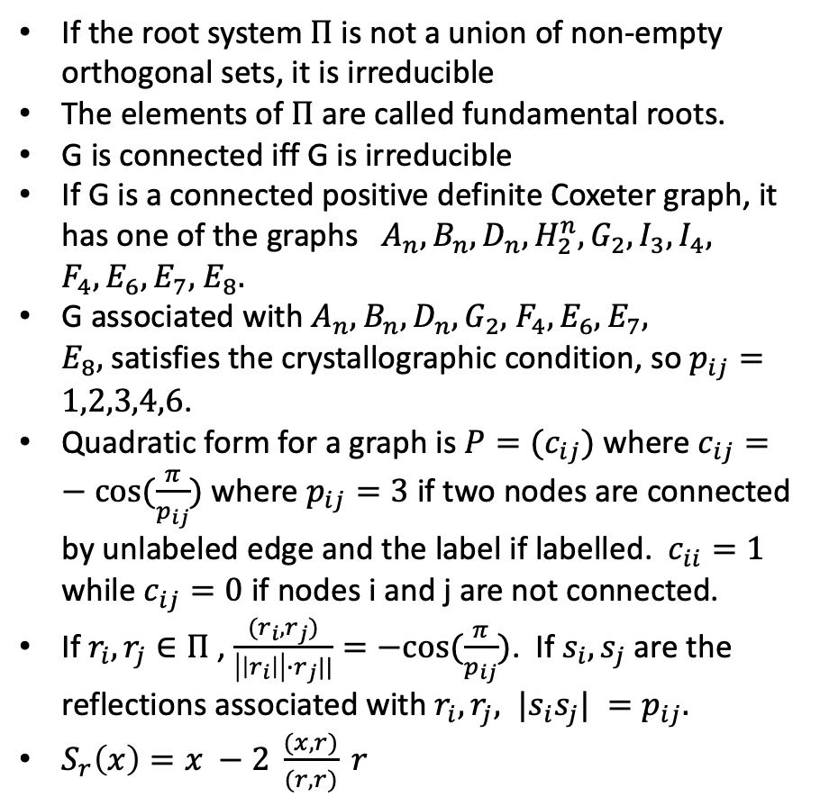

Coxeter groups
…
If the root system $Π$ is not a union of non-empty orthogonal sets, it is irreducible
The elements of $Π$ are called fundamental roots.
G is connected iff G is irreducible
If G is a connected positive definite Coxeter graph, it has one of the graphs${ A}_{n}, B_{n},D_{n}, {H_{2}^{n}, G}_{2},I_{3}, I_{4},$ $F_{4}, E_{6},E_{7},$ $E_{8}.$
G associated with $A_{n}, B_{n},D_{n}, G_{2},$ $F_{4}, E_{6},E_{7},$ $E_{8},$satisfies the crystallographic condition, so $p_{ij}=1,2,3,4,6$.
Quadratic form for a graph is $P=(c_{ij})$ where $c_{ij}=−cos⁡(\frac{π}{p_{ij}})$ where $p_{ij}=3$ if two nodes are connected by unlabeled edge and the label if labelled. $c_{ii}=1$ while $c_{ij}=0$ if nodes i and j are not connected.
If $r_{i}, r_{j}∈Π$ , $\frac{(r_{i}, r_{j})}{\left|\left|r_{i}\right|\right|∙r_{j}||}=−cos⁡(\frac{π}{p_{ij}})$. If $s_{i}, s_{j}$ are the reflections associated with $r_{i}, r_{j}, {|s}_{i}s_{j}| =p_{ij}.$
$S_{r}\left(x\right)=x −2 \frac{(x,r)}{(r,r)} r$
A_{n}
4
…
B_{n}
D_{n}, $n≥4$
…
6
G₂
5
5
I₃
I₄
4
F₄
E₆
E₇
E₈

