Slide 1

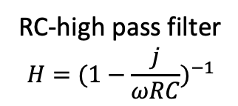
+
.33 uF
+
1000 uF
LM7805
Power supply
+
C
R
.33 uF
RC-high pass filter
$$H={(1−\frac{j}{ωRC})}^{−1}$$
Voltage regulator
Line filter
R
C
L=500mH
C=120mF
R= 60$Ω$
RC low pass filter
ZENER
H= R(1+j/(wRC))⁻¹
RC Band-pass filter
H= R(R+j(wL-1/(wC)))⁻¹
Voltage regulator

