Slide 1
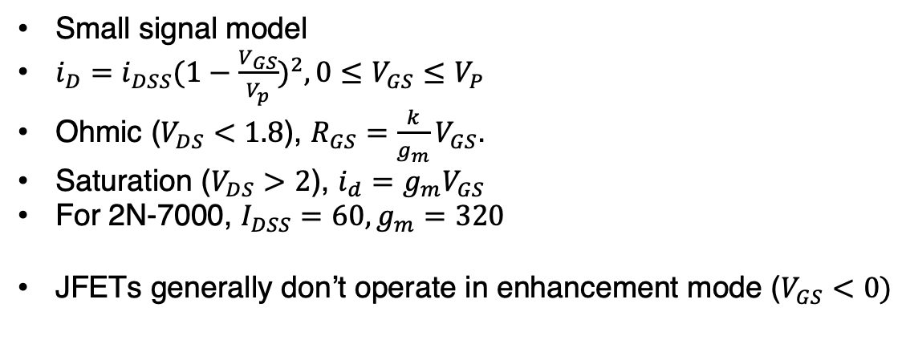
FETs
N channel JFET
N channel enhancement insulated MOSFET
From electronics notes
source gate drain
2N-7000 package
Small signal model
$i_{D}=i_{DSS}{(1−\frac{V_{GS}}{V_{p}})}^{2}, 0≤V_{GS}≤V_{P}$
Ohmic ($V_{DS}<1.8$), $R_{GS}=\frac{k}{g_{m}}V_{GS}$.
Saturation ($V_{DS}>2$), $i_{d}=g_{m}V_{GS}$
For 2N-7000, $I_{DSS}=60, g_{m}=320$
JFETs generally don’t operate in enhancement mode ($V_{GS}<0)$
R_{D}
D
G
S

