Slide 1
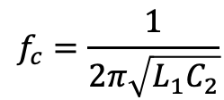
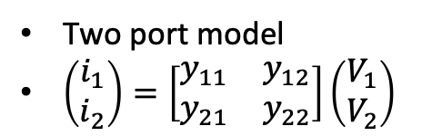
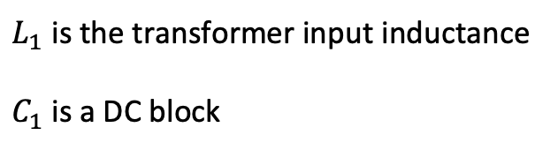
FM Ratio Modulator
Thevenin, Norton and two port models
R_{Th}
R_{Nor}
carrier
Two port model
$\left(\begin{matrix}i_{1} \\ i_{2}\end{matrix}\right)=\left[\begin{matrix}y_{11} & y_{12} \\ y_{21} & y_{22}\end{matrix}\right]\left(\begin{matrix}V_{1} \\ V_{2}\end{matrix}\right)$
Modulating signal
FM Ratio Detector
$$f_{c}=\frac{1}{2π\sqrt{{L_{1}C}_{2}}}$$
C₁
100 pF
100K
$L_{1}$ is the transformer input inductance
$C_{1}$ is a DC block
C₂
out
in
100 pF
100K

