Slide 1
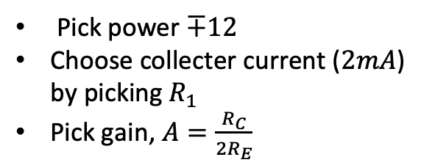
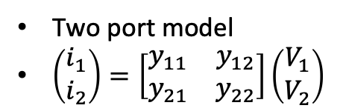
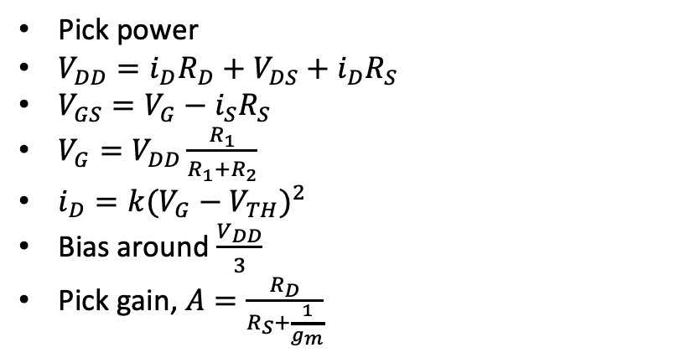
CMOS Common Emitter amp
Differential amp
Pick power
$V_{DD}=i_{D}R_{D}+V_{DS}+i_{D}R_{S}$
$V_{GS}=V_{G}−i_{S}R_{S}$
$V_{G}=V_{DD}\frac{R_{1}}{R_{1}+R_{2}}$
$i_{D}=k{(V_{G}−V_{TH})}^{2}$
Bias around $\frac{V_{DD}}{3}$
Pick gain, $A=\frac{R_{D}}{R_{S}+\frac{1}{g_{m}}}$
Two port model
$\left(\begin{matrix}i_{1} \\ i_{2}\end{matrix}\right)=\left[\begin{matrix}y_{11} & y_{12} \\ y_{21} & y_{22}\end{matrix}\right]\left(\begin{matrix}V_{1} \\ V_{2}\end{matrix}\right)$
R_{C}
R_{C}
v_{in}
v_{O}
v_{in}
R_{E}
R_{E}
R₁
Pick power $∓12$
Choose collecter current ($2mA$) by picking $R_{1}$
Pick gain, $A=\frac{R_{C}}{2R_{E}}$
V_{DD}
R_{D}
D
C_{i}
R₁
C_{o}
S
R₂
R_{S}

