Slide 1
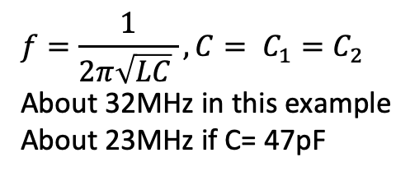
Colpitts
9v
C₁ (22 pF)
1K
.1 uF
L (1uH)
47K
C₂=C₁
.1uF
2.7K
100
$$f=\frac{1}{2π\sqrt{LC} }, C= C_{1}=C_{2}$$
About 32MHz in this example
About 23MHz if C= 47pF

