Slide 1
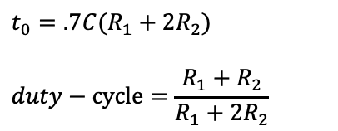

Pin 1: -Vs
Pin 8: +Vs
Pin 2 (Trigger): Out HIGH if V < V_{CC}/3. Pin 2 controls pin 6. If pin 2 is LOW, and pin 6 LOW, output goes and stays HIGH. If pin 6 HIGH, and pin 2 goes LOW, output goes LOW while pin 2 LOW. Pin 2has a very high impedance (about 10M) and will trigger with about 1uA. Pin 3 (Output): (Pins 3 and 7 are "in phase.") Goes HIGH (about 2v less than rail) and LOW (about 0.5v less than 0v) and will deliver up to 200mA. Pin 4 (Reset): Internally connected HIGH via 100k. Must go below 0.8v to reset the chip. Pin 5 (Control): voltage applied to this pin will vary the timing of the RC network (quite considerably). Pin 6 (Threshold): HIGH if > 2 V_{CC} /3, make output LOW only if pin 2 is HIGH. Pin 6 has very high impedance (~10M) and will trigger with about 0.2uA. Pin 7 (Discharge): Pin 7 is equal to pin 3 but pin 7 does not go high - it goes OPEN. When LOW it sinks about 200mA.
555 one shot
+Vs
1
8
555
R
2
7
$$t_{0}=.7 RC$$
out
3
6
C
+Vs
4
5
$$.1μF$$
555 astable
+Vs
1
8
2
555
R₁
1 (o1)
2 (i1-)
3 (i1+)
4 (V+)
5 (i2+)
6 (i2-)
7 (o2)
(o4) 14
(i4-) 13
(i4+) 12
(GND) 11
(i3-) 10
(i3+) 9
(o3) 8
7
$$t_{0}=.7C(R_{1}+2R_{2})$$
$$duty−cycle=\frac{{R_{1}+R}_{2}}{R_{1}+{2R}_{2}}$$
3
R₂
324 op amp
out
6
4
5
C
$$.1μF$$

