Slide 1
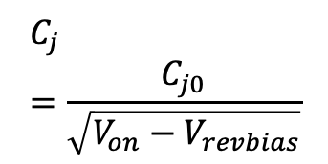
R
$$C_{j}=\frac{C_{j0}}{\sqrt{V_{on}−V_{revbias}}}$$
R
L
C
L
C
Varactor model
Z²=R²+(wL-(1/wC))²
Z=(L/C-j(R/wC))(R+j(wL-(1/wC))⁻¹
f₀= (2p)⁻¹(LC)^{-1/2}
v_{in}
.0025
C
V_{cc}
20K
11K
R
Colpitts oscillator
L
C₂
.01
f= (2p)⁻¹((1/L)(1/C₁+1/C₂))^{1/2}
For high pass
Swap input
resistors for caps
out
L
62K
Active low pass
C₁
C₂
Flat side transistor (L to R): E, B. C
𝝿 and T impedance matching

