Slide 1

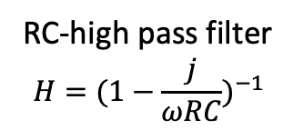
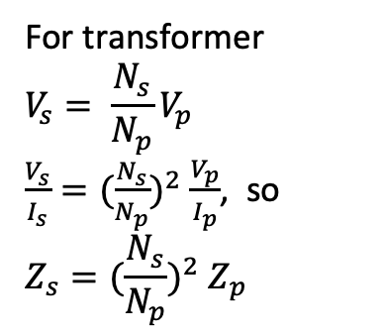
+
For transformer
$$V_{s}= \frac{N_{s}}{N_{p}}V_{p}$$
$\frac{V_{s}}{I_{s}}={(\frac{N_{s}}{N_{p}})}^{2} \frac{V_{p}}{I_{p}}$, so
$$Z_{s}={(\frac{N_{s}}{N_{p}})}^{2} Z_{p}$$
.33 uF
+
1000 uF
LM7805
Power supply
+
C
R
.33 uF
RC-high pass filter
$$H={(1−\frac{j}{ωRC})}^{−1}$$
Voltage regulator
Line filter
R
C
L=500mH
C=120mF
R= 60$Ω$
RC low pass filter
ZENER
H= R(1+j/(wRC))⁻¹
RC Band-pass filter
H= R(R+j(wL-1/(wC)))⁻¹
Voltage regulator

Slide 2
v₊
C
v₊
C
R
v_{i}
R_{i}
R_{o}
v_{o}
Av_{i}
R_{L}
v_{o}
v_{o}
v₋
v₋
Ideal Amplifier
Integrator
Differentiator
R₁
R₁
v₊
R_{F}
v₊
R_{F}
v₊
v_{o}
v_{o}
v_{o}
v₋
v₋
v₋
Inverting Amp
Non-inverting Amp
Follower as buffer
c
b
r_{p}
bi_{b}
r_{x}
r_{p}
c
v_{s}
R_{S}
b
c_{m}
r_{o}
c_{p}
bi_{b}
e
e
Bipolar source model
Simple bipolar model
High frequency bipolar model (npn)

Slide 3
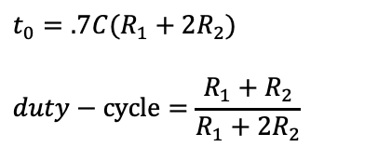

Pin 1: -Vs
Pin 8: +Vs
Pin 2 (Trigger): Out HIGH if V < V_{CC}/3. Pin 2 controls pin 6. If pin 2 is LOW, and pin 6 LOW, output goes and stays HIGH. If pin 6 HIGH, and pin 2 goes LOW, output goes LOW while pin 2 LOW. Pin 2has a very high impedance (about 10M) and will trigger with about 1uA.
Pin 3 (Output): (Pins 3 and 7 are "in phase.") Goes HIGH (about 2v less than rail) and LOW (about 0.5v less than 0v) and will deliver up to 200mA.
Pin 4 (Reset): Internally connected HIGH via 100k. Must go below 0.8v to reset the chip.
Pin 5 (Control): voltage applied to this pin will vary the timing of the RC network (quite considerably).
Pin 6 (Threshold): HIGH if > 2 V_{CC} /3, make output LOW only if pin 2 is HIGH. Pin 6 has very high impedance (~10M) and will trigger with about 0.2uA.
Pin 7 (Discharge): Pin 7 is equal to pin 3 but pin 7 does not go high - it goes OPEN. When LOW it sinks about 200mA.
555 one shot
+Vs
1
8
555
R
2
7
$$t_{0}=.7 RC$$
out
3
6
C
+Vs
4
5
$$.1μF$$
555 astable
+Vs
1
8
2
555
R₁
1 (o1)
2 (i1-)
3 (i1+)
4 (V+)
5 (i2+)
6 (i2-)
7 (o2)
(o4) 14
(i4-) 13
(i4+) 12
(GND) 11
(i3-) 10
(i3+) 9
(o3) 8
7
$$t_{0}=.7C(R_{1}+2R_{2})$$
$$duty−cycle=\frac{{R_{1}+R}_{2}}{R_{1}+{2R}_{2}}$$
3
R₂
324 op amp
out
6
4
5
C
$$.1μF$$

Slide 4
V_{CC}
V_{CC}
R₁
R_{C}
C_{o}
R₁
C_{i}
C_{i}
C_{o}
v_{s}
R₂
v_{s}
R₂
C_{E}
R_{E}
R_{E}
Common emitter amp
Common collector amp (Emitter Follower)
V_{CC}
16k
16k
C_{i}
R_{C}
C_{o}
.02uF
741
R_{E}
R₁
.01uF
.01uF
1k
v_{i}
8k
R₂
C_{B}
Advanced notch
100
Common base amp

Slide 5
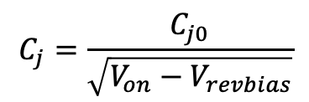
R
$$C_{j}=\frac{C_{j0}}{\sqrt{V_{on}−V_{revbias}}}$$
R
L
C
L
C
Varactor model
Z²=R²+(wL-(1/wC))²
Z=(L/C-j(R/wC))(R+j(wL-(1/wC))⁻¹
f₀= (2p)⁻¹(LC)^{-1/2}
v_{in}
.0025
C
V_{cc}
20K
11K
R
Colpitts oscillator
L
C₂
.01
f= (2p)⁻¹((1/L)(1/C₁+1/C₂))^{1/2}
For high pass
Swap input
resistors for caps
out
L
62K
Active low pass
C₁
C₂
Flat side transistor (L to R): E, B. C
𝝿 and T impedance matching

Slide 6
SN74LS00
SN74LS02
SN74LS06
SN74LS10
4013
4017
1 (Y)
2 (A)
3 (B)
4 (Y)
5 (A)
6 (B)
7 (Gnd)
(V+) 14
(Q) 13
(!Q) 12
(C) 11
(R) 10
(K) 9
(J) 8
1 (A)
2 (!A)
3 (B)
4 (!B)
5 (C)
6 (!C)
7 (Gnd)
(V+) 14
(D) 13
(!!D) 12
(E) 11
(E!) 10
(F) 9
(!F) 8
1 (A1)
2 (A2)
3 (C1)
4 (C2)
5 (C3)
6 (CO)
7 (Gnd)
1 (Q)
2 (!Q)
3 (C)
4 (R)
5 (D)
6 (S)
7 (Gnd)
(V+) 14
(Q) 13
(!Q) 12
(C) 11
(R) 11
(D) 10
(S) 9
1 (5)
2 (1)
3 (0)
4 (2)
5 (6)
6 (7)
7 (3)
8 (Gnd)
(V+) 16
(R) 15
(CLK) 14
(CKE) 13
(CO) 12
(9) 11
(4) 10
(8) 9
1 (A)
2 (B)
3 (Y)
4 (Y)
5 (B)
6 (A)
7 (Gnd)
(V+) 14
(A) 13
(B) 12
(Y) 11
(Y) 10
(B) 9
(A) 8
(V+) 14
(A3) 13
(AO) 12
(B3) 11
(B2) 10
(B1) 9
(BO) 8
4 NAND
4 NOR
6 Inverter
3 3-NOR
Dual D-FF
Counter
1 (o1)
2 (i1-)
3 (i1+)
4 (V+)
5 (i2+)
6 (i2-)
7 (o2)
(o4) 14
(i4-) 13
(i4+) 12
(GND) 11
(i3-) 10
(i3+) 9
(o3) 8
1 (GAIN)
2 (IN-)
3 (IN+)
4 (GND)
(GAIN) 8
(BYP) 7
(V+) 6
(OUT) 5
Offset/null
V_{in}-
V_{S}+
V_{in}+
741
V_{out}
V_{S}-
Offset/null
386 amp
324 op amp

Slide 7
v₁
10K
R
R
10K
C/2
v₁
R/2
10K
v₂
10K
v₂
C
C
Notch Filter
4.7K
OR
4.7K
AND
.01
R₁
10K
10K
6.2K
.01
5000pF
20 mH
500pF
100pF
SB
Q
8.2K
1
820
.01
15K
QB
RB
Debounce
Square Wave generator
Oscillator
f= (2p)⁻¹(LC)^{1/2}

Slide 8
SPST
Square wave generator
Pulse generator
.01
10K
100K
+
9v
+
8
1
100K
-
-
10K
7
555
2
1K
6
3
100
47K
220
324
5
4
100K
100K
10mF
SPKR
100K
.01
100K
1
+
3
13
O₁
S₁
D
1
2
2
11
-
100K
12
10K
3
5
4
8
For D=0, 01
For D=1, 10
10
9
O₂
S₂
T
6
100K
4001 (nor). 7, gnd; 8,9,12,13,14, V+
4011 (FF). 7, gnd; 14, V+
680
D-latch

Slide 9
1
3
13
O₁
S₁
D
1
2
2
11
100K
12
10K
3
5
4
8
For D=0, 01
For D=1, 10
10
9
O₂
S₂
T
6
100K
4001 (nor). 7, gnd; 8,9,12,13,14, V+
4011 (FF). 7, gnd; 14, V+
680
D-latch
50K
.1
.047
470
10K
100K
out
100
.1
220K
47K
Sawtooth
Frequency Shift Oscillator

Slide 10
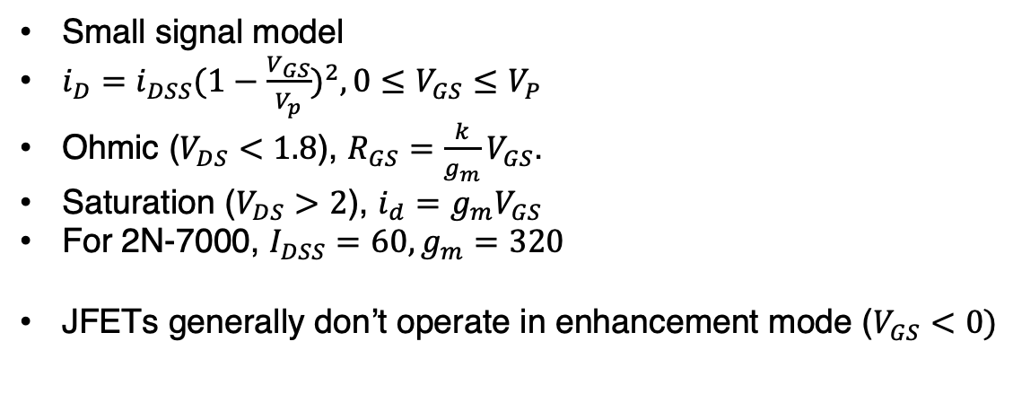
FETs
N channel JFET
N channel enhancement insulated MOSFET
From electronics notes
source gate drain
2N-7000 package
Small signal model
      $i_{D}=i_{DSS}{(1−\frac{V_{GS}}{V_{p}})}^{2}, 0≤V_{GS}≤V_{P}$
      Ohmic ($V_{DS}<1.8$), $R_{GS}=\frac{k}{g_{m}}V_{GS}$.
      Saturation ($V_{DS}>2$), $i_{d}=g_{m}V_{GS}$
      For 2N-7000, $I_{DSS}=60, g_{m}=320$
      JFETs generally don’t operate in enhancement mode ($V_{GS}<0)$
R_{D}
D
G
S

Slide 11

FETAmps
R_{D}
C_{out}
C_{in}
G
out
D
Common Source
              $V_{DD}=12v, i_{DSS}=35mA, V_{p}=−3v$
              $A_{V}=10, i_{DQ}=10mA$
              $R_{S}=−\frac{V_{P}}{i_{DQ}}(1−\sqrt{\frac{i_{DQ}}{i_{DSS}}}$)= 139 (say $150Ω$)
              $A_{V}=−\frac{R_{D}}{R_{S}}$, $R_{D}=1,500Ω$
          Common Drain
in
R_{G}
S
R_{S}
C_{in}
G
D
in
C_{out}
S
R_{G}
out
R_{S}
R_{L}

Slide 12
Summing amp
Current to Voltage
R_{f}
R₁
R_{f}
Difference Amp
R_{f}
R₂
R₂
R₁
Schmitt Trigger
R
14k
Peak Detector
16k
470k

Slide 13
Comparator
+
9v
-
3
4
1K
4.7K
1K
+
324
1
4.7K
1K
2
-
11
100 uF
100 uF
+
1K
-
+
10K
10K
D
Astable Multivibrator
-
Push-pull amp
.001uF
9v
AM Detectors
33K
10K
.047uF
470K
100
2.2K
330K
100
.02uF
3.3K
.01uF
47
47pf

Slide 14
Phase lock loop
Current source
12
10K
.1 uF
.1 uF
2
10
4.7K
8
4.7K
Load
565
9
.022 uF
3
7
+
4.7K
4
10 uF
5
1
VCO(out)
-12
.1 uF
Mixer
10K
Crystal equivalent
10K

Slide 15
AM modulator
V_{CC}
10K
R_{in}
324
56K
Out
.32mF
.470pF
1K
Carrier
100nF
15K
4.7K
Crystal oscillator
Audio
FM modulator
10K
5K
10pF
VCO
VCO
100pF
Carrier
FM demodulator

Slide 16
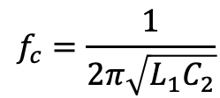
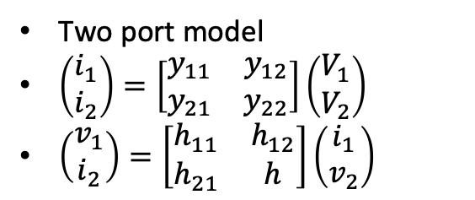
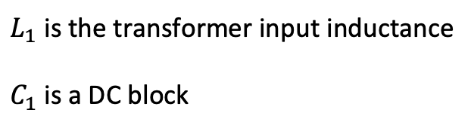
Thevenin, Norton and two port models
FM Ratio Modulator
R_{Th}
R_{Nor}
Two port model
$\left(\begin{matrix}i_{1} \\ i_{2}\end{matrix}\right)=\left[\begin{matrix}y_{11} & y_{12} \\ y_{21} & y_{22}\end{matrix}\right]\left(\begin{matrix}V_{1} \\ V_{2}\end{matrix}\right)$
$\left(\begin{matrix}v_{1} \\ i_{2}\end{matrix}\right)=\left[\begin{matrix}h_{11} & h_{12} \\ h_{21} & h\end{matrix}\right]\left(\begin{matrix}i_{1} \\ v_{2}\end{matrix}\right)$
carrier
Modulating signal
FM Ratio Detector
$$f_{c}=\frac{1}{2π\sqrt{{L_{1}C}_{2}}}$$
C₁
100 pF
100K
$L_{1}$ is the transformer input inductance
$C_{1}$ is a DC block
C₂
out
in
100 pF
100K

Slide 17
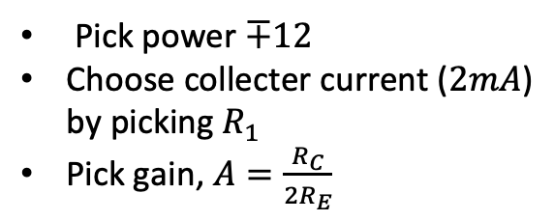
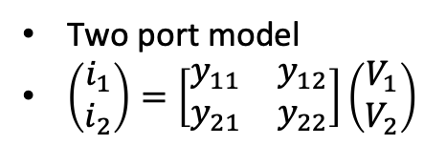
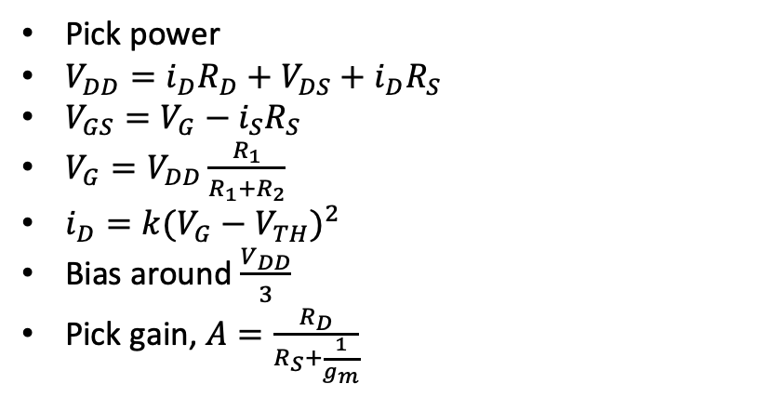
CMOS Common Emitter amplifier
Differential amplifier
Pick power
$V_{DD}=i_{D}R_{D}+V_{DS}+i_{D}R_{S}$
$V_{GS}=V_{G}−i_{S}R_{S}$
$V_{G}=V_{DD}\frac{R_{1}}{R_{1}+R_{2}}$
$i_{D}=k{(V_{G}−V_{TH})}^{2}$
Bias around $\frac{V_{DD}}{3}$
Pick gain, $A=\frac{R_{D}}{R_{S}+\frac{1}{g_{m}}}$
R_{C}
R_{C}
v_{in}
v_{O}
v_{in}
R_{E}
R_{E}
Two port model
$\left(\begin{matrix}i_{1} \\ i_{2}\end{matrix}\right)=\left[\begin{matrix}y_{11} & y_{12} \\ y_{21} & y_{22}\end{matrix}\right]\left(\begin{matrix}V_{1} \\ V_{2}\end{matrix}\right)$
R₁
V_{DD}
Pick power $∓12$
Choose collecter current ($2mA$) by picking $R_{1}$
Pick gain, $A=\frac{R_{C}}{2R_{E}}$
R_{D}
D
C_{i}
R₁
C_{o}
S
R₂
R_{S}

Slide 18


Variable power supply
YD-1485
1N4001
2N6121
1K
2.7K
100uF
1000 uF
2N3904
10K
1N5247
SDR
$$⨂$$
LPF
ADC
BPF
90
$$⨂$$
LPF
ADC

Slide 19
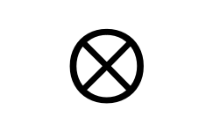
PLL as FM detector with 565
4.5V
1 (gnd)
565
6 (NC)
v_{in}
1K
2
C_{by}
v_{out}
$$⊗$$
C_{by}
3
7
1K
5
330pF
VCO
C_{by}
4
10 (V_{CC})
V_{CC}
8
9
C_{by}
100 pF
R

Slide 20
VCO
9.0V
100
.01 uF
1000pF
10K
68 pF
27pF
100K
68 pF
100

Slide 21
SA612 Mixer
8V
Normally, input goes here
.1uF
SA602 Mixer
1
8
2
7
.1uF
47pF
270pF
3
6
4.91MHz
4
5
.1uF
~4.91MHz
Outputs (4,5) are 180 degrees out of phase

Slide 22

Colpitts 1
9v
9v
_{1uH}
1000 pF
2.2K
25.3MHz
.5uA through R_{bias}
_{1uH}
2.2K
60 pF
Noise
Rbias
120 pF
$$P_{N}=kTB$$

Slide 23
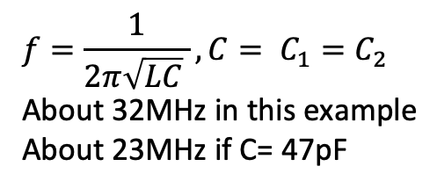
Colpitts 2
9v
C₁ (22 pF)
1K
.1 uF
L (1uH)
47K
C₂=C₁
.1uF
2.7K
100
$$f=\frac{1}{2π\sqrt{LC} }, C= C_{1}=C_{2}$$
About 32MHz in this example
About 23MHz if C= 47pF

Slide 24
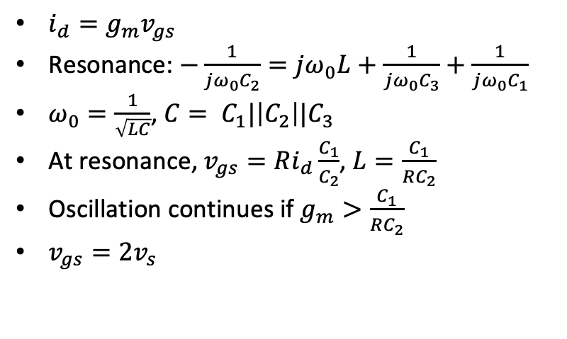
Norcal Clapp
$i_{d}=g_{m}v_{gs}$
Resonance: $−\frac{1}{jω_{0}C_{2}}=jω_{0}L+\frac{1}{jω_{0}C_{3}}+\frac{1}{jω_{0}C_{1}}$
$ω_{0}=\frac{1}{\sqrt{LC}}$, $C= C_{1}|\left|C_{2}\right||C_{3}$
At resonance, $v_{gs}=Ri_{d}\frac{C_{1}}{C_{2}}$, $L=\frac{C_{1}}{RC_{2}}$
Oscillation continues if $g_{m}>\frac{C_{1}}{RC_{2}}$
$v_{gs}=2v_{s}$
9v
C₃
C₁ (1200pF)
L (19uH)
C₂ (1200 pF)
out
R

Slide 25
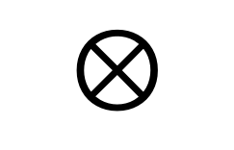
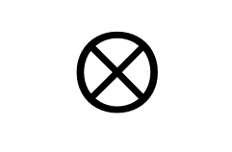
Norcal 40A
7 MHz
2W
<10 MHz
Harmonic
Filter
RF
Filter
Power
Amp
$$⊗$$
RF Mixer
20 mW
4.9 MHz
9.1 MHz
Driver
IF
Filter
300 uW
VFO
2.1 MHz
Product
Detector
Buffer
$$⊗$$
BFO
4.9 MHz
10 uW
9.8 MHz
Audio
Transmit
Filter
AGC
7 MHz
2.8 MHz
Transmit
Mixer
$$⊗$$
AGC
Detector
Audio
Amp
Key
Transmit oscillator
4.9 MHz

Slide 26
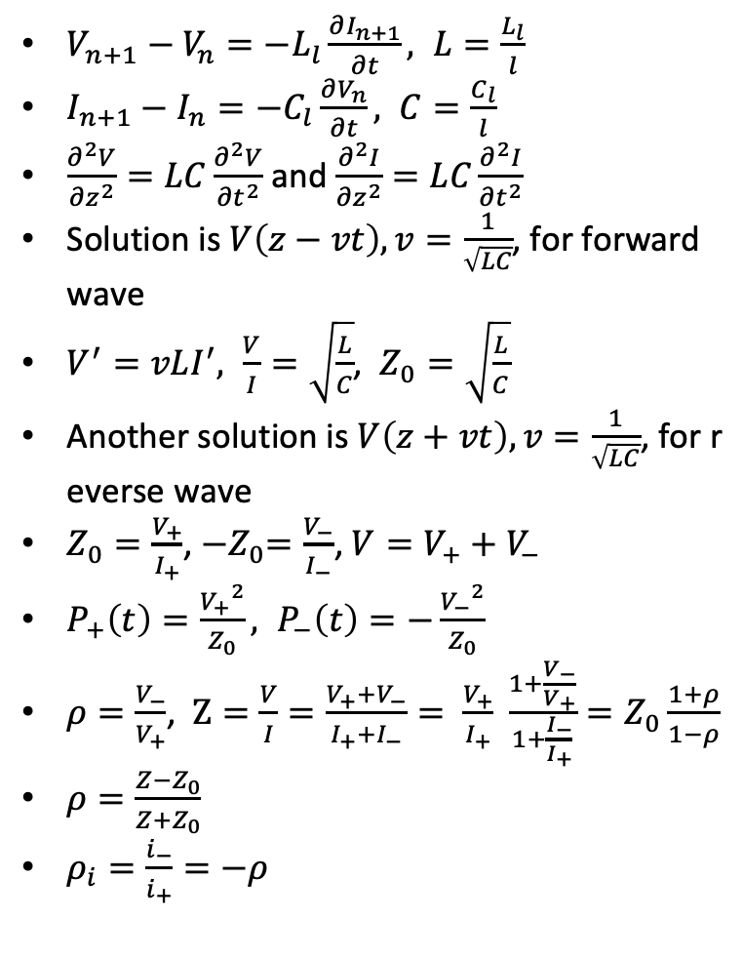
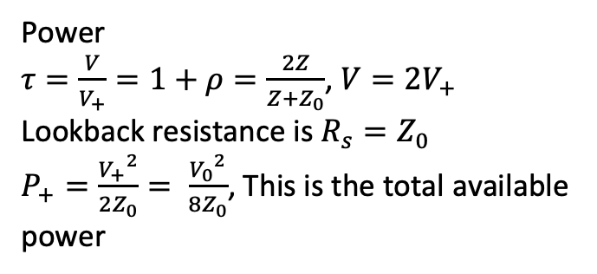
Transmission Lines
$V_{n+1}−V_{n}=−L_{l}\frac{∂I_{n+1}}{∂t}, L=\frac{L_{l}}{l}$
$I_{n+1}−I_{n}=−C_{l}\frac{∂V_{n}}{∂t}, C=\frac{C_{l}}{l}$
$\frac{∂^{2}V}{{∂z}^{2}}=LC\frac{∂^{2}V}{{∂t}^{2}}$ and $\frac{∂^{2}I}{{∂z}^{2}}=LC\frac{∂^{2}I}{{∂t}^{2}}$
Solution is $V\left(z−vt\right), v=\frac{1}{\sqrt{LC}}$, for forward wave
$V^{′}=vLI^{′}, \frac{V}{I}=\sqrt{\frac{L}{C}}$, $Z_{0}=\sqrt{\frac{L}{C}}$
Another solution is $V\left(z+vt\right), v=\frac{1}{\sqrt{LC}}$, for reverse wave
$Z_{0}=\frac{V_{+}}{I_{+}}$, ${−Z}_{0}=\frac{V_{−}}{I_{−}}$, $V=V_{+}+V_{−}$
$P_{+}\left(t\right)=\frac{{V_{+}}^{2}}{Z_{0}}, P_{−}\left(t\right)=−\frac{{V_{−}}^{2}}{Z_{0}}$
$ρ=\frac{V_{−}}{V_{+}}$, $Z=\frac{V}{I}=\frac{V_{+}+V_{−}}{I_{+}+I_{−}}= \frac{V_{+}}{I_{+}} \frac{1+\frac{V_{−}}{V_{+}}}{1+\frac{I_{−}}{I_{+}}}=Z_{0}\frac{1+ρ}{1−ρ}$
$ρ=\frac{Z−Z_{0}}{Z+Z_{0}}$
$ρ_{i}=\frac{i_{−}}{i_{+}}=−ρ$
I_{n}
V_{n}
L_{l}
…
C_{l}
Power
$τ=\frac{V}{V_{+}}=1+ρ=\frac{2Z}{Z+Z_{0}}$, $V=2V_{+}$
Lookback resistance is $R_{s}=Z_{0}$
$P_{+}=\frac{{V_{+}}^{2}}{2Z_{0}}= \frac{{V_{0}}^{2}}{8Z_{0}}$, This is the total available power

Slide 27
Filters
Low pass
L₂
L₄
C₁
C₂
C₃
High pass
C₁
C₂
C₃
L₂
L₄
7 MHz bandpass
C₁ (34.5 pF)
L₂ (15 uH)
C₂ (6nF)
L₄ (8nH)

Slide 28
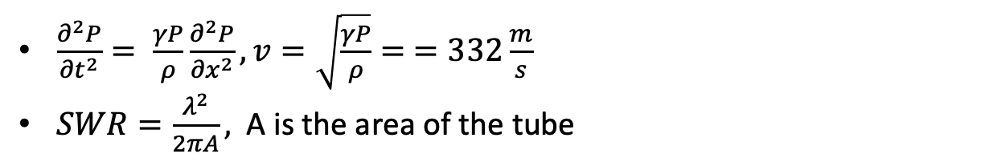
Acoustics
$\frac{∂^{2}P}{{∂t}^{2}}= \frac{γP}{ρ}\frac{∂^{2}P}{{∂x}^{2}}, v=\sqrt{\frac{γP}{ρ}}= =332\frac{m}{s}$
$SWR=\frac{λ^{2}}{2πA},$ A is the area of the tube

Slide 29
Transmitter switch
2N3906
8V
8V TX
R₂₄ (150K)
When key is down, transistor conducts
R₉ (47K)
Key jack
C₄₇ (47nF)
relay

Slide 30

Receiver switch
C₁
50pF
L₁ (15uH)
8V TX
Receiver mixer or an oscilloscope
With 50$Ω$
2N4124
Harmonic filter
R₁
1.8K
C₂
47nF
If using function generator
use a 1.8K resistor
When transistor conducts the receiver filter shorts

Slide 31
Norcal Harmonic Filter
L₇
L₈
Power amp, or,
function generator
Antenna
Jack out
C₄₅
330pF
C₄₆
820pF
C₄₇
330pF
L₇, L₈ use T37-2 core, 18 turns, 1.3uH
Compare loss at 7MHz and 14MHz

Slide 32
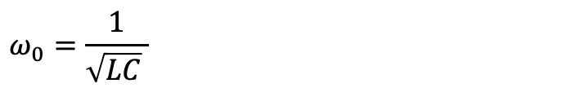
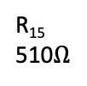
Norcal VCO
$$ω_{0}=\frac{1}{\sqrt{LC} }$$
RIT 1
R₁₇
10K
R₂₀
4.7K
8V
C₅₄
47nF
R₁₉
47K
C₄₉
47pF
C₅₁
390pF
J309
R₁₅
510$Ω$
LM393 pin 7
C₅₂
1200pF
R₂₃
1.8K
C₅₀
25pF
D₉
R₂₁
47K
D₈
MVAM108
L₉
TX VFO
C₇
10pnF
C₅₃
1200pF
RFC
1mH
RX VFO
C₃₂
150 pF
L9: T68-7 62 turns
Check MVAM108 capacitor when R₁₇ is high and low
Start resistor (R₂₁) pulls gat to ground at start
When gain limiting diode (D9) conducts, it pulls gate negative
Oscillator keeps growing as long as g_{m}>1/R

Slide 33
Norcal Receiver Incremental Tuning (RIT)
RIT 1
R₁₆
1K
R₁₅
510
LM393
8
1
7
8V
2
3
C₄
5pF
6
4
5
on
1.4V
From VFO
off
8V TX
LM393 is a comparator
For function generator connect through 1.5K

Slide 34
Norcal RF Filter
C₁
50 pF
L₁
15uH
RX Ant
8V TX
2N4124
To RF
Mixer
R₁
1.8K
R₂
1K
C₃
47nF
To receiver
switch

Slide 35
Norcal RF Mixer
8V
C₄
5pF
RF
Filter
SA602
8
C₂
50pF
1
T₂
C₁₈
47nF
7
50mVpp if
using function
generator
2
C₅
10nF
RX VFO
3
6
From VCO
4
5
C₆
47pF
T₃
IF Filter

Slide 36

Norcal IF Cohn Filter
X₁ through X₄ are 4.91 MHz
C₁₀, C₁₁, C₁₂ are 270 pF
Set function generator to 50mV_{pp} from function generator
Calculate R and X for filter
C₉
X₁
X₂
X₃
X₄
C₁₃
C₁₀
C₁₁
C₁₂
L₉ (18 uH)
200$Ω$
C₁₄
47pF
To SA602 wants 1.5K
Matching network
Equivalent circuit for
crystal and generator

Slide 37
Norcal Product Detector
8V
1.4V
SA602
C₁₈
270 pF
8
1
IF in
7
2
C_{15. +}
2.2uF
C₁₇
50 pF
3
6
4
5
4.91 MHz
AF1
AF2
620 Hz output through AF1 and AF2

Slide 38
Norcal AGC
8V TX
8V
Connect to
function generator
through 300K, here
R₂₀
4.7K
R₃
150K
C₄₁
100uF
C₅₅
100nF
AF2
J309
R_{5c}
2.2M
C₅₅
10nF
R_{5a}
2.2M
C₂₇
100uF
R₇
47K
To audio
in
D₁
D₂
From product
detector
C₂₈
100nF
Key tune
D₄
D₆
R₆
10K
Threshold
R_{5b}
2.2M
R_{5d}
2.2M
D₅
AGC pt at
audio amp
AF1
C₂₁
100nF

Slide 39
Norcal Audio Amp
8V
C₂₃
2.2uF
+
C₅₅ (10 nF)
1
2
8
R₂₂
1.8K
+
Audio in
5
3
386
4
-
6
+
+
C₂₇ (100 uF)
AGC pt
C₃₀ (2.2 uF)
R₆
500
Speaker
+
C₂₆ (10 uF)

Slide 40
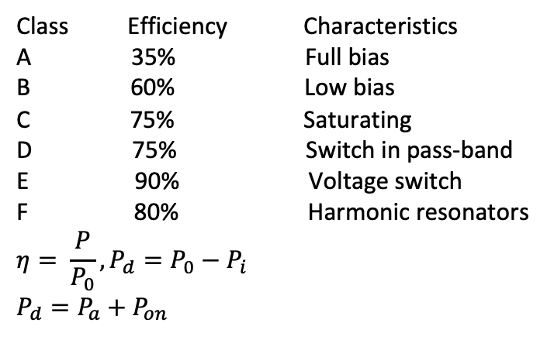
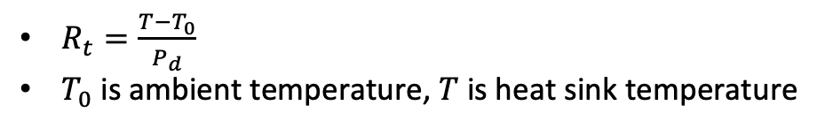


Norcal Power Amp
Class Efficiency Characteristics
A 35% Full bias
B 60% Low bias
C 75% Saturating
D 75% Switch in pass-band
E 90% Voltage switch
F 80% Harmonic resonators
$$η= \frac{P}{P_{0}}, P_{d}=P_{0}−P_{i}$$
$$P_{d}=P_{a}+P_{on}$$
Norcal-40 Power amp is class C
8V
R₁₄
1$Ω$
RFC
18uH
Supply power
3,200 mW
2N3553
Harmonic
Filter
Driver
C₄₄
47nF
Active loss
P_{a}, 260 mW
R₁₄
100$Ω$
IN4753A
Power transistor
$R_{t}=\frac{T−T_{0}}{P_{d}}$
$T_{0}$ is ambient temperature, $T$ is heat sink temperature
Active loss
P_{on}, 430 mW
Antenna
2500 mW

Slide 41
Amplifier classes
I
I
V
t
t
t
Class A
Class B
Class C
V
V
V
t
t
t
Class D
Class E
Class F

Slide 42









Norcal matching transformers
T₁ is driver matcher uses FT 37-43
Measurement circuit below
T₁, 14:4
50$Ω$
200$Ω$
100$Ω$
50$Ω$
1K$Ω$
T₂ is RF matcher uses FT 37-61
Measurement circuit below
C₄
5pF
T₂, 1:20
50$Ω$
C₂
50pF
1.5K$Ω$
T₃, 23:6
T₃ is IF matcher uses FT 37-61
Measurement circuit below
L₄, 18uH
750$Ω$
C₁₄
47pF
C₆
47pF
1.5K$Ω$

Slide 43


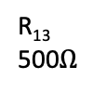


Norcal Driver
$Use 50Ω$ scope probe
8V
out
T₁
R₁₄
100$Ω$
2N2222A
R₁₁
510$Ω$
R₁₂
20$Ω$
R₁₃
500$Ω$
+
Key jack
C₅₆
10uF
C₄₈
10nF

Slide 44
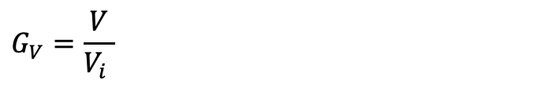


Norcal Buffer
8V TX
C₃₆
47nF
Function
Generator
C₃₉
50pF
Pin 4 transmit
mixer
C₃₇
5pF
R₁₀
510$Ω$
1.5K
Driver
C₃₈
100pF
C₅₀
25pF
L₆
3.1uF
J309
R₁₁
510$Ω$
$$G_{V}=\frac{V}{V_{i} }$$

Slide 45
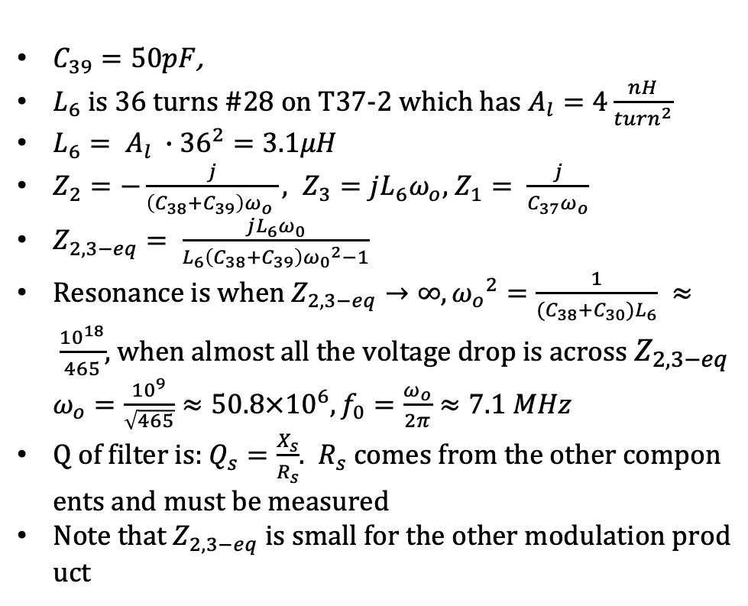
Norcal transmit bandpass filter
$C_{39}=50pF$,
$L_{6}$ is 36 turns #28 on T37-2 which has $A_{l}=4\frac{nH}{{turn}^{2}}$
$L_{6}= A_{l} ∙{36}^{2}=3.1μH$
$Z_{2}=−\frac{j}{\left(C_{38}+C_{39}\right)ω_{o} }, Z_{3}=jL_{6}ω_{o}$, $Z_{1}= \frac{j}{C_{37}ω_{o}}$
$Z_{2,3−eq}= \frac{jL_{6}ω_{0}}{L_{6}\left(C_{38}+C_{39}\right){ω_{0}}^{2}−1}$
Resonance is when $Z_{2,3−eq}→∞, {ω_{o}}^{2}=\frac{1}{(C_{38}+C_{30})L_{6}} ≈ \frac{{10}^{18}}{465}$, when almost all the voltage drop is across $Z_{2,3−eq}$ $ω_{o}=\frac{{10}^{9}}{\sqrt{465}}≈50.8×{10}^{6}, f_{0}=\frac{ω_{o}}{2π}≈7.1 MHz$
Q of filter is: $Q_{s}=\frac{X_{s}}{R_{s}}$. $R_{s}$ comes from the other components and must be measured
Note that $Z_{2,3−eq}$ is small for the other modulation product
C37 (5pF)
C₃₉
C₃₈ (100pF)
L₆

Slide 46
Norcal transmit mixer and oscillator
8V
TX VFO
C₃₁
5 pF
SA602
C₃₆
270 pF
8
1
7
2
C₃₃
47nF
C₃₄
50 pF
L₅
18 uH
3
6
5
4
4.91 MHz
Buffer
Amp

Slide 47
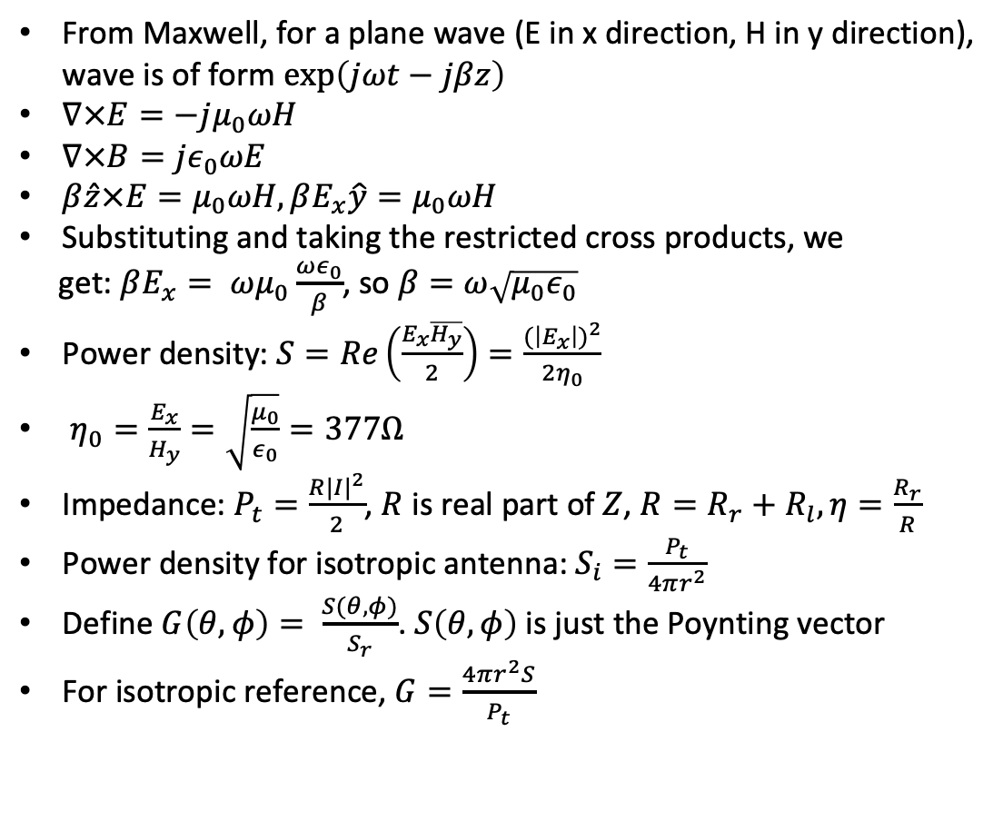
Antennas and propagation
From Maxwell, for a plane wave (E in x direction, H in y direction), wave is of form $\exp\left(jωt−jβz\right)$
$∇×E=−jμ_{0}ωH$
$∇×B=jε_{0}ωE$
$β\hat{z}×E=μ_{0}ωH, βE_{x}\hat{y}=μ_{0}ωH$
Substituting and taking the restricted cross products, we
get: $βE_{x}= ωμ_{0}\frac{ωε_{0}}{β}$, so $β=ω\sqrt{μ_{0}ε_{0}}$
Power density: $S=Re\left(\frac{E_{x}\overline{H_{y}}}{2}\right)=\frac{{(\left|E_{x}\right|)}^{2}}{2η_{0}}$
$η_{0}=\frac{E_{x}}{H_{y}}=\sqrt{\frac{μ_{0}}{ε_{0}}}=377Ω$
Impedance: $P_{t}=\frac{R{|I|}^{2}}{2}$, $R$ is real part of $Z$, $R=R_{r}+R_{l}, η=\frac{R_{r}}{R}$
Power density for isotropic antenna: $S_{i}=\frac{P_{t}}{4πr^{2}}$
Define $G\left(θ,φ\right)= \frac{S(θ,φ)}{S_{r}}$. $S\left(θ,φ\right)$ is just the Poynting vector
For isotropic reference, $G=\frac{4πr^{2}S}{P_{t}}$
Receiving antenna Thevenin
C
R

Slide 48
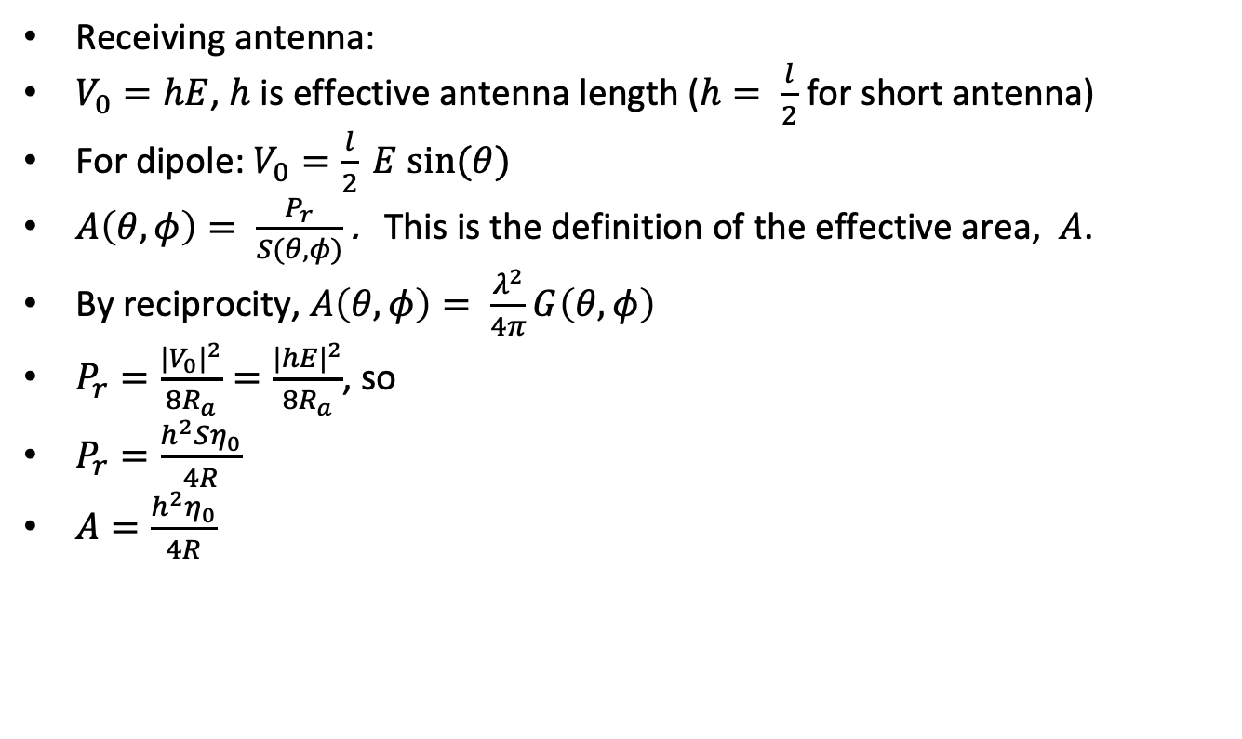
Antennas and propagation
Receiving antenna:
                $V_{0}=hE$, $h$ is effective antenna length ($h= \frac{l}{2}$ for short antenna)
                For dipole: $V_{0}=\frac{l}{2} E sin⁡(θ)$
    $A\left(θ, φ\right)= \frac{P_{r}}{S(θ,φ)}$ . This is the definition of the effective area, $A$.
    By reciprocity, $A\left(θ, φ\right)= \frac{λ^{2}}{4π}G\left(θ, φ\right)$
    $P_{r}=\frac{{{|V}_{0}|}^{2}}{8R_{a}}=\frac{{|hE|}^{2}}{8R_{a}}$, so
    $P_{r}=\frac{h^{2}Sη_{0}}{4R}$
    $A=\frac{h^{2}η_{0}}{4R}$

Slide 49
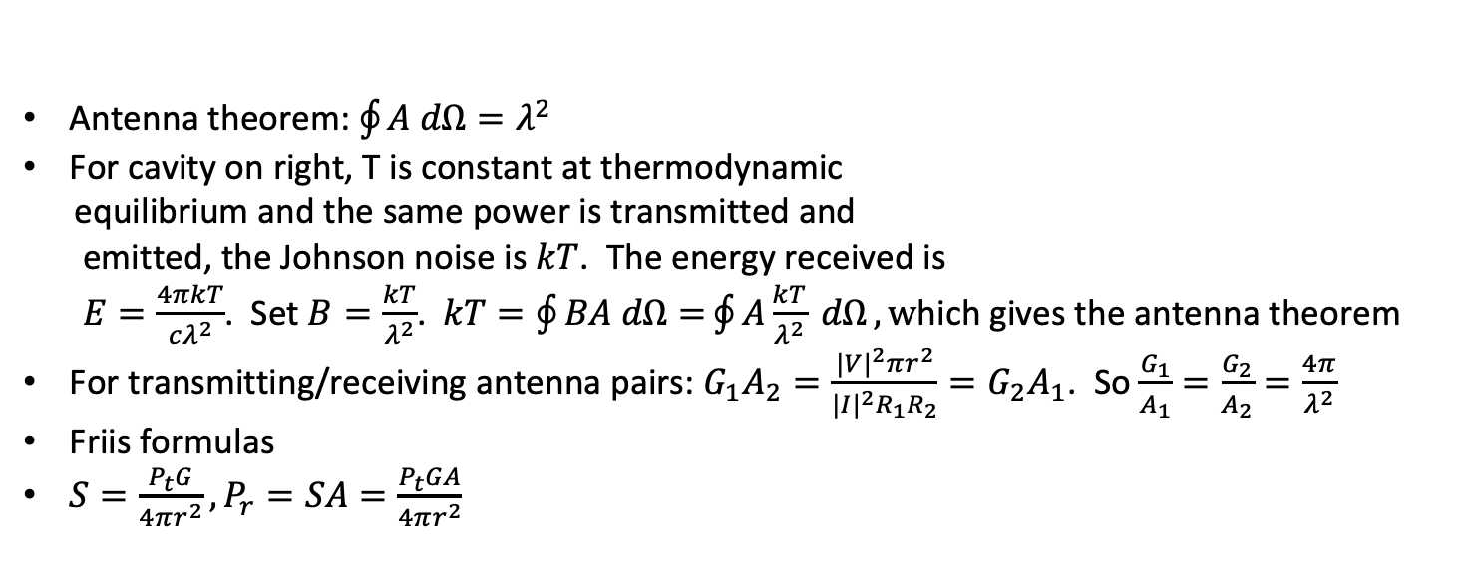
Antennas and propagation
Insulated cavity
T
A
Antenna theorem: $\oint{A dΩ=λ^{2}}$
For cavity on right, T is constant at thermodynamic
equilibrium and the same power is transmitted and
emitted, the Johnson noise is $kT$. The energy received is
$E=\frac{4πkT}{cλ^{2}}$. Set $B=\frac{kT}{λ^{2}}$. $kT=\oint{BA dΩ=}\oint{A\frac{kT}{λ^{2}} dΩ}, w$hich gives the antenna theorem
For transmitting/receiving antenna pairs: $G_{1}A_{2}=\frac{{|V|}^{2}πr^{2}}{{|I|}^{2}R_{1}R_{2}}=G_{2}A_{1}$. So $\frac{G_{1}}{A_{1}}=\frac{G_{2}}{A_{2}}=\frac{4π}{λ^{2}}$
Friis formulas
${S=\frac{P_{t}G}{4πr^{2}}, P}_{r}=SA=\frac{P_{t}GA}{4πr^{2}}$

Slide 50
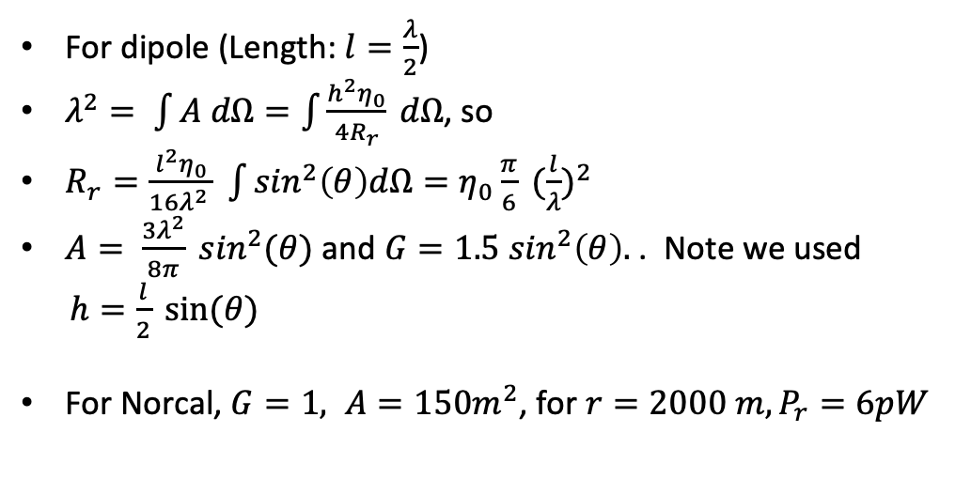
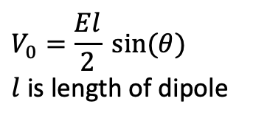
Reciprocity and dipole
Dipole Thevenin equivalent circuit
For dipole (Length: $l=\frac{λ}{2}$)
$λ^{2}= \int{A dΩ=\int{\frac{h^{2}η_{0}}{4R_{r}} dΩ}}$, so
$R_{r}=\frac{l^{2}η_{0}}{16λ^{2} } \int{\sin^{2}\left(θ\right)dΩ=η_{0}\frac{π}{6}} {(\frac{l}{λ})}^{2}$
$A= \frac{3λ^{2}}{8π} \sin^{2}(θ)$ and $G=1.5\sin^{2}\left(θ\right).$ . Note we used
$h=\frac{l}{2} sin⁡(θ)$
For Norcal, $G=1, A=150m^{2}$, for $r=2000 m, P_{r}=6pW$
C
R
$$V_{0}=\frac{El}{2} sin⁡(θ)$$
$l$ is length of dipole

Slide 51
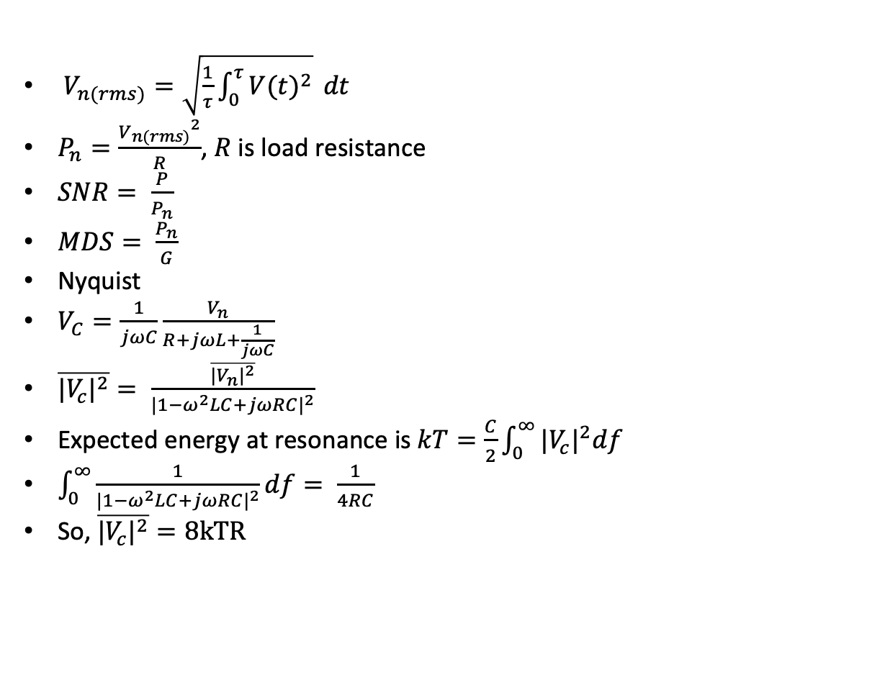
Noise
$V_{n(rms)}=\sqrt{\frac{1}{τ}\int_{0}^{τ}{{V(t)}^{2}}} dt$
$P_{n}=\frac{{V_{n(rms)}}^{2}}{R}$, $R$ is load resistance
$SNR= \frac{P}{P_{n}}$
$MDS= \frac{P_{n}}{G}$
Nyquist
$V_{C}=\frac{1}{jωC}\frac{V_{n}}{R+jωL+\frac{1}{jωC}}$
$\overline{{|V_{c}|}^{2}}= \frac{\overline{{|V_{n}|}^{2}}}{{|1−ω^{2}LC+jωRC|}^{2}}$
Expected energy at resonance is $kT=\frac{C}{2}\int_{0}^{∞}{{|V_{c}|}^{2}df}$
$\int_{0}^{∞}{\frac{1}{{|1−ω^{2}LC+jωRC|}^{2}}df}= \frac{1}{4RC}$
So, $\overline{{|V_{c}|}^{2}}=8kTR$

Slide 52
+
-
Passives
ADC
DAC
LPF

Slide 53
0
0
-
+
1
1
op amp or comparator
2
2
3
3
-
+
comparator
with hysteresis
inverters
buffers
0
0
1
1
2
2
SET
RSTB
SET
D
Q
D
Q
D
Q
D
Q
0
0
QB
QB
QB
G
RSTB
EN
EN
1
1
Type D Flip-Flops
transparent latch
SET
RSTB
D
Q
D
Q
D
Q
QB
QB
QB
RSTB
EN
register

Slide 54
S
Q
SB
SB | RB | Action
0 | 0 | Q=1 QB=1
0 | 1 | Q=1 QB=0
1 | 0 | Q=0 QB=1
1 | 1 | Keep state
Q
EN
SB
Q
QB
RB
QB
R
QB
RB
EN | Action
0 | Keep state
1 | same as SR latch
S
Q
EN
R
S | R | Action
0 | 0 | Keep state
0 | 1 | Q=0 QB=1
1 | 0 | Q=1 QB=0
1 | 1 | Q=0 QB=0
R
QB
Q
R
Q
Gated SR Latch
S
QB
SET
J | K | Next Value
0 | 0 | No Change
0 | 1 | Q=0
1 | 0 | Q=1
1 | 1 | Toggle
QB
J
Q
S
K
QB
RSTB
-
+
-
X
Σ
+
http://www.eehomepage.com/symbols.ppt. Copyright 2008 by EE HomePage.com. These symbols may be freely reused.

Slide 55
G
S
D
G
N-channel
P-channel
D
S
T1
G
T2
Triac
SCR
http://www.eehomepage.com/symbols.ppt
Copyright 2008 by EE HomePage.com
These symbols may be freely reused.
D

Slide 56
Input
Output
BiDi
L
3Φ motor
L
motor
varistor
+
+
R
V
+
-
-
-

