Slide 1
Cryptography and Cryptanalysis
Introduction
John Manferdelli
JohnManferdelli@hotmail.com
© 2004-2023, John L. Manferdelli.
This material is provided without warranty of any kind including, without limitation, warranty of non-infringement or suitability for any purpose. This material is not guaranteed to be error free and is intended for instructional use only.

Slide 2
Administrivia
Office hours: M 2:00-4:00 (and by appointment)
Grading
Take-home exam: 50%
Class project: 50%, selected with instructor
Web page:

Slide 3
Basic Setup

Slide 4
The wiretap channel: “In the beginning”
The Sender
Alice
The Receiver
Bob
Noisy insecure
channel
Plaintext
(P)
Encrypt
Decrypt
Plaintext
(P)
Key (K₁)
Key (K₂)
Eavesdropper
Message sent is:
C= E_{K1}(P)
Decrypted as:
P=D_{K2}(C)
P is called plaintext.
C is called ciphertext.
Symmetric Key: K₁=K₂
Public Key: K₁≠K₂
K₁ is publicly known
K₂ is Bob’s secret

Slide 5
Cryptography and adversaries
Cryptography is computing in the presence of an adversary.
An adversary is characterized by:
Talent
Nation state: assume infinite intelligence.
Wealthy, unscrupulous criminal: not much less.
Access to information
Ciphertext only, probable plaintext attacks, known plaintext/ciphertext attacks, chosen plaintext attacks, adaptive interactive, chosen plaintext attacks (oracle model).
Computational resources

Slide 6
Computational strength of adversary (edging towards high class version)
Infinite - Perfect Security
Information Theoretic
Doesn’t depend on computing resources or time available
Polynomial
Asymptotic measure of computing power
Indicative but not dispositive
Realistic
The actual computing resources under known or suspected attacks.
This is us, low brow.

Slide 7
Information strength of the adversary (high class version)
Ciphertext only (Yikes!)
Rare these days
Corresponding Plaintext/Ciphertext attack
Chosen Plaintext Attack (CPA, offline attack)
The adversary can only encrypt messages
Non-adaptive Chosen Ciphertext Attack (CCA1)
The adversary has access to a decryption oracle until, but not after, it is given the target ciphertext
Adaptive Chosen Ciphertext Attack (CCA2)
The adversary has unlimited access to a decryption oracle, except that the oracle rejects the target ciphertext
The CCA2 model is very general – in practice, adversaries are much weaker than a full-strength CCA2 adversary.
Yet, many adversaries are too strong to fit into CCA1
Notes:
”Many adversaries too strong for CCA1”: This is true for any attack where the adversary is able to extract any information about ciphertexts related to the target ciphertext. Typical examples are Bleichenbacher’s Million Messages Attack and Manger’s observation on RSA-OAEP. This model is considerably weaker than full CCA2 but is not properly included in CCA1.

Slide 8
Adversaries and their discontents
Wiretap Adversary (Eve)
Eve
Bob
Alice
Plaintext
(P)
Encrypt
Decrypt
Plaintext
(P)
Channel
Man in the Middle Adversary (Mallory)
Alice
Bob
Plaintext
(P)
Encrypt
Decrypt
Plaintext
(P)
Mallory
Channel

Slide 9
Dramatis persona
Users
Alice (party A)
Bob (party B)
Trent (trusted authority)
Peggy and Victor (authentication participants)
Users Agents
Cryptographic designer
Personnel Security
Security Guards
Security Analysts
Adversaries
Eve (passive eavesdropper)
Mallory (active interceptor)
Fred (forger)
Daffy (disruptor)
Mother Nature
Users (Yes Brutus, the fault lies in us, not the stars)
Adversaries Agents
Dopey (dim attacker)
Einstein (smart attacker --- you)
Rockefeller (rich attacker)
Klaus (inside spy)

Slide 10
It’s not just about communications privacy
Users want:
Privacy/Confidentiality
Integrity
Authentication
Non-repudiation
Quality of Service
Adversaries want to:
Read a message
Get key, read all messages
Corrupt a message
Impersonate
Repudiate
Deny or inhibit of service

Slide 11
Cryptographic toolchest
Symmetric ciphers (includes classical ciphers)
Block ciphers
Stream ciphers
Codes
Asymmetric ciphers (Public Key)
Cryptographic Hashes
Entropy and random numbers
Protocols and key management

Slide 12
Symmetric ciphers
Encrypt
E_{k}(P)
Ciphertext (C)
Plaintext (P)
Decrypt
D_{k}(P)
Plaintext (P)
Key (k)
Key (k)
Encryption and Decryption use the same key.
The transformations are simple and fast enough for practical implementation and use.
Two major types: Stream ciphers and block ciphers.
Examples: DES, AES, RC4, A5, Enigma, SIGABA, etc.
Can’t be used for key distribution or authentication.

Slide 13
Asymmetric (Public Key) ciphers
Encrypt
E_{k}(P)
Ciphertext (C)
Plaintext (P)
Decrypt
D_{k}(P)
Plaintext (P)
Public Key (P_{k})
Private Key (p_{k})
Encryption and Decryption use different keys.
P_{k} is called the public key and p_{k} is the private key. Knowledge of P_{k} is sufficient to encrypt. Given P_{k} and C, it is infeasible to compute p_{k} and infeasible to compute P from C.
Invented in mid 70’s –Hellman, Merkle, Rivest, Shamir, Adleman, Ellis, Cocks, Williamson
Public Key systems used to distribute keys, sign documents. Used in https:. Much slower than symmetric schemes.

Slide 14
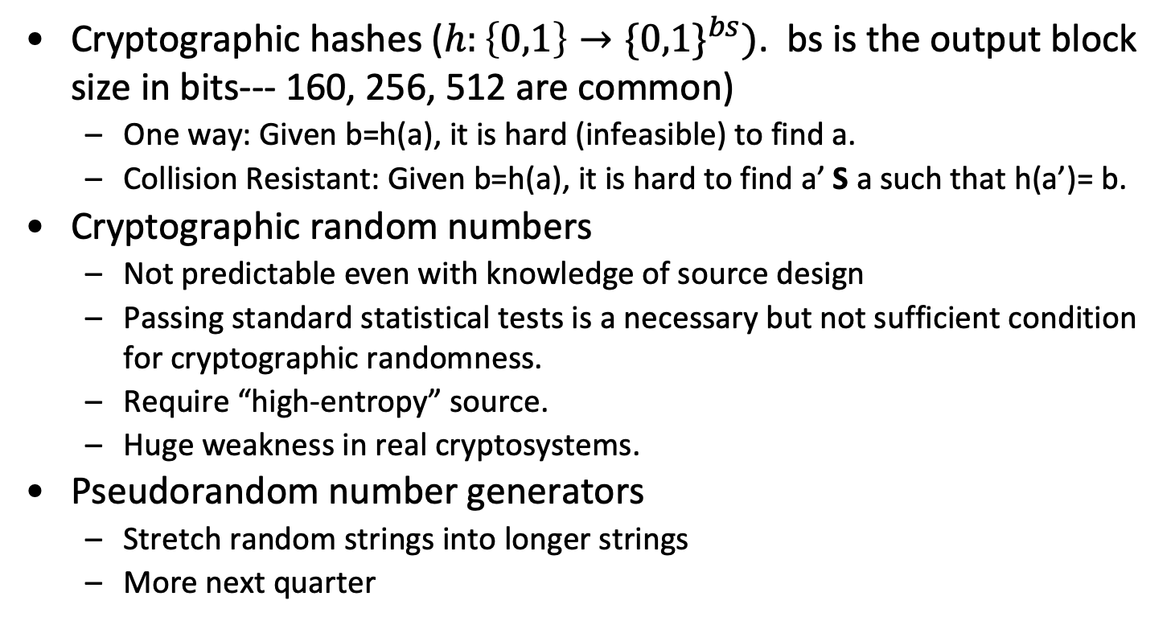
Cryptographic hashes, random numbers
Cryptographic hashes ($h:\left\{0,1\right\}→{\{0,1\}}^{bs})$. bs is the output block size in bits--- 160, 256, 512 are common)
One way: Given b=h(a), it is hard (infeasible) to find a.
Collision Resistant: Given b=h(a), it is hard to find a’ S a such that h(a’)= b.
Cryptographic random numbers
Not predictable even with knowledge of source design
Passing standard statistical tests is a necessary but not sufficient condition for cryptographic randomness.
Require “high-entropy” source.
Huge weakness in real cryptosystems.
Pseudorandom number generators
Stretch random strings into longer strings
More next quarter

Slide 15
Algorithm Speed
Algorithm | Speed
RSA-1024 Encrypt | .32 ms/op (128B), 384 KB/sec
RSA-1024 Decrypt | 10.32 ms/op (128B), 13 KB/sec
AES-128 | .53 ms/op (16B), 30MB/sec
RC4 | .016 ms/op (1B), 63 MB/sec
DES | .622 ms/op (8B), 12.87 MB/sec
SHA-1 | 48.46 MB/sec
SHA-256 | 24.75 MB/sec
SHA-512 | 8.25 MB/sec
Timings do not include setup. All results typical for a 850MHz x86.

Slide 16
Mechanisms for insuring message privacy
Ciphers
Codes
Stegonography
Secret Writing (Bacon’s “Cipher”)
Watermarking
We’ll focus on ciphers which are best suited for mechanization, safety and high throughput.

Slide 17
Codes and Code Books
One Part Code
A 2
Able 8
Two Part
In first book, two columns. First column contains words/letters in alphabetical order, second column has randomly ordered code groups
In second code book, columns are switched and ordered by code groups.
Sometimes additive key is added (mod 10) to the output stream
Code-book based codes are “manual.” We will focus on ciphers from now on.
“Codes” also refers to “error correcting” codes which are used to communicate reliably over “noisy” channels. This area is related to cryptography. See, MacWilliams and Sloane or van Lint.

Slide 18
Basic Ciphers
Monoalphabetic Substitution
Shift
Mixed alphabet
Transposition
Polyalphabetic Substitution
Vigenere
One Time Pad
Linear Feedback Shift Register

Slide 19
Kerckhoffs’ Principle
The confidentiality required to ensure practical communications security must reside solely in the knowledge of the key.
Communications security cannot rely on secrecy of the algorithms or protocols
We must assume that the attacker knows the complete details of the cryptographic algorithm and implementation
This principle is just as valid now as in the 1800’s.

Slide 20
Cipher Requirements
WW II
Universally available (simple, light instrumentation) – interoperability.
Compact, rugged: easy for people (soldiers) to use.
Security in key only: We assume that the attacker knows the complete details of the cryptographic algorithm and implementation
Adversary has access to some corresponding plain and ciphertext
Now
Adversary has access to unlimited ciphertext and lots of chosen text.
Implementation in digital devices (power/speed) paramount.
Easy for computers to use.
Resistant to ridiculous amount of computing power.

Slide 21
“Simple” attacks
Exhaustive search of theoretical key space.
Exhaustive search of actual key space as restricted by poor practice.
Exploiting bad key management or storage.
Stealing keys.
Exploiting encryption errors.
Spoofing (ATM PIN).
Leaking due to size, position, language choice, frequency, inter-symbol transitions, timing differences, side channels.

Slide 22
Paper and pencil ciphers --- “In the beginning”

Slide 23
Transposition
A transposition rearranges the letters in a text.
Example: Grilles
Plain-text: BULLWINKLE IS A DOPE
Written into a predefined rectangular array
B U L L
W I N K
L E I S → BWLAEUINEDLNIOLKSP
A D O P
E
c_{i}= p_{S(i)} where
S=(1)(2,5,17,16,12,11,7,6)(3,9,14,4,13,15,8,10)
Another example: Rail fence cipher.

Slide 24
Breaking filled columnar transposition
Message (from Sinkov)
EOEYE GTRNP SECEH HETYH SNGND DDDET OCRAE RAEMH
TECSE USIAR WKDRI RNYAR ABUEY ICNTT CEIET US
Procedure
Determine rectangle dimensions (s, w) by noting that message length=m =s x w. Here m=77, so s=7, w=11 or s=11, w=7
Anagram to obtain relative column positions
Note a transposition is easy to spot since letter frequency is the same as regular English.

Slide 25
Anagramming
Look for words, digraphs, etc.
Note: Everything is very easy in corresponding plain/ciphertext attack
1
E
O
E
Y
E
G
T
R
N
P
S
2E
C
E
H
H
E
T
Y
H
S
N
3
G
N
D
D
D
D
E
T
O
C
R
4A
E
R
A
E
M
H
T
E
C
S
5
E
U
S
I
A
R
W
K
D
R
I
6
R
N
Y
A
R
A
N
U
E
Y
I
7
C
N
T
T
C
E
I
E
T
U
S
3
G
N
D
D
D
D
E
T
O
C
R
6
R
N
Y
A
R
A
N
U
E
Y
I
1
E
O
E
Y
E
G
T
R
N
P
S
5
E
U
S
I
A
R
W
K
D
R
I
7
C
N
T
T
C
E
I
E
T
U
S
2E
C
E
H
H
E
T
Y
H
S
N
4A
E
R
A
E
M
H
T
E
C
S
→

Slide 26
Alphabetic substitution
A monoalphabetic cipher maps each occurrence of a plaintext character to a cipher-text character (the same one every time).
A polyalphabetic cipher maps each occurrence of a plaintext character to more than one cipher-text character.
A polygraphic cipher maps more than one plain-text character at a time
Groups of plaintext characters are replaced by assigned groups of cipher-text characters

Slide 27
Et Tu Brute?: Substitutions
Caeser Cipher (Shift)
Message: B U L L W I N K L E I S A D O P E
Cipher: D W N N Y K P M N G K U C F Q S G
c= pC^{k}, C= (ABCDEFGHIJKLMNOPQRSTUVWXYZ), k= 2 here
k=3 for classical Caeser
More generally, any permutation of alphabet

Slide 28
Attacks on substitution
Letter Frequency
A .0651738 B .0124248 C .0217339 D .0349835
E .1041442 F .0197881 G .0158610 H .0492888
I .0558094 J .0009033 K .0050529 L .0331490
M .0202124 N .0564513 O .0596302 P .0137645
Q .0008606 R .0497563 S .0515760 T .0729357
U .0225134 V .0082903 W .0171272 X .0013692
Y .0145984 Z .0007836 sp .1918182
Probable word.
Corresponding plain/cipher text makes this trivial.

Slide 29
Inter symbol information
Bigraphs
EN RE ER NT TH
ON IN TE AN OR
ST ED NE VE ES
ND TO SE AT TI
Trigraphs
ENT ION AND ING IVE
TIO FOR OUR THI ONE
Words
THE OF AND TO A
IN THAT IS I IT
FOR AS WITH WAS HIS
HE BE NOT BY BUT
HAVE YOU WHICH ARE ON

Slide 30
Letter frequency far graph

Slide 31
Breaking a mono-alphabet substitution
LB HOMVY QBF TFIL EOON LWO HFLLBY SDJVYM FNADPZI
Ch # Freq Ch # Freq Ch # Freq Ch # Freq
L 5 0.125 F 4 0.100 O 4 0.100 B 3 0.075
Y 3 0.075 D 2 0.050 M 2 0.050 N 2 0.050
H 2 0.050 V 2 0.050 I 2 0.050 E 1 0.025
P 1 0.025 Q 1 0.025 S 1 0.025 T 1 0.025
A 1 0.025 W 1 0.025 J 1 0.025 Z 1 0.025
40 characters, index of coincidence: 0.044.
LB HOMVY QBF TFIL EOON LWO HFLLBY SDJVYM FNADPZI
to begin you must keep the button facing upwards

Slide 32
Breaking a mono-alphabet substitution
FMGWG OWG O XQJYGW UI YOEE YGOWLXPH LXHLRG FMG LHLH
FMOF KOX YG MGOWR
Ch # Freq Ch # Freq Ch # Freq Ch # Freq
G 9 0.161 O 7 0.125 L 5 0.089 W 5 0.089
M 4 0.071 H 4 0.071 F 4 0.071 X 4 0.071
Y 4 0.071 R 2 0.036 E 2 0.036 Q 1 0.018
I 1 0.018 U 1 0.018 J 1 0.018 K 1 0.018
P 1 0.018 56 characters, index of coincidence: 0.071.
FMGWG OWG O XQJYGW UI YOEE YGOWLXPH LXHLRG FMG
there are a number of ball bearings inside the
LHLH FMOF KOX YG MGOWR
isis that can be heard

Slide 33
Using probable words
From Eli Biham’s notes (127 characters)
UCZCS NYEST MVKBO RTOVK VRVKC ZOSJM UCJMO MBRJM
VESZB SMOSJ OBKYE MJTRV VEMPY JMOMJ AMVEM HKOVJ
KTRVK CZCQV EMNMV VMJOS ZHVER OVEMP BSZTM MSOKN
PTJCI MZ
C-letter | # Occur | Pletter | ExpOcc
M | 19 | e | 15
V | 15 | t | 12
O | 11 | a | 10
J | 10 | o | 10
S | 9 | n | 9
E | 8 | i | 9
K | 8 | s | 8
Z | 7 | r | 8
C | 7 | h | 7
R | 6 | l | 5
T | 6 | d | 5
B | 5 | c | 4
N | 3 | U | 4
C-letter | # Occur | Pletter | ExpOcc
Y | 3 | u | 4
P | 3 | p | 3
H | 2 | f | 3
U | 2 | m | 3
A | 1 | y | 2
I | 1 | b | 2
Q | 1 | g | 2
D | 0 | v | 1
F | 0 | k | 1
W | 0 | q | 0
L | 0 | x | 0
G | 0 | j | 0
X | 0 | z | 0

Slide 34
Breaking mono-alphabet with probable word
From Eli Biham’s notes (127 characters)
UCZCS NYEST MVKBO RTOVK VRVKC ZOSJM UCJMO MBRJM
VESZB SMOSJ OBKYE MJTRV VEMPY JMOMJ AMVEM HKOVJ
KTRVK CZCQV EMNMV VMJOS ZHVER OVEMP BSZTM MSOKN
PTJCI MZ
By frequency and contact VEM is likely to be the and thus P is likely y or m.
Playing around with other high frequency letters UCZCA could be “monoa” which suggests “monoalphabet” which is a fine probable word. The rest is easy.
Word structure (repeated letters) can also quickly isolate text like “beginning” or “committee”

Slide 35
Breaking mono-alphabet with probable word
UCZCS NYEST MVKBO RTOVK VRVKC ZOSJM UCJMO MBRJM
monoa lphab etics ubsti tutio nsare mores ecure
VESZB SMOSJ OBKYE MJTRV VEMPY JMOMJ AMVEM HKOVJ
thanc aesar scsph erbut theyp reser vethe distr
KTRVK CZCQV EMNMV VMJOS ZHVER OVEMP BSZTM MSOKN
ibuti onoft helet tersa ndthu sthey canbe easil
PTJCI MZ
ybrok en
Word breaks make it easier

Slide 36
Vigenere polyalphabetic cipher
6 Alphabet Direct Standard Example (Keyword: SYMBOL)
ABCDEFGHIJKLMNOPQRSTUVWXYZ PLAIN: GET OUT NOW
-------------------------- KEY: SYM BOL SYM
STUVWXYZABCDEFGHIJKLMNOPQR CIPHER: YCF PIE FMI
YZABCDEFGHIJKLMNOPQRSTUVWX
MNOPQRSTUVWXYZABCDEFGHIJKL
BCDEFGHIJKLMNOPQRSTUVWXYZA
OPQRSTUVWXYZABCDEFGHIJKLMN
LMNOPQRSTUVWXYZABCDEFGHIJK

Slide 37
Initial Mathematical Techniques

Slide 38
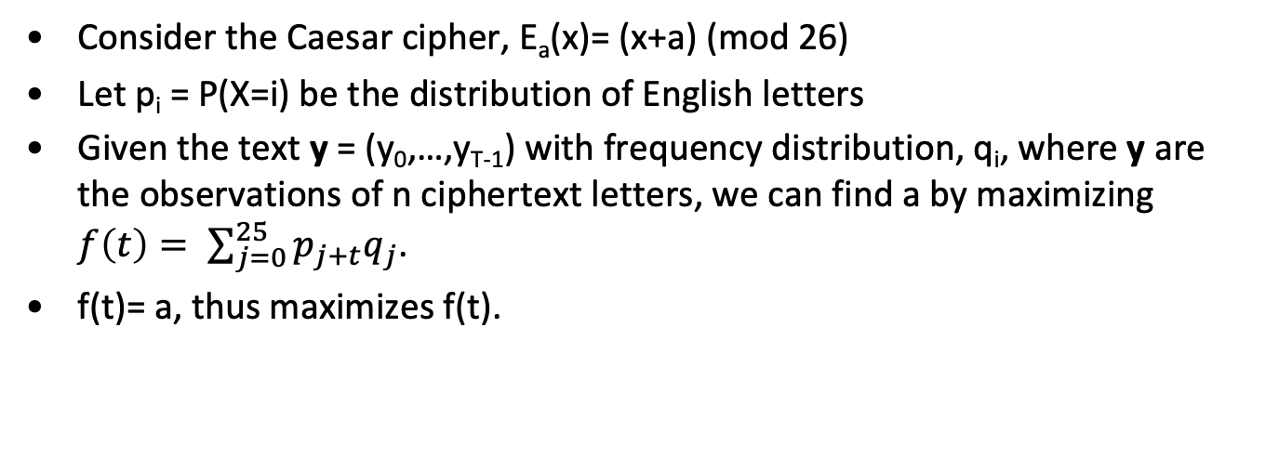
Matching distributions
Consider the Caesar cipher, E_{a}(x)= (x+a) (mod 26)
Let p_{i} = P(X=i) be the distribution of English letters
Given the text y = (y₀,…,y_{T-1}) with frequency distribution, q_{i}, where y are the observations of n ciphertext letters, we can find a by maximizing $f\left(t\right)= \sum_{j=0}^{25}{p_{j+t}q_{j}}$.
f(t)= a, thus maximizes f(t).

Slide 39
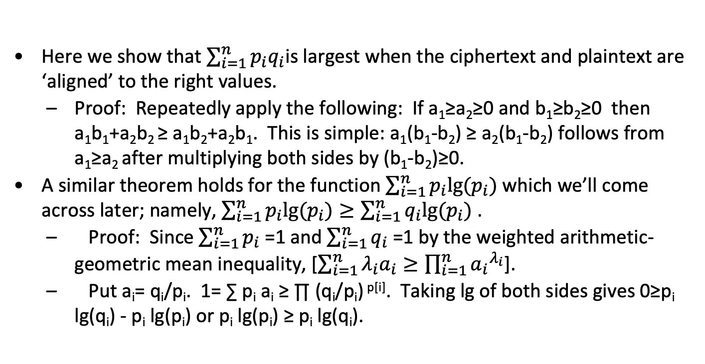
Correct alignments
Here we show that $\sum_{i=1}^{n}{p_{i}q_{i}}$is largest when the ciphertext and plaintext are ‘aligned’ to the right values.
Proof: Repeatedly apply the following: If a₁≥a₂≥0 and b₁≥b₂≥0 then a₁b₁+a₂b₂ ≥ a₁b₂+a₂b₁. This is simple: a₁(b₁-b₂) ≥ a₂(b₁-b₂) follows from a₁≥a₂ after multiplying both sides by (b₁-b₂)≥0.
A similar theorem holds for the function $\sum_{i=1}^{n}{p_{i}lg⁡(p_{i})}$ which we’ll come across later; namely, $\sum_{i=1}^{n}{p_{i}lg⁡(p_{i})}≥\sum_{i=1}^{n}{q_{i}lg⁡(p_{i})}$ .
Proof: Since $\sum_{i=1}^{n}{p_{i}}$=1 and $\sum_{i=1}^{n}{q_{i}}$=1 by the weighted arithmetic-geometric mean inequality, [$\sum_{i=1}^{n}{λ_{i}a_{i}}≥\prod_{i=1}^{n}{{a_{i}}^{λ_{i}}}$].
Put a_{i}= q_{i}/p_{i}. 1= ∑ p_{i} a_{i} ≥ ∏ (q_{i}/p_{i}) ^{p[i]}. Taking lg of both sides gives 0≥p_{i} lg(q_{i}) - p_{i} lg(p_{i}) or p_{i} lg(p_{i}) ≥ p_{i} lg(q_{i}).

Slide 40
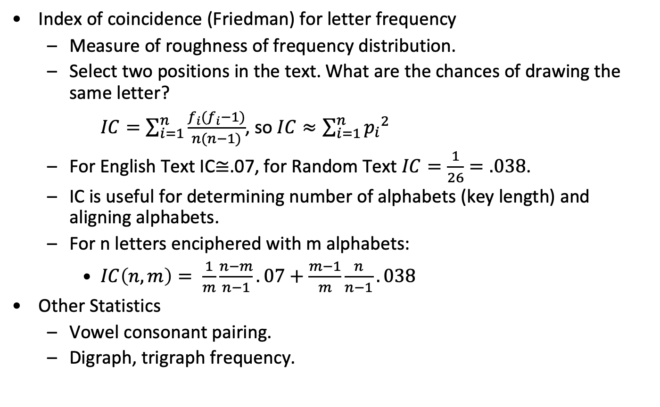
Statistical tests for alphabet identification
Index of coincidence (Friedman) for letter frequency
Measure of roughness of frequency distribution.
Select two positions in the text. What are the chances of drawing the same letter?
$IC=\sum_{i=1}^{n}{\frac{f_{i}(f_{i}−1)}{n(n−1)}}$, so $IC≈\sum_{i=1}^{n}{{p_{i}}^{2}}$
For English Text IC≅.07, for Random Text $IC=\frac{1}{26}=.038$.
IC is useful for determining number of alphabets (key length) and aligning alphabets.
For n letters enciphered with m alphabets:
$IC\left(n,m\right)= \frac{1}{m}\frac{n−m}{n−1}.07+\frac{m−1}{m}\frac{n}{n−1}.038$
Other Statistics
Vowel consonant pairing.
Digraph, trigraph frequency.

Slide 41
Statistical estimation and mono-alphabetic shifts
Solving for the “shift’’ using the frequency matching techniques is usually dispositive.
For general substitutions, while frequency matching maximization is very helpful, it is scarcely adequate because of variation from the “ideal” distribution.
Inter-symbol dependency becomes more important so we must use probable words or look for popular words. For example, in English, “the” almost always helps a lot.
Markov modeling (next topic) can be dispositive for general substitutions. We introduce it here not because you need it but the mono-alphabet setting is a good way to understand it first time around.
In more complex situations, it can be critical.

Slide 42
Group Theory in Cryptography
Groups are sets of elements that have a binary operation with the following properties:
If x,y,z𝝴G, xy𝝴G and (xy)z=x(yz). It is not always true that xy=yx.
There is an identity element 1𝝴G and 1x=x1=x for all x in G
For all, x𝝴G there is an element x⁻¹𝝴G and x x⁻¹ = 1= x⁻¹ x
One very important group is the group of all bijective maps from a set of n elements to itself denoted 𝛴_{n} or S_{n}.
The “binary operation” is the composition of mappings. The identity element leaves every element alone.
The inverse of a mapping, x, “undoes” what x does.

Slide 43
Operations in the symmetric group
If s 𝝴 S_{n} and the image of x is y we can write this two ways:
From the left, y= 𝜎(x). This is the usual functional notation your used to where mappings are applied “from the left”. When mappings are applied from the left and 𝜎 and 𝛿 are elements of S_{n}, 𝜎𝛿 denotes the mapping obtained by applying 𝛿 first and then 𝜎 - i.e. y= 𝜎 (𝛿(x)).
From the right, y=(x)𝜎. For them, 𝞂d denotes the mapping obtained by applying 𝜎 first and then 𝛿 - i.e. y= ((x)𝜎)𝛿.

Slide 44
Element order and cycle notation
The smallest k such that 𝞂^{k}=1 is called the order of 𝞂.
G is finite if it has a finite number of elements (denoted |G|).
In a finite group, all elements have finite order
Lagrange’s Theorem: The order of each element divides |G|.
Example. Let G= S₄.
𝜎= 1→2, 2→3, 3→4, 4→1, d= 1→3, 2→4, 3→1, 4→2.
𝜎⁻¹= 1→4, 2→1, 3→2, 4→3
Applying mappings “from the left”, 𝜎𝛿 = 1→4, 2→1,3→2,4→3.
Sometimes s is written like this:
𝜎 = 1 2 3 4
2 3 4 1
Sometimes permutations are written as products of cycles: 𝜎 =(1234)and 𝛿= (13)(24).

Slide 45
William Freidman

Slide 46
Vigenere -polyalphabetic cipher
6 Alphabet Direct Standard Example (Keyword: SYMBOL)
ABCDEFGHIJKLMNOPQRSTUVWXYZ PLAIN: GET OUT NOW
-------------------------- KEY: SYM BOL SYM
STUVWXYZABCDEFGHIJKLMNOPQR CIPHER: YCF PIE FMI
YZABCDEFGHIJKLMNOPQRSTUVWX
MNOPQRSTUVWXYZABCDEFGHIJKL
BCDEFGHIJKLMNOPQRSTUVWXYZA
OPQRSTUVWXYZABCDEFGHIJKLMN
LMNOPQRSTUVWXYZABCDEFGHIJK

Slide 47
Constructing Vigenere Alphabets
Direct Standard:
ABCDEFGHIJKLMNOPQRSTUVWXYZ
Reverse Standard:
ZYXWVUTSRQPONMLKJIHGFEDCBA
Keyword Direct (Keyword: NEW YORK CITY):
NEWYORKCITABDFGHJLMPQRSUVZ
Keyword Transposed (Keyword: CHICAGO):
CHIAGO
BDEFJK
LMNPQR
STUVWX
YZ
CBLSYHDMTZIENUAFPVGJQWOKRX

Slide 48
Mathematical description of Vigenere
Suppose we have a sequence letters (a message), s₀, s₁, …, s_{n}.
The transposition cipher, 𝜎𝝴S_{m}, works on blocks of m letters as follows. Let j= um+v, v<m, C(s_{j})= s_{um+s(v)} where the underlying set of elements, S_{m}, operates on is {0, 1, 2, …, m-1}.
If the first cipher alphabet of a Vigenere substitution is 𝜎𝝴S₂₆ where the underlying set of elements, S_{m}, operates on is {a, b, …, z} then C(s_{j})= 𝜎P^{(i mod k)}(s_{j}) where P is the cyclic permutation (a,b,c,…,z). Sometimes k=26 or could be the size of the codeword.
Mixing many of these will obviously lead to complicated equations that are hard to solve.

Slide 49
Solving Vigenere
Determine Number of Alphabets
Repeated runs yield interval differences. Number of alphabets is the gcd of these. (Kasiski)
Statistics: Index of coincidence
Determine plaintext alphabet
Determine ciphertext alphabets

Slide 50
Example of Vigenere
Encrypt the following message using a Vigeniere cipher with direct standard alphabets. Key: JOSH.
All persons born or naturalized in the United States, and
subject to the jurisdiction thereof, are citizens of the
United States and of the state wherein they reside. No
state shall make or enforce any law which shall abridge
the privileges or immunities of citizens of the United
States; nor shall any state deprive any person of life,
liberty, or property, without due process of law; nor deny
to any person within its jurisdiction the equal protection
of the laws.
We’ll calculate the index of coincidence of the plaintext and cipher-text.
Then break the cipher-text into 4 columns and calculate the index of coincidence of the columns (which should be mono-alphabets).

Slide 51
Message as “five” group and IC
ALLPE RSONS BORNO RNATU RALIZ EDINT HEUNI TEDST ATESA NDSUB JECTT
OTHEJ URISD ICTIO NTHER EOFAR ECITI ZENSO FTHEU NITED STATE SANDO
FTHES TATEW HEREI NTHEY RESID ENOST ATESH ALLMA KEORE NFORC EANYL
AWWHI CHSHA LLABR IDGET HEPRI VILEG ESORI MMUNI TIESO FCITI ZENSO
FTHEU NITED STATE SNORS HALLA NYSTA TEDEP RIVEA NYPER SONOF LIFEL
IBERT YORPR OPERT YWITH OUTDU EPROC ESSOF LAWNO RDENY TOANY PERSO
NWITH INITS JURIS DICTI ONTHE EQUAL PROTE CTION OFTHE LAWS
Ch Count Freq Ch Count Freq Ch Count Freq Ch Count Freq
E 49 0.129 T 42 0.111 I 32 0.084 O 29 0.077
S 28 0.074 N 28 0.074 R 26 0.069 A 25 0.066
H 18 0.047 L 16 0.042 D 13 0.034 U 11 0.029
F 10 0.026 C 9 0.024 P 9 0.024 Y 8 0.021
W 7 0.018 B 4 0.011 M 3 0.008 J 3 0.008
Z 3 0.008 V 2 0.005 G 2 0.005 K 1 0.003
Q 1 0.003 X 0 0.000
379 characters, index of coincidence: 0.069, IC (square approx): 0.071.

Slide 52
IC for cipher-text
JZDWN FKVWG TVABG YWOLB AODPI SVPWH ZLDBA ANRKA JHWZJ BVZDP BLLHL
VCVWQ DFAZM WUARC FAQSJ LXTSY NQAAR NWUBC XAQSM URHWK BHSAN GSUMC
XAQSK AJHWD QSJLR BLONM JLBWV LWCKA JHWZQ ODSVO CLXFW UOCJJ NOFFU
OODQW UOBVS SUOTY RRYLC VWWAW NPUSY LBCJP VAMUR HALBC XJRHA GNBKV
OHZLD BAANR KAJHW ZWCJZ QODSJ BQZCO LLMSH YRJWH WMHLA GGUXT DPOSD
PKSJA HCJWA CHLAH QDRHZ VDHVB NDJVL SKZXT DHFBG YMSFF CCSUH DWYBC
FDRHZ PWWLZ SIJPB RAJCW GUCVW LZISS YFGAN QLPXB GMCVW SJKK
Ch Count Freq Ch Count Freq Ch Count Freq Ch Count Freq
W 29 0.077 A 28 0.074 S 23 0.061 L 23 0.061
J 22 0.058 H 22 0.058 C 20 0.053 B 20 0.053
D 18 0.047 V 17 0.045 O 15 0.040 Z 15 0.040
R 14 0.037 U 13 0.034 N 12 0.032 Q 12 0.032
F 11 0.029 K 11 0.029 P 10 0.026 G 10 0.026
Y 9 0.024 M 9 0.024 X 8 0.021 T 5 0.013
I 3 0.008 E 0 0.000 0 0.000
379 characters, index of coincidence: 0.045, IC (square approx): 0.048

Slide 53
Cipher-text broken into 4 columns with IC
JNWAW AIWDN JJDLC DMRQX NRBQR BNMQJ QRNBW JQVXO
NUQBU RCAUB VRBRN ODNJW QJCMR WAXOK HAARD NLXFM
CHBRW SBCCZ YNXCJ
Column 1: 95 characters, index of coincidence: 0.058, IC (square approx): 0.068.
ZFGBO OSHBR HBPHV FWCST QNCSH HGCSH SBMWC HOOFC
OOWVO RVWSC AHCHB HBRHC OBOSJ MGTSS CCHHH DSTBS
CDCHW IRWVI FQBVK
Column 2: 95 characters, index of coincidence: 0.077, IC (square approx): 0.087.
DKTGL DVZAK WVBLW AUFJS AWXMW SSXKW JLJVK WDCWJ
FOUST YWNYJ MAXAK ZAKWJ DQLHW HGDDJ JHQZV JKDGF
SWFZL JAGWS GLGWK
Column 3: 95 characters, index of coincidence: 0.060, IC (square approx): 0.070.
WVVYB PPLAA ZZLVQ ZAALY AUAUK AUAAD LOLLA ZSLUJ
FDOSY LWPLP ULJGV LAAZZ SZLYH LUPPA WLDVB VZHYF
UYDPZ PJULS APMS
Column4: 94 characters, index of coincidence: 0.081, IC (square approx): 0.090.

Slide 54
Breaking a Vigenere
Break the Vigenere based cipher-text below. Plaintext and cipher-text alphabets are direct standard. What is the key length? What is the key?
IGDLK MJSGC FMGEP PLYRC IGDLA TYBMR KDYVY XJGMR TDSVK ZCCWG ZRRIP
UERXY EEYHE UTOWS ERYWC QRRIP UERXJ QREWQ FPSZC ALDSD ULSWF FFOAM
DIGIY DCSRR AZSRB GNDLC ZYDMM ZQGSS ZBCXM OYBID APRMK IFYWF MJVLY
HCLSP ZCDLC NYDXJ QYXHD APRMQ IGNSU MLNLG EMBTF MLDSB AYVPU TGMLK
MWKGF UCFIY ZBMLC DGCLY VSCXY ZBVEQ FGXKN QYMIY YMXKM GPCIJ HCCEL
PUSXF MJVRY FGYRQ

Slide 55
Look for repeats
1 2 3 4 5 6 7 8 9 10 11
IGDLK MJSGC FMGEP PLYRC IGDLA TYBMR KDYVY XJGMR TDSVK ZCCWG ZRRIP 1
UERXY EEYHE UTOWS ERYWC QRRIP UERXJ QREWQ FPSZC ALDSD ULSWF FFOAM 2
DIGIY DCSRR AZSRB GNDLC ZYDMM ZQGSS ZBCXM OYBID APRMK IFYWF MJVLY 3
HCLSP ZCDLC NYDXJ QYXHD APRMQ IGNSU MLNLG EMBTF MLDSB AYVPU TGMLK 4
MWKGF UCFIY ZBMLC DGCLY VSCXY ZBVEQ FGXKN QYMIY YMXKM GPCIJ HCCEL 5
PUSXF MJVRY FGYRQ
First Repetition: 20, Second: 25. Third: 35. (20,25,35)=5
ALDSD
APRMK
APRMQ
AZSRB
DCSRR
DGCLY
DIGIY
EEYHE
EMBTF
ERYWC
FFOAM
FGXKN
FGYRQ
FMGEP
FPSZC
GNDLC
GPCIJ
HCCEL
HCLSP
IFYWF
IGDLA
IGDLK
IGNSU
KDYVY
MJSGC
MJVLY
MJVRY
MLDSB
MLNLG
MWKGF
NYDXJ
OYBID
PLYRC
PUSXF
QREWQ
QRRIP
QYMIY
QYXHD
TDSVK
TGMLK
TYBMR
UCFIY
UERXJ
UERXY
ULSWF
UTOWS
VSCXY
XJGMR
YMXKM
YVPU
ZBCXM
ZBMLC
ZBVEQ
ZCCWG
ZCDLC
ZQGSS
ZRRIP
ZYDMM

Slide 56
IC study of 5 alphabet hypothesis
Full Cipher
Ch Count Freq Ch Count Freq Ch Count Freq Ch Count Freq
Y 23 0.079 M 21 0.072 C 19 0.066 R 18 0.062
G 17 0.059 L 16 0.055 D 16 0.055 S 15 0.052
F 13 0.045 I 12 0.041 P 11 0.038 E 11 0.038
X 10 0.034 Z 10 0.034 Q 9 0.031 B 8 0.028
K 8 0.028 U 8 0.028 W 7 0.024 A 7 0.024
J 7 0.024 V 7 0.024 N 5 0.017 T 5 0.017
H 4 0.014 O 3 0.010 0 0.000
290 characters, index of coincidence: 0.044, IC (square approx): 0.047.
Column 1 of 5
Ch Count Freq Ch Count Freq Ch Count Freq Ch Count Freq
Z 8 0.138 M 6 0.103 A 5 0.086 U 5 0.086
F 5 0.086 I 4 0.069 Q 4 0.069 T 3 0.052
D 3 0.052 E 3 0.052 H 2 0.034 P 2 0.034
G 2 0.034 O 1 0.017 K 1 0.017 V 1 0.017
X 1 0.017 Y 1 0.017 N 1 0.017 S 0 0.000
B 0 0.000 C 0 0.000 J 0 0.000 W 0 0.000
L 0 0.000 R 0 0.000 0 0.000
58 characters, index of coincidence: 0.059, IC (square approx): 0.075.

Slide 57
IC of columns
Column 2 of 5
Ch Count Freq Ch Count Freq Ch Count Freq Ch Count Freq
G 7 0.121 Y 7 0.121 C 6 0.103 L 5 0.086
P 4 0.069 R 4 0.069 J 4 0.069 E 3 0.052
B 3 0.052 M 3 0.052 F 2 0.034 D 2 0.034
Q 1 0.017 N 1 0.017 S 1 0.017 T 1 0.017
U 1 0.017 W 1 0.017 I 1 0.017 Z 1 0.017
O 0 0.000 K 0 0.000 V 0 0.000 H 0 0.000
X 0 0.000 A 0 0.000 0 0.000
58 characters, index of coincidence: 0.058, IC(square approx): 0.074.
Column 3 of 5
Ch Count Freq Ch Count Freq Ch Count Freq Ch Count Freq
D 8 0.138 S 7 0.121 R 6 0.103 C 6 0.103
Y 6 0.103 V 4 0.069 G 4 0.069 B 3 0.052
X 3 0.052 M 3 0.052 O 2 0.034 N 2 0.034
F 1 0.017 E 1 0.017 K 1 0.017 L 1 0.017
P 0 0.000 Q 0 0.000 A 0 0.000 T 0 0.000
U 0 0.000 H 0 0.000 W 0 0.000 I 0 0.000
J 0 0.000 Z 0 0.000 0 0.000
58 characters, index of coincidence: 0.071, IC (square approx): 0.087.

Slide 58
IC of columns continued
Column 4 of 5
Ch Count Freq Ch Count Freq Ch Count Freq Ch Count Freq
L 9 0.155 I 7 0.121 W 6 0.103 X 6 0.103
S 5 0.086 M 5 0.086 R 5 0.086 E 3 0.052
H 2 0.034 V 2 0.034 G 2 0.034 K 2 0.034
A 1 0.017 P 1 0.017 T 1 0.017 Z 1 0.017
C 0 0.000 Q 0 0.000 D 0 0.000 J 0 0.000
U 0 0.000 F 0 0.000 B 0 0.000 N 0 0.000
Y 0 0.000 O 0 0.000 0 0.000
58 characters, index of coincidence: 0.075, IC (square approx): 0.091.
Column 5 of 5
Ch Count Freq Ch Count Freq Ch Count Freq Ch Count Freq
Y 9 0.155 C 7 0.121 F 5 0.086 M 4 0.069
P 4 0.069 Q 4 0.069 K 4 0.069 J 3 0.052
R 3 0.052 D 3 0.052 G 2 0.034 S 2 0.034
U 2 0.034 B 2 0.034 A 1 0.017 N 1 0.017
E 1 0.017 L 1 0.017 H 0 0.000 O 0 0.000
T 0 0.000 I 0 0.000 V 0 0.000 W 0 0.000
X 0 0.000 Z 0 0.000 0 0.000
58 characters, index of coincidence: 0.063, IC (square approx): 0.079.

Slide 59
Since the alphabets are standard study most likely slides
Side normal alphabet against input alphabet and check distance:
D_{i}= ∑_{i=0}²⁵(d_{i}-d’_{((i+s)(mod 26))})². d_{i} is the cipher alphabet frequency, d_{i}’ is the normal alphabet frequency.
Alphabet 1
Slide Distance
00 (A) 0.0656
01 (B) 0.0556
02 (C) 0.0703
03 (D) 0.0753
04 (E) 0.0704
05 (F) 0.0775
06 (G) 0.0616
07 (H) 0.0619
08 (I) 0.0401
09 (J) 0.0896
10 (K) 0.0899
11 (L) 0.0666
12 (M) 0.0163
Alphabet 1
Slide Distance
13 (N) 0.0707
14 (O) 0.0791
15 (P) 0.0723
16 (Q) 0.0603
17 (R) 0.0621
18 (S) 0.0736
19 (T) 0.0700
20 (U) 0.0693
21 (V) 0.0440
22 (W) 0.0679
23 (X) 0.0704
24 (Y) 0.0816
25 (Z) 0.0553
Alphabet 2
Slide Distance
00 (A) 0.0724
01 (B) 0.0733
02 (C) 0.0540
03 (D) 0.0795
04 (E) 0.0712
05 (F) 0.0649
06 (G) 0.0730
07 (H) 0.0645
08 (I) 0.0785
09 (J) 0.0625
10 (K) 0.0701
11 (L) 0.0404
12 (M) 0.0784
Alphabet 2
Slide Distance
13 (N) 0.0494
14 (O) 0.0724
15 (P) 0.0636
16 (Q) 0.0689
17 (R) 0.0691
18 (S) 0.0693
19 (T) 0.0702
20 (U) 0.0446
21 (V) 0.0752
22 (W) 0.0777
23 (X) 0.0732
24 (Y) 0.0135
25 (Z) 0.0754

Slide 60
Slides continued
Side normal alphabet against input alphabet and check distance:
D_{i}= ∑ _{i=0}²⁵(d_{i}-d’_{((i+s)(mod 26))})². d_{i} is the cipher alphabet frequency, d_{i}’ is the normal alphabet frequency.
Alphabet 3
Slide Distance
00 (A) 0.0764
01 (B) 0.0901
02 (C) 0.0841
03 (D) 0.0836
04 (E) 0.0744
05 (F) 0.0823
06 (G) 0.0849
07 (H) 0.0960
08 (I) 0.0966
09 (J) 0.0718
10 (K) 0.0338
11 (L) 0.0755
12 (M) 0.0917
Alphabet 3
Slide Distance
13 (N) 0.0647
14 (O) 0.0599
15 (P) 0.0763
16 (Q) 0.0838
17 (R) 0.0799
18 (S) 0.0907
19 (T) 0.0871
20 (U) 0.0741
21 (V) 0.0752
22 (W) 0.1086
23 (X) 0.0919
24 (Y) 0.0494
25 (Z) 0.0426
Alphabet 4
Slide Distance
00 (A) 0.0711
01 (B) 0.1091
02 (C) 0.1079
03 (D) 0.0672
04 (E) 0.0231
05 (F) 0.0829
06 (G) 0.0878
07 (H) 0.0751
08 (I) 0.0675
09 (J) 0.0893
10 (K) 0.0924
11 (L) 0.0896
12 (M) 0.1074
Alphabet 4
Slide Distance
13 (N) 0.0929
14 (O) 0.0839
15 (P) 0.0734
16 (Q) 0.1000
17 (R) 0.0759
18 (S) 0.0577
19 (T) 0.0508
20 (U) 0.0782
21 (V) 0.0949
22 (W) 0.0971
23 (X) 0.0860
24 (Y) 0.0832
25 (Z) 0.0876

Slide 61
Slides concluded
Side normal alphabet against input alphabet and check distance:
D_{i}= ∑ _{i=0}²⁵(d_{i}-d’_{((i+s)(mod 26))})². d_{i} is the cipher alphabet frequency, d_{i}’ is the normal alphabet frequency.
Alphabet 5
Slide Distance
00 (A) 0.0900
01 (B) 0.0696
02 (C) 0.0624
03 (D) 0.0871
04 (E) 0.0888
05 (F) 0.0598
06 (G) 0.0763
07 (H) 0.0732
08 (I) 0.0833
09 (J) 0.0663
10 (K) 0.0593
11 (L) 0.0539
12 (M) 0.0599
Alphabet 5
Slide Distance
13 (N) 0.0684
14 (O) 0.0759
15 (P) 0.0846
16 (Q) 0.0613
17 (R) 0.0724
18 (S) 0.0806
19 (T) 0.0889
20 (U) 0.0466
21 (V) 0.0833
22 (W) 0.0781
23 (X) 0.0661
24 (Y) 0.0215
25 (Z) 0.0699

Slide 62
Vigenere Table
Vigenere Tableau
ABCDEFGHIJKLMNOPQRSTUVWXYZ
--------------------------
MNOPQRSTUVWXYZABCDEFGHIJKL
YZABCDEFGHIJKLMNOPQRSTUVWX
KLMNOPQRSTUVWXYZABCDEFGHIJ
EFGHIJKLMNOPQRSTUVWXYZABCD
YZABCDEFGHIJKLMNOPQRSTUVWX

Slide 63
The answer is…
WITHM ALICE TOWAR DNONE WITHC HARIT YFORA LLWIT
HFIRM NESSI NTHER IGHTA SGODG IVESU STOSE ETHER
IGHTL ETUSS TRIVE ONTOF INISH THEWO RKWEA REINT
OBIND UPTHE NATIO NSWOU NDSTO CAREF ORHIM WHOSH
ALLHA VEBOR NETHE BATTL EANDF ORHIS WIDOW ANDHI
SORPH ANTOD OALLW HICHM AYACH IEVEA NDCHE RISHA
JUSTA NDLAS TINGP EACEA MONGO URSEL VESAN DWITH
ALLNA TIONS
Key Length: 5
Key: MYKEY
Cipher only < 25k [assuming 25 letters are required to identify one letter with high certainty, a pretty conservative assumption. You could argue it was as small as about 8k.].

Slide 64
Probable Word Method
c_{i}= p_{i}SC^{i-1}, S=(AJDNCHEMBOGF)(IRQPKL)(Z)(Y)(W)(V)(U)(T)(S)
Placing a probable word gets several letters.
Equivalent letters (in the different cipher alphabets) can be obtained be applying C or C⁻¹.

Slide 65
Differencing
Sliding Components
L J T Z G X V Y V T Q G K S Y X S
Cipher Text
B U L L W I N K L E I S A D O P E
Probable Text
J O H N J O H N J O H N J O H N J
Difference

Slide 66
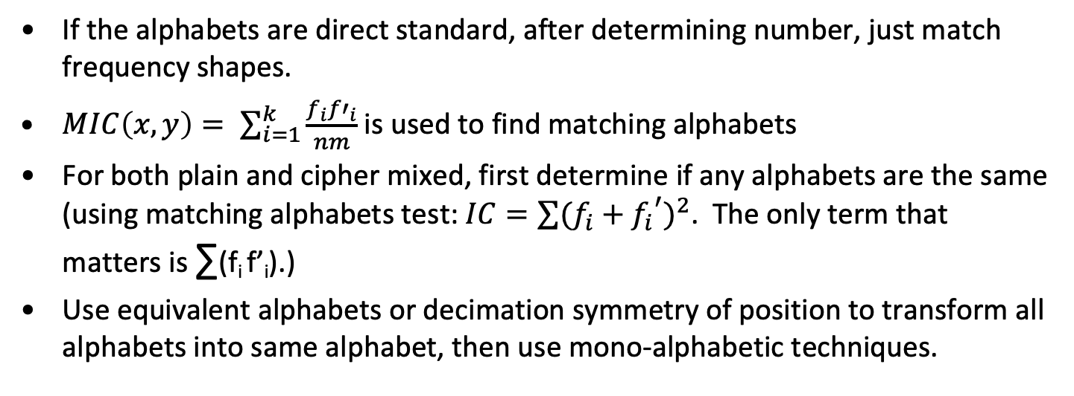
Vigenere Cipher Solutions
If the alphabets are direct standard, after determining number, just match frequency shapes.
$MIC\left(x, y\right)= \sum_{i=1}^{k}{\frac{f_{i}{f′}_{i}}{nm}}$ is used to find matching alphabets
For both plain and cipher mixed, first determine if any alphabets are the same (using matching alphabets test: $IC=\sum{{(f_{i}+{f_{i}}^{′})}^{2}}$. The only term that matters is ∑(f_{i} f’_{i}).)
Use equivalent alphabets or decimation symmetry of position to transform all alphabets into same alphabet, then use mono-alphabetic techniques.

Slide 67
Equivalent alphabets
Suppose a message is sent with a mixed plaintext alphabet (permuted by 𝜎) but a direct standard cipher text alphabet.
Each position of the message represents the same plaintext letter.
The Vigeniere table looks like this:
𝜎(A) 𝜎(B) 𝜎(C) 𝜎(D) 𝜎(E) 𝜎(F) 𝜎(G) 𝜎(H) …
-------------------------------------------
A B C D E F G H …
B C D E F G H I …
C D E F G H I J …
D E F G H I J K …
… … … … … … … …

Slide 68
Equivalent alphabets - continued
If the message bits are m₁, m₂, m₃, … and there are k alphabets used, the message is enciphered as 𝜎⁻¹(m₁), 𝜎⁻¹(m₂)+1, 𝜎⁻¹(m₃)+2,… or in general,
(𝜎⁻¹(m_{i})+(i-1)(mod k)) (mod 26)).
Note that the “columns” retain the correct order of the k enciphering alphabets.
By substituting the letters (B for A in the second cipher alphabet, etc.), the cipher-text becomes a mono-alphabet which can be solved the usual way.

Slide 69
Mixed plaintext and cipher-text alphabets
In general, this is harder but may still be solvable with a shortcut. Suppose, for example, we encrypt the same message two different ways (say with k₁ and k₂ mixed plain/cipher alphabets).
Example from Sinkov. The same message with two different keys.
WCOAK TJYVT VXBQC ZIVBL AUJNY BBTMT JGOEV GUGAT KDPKV GDXHE WGSFD
XLTMI NKNLF XMGOG SZRUA LAQNV IXDXW EJTKI TAOSH NTLCI VQMJQ FYYPB
CZOPZ VOGWZ KQZAY DNTSF WGOVI IKGXE GTRXL YOIP
TXHHV JXVNO MXHSC EEYFG EEYAQ DYHRK EHHIN OPKRO ZDVFV TQSIC SIMJK
ZIHRL CQIBK EZKFL OZDPA OJHMF LVHRL UKHNL OVHTE HBNHG MQBXQ ZIAGS
UXEYR XQJYC AIYHL ZVMQV QGUKI QDMAC QQBRB SQNI

Slide 70
Mixed plain and cipher alphabets
The Vigenere table looks like this:
𝜎(A) 𝜎(B 𝜎(C) 𝜎(D) 𝜎(E) 𝜎(F) 𝜎(G) 𝜎(H)ρ…
-------------------------------------------
ρ(A) ρ(B) ρ(C) ρ(D) ρ(E) ρ(F) ρ(G) ρ(H) …
ρ(B) ρ(C) ρ(D) ρ(E) ρ(F) ρ(G) ρ(H) ρ(I) …
ρ(C) ρ(D) ρ(E) ρ(F) ρ(G) ρ(H) ρ(I) ρ(J) …
ρ(D) ρ(E) ρ(F) ρ(G) ρ(H) ρ(I) ρ(J) ρ(K) …
… … … … … … … …
If the message bits are m₁, m₂, m₃, … and there are k alphabets used, the message is enciphered as ρ(𝜎⁻¹(m₁)), ρ(𝜎⁻¹(m₂)+1), ρ(𝜎⁻¹(m₃)+2),… or in general ρ(((𝜎⁻¹(m_{i})+(i-1)(mod k)) (mod 26)).

Slide 71
Mixed plain and cipher example
Plain
NEWYORKCITABDFGHJKLMPQSUVZ
Cipher
CHIAGO
BDEFJK
LMNPQR
STUVWX
YZ → CBLSYHDMTZIENUAFPVGJQWOKRX
NEWYORKCITABDFGHJKLMPQSUVZ
CBLSYHDMTZIENUAFPVGJQWOKRX

Slide 72
Alphabet rewritten
NEWYORKCITABDFGHJLMPQRSUVZ ABCDEFGHIJKLMNOPQRSTUVWXYZ
-------------------------- --------------------------
CBLSYHDMTZIENUAFPVGJQWOKRX IENUAFPVGJQWOKRXCBLSYHDMTZ
BLSYHDMTZIENUAFPVGJQWOKRXC ENUAFPVGJQWOKRXCBLSYHDMTZI
LSYHDMTZIENUAFPVGJQWOKRXCB NUAFPVGJQWOKRXCBLSYHDMTZIE
SYHDMTZIENUAFPVGJQWOKRXCBL UAFPVGJQWOKRXCBLSYHDMTZIEN
YHDMTZIENUAFPVGJQWOKRXCBLS AFPVGJQWOKRXCBLSYHDMTZIENU
HDMTZIENUAFPVGJQWOKRXCBLSY FPVGJQWOKRXCBLSYHDMTZIENUA
DMTZIENUAFPVGJQWOKRXCBLSYH PVGJQWOKRXCBLSYHDMTZIENUAF
MTZIENUAFPVGJQWOKRXCBLSYHD VGJQWOKRXCBLSYHDMTZIENUAFP
TZIENUAFPVGJQWOKRXCBLSYHDM GJQWOKRXCBLSYHDMTZIENUAFPV
ZIENUAFPVGJQWOKRXCBLSYHDMT JQWOKRXCBLSYHDMTZIENUAFPVG
IENUAFPVGJQWOKRXCBLSYHDMTZ QWOKRXCBLSYHDMTZIENUAFPVGJ
ENUAFPVGJQWOKRXCBLSYHDMTZI WOKRXCBLSYHDMTZIENUAFPVGJQ
NUAFPVGJQWOKRXCBLSYHDMTZIE OKRXCBLSYHDMTZIENUAFPVGJQW

Slide 73
Alphabet rewritten
NEWYORKCITABDFGHJLMPQRSUVZ ABCDEFGHIJKLMNOPQRSTUVWXYZ
-------------------------- --------------------------
UAFPVGJQWOKRXCBLSYHDMTZIEN KRXCBLSYHDMTZIENUAFPVGJQWO
AFPVGJQWOKRXCBLSYHDMTZIENU RXCBLSYHDMTZIENUAFPVGJQWOK
FPVGJQWOKRXCBLSYHDMTZIENUA XCBLSYHDMTZIENUAFPVGJQWOKR
PVGJQWOKRXCBLSYHDMTZIENUAF CBLSYHDMTZIENUAFPVGJQWOKRX
VGJQWOKRXCBLSYHDMTZIENUAFP BLSYHDMTZIENUAFPVGJQWOKRXC
GJQWOKRXCBLSYHDMTZIENUAFPV LSYHDMTZIENUAFPVGJQWOKRXCB
JQWOKRXCBLSYHDMTZIENUAFPVG SYHDMTZIENUAFPVGJQWOKRXCBL
QWOKRXCBLSYHDMTZIENUAFPVGJ YHDMTZIENUAFPVGJQWOKRXCBLS
WOKRXCBLSYHDMTZIENUAFPVGJQ HDMTZIENUAFPVGJQWOKRXCBLSY
OKRXCBLSYHDMTZIENUAFPVGJQW DMTZIENUAFPVGJQWOKRXCBLSYH
KRXCBLSYHDMTZIENUAFPVGJQWO MTZIENUAFPVGJQWOKRXCBLSYHD
RXCBLSYHDMTZIENUAFPVGJQWOK TZIENUAFPVGJQWOKRXCBLSYHDM
XCBLSYHDMTZIENUAFPVGJQWOKR ZIENUAFPVGJQWOKRXCBLSYHDMT

Slide 74
Letter identification and alphabet chaining
Using IC, we determine first uses 6 alphabets, the second, 5. Same letters at the following positions:
X C D V Z A Q Q G I
15 42 45 72 75 102 105 132 135
Msg1, alphabet 5 = Msg2, alphabet 2. Msg1, alphabet 3 = Msg2, alphabet 5. Can confirm with IC test.
If we have two rows separated by k (3, in our example):
Plain: A B C D E F G H I J K L M N O P Q R S T U V W X Y Z
Cipher 1: I E M N B U A F T P D V G C Y J Q H W Z O K L R S X
Cipher 2: U A I F Y P V G E J Z O W S M O K T R N X C H B D L

Slide 75
Alphabet Chaining
Plain: A B C D E F G H I J K L M N O P Q R S T U V W X Y Z
Cipher 1: I E M N B U A F T P D V G C Y J Q H W Z O K L R S X
Cipher 4: U A I F Y P V G E J Z Q W S M O K T R N X C H B D L
The decimated interval is:
I U P J O X L H T E A V Q K C S D Z N F G W R B Y M
Rearranging by decimation:
A F J P U Z W R I B G L Q V N Y K T D H M S X E O C
I U P J O X L H T E A V Q K C S D Z N F G W R B Y M
Rearranging we get the original sequence.

Slide 76
Review of attacks on poly-alphabet
Letter Frequency, multi-gram frequencies, transition probabilities
Index of coincidence
Alphabet chaining
Sliding probable text
Limited key-space search
Long repeated sequences in cipher-text
Markoff like contact processes
Decimation of sequences
Direct and indirect symmetries

Slide 77
More sophisticated mathematical technique
(Possible project)

Slide 78
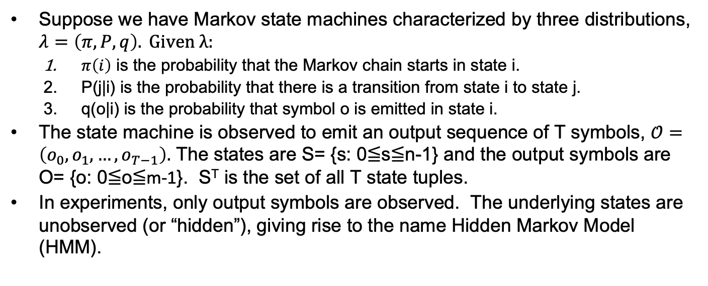
Maximum Likelihood and Hidden Markov models
Suppose we have Markov state machines characterized by three distributions, $λ=\left(π, P, q\right). Given λ:$
$π\left(i\right)$ is the probability that the Markov chain starts in state i.
P(j|i) is the probability that there is a transition from state i to state j.
q(o|i) is the probability that symbol o is emitted in state i.
The state machine is observed to emit an output sequence of T symbols, $𝒪=\left(o_{0},o_{1},…,o_{T−1}\right).$ The states are S= {s: 0≦s≦n-1} and the output symbols are O= {o: 0≦o≦m-1}. S^{T} is the set of all T state tuples.
In experiments, only output symbols are observed. The underlying states are unobserved (or “hidden”), giving rise to the name Hidden Markov Model (HMM).

Slide 79
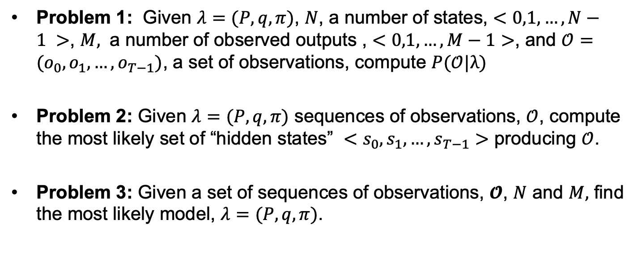
The three problems
Problem 1: Given $λ=(P, q, π)$, $N$, a number of states, $<0,1,…,N−1 >$, $M,$ a number of observed outputs , $<0,1,…,M−1>$, and $𝒪=(o_{0},o_{1},…,o_{T−1})$, a set of observations, compute $P(𝒪|λ)$
Problem 2: Given $λ=(P, q, π)$ sequences of observations, $𝒪$, compute the most likely set of “hidden states” $<s_{0},s_{1},…,s_{T−1}>$ producing $𝒪$.
Problem 3: Given a set of sequences of observations, $𝓞$, $N$ and $M,$ find the most likely model, $λ=(P, q, π)$.

Slide 80
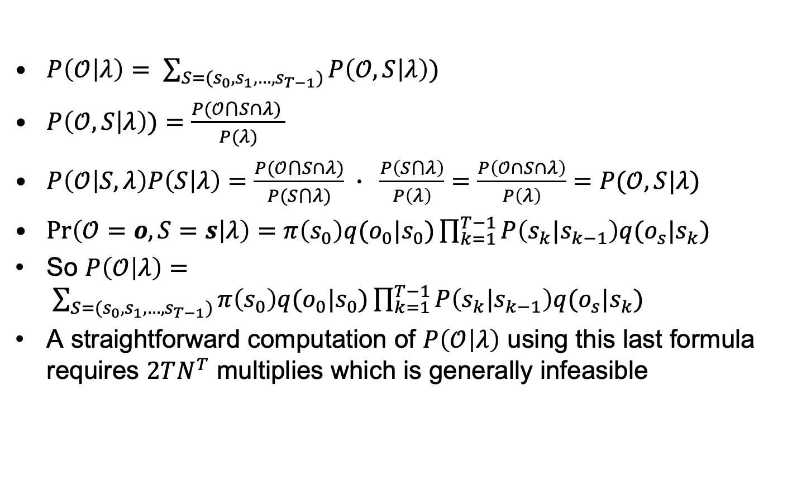
Problem 1
$P\left(𝒪 | λ\right)= \sum_{S=(s_{0},s_{1},…,s_{T−1})}{P\left(𝒪, S | λ\right))}$
$P\left(𝒪, S | λ\right))=\frac{P(𝒪⋂S∩λ) }{P(λ)}$
$P\left(𝒪 | S,λ\right)P\left(S | λ\right)=\frac{P(𝒪⋂S∩λ)}{P(S⋂λ)} ∙ \frac{P\left(S⋂λ\right)}{P\left(λ\right)}=\frac{P\left(𝒪∩S∩λ\right)}{P\left(λ\right)}=P(𝒪,S|λ)$
$\operatorname{Pr}\left(𝒪=o, S=s | λ\right)=π\left(s_{0}\right)q(o_{0}|s_{0})\prod_{k=1}^{T−1}{P\left(s_{k}|s_{k−1}\right)q(o_{s}|s_{k})}$
So $P\left(𝒪 | λ\right)= \sum_{S=(s_{0},s_{1},…,s_{T−1})}{π\left(s_{0}\right)q(o_{0}|s_{0})\prod_{k=1}^{T−1}{P\left(s_{k}|s_{k−1}\right)q(o_{s}|s_{k})}}$
A straightforward computation of $P\left(𝒪 | λ\right)$ using this last formula requires $2TN^{T}$ multiplies which is generally infeasible

Slide 81
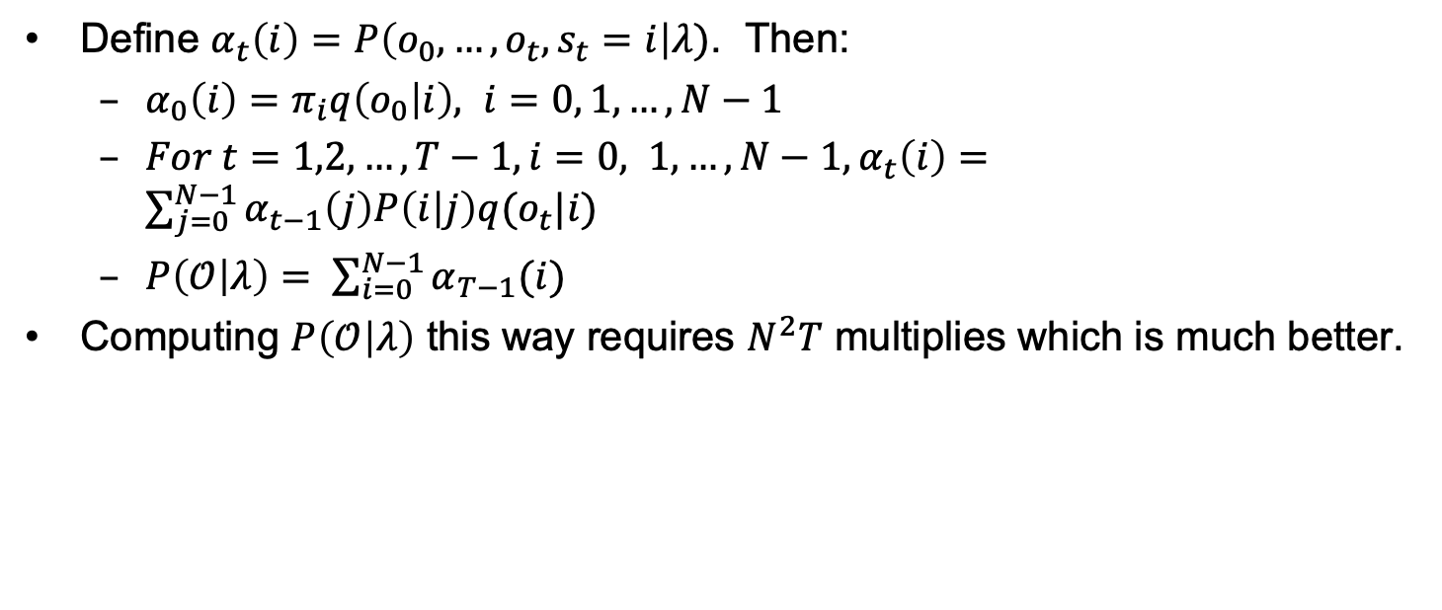
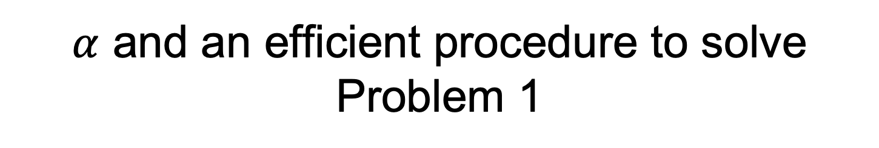
$α$ and an efficient procedure to solve Problem 1
Define $α_{t}\left(i\right)=P\left(o_{0},…,o_{t}, s_{t}=i\right|λ)$. Then:
$α_{0}\left(i\right)=π_{i}q\left(o_{0} | i\right), i=0, 1, …, N−1$
$For t=1,2,…,T−1, i=0, 1,…,N−1, α_{t}\left(i\right)=\sum_{j=0}^{N−1}{α_{t−1}\left(j\right)P\left(i | j\right)q(o_{t}|i)}$
$P\left(𝒪 | λ\right)= \sum_{i=0}^{N−1}{α_{T−1}(i)}$
Computing $P\left(𝒪 | λ\right)$ this way requires $N^{2}T$ multiplies which is much better.

Slide 82
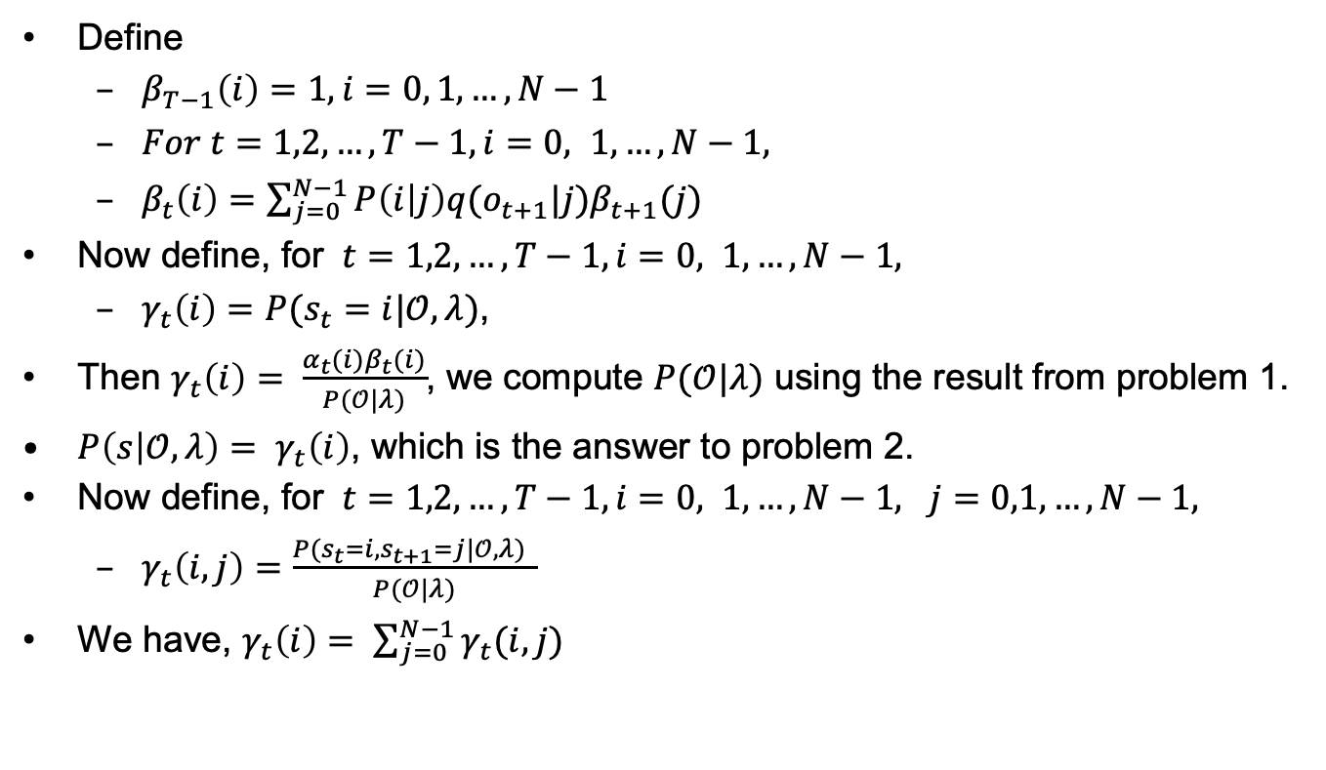

Problem 2 with $β$ and $γ$
Define
$β_{T−1}\left(i\right)=1, i=0, 1, …, N−1$
$For t=1,2,…,T−1, i=0, 1,…,N−1,$
$β_{t}\left(i\right)=\sum_{j=0}^{N−1}{P\left(i | j\right)q(o_{t+1}|j)β_{t+1}(j)}$
Now define, for $t=1,2,…,T−1, i=0, 1,…,N−1,$
$γ_{t}\left(i\right)=P(s_{t}=i|𝒪,λ)$,
Then $γ_{t}\left(i\right)= \frac{α_{t}(i)β_{t}(i)}{P(𝒪|λ)}$, we compute $P(𝒪|λ)$ using the result from problem 1.
$P\left(s | 𝒪, λ\right)= γ_{t}\left(i\right)$, which is the answer to problem 2.
Now define, for $t=1,2,…,T−1, i=0, 1,…,N−1, j=0,1,…,N−1,$
$γ_{t}\left(i,j\right)=\frac{P(s_{t}=i,s_{t+1}=j|𝒪,λ) }{P(𝒪|λ)}$
We have, $γ_{t}\left(i\right)= \sum_{j=0}^{N−1}{γ_{t}(i,j)}$

Slide 83
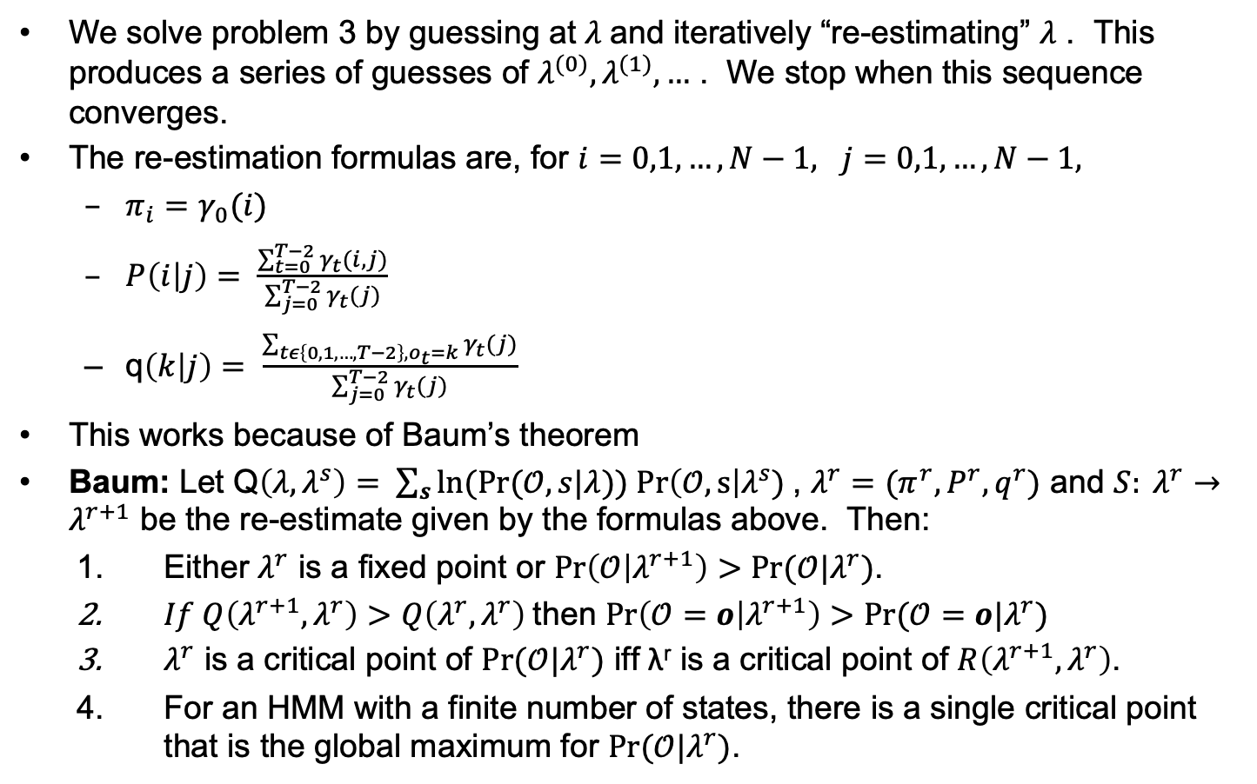
Problem 3
We solve problem 3 by guessing at $λ$and iteratively “re-estimating” $λ$ . This produces a series of guesses of $λ^{(0)},λ^{(1)},…$ . We stop when this sequence converges.
The re-estimation formulas are, for $i=0,1,…,N−1, j=0,1,…,N−1,$
$π_{i}=γ_{0}(i)$
$P\left(i | j\right)= \frac{\sum_{t=0}^{T−2}{γ_{t}(i,j)}}{\sum_{j=0}^{T−2}{γ_{t}(j)}}$
q$\left(k | j\right)= \frac{\sum_{tε\left\{0,1,…,T−2\right\},o_{t}=k}{γ_{t}(j)}}{\sum_{j=0}^{T−2}{γ_{t}(j)}}$
This works because of Baum’s theorem
Baum: Let Q$\left(λ, λ^{s}\right)= \sum_{s}{ln(Pr⁡(𝒪, s|λ})) Pr\left(𝒪,s\right|λ^{s})$, $λ^{r}=(π^{r},P^{r},q^{r})$ and $S: λ^{r}→λ^{r+1}$ be the re-estimate given by the formulas above. Then:
Either $λ^{r}$ is a fixed point or $\operatorname{Pr}\left(𝒪 | λ^{r+1}\right)>Pr⁡(𝒪|λ^{r})$.
$If Q\left(λ^{r+1}, λ^{r}\right)>Q\left(λ^{r}, λ^{r}\right)$then $\operatorname{Pr}\left(𝒪=o | λ^{r+1}\right)>Pr⁡(𝒪=o|λ^{r})$
$λ^{r}$ is a critical point of $Pr⁡(𝒪|λ^{r})$ iff λ^{r} is a critical point of $R\left(λ^{r+1}, λ^{r}\right)$.
For an HMM with a finite number of states, there is a single critical point that is the global maximum for $Pr(𝒪|λ^{r})$.

Slide 84
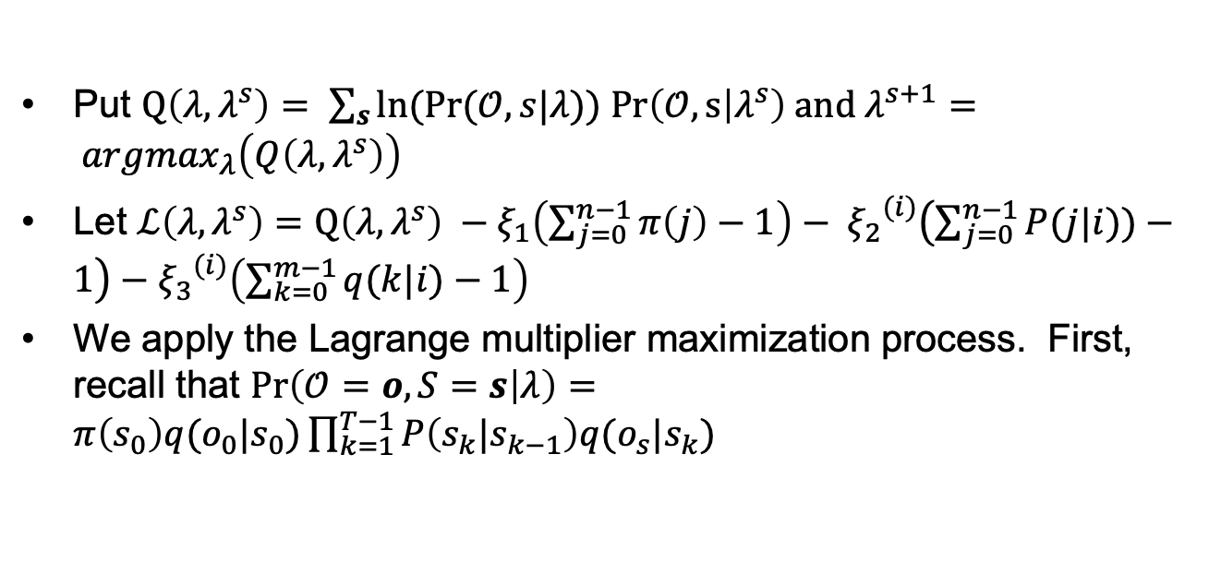
Derivation of Baum Welch re-estimation
Put $Q\left(λ, λ^{s}\right)= \sum_{s}{ln(Pr⁡(𝒪, s|λ})) Pr\left(𝒪, s | λ^{s}\right)$ and $λ^{s+1}= {argmax}_{λ}\left(Q\left(λ, λ^{s}\right)\right)$
Let $ℒ\left(λ, λ^{s}\right)=Q\left(λ, λ^{s}\right) −ξ_{1}\left(\sum_{j=0}^{n−1}{π\left(j\right)}−1\right)− {ξ_{2}}^{(i)}\left(\sum_{j=0}^{n−1}{P(j|i))}−1\right)−{ξ_{3}}^{(i)}\left(\sum_{k=0}^{m−1}{q(k|i)}−1\right)$
We apply the Lagrange multiplier maximization process. First, recall that $\operatorname{Pr}\left(𝒪=o, S=s | λ\right)=π\left(s_{0}\right)q(o_{0}|s_{0})\prod_{k=1}^{T−1}{P\left(s_{k}|s_{k−1}\right)q(o_{s}|s_{k})}$

Slide 85
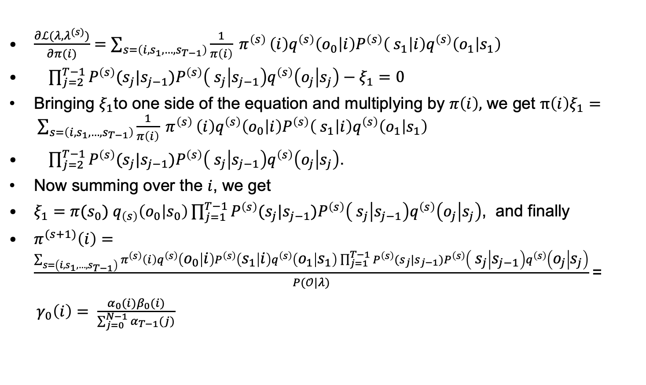
Derivation of Baum Welch re-estimation
$\frac{∂ℒ(λ,λ^{(s)})}{∂π(i)}=\sum_{s=\left(i,s_{1},…,s_{T−1}\right)}{\frac{1}{π\left(i\right)} π^{\left(s\right)}}\left(i\right)q^{\left(s\right)}\left(o_{0} | i\right){P^{\left(s\right)}\left( s_{1} | i\right)q}^{\left(s\right)}\left(o_{1} | s_{1}\right)$
$\prod_{j=2}^{T−1}{P^{\left(s\right)}(s_{j}|s_{j−1}}){P^{\left(s\right)}\left( s_{j} | s_{j−1}\right)q}^{\left(s\right)}\left(o_{j} | s_{j}\right)−ξ_{1}=0$
Bringing $ξ_{1}$to one side of the equation and multiplying by $π\left(i\right),$ we get $π\left(i\right)ξ_{1}= \sum_{s=\left(i,s_{1},…,s_{T−1}\right)}{\frac{1}{π\left(i\right)} π^{\left(s\right)}}\left(i\right)q^{\left(s\right)}\left(o_{0} | i\right){P^{\left(s\right)}\left( s_{1} | i\right)q}^{\left(s\right)}\left(o_{1} | s_{1}\right)$
$\prod_{j=2}^{T−1}{P^{\left(s\right)}(s_{j}|s_{j−1}}){P^{\left(s\right)}\left( s_{j} | s_{j−1}\right)q}^{\left(s\right)}\left(o_{j} | s_{j}\right)$.
Now summing over the $i$, we get
$ξ_{1}=π(s_{0}){ q}_{\left(s\right)}\left(o_{0} | s_{0}\right)\prod_{j=1}^{T−1}{P^{\left(s\right)}(s_{j}|s_{j−1}}){P^{\left(s\right)}\left( s_{j} | s_{j−1}\right)q}^{\left(s\right)}\left(o_{j} | s_{j}\right)$, and finally
$π^{(s+1)}\left(i\right)=\frac{\sum_{s=\left(i,s_{1},…,s_{T−1}\right)}{π^{\left(s\right)}}\left(i\right)q^{\left(s\right)}\left(o_{0} | i\right){P^{\left(s\right)}\left(s_{1} | i\right)q}^{\left(s\right)}\left(o_{1} | s_{1}\right)\prod_{j=1}^{T−1}{P^{\left(s\right)}(s_{j}|s_{j−1}}){P^{\left(s\right)}\left( s_{j} | s_{j−1}\right)q}^{\left(s\right)}\left(o_{j} | s_{j}\right)}{P(𝒪|λ)}$=
$γ_{0}\left(i\right)= \frac{α_{0}(i)β_{0}(i)}{\sum_{j=0}^{N−1}{α_{T−1}(j)}}$

Slide 86
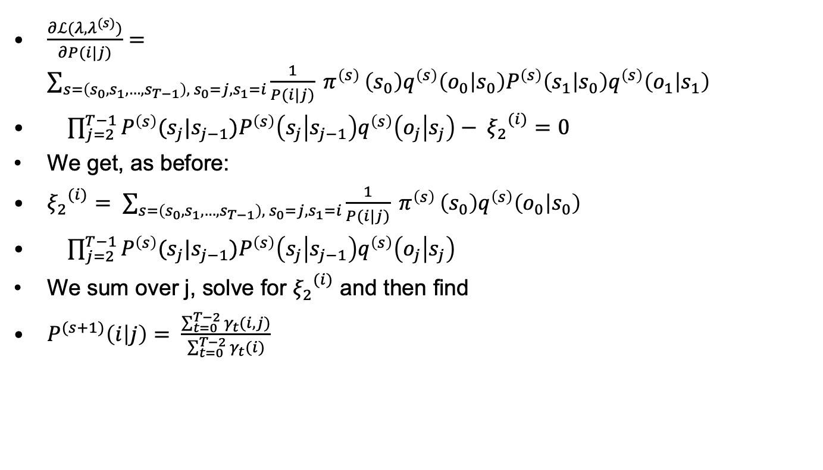
Derivation of Baum Welch re-estimation
$\frac{∂ℒ(λ,λ^{(s)})}{∂P(i|j)}=\sum_{s=\left(s_{0},s_{1},…,s_{T−1}\right), { s}_{0}=j, s_{1}=i}{\frac{1}{P(i|j)} π^{\left(s\right)}}\left(s_{0}\right)q^{\left(s\right)}\left(o_{0} | s_{0}\right){P^{\left(s\right)}\left(s_{1} | s_{0}\right)q}^{\left(s\right)}\left(o_{1} | s_{1}\right)$
$\prod_{j=2}^{T−1}{P^{\left(s\right)}(s_{j}|s_{j−1}}){P^{\left(s\right)}\left(s_{j} | s_{j−1}\right)q}^{\left(s\right)}\left(o_{j} | s_{j}\right)− {ξ_{2}}^{(i)}=0$
We get, as before:
${ξ_{2}}^{(i)}= \sum_{s=\left(s_{0},s_{1},…,s_{T−1}\right), { s}_{0}=j, s_{1}=i}{\frac{1}{P(i|j)} π^{\left(s\right)}}\left(s_{0}\right)q^{\left(s\right)}\left(o_{0} | s_{0}\right)$
$\prod_{j=2}^{T−1}{P^{\left(s\right)}(s_{j}|s_{j−1}}){P^{\left(s\right)}\left(s_{j} | s_{j−1}\right)q}^{\left(s\right)}\left(o_{j} | s_{j}\right)$
We sum over j, solve for ${ξ_{2}}^{(i)}$ and then find
$P^{(s+1)}\left(i | j\right)= \frac{\sum_{t=0}^{T−2}{γ_{t}(i,j)}}{\sum_{t=0}^{T−2}{γ_{t}(i)}}$

Slide 87
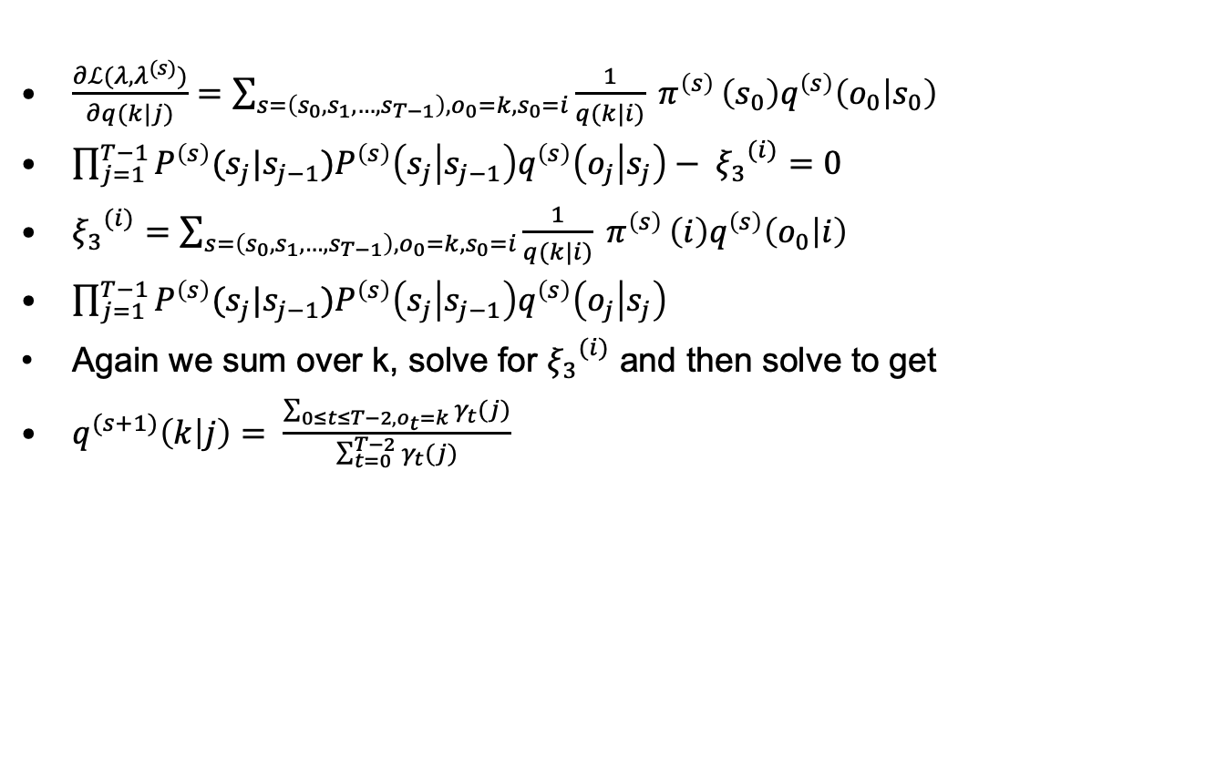
Derivation of Baum Welch re-estimation
$\frac{∂ℒ(λ,λ^{(s)})}{∂q(k|j)}=\sum_{s=\left(s_{0},s_{1},…,s_{T−1}\right), o_{0}=k, s_{0}=i}{\frac{1}{q(k|i)} π^{\left(s\right)}}\left(s_{0}\right)q^{\left(s\right)}\left(o_{0} | s_{0}\right)$
$\prod_{j=1}^{T−1}{P^{\left(s\right)}(s_{j}|s_{j−1}}){P^{\left(s\right)}\left(s_{j} | s_{j−1}\right)q}^{\left(s\right)}\left(o_{j} | s_{j}\right)− {ξ_{3}}^{(i)}=0$
${ξ_{3}}^{(i)}=\sum_{s=\left(s_{0},s_{1},…,s_{T−1}\right), o_{0}=k, s_{0}=i}{\frac{1}{q(k|i)} π^{\left(s\right)}}\left(i\right)q^{\left(s\right)}\left(o_{0} | i\right)$
$\prod_{j=1}^{T−1}{P^{\left(s\right)}(s_{j}|s_{j−1}}){P^{\left(s\right)}\left(s_{j} | s_{j−1}\right)q}^{\left(s\right)}\left(o_{j} | s_{j}\right)$
Again we sum over k, solve for ${ξ_{3}}^{(i)}$ and then solve to get
$q^{(s+1)}\left(k | j\right)= \frac{\sum_{0≤t≤T−2, o_{t}=k}{γ_{t}(j)}}{\sum_{t=0}^{T−2}{γ_{t}(j)}}$

Slide 88
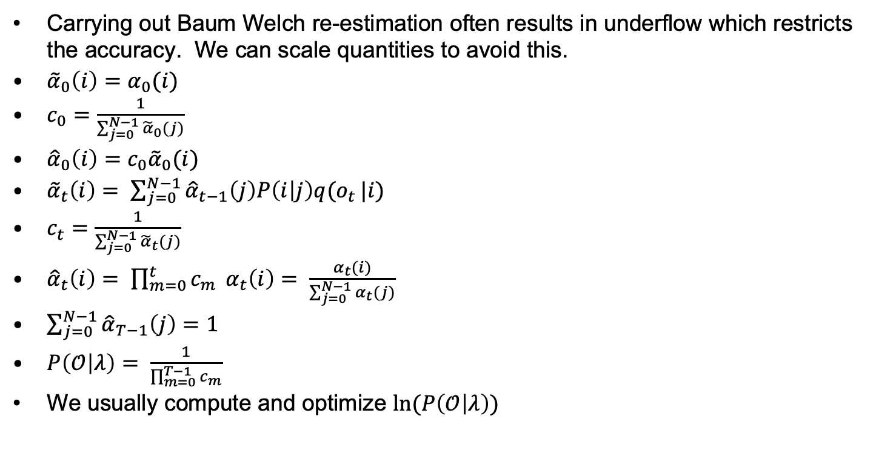
Scaling
Carrying out Baum Welch re-estimation often results in underflow which restricts the accuracy. We can scale quantities to avoid this.
${\tilde{α}}_{0}\left(i\right)=α_{0}(i)$
$c_{0}=\frac{1}{\sum_{j=0}^{N−1}{{\tilde{α}}_{0}(j)}}$
${\hat{α}}_{0}\left(i\right)=c_{0}{\tilde{α}}_{0}(i)$
${\tilde{α}}_{t}\left(i\right)= \sum_{j=0}^{N−1}{{\hat{α}}_{t−1}\left(j\right)P\left(i | j\right)q(o_{t}}|i)$
$c_{t}=\frac{1}{\sum_{j=0}^{N−1}{{\tilde{α}}_{t}(j)}}$
${\hat{α}}_{t}\left(i\right)= \prod_{m=0}^{t}{c_{m}} α_{t}\left(i\right)= \frac{α_{t}(i)}{\sum_{j=0}^{N−1}{α_{t}(j)}}$
$\sum_{j=0}^{N−1}{{\hat{α}}_{T−1}\left(j\right)=1}$
$P\left(𝒪 | λ\right)= \frac{1}{\prod_{m=0}^{T−1}{c_{m}}}$
We usually compute and optimize $ln⁡(P\left(𝒪 | λ\right))$

Slide 89
EM example
m=4, T=48 observations
p: 0.25, 0.25, 0.25, 0.25
P: .2 .2 .5 .1
.333 .333 .167 .167
.2 .4 .1 .3
.5 0 .25 .25
50th re-estimation settles on:
i: 0 1 2 3
q(i|0): 1 0 0 0
q(i|1): 0 0 1 0
q(i|2): 0 1 0 0
q(i|3): 0 0 0 1
i j → | 0 | 1 | 2 | 3
0 | 1.00000 | 0 | 0 | 0
1 | .000004 | .000001 | .906980 | .093015
2 | .000023 | .998303 | .001667 | 0
3 | .000023 | 0 | 0 | .999977
Example from Konheim

Slide 90
Other paper and pencil systems

Slide 91
Polygraphic Substitution
Playfair di-graphic substitution
Write alphabet in square.
For two consecutive letter use other two letters in rectangle
If letters are horizontal or vertical, use letters to right or below.
OHNMA
FERDL
IBCGK TH→ QM
PQSTU
VWXYZ
Hill’s multi-graphic substitution
Convert letters into numbers (0→25).
Multiply 2-tuples by encrypting 2x2 matrix.
Better have inverse in multiplicative group mod 26.

Slide 92
Identifying Playfair
Rare consonants j, k, q, x, and z will appear in higher frequencies than plaintext and digraphs containing these consonants will appear more frequently
There are an even number of letters in the cipher-text
When the cipher-text is broken up into di-grams, doubled letters such as SS, EE, MM, . . . will not appear.

Slide 93
Hill Cipher
Each character is assigned a numerical value
a = 0, b = 1, . . ., z = 25
for m = 3 the transformation of p₁p₂p₃ to c₁c₂c₃ is given by 3 equations:
c₁ = (k₁₁p₁ + k₁₂p₂ + k₁₃p₃) mod 26
c₂ = (k₂₁p₁ + k₂₂p₂ + k₂₃p₃) mod 26
c₃ = (k₃₁p₁ + k₃₂p₂ + k₃₃p₃) mod 26
KEY
Slide by Richard Spillman

Slide 94
Hill Matrix
The Hill cipher is really a matrix multiplication system
The enciphering key is an n x n matrix, M
The deciphering key is M⁻¹
For example, if n = 3 one possible key is:
M = ( )
M⁻¹ = ( )
17 17 5
21 18 21
2 2 19
4 9 15
15 17 6
24 0 17
(
)
17 17 5
21 18 21
2 2 19
(
) = ( ) mod 26
Encrypt ‘n o w’
13
14
22
23
20
4
13 14 22
Slide by Richard Spillman
x u e

Slide 95
Breaking Hill
The Hill cipher is resistant to a cipher-text only attack with reasonable message size.
In fact, the larger the matrix, the more resistant the cipher becomes.
It is easy to break using a known plaintext attack.
The process is much like the method used to break an affine cipher in that the known plaintext/ciphertext group is used to set up a system of equations which when solved will reveal the key.

Slide 96
Hill Cipher
The Hill cipher is a block cipher with block size is 2 over the “normal” alphabet.
Assign each letter a number between 0 and 25 (inclusive)
For example, a = 0, b = 1, . . ., z = 25 (z is used as space)
Let p₁p₂ be two successive plaintext letters. c₁c₂ are the cipher-text output, where:
Apply the inverse of the “key matrix” [k₁₁ k₁₂|k₂₁ k₂₂] to transform ciphertext into plaintext
Works better if we add space (27=3³ letters) or throw out a letter (25=5²) so there is an underlying finite field
c₁ = k₁₁p₁ + k₁₂p₂ (mod 26)
c₂ = k₂₁p₁ + k₂₂p₂ (mod 26)

Slide 97
Breaking Hill
The Hill cipher is resistant to a cipher-text only attack with limited cipher-text.
Increasing the block size increases the resistance.
It is trivial to break using a known plaintext attack.
The process is much like the method used to break an affine cipher. Corresponding plaintext/ciphertext are used to set up a system of equations whose solutions are the key bits.

Slide 98
End

