Slide 1
Cryptanalysis
Lattices
John Manferdelli
JohnManferdelli@hotmail.com
© 2004-2025, John L. Manferdelli.
This material is provided without warranty of any kind including, without limitation, warranty of non-infringement or suitability for any purpose. This material is not guaranteed to be error free and is intended for instructional use only.

Slide 2
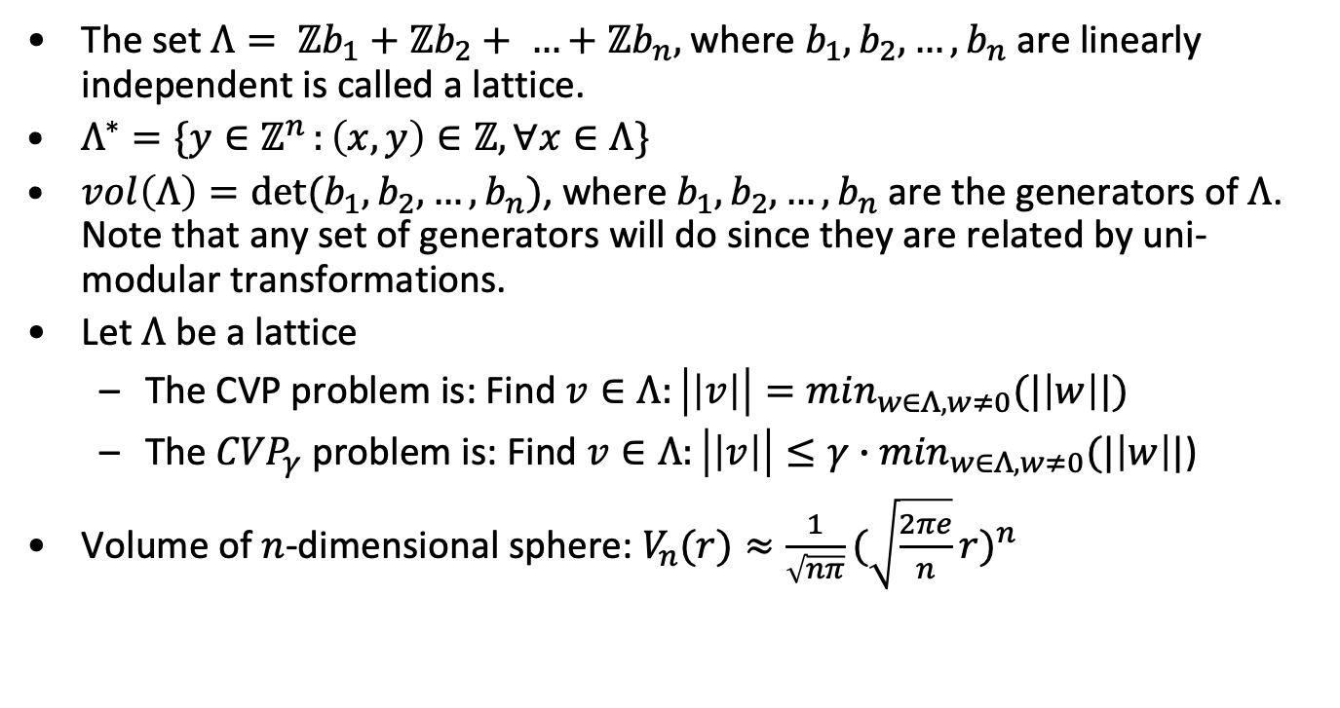
Lattices
The set $Λ= ℤb_{1}+ℤb_{2}+ …+ℤb_{n},$where $b_{1}, b_{2},…,b_{n}$ are linearly independent is called a lattice.
$Λ^{∗}=\{y∈ℤ^{n }:\left(x,y\right)∈ℤ, ∀x∈Λ\}$
$vol\left(Λ\right)=det⁡(b_{1},b_{2},…,b_{n})$, where $b_{1}, b_{2},…,b_{n}$ are the generators of $Λ$. Note that any set of generators will do since they are related by uni-modular transformations.
Let $Λ$ be a lattice
The CVP problem is: Find $v∈Λ:\left|\left|v\right|\right|=\min_{w∈Λ, w≠0}(|\left|w\right||)$
The ${CVP}_{γ}$ problem is: Find $v∈Λ:\left|\left|v\right|\right|≤{γ∙min}_{w∈Λ, w≠0}(|\left|w\right||$)
Volume of $n$-dimensional sphere: $V_{n}(r)≈\frac{1}{\sqrt{nπ}}{(\sqrt{\frac{2πe}{n}}r)}^{n}$

Slide 3
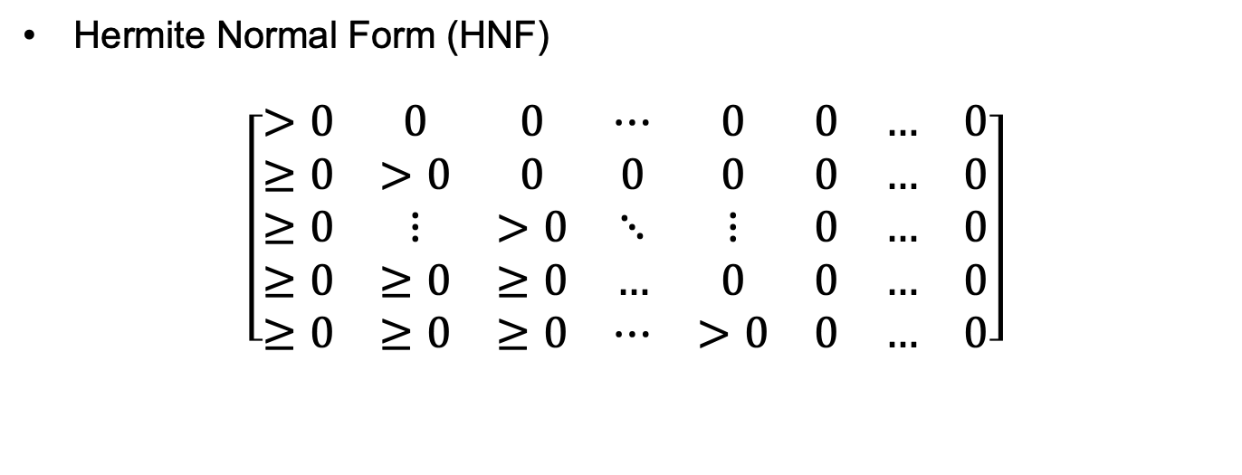
Definitions
Hermite Normal Form (HNF)
$$\left[\begin{matrix}>0 & 0 & 0 & ⋯ & 0 & 0 & … & 0 \\ ≥0 & >0 & 0 & 0 & 0 & 0 & … & 0 \\ ≥0 & ⋮ & >0 & ⋱ & ⋮ & 0 & … & 0 \\ ≥0 & ≥0 & ≥0 & … & 0 & 0 & … & 0 \\ ≥0 & ≥0 & ≥0 & ⋯ & >0 & 0 & … & 0\end{matrix}\right]$$

Slide 4
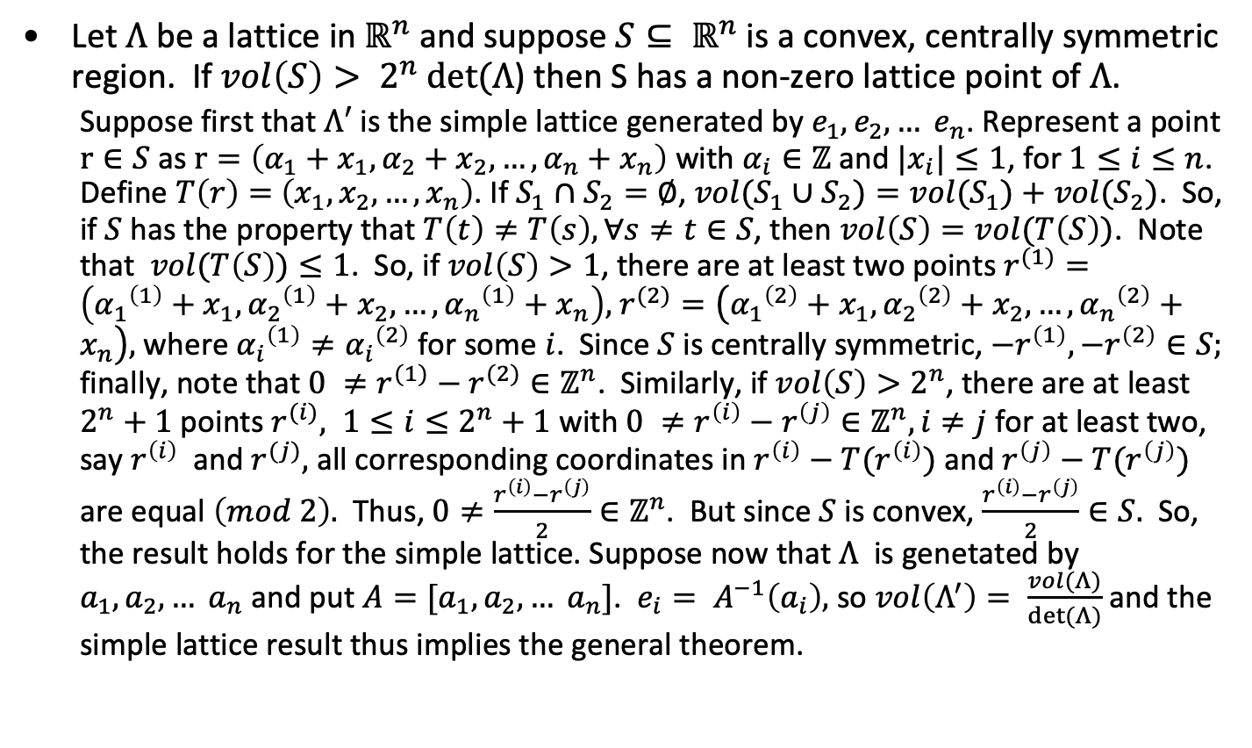
Minkowski’s Theorem
Let $Λ$ be a lattice in $ℝ^{n}$ and suppose $S⊆ ℝ^{n}$ is a convex, centrally symmetric region. If $vol\left(S\right)> 2^{n} det⁡(Λ$) then S has a non-zero lattice point of $Λ$.
Suppose first that $Λ′$ is the simple lattice generated by $e_{1},e_{2}, … e_{n}$. Represent a point $r∈S$ as$r=\left(α_{1}+x_{1},α_{2}+x_{2}, …,α_{n}+x_{n}\right)$ with $α_{i}∈ℤ$ and $|x_{i}|≤1$, for $1≤i≤n$. Define $T\left(r\right)=$ $\left(x_{1},x_{2}, …,x_{n}\right)$. If $S_{1}∩S_{2}=∅$, ${vol(S}_{1}∪S_{2})=vol(S_{1})+vol(S_{2})$. So, if $S$has the property that $T\left(t\right)≠T\left(s\right), ∀s≠t∈S$, then $vol\left(S\right)=vol(T\left(S\right))$. Note that $vol(T\left(S\right))≤1$. So, if $vol\left(S\right)>1$, there are at least two points $r^{(1)}=\left({α_{1}}^{\left(1\right)}+x_{1},{α_{2}}^{\left(1\right)}+x_{2}, …,{α_{n}}^{\left(1\right)}+x_{n}\right),$ $r^{(2)}=\left({α_{1}}^{\left(2\right)}+x_{1},{α_{2}}^{\left(2\right)}+x_{2}, …,{α_{n}}^{\left(2\right)}+x_{n}\right),$ where ${α_{i}}^{\left(1\right)}≠{α_{i}}^{\left(2\right)}$ for some $i$. Since $S$ is centrally symmetric, $−r^{\left(1\right)}, −r^{\left(2\right)}∈S;$ finally, note that $0 ≠r^{(1)}−r^{(2)}∈ℤ^{n}$. Similarly, if $vol\left(S\right)>2^{n}$, there are at least $2^{n}+1$ points $r^{(i)}, 1≤i≤2^{n}+1$ with $0 ≠r^{\left(i\right)}−r^{\left(j\right)}∈ℤ^{n}, i≠j$ for at least two, say $r^{\left(i\right)}$ and $r^{(j)},$ all corresponding coordinates in $r^{\left(i\right)}−T(r^{\left(i\right)})$ and $r^{\left(j\right)}−T(r^{\left(j\right)})$ are equal $\left(mod 2\right).$ Thus, $0≠\frac{r^{\left(i\right)}−r^{\left(j\right)}}{2}∈ℤ^{n}$. But since $S$ is convex, $\frac{r^{\left(i\right)}−r^{\left(j\right)}}{2}∈S.$ So, the result holds for the simple lattice. Suppose now that $Λ$ is genetated by $a_{1},a_{2}, … a_{n}$ and put $A=[a_{1},a_{2}, … a_{n}]$. $e_{i}= A^{−1}\left(a_{i}\right),$ so $vol\left(Λ^{′}\right)= \frac{vol(Λ)}{det⁡(Λ)}$ and the simple lattice result thus implies the general theorem.

Slide 5
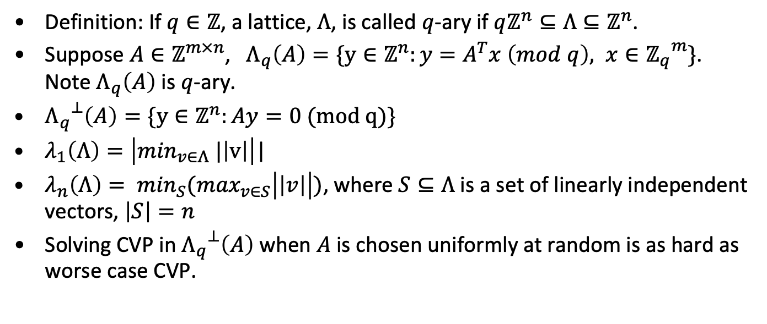
q-ary lattices and other definitions
Definition: If $q∈ℤ$, a lattice, $Λ$, is called $q$-ary if $qℤ^{n}⊆Λ⊆ℤ^{n}$.
Suppose $A∈ℤ^{m×n}$, $Λ_{q}\left(A\right)=\{y∈ℤ^{n}:y=A^{T}x \left(mod q\right), x∈{ℤ_{q}}^{m}\}$. Note $Λ_{q}\left(A\right)$ is $q$-ary.
${Λ_{q}}^{⊥}\left(A\right)=\{y∈ℤ^{n}:Ay=0 (mod q)\}$
$λ_{1}\left(Λ\right)=\left|\min_{v∈Λ} |\left|v\right|\right|$|
$λ_{n}\left(Λ\right)= \min_{S}(\max_{v∈S}\left|\left|v\right|\right|)$, where $S⊆Λ$ is a set of linearly independent vectors, $\left|S\right|=n$
Solving CVP in ${Λ_{q}}^{⊥}\left(A\right)$ when $A$ is chosen uniformly at random is as hard as worse case CVP.

Slide 6
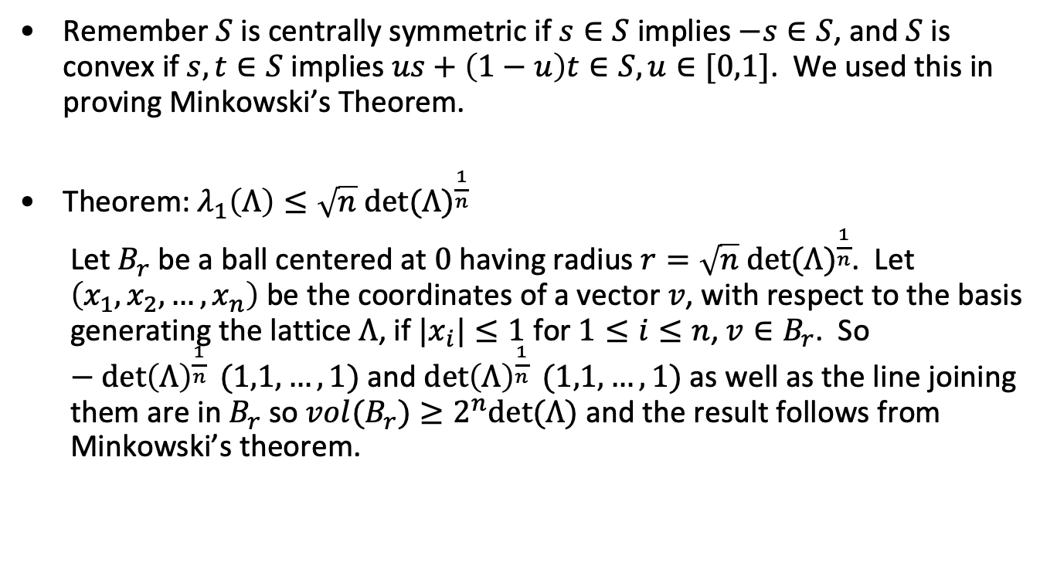
Some simple results
Remember $S$ is centrally symmetric if $s∈S$ implies $−s∈S$, and $S$ is convex if $s,t∈S$ implies $us+\left(1−u\right)t∈S, u∈[0,1]$. We used this in proving Minkowski’s Theorem.
Theorem: $λ_{1}\left(Λ\right)≤\sqrt{n} {det⁡(Λ)}^{\frac{1}{n}}$
Let $B_{r}$ be a ball centered at $0$ having radius $r=\sqrt{n} {det⁡(Λ)}^{\frac{1}{n}}$. Let $\left(x_{1},x_{2}, …,x_{n}\right)$ be the coordinates of a vector $v$, with respect to the basis generating the lattice $Λ$, if $|x_{i}|≤1$ for $1≤i≤n$, $v∈B_{r}$. So $−{\det\left(Λ\right)}^{\frac{1}{n}} (1,1,…,1)$ and ${\det\left(Λ\right)}^{\frac{1}{n}} (1,1,…,1)$ as well as the line joining them are in $B_{r}$ so $vol(B_{r})≥2^{n}det⁡(Λ)$ and the result follows from Minkowski’s theorem.

Slide 7
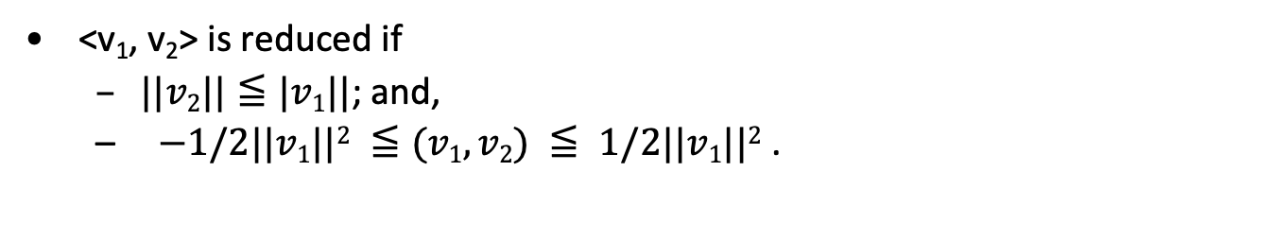
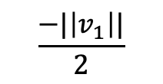
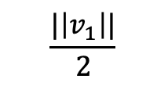
Reduced Basis
<v₁, v₂> is reduced if
$||v2||≦|v1||$; and,
$−1/2||v1||2 ≦(v1, v2) ≦ 1/2||v1||2$ .
v₂
v₂
v₁
v₁
$$\frac{−|\left|v_{1}\right||}{2}$$
$$\frac{|\left|v_{1}\right||}{2}$$
Reduced
Not

Slide 8
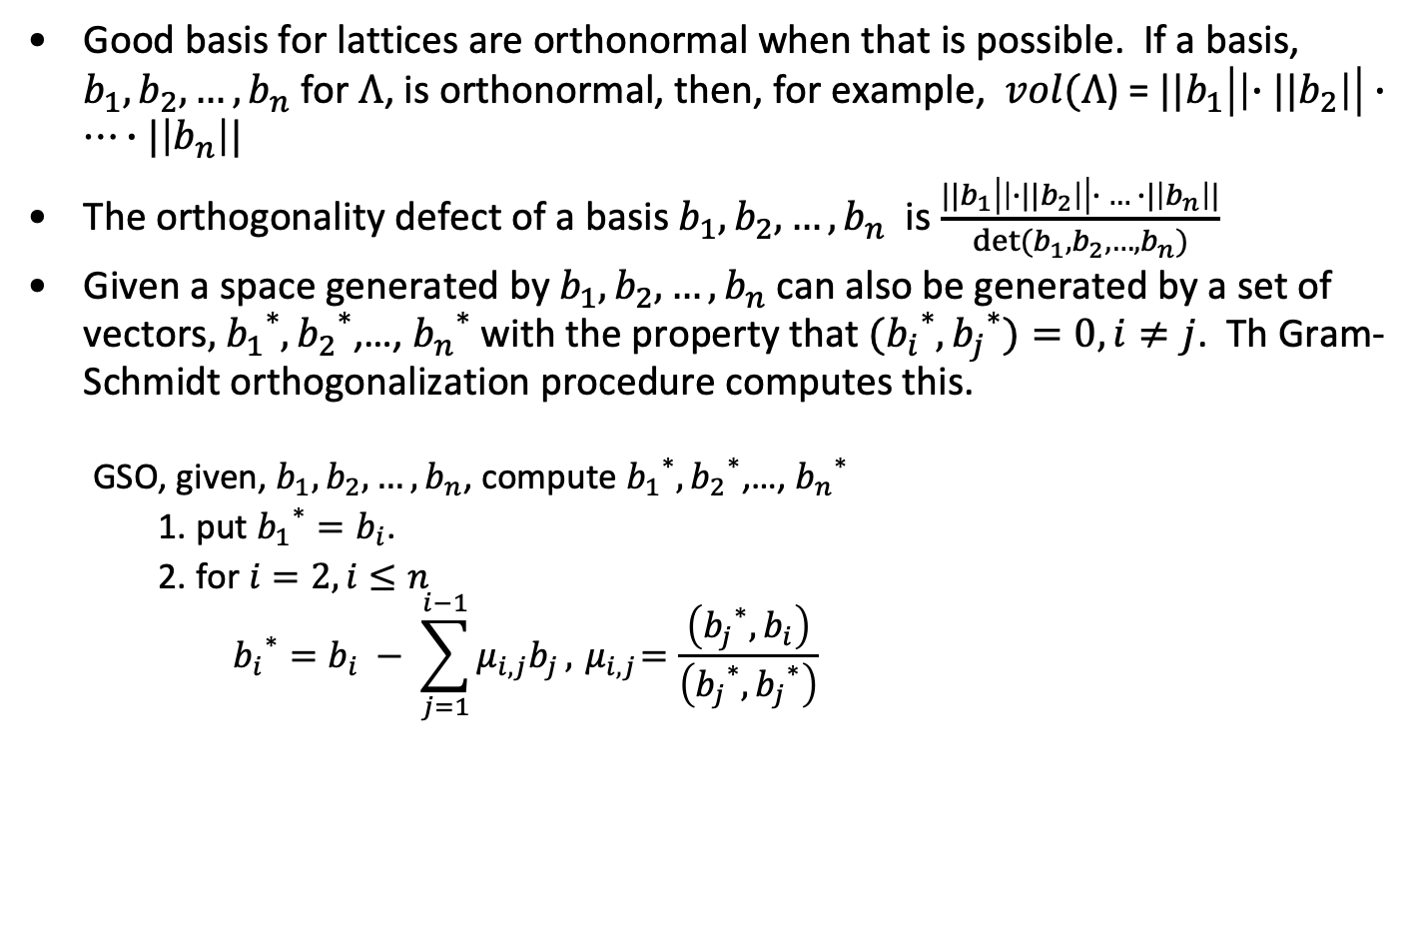
Good basis and Gram-Schmidt Orthogonalization
Good basis for lattices are orthonormal when that is possible. If a basis, $b_{1}, b_{2},…,b_{n}$ for $Λ$, is orthonormal, then, for example, $vol(Λ$) = ${||b}_{1}\left|\left|{∙||b}_{2}\right|\right|∙…∙|\left|b_{n}\right||$
The orthogonality defect of a basis $b_{1}, b_{2},…,b_{n}$ is $\frac{{||b}_{1}\left|\left|{∙||b}_{2}\right|\right|∙ … ∙|\left|b_{n}\right||}{det⁡(b_{1}, b_{2},…,b_{n})}$
Given a space generated by $b_{1}, b_{2},…,b_{n}$ can also be generated by a set of vectors$,$ ${b_{1}}^{∗},{b_{2}}^{∗}$,…, ${b_{n}}^{∗}$ with the property that ${{(b}_{i}}^{∗},{b_{j}}^{∗})=0, i≠j$. Th Gram-Schmidt orthogonalization procedure computes this.
GSO, given, $b_{1}, b_{2},…,b_{n}$, compute ${b_{1}}^{∗},{b_{2}}^{∗}$,…, ${b_{n}}^{∗}$
put ${b_{1}}^{∗}=b_{i}$.
for $i=2, i≤n$
$${b_{i}}^{∗}=b_{i} − \sum_{j=1}^{i−1}{μ_{i,j}b_{j}}, { μ}_{i,j}=\frac{\left({b_{j}}^{∗}, b_{i}\right)}{\left({b_{j}}^{∗},{b_{j}}^{∗}\right)}$$

Slide 9
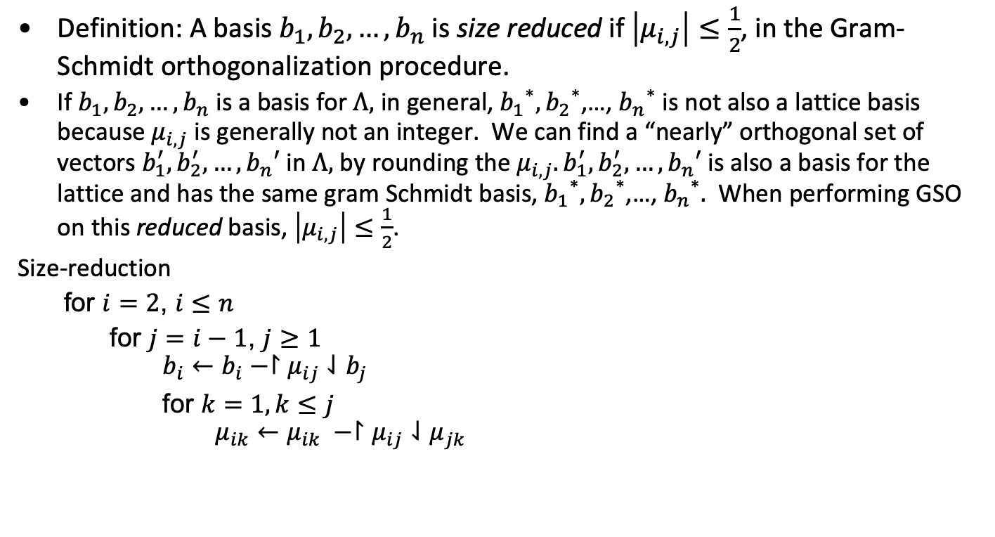
Size Reduction
Definition: A basis $b_{1}, b_{2},…,b_{n}$ is size reduced if $\left|μ_{i,j}\right|≤\frac{1}{2}$, in the Gram-Schmidt orthogonalization procedure.
If $b_{1}, b_{2},…,b_{n}$ is a basis for $Λ,$ in general, ${b_{1}}^{∗},{b_{2}}^{∗}$,…, ${b_{n}}^{∗}$ is not also a lattice basis because${ μ}_{i,j}$ is generally not an integer. We can find a “nearly” orthogonal set of vectors $b_{1}^{′}, b_{2}^{′}, …,b_{n}′$ in $Λ,$ by rounding the $μ_{i,j}. b_{1}^{′}, b_{2}^{′}, …,b_{n}′$is also a basis for the lattice and has the same gram Schmidt basis, ${b_{1}}^{∗},{b_{2}}^{∗}$,…, ${b_{n}}^{∗}.$ When performing GSO on this reduced basis, $\left|μ_{i,j}\right|≤\frac{1}{2}$.
Size-reduction
for $i=2$, $i≤n$
for $j=i−1$, $j≥1$
$$b_{i}←b_{i}−↾μ_{ij}⇃b_{j}$$
for $k=1, k≤j$
$$μ_{ik}←μ_{ik} −↾μ_{ij}⇃μ_{jk}$$

Slide 10
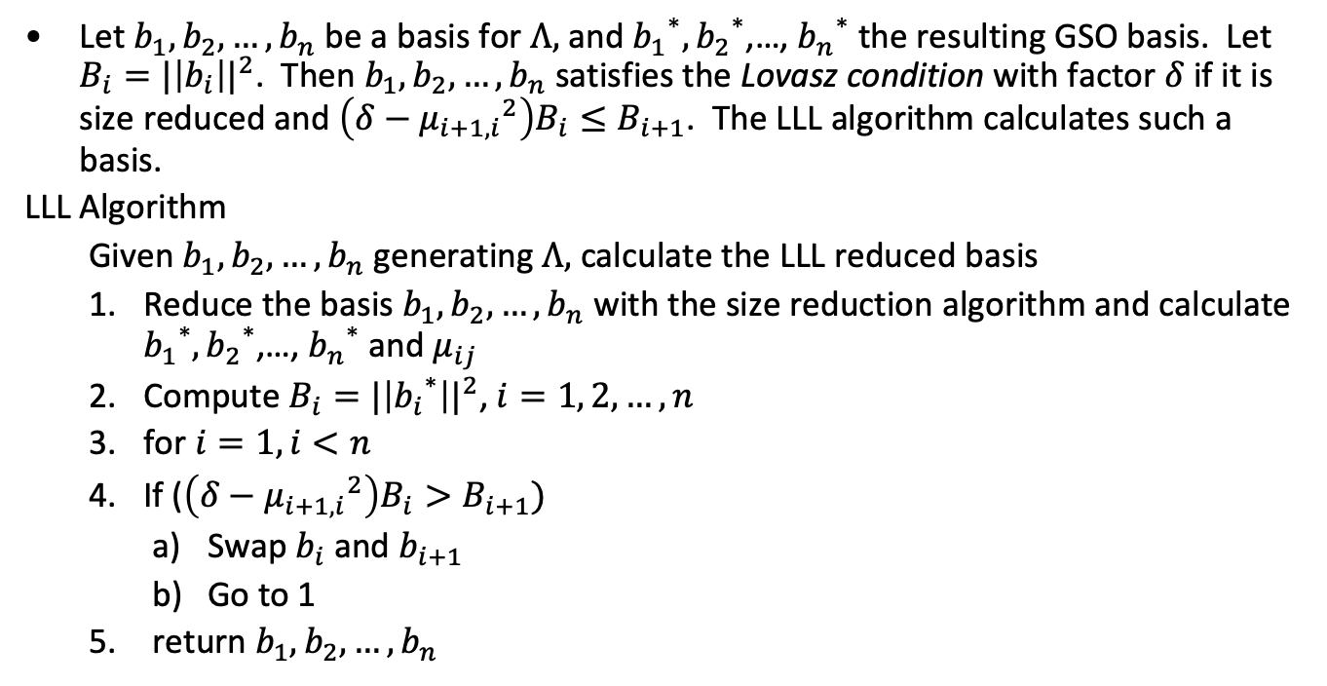
Size reduction and basis reordering
Let $b_{1}, b_{2},…,b_{n}$ be a basis for $Λ,$ and ${b_{1}}^{∗},{b_{2}}^{∗}$,…, ${b_{n}}^{∗}$ the resulting GSO basis. Let $B_{i}={|\left|b_{i}\right||}^{2}$. Then $b_{1}, b_{2},…,b_{n}$ satisfies the Lovasz condition with factor $δ$ if it is size reduced and $\left(δ−{μ_{i+1,i}}^{2}\right)B_{i}≤B_{i+1}$. The LLL algorithm calculates such a basis.
LLL Algorithm
Given $b_{1}, b_{2},…,b_{n}$ generating $Λ,$ calculate the LLL reduced basis
Reduce the basis $b_{1}, b_{2},…,b_{n}$ with the size reduction algorithm and calculate ${b_{1}}^{∗},{b_{2}}^{∗}$,…, ${b_{n}}^{∗}$ and $μ_{ij}$
Compute $B_{i}={|\left|{b_{i}}^{∗}\right||}^{2}$, $i=1, 2, …, n$
for $i=1, i<n$
If ($\left(δ−{μ_{i+1,i}}^{2}\right)B_{i}>B_{i+1})$
Swap $b_{i}$ and $b_{i+1}$
Go to 1
return $b_{1}, b_{2},…,b_{n}$

Slide 11
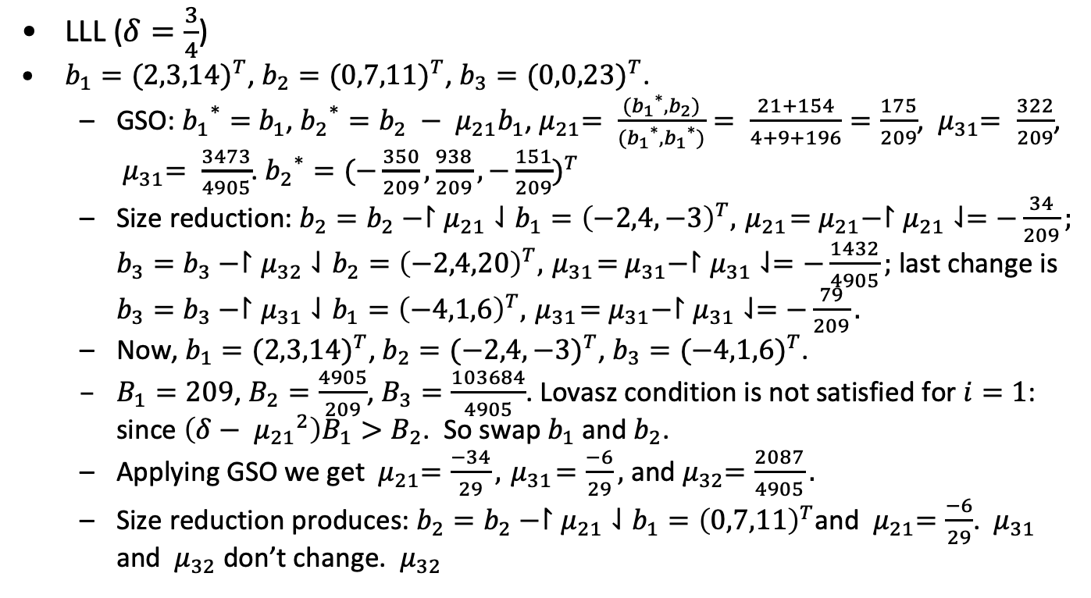
Example (LLL including GSO)
LLL ($δ=\frac{3}{4}$)
$b_{1}={(2,3,14)}^{T}$, $b_{2}={(0,7,11)}^{T}$, $b_{3}={(0,0,23)}^{T}$.
GSO: ${b_{1}}^{∗}=$ $b_{1}$, ${b_{2}}^{∗}=b_{2} − μ_{21}b_{1}$,${ μ}_{21}= \frac{({b_{1}}^{∗},b_{2})}{({b_{1}}^{∗},{b_{1}}^{∗})}= \frac{21+154}{4+9+196}=\frac{175}{209}$, ${ μ}_{31}= \frac{322}{209}$, ${ μ}_{31}= \frac{3473}{4905}$. ${b_{2}}^{∗}={(−\frac{350}{209}, \frac{938}{209}, −\frac{151}{209})}^{T}$
Size reduction: $b_{2}=b_{2}−↾μ_{21}⇃b_{1}={\left(−2,4,−3\right)}^{T},{ μ}_{21}={ μ}_{21}−↾μ_{21}⇃=−\frac{34}{209};$ $b_{3}=b_{3}−↾μ_{32}⇃b_{2}={\left(−2,4,20\right)}^{T},{ μ}_{31}={ μ}_{31}−↾μ_{31}⇃=−\frac{1432}{4905};$ last change is $b_{3}=b_{3}−↾μ_{31}⇃b_{1}={\left(−4,1,6\right)}^{T},{ μ}_{31}={ μ}_{31}−↾μ_{31}⇃=−\frac{79}{209}.$
Now, $b_{1}={(2,3,14)}^{T}$, $b_{2}={(−2,4,−3)}^{T}$, $b_{3}={(−4,1,6)}^{T}$.
$B_{1}=209$, $B_{2}=\frac{4905}{209}$, $B_{3}=\frac{103684}{4905}$. Lovasz condition is not satisfied for $i=1$: since $\left(δ−{{ μ}_{21}}^{2}\right)B_{1}>B_{2}$. So swap $b_{1}$ and $b_{2}$.
Applying GSO we get ${ μ}_{21}=\frac{−34}{29}, { μ}_{31}=\frac{−6}{29},$ and${ μ}_{32}=\frac{2087}{4905}.$
Size reduction produces: $b_{2}=b_{2}−↾μ_{21}⇃b_{1}={\left(0,7,11\right)}^{T}$and ${ μ}_{21}=\frac{−6}{29}$. ${ μ}_{31}$ and ${ μ}_{32}$ don’t change. ${ μ}_{32}$
From Heiko Knopse

Slide 12
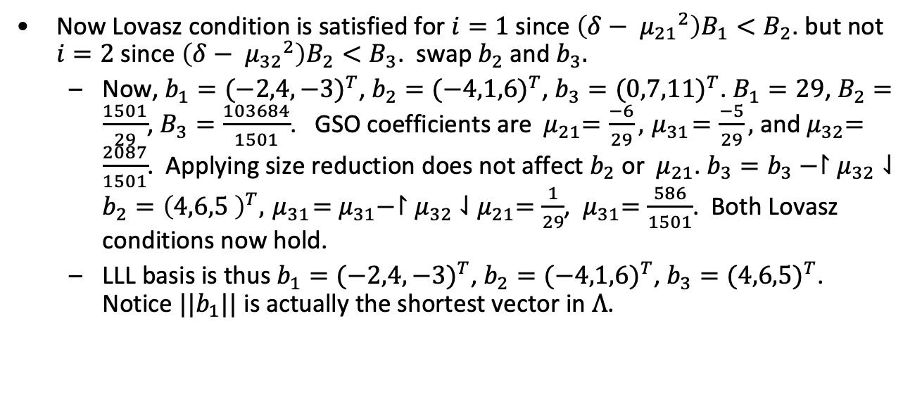
Example (LLL including GSO) - continued
Now Lovasz condition is satisfied for $i=1$ since $\left(δ−{{ μ}_{21}}^{2}\right)B_{1}<B_{2}$. but not $i=2$ since $\left(δ−{{ μ}_{32}}^{2}\right)B_{2}<B_{3}$. swap $b_{2}$ and $b_{3}.$
Now, $b_{1}={(−2,4,−3)}^{T}$, $b_{2}={(−4,1,6)}^{T}$, $b_{3}={(0,7,11)}^{T}$. $B_{1}=29$, $B_{2}=\frac{1501}{29}$, $B_{3}=\frac{103684}{1501}$. GSO coefficients are ${ μ}_{21}=\frac{−6}{29}, { μ}_{31}=\frac{−5}{29},$ and${ μ}_{32}=\frac{2087}{1501}$. Applying size reduction does not affect $b_{2}$ or ${ μ}_{21}$. $b_{3}=b_{3}−↾μ_{32}⇃b_{2}={\left(4,6,5 \right)}^{T},{ μ}_{31}={ μ}_{31}−↾μ_{32}⇃{ μ}_{21}=\frac{1}{29}$, ${ μ}_{31}=\frac{586}{1501}$. Both Lovasz conditions now hold.
LLL basis is thus $b_{1}={(−2,4,−3)}^{T}$, $b_{2}={(−4,1,6)}^{T}$, $b_{3}={(4,6,5)}^{T}$. Notice $||b_{1}||$ is actually the shortest vector in $Λ$.
From Heiko Knopse

Slide 13
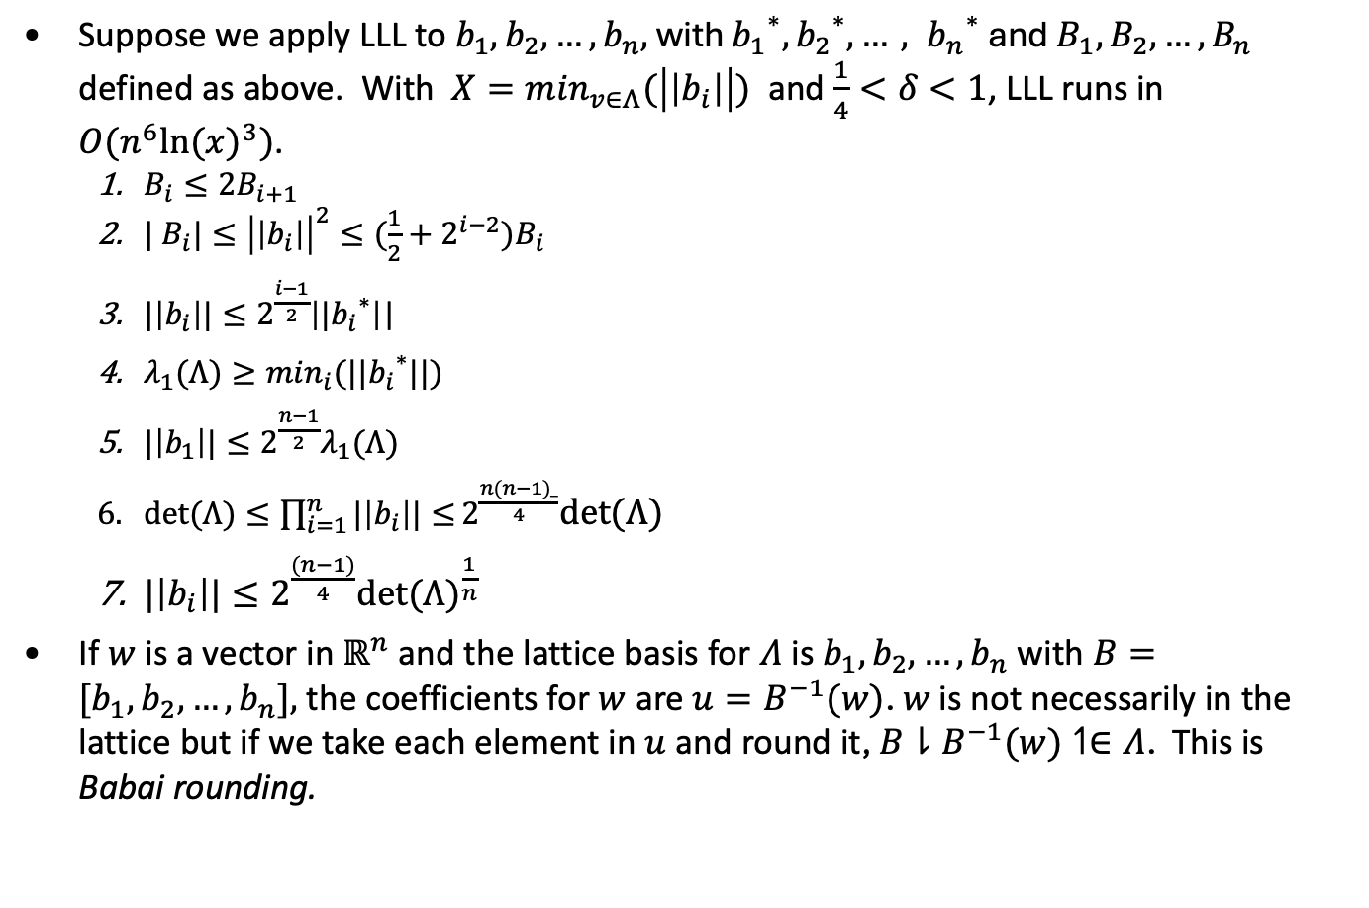
LLL Properties
Suppose we apply LLL to $b_{1}, b_{2},…,b_{n},$ with ${b_{1}}^{∗},{b_{2}}^{∗}{{, …, b}_{n}}^{∗}$ and $B_{1}, B_{2},…,B_{n}$ defined as above. With $X=\min_{v∈Λ}(\left|\left|b_{i}\right|\right|)$ and $\frac{1}{4}<δ<1$, LLL runs in $O(n^{6}{ln⁡(x)}^{3})$.
$B_{i}≤2B_{i+1}$
$| B_{i}|≤{\left|\left|b_{i}\right|\right|}^{2}≤(\frac{1}{2}+2^{i−2})B_{i}$
$|\left|b_{i}\right||≤2^{\frac{i−1}{2}}\left|{{|b}_{i}}^{∗}\right|$|
$λ_{1}(Λ)≥\min_{i}(||{b_{i}}^{∗}||)$
$|\left|b_{1}\right||≤2^{\frac{n−1}{2}}λ_{1}(Λ)$
$det⁡(Λ)≤\prod_{i=1}^{n}{|\left|b_{i}\right||≤}2^{\frac{n(n−1)_}{4}}det⁡(Λ)$
$|\left|b_{i}\right||≤2^{\frac{(n−1)}{4}}{det⁡(Λ)}^{\frac{1}{n}}$
If $w$ is a vector in $ℝ^{n}$ and the lattice basis for $Λ$ is $b_{1}, b_{2},…,b_{n}$ with $B={[b}_{1}, b_{2},…,b_{n}],$ the coefficients for $w$ are $u=B^{−1}(w)$. $w$ is not necessarily in the lattice but if we take each element in $u$ and round it, $B⇂B^{−1}(w)↿∈Λ$. This is Babai rounding.

Slide 14
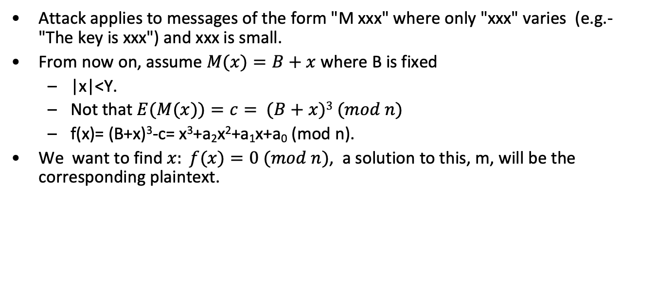
Attack on RSA using LLL
Attack applies to messages of the form "M xxx" where only "xxx" varies (e.g.- "The key is xxx") and xxx is small.
From now on, assume $M(x)=B+x$where B is fixed
|x|<Y.
Not that $E(M(x))=c= (B+x)3 (mod n)$
f(x)= (B+x)³-c= x³+a₂x²+a₁x+a₀ (mod n).
We want to find $x: f(x)=0 (mod n)$, a solution to this, m, will be the corresponding plaintext.

Slide 15
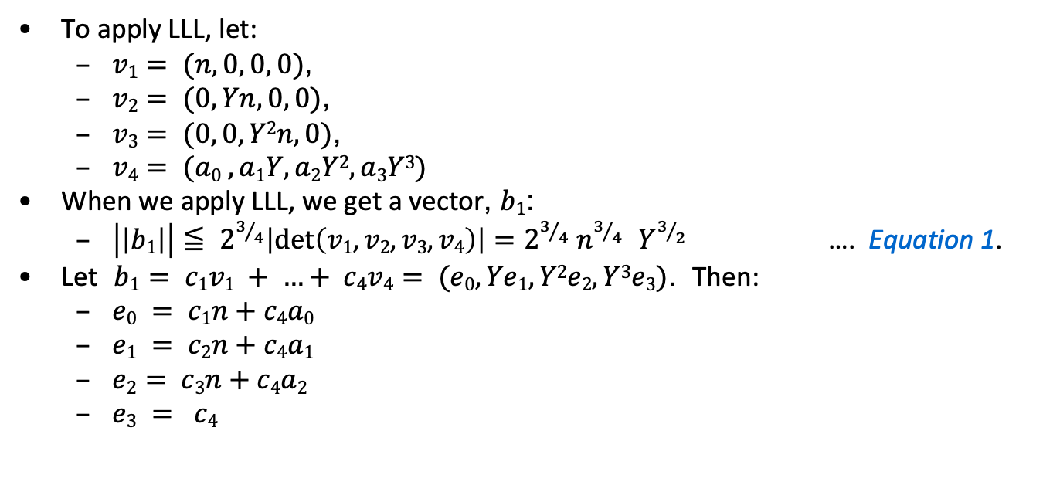
Attack on RSA using LLL
To apply LLL, let:
$v1= (n, 0, 0, 0)$,
$v2= (0, Yn, 0, 0)$,
$v3= (0, 0, Y2n, 0)$,
$v4= (a0 , a1Y, a2Y2, a3Y3)$
When we apply LLL, we get a vector, $b1$:
$\left|\left|b1\right|\right|≦ 2^{3/4}\left|\det\left(v1, v2, v3, v4\right)\right|=2^{3/4} n^{3/{4 } } Y^{3/2}$ …. Equation 1.
Let $b1= c1v1 + …+ c4v4= (e0, Ye1, Y2e2, Y3e3)$. Then:

Slide 16
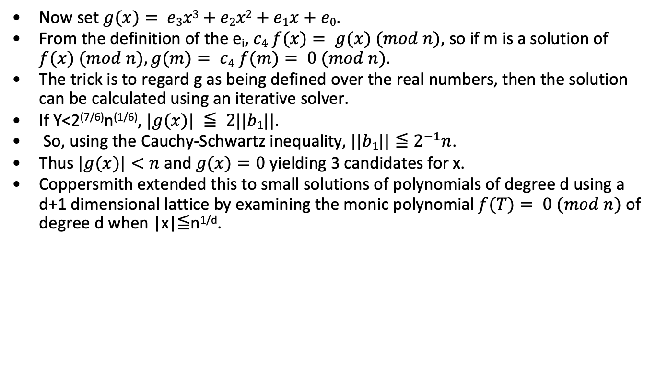
Attack on RSA using LLL
Now set $g(x)= e3x3+e2x2+e1x+e0$.
From the definition of the e_{i}, $c4 f(x)= g(x) (mod n)$, so if m is a solution of $f(x) (mod n), g(m)= c4 f(m)= 0 (mod n)$.
The trick is to regard g as being defined over the real numbers, then the solution can be calculated using an iterative solver.
If Y<2^{(7/6)}n^{(1/6)}, $|g(x)| ≦ 2||b1||$.
So, using the Cauchy-Schwartz inequality, $||b1||≦2^{−1}n$.
Thus $|g(x)|<n$and $g(x)=0$ yielding 3 candidates for x.
Coppersmith extended this to small solutions of polynomials of degree d using a d+1 dimensional lattice by examining the monic polynomial $f(T)= 0 (mod n)$ of degree d when |x|≦n^{1/d}.

Slide 17
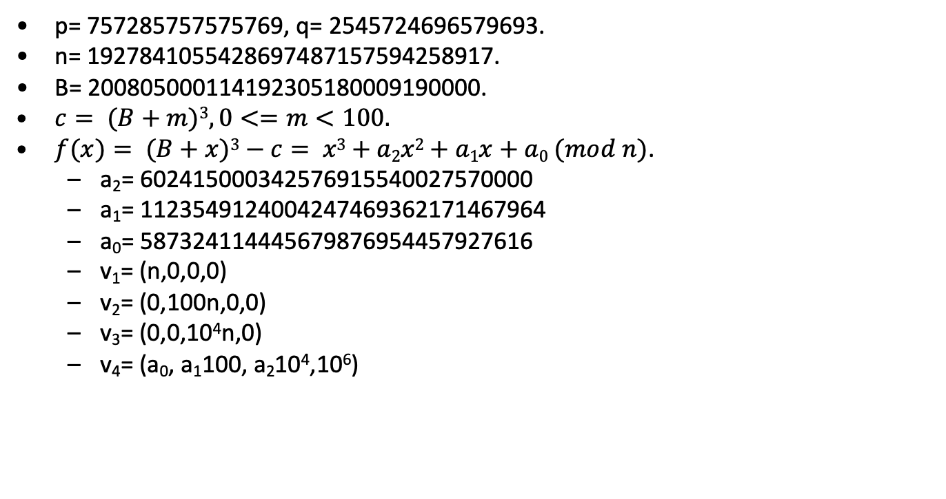
Example attack on RSA using LLL
p= 757285757575769, q= 2545724696579693.
n= 1927841055428697487157594258917.
B= 200805000114192305180009190000.
$c= (B+m)3, 0<=m<100.$
$f(x)= (B+x)3−c= x3+a2x2+a1x+a0 (mod n)$.
a₂= 602415000342576915540027570000
a₁= 1123549124004247469362171467964
a₀= 587324114445679876954457927616
v₁= (n,0,0,0)
v₂= (0,100n,0,0)
v₃= (0,0,10⁴n,0)
v₄= (a₀, a₁100, a₂10⁴,10⁶)

Slide 18
Example attack on RSA using LLL
Apply LLL, b₁=
308331465484476402v₁ + 589837092377839611v₂ +
316253828707108264v₃ + (-1012071602751202635)v₄ =
(246073430665887186108474, -577816087453534232385300,
405848565585194400880000, -1012071602751202635000000)
g(x)= (-1012071602751202635) t³ + 40584856558519440088 t² +
(-57781608745353442323853) t +246073430665887186108474.
Roots of g(x) are 42.0000000, (-.9496±76.0796i)
The answer is 42.

Slide 19
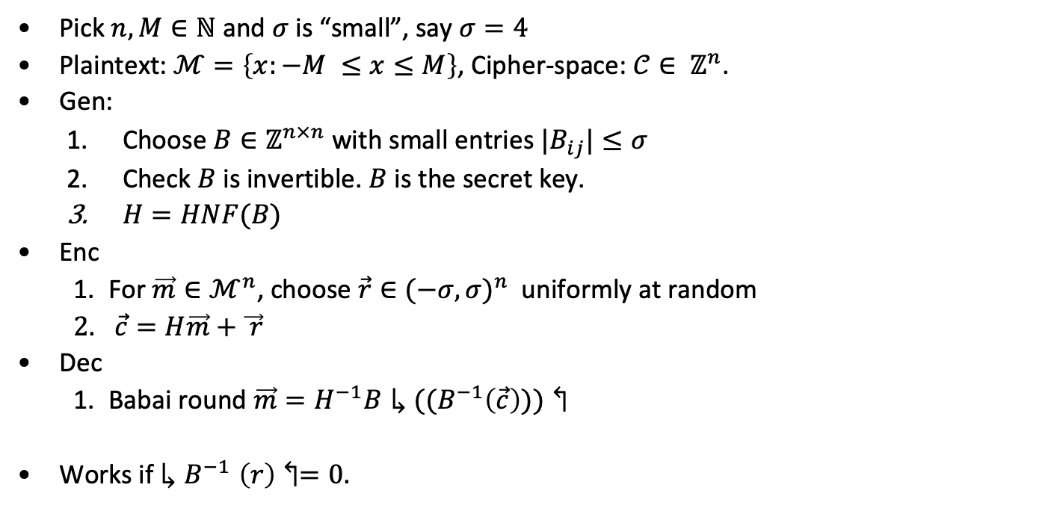
GGH Public Key System
Pick $n,M∈ℕ$ and $σ$ is “small”, say $σ=4$
Plaintext: $ℳ=\left\{x:−M ≤x≤M\right\}$, Cipher-space: $𝒞∈ ℤ^{n}$.
Gen:
Choose $B∈ℤ^{n×n}$ with small entries $|B_{ij}|≤σ$
Check $B$ is invertible. $B$ is the secret key.
$H=HNF(B)$
Enc
For $\vec{m}∈ℳ^{n}$, choose $\vec{r}∈{(−σ,σ)}^{n}$ uniformly at random
$\vec{c}=H\vec{m}+\vec{ r}$
Dec
Babai round ${\vec{m}=H}^{−1}B↳((B^{−1}\left(\vec{c}\right)))↰$
Works if ${↳B}^{−1}\left(r\right)↰=0.$

Slide 20
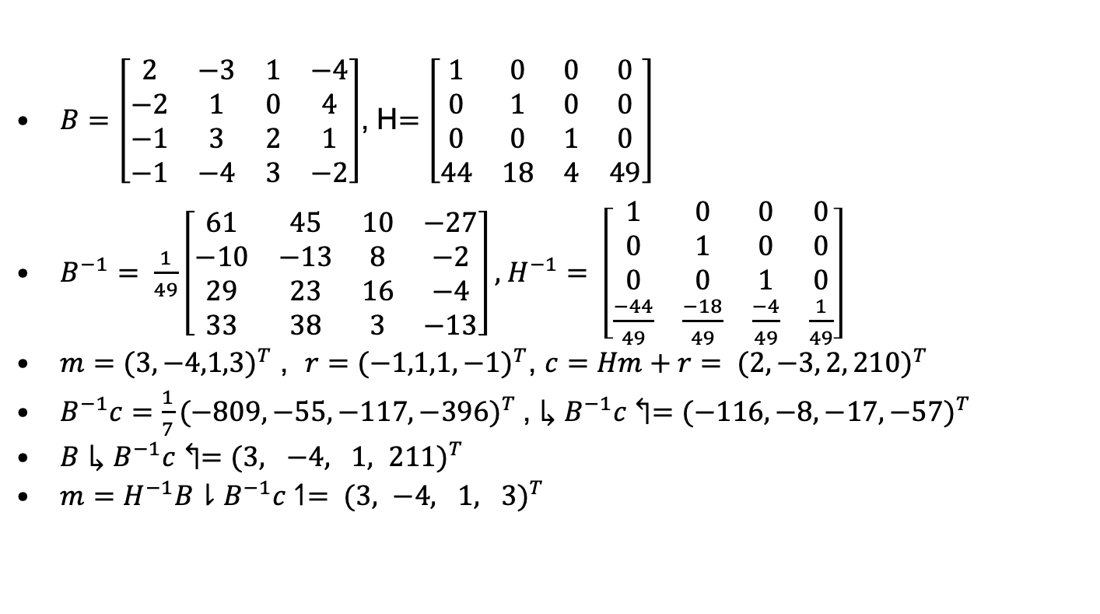
GGH Example
$B=\left[\begin{matrix}2 & −3 & 1 & −4 \\ −2 & 1 & 0 & 4 \\ −1 & 3 & 2 & 1 \\ −1 & −4 & 3 & −2\end{matrix}\right]$, H$=\left[\begin{matrix}1 & 0 & 0 & 0 \\ 0 & 1 & 0 & 0 \\ 0 & 0 & 1 & 0 \\ 44 & 18 & 4 & 49\end{matrix}\right]$
$B^{−1}= \frac{1}{49}\left[\begin{matrix}61 & 45 & 10 & −27 \\ −10 & −13 & 8 & −2 \\ 29 & 23 & 16 & −4 \\ 33 & 38 & 3 & −13\end{matrix}\right],$ $H^{−1}= \left[\begin{matrix}1 & 0 & 0 & 0 \\ 0 & 1 & 0 & 0 \\ 0 & 0 & 1 & 0 \\ \frac{−44}{49} & \frac{−18}{49} & \frac{−4}{49} & \frac{1}{49}\end{matrix}\right]$
$m={(3,−4,1,3)}^{T}$ , $r={(−1,1,1,−1)}^{T}$, $c=Hm+r= {(2,−3, 2, 210)}^{T}$
$B^{−1}c=\frac{1}{7}{(−809,−55,−117,−396)}^{T}$, $↳B^{−1}c↰={(−116, −8, −17, −57)}^{T}$
$B↳B^{−1}c↰={(3, −4, 1, 211)}^{T}$
$m=H^{−1}B⇂B^{−1}c↿= {(3, −4, 1, 3)}^{T}$
From Heiko Knopse

Slide 21
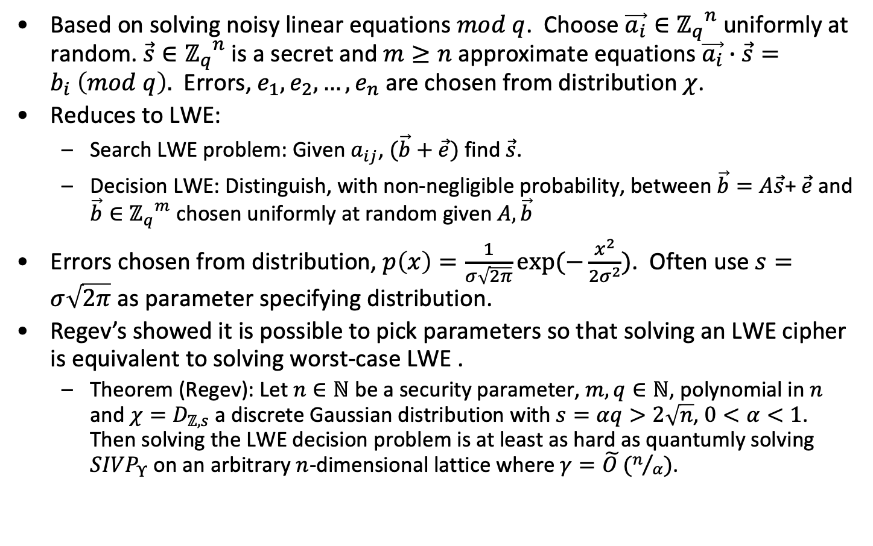
Learning with Errors (LWE)
Based on solving noisy linear equations $mod q$. Choose $\vec{a_{i}}∈{ℤ_{q}}^{n}$ uniformly at random. $\vec{s}∈{ℤ_{q}}^{n}$ is a secret and $m≥n$ approximate equations $\vec{a_{i}}∙\vec{s}=b_{i} \left(mod q\right).$ Errors, $e_{1},e_{2},…,e_{n}$ are chosen from distribution $χ$.
Reduces to LWE:
Search LWE problem: Given $a_{ij}$, $(\vec{b}+\vec{e})$ find $\vec{s}$.
Decision LWE: Distinguish, with non-negligible probability, between $\vec{b}=A\vec{s}$+ $\vec{e}$ and $\vec{b}∈{ℤ_{q}}^{m}$ chosen uniformly at random given $A,\vec{b}$
Errors chosen from distribution, $p\left(x\right)=\frac{1}{σ\sqrt{2π}}exp⁡(−\frac{x^{2}}{2σ^{2}})$. Often use $s=σ\sqrt{2π}$ as parameter specifying distribution.
Regev’s showed it is possible to pick parameters so that solving an LWE cipher is equivalent to solving worst-case LWE .
Theorem (Regev): Let $n∈ℕ$ be a security parameter, $m, q∈ℕ$, polynomial in $n$ and $χ=D_{ℤ,s}$ a discrete Gaussian distribution with $s=αq>2\sqrt{n}$, $0<α<1$. Then solving the LWE decision problem is at least as hard as quantumly solving ${SIVP}_{Υ}$ on an arbitrary $n$-dimensional lattice where $γ=\tilde{O }(n/α)$.

Slide 22
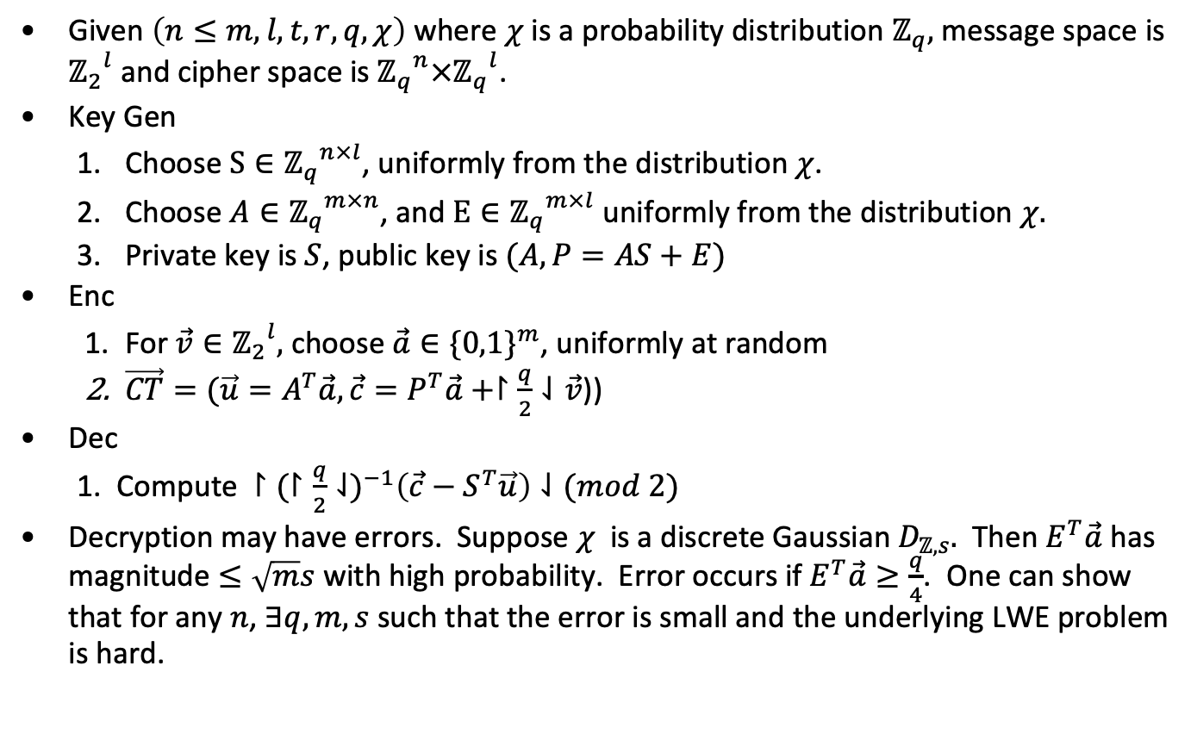
LWE cryptosystem
Given $\left(n≤m, l, t, r,q, χ\right)$ where $χ$ is a probability distribution $ℤ_{q},$message space is ${ℤ_{2}}^{l}$ and cipher space is ${ℤ_{q}}^{n}×{ℤ_{q}}^{l}$.
Key Gen
Choose $S∈{ℤ_{q}}^{n×l}$, uniformly from the distribution $χ$.
Choose $A∈{ℤ_{q}}^{m×n}$, and $E∈{ℤ_{q}}^{m×l}$ uniformly from the distribution $χ.$
Private key is $S$, public key is $(A, P=AS+E)$
Enc
For $\vec{v}∈{ℤ_{2}}^{l},$ choose $\vec{a}∈{\{0,1\}}^{m}$, uniformly at random
$\vec{CT}=(\vec{u}=A^{T}\vec{a}, \vec{c}=P^{T}\vec{a}+↾\frac{q}{2}⇃\vec{v}$))
Dec
Compute $↾{(↾\frac{q}{2}⇃)}^{−1}\left(\vec{c}−S^{T}\vec{u}\right)⇃(mod 2)$
Decryption may have errors. Suppose $χ$ is a discrete Gaussian $D_{ℤ,s}.$ Then $E^{T}\vec{a}$ has magnitude $≤\sqrt{m}s$ with high probability. Error occurs if $E^{T}\vec{a}≥\frac{q}{4}$. One can show that for any $n$, $∃q,m,s$ such that the error is small and the underlying LWE problem is hard.

Slide 23
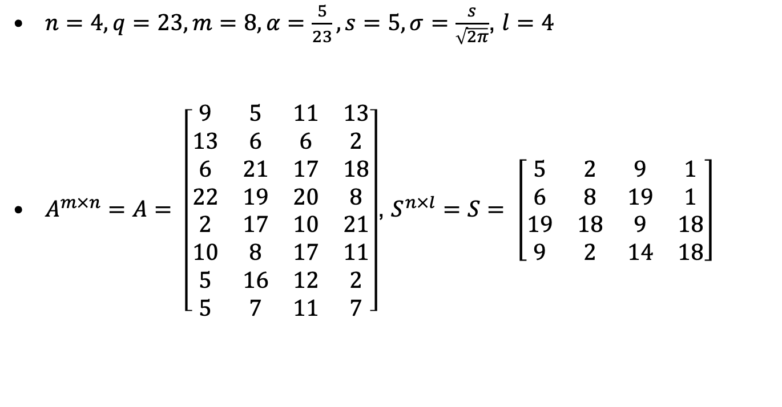
LWE example
$n=4, q=23,m=8, α=\frac{5}{23}, s=5, σ=\frac{s}{\sqrt{2π}}$, $l=4$
$A^{m×n}=A= \left[\begin{matrix}9 & 5 & 11 & 13 \\ 13 & 6 & 6 & 2 \\ 6 & 21 & 17 & 18 \\ 22 & 19 & 20 & 8 \\ 2 & 17 & 10 & 21 \\ 10 & 8 & 17 & 11 \\ 5 & 16 & 12 & 2 \\ 5 & 7 & 11 & 7\end{matrix}\right]$, $S^{n×l}=S= \left[\begin{matrix}5 & 2 & 9 & 1 \\ 6 & 8 & 19 & 1 \\ 19 & 18 & 9 & 18 \\ 9 & 2 & 14 & 18\end{matrix}\right]$
From Heiko Knopse

Slide 24
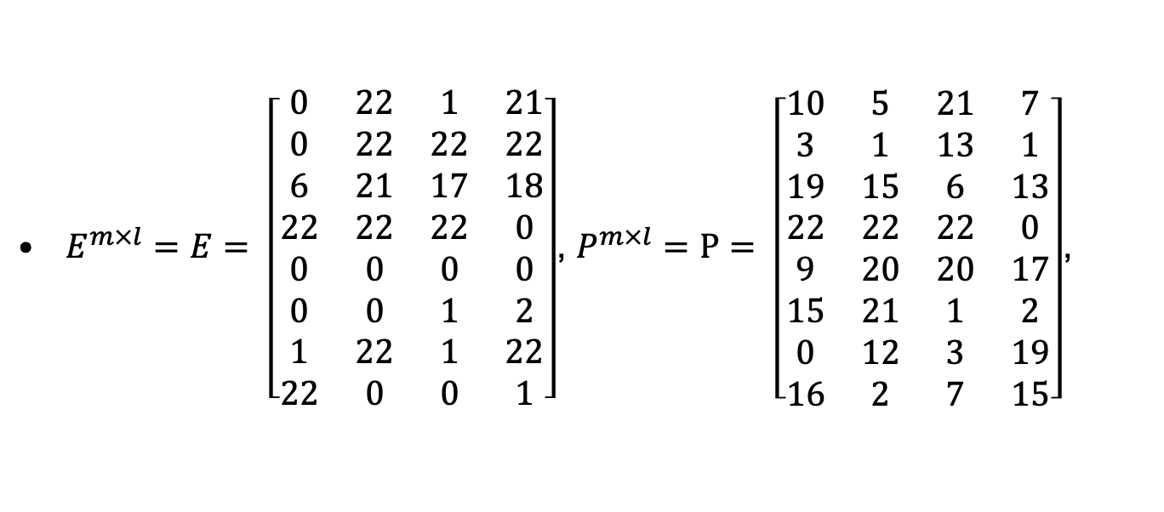
LWE example
$E^{m×l}=E= \left[\begin{matrix}0 & 22 & 1 & 21 \\ 0 & 22 & 22 & 22 \\ 6 & 21 & 17 & 18 \\ 22 & 22 & 22 & 0 \\ 0 & 0 & 0 & 0 \\ 0 & 0 & 1 & 2 \\ 1 & 22 & 1 & 22 \\ 22 & 0 & 0 & 1\end{matrix}\right]$, $P^{m×l}=P= \left[\begin{matrix}10 & 5 & 21 & 7 \\ 3 & 1 & 13 & 1 \\ 19 & 15 & 6 & 13 \\ 22 & 22 & 22 & 0 \\ 9 & 20 & 20 & 17 \\ 15 & 21 & 1 & 2 \\ 0 & 12 & 3 & 19 \\ 16 & 2 & 7 & 15\end{matrix}\right]$,
From Heiko Knopse

Slide 25
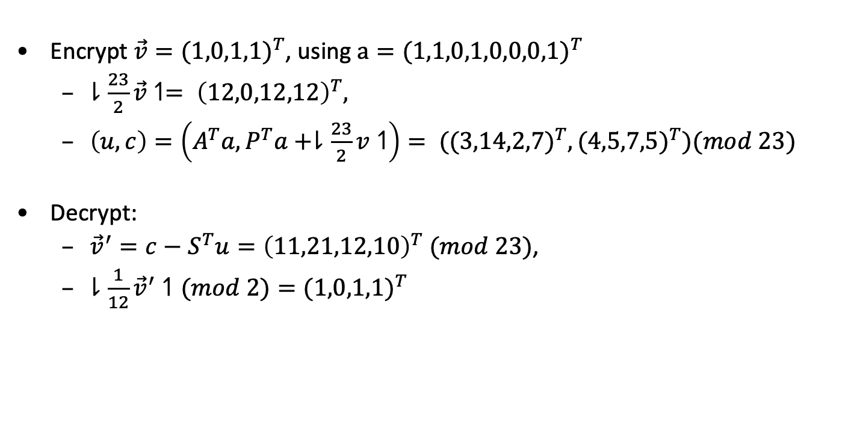
LWE example
Encrypt $\vec{v}={(1,0,1,1)}^{T}$, using $a={(1,1,0,1,0,0,0,1)}^{T}$
$⇂\frac{23}{2}\vec{v}↿= {\left(12,0,12,12\right)}^{T},$
$\left(u,c\right)=\left(A^{T}a,P^{T}a+⇂\frac{23}{2}v↿\right)= {((3,14,2,7)}^{T},{(4,5,7,5)}^{T})(mod 23)$
Decrypt:
${\vec{v}}^{′}=c−S^{T}u={\left(11,21,12,10\right)}^{T} (mod 23)$,
$⇂\frac{1}{12}{\vec{v}}^{′}↿(mod 2)={(1,0,1,1)}^{T}$
From Heiko Knopse

Slide 26
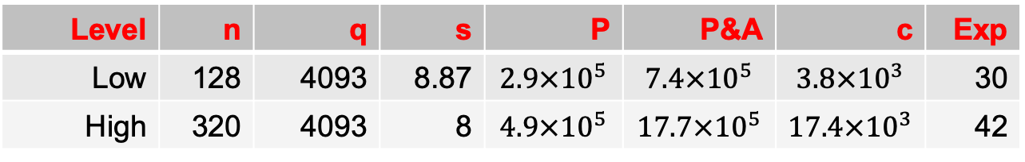
LWE/Ring-LWE parameters
Level | n | q | s | P | P&A | c | Exp
Low | 128 | 4093 | 8.87 | $$2.9×{10}^{5}$$ | $$7.4×{10}^{5}$$ | $$3.8×{10}^{3}$$ | 30
High | 320 | 4093 | 8 | $$4.9×{10}^{5}$$ | $$17.7×{10}^{5}$$ | $$17.4×{10}^{3}$$ | 42
Ring-LWE cuts ciphertext by factor of n

Slide 27
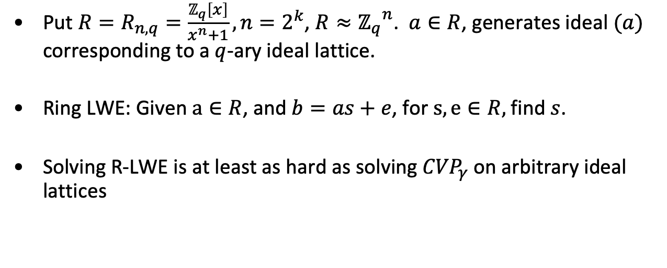
Ring-LWE
Put $R=R_{n,q}=\frac{ℤ_{q}\left[x\right]}{x^{n}+1}, n=2^{k}$, $R≈{ℤ_{q}}^{n}$. $a∈R$, generates ideal $(a)$ corresponding to a $q$-ary ideal lattice.
Ring LWE: Given $a∈R$, and $b=as+e$, for $s,e∈R,$ find $s$.
Solving R-LWE is at least as hard as solving ${CVP}_{γ}$ on arbitrary ideal lattices

Slide 28
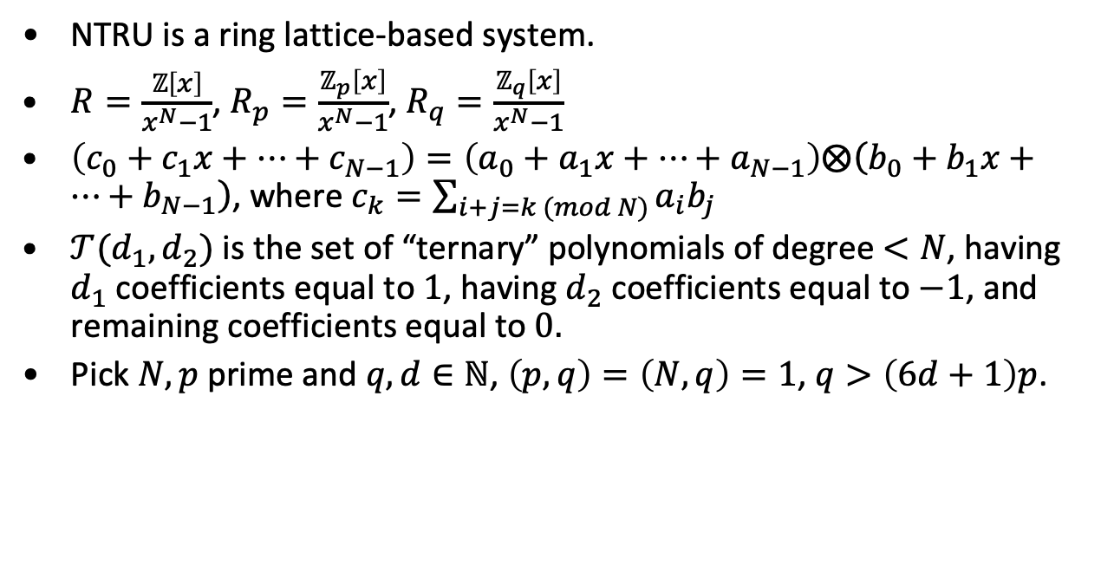
NTRU Public Key System
NTRU is a ring lattice-based system.
$R=\frac{ℤ\left[x\right]}{x^{N}−1}$, $R_{p}=\frac{ℤ_{p}\left[x\right]}{x^{N}−1}$, $R_{q}=\frac{ℤ_{q}\left[x\right]}{x^{N}−1}$
$\left(c_{0}+c_{1}x+…+c_{N−1}\right)=\left(a_{0}+a_{1}x+…+a_{N−1}\right)⨂\left(b_{0}+b_{1}x+…+b_{N−1}\right)$, where $c_{k}=\sum_{i+j=k (mod N)}{a_{i}b_{j}}$
$𝒯(d_{1},d_{2})$ is the set of “ternary” polynomials of degree $<N$, having $d_{1}$ coefficients equal to $1$, having $d_{2}$ coefficients equal to $−1$, and remaining coefficients equal to $0.$
Pick $N,p$ prime and $q,d∈ℕ$, $\left(p,q\right)=\left(N,q\right)=1$, $q>\left(6d+1\right)p$.

Slide 29
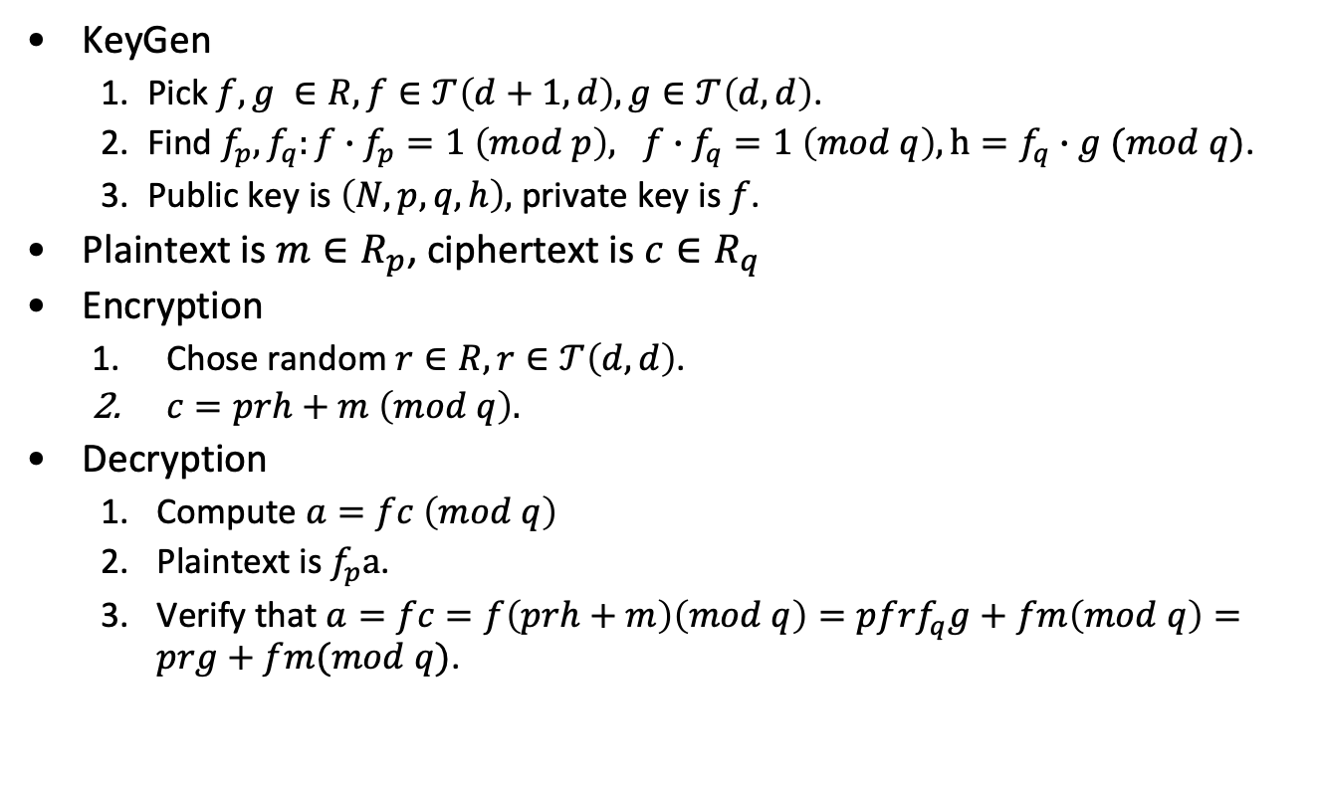
NTRU Public Key System
KeyGen
Pick $f,g ∈R, f∈𝒯\left(d+1,d\right),g∈𝒯\left(d,d\right)$.
Find $f_{p}, f_{q}:f∙f_{p}=1 \left(mod p\right), f∙f_{q}=1 \left(mod q\right), h=f_{q}∙g (mod q)$.
Public key is $\left(N,p,q,h\right),$ private key is $f$.
Plaintext is $m∈R_{p}$, ciphertext is $c∈R_{q}$
Encryption
Chose random $r∈R, r∈𝒯\left(d,d\right)$.
$c=prh+m \left(mod q\right).$
Decryption
Compute $a=fc \left(mod q\right)$
Plaintext is $f_{p}a$.
Verify that $a=fc=f\left(prh+m\right)\left(mod q\right)=pfrf_{q}g+fm\left(mod q\right)=prg+fm(mod q)$.

Slide 30
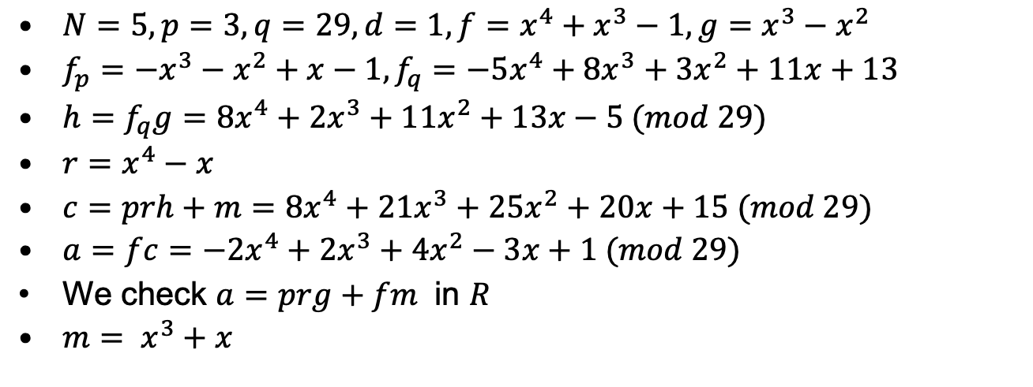
NTRU Example
$N=5, p=3, q=29,d=1, f=x^{4}+x^{3}−1,g=x^{3}−x^{2}$
$f_{p}={−x}^{3}−x^{2}+x−1,f_{q}={−5x}^{4}+{8x}^{3}+{3x}^{2}+11x+13$
$h=f_{q}g=8x^{4}+2x^{3}+{11x}^{2}+13x−5 (mod 29)$
$r=x^{4}−x$
$c=prh+m=8x^{4}+21x^{3}+{25x}^{2}+20x+15 (mod 29)$
$a=fc=−2x^{4}+2x^{3}+{4x}^{2}−3x+1 (mod 29)$
We check $a=prg+fm$ in $R$
$m= x^{3}+x$
From Heiko Knopse

Slide 31
Some NIST Round 3 entries
Public-Key Encryption/KEMs
Classic McEliece
CRYSTALS-KYBER
NTRU
SABER
Digital Signatures
CRYSTALS-DILITHIUM
FALCON
Rainbow
Public-Key Encryption/KEMs (Alternates)
BIKE;
FrodoKEM
HQC
NTRU Prime
SIKE
Digital Signatures
GeMSS
Picnic
SPHINCS+
Winner: Dilithium (signing), Kyber (key-encapsulation)

Slide 32
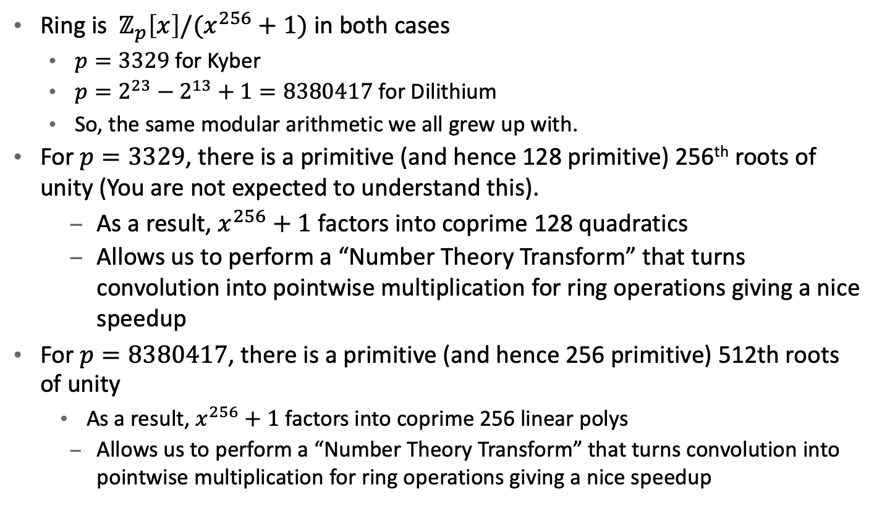
Common features of Dilithium and Kyber
Ring is $ℤ_{p}\left[x\right]/(x^{256}+1)$ in both cases
$p=3329$ for Kyber
$p=2^{23}−2^{13}+1=8380417$ for Dilithium
So, the same modular arithmetic we all grew up with.
For $p=3329$, there is a primitive (and hence 128 primitive) 256th roots of unity (You are not expected to understand this).
As a result, $x^{256}+1$ factors into coprime 128 quadratics
Allows us to perform a “Number Theory Transform” that turns convolution into pointwise multiplication for ring operations giving a nice speedup
For $p=8380417$, there is a primitive (and hence 256 primitive) 512th roots of unity
As a result, $x^{256}+1$ factors into coprime 256 linear polys
Allows us to perform a “Number Theory Transform” that turns convolution into pointwise multiplication for ring operations giving a nice speedup

Slide 33
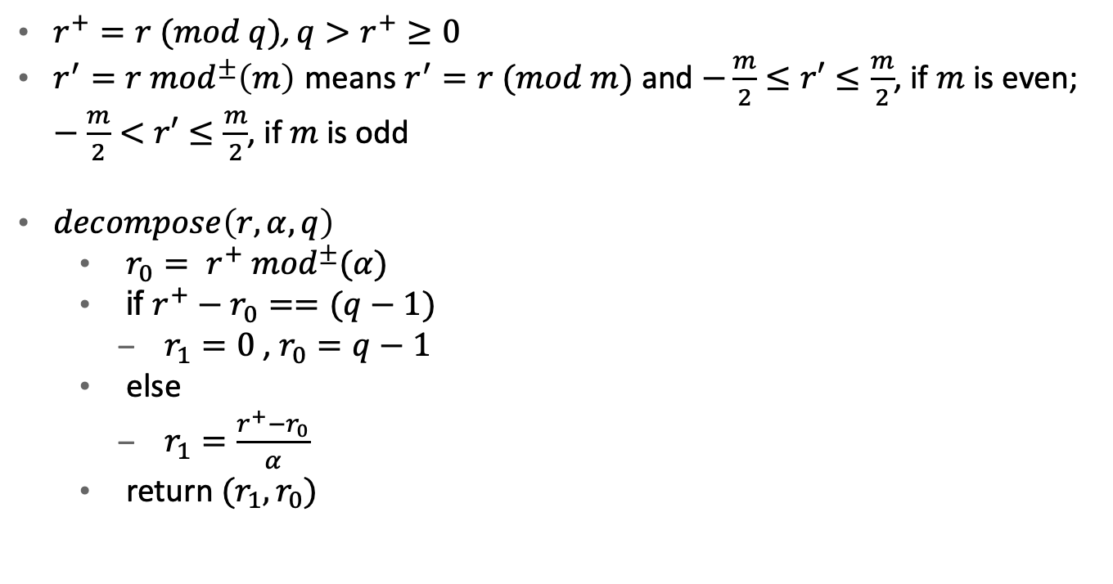
Useful definitions
$r^{+}=r (mod q)$, ${q>r}^{+}≥0$
$r^{′}=r {mod}^{±}\left(m\right)$ means $r^{′}=r (mod m)$ and $−\frac{m}{2}≤r′≤\frac{m}{2}$, if $m$ is even; $−\frac{m}{2}<r′≤\frac{m}{2}$, if $m$ is odd
$decompose\left(r, α,q\right)$
$r_{0}= r^{+} {mod}^{±}(α)$
if $r^{+}−r_{0}==(q−1)$
$r_{1}=0$, $r_{0}=q−1$
else
$r_{1}=\frac{r^{+}−r_{0}}{α}$
return $(r_{1}, r_{0})$

Slide 34

Useful definitions
$lowbits(x, α, q)$
$\left(r_{1}, r_{0}\right)=decompose(x, α, q)$
return $r_{0}$
$highbits(x, α, q)$
$\left(r_{1}, r_{0}\right)=decompose(x, α, q)$
return $r_{1}$
$power2round\left(r, d, q\right)$
$r^{+}=r mod(q)$
$r_{0}= {r^{+} mod}^{±}(2^{d})$
return $(\frac{r^{+}−r_{0}}{2^{d}}, r_{0})$

Slide 35
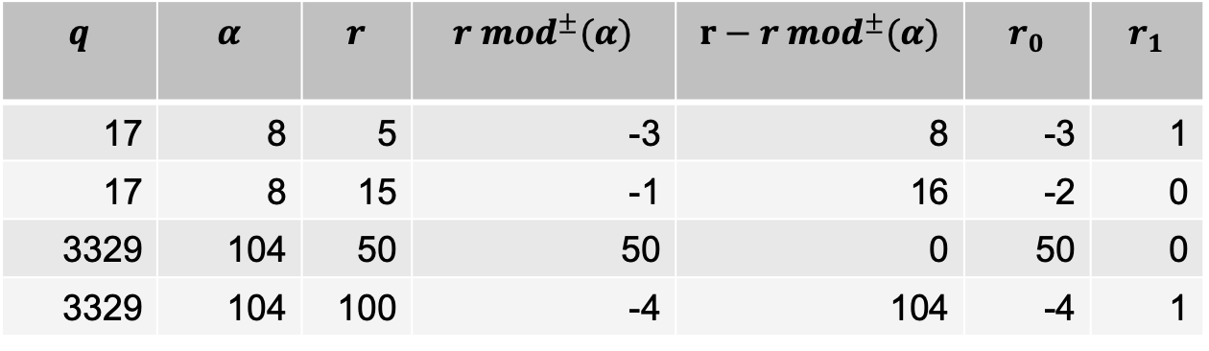
Examples
$decompose(r, α,q)$ examples (second shows roundoff edge case)
$$q$$ | $$α$$ | $$r$$ | $$r {mod}^{±}(α)$$ | $$r−r {mod}^{±}(α)$$ | $$r_{0}$$ | $$r_{1}$$
17 | 8 | 5 | -3 | 8 | -3 | 1
17 | 8 | 15 | -1 | 16 | -2 | 0
3329 | 104 | 50 | 50 | 0 | 50 | 0
3329 | 104 | 100 | -4 | 104 | -4 | 1

Slide 36
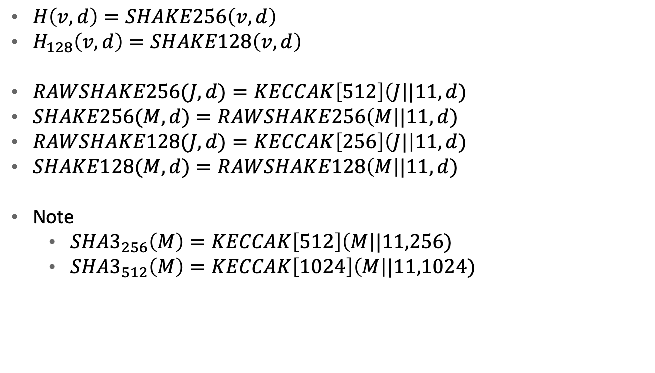
SHAKE-256/SHAKE-128
$H\left(v,d\right)=SHAKE256\left(v,d\right)$
$H_{128}\left(v,d\right)=SHAKE128\left(v,d\right)$
$RAWSHAKE256(J,d)=KECCAK\left[512\right]\left(J\right||11,d)$
$SHAKE256(M,d)=RAWSHAKE256\left(M\right||11,d)$
$RAWSHAKE128(J,d)=KECCAK\left[256\right]\left(J|\right|11,d)$
$SHAKE128(M,d)=RAWSHAKE128\left(M\right||11,d)$
Note
${SHA3}_{256}\left(M\right)=KECCAK\left[512\right]\left(M\right||11,256)$
${SHA3}_{512}\left(M\right)=KECCAK\left[1024\right]\left(M\right||11,1024)$

Slide 37
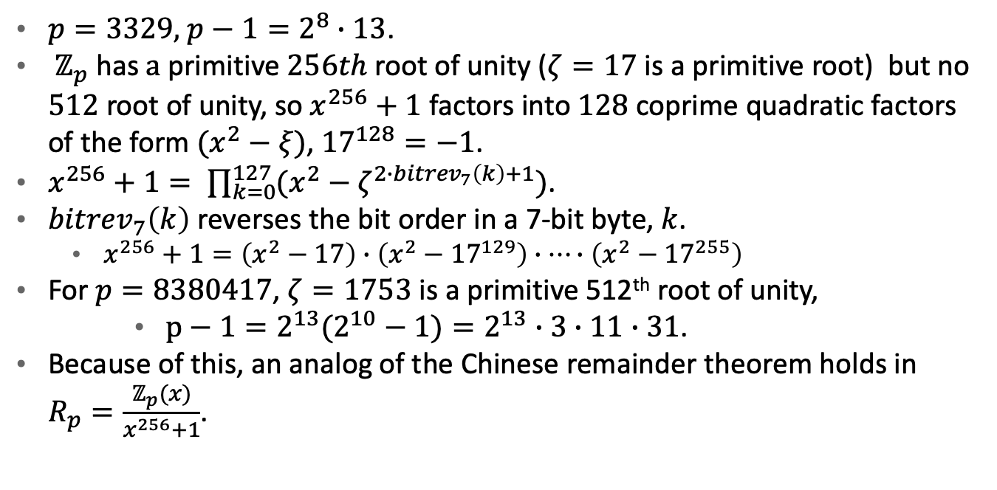
Number Theory Transform (NTT)
$p=3329,$ $p−1=2^{8}∙13$.
$ℤ_{p}$ has $a$primitive $256th$ root of unity ($ζ=17$ is a primitive root) but no $512$ root of unity, so $x^{256}+1$ factors into $128$ coprime quadratic factors of the form $(x^{2}−ξ)$, ${17}^{128}=−1$.
$x^{256}+1= \prod_{k=0}^{127}{(x^{2}−ζ^{2∙{bitrev}_{7}\left(k\right)+1})}$.
${bitrev}_{7}\left(k\right)$ reverses the bit order in a 7-bit byte, $k$.
$x^{256}+1=\left(x^{2}−17\right)∙\left(x^{2}−{17}^{129}\right)∙…∙\left(x^{2}−{17}^{255}\right)$
For $p=8380417$, $ζ=1753$ is a primitive 512th root of unity,
$p−1={2^{13}(2}^{10}−1)=2^{13}∙3∙11∙31$.
Because of this, an analog of the Chinese remainder theorem holds in $R_{p}=\frac{ℤ_{p}(x)}{x^{256}+1}$.

Slide 38
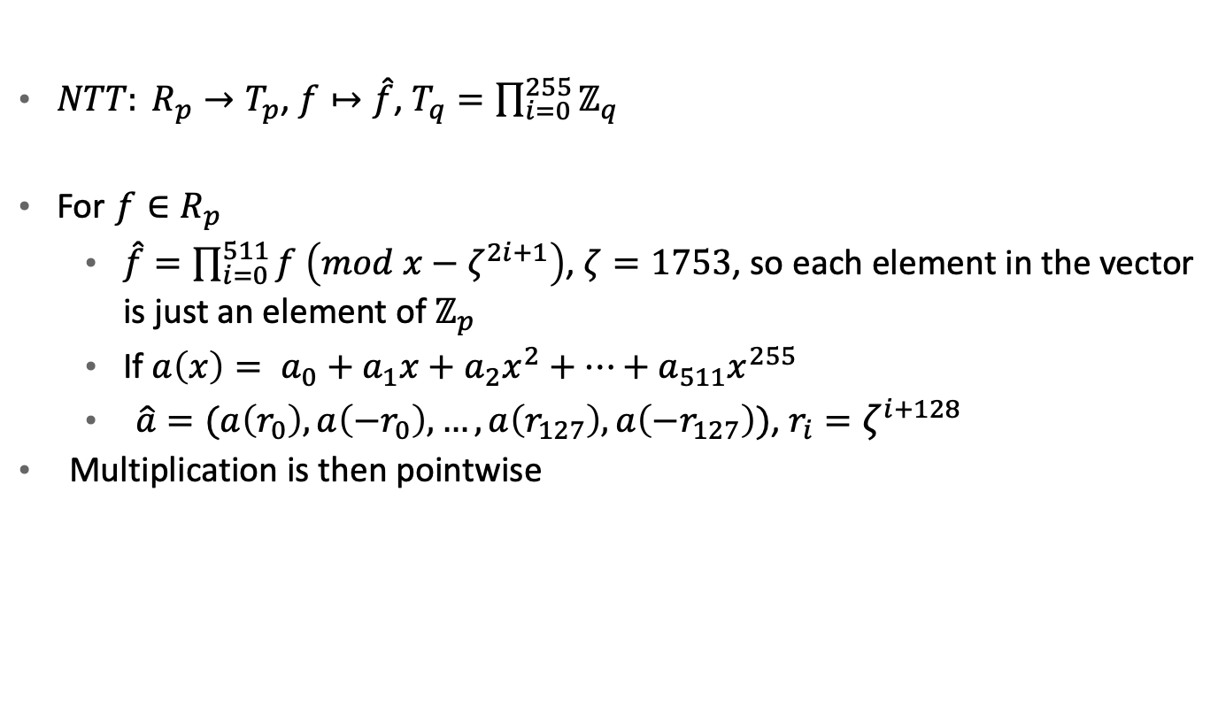
NTT for DIlithium
$NTT: R_{p}→T_{p}$, $f↦\hat{f}$, $T_{q}=\prod_{i=0}^{255}{ℤ_{q}}$
For $f∈R_{p}$
$\hat{f}=\prod_{i=0}^{511}{f \left(mod x−ζ^{2i+1}\right)}$, $ζ=1753$, so each element in the vector is just an element of $ℤ_{p}$
If $a\left(x\right)= a_{0}+a_{1}x+a_{2}x^{2}+…+a_{511}x^{255}$
$\hat{a}=(a\left(r_{0}\right),a\left(−r_{0}\right),…,a\left(r_{127}\right),a\left(−r_{127}\right))$, $r_{i}=ζ^{i+128}$
Multiplication is then pointwise

Slide 39
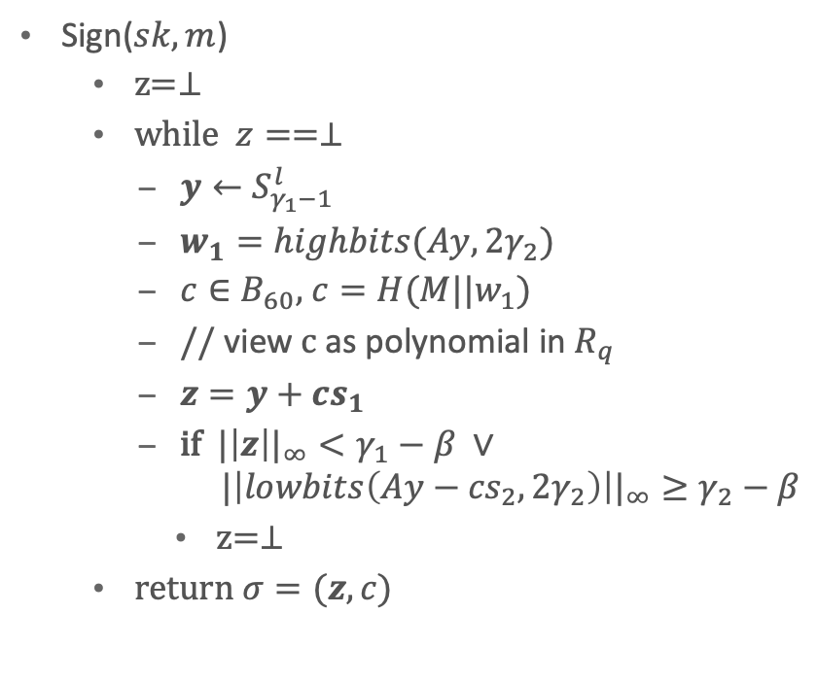
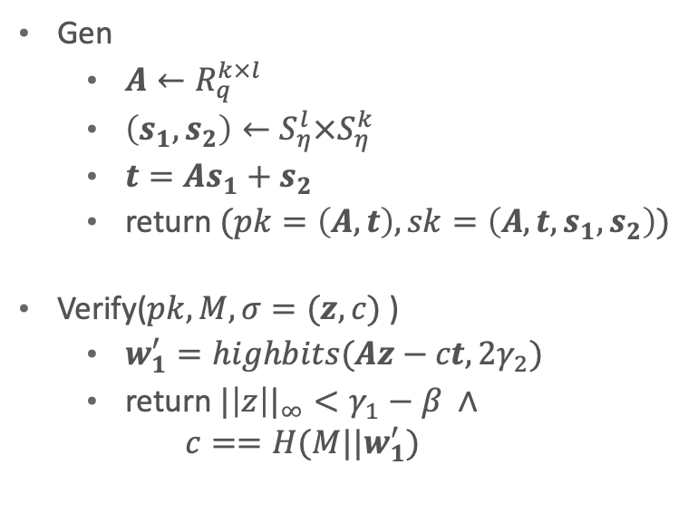

Dilithium template
Gen
$A←R_{q}^{k×l}$
$\left(s_{1}, s_{2}\right)←S_{η}^{l}×S_{η}^{k}$
$t=As_{1}+s_{2}$
return $(pk=\left(A,t\right), sk=\left(A,t,s_{1},s_{2}\right))$
Verify($pk, M, σ=(z,c)$)
$w_{1}^{′}=highbits(Az−ct, 2γ_{2})$
return ${|\left|z\right||}_{∞}<γ_{1}−β ∧$
$$c==H(M||w_{1}^{′})$$
Sign($sk, m$)
z=$⊥$
while $z==⊥$
$y←S_{γ_{1}−1}^{l}$
$w_{1}=highbits(Ay,2γ_{2})$
$c∈B_{60}$, $c=H(M||w_{1})$
// view c as polynomial in $R_{q}$
$z=y+cs_{1}$
if ${|\left|z\right||}_{∞}<γ_{1}−β ∨$
$${|\left|lowbits\left(Ay−{cs}_{2},2γ_{2}\right)\right||}_{∞}≥γ_{2}−β$$
z=$⊥$
return $σ=(z, c)$
For real Dilithium, $k=5, l=4$

Slide 40
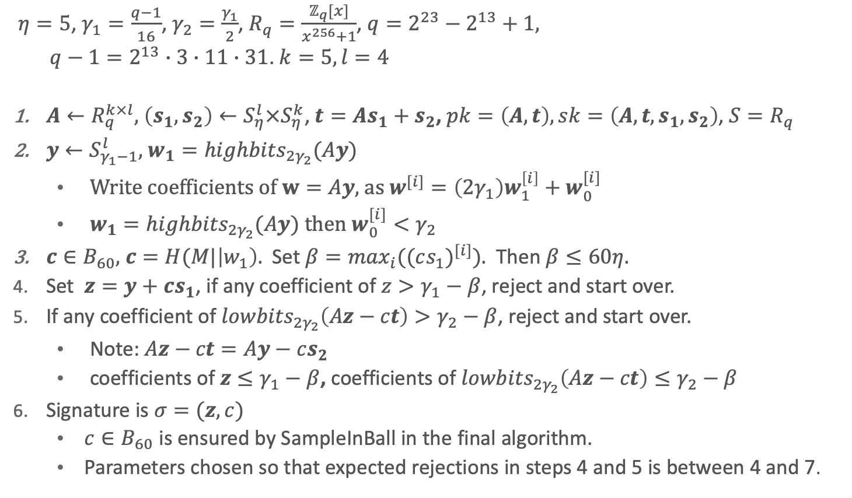
Dilithium security argument -1
$η=5$, $γ_{1}=\frac{q−1}{16}$, $γ_{2}=\frac{γ_{1}}{2}$, $R_{q}=\frac{ℤ_{q}[x]}{x^{256}+1}$, $q=2^{23}−2^{13}+1,$
$q−1=2^{13}∙3∙11∙31$. $k=5,l=4$
$A←R_{q}^{k×l}$, $\left(s_{1}, s_{2}\right)←S_{η}^{l}×S_{η}^{k}$, $t=As_{1}+s_{2}$, $pk=\left(A,t\right), sk=\left(A,t,s_{1},s_{2}\right)$, $S=R_{q}$
$y←S_{γ_{1}−1}^{l}$, $w_{1}={highbits}_{2γ_{2}}(Ay)$
Write coefficients of $w=Ay$, as $w^{[i]}=\left(2γ_{1}\right)w_{1}^{\left[i\right]}+w_{0}^{[i]}$
$w_{1}={highbits}_{2γ_{2}}(Ay)$ then $w_{0}^{[i]}<γ_{2}$
$c∈B_{60}$, $c=H(M|\left|w_{1}\right).$ Set $β=\max_{i}({(cs_{1})}^{[i]})$. Then $β≤60η$.
Set $z=y+cs_{1}$, if any coefficient of $z>γ_{1}−β$, reject and start over.
If any coefficient of ${lowbits}_{2γ_{2}}\left(Az−ct\right)>γ_{2}−β$, reject and start over.
Note: $Az−ct=Ay−cs_{2}$
coefficients of $z≤γ_{1}−β$, coefficients of ${lowbits}_{2γ_{2}}\left(Az−ct\right)≤γ_{2}−β$
Signature is $σ=(z,c)$
$c∈B_{60}$ is ensured by SampleInBall in the final algorithm.
Parameters chosen so that expected rejections in steps 4 and 5 is between 4 and 7.

Slide 41
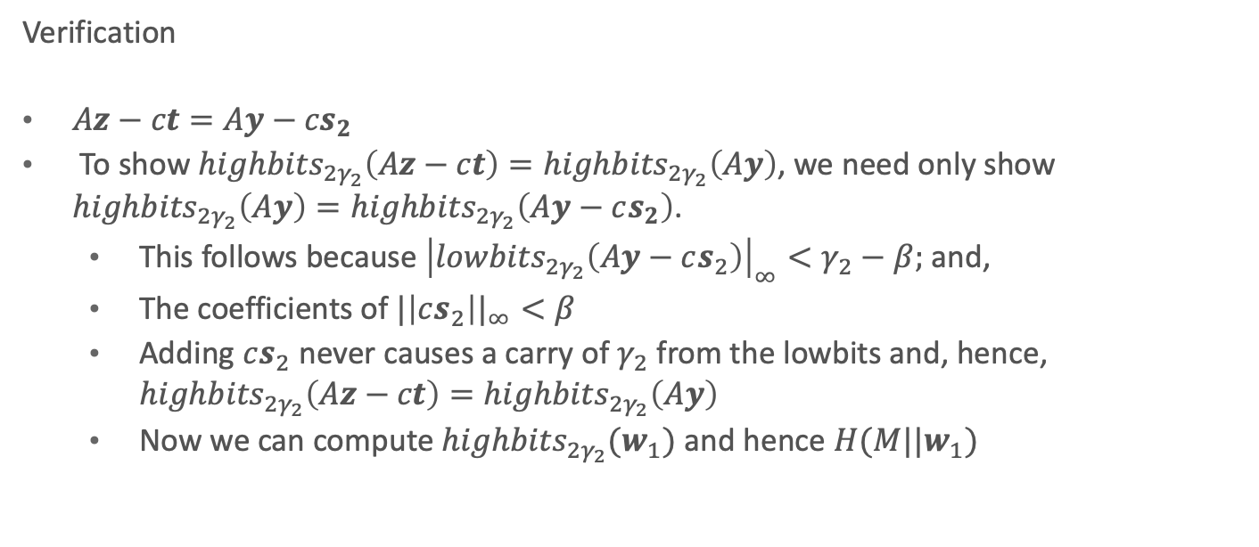
Dilithium security argument - 2
Verification
$Az−ct=Ay−{cs}_{2}$
To show ${highbits}_{2γ_{2}}\left(Az−ct\right)=$ ${highbits}_{2γ_{2}}\left(Ay\right)$, we need only show ${highbits}_{2γ_{2}}\left(Ay\right)={highbits}_{2γ_{2}}\left(Ay−cs_{2}\right)$.
This follows because ${\left|{lowbits}_{2γ_{2}}\left(Ay−cs_{2}\right)\right|}_{∞}<γ_{2}−β;$ and,
The coefficients of ${|\left|cs_{2}\right||}_{∞}<β$
Adding $cs_{2}$ never causes a carry of $γ_{2}$ from the lowbits and, hence, ${highbits}_{2γ_{2}}\left(Az−ct\right)=$ ${highbits}_{2γ_{2}}\left(Ay\right)$
Now we can compute ${highbits}_{2γ_{2}}(w_{1})$ and hence $H(M||w_{1})$

Slide 42
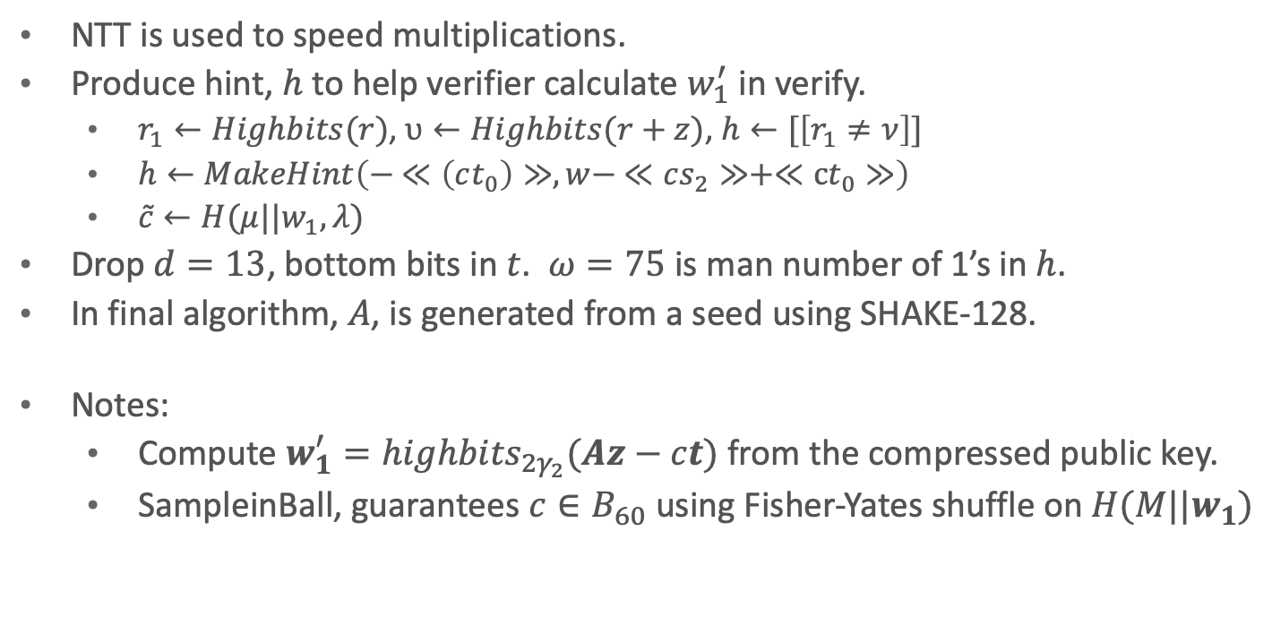
Template → Dilithium
NTT is used to speed multiplications.
Produce hint, $h$ to help verifier calculate $w_{1}^{′}$ in verify.
$r_{1}←Highbits(r)$, $υ←Highbits(r+z)$, $h←[\left[r_{1}≠ν\right]]$
$h←MakeHint\left(− ≪\left(ct_{0}\right)≫,w− ≪cs_{2}≫+≪ct_{0}≫\right)$
$\tilde{c}←H(μ||w_{1}, λ)$
Drop $d=13$, bottom bits in $t$. $ω=75$ is man number of 1’s in $h$.
In final algorithm, $A$, is generated from a seed using SHAKE-128.
Notes:
Compute $w_{1}^{′}={highbits}_{2γ_{2}}(Az−ct)$ from the compressed public key.
SampleinBall, guarantees $c∈B_{60}$ using Fisher-Yates shuffle on $H(M||w_{1})$

Slide 43
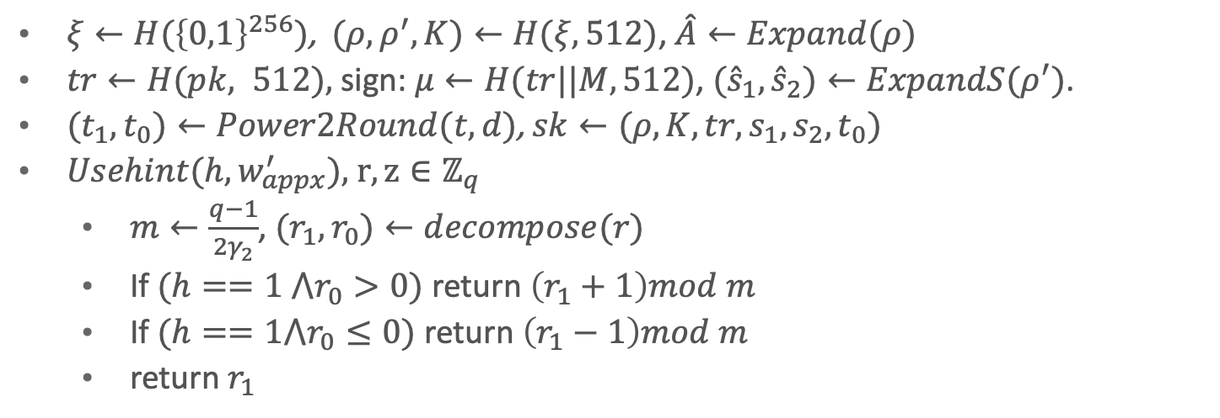
Template → Dilithium
$ξ←H({\left\{0,1\right\}}^{256})$, $(ρ,ρ^{′},K)←H(ξ,512)$, $\hat{A}←Expand(ρ)$
$tr←H(pk, 512),$ sign: $μ←H(tr||M, 512)$, $({\hat{s}}_{1}, {\hat{s}}_{2})←ExpandS(ρ^{′})$.
$(t_{1},t_{0})←Power2Round(t,d)$, $sk←(ρ,K,tr,s_{1},s_{2},t_{0})$
$Usehint(h,w_{appx}^{′}),$ $r,z∈ℤ_{q}$
$m←\frac{q−1}{2γ_{2}}$, $(r_{1},r_{0})←decompose(r)$
If $(h==1 ⋀r_{0}>0)$ return $\left(r_{1}+1\right)mod m$
If $(h==1⋀r_{0}≤0)$ return $\left(r_{1}−1\right)mod m$
return $r_{1}$
Algorithm | Public key | Private key size | Signature size
ML-DSA-87 | 4864 | 2592 | 4595

Slide 44
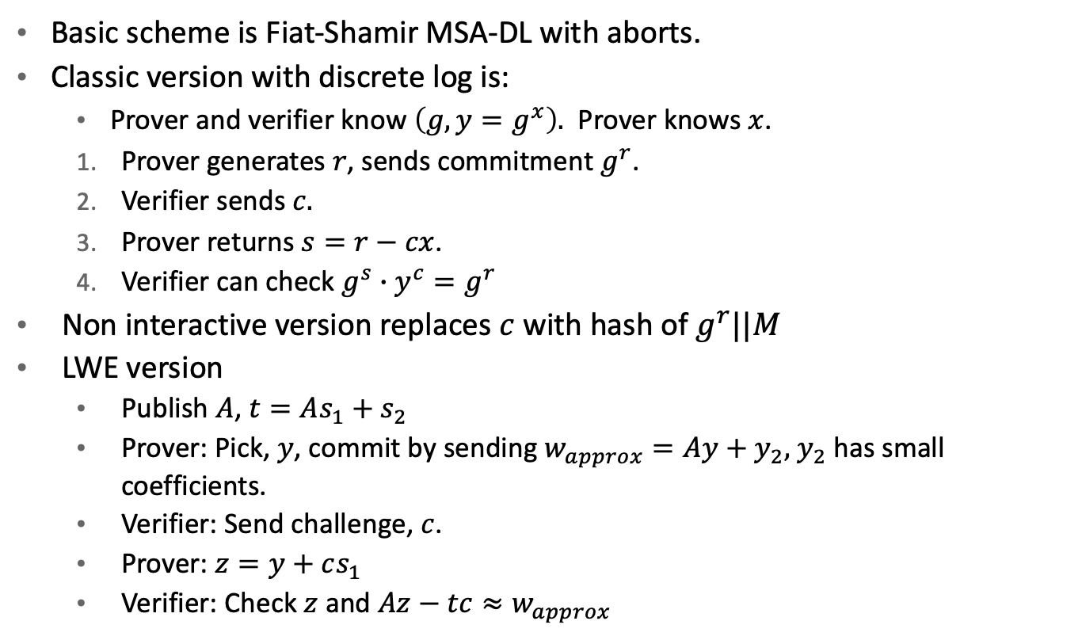
Dilithium, unedited, motivation
Basic scheme is Fiat-Shamir MSA-DL with aborts.
Classic version with discrete log is:
Prover and verifier know $\left(g, y=g^{x}\right).$ Prover knows $x$.
Prover generates $r$, sends commitment $g^{r}$.
Verifier sends $c.$
Prover returns $s=r−cx$.
Verifier can check $g^{s}∙y^{c}=g^{r}$
Non interactive version replaces $c$ with hash of $g^{r}||M$
LWE version
Publish $A$, $t=As_{1}+s_{2}$
Prover: Pick, $y$, commit by sending $w_{approx}=Ay+y_{2},$ $y_{2}$ has small coefficients.
Verifier: Send challenge, $c$.
Prover: $z=y+cs_{1}$
Verifier: Check $z$ and $Az−tc≈w_{approx}$

Slide 45
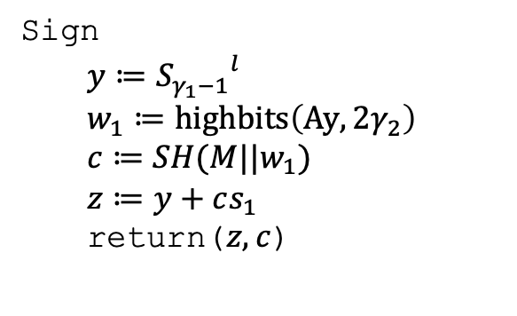
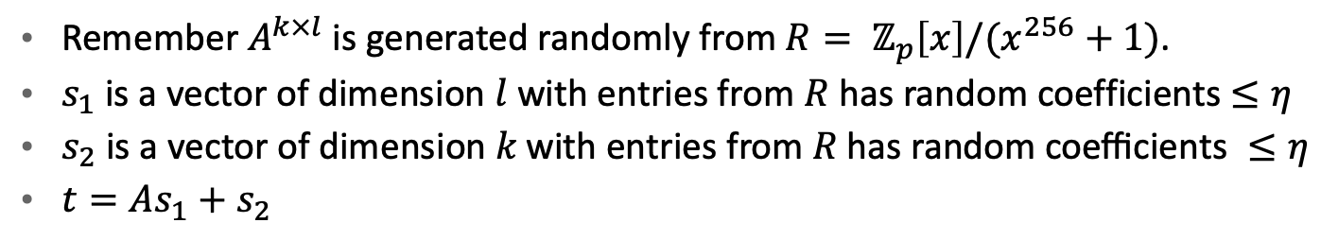
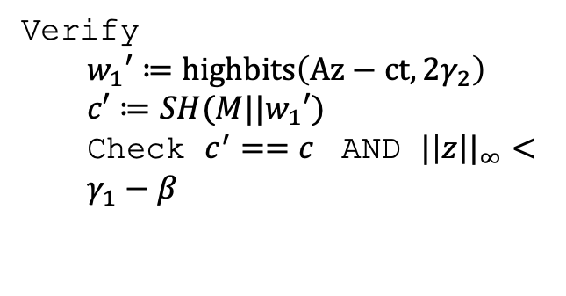
Dilithium (simplified)
Remember $A^{k×l}$ is generated randomly from $R= ℤ_{p}\left[x\right]/(x^{256}+1)$.
$s_{1}$ is a vector of dimension $l$ with entries from $R$ has random coefficients $≤η$
$s_{2} \text{is} \text{a} \text{vector} \text{of} \text{dimension} k \text{with} \text{entries} \text{from} R \text{has} \text{random} \text{coefficients} ≤η$
$t=As_{1}+s_{2}$
Sign
$$y≔{S_{γ_{1}−1}}^{l}$$
$$w_{1}≔highbits\left(Ay, 2γ_{2}\right)$$
$$c≔SH(M||w_{1})$$
$$z≔y+cs_{1}$$
return($z,c$)
Verify
$$w_{1}′≔highbits\left(Az−ct, 2γ_{2}\right)$$
$$c′≔SH(M||w_{1}′)$$
Check $c^{′}==c$ AND ${|\left|z\right||}_{∞}<γ_{1}−β$

Slide 46
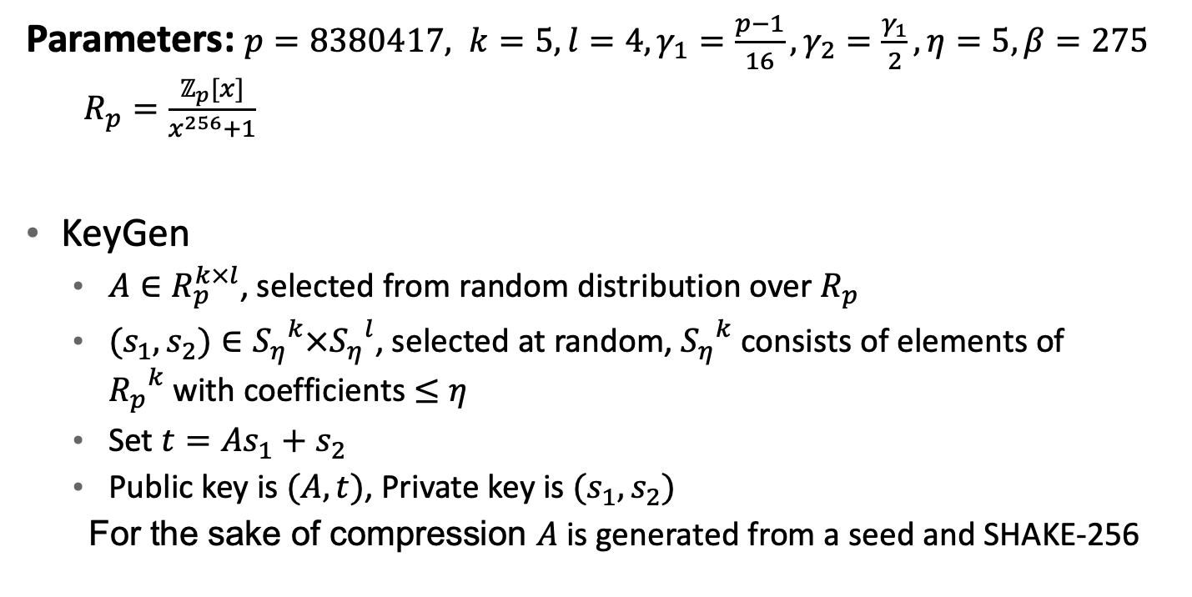
Dilithium (less simplified)
Parameters: $p=8380417, k=5, l=4, γ_{1}=\frac{p−1}{16}, γ_{2}=\frac{γ_{1}}{2}, η=5, β=275$
$R_{p}=\frac{ℤ_{p}[x]}{x^{256}+1}$
KeyGen
$A∈R_{p}^{k×l}$, selected from random distribution over $R_{p}$
$(s_{1}, s_{2})∈{S_{η}}^{k}×{S_{η}}^{l}$, selected at random, ${S_{η}}^{k}$ consists of elements of ${R_{p}}^{k}$with coefficients $≤η$
Set $t=As_{1}+s_{2}$
Public key is $(A, t)$, Private key is $(s_{1}, s_{2})$
For the sake of compression $A$ is generated from a seed and SHAKE-256

Slide 47
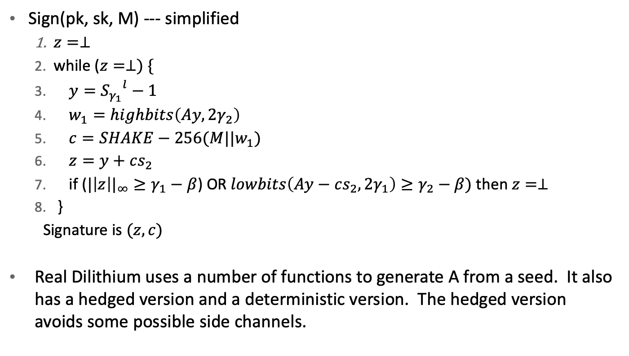
Dilithium
Sign(pk, sk, M) --- simplified
$z=⊥$
while ($z=⊥) \{$
$y={S_{γ_{1}}}^{l}−1$
$w_{1}=highbits\left(Ay, 2γ_{2}\right)$
$c=SHAKE−256(M||w_{1})$
$z=y+cs_{2}$
if (${|\left|z\right||}_{∞}≥γ_{1}−β$) OR $lowbits\left(Ay−cs_{2}, 2γ_{1}\right)≥γ_{2}−β)$ then $z=⊥$
}
Signature is $(z,c)$
Real Dilithium uses a number of functions to generate A from a seed. It also has a hedged version and a deterministic version. The hedged version avoids some possible side channels.

Slide 48
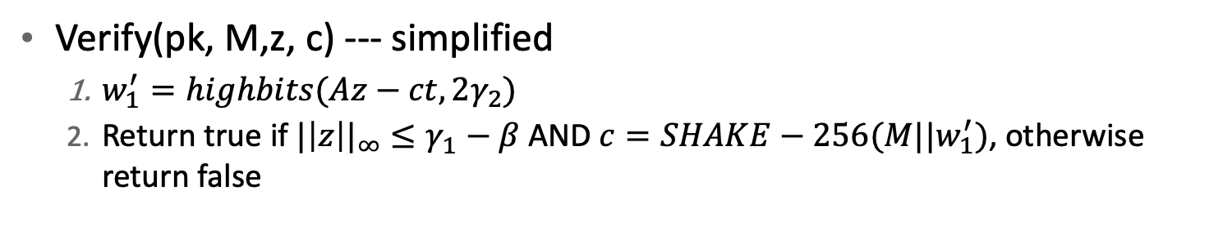
Dilithium
Verify(pk, M,z, c) --- simplified
$w_{1}^{′}=highbits(Az−ct, 2γ_{2})$
Return true if ${|\left|z\right||}_{∞}≤γ_{1}−β$ AND $c=SHAKE−256(M||w_{1}^{′})$, otherwise return false

Slide 49

Useful definitions
u$sehint\left(h,r\right)$
$m= \frac{p−1}{2γ_{2}}$
$\left(r_{1}, r_{0}\right)=decompose\left(r,2γ_{2},p\right)$
If $h==1$ and $r_{0}>0$ then return $\left(r_{1}+1\right)mod(m)$
If $h==1$ and $r_{0}≤0$ then return $\left(r_{1}−1\right)mod\left(m\right)$
return $r_{1}$
$makehint\left(z, r\right)$. // are highbits of $z+r$ different from highbits of $r$
$r_{1}=highbits(r)$
$v_{1}=highbits(r+z)$
return $r_{1}≠v_{1}$

Slide 50

Useful definitions
$RejNTTPoly\left(ρ\right)$ // returns NTT polynomial
$c=0$ ; $j=0$
while ($j<256$)
$\hat{a}\left[j\right]=coeffFromThreeBytes(H_{128}(ρ|\left|c\right),H_{128}(ρ|\left|c+1\right), …,H_{128}(ρ|\left|c+2\right))$
$c+=3$
If ($\hat{a}\left[j\right]≠⊥$) then $j++$
return $\hat{a}$
$RejBoundedPoly\left(ρ\right)$
$c=0$ ; $j=0$
while ($j<256$)
$z=H\left(ρ\right)\left[c\right]$
$z_{0}=CoeffFromHalfByte(z mod\left(16\right),η)$
$z_{1}=CoeffFromHalfByte(⇂z/16⇃,η)$
If ($z_{0}≠⊥$)
$a_{j}=z_{0}$; $j++$
If ($z_{1}≠⊥$ and $j<256$)
$a_{j}=z_{1}$; $j++$
$c++$
return $a$

Slide 51

Useful definitions
$ExpandA\left(ρ\right)$
$for \left(r=0;r<k;k++\right)$
$$for (s=0;s<l$$
$$\hat{A}\left[r,s\right]=RejNTTPoly(ρ\left|\left|IntegerToBits\left(s, 8\right)\right|\right|INtegerToBits\left(r,8\right))$$
$$return \hat{A}$$
$ExpandS\left(ρ\right)$
$for$ (r=0; r<l; r++)
$s_{1}\left[r\right]=RejBoundedPoly(ρ||IntegerToBits\left(r,16\right))$
$for\text{ (}\text{r}\text{=0; }\text{r}\text{<}\text{k}\text{; }\text{r}\text{++)}$
$s_{2}\left[r\right]=RejBoundedPoly(ρ||IntegerToBits\left(r+l16\right))$
$return (s_{1}, s_{2})$
$ExpandMask\left(ρ,μ\right)$
$c=1+bitlen(γ_{1}−1)$
$for\left(r=0;r<l;r++\right)$
$n=IntegerToBits(μ+r,16)$
$ν=(H(ρ|\left|n\right)\left[32rc\right],H(ρ|\left|n\right)\left[32rc+1\right]$,…, $H(ρ|\left|n\right)\left[32rc+32c−1\right]$)
$s\left[r\right]=BitUnpack(υ,γ_{1}−1,γ_{1})$
return s

Slide 52

Useful definitions
// Calculate c(x), coefficients are 1, -1 or 0
$SampleinBall\left(ρ, τ\right)$
$c\left(x\right)≔0$; k=8;
$for\left(i=256−τ;i<256;i++\right)$
$while(H\left(ρ\right)[\left[k]\right]>i)$ // $H\left(ρ\right)[\left[k]\right]$ is $k$th byte
k++
$$j=H\left(ρ\right)\left[k\right]$$
$$c_{i}=c_{j}$$
$c_{j}={(−1)}^{H\left(ρ\right)[i+τ−256]}$ // [k] is bit position k
$$k++$$
return c
SampleInBall generates an element of $B_{60 }$pseudorandomly; it is based on the Fisher-Yates shuffe. The first 8 bytes of H(ρ) choose the signs of the nonzero entries of c; subsequent bytes choose the positions of those nonzero entries
Here $H$ is SHAKE256 used as an XOF.

Slide 53

NTT for Dilithium
$NTT(w)$ --- outputs $\hat{w_{j}}=(w\left(ζ_{0}\right),w\left({−ζ}_{0}\right),w\left(ζ_{1}\right),w\left({−ζ}_{1}\right),…,w\left({−ζ}_{127}\right))$
$for\left(j=0;j<256;j++\right)$ $\hat{w}\left[j\right]=w[j]$
$k=0;len=128$
$while\left(len≥1\right)$
$start=0$
while ($start<256)$
$k++$
$zeta= ζ^{bitrev(k)} mod\left(q\right)$
for($j=start;j≤start+len−1)$
$t=zeta∙\hat{w}[j+len]$
$\hat{w}\left[j+len\right]= \hat{w}\left[j\right]−t$
$\hat{w}\left[j\right]= \hat{w}\left[j\right]+t$
$start+=2∙len$
$len=len/2$

Slide 54

NTT for Dilithium
${NTT}^{−1}(\hat{w})$
$for\left(j=0;j<256;j++\right)$ $w\left[j\right]=\hat{w}\left[j\right]$
$k=256;len=1$
$while\left(len<256\right)$
$start=0$
while ($start<256)$
$k−−$
$zeta= ζ^{bitrev(k)} mod\left(q\right)$
for($j=start;j≤start+len−1)$
$t=w\left[j\right]$
$w\left[j\right]=t+w\left[j+len\right]$
$w\left[j+len\right]=t−w\left[j+len\right]$
$w\left[j+len\right]=zeta∙w\left[j+len\right]$
$start+=2∙len$
$len=len/2$
$f=8347861$
$for\left(j=0;j<256;j++\right)$ $w\left[j\right]=f∙w[j]$

Slide 55

Dilithium, unedited, motivation
Preliminary lattice version is prover generates: $A∈{ℤ_{q}}^{k×l},$ $S_{1}∈{ℤ_{q}}^{l×n},$ $S_{2}∈{ℤ_{q}}^{k×n},$ with short coefficients and computes $t=AS_{1}+S_{2}$. Public key is $(A, t)$. Private key is $(S_{1},S_{2})$
Prover generates $y∈ {ℤ_{q}}^{l}$ with “small coefficients”. Sends commitment as $Ay$
Verifiers sends challenge $c∈{ℤ_{q}}^{n}$ with small coefficients
Prover returns $z=y+S_{1}c$.
Verifier checks coefficients of $z$ are small and that $Az−tc≈Ay$
To avoid having $z$ leak $S_{1}$, signer applies rejection sampling to $z$.
Dilithium
Uses elements of $R_{q}=\frac{ℤ_{q}\left[x\right]}{x^{256}+1}$ rather than $ℤ_{q}.$
Uses a seed, $ρ,$ to generate $A$, compresses t by dropping low order bits.
Signs a message representative, $μ$, which is a hash of the public key and the message
Uses a rounded version of $w=Ay$, $w_{1}$.
Provides a hint, $h$, to help reconstruct $w_{1}$ from $z$

Slide 56

Dilithium parameters for security category 5
Parameter | Meaning | Value
$$q$$ | modulus | 8380417
$$d$$ | # dropped bits from t | 13
$$τ$$ | # $±1$s in $c(x)$ | 60
$$λ$$ | Collision strength | 256
$$γ_{1}$$ | Coefficient range of $y$ | $$2^{19}$$
$$γ_{2}$$ | Low order rounding range | $$\frac{q−1}{32}$$
$$(k,l)$$ | Dimensions of $A$ | $$(8,7)$$
$$η$$ | Private key range | 2
$$β=τ∙η$$ |  | 120
$$ω$$ | Max # of 1’s in hint | 75

Slide 57

Dilithium, Keygen
Keygen
$ξ ≔ {ℤ_{2}}^{256}$ (random)
$\left(ρ,ρ^{′},K\right)≔H\left(ξ, 1024\right)$, (256, 512, 256) bits respectively
$\hat{A}≔ExpandA(ρ)$
$\left(s_{1}, s_{2}\right)≔ExpandS\left(ρ^{′}\right)$
$t ≔ {NTT}^{−1}\left(\hat{A} NTT\left(s_{1}\right)\right)+ s_{2}$
$\left(t_{1}, t_{0}\right)≔Power2Round\left(t,d\right)$
$pk ≔ pkEncode(ρ, t_{1})$
$tr ≔H\left(BytesToBits\left(pk\right), 512\right)$
$sk ≔skEncode\left(ρ,K,tr,s_{1},s_{2},t_{0}\right)$
return $(pk, sk)$

Slide 58

Dilithium, Sign
$\left(ρ,K,tr,s_{1},s_{2},t_{0}\right)≔skdecode\left(sk\right)$
$\hat{s_{1}}≔NTT(s_{1})$, $\hat{s_{2}}≔NTT(s_{2})$, $\hat{s_{1}}≔NTT\left(t_{0}\right)$; $\hat{A}≔ExpandA(ρ)$
$μ ≔H(tr||M, 512)$; $rnd ≔ {ℤ_{2}}^{256}$
$ρ^{′}≔H\left(K\left|\left|rnd\right|\right|μ, 512\right)$
$κ=0$
while(1) {
$y=ExpandMask(ρ^{′},κ)$
$w ≔ {NTT}^{−1}\left(\hat{A }NTT\left(y\right)\right)$, $w_{1} ≔highbits(w, 2γ_{2})$
$\tilde{c} ≔H(μ||w1Encode\left(w_{1}\right), 2λ)$
$\left({\hat{c}}_{1},{\hat{c}}_{2}\right)≔$first 256 and last $256−2λ$ bits
$c ≔SampleBall({\hat{c}}_{1})$; $\hat{c}=NTT(c)$
$cs_{1}≔ {NTT}^{−1}(\hat{c} {\hat{s}}_{1})$; $cs_{2}≔ {NTT}^{−1}(\hat{c}{\hat{s }}_{2})$;
$z ≔y+cs_{1}$
$r_{0}≔lowbits(w−cs_{2}$)
If (${|\left|z\right||}_{∞}≥γ_{1}−β$ or ${|\left|r_{0}\right||}_{∞}≥γ_{2}−β$ then continue
$ct_{0}≔ {NTT}^{−1}(\tilde{c}t_{0})$; $h≔makehint\left(−ct_{0},w−cs_{2}+ct_{0}\right)$
If $({\left|\left|ct_{0}\right|\right|}_{∞}<γ_{2}$and # 1’s in $h≤ω)$ then break
$κ+=l$ }
$σ≔sigEncode(\tilde{c}, z {mod}^{±}\left(q\right), h)$

Slide 59

Dilithium, Verify
Verify
$\left(ρ, t_{1}\right)≔pkdecode\left(pk\right)$
$(\tilde{c}, z,h) ≔sigdecode(σ)$
$\hat{A}≔ExpandA(ρ)$
$tr ≔H\left(BytestoBits\left(pk\right), 512\right)$
$μ ≔H(tr||M, 512)$
$\left({\tilde{c}}_{1},{\tilde{c}}_{2}\right)≔$ first 256 and last $256−2λ$ bits
$c ≔SampleBall({\tilde{c}}_{1})$
$w_{appx}^{′} ≔ {NTT}^{−1}(\tilde{A}∙NTT\left(z\right)−NTT\left(c\right)NTT\left(t_{1}2^{d}\right))$
$w_{1}^{′}≔usehint(h,w_{appx}^{′}$) // $w_{approx}=(Az−ct_{1})∙2^{d}$
$\tilde{c}′ ≔H(μ||w1Encode\left(w_{1}^{′}, 2λ\right))$
return ${|\left|z\right||}_{∞}<γ_{1}−β$ and $\tilde{c}==\tilde{c}′$ and # 1’s in $h ≤ω$

Slide 60

Kyber
Kyber is a key encapsulation algorithm that uses a public key encryption algorithm similar to Dilithium in conjunction with an encapsulation mechanism (Fujisaki-Okamoto transform) which converts a conditionally secure encryption into a CCA safe encapsulation. Here are some definitions.
${PRF}_{η }\left(s,b\right)=shake256(s||b, 64∙η)$
$XOF\left(ρ,i,j\right)=shake128\left(ρ\left|\left|i\right|\right|j\right)$
$H\left(s\right)={sha3}_{256}(s)$, $J\left(s\right)={shake256}_{32}(s)$
$G\left(s\right)={sha3}_{512}(s)$
$NTT$ and ${NTT}^{−1}$ are different for Kyber and Dilithium
Fujisaki-Okamoto transform:
$ℰ_{pk}^{hy}\left(m\right)= ℰ_{pk}^{asym}\left(σ,H(σ,m)\right)||ℰ_{G(σ)}^{sym}(m)$
$σ$ is random string, $G,H$ are hash functions, $ℰ_{G(σ)}^{sym}$ is symmetric encryption with key $G(σ)$ and $ℰ_{pk}^{asym}$ is original asymmetric encryption algorithm.

Slide 61

Useful definitions
Parse: $ℬ^{∗}→R_{q}^{n}$
Input: $B=b_{0}, b_{1}, …∈ℬ^{∗}$
Output: $\hat{a}∈R_{q}^{n},$
$$i=0;j=0;$$
while $j<i$
$$d= b_{i}+256∙b_{i+1}$$
if $d<19q$
$$\hat{a_{j}}=d$$
$$j++$$
$$i+=2$$
return ${\hat{a}}_{0}+{\hat{a}}_{1}x+…+{\hat{a}}_{n−1}x^{n−1}$

Slide 62

Useful definitions
$SamplePolyCBD\left(B, η\right))$ --- samples from (Central Binomial) distribution $D_{η}(R_{q})$
Output: $f∈R_{q}^{256}$
$$b ≔ByteToBits\left(B\right)$$
$$for\left(i=0;i<256;i++\right)$$
$x=\sum_{j=0}^{η−1}{b[2iη+j]}$; $y=\sum_{j=0}^{η−1}{b[2iη+η+j]}$
$$f\left[i\right]≔\left(x−y\right) mod(q)$$
return $f$
$Sample\left(a_{1}, a_{2},…, a_{η}, b_{1}, …,b_{η}\right)←{\{0,1\}}^{2η}$, output $\sum_{i=1}^{η}{(a_{i}−b_{i})}$
For central binomial distribution with $N=10000, p=\frac{1}{2}, σ=\sqrt{Np(1−p)}$,
$P\left(4900≤n_{1}≤5100\right)= \sum_{j=4900}^{5100}{\left(\begin{matrix}N \\ j\end{matrix}\right) p^{j}{(1−p)}^{N−j}≈Φ(\frac{5100−5000}{50})}−Φ(\frac{5100−5000}{50})$,
$Φ$ is CDF for normal distribution

Slide 63

Useful definitions
${encode}_{d}\left(x\right)$, $x$is an array of length 256, $m=2^{d}$, $1≤d≤12$
for (i = 0; i < 256; i++)
$a=x[i$]
for (j=0; j < d; j++)
$b\left[d∙i+j\right]=a (mod 2)$
$a= \frac{a−b\left[d∙i+j\right]}{2}$
return bits-to-bytes(b)
${decode}_{d}(x)$, $x$ is a byte array of length $32d,$ $m=2^{d}$, $1≤d≤12$
$b=bytes−to−bits(x)$
for (i=0; i < 256; i++)
$out\left[i\right]= \sum_{j=0}^{d−1}{b[i∙d+j]∙2^{j}}$
return $out$

Slide 64

Useful definitions
$SampleNTT()$ --- samples uniformly from $T_{q}$
$$i ≔0;j ≔0$$
$$while \left(j<256\right)$$
$$d_{1}=b\left[i\right]+256(b\left[i+1\right]mod(16)$$
$$d_{2}=b\left[i+1\right]/16+16(b\left[i+2\right]$$
If ($d_{1}<q)$
$\hat{a}\left[j\right]=d_{1}$ ; $j++$
If ($d_{2}<q$ and $j<256$
$\hat{a}\left[j\right]=d_{2}$ ; $j++$
$$i+=3$$
return $\hat{a}$

Slide 65

Useful definitions
${compress}_{q}\left(x,d\right)$
$x→↾\frac{2^{d}}{q}∙x⇃$
${decompress}_{q}\left(y,d\right)$
$$y→↾\frac{q}{2^{d}}∙y⇃$$
${compress}_{q}\left({decompress}_{q}\left(x,d\right),d\right)=x$
${decompress}_{q}\left({compress}_{q}\left(y,d\right),d\right)=t$, $\left(t−y\right){mod}^{±}\left(q\right)≤↾\frac{q}{2^{d+1}}⇃$

Slide 66

NTT for Kyber
Note $x^{256}+1= \prod_{k=0}^{127}{(x^{2}−ζ^{2∙{bitrev}_{7}\left(k\right)+1})}$. This allows us to decompose an element in $R_{p}$ into 127 coprime quadratics and recreate it using the Chinese Remainder Theorem. $ζ=17.$
$NTT: R_{p}→T_{p}$, $f↦\hat{f}$
For $f∈R_{p}$
$\hat{f}=(\prod_{i=0}^{127}{f \left(mod x^{2}−ζ^{2{rev}_{7}\left(i\right)+1}\right)}$
$\hat{g}=({\hat{g}}_{0,0}+{\hat{g}}_{01}x,{\hat{g}}_{1,0}+{\hat{g}}_{11}x, …,{\hat{g}}_{127,0}+{\hat{g}}_{127,1}x)$
$NTT\left(g\right)=\hat{g}=({\hat{g}}_{0,0}, {\hat{g}}_{01} ,{\hat{g}}_{1,0}, {\hat{g}}_{11}, …,{\hat{g}}_{127,0}, {\hat{g}}_{127,1})$
Operations are performed element-wise
For $\hat{h}=\hat{f}∙\hat{g}$,
${\hat{h}}_{2i}+{\hat{h}}_{2i+1}x=({\hat{f}}_{2i}+{\hat{f}}_{2i+1}x)∙\left({\hat{g}}_{2i}+{\hat{g}}_{2i+1}x\right)(mod x^{2}−ζ^{2{rev}_{7}\left(i\right)+1})$

Slide 67

NTT for Kyber
$NTT\left(f\right)$
$\hat{f}=f$; $k=1$
for($len=128;len≥2;len=len/2$)
for($start=128;start<256;start+=2len$)
$zeta=ζ^{bitrev(k)} mod(q)$; $k++$
for($j=start;j<start+len;j++$)
$t=zeta∙\hat{f}\left[j+len\right] mod(q)$
$\hat{f}\left[j+len\right]=\hat{f}\left[j\right]−t mod(q)$
$\hat{f}\left[j\right]=\hat{f}\left[j\right]+t mod(q)$
return($\hat{f}$)

Slide 68

NTT for Kyber
${NTT}^{−1}\left(\hat{f}\right)$
$f=\hat{f}$; $k=127$
for($len=2;len≤128≤;len=2∙len$)
for($start=0;start<256;start+=2len$)
$zeta=ζ^{bitrev(k)} mod(q)$; $k−=1$
for($j=start;j<start+len;j++$)
$t=f[j] mod(q)$
$f\left[j\right]=f\left[j\right]+f\left[j+len\right] mod(q)$
$f\left[j+len\right]=zeta∙(f\left[j+len\right]−t) mod(q)$
return($f∙3303 mod(q)$)

Slide 69

NTT for Kyber
$MultiplyNTT\left(\hat{f},\hat{g}\right)$
For($i=0;i<128;i++)$
$({\hat{h}}_{2i}, {\hat{h}}_{2i+1})←Basecasemultiply({\hat{f}}_{2i}, {\hat{f}}_{2i+1},{\hat{g}}_{2i}, {\hat{g}}_{2i+1}, ζ^{2∙bitrev\left(i\right)+1})$
Basecasemultiply$(a_{0},a_{1},b_{0},b_{1},γ)$
$c_{0}←a_{0}∙b_{0}+a_{1}∙b_{1}∙γ$
$c_{1}←a_{0}∙b_{1}+a_{1}∙b_{0}$
return $(c_{0}, c_{1})$

Slide 70

Kyber (simplified a little)
Parameters: $(p=3329, R_{p}=\frac{ℤ_{p}\left[x\right]}{x^{256}+1}, k=4, η_{1}=η_{2}=2)$, $\hat{x}=NTT(x)$
${KeyGen}_{PKE}$ generates a Dilithium-like key (see full version)
$\hat{t}=\hat{A}\hat{s}+\hat{e}$, $A$ is generated from seed $ρ$. $A∈R_{p}^{k×k}$, $s,e∈R_{p}^{k}$
${Enc}_{PKE}(pk,m,r)$ // encrypt $m$
$r={Sample}_{η_{1}}({PRF}_{η_{1}}\left(r,N\right))$, $e_{1}={Sample}_{η_{2}}({PRF}_{η_{2}}\left(r,N\right))$, $e_{2}={Sample}_{η_{2}}({PRF}_{η_{2}}\left(r,N\right))$
$u=A^{T}r+e_{1}$
$υ= (t^{T}∙r)+e_{2}+↱\frac{q}{2}↲∙m$
$c_{1}= {compress}_{p}\left(u,d_{u}\right))$, $c_{2}={compress}_{p}\left(υ,d_{v}\right)$
return $(c_{1},c_{2})$
${Dec}_{PKE}(c_{1}, c_{2})$ // recover $m$
$u={decompress}_{p}(c_{1},d_{u})$, $ν={decompress}_{p}(c_{2},d_{v})$
$w=υ−s^{T}∙u$ ; return ${compress}_{p}\left(w, 1\right)$
$compress$ removes the errors

Slide 71

Correctness
$t={decompress}_{p}\left({compress}_{p}\left(As+e, d_{u}\right), d_{u}\right)=As+e+c_{t}$
$u={decompress}_{p}\left({compress}_{p}\left(A^{T}r+e_{1}, d_{u}\right), d_{u}\right)=Ar+e_{1}+c_{u}$
$υ={decompress}_{p}\left({compress}_{p}\left(t^{T}∙r+e_{2}+↱\frac{q}{2}↲∙m, d_{v}\right), d_{v}\right)=$
${ (As+e) }^{T}∙r+$ $e_{2}+↱\frac{q}{2}↲∙m+c_{ν}+c_{t}^{T}∙r$
${|(As+e) }^{T}∙r+e_{2}+c_{ν}+c_{t}^{T}∙r−s^{T}∙e_{1}−s^{T}∙c_{u}|<↱\frac{q}{4}↲$
$ν−s^{T}∙u=w+m∙↱\frac{q}{2}↲$, ${|\left|w\right||}_{∞}<↱\frac{q}{4}↲$
So, if $m^{′}={compress}_{q}(ν−s^{T}∙u,1)$,
${\left|w+↱\frac{q}{2}↲∙m−↱\frac{q}{2}↲∙m^{′}\right|}_{∞}≤↱\frac{q}{4}↲$, hence
${||↱\frac{q}{2}↲∙\text{(}m\text{−}m^{′}) \text{||}}_{∞}<2∙↱\frac{q}{4}↲$ and so $m=m^{′}$

Slide 72

Kyber simplified a little
$KEMKeygen$
$z= ℤ_{2}^{256}$(random)
$\left({ek}_{PKE},{dk}_{PKE}\right)={KeyGen}_{PKE}$()
${ek}_{KEM}={ek}_{PKE}$; ${dk}_{KEM}={dk}_{PKE}\left|\left|e_{PKE}\right|\right|H\left(e_{PKE}\right)||z)$
return $({ek}_{KEM},{dk}_{KEM}$)
$KEMencaps({pk}_{KEM})$
$m$ is a random 32-byte value
$\left(K, r\right)={SHA3}_{512}(m||H\left(e_{PKE}\right))$
$c={Enc}_{PKE} (ek, m, r)$
return $(K, c)$
$KEMdecaps({sk}_{KEM})$
$m^{′}={Dec}_{PKE}\left(dk, c\right)$
$\left(K^{′}, r^{′}\right)= {SHA3}_{512}(m^{′}||H\left(e_{PKE}\right))$
$\overline{K}=SHAKE256 (z||c, 32)$
$c^{′}={Enc}_{PKE}(e_{PKE},m^{′},r^{′})$
If ($c==c′$) return K$′$ else error

Slide 73

Kyber parameters
Alg | $$n$$ | $$q$$ | $$k$$ | $$η_{1}$$ | $$η_{2}$$ | $$d_{u}$$ | $$d_{v}$$ | Strength
KEM-512 | 256 | 3329 | 2 | 3 | 2 | 10 | 768 | 128
KEM-768 | 256 | 3329 | 3 | 2 | 2 | 10 | 1088 | 192
KEM-1024 | 256 | 3329 | 4 | 2 | 2 | 11 | 1568 | 256
ML-KEM-1024 is security category 5
Type | Encap-key | Decap-key | Ciphertext | Key
KEM-512 | 800 | 1632 | 768 | 32
KEM-768 | 1184 | 2400 | 1088 | 32
KEM-1024 | 1568 | 3168 | 1568 | 32
Size in bytes

Slide 74

Full Kyber
${KeyGen}_{PKE}$
$d={ℤ_{2}}^{256}$, random
$\left(ρ, σ\right)=G\left(d\right)$; $N=0$
$for\left(i=0;i<k;i++\right)$
$for \left(j=0;j<k;j++\right)$
$\hat{A}\left[i,j\right]=SampleNTT(XOF(ρ,i,j)$
$for\left(i=0;i<k;i++\right)$
$s\left[i\right]=SamplePolyCBD\left({PRF}_{η_{1}}\left(σ,N\right)\right);N++$
$for\left(i=0;i<k;i++\right)$
$e\left[i\right]= SamplePolyCDB\left({PRF}_{η_{1}}\left(σ,N\right)\right);N++$
$\hat{s}=NTT(s)$; $\hat{e}=NTT(e)$
$\hat{t}=\hat{A}\hat{s}+\hat{e}$
${ek}_{PKE}={ByteEncode}_{12}\left(\hat{t}\right)||ρ$; ${dk}_{PKE}={ByteEncode}_{12}\left(\hat{s}\right)$
return $(e_{PKE},d_{PKE})$

Slide 75

Full Kyber
${Enc}_{PKE}(ek, m,r)$ // $r$is randomness, $\left(u,ν\right)=(A^{T}r+e_{1}, t^{T}∙r+e_{2})$,
// $μ$ added to term 2, $ek$ is $384k+32$ bytes, $m$ and $r$ are 32 bytes.
$N=0;$ $\hat{t}={ByteDecode}_{12}\left({ek}_{PKE}\left[0:384k\right]\right)$; $ρ= {ek}_{PKE}[384k+384k+32]$
$$for\left(i=0;i<k;i++\right)$$
$$for \left(j=0;j<k;j++\right)$$
$$\hat{A}\left[i,j\right]=SampleNTT(XOF(ρ,i,j)$$
$$for\left(i=0;i<k;i++\right)$$
$$r\left[i\right]={SamplePolyCBD}_{η_{1}}\left({PRF}_{η_{2}}\left(r,N\right)\right);N++$$
$$for\left(i=0;i<k;i++\right)$$
$$e_{1}\left[i\right]={SamplePolyCBD}_{η_{2}}\left({PRF}_{η_{2}}\left(r,N\right)\right);N++$$
$$e_{2}={SamplePolyCBD}_{η_{2}}\left({PRF}_{η_{2}}\left(r,N\right)\right)$$
$$\hat{r}=NTT\left(r\right)$$
$$u\left(x\right)={NTT}^{−1}\left({\hat{A}}^{T}\hat{r}\right)+e_{1}$$
$μ={decompress}_{1}({decode}_{1}\left(m\right))$, $υ={NTT}^{−1}({\hat{t}}^{T}∙\hat{r})+e_{2}+μ$
${ c}_{1}={encode}_{d_{u}}({compress}_{d_{u}}\left(u\right))$, $c_{2}={encode}_{d_{v}}\left({compress}_{d_{v}}\left(r\right)\right)$
return $(c_{1}, c_{2})$

Slide 76

Full Kyber
${Dec}_{PKE}\left({dk, c}_{1}, c_{2}\right)$ // $dk$ is $384k$ bytes, $(c_{1},c_{2})$ are $384d_{u}+d_{v}$ bytes.
$c_{1}=c[0:32d_{u}k]$; $c_{2}=c[32{(d}_{u}k+d_{v})]$
$u={decompress}_{d_{u}}\left({ByteDecode}_{d_{u}}\left(c_{1}\right)\right)$
$υ={decompress}_{d_{v}}\left({ByteDecode}_{d_{v}}\left(c_{2}\right)\right)$
$\hat{s}={ByteDecode}_{12}(d_{PKE})$
$w=υ−{NTT}^{−1}({\hat{s}}^{T}∙NTT\left(u\right))$
$m= {ByteEncode}_{1}({compress}_{1}(w))$
return $m$ // $32$ bytes

Slide 77

Full Kyber
${Keygen}_{KEM}$()
$z= {ℤ_{2}}^{256}\text{ (}\text{random}\text{)}$
$\left({ek}_{PKE},{dk}_{PKE}\right)={KeyGen}_{PKE}\text{()}$
${ek}_{KEM}={ek}_{PKE}\text{; }{dk}_{KEM}={dk}_{PKE}\left||{ek}_{PKE}|\right|H\left({ek}_{PKE}\right)||z)$
$\text{return} ({ek}_{KEM},{dk}_{KEM}\text{)}$
$\hat{t}=\hat{A}\hat{s}+\hat{e}$, $A$ is generated from seed $ρ$
return $\left({ek}_{PKE},{dk}_{PKE}\right)$ // ${ek}_{PKE}$ is $384k+32$ bytes, ${dk}_{PKE}$ is $384k+96$ bytes.

Slide 78

Full Kyber
$KEMencaps({ek}_{KEM})$. // ${ek}_{KEM}$ is $384k+32$ bytes
$m←Rand(32)$ // 32-byte
$\left(K, r\right)=G(m||H\left(ek\right))$ // $K$ is shared key, $r$ is random input to Encaps
$c={Enc}_{PKE} (ek, m, r)$
return $\left(K, c\right)$ // $K$ is $32$ bytes

Slide 79

Full Kyber
$KEMdecaps(c,dk)$ // $c$ is ${32(d}_{u}k+d_{v})$ bytes, $dk$ is $768k+96$ bytes.
${dk}_{PKE}=dk\left[0:384k\right]$
${ek}_{PKE}=dk\left[384k:768k+32\right]$
$h=dk[768k+32$: $768k+64]$
$z=dk\left[768k+\text{64}\text{:} 768k+96\right]$
$m^{′}={Dec}_{PKE}\left(dk, c\right)$
$\left(K^{′}, r^{′}\right)=G(m^{′}||H\left(e_{k}\right))$
$\overline{K}=J(z||c, 32)$
$c^{′}={Enc}_{PKE}(ek,m^{′},r^{′})$
If ($c==c′$) return K$′$ else return error

Slide 80

Kyber Notes
Define ${Adv}_{m,k,η}^{mlwe}=|Pr⁡[{b^{′}=1, A←R_{q}^{m×k};\left(s,e\right)←β_{η}^{k}×β_{η}^{m};b=As+e;b^{′}=A\left(A,b\right)}]−\operatorname{Pr}{[\left(b^{′}=1, A←R_{q}^{m×k};b←R_{q}^{m}\right)};$ $b^{′}=A\left(A,b\right)]|$.
Theorem: Suppose XOF and G are random oracles. For all adversaries, A, there are adversaries, B, C:${ Adv}_{kyber,CPAPKE}^{cpa}(\left(A\right)≤2$ ${Adv}_{k+1,k,η}^{mlwe}\left(B\right)+{Adv}_{PRF}^{prf}\left(C\right)$
Theorem: Suppose XOF and G are random oracles. For any classical adversary, A, that make at most $q_{RO}$ to random oracles XOF, H, G there are adversaries B, C of the same running time: ${ Adv}_{kyber,CCAKEM}^{cca}(\left(A\right)≤2$ ${Adv}_{k+1,k,η}^{mlwe}\left(B\right)+{Adv}_{PRF}^{prf}\left(C\right)+4δq_{RO}$
Theorem: Suppose XOF and G are random oracles. For any quantum adversary, A, that make at most $q_{RO}$ to random oracles XOF, H, G there are adversaries B, C of the same running time: ${ Adv}_{kyber,CCAKEM}^{cca}(\left(A\right)≤4q_{RO}\sqrt{{Adv}_{k+1,k,η}^{mlwe}\left(B\right)}+{Adv}_{PRF}^{prf}\left(C\right)+8δ{q_{RO}}^{2}$

Slide 81

Kyber Parameters
Alg | Failure rate | Alg | Failure rate | Alg | Failure rate
KEM-512 | $$2^{−139}$$ | KEM-768 | $$2^{−164}$$ | KEM-1024 | $$2^{−174}$$
Failure rates

Slide 82
Attacks
The Blum-Kalai-Wasserman (BKW) algorithm is a combinatorial algorithm used to solve the Learning With Errors (LWE).
The attack typically involves two main phases:
Reduction Phase: This phase progressively reduces the dimension of the LWE/LWR problem, essentially trying to simplify the equations involved. This is achieved by combining samples (vectors with associated 'noise' or errors) in a way that eliminates certain positions in the vectors, albeit at the cost of increasing the noise in the remaining positions.
Solving Phase: Once the problem is reduced to a manageable size, the remaining entries of the secret are recovered. This often involves techniques like hypothesis testing to distinguish the correct guess of the secret sub-vector from incorrect ones.

Slide 83
End

Slide 84
LLL Theorem
Let L be the n-dimensional lattice generated by <v₁, …, v_{n}> and l the length of the shortest vector in L. The LLL algorithm produces a reduced basis <b₁, …, b_{n}> of L.
||b₁|| ≦ 2^{(n-1)/4}D^{1/n}.
||b₁|| ≦ 2^{(n-1)/2}l.
||b₁|| ||b₂|| … ||b_{n}|| ≦ 2^{n(n-1)/4}D.
If ||b_{i}||²≤C algorithm takes O(n⁴ lg(C)) .

Slide 85
Gauss again
Let <v₁, v₂> be a basis for a two-dimensional lattice L in R². The following algorithm produces a reduced basis.
for(;;) {
if(||v₁||>||v₂||)
swap v₁ and v₂;
t= [(v₁, v₂)/(v₁, v₁)]; // [] is the “closest integer” function
if(t==0)
return;
v₂ = v₂-tv₁;
}
<v₁, v₂> is now a reduced basis and v₁ is a shortest vector in the lattice.

