Slide 1
Cryptanalysis
Cryptography joins the twentieth century
John Manferdelli
JohnManferdelli@hotmail.com
© 2004-2020, John L. Manferdelli.
This material is provided without warranty of any kind including, without limitation, warranty of non-infringement or suitability for any purpose. This material is not guaranteed to be error free and is intended for instructional use only.

Slide 2
Outline
Measuring information
Quantifying uncertainty
Perfect cryptosystems based on information limits
Correlating information complexity and the difficulty of breaking a cryptosystem
The rise of the machines
Enigma
Breaking Enigma: bad key management
Breaking Enigma: isolating component transformations
Breaking Enigma: the birth of digital computers
Lesson: Measuring safety is not an easy business

Slide 3
Measuring information: Claude Shannon
Reference: Shannon, Communication Theory of Secrecy Systems (online)

Slide 4
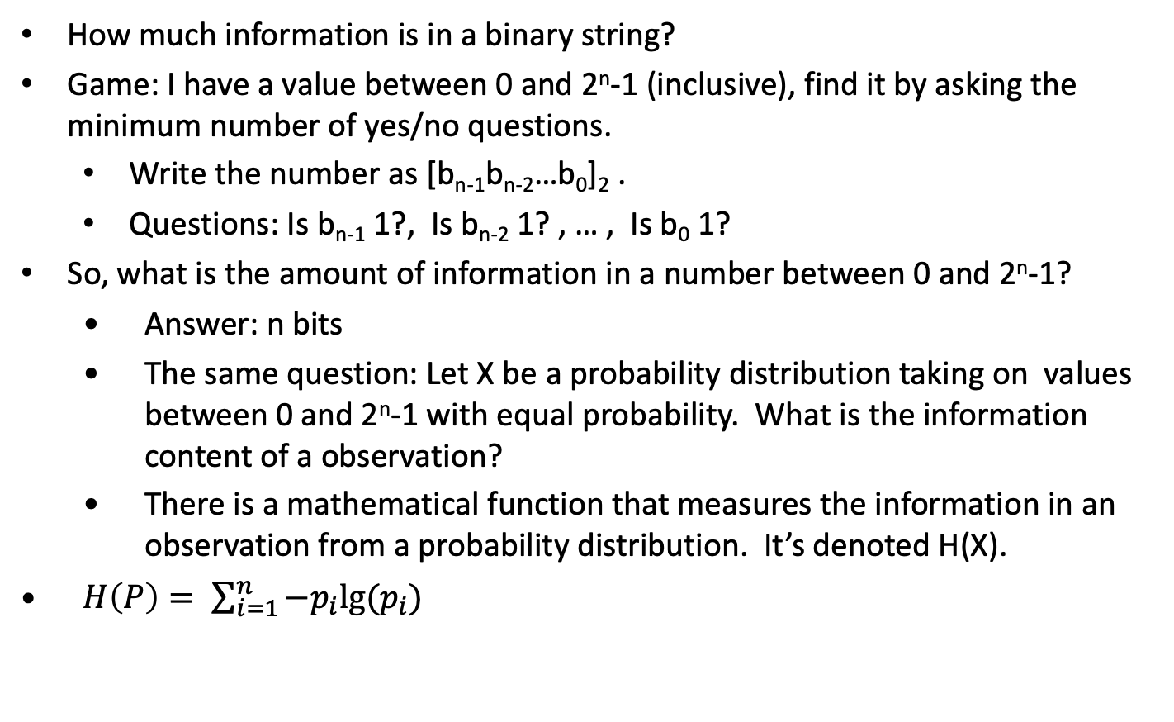
Information Theory Motivation
How much information is in a binary string?
Game: I have a value between 0 and 2^{n}-1 (inclusive), find it by asking the minimum number of yes/no questions.
Write the number as [b_{n-1}b_{n-2}…b₀]₂ .
Questions: Is b_{n-1} 1?, Is b_{n-2} 1? , … , Is b₀ 1?
So, what is the amount of information in a number between 0 and 2^{n}-1?
Answer: n bits
The same question: Let X be a probability distribution taking on values between 0 and 2^{n}-1 with equal probability. What is the information content of a observation?
There is a mathematical function that measures the information in an observation from a probability distribution. It’s denoted H(X).
$H\left(P\right)= \sum_{i=1}^{n}{−p_{i}lg⁡(p_{i})}$

Slide 5

What is the form of H(X)?
If H is continuous and satisfies:
$H\left(\frac{1}{n},…,\frac{1}{n}\right)<H\left(\frac{1}{n+1},…,\frac{1}{n+1}\right)$
$H\left(p_{1}, …,p_{n}\right)=H\left(p_{1}, …,qp_{j},{(1−q)p}_{j},…,p_{n}\right)$
$H\left(\frac{1}{n},…,\frac{1}{n}\right)$= 1
$H\left(p_{1}, …,p_{n}\right)$ is maximized if $p_{j}= \frac{1}{n}$ for all j

Slide 6
Information Theory
The “definition” of H(X) has two desirable properties:
Doubling the storage (the bits your familiar with) doubles the information content
H(1/2, 1/3, 1/6)= H(1/2, 1/2) + ½ H(2/3,1/3)
It was originally developed to study how efficiently one can reliably transmit information over “noisy” channel.
Applied by Shannon to Cryptography (BTSJ, 1949)
Thus information learned about Y by observing X is
I(Y,X)= H(Y)-H(Y|X)=H(X)+H(Y)−H(X,Y).
Used to estimate requirements for cryptanalysis of a cipher.

Slide 7
Sample key distributions
Studying key search
Distribution A: 2 bit key each key equally likely
Distribution B: 4 bit key each key equally likely
Distribution C: n bit key each key equally likely
Distribution A’: 2 bits with distribution (1/2, 1/6, 1/6, 1/6)
Distribution B’: 4 bits with distribution (1/2, 1/30, 1/30, …, 1/30)
Distribution C’: n bits with distribution (1/2, ½ 1/(2^{n}-1),…,½ 1/(2^{n}-1))

Slide 8
H for the key distributions
Distribution A: H(X)= ¼ lg(4) + ¼ lg(4) + ¼ lg(4) +1/4 lg(4) = 2 bits
Distribution B: H(X)= 16x(1/16) lg(16)= 4 bits
Distribution C: H(X)= 2^{n}x(1/2^{n}) lg(2^{n}) = n bits
Expected time for key search is ~ 2^{n}.
Distribution A’: H(X) = ½ lg(2) + 3 x(1/6 lg(6))= 1.79 bits
Distribution B’: H(X) = ½ lg(2) + 15 x(1/30 lg(30))= 2.95 bits
Distribution C’: H(X) = ½ lg(2) + ½(2^{n}-1)x(1/(2^{n}-1) lg(2^{n}-1))= n/2+1 bits
Expected time for key search is ~ ½(2^{n}+1).

Slide 9
Coding theory and Information
Shannon Source Coding: If a memoryless source has entropy H then any uniquely decipherable code over an alphabet Σ with D symbols must have length ≥H. Further, there is a uniquely decipherable code with average length ≤ 1+H/lg(D).
Applications to compression
Pick 0 with probability .8 and all of the remaining (2^{n}-1) n bit numbers with equal probability
H= - .8 lg(.8) -S .2(2^{n}-1)⁻¹lg((2^{n}-1)⁻¹).
For n=10, we get H= 2.7 bits (Not 10!)
How many bits on average does it take to encode n bits with the distribution above?
Code 0,1 with one bit, 2→3 with two bits, …, 2^{n-1}→2^{n}-1 with n bits.
For n=10, the average bit length is:
.8x1 + .2/1023(1x1+2x2+4x3+8x4+…+512x10)=2.7

Slide 10
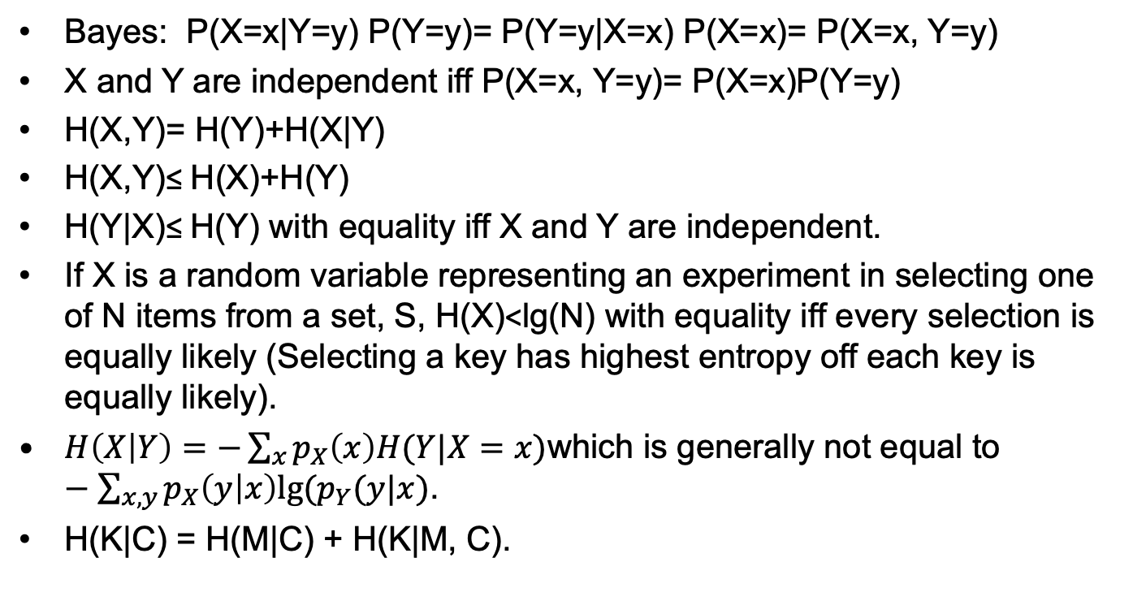
Some Theorems
Bayes: P(X=x|Y=y) P(Y=y)= P(Y=y|X=x) P(X=x)= P(X=x, Y=y)
X and Y are independent iff P(X=x, Y=y)= P(X=x)P(Y=y)
H(X,Y)= H(Y)+H(X|Y)
H(X,Y)≤ H(X)+H(Y)
H(Y|X)≤ H(Y) with equality iff X and Y are independent.
If X is a random variable representing an experiment in selecting one of N items from a set, S, H(X)<lg(N) with equality iff every selection is equally likely (Selecting a key has highest entropy off each key is equally likely).
$H\left(X | Y\right)=−\sum_{x}{p_{X}\left(x\right)H(Y|X=x)}$which is generally not equal to $−\sum_{x, y}{p_{X}\left(y | x\right)lg⁡(p_{Y}(y|x)}$.
H(K|C) = H(M|C) + H(K|M, C).

Slide 11
Huffman Coding
Uniquely readable
Average length, L, satisfies
H(X) < L< H(X)+1
Morse Code
A | . - | N | - .
B | - . . . | O | - - -
C | - . - . | P | . - - .
D | - . . | Q | - - . -
E | . | R | . - .
F | . . - . | S | . . .
G | - - . | T | -
H | . . . . | U | . . -
I | . . | V | . . . -
J | . - - - | W | . - -
K | - . - | X | - . . -
L | . - . . | Y | - . - -
M | - - | Z | - - . .
0
S1
.4
10
S2
1.0
.35
110
1
S3
.6
.2
11
111
.25
S4
.05
H(X)= -(.4lg(.4)) + .35 lg(.35) + .2 lg(.2) + .05 lg(.05))
H(X)= 1.74, [H(X)]= 2. [y] means the ceiling function, the smallest integer greater than or equal to y.

Slide 12
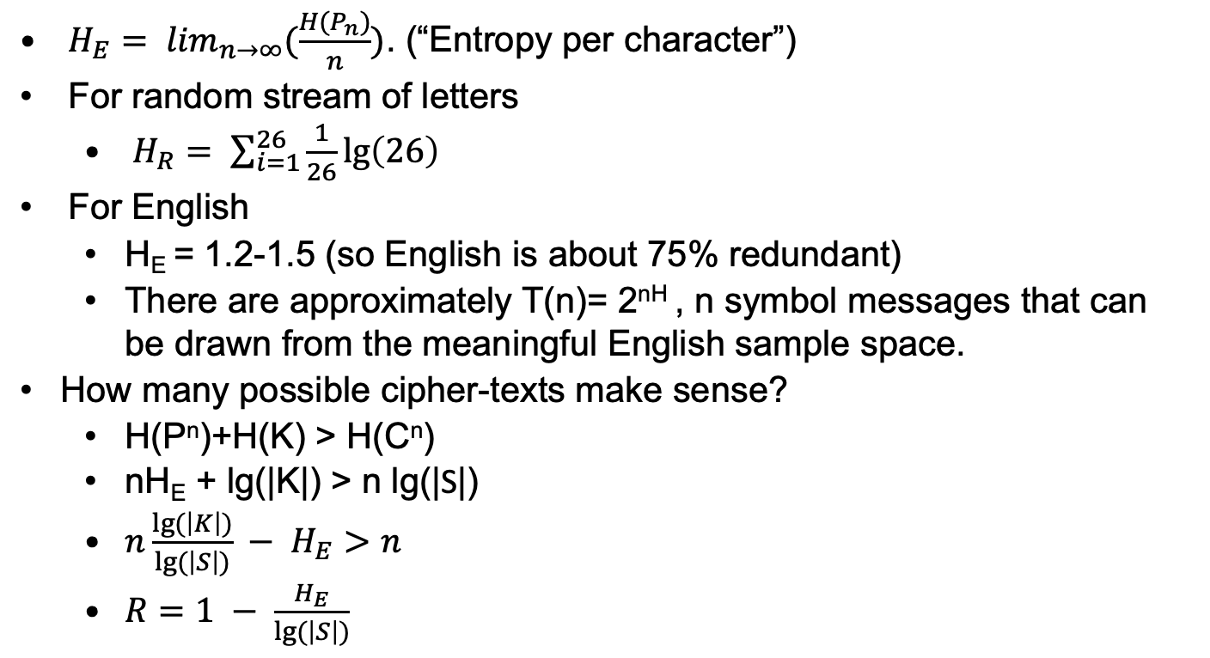
Long term equivocation
$H_{E}= \lim_{n→∞}(\frac{H(P_{n})}{n})$. (“Entropy per character”)
For random stream of letters
$H_{R}= \sum_{i=1}^{26}{\frac{1}{26}\lg\left(26\right)}$
For English
H_{E} = 1.2-1.5 (so English is about 75% redundant)
There are approximately T(n)= 2^{nH} , n symbol messages that can be drawn from the meaningful English sample space.
How many possible cipher-texts make sense?
H(P^{n})+H(K) > H(C^{n})
nH_{E} + lg(|K|) > n lg(|S|)
$n\frac{lg⁡(\left|K\right|)}{lg⁡(\left|S\right|)} − H_{E}>n$
$R=1 − \frac{H_{E}}{lg⁡(\left|S\right|)}$

Slide 13
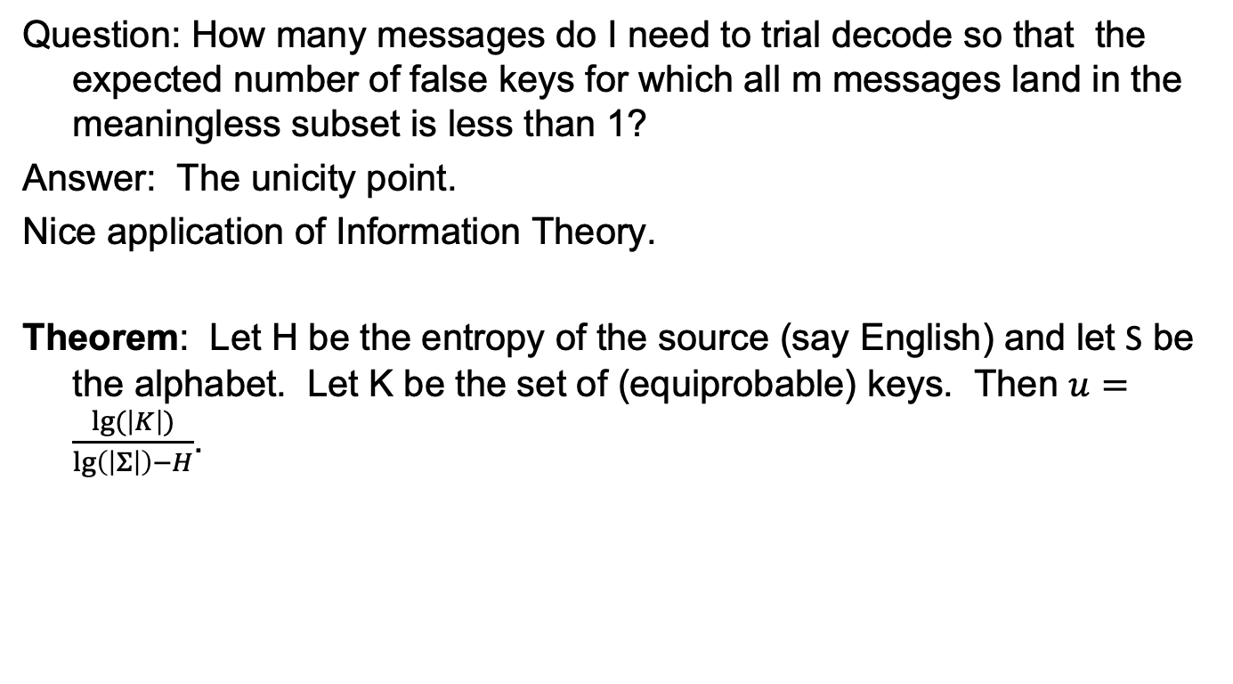
Unicity and random ciphers
Question: How many messages do I need to trial decode so that the expected number of false keys for which all m messages land in the meaningless subset is less than 1?
Answer: The unicity point.
Nice application of Information Theory.
Theorem: Let H be the entropy of the source (say English) and let S be the alphabet. Let K be the set of (equiprobable) keys. Then $u=\frac{lg⁡(\left|K\right|)}{\lg\left(\left|Σ\right|\right)−H}$.

Slide 14
Unicity for random ciphers
Cipher Messages
|S|^{n}
Non-Meaningful Messages
Meaningful Messages
2^{Hn}
Decoding with correct key
Decoding with incorrect key

Slide 15
Unicity distance for mono-alphabet
H_{CaeserKey}= H_{random} = lg(26)= 4.7004
H_{English} ≅1.2.
For Caeser, u ≅ lg(26)/(4.7-1.2)≅4 symbols, for cipher-text only attack. For known plaintext/cipher-text, only 1 corresponding plain/cipher symbol is required for unique decode.
For arbitrary substitution, u ≅ lg(26!)/(4.7-1.2) ≅ 25 symbols for cipher-text only attack. For corresponding plain/cipher-text attack, about 8-10 symbols are required.
Both estimates are remarkably close to actual experience.

Slide 16
Information theoretic estimates to break mono-alphabet
Cipher | Type of Attack | Information Resources | Computational Resources
Caeser | Ciphertext only | U= 4.7/1.2=4 letters | 26 computations
Caeser | Known plaintext | 1 corresponding plain/cipher pair | 1
Substitution | Ciphertext only | ~30 letters | O(1)
Substitution | Known plaintext | ~10 letters | O(1)

Slide 17
One Time Pad (OTP)
The one time pad or Vernam cipher takes a plaintext consisting of symbols p= (p₀, p₁, …, p_{n}) and a key-stream k= (k₀, k₁, …, k_{n}) where the symbols come from the alphabet Z_{m} and produces the cipher-text c= (c₀, c₁, …, c_{n}) where c_{i}= (p_{i}+ k_{i}) (mod m).
m=2 in the binary case and m=26 in the case of the roman alphabet.
Unfortunately, OTP requires shared keys as long as the sum of the lengths of all plaintexts sent.
Stream ciphers replace the ‘perfectly random’ sequence k with a pseudo-random sequence k’ (based on a much smaller input key k_{s} and a stream generator R).

Slide 18
One-time pad alphabetic encryption
Plaintext +Key (mod 26)= Ciphertext
B U L L W I N K L E I S A D O P E
1 20 11 11 22 08 13 10 11 04 08 18 00 03 14 15 04
Plaintext
N O W I S T H E T I M E F O R A L
13 14 22 08 18 19 07 04 19 08 12 04 05 14 17 00 11
Key
14 8 07 19 14 01 20 14 04 12 20 22 05 17 05 15 15
O S H T 0 B U O E M U W F R F P P
Ciphertext
Legend
A B C D E F G H I J K L M
00 01 02 03 04 05 06 07 08 09 10 11 12
N O P Q R S T U V W X Y Z
13 14 15 16 17 18 19 20 21 22 23 24 25

Slide 19
One-time pad alphabetic decryption
Ciphertext+26-Key (mod 26)= Plaintext
14 8 07 19 14 01 20 14 04 12 20 22 05 17 05 15 15
O S H T 0 B U O E M U W F R F P P
Ciphertext
N O W I S T H E T I M E F O R A L
13 14 22 08 18 19 07 04 19 08 12 04 05 14 17 00 11
Key
B U L L W I N K L E I S A D O P E
1 20 11 11 22 08 13 10 11 04 08 18 00 03 14 15 04
Plaintext
Legend
A B C D E F G H I J K L M
00 01 02 03 04 05 06 07 08 09 10 11 12
N O P Q R S T U V W X Y Z
13 14 15 16 17 18 19 20 21 22 23 24 25

Slide 20
Binary one-time pad
Plaintext ⊕ Key = Ciphertext
Ciphertext ⊕ Key = Plaintext
10101110011100000101110110110000
Plaintext
00101010011010110001010110010111
Key
10100100000110110100100000100111
Ciphertext
00101010011010110001010110010111
Key
10101110011100000101110110110000
Plaintext

Slide 21
The one time pad has perfect security
One-time pad is perfect: E is perfect if H(X|Y)=H(X) where X is a plain text distribution and Y is the cipher text distribution.
Proof:
H(X|Y) = -∑_{y in Y} P(Y=y) H(X|Y=y))= -∑_{y in Y} P(Y=y) ∑_{x in X} P(X=x|Y=y) lg(P(X=x|Y=y)).
P(X=x|Y=y) P(Y=y)= P(X=x, Y=y) and P(X=x,Y=y)= Pr(X=x, K=x+y)= P(X=x)P(K=k).
So H(X|Y) = -∑_{y in Y, x in X} P(X=x,Y=y) [lg(P(X=x,Y=y) – P(Y=y)]
= -∑_{y in Y, x in X} P(X=x, Y=y) lg(P(X=x, Y=y)) +∑_{y in Y, x in X} P(X=x,Y=y) lg(P(Y=y))
= -∑_{x in X, y} _{in Y} P(X=x)P(K=x+y)lg(P(X=x) - ∑_{x in X, y} _{in Y} P(X=x) P(Y=x+k)lg(P(Y=x+k)
+∑_{y in Y, x in X} P(X=x) P(Y=Y)lg(P(Y=y))
= H(X)

Slide 22
Shannon: Mixing cryptographic elements to produce strong cipher
Diffusion – transposition
Using group theory, the action of a transposition 𝜏 on a₁ a₂ …, a_{k} could be written as a_{𝜏(1)} a_{𝜏(2)} …, a_{𝜏(k)} .
Confusion – substitution
The action of a substitution 𝜎 on a₁ a₂ …, a_{k} can be written as
𝜎(a₁) 𝜎(a₂) … 𝜎(a_{k}).
Transpositions and substitutions may depend on keys. Keyed permutations may be written as 𝜎_{k}(x). A block cipher on b bits is nothing more than a keyed permutation on 2^{b} symbols.
Iterative Ciphers – staged iteration of permutation (transposition) and key dependent substitution to construct cipher. (DES, AES)

Slide 23
Interlude: Think like an adversary
Alice has a bank account at the First National Bank and she does some online transactions. One of the services she can use is “Transfer money to another account.” This is done using a One Time Pad system set up by the Bank. Alice and the Bank get together and share series of one time pad keys. The Bank assured Alice this system is safe because one time pads are unbreakable. To transfer money, Alice sends a message like the one below to her Bank, encrypting it with the one time pad:
ALICE, ACCOUNT NUMBER, 123-456789 TRANSFERS $000020 to
RECEPIENT, ACCOUNT NUMBER, 321-987654. SIGNED, ALICE.
Alice has a friend named Mallory, who is a “man in the middle” based attacker. Recall the Alice-Mallory-Bob adversarial model.
Alice
Bank (Bob)
Plaintext
(P)
Encrypt
Decrypt
Plaintext
(P)
Mallory
Channel

Slide 24
Interlude: The Sting
One day, Alice and Mallory are having lunch and Alice runs out of cash. Mallory offers to loan her $20 and says: “You can repay me with an electronic transfer, my account number is 666-123456.
Alice sends the following message to her bank and encrypts it with the one-time pad:
1234567890123456789012345678901234567890123456789012345
ALICE, ACCOUNT NUMBER, 123-456789 TRANSFERS $000020 to
MALLORY, ACCOUNT NUMBER, 666-123456. SIGNED, ALICE.
The numbers on the top are not sent, they just show the byte position of the characters in the message.
Mallory intercepts the message (perhaps she controls an internet router between Alice and her Bank). She can’t decrypt it but flips the bits at character position 46 by xoring in the 8 bit string 00000001 (thus changing the ascii character “0” in this position to ascii “1”) and sends it to the Bank.

Slide 25
It’s bad … and worse
When the Bank decrypts the modified message it gets:
ALICE, ACCOUNT NUMBER, 123-456789 TRANSFERS $100020 to
MALLORY, ACCOUNT NUMBER, 666-123456. SIGNED, ALICE.
Oops.
It’s actually worse for the Bank than Alice (in the US). Alice hires a cryptographer who goes to Court and explains how easy it is to mount this attack. Alice, grief stricken, explains that the Bank told her this was “completely safe.” The Court says: “The Bank must cover the loss.”
Oops.
By the way, Alice and Mallory might have colluded from the beginning and shared this attack with their best 1000 friends. What happens to the Bank?
Problem: The message was neither integrity protected or signed.

Slide 26
Rise of the Machines

Slide 27
The “Machine” Ciphers
Simple Manual Wheel
Jefferson
Rotor
Enigma
Hebern
SIGABA
TYPEX
Stepping switches
Purple
Mechanical Lug and cage
M209

Slide 28
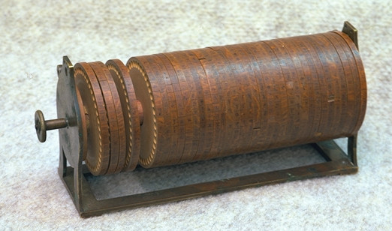
Jefferson Cipher
The French have another name for this cipher.

Slide 29
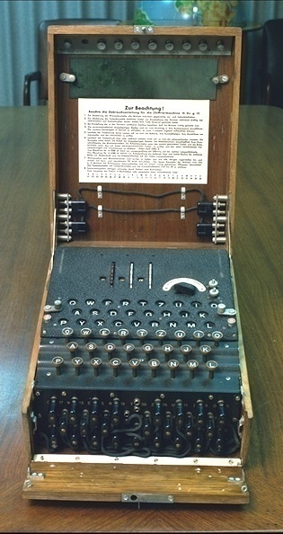
Enigma

Slide 30
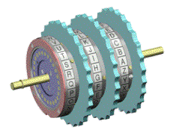
Enigma Cryptographic Elements (Army Version)
Three moveable rotors
Select rotors and order
Set initial positions
Moveable ring on rotor
Determine rotor ‘turnover’
Plugboard (Stecker)
Interchanges pairs of letters
Reversing drum (Umkehrwalze)
Static reflector
See next page
Three Rotors on axis

Slide 31
Diagrammatic Enigma Structure
U
L
M
N
S
Lamps
Message flows right to left
U: Umkehrwalze (reversing drum)
N,M,L: First (fastest), second
third rotors
S: Stecker (plugboard)
Keyboard
L
B
Diagram courtesy of Carl Ellison

Slide 32
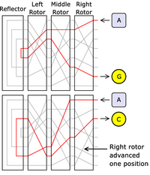
Enigma Structure
Follow the electrons:
Original slide by Mark Stamp

Slide 33
Enigma Data
Rotors
Input ABCDEFGHIJKLMNOPQRSTUVWXYZ
Rotor I EKMFLGDQVZNTOWYHXUSPAIBRCJ
Rotor II AJDKSIRUXBLHWTMCQGZNPYFVOE
Rotor III BDFHJLCPRTXVZNYEIWGAKMUSQO
Rotor IV ESOVPZJAYQUIRHXLNFTGKDCMWB
Rotor V VZBRGITYUPSDNHLXAWMJQOFECK
Rotor VI JPGVOUMFYQBENHZRDKASXLICTW
Rotor VII NZJHGRCXMYSWBOUFAIVLPEKQDT
Ring Turnover
Rotor I R
Rotor II F
Rotor III W
Rotor IV K
Rotor V A
Rotors VI A/N
Reflector B (AY) (BR) (CU) (DH) (EQ) (FS) (GL) (IP)
(JX) (KN) (MO) (TZ) (VW)
Reflector C (AF) (BV) (CP) (DJ) (EI) (GO) (HY) (KR)
(LZ) (MX) (NW) (TQ) (SU)

Slide 34
Visualizing rotor motion
Original position (“A”)
ABCDEFGHIJKLMNOPQRSTUVWXYZ Input
EKMFLGDQVZNTOWYHXUSPAIBRCJ Rotor output
EKMFLGDQVZNTOWYHXUSPAIBRCJ Final output
Rotor moves 25 position (“Z”)
ABCDEFGHIJKLMNOPQRSTUVWXYZ Input
ZABCDEFGHIJKLMNOPQRSTUVWXY Input to rotor (shifted)
JEKMFLGDQVZNTOWYHXUSPAIBRC Rotor output
KFLNGMHERWAOUPXZIYVTQBJCSD
If rotor is R and P=(ABCD…Z), the effect at rotor position 1, writing permutations “from the right,” is x_{in}(PRP⁻¹)= x_{out}.

Slide 35
First 13 settings of Rotor I
abcdefghijklmnopqrstuvwxyz
Step
0(A) EKMFLGDQVZNTOWYHXUSPAIBRCJ
1(B) JLEKFCPUYMSNVXGWTROZHAQBID
2(C) KDJEBOTXLRMUWFVSQNYGZPAHCI
3(D) CIDANSWKQLTVEURPMXFYOZGBHJ
4(E) HCZMRVJPKSUDTQOLWEXNYFAGIB
5(F) BYLQUIOJRTCSPNKVDWMXEZFHAG
6(G) XKPTHNIQSBROMJUCVLWDYEGZFA
7(H) JOSGMHPRAQNLITBUKVCXDFYEZW
8(I) NRFLGOQZPMKHSATJUBWCEXDYVI
9(J) QEKFNPYOLJGRZSITAVBDWCXUHM
10(K) DJEMOXNKIFQYRHSZUACVBWTGLP
ll(L) IDLNWMJHEPXQGRYTZBUAVSFKOC
12(M) CKMVLIGDOWPFQXSYATZUREJNBH

Slide 36
Last 13 settings of Rotor I
abcdefghijklmnopqrstuvwxyz
Step
13(N) JLUKHFCNVOEPWRXZSYTQDIMAGB
14(O) KTJGEBMUNDOVQWYRXSPCHLZFAI
15(P) SIFDALTMCNUPVXQWROBGKYEZHJ
16(Q) HECZKSLBMTOUWPVQNAFJXDYGIR
17(R) DBYJRKALSNTVOUPMZEIWCXFHQG
18(S) AXIQJZKRMSUNTOLYDHVBWEGPFC
19(T) WHPIYJQLRTMSNKXCGUAVDFOEBZ
20(U) GOHXIPKQSLRMJWBFTZUCENDAYV
21(V) NGWHOJPRKQLIVAESYTBDMCZXUF
22(W) FVGNIOQJPKHUZDRXSACLBYWTEM
23(X) UFMHNPIOJGTYCQWRZBKAXVSDLE
24(Y) ELGMOHNIFSXBPVQYAJZWURCKDT
25(Z) KFLNGMHERWAOUPXZIYVTQBJCSD

Slide 37
Military Enigma
Encryption Equation: c= (p)P^{i}NP^{-i} P^{j}MP^{-j} P^{k}LP^{-k} U P^{k}L⁻¹P^{-k} P^{j}M⁻¹P^{-j} P^{i}N⁻¹P^{-i}
K: Keyboard
P=(ABCDEFGHIJKLMNOPQRSTUVWXYZ)
N: First Rotor
M: Second Rotor
L: Third Rotor
U: Reflector. Note: U=U⁻¹.
i, j, k: Number of rotations of first, second and third rotors respectively.
Note (p)E=c → (c)E=p. E=E⁻¹.
Later military models added plugboard (S) and additional rotor (not included). The equation with plugboard is:
c=(p)S P^{i}NP^{-i} P^{j}MP^{-j} P^{k}LP^{-k} U P^{k}L⁻¹P^{-k} P^{j}M⁻¹P^{-j} P^{i}N⁻¹P^{-i} S⁻¹

Slide 38
Group Theory for Rotors
Writing cryptographic processes as group operation can be very useful. For example, if R denotes the mapping of a “rotor” and C=(1,2,…,26), the mapping of the rotor “turned” one position is CRC⁻¹.
A prescription for solving ciphers is to represent the cipher in terms of the basic operations and then solve the component transformations. That is how we will break Enigma.
For most ciphers, the components are substitution and transposition; some of which are “keyed”.
For Enigma, you should know the following:
Theorem: If s=(a₁₁ a₁₂ … a_{1i}) (a₁₁ … a_{1j}) … (a₁₁ … a_{1k})then dsd⁻¹= (da₁₁ da₁₂ … da_{1i}) (da₁₁ … da_{1j}) … (da₁₁ … da_{1k}).
When permutations are written as products of cycles, it is very easy to calculate their order. It is the LCM of the length of the cycles.

Slide 39
Military Enigma Key Length
Key Length (rotor order, rotor positions, plug-board)
60 rotor orders. lg(60)= 5.9 bits. [Original Army cipher with 5 rotors]
26*26*26 = 17576 initial rotor positions. lg(17576)= 14.1 bits of key
10 exchanging steckers were specified yielding C(26,2) C(24,2)…C(8,2)/10! = 150,738,274,937,250. lg(150,738,274,937,250)= 47.1 bits as used
Bits of key: 5.9 + 14.1 + 47.1 = 67.1 bits
Moveable ring lg(26²)= 9.4 bits
Note: plugboard triples entropy of key!
Rotor Wiring State
lg(26!) = 88.4 bits/rotor.
Total Key including rotor wiring:
67.1 bits + 3 x 88.4 bits = 312.3 bits

Slide 40
Method of Batons
Applies to Enigma
Without plug-board
With fast rotor ordering known and only the fast rotor moving
With a “crib”
Let N be the fast rotor and Z the combined effect of the other apparatus, then N⁻¹ZN(p)=c, for first character.
In general, ZP^{-i}N P^{i}p(i)= P^{-i}NP^{i} c(i) (from left)
Since ZP^{-i}NP^{i} (p)=P^{-i}NP^{i} (c), we know the wiring of N and a crib, we can play the crib against each of the 26 possible positions of N for the plaintext and the cipher text. In the correct position, there will be no “scritches” or contradictions in repeated letters.
This method was used to “analyze” the early Enigma variants used in the Spanish Civil War and is the reason the Germans added the plugboard. Countermeasure: Move fast rotor next to reflector.

Slide 41
Method of Batons: example
Crib: RECONAISSANCE
r e c o n n a i s s a n c e
U P Y T E Z O J Z E G B O T
Rotor I
01234567890123456789012345
ABCDEFGHIJKLMNOPQRSTUVWXYZ
EKMFLGDQVZNTOWYHXUSPAIBRCJ
P shifted by Y
YZABCDEFGHIJKLMNOPQRSTUVWX
ABCDEFGHIJKLMNOPQRSTUVWXYZ
Rotor position A: ZN(p) over N(c), sample sritch in red
UFJRQNXAWBDRMH
AWCYRGUQINNDSM
Rotor position Y: ZN(p) over N(c), no scritch
JGMGFUHRWCNSEW
UZCZBJOTAMQESA

Slide 42
Polish (Rejewski) Attack
Rejewski exploited weakness in German keying procedure to determine rotor wiring
Rejewski had ciphertext for several months but no Enigma.
Rejewski had stecker settings for 2 months (from a spy via the French in 12/32), leaving 265.2 bits of key (the rotor wirings) to be found. He did.
Poles determined the daily keys
Rejewski catalogued the characteristics of rotor settings to detect daily settings. He did this with two connected Enigmas offset by 3 positions (the “cyclotometer”).
In 9/38, when the “message key” was no longer in this way, Rejewski’s characteristics stopped working.

Slide 43
Early German Keying Procedure
Every signal officer had a list of global Enigma keys
Stecker (reflector) wiring
Rotor position
Turnover settings
Rotor starting position
To send a message:
Operator picks three letter key (ABC) called the indicator
Uses daily setting to encrypt the indicator twice
Transmits these 6 letters
Reset rotors to indicator setting
Encrypt message
The indicator is an ephemeral key used to reduce exposure of the daily keys.
Good idea, in principal. Not so good in practice.

Slide 44
Two Theorems
Theorem 1: If S= (a₁, a₂, …, a_{n1}) (b₁, b₂, …, b_{n2})… and T is another permutation, then the effect of T⁻¹ST, operating from the left, is T⁻¹ST = (a₁T, a₂T, …, a_{n1}T) (b₁T, b₂T, …, b_{n2}T).
Example: S= (12345) (67), T= (17)(26)(35).
T⁻¹ST= (76543)(12)
Theorem 2: Let S be a permutation of even degree. S can be decomposed into pairs of cycles of equal length if and only if it can be written as the product of two transpositions.
Example: S= (1234)(8765). A= (15)(26)(37)(48), B= (25)(36)(47)(18). AB= (1234)(8765).
Note: permutations applied “from the right” here.
You never know when group theory can help!

Slide 45
Plan of attack
Define E(i,j,k)= P^{i}NP^{-i} P^{j}MP^{-j} P^{k}LP^{-k} U P^{k}L⁻¹P^{-k} P^{j}M⁻¹P^{-j} P^{i}N⁻¹P^{-i}
Here, N is rotor 1, M is rotor 2, L is rotor 3 and U is the reflector.
Let A= E(1,j,k), B= E(2,j,k), C= E(3,j,k),
D= E(4,j,k), E= E(5,j,k), F= E(6,j,k).
Suppose the (unknown) message key is abg.
A,B,C,D,E,F are involutions representing the effect of Enigma on, abgabg. The six letter output on abgabg is called the indicator.
Now suppose the six letter indicator for a message is ktz svf.
aA=k, aD=s; bB=t, bE=v; and gC=z, gF=f, for unknown letters a, b, g.
Since, A= A⁻¹, etc., we obtain t(AD)=s, v(BE)= z(CF).
In the first part of the attack
Use message indicators to construct (AD), (BE) and (CF).
Then use (AD), (BE) and (CF) to find A, B, C, D, E, F.

Slide 46
Getting the rotor
Set
Q= MLRL⁻¹M⁻¹, U= NP⁻¹QPN⁻¹, V= NP⁻²QP²N⁻¹,
W= NP⁻³QP³N⁻¹, X= NP⁻⁴QP⁴N⁻¹, Y= NP⁻⁵QP⁵N⁻¹,
Z= NP⁻⁶QP⁶N⁻¹, H=NPN⁻¹.
Use the knowledge of A and S to compute
U=P⁻¹S⁻¹ASP¹, V=P⁻²S⁻¹ASP², W=P⁻³S⁻¹ASP³, X=P⁻⁴S⁻¹ASP⁴
Y=P⁻⁵S⁻¹ASP⁵, Z=P⁻⁶S⁻¹ASP⁶
Next note
UV= NP⁻¹(QP⁻¹QP)P¹N⁻¹, VW= NP⁻²(QP⁻¹QP)P²N⁻¹.
WX= NP⁻³(QP⁻¹QP)P³N⁻¹, XY= NP⁻⁴(QP⁻¹QP)P⁴N⁻¹, YZ= NP⁻⁵(QP⁻¹QP)P⁵N⁻¹.
Now we can calculate H.
(VW)= H⁻¹(UV)H, (WX)= H⁻¹(VW)H,
(XY)= H⁻¹(WX)H, (YZ)= H⁻¹(XY)H.
Finally, H=NPN⁻¹ lets us compute N.

Slide 47
Calculate (AD), (BE), (CF)
c=(p)S P^{i}NP^{-i} P^{j}MP^{-j} P^{k}LP^{-k} U P^{k}L⁻¹P^{-k} P^{j}M⁻¹P^{-j} P^{i}N⁻¹P^{-i} S⁻¹
Using the message indicators and:
AD= SP¹NP⁻¹QP¹N⁻¹P³NP⁻⁴QP⁴N⁻¹P⁻⁴S⁻¹. (c₁)AD= c₄.
BE= SP²NP⁻²QP²N⁻¹P³NP⁻⁵QP⁵N⁻¹P⁻⁵S⁻¹. (c₂)BE= c₅.
CF= SP³NP⁻³QP³N⁻¹P³NP⁻⁶QP⁶N⁻¹P⁻⁶S⁻¹. (c₃)CF= c₆.
We can find AD, BE and CF after about 80 messages.

Slide 48
Calculate A, B, C, D, E, F
Suppose
AD= (dvpfkxgzyo)(eijmunqlht)(bc)(rw)(a)(s)
BE= (blfqveoum)(hjpswizrn)(axt)(cgy)(d)(k)
CF= (abviktjgfcqny)(duzrehlxwpsmo)
We know from the theorem that A maps the top line to
the bottom line when the bottom is slid the correct amount
dvpfkxgzyodvpfkxgzy and bcb
thlqnumjie wr
For some bottom displacement of each line and D can then be calculated as in theorem 2 but what is the correct slide?
We can calculate B, C and E and F in a similar manner provided we know the correct displacement.

Slide 49
Cillies
We can find the correct positions by trial and error but that’s very time consuming.
Frequently, operators chose the same letter for each character of the message code. These were called cillies
Suppose this happened and we saw the indicator
YSG SWK under this assumption for
AD=(DP)(SY)(ABQHZUIWOXL)(MNJRVTGCKEF)
BE=(AJV)(HNY)(BFZSWGCIMO)(DKTLRXEQUP)
𝛼A=y, 𝛼B=s, 𝛼C=g, aD=s, 𝛼E=w, 𝛼F=k for some unknown 𝛼.
Then A=(𝛼y)(𝛽s) …, B=(𝛼s)…, C= (𝛼g))…, D=(𝛼s)(𝛽y) …, E= (𝛼w)…, F= (𝛼k)… Thus a=p, b=d or a=d, b=p.
a cannot be s since then we’d have A=(dy)(ps) …, B=(ds) …, C= (dg)…, D= (ds)(py) …, E=(sw)…, F=(sk). But this contradicts the fact that s and w are in the same cycle in BE.
So A=(yp)(sd) …, B=(sp)…, C=(gp))…, D=(sp)(yd) …, E= (wp)…, F=(kp)…
We can use these to align the alphabets.

Slide 50
Calculate A, B, C, D, E, F
We get
A= (as)(bw)(cr)(dt)(vh)(pl)(fq)(kn)(xu)(gm)(zj)(yi)(oe)
B= (dk)(ay)(xg)(tc)(bj)(lh)(fn)(qr)(vz)(ei)(ow)(us)(mp)
C= (ax)(bl)(vh)(ie)(kr)(tz)(ju)(gd)(fo)(cm)(qs)(np)(yw)
D= (as)(bw)(cr)(ft)(kh)(xl)(gq)(zn)(yu)(om)(dj)(vi)(pe)
E= (dh)(xy)(tg)(ac)(qn)(vr)(ez)(oi)(uw)(ms)(bp)(lj)(fh)
F= (co)(qm)(ns)(xp)(aw)(bx)(vl)(ih)(ke)(tr)(jz)(yu)(fd)

Slide 51
U, V, W, X, Y, Z
A= SPUP⁻¹S⁻¹ so, U= P⁻¹S⁻¹ASP¹. This and similar equations yield:
U= P⁻¹S⁻¹ASP¹
V= P⁻²S⁻¹BSP²
W= P⁻³S⁻¹CSP³
X= P⁻⁴S⁻¹DSP⁴
Y= P⁻⁵S⁻¹ESP⁵
Z= P⁻⁶S⁻¹FSP⁶
S= (ap)(bl)(cz)(fh)(jk)(qu)
Putting this all together, we can compute U,V,W,X,Y,Z.
U=(ax)(bh)(ck)(dr)(ej)(fw)(gi)(lp)(ms)(nz)(oh)(qt)(uy)
V=(ar)(bv)(co)(dh)(fl)(gk)(iz)(jp)(mn)(qy)(su)(tw)(xe)
W=(as)(bz)(cp)(dg)(eo)(fw)(gj)(hl)(iy)(kr)(mu)(nt)(vx)
X=(ap)(bf)(cu)(dv)(ei)(gr)(ho)(jn)(ky)(lx)(mz)(qf)(tw)

Slide 52
Calculate (UV), (VW), (WX)
UV= (aepftybsnikod)(rhcgzmuvqwljy)
VW= (ydlwnuakjcevz)(ibxopgrsmtvhq))
WX= (uzftjryehxdsp)(caqvloikgnwbm)
(VW)= H⁻¹(UV)H, (WX)= H⁻¹(VW)H. The only consistent value of H satisfying Theorem 1 is
H= (ayuricxqmgovskedzplfwtnjhb)
Finally, H= NPN⁻¹, so
N: abcdefghijklmnopqrstuvwxyz
azfpotjyexnsiwkrhdmvclugbq
N= (a)(bzqhy)(cftvlsmieoknwu)(dpr)(gjx)
We have our rotor.

Slide 53
Turing Bombe - Introduction
Assume we know all rotor wirings and the plaintext for some received cipher-text. We do not know plugboard, rotor order, ring and indicator.
We need a crib characteristic that is plugboard invariant.
Position 123456789012345678901234
Plain Text OBERKOMMANDODERWEHRMACHT
CipherText ZMGERFEWMLKMTAWXTSWVUINZ
Observe the loop A[9]→M[7]→E[14]→A.
If M_{i} is the effect of the machine at position i and S is the stecker, for the above we have “E”= (“M”)SM₇S and (“E”)M₇M₉M₁₄=“E”. This return could happen accidently so we use another (E[4]→R[15]→W[8]→M[7]→E) to confirm as (“E”)M₄M₁₅M₈M₇= “E”.

Slide 54
Turing Bombe – the menu
Want short enough text for no “turnovers”.
Position 123456789012345678901234
Plain text ABSTIMMSPRUQYY
Cipher text ISOAOGTPCOGNYZ
4
1
5
10
T
A
I
O
R
7
3
8
9
M
S
P
C
6
2
G
13
Y
B
11
14
Y
Z

Slide 55
Turing Bombe -1
Each cycle can be turned into a ring of Enigma machines.
In a ring of Enigmas, all the S cancel each other out!
The key search problem is now reduced from 67.5 to 20 bits !!!!
At 10 msec/test, 20 bits takes 3 hours.
Turing wanted ~4 loops to cut down on “false alarms.”
About 20 letters of “crib” of know plaintext were needed to fine enough loops.
Machines which did this testing were called “Bombe’s”.
Built by British Tabulating Machine Company.
Courtesy of Carl Ellison

Slide 56
Test Register in Bombes
In the diagram below, each circle is a 26-pin connector and each line a 26-wire cable. The connector itself is labeled with a letter from the outside alphabet while its pins are labeled with letters from the inside alphabet. Voltage on X(b) means that X maps to b through the plugboard.
12
10
P
1
A
d
a
M
f
X
11
3
b
X:
a b c d e f g h i j k l m n o p q r s t u v w x y z
Courtesy of Carl Ellison

Slide 57
Welchman’s Improvement
With enough interconnected loops, when you apply voltage to X(b), you will see one of three possibilities on the pins of connector X:
01000000000000000000000000 X maps to b
11101111111111111111111111 X really maps to d
11111111111111111111111111 wrong Enigma key
Gordon Welchman realized that if X(b) then B(x), because the plugboard was a self-inverse (S=S⁻¹).
His diagonal board wired X(a) to A(x), D(q) to Q(d), etc.
With that board, the cryptanalyst didn’t need loops -- just enough text
This cut the size of the required crib in half.
Courtesy of Carl Ellison

Slide 58
Stream Ciphers

Slide 59
Binary one-time pad
Plaintext ⊕ Key = Ciphertext
Ciphertext ⊕ Key = Plaintext
10101110011100000101110110110000
Plaintext
00101010011010110001010110010111
Key
10100100000110110100100000100111
Ciphertext
00101010011010110001010110010111
Key
10101110011100000101110110110000
Plaintext

Slide 60
Linear Feedback Shift Registers (LFSR)
⊕
⊕
⊕
⊕
&
&
&
&
&
c_{m}
C_{m-1}
C_{m-2}
…
…
…
…
c₂
c₁
z₀
z₁
z₂
z₃
…
…
…
z_{m-2}
z_{m-1}
Out
State at time t: S(t)= <z₀, z₁, …, z_{m-1}>=<s_{t}, s_{t+1}, …, s_{t+m-1}>.
Recurrence is s_{j+1}= c₁s_{j} + … + c_{m} s_{j-m-1},
At time t, LFSR outputs z₀ =s_{t}, shifts, and replaces z_{m-1} with c₁z_{m-1} + … + c_{m} z₀.

Slide 61
LFSR performance metrics
The output sequence of and LFSR is periodic for all initial states. The maximal period is 2^{m}-1.
A non-singular LFSR with primitive feedback polynomial has maximal period of all non-zero initial states
A length m LFSR is determined by 2m consecutive outputs
Linear complexity of sequence z₀, z₁, …, z_{n} is the length of the smallest LFSR that generates it
Berlekamp-Massey: O(n²) algorithm for determining linear complexity

Slide 62
Linear Complexity, simple O(n³) algorithm
There is a non-singular LFSR of length m which generates s₀, s₁, …, s_{k}… iff there are c₁, …, c_{m} such that:
s_{m+1}= c₁ s_{m}+ c₂ s_{m-1} + …+ c_{m} s₁
s_{m+2}= c₁ s_{m+1}+ c₂ s_{m} + …+ c_{m} s₂
…
s_{2m}= c₁ s_{2m-1}+ c₂ s_{2m-2} + …+ c_{m} s_{m+1}
To solve for the c_{i}’s just use Gaussian Elimination (see math summary) which is O(n³).
But there is a more efficient way!

Slide 63
Example: Breaking a LFSR
z_{n+1}= c₁z_{n} + … + c_{m} z_{n-m-1}. m=8.
Plain: 1 0 0 1 1 1 0 1 0 1 1 1 0 0 1 0 1 1 1
Cipher: 1 1 1 1 0 0 1 0 1 0 1 0 1 1 0 0 0 1 0
LFSR Output: 0 1 1 0 0 1 1 1 1 1 0 1 1 1 1 0 1 0 1
 | c₈ | c₇ | c₆ | c₅ | c₄ | c₃ | c₂ | c₁
i | Z₀ | Z₁ | Z₂ | Z₃ | Z₄ | Z₅ | Z₆ | Z₇ | S_{i+8}
0 | 0 | 1 | 1 | 0 | 0 | 1 | 1 | 1 | 1
1 | 1 | 1 | 0 | 0 | 1 | 1 | 1 | 1 | 1
2 | 1 | 0 | 0 | 1 | 1 | 1 | 1 | 1 | 0
3 | 0 | 0 | 1 | 1 | 1 | 1 | 1 | 0 | 1
4 | 0 | 1 | 1 | 1 | 1 | 1 | 0 | 1 | 1
5 | 1 | 1 | 1 | 1 | 1 | 0 | 1 | 1 | 1
6 | 1 | 1 | 1 | 1 | 0 | 1 | 1 | 1 | 1
7 | 1 | 1 | 1 | 0 | 1 | 1 | 1 | 1 | 0
GE gives solution (c₁, c₂,…, c₈): 10110011

Slide 64
LFSR as linear recurrence
G(x) is power series representing the LFSR, coefficients are outputs.
G(x)= a₀ + a₁ x + a₂ x² + … + a_{k} x^{k} + …
Let c(x)= c₁ x + … + c_{m} x^{m}.
Because of the recurrence, a_{t+m} = ∑_{0<i<m+1} c_{i} a_{t+m-i},
G(x)= a₀ + a₁ x + a₂ x² + … + a_{m-1} x^{m-1} + x^{m} (c₁ a_{m-1} + …+c_{m}a₀)+ x^{m+1} (c₁ a_{m} + …+c_{m}a₁)+ x^{m+2} (c₁ a_{m+1} + …+c_{m}a₂)+…
After some playing around, this can be reduced to an equation of the form G(x)= K/(1-c(x)), where K is a constant that depends on initial state only. Let f(x)= 1-c(x) be the called the connection polynomial. [1-c(x)=1+c(x) (mod 2), of course].
If the period of the sequence is p, G(x)= (a₀ + a₁ x + … + a_{p-1} x^{p-1})+ x^{p}(a₀ + a₁ x + … + a_{p-1} x^{p-1}) + …= (a₀ + a₁ x + … + a_{p-1} x^{p-1})(1+x^{p} +x^{2p} + …)
We get (a₀ + a₁ x + … + a_{p-1} x^{p-1})/(1-x^{p})= K/(f(x)) so f(x) | 1-x^{p} and f(x) is the equation for a root of 1. If f(x) is a primitive root of 1 p will be as large as possible, namely, p=2^{m}-1.

Slide 65
Geffe Generator
Three LFSRs of maximal periods (2ª-1), (2^{b}-1), (2^{c}-1) respectively.
Output filtered by f(x_{a}, x_{b}, x_{c})= x_{a} x_{b} + x_{b} x_{c} + x_{c}
Period: (2ª-1)(2^{b}-1)(2^{c}-1)
Linear complexity: ab+bc+c
Simple non-linear filter.

Slide 66
Geffe Generator
LFSR_{a}
State at t: S_{a}(t)
x_{a} | x_{b} | x_{c} | f(x_{a}, x_{b}, x_{c})
0 | 0 | 0 | 0
0 | 0 | 1 | 1
0 | 1 | 0 | 0
0 | 1 | 1 | 0
1 | 0 | 0 | 0
1 | 0 | 1 | 1
1 | 1 | 0 | 1
1 | 1 | 1 | 0
LFSR_{b}
State at t: S_{b}(t)
f(x_{a}, x_{b}, x_{c})= x_{a} x_{b} + x_{b} x_{c} + x_{c}
LFSR_{c}
State at t: S_{c}(t)
y(t)
Note that x_{c} and f(x_{a}, x_{b}, x_{c}) agree 75% of the time.

Slide 67
Correlation attack: breaking Geffe
Guess S_{c}(0) and check the agreement of S_{c}(t)_{out} and y(t).
If guess is right, they will agree much more often than half the time
If guess is wrong, they will agree about half the time
In this way, we obtain S_{c}(0).
Now guess S_{b}(0).
Compare y(t) and x_{a} S_{b}(t)_{out}+S_{b}(t)_{out}S_{c}(t)_{out}+S_{c}(t)_{out}.
If guess is right, they will agree much more often than half the time.
If not, they will agree about half the time.
In this way, we obtain S_{b}(0).
Now guess S_{a}(0).
y(t) and S_{a}(t) S_{b}(t)_{out}+S_{b}(t) _{out} S_{c}(t)_{out}+S_{c}(t)_{out} will be the same as y(t) for the correct guess.
Complexity of attack (on average) is about 2^{a-1}+ 2^{b-1}+ 2^{c-1} rather than about 2^{a+b+c-1} which is what we’d hoped for.

Slide 68
Berlekamp-Massey
Given output of LFSR, s₀, s₁, …, s_{N-1} , calculate length, L, of smallest LFSR that produces <s_{i}>. Algorithm below is O(n²). In the algorithm below, the connection polynomial is: c(x) = c₀ + c₁ x + … + c_{L}x^{L} and c₀=1 always.
c(x)=1; L= 0; m=-1; b(x)=1;
for(n=0; n<N; n++)
d= s_{n} + ∑_{i=1}^{L-1} c_{i} s_{n-i} // d is the “discrepency”
if(d!=0) {
t(x)= c(x);
c(x)= c(x) + b(x) x^{n-m};
if(L<=n/2)) {
L=n+1-L;
m= n;
b(x)= t(x);
}
}
}

Slide 69
Berlekamp-Massey example
s₀, s₁, …, s_{N-1} = 001101110, N=9
n | s_{n} | t(x) | c(x) | L | m | b(x) | d
- | - | - | 1 | 0 | -1 | 1 | -
0 | 0 | - | 1 | 0 | -1 | 1 | 0
1 | 0 | - | 1 | 0 | -1 | 1 | 0
2 | 1 | 1 | 1+x³ | 3 | 2 | 1 | 1
3 | 1 | 1+x³ | 1+x+x³ | 3 | 2 | 1 | 1
4 | 0 | 1+x+x³ | 1+x+x²+x³ | 3 | 2 | 1 | 1
5 | 1 | 1+x+x²+x³ | 1+x+x² | 3 | 2 | 1 | 1
6 | 1 | 1+x+x²+x³ | 1+x+x² | 3 | 2 | 1 | 0
7 | 1 | 1+x+x² | 1+x+x²+x⁵ | 5 | 7 | 1+x+x² | 1
8 | 0 | 1+x+x²+x⁵ | 1+x³+x⁵ | 5 | 7 | 1+x+x² | 1

Slide 70
Linear complexity and linear profile
“Best” (i.e.-highest) linear complexity for S_{N}= s₀, s₁, …, s_{N-1} is L=N/2.
Complexity profile for S is the sequence of linear complexities L₁, L₂, …, L_{N-1} for S₁, S₁, … , S_{N}.
For a “strong” shift register, we want not just large L but large L_{k} for subsequences (thus hug the line L= N/2).
E(L(< s₀, s₁, …, s_{N-1}>))= N/2+ (4+(∑_{i=0}^{N-1} s_{i}) (mod 2))/18- 2^{-N}(N/3+2/9)

Slide 71
Shrinking Generator
Two LFSRs of maximal periods (2^{s}-1), (2ª-1) respectively. (a,s)=1.
Output is output of A clocked by S.
Period: (2^{s-1}-1)(2ª-1).
Linear Complexity: a2^{s-2}<c<a2^{s-1}
SEAL cipher from Coppersmith.

Slide 72
RC4 Initialization
Array key contains N bytes of key
Array S always has a permutation of 0,1,…,255
for i = 0 to 255
S[i] = i
K[i] = key[i (mod N)]
next i
j = 0
for i = 0 to 255
j = (j + S[i] + K[i]) (mod 256)
swap(S[i],S[j])
next i
i = j = 0
Slide adapted from Mark Stamp

Slide 73
RC4 Keystream
For each keystream byte, swap elements of array S and select a byte from the array:
i = (i + 1) (mod 256)
j = (j + S[i]) (mod 256)
swap(S[i], S[j])
t = (S[i] + S[j]) (mod 256)
keystreamByte = S[t]
Use keystream bytes like a one-time pad
XOR to encrypt or decrypt
Slide adapted from Mark Stamp

Slide 74
End

Slide 75
RC4 Weakness
RC4 Weakness: Let S_{i} be the state at time i, N = 2n (n = 8, usually). Let ⟨z_{i}⟩ be the output sequence.
P(z₂) = 0) = 2N .
Proof: Suppose S₀[2] = 0, S₀[1] ̸= 2, S₀[1] = X, S₀[X] = Y .
Round 1: i = 1, X = S₀[1] + 0. Exchange S₀[1] and S₀[Y ].
Round 2: i = 2, j = X + S₁[2] = X, Output S₁[S₁[2] + S₁[X]] = S₁[X] = 0. So P(z_{j} = 0) ≈ 1
N + 1 N (1 − 1N ) ≈ 2
N . So by Bayes, if z₂ = 0, we can extract byte of state with probability 1/2 .
Slide adapted from Mark Stamp

Slide 76

Enigma: method of batons
Encryption equation with no Stecker: $c=(p){R_{1}}^{i}{R_{2}}^{j}$ ${R_{3}}^{k}Z{R_{3}}^{−k}$ ${R_{2}}^{−j}$ ${R_{1}}^{−i}$
Trial encrypt plaintext with fast rotor in each possible position.
Correct position will produce isomorphic text.

Slide 77
Visualizing rotor motion
a b c d e f g h i j k l m n o p q r s t u v w x y z
step
0 E K M F L G D Q V Z N T O W Y H X U S P A I B R C J
1 J L E K F C P U Y M S N V X G W T R O Z H A Q B I D
2 K D J E B O T X L R M U W F V S Q N Y G Z P A H C I
3 C I D A N S W K Q L T V E U R P M X F Y O Z G B H J
4 H C Z M R V J P K S U D T Q O L W E X N Y F A G I B
R 5 B Y L Q U I O J R T C S P N K V D W M X E Z F H A G
O 6 X K P T H N I Q S B R O M J U C V L W D Y E G Z F A
T 7 J O S G M H P R A Q N L I T B U K V C X D F Y E Z W
O 8 N R F L G O Q Z P M K H S A T J U B W C E X D Y V I
R 9 Q E K F N P Y O L J G R Z S I T A V B D W C X U H M
10 D J E M O X N K I F Q Y R H S Z U A C V B W T G L P
I 11 I D L N W M J H E P X Q G R Y T Z B U A V S F K O C
12 C K M V L I G D O W P F Q X S Y A T Z U R E J N B H
13 J L U K H F C N V O E P W R X Z S Y T Q D I M A G B
14 K T J G E B M U N D O V Q W Y R X S P C H L Z F A I
15 S I F D A L T M C N U P V X Q W R O B G K Y E Z H J
16 H E C Z K S L B M T O U W P V Q N A F J X D Y G I R
17 D B Y J R K A L S N T V O U P M Z E I W C X F H Q G
18 A X I Q J Z K R M S U N T O L Y D H V B W E G P F C
19 W H P I Y J Q L R T M S N K X C G U A V D F O E B Z
20 G O H X I P K Q S L R M J W B F T Z U C E N D A Y V
21 N G W H O J P R K Q L I V A E S Y T B D M C Z X U F
22 F V G N I O Q J P K H U Z D R X S A C L B Y W T E M
23 U F M H N P I O J G T Y C Q W R Z B K A X V S D L E
24 E L G M O H N I F S X B P V Q Y A J Z W U R C K D T
25 K F L N G M H E R W A O U P X Z I Y V T Q B J C S D
a b c d e f g h i j k l m n o p q r s t u v w x y z

Slide 78
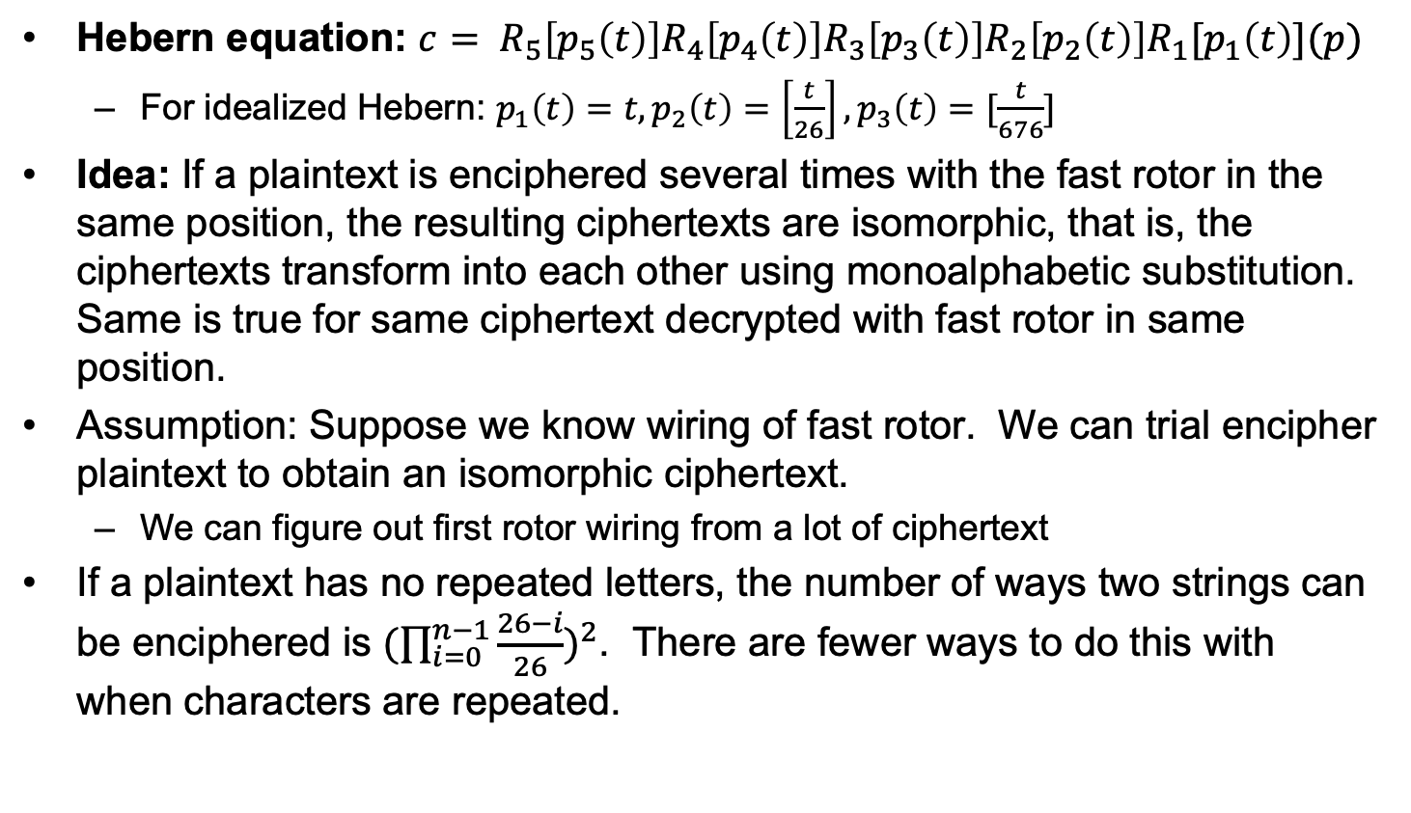
Hebern machines
Hebern equation: $c= R_{5}\left[p_{5}\left(t\right)\right]R_{4}\left[p_{4}\left(t\right)\right]R_{3}\left[p_{3}\left(t\right)\right]R_{2}\left[p_{2}\left(t\right)\right]R_{1}[p_{1}\left(t\right)](p)$
For idealized Hebern: $p_{1}\left(t\right)=t, p_{2}\left(t\right)=\left[\frac{t}{26}\right], p_{3}\left(t\right)=[\frac{t}{676}]$
Idea: If a plaintext is enciphered several times with the fast rotor in the same position, the resulting ciphertexts are isomorphic, that is, the ciphertexts transform into each other using monoalphabetic substitution. Same is true for same ciphertext decrypted with fast rotor in same position.
Assumption: Suppose we know wiring of fast rotor. We can trial encipher plaintext to obtain an isomorphic ciphertext.
We can figure out first rotor wiring from a lot of ciphertext
If a plaintext has no repeated letters, the number of ways two strings can be enciphered is ${(\prod_{i=0}^{n−1}{\frac{26−i}{26}})}^{2}$. There are fewer ways to do this with when characters are repeated.

Slide 79
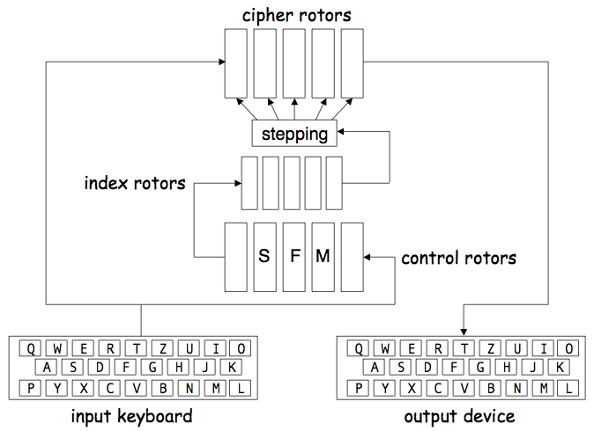
Sigaba Wiring Diagram
Control and index rotors determine stepping of cipher rotors

Slide 80
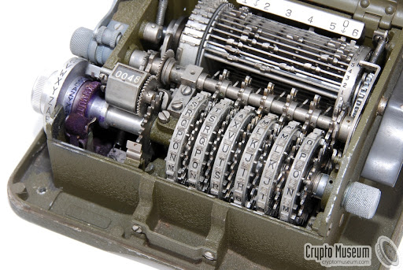
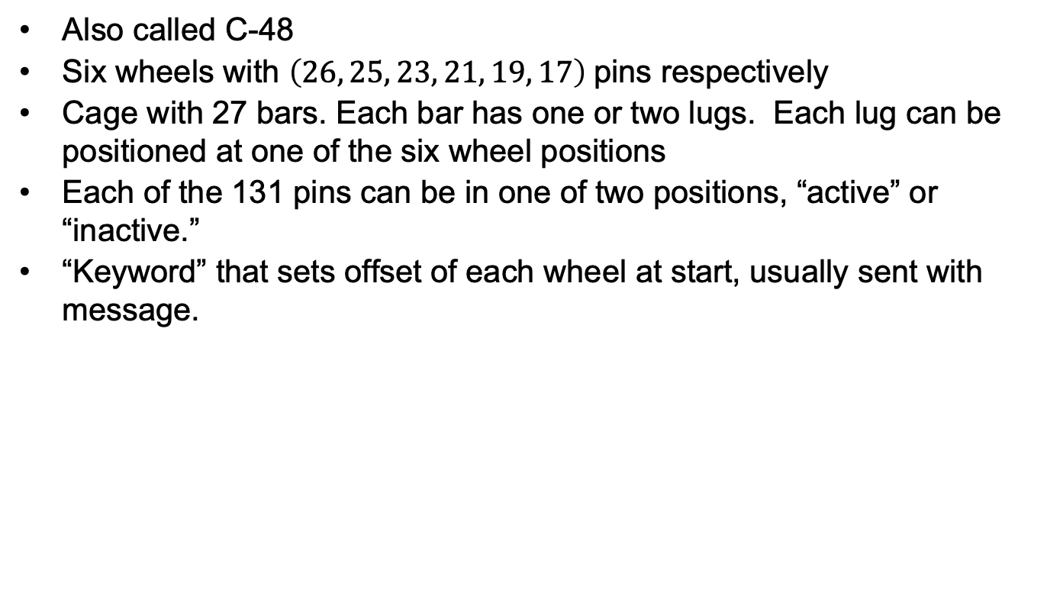
M209
Also called C-48
Six wheels with $\left(26, 25, 23, 21, 19, 17\right)$ pins respectively
Cage with 27 bars. Each bar has one or two lugs. Each lug can be positioned at one of the six wheel positions
Each of the 131 pins can be in one of two positions, “active” or “inactive.”
“Keyword” that sets offset of each wheel at start, usually sent with message.

Slide 81
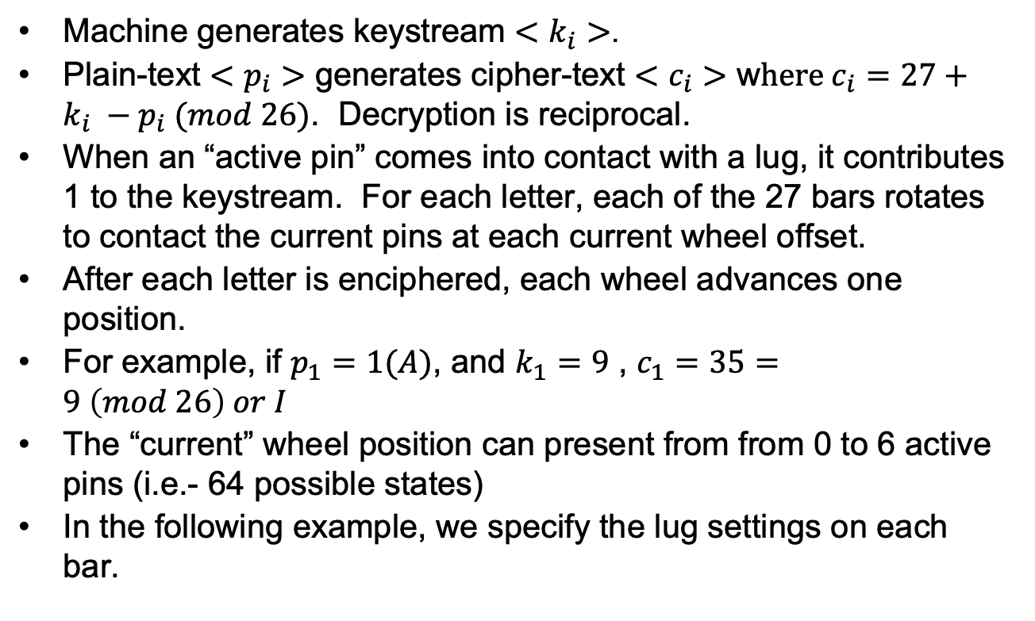
M209
Machine generates keystream $<k_{i}>$.
Plain-text $<p_{i}>$ generates cipher-text $<c_{i}>$ w$here c_{i}=27+k_{i} −p_{i} (mod 26)$. Decryption is reciprocal.
When an “active pin” comes into contact with a lug, it contributes 1 to the keystream. For each letter, each of the 27 bars rotates to contact the current pins at each current wheel offset.
After each letter is enciphered, each wheel advances one position.
For example, if $p_{1}=1(A)$, and $k_{1}=9$ , $c_{1}=35=9 \left(mod 26\right) or I$
The “current” wheel position can present from from 0 to 6 active pins (i.e.- 64 possible states)
In the following example, we specify the lug settings on each bar.

Slide 82
M209
Consider the lug settings, where “1” indicates lug presence
With these settings, wheel 1 can contribute up to 8 ticks, wheel 2, 2 ticks, wheel 3, 1 tick, wheel 4, 3 ticks, wheel 5 8 ticks and wheel 6, 4 ticks, for a maximum count of 26.
Bar | Lugs | Bar | Lugs | Bar | Lugs
1 | 100000 | 10 | 001000 | 19 | 000010
2 | 100000 | 11 | 000110 | 20 | 000010
3 | 100000 | 12 | 000110 | 21 | 000010
4 | 100000 | 13 | 000010 | 22 | 000010
5 | 100000 | 14 | 000010 | 23 | 000011
6 | 100000 | 15 | 000010 | 24 | 000001
7 | 100000 | 16 | 000010 | 25 | 000001
8 | 110000 | 17 | 000010 | 26 | 000001
9 | 010010 | 18 | 000010 | 27 | 000001

Slide 83
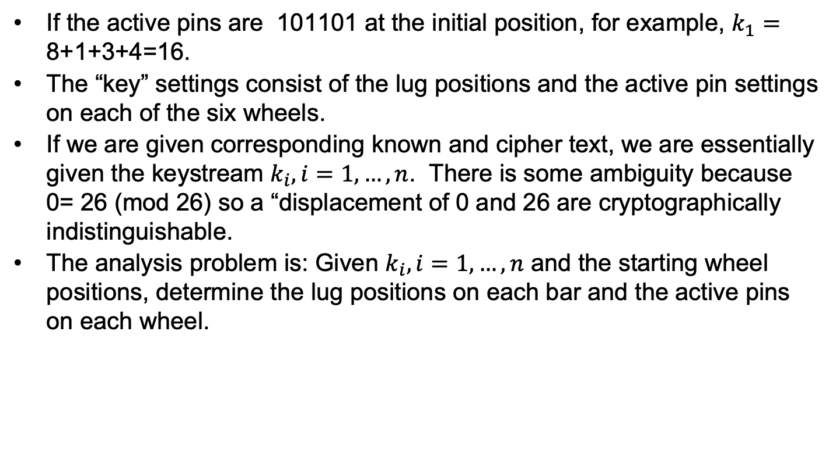
M209
If the active pins are 101101 at the initial position, for example, $k_{1}=$ 8+1+3+4=16.
The “key” settings consist of the lug positions and the active pin settings on each of the six wheels.
If we are given corresponding known and cipher text, we are essentially given the keystream $k_{i}, i=1,…,n$. There is some ambiguity because 0= 26 (mod 26) so a “displacement of 0 and 26 are cryptographically indistinguishable.
The analysis problem is: Given $k_{i}, i=1,…,n$ and the starting wheel positions, determine the lug positions on each bar and the active pins on each wheel.

Slide 84
M209 example
M209 simulator
27 lugs in total
Machine state:
wheel 1: 01010101000010100101010001
wheel 2: 0000110000101100110000101
wheel 3: 00111000001101100011010
wheel 4: 101011101010110010101
wheel 5: 0101000001001100010
wheel 6: 11000101100001101
lugs on wheel: 04 05 03 07 02 06
wheel positions: 0 0 0 0 0 0
keystream: 13 12 10 09 15 22 07 10 13 02 15 03 18 23 13 00 18 17 16 07 09 14 13 07 11 20 10 14 02 16 11 19 02 20 16 11 05 15 09 15 04 23 21 04 10 04 07 24 16 08 18 12 13 04 12 18 09 07 15 13 17 00 12 12 13 16 11 21 13 19 02 14 08 20 07 13 13 06 00 21 08 17 09 14 13 17 13 08 17 09 20 05 22

Slide 85
M209 example
Message is 93 letters long
Plain :
HELLOTHERETHISISAMUCHLONGERMESSAGEFORBILLYFRIEDMANABRAHAMSINKOVSOLOMONKULLBACKANDFRANKROWLETT
Cipher :
GIZYBDAGWYWWKFFISFWFCDZUFQTCYYTTWQLXOOBETZQNCAEMQVSLWEFSXPHAHMRUZFXJZGSUXJGNLWAIFMSOAHWUVYQMD
Decrypted:
HELLOTHERETHISISAMUCHLONGERMESSAGEFORBILLYFRIEDMANABRAHAMSINKOVSOLOMONKULLBACKANDFRANKROWLETT

Slide 86
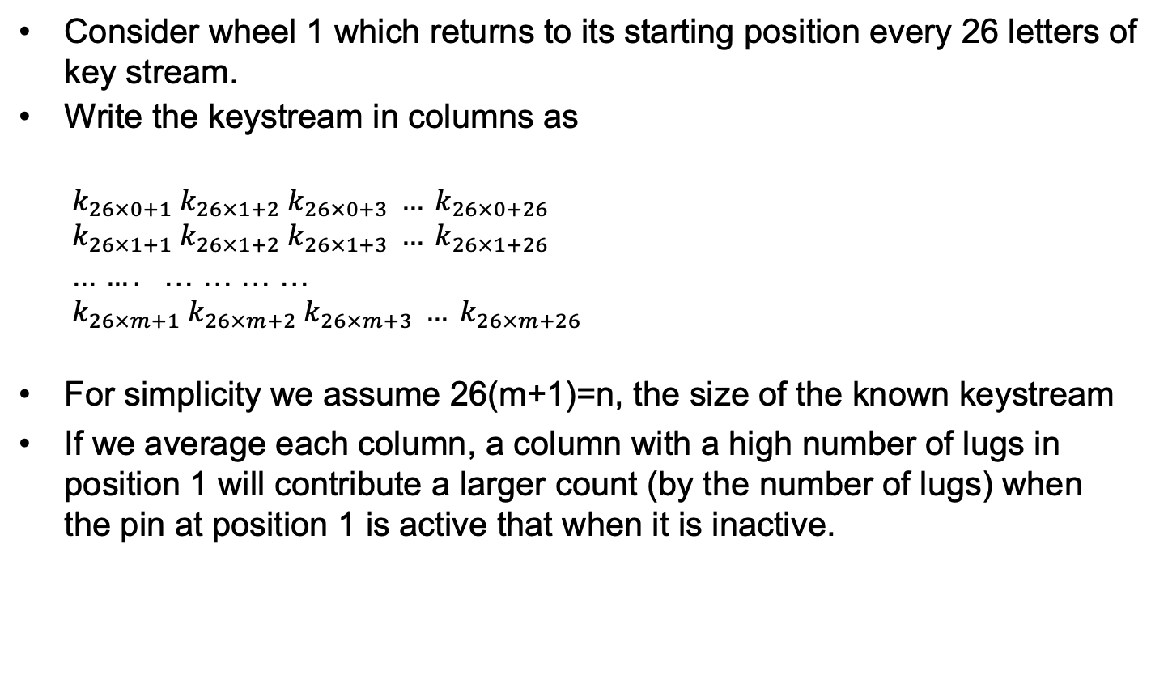
M209 –basic attack
Consider wheel 1 which returns to its starting position every 26 letters of key stream.
Write the keystream in columns as
$$k_{26×0+1} k_{26×1+2} k_{26×0+3} … k_{26×0+26}$$
$$k_{26×1+1} k_{26×1+2} k_{26×1+3} … k_{26×1+26}$$
... $….$ … … … …
$$k_{26×m+1} k_{26×m+2} k_{26×m+3} … k_{26×m+26}$$
For simplicity we assume 26(m+1)=n, the size of the known keystream
If we average each column, a column with a high number of lugs in position 1 will contribute a larger count (by the number of lugs) when the pin at position 1 is active that when it is inactive.

Slide 87
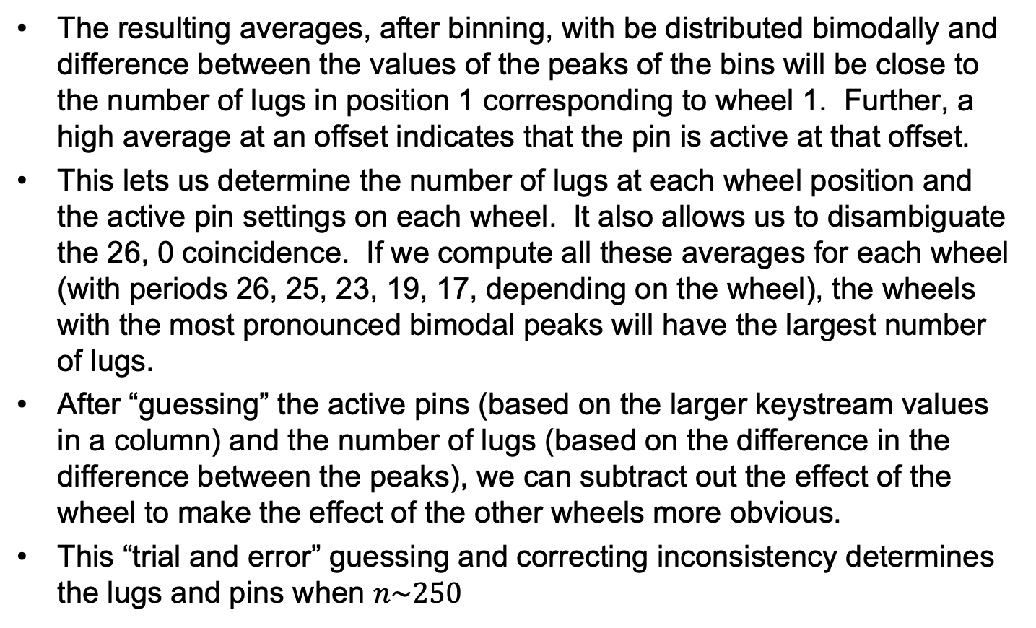
M209 –basic attack
The resulting averages, after binning, with be distributed bimodally and difference between the values of the peaks of the bins will be close to the number of lugs in position 1 corresponding to wheel 1. Further, a high average at an offset indicates that the pin is active at that offset.
This lets us determine the number of lugs at each wheel position and the active pin settings on each wheel. It also allows us to disambiguate the 26, 0 coincidence. If we compute all these averages for each wheel (with periods 26, 25, 23, 19, 17, depending on the wheel), the wheels with the most pronounced bimodal peaks will have the largest number of lugs.
After “guessing” the active pins (based on the larger keystream values in a column) and the number of lugs (based on the difference in the difference between the peaks), we can subtract out the effect of the wheel to make the effect of the other wheels more obvious.
This “trial and error” guessing and correcting inconsistency determines the lugs and pins when $n\sim 250$

Slide 88
M209 – basic attack
Here is what the initial data might look like, when we pick the “obviously” bimodal spread at wheel 4:
M209 analysis, key length is 250
Global average: 12.09
Wheel 4
pin 0: 14.50
pin 1: 8.08
pin 2: 14.58
pin 3: 8.58
pin 4: 14.83
pin 5: 14.75
pin 6: 15.58
pin 7: 8.33
pin 8: 15.42
pin 9: 6.42
pin 10: 16.33
pin 11: 7.42
pin 12: 16.00
pin 13: 14.25
pin 14: 8.50
pin 15: 7.67
pin 16: 16.08
pin 17: 7.58
pin 18: 15.25
pin 19: 8.36
pin 20: 15.27

Slide 89
M209 – basic attack
After binning:
0:
1:
2:
3:
4:
5:
6: x
7: xxx
8: xxxxx
9:
10:
11:
12:
13:
14: xxxxx
15: xxxx
16: xxx
17:
18:
19:
20:
This indicates that there are about 6 lugs in wheel position 4 and pins 0,2,4,5,6,8,10,12,13,16,18,20 are likely active while the remaining pins are not.
This is right, almost. There are actually 7 lugs at wheel 4.

Slide 90
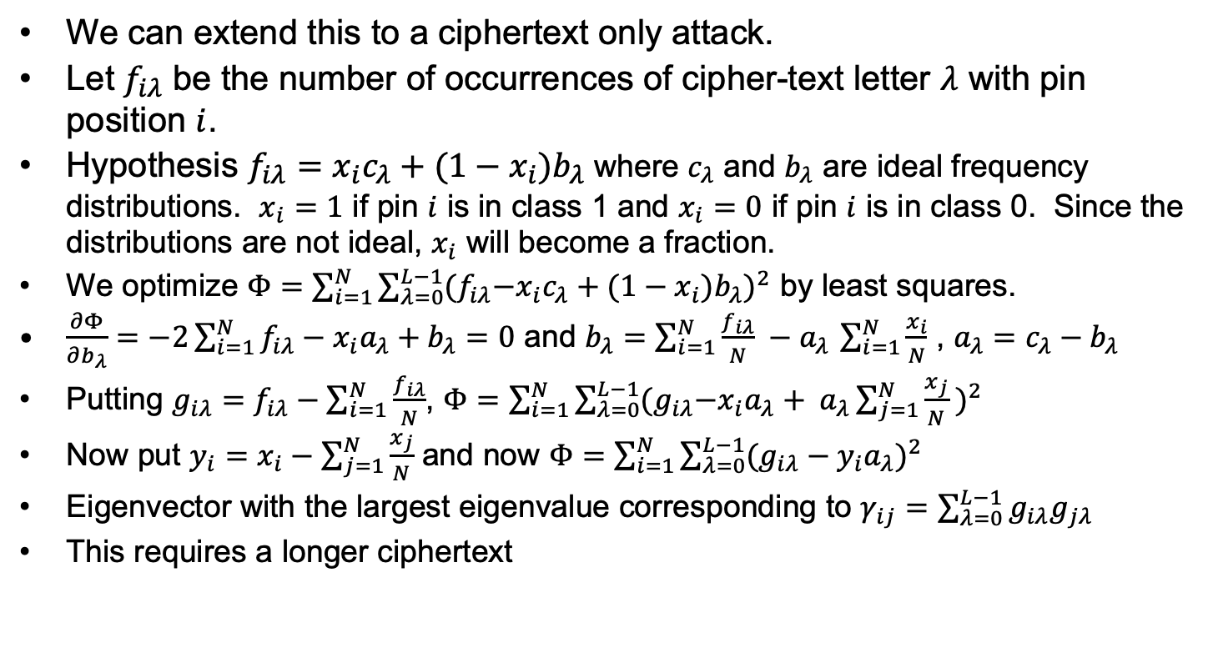
M209 cipher-text only cryptanalysis
We can extend this to a ciphertext only attack.
Let $f_{iλ}$ be the number of occurrences of cipher-text letter $λ$ with pin position $i$.
Hypothesis $f_{iλ}=x_{i}c_{λ}+(1−x_{i})b_{λ}$ where $c_{λ}$ and $b_{λ}$ are ideal frequency distributions. $x_{i}=1$ if pin $i$ is in class 1 and $x_{i}=0$ if pin $i$ is in class 0. Since the distributions are not ideal, $x_{i}$ will become a fraction.
We optimize $Φ=\sum_{i=1}^{N}{\sum_{λ=0}^{L−1}{{{(f}_{iλ}−x_{i}c_{λ}+(1−x_{i})b_{λ})}^{2}}}$ by least squares.
$\frac{∂Φ}{∂b_{λ}}=−2\sum_{i=1}^{N}{f_{iλ}−x_{i}a_{λ}+b_{λ}}=0$ and $b_{λ}=\sum_{i=1}^{N}{\frac{f_{iλ}}{N}} −a_{λ }\sum_{i=1}^{N}{\frac{x_{i}}{N}}$ , $a_{λ}=c_{λ}−b_{λ}$
Putting $g_{iλ}=f_{iλ}−\sum_{i=1}^{N}{\frac{f_{iλ}}{N}}$, $Φ=\sum_{i=1}^{N}{\sum_{λ=0}^{L−1}{{{(g}_{iλ}−x_{i}a_{λ}+ a_{λ}\sum_{j=1}^{N}{\frac{x_{j}}{N}} )}^{2}}}$
Now put $y_{i}=x_{i}−\sum_{j=1}^{N}{\frac{x_{j}}{N}}$ and now $Φ=\sum_{i=1}^{N}{\sum_{λ=0}^{L−1}{{(g_{iλ}−y_{i}a_{λ})}^{2}}}$
Eigenvector with the largest eigenvalue corresponding to $γ_{ij}=\sum_{λ=0}^{L−1}{g_{iλ}g_{jλ}}$
This requires a longer ciphertext

Slide 91
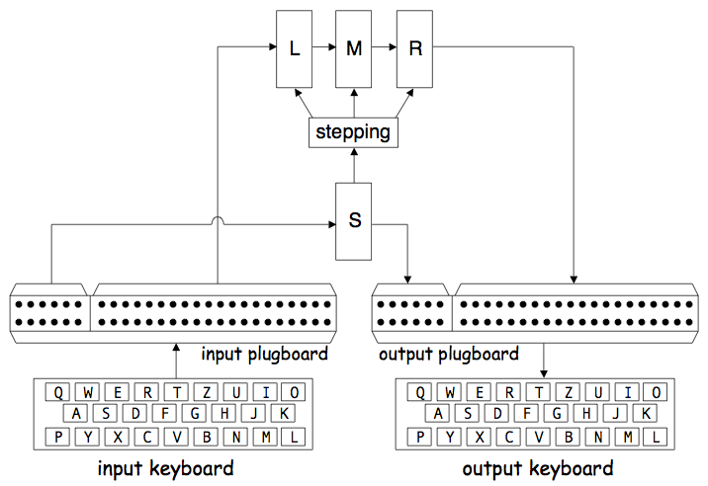
Purple
Input letter permuted by plugboard.
Vowels and consonants sent thru different switches.
The “6-20 split”

Slide 92
Purple
Switch S
Steps once for each letter typed
Permutes vowels
Switches L,M,R
One of these steps for each letter typed
L,M,R stepping determined by S

Slide 93
Purple
Switched permutations
Not rotors!!!
S,L,M, and R are switches
Each step, one of the perms switches to a different permutation

Slide 94
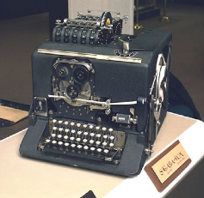
Sigaba
From Stamp

Slide 95
Sigaba Wiring Diagram
Index rotors do not step
Control rotors
Middle 3 step as: slow, fast, medium
Outside rotors don’t step
Cipher rotors
At least 1, at most 4 step each time
When a letter is typed
4 inputs to control rotors activated
These are: F,G,H,I
Then 4 (scrambled) letters output
Outputs of control rotors combined
Then fed into index rotors
Outputs of control rotors combined
Result(s) go into index rotors
From 1 to 4 inputs to index rotors
Index rotor outputs combined in pairs
Active index rotor outputs determine which cipher rotors step
From Stamp

Slide 96
Cipher Rotor Stepping
F,G,H,I input to control rotors
Let I₀,I₁,…,I₉ be inputs to index rotors
I₀ is always inactive, and…
A,B,C,…, Z are control rotor outputs
I₁ = B | I₂ = C | I₃ = D∨E
I₄ = F∨G∨H | I₅ = I∨J∨K | I₆ = L∨M∨N∨O
I₇ = P∨Q∨R∨S∨T | I₈ = U∨V∨W∨X∨Y∨Z | I₉ = A
Let O₀,O₁,…,O₉ be index rotor outputs
If C_{i} == 1, cipher rotor i steps
Cipher rotors numbered left-to-right
C₀ = O₀∨O₉ | C₁ = O₇∨O₈ | C₂ = O₅∨O₆ | C₃ = O₃∨O₄ | C₄ = O₁∨O₂
Note that 1 to 4 of the O_{i} are active
Implies that 1 to 4 of C_{i} are active
From Stamp

Slide 97
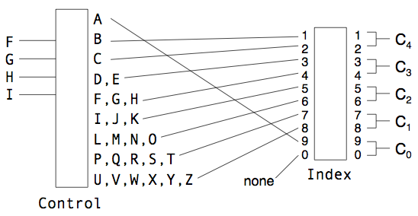
Stepping Maze
If cipher/control rotors all set to “A”
And index rotors all set to “0”
Select 5 cipher rotors: (26!)⁵ = 2⁴⁴²
Select 5 control rotors: (26!)⁵ = 2⁴⁴²
Select 5 index rotors: (10!)⁵ = 2¹⁰⁹
Keyspace is enormous: 993 bits!
Model control permutations as random
Probabilities of the C_{i} are not uniform
From Stamp

Slide 98
Sigaba Attack
Assumptions
Full 95.6 bit WWII key-space is used
Trudy has a Sigaba machine (so Trudy knows rotor permutations)
Trudy has some known plaintext
Goal: use as little-known plaintext as possible
Primary phase
Find all cipher rotor settings that are consistent with known plaintext
Requires some amount of known plaintext
Secondary phase
Find control rotor settings, index perm
May require more known plaintext
From Stamp

Slide 99
Primary Phase
Select and initialize cipher rotors
Binomial(10,5) ⋅ 5! ⋅ 2⁵ ⋅ 26⁵ = 2^{43.4} settings
For each of these 2^{43.4} settings, how many cipher perms are possible at next step?
From 1 to 4 cipher rotors can step
30 ways that 1 to 4 (out of 5) rotors can step
Given a putative cipher rotor setting…
Check whether it matches known plaintext. If not, discard it
If a match, try all 30 steps and keep any that match with next known plaintext
Repeat until either
No matches (putative setting is discarded)
Used all known plaintext (save for secondary)
From Stamp

Slide 100
Primary Phase
Correct rotor setting is said to be causal
All incorrect settings are random
First letter matches with probability 1/26
If it matches, then must try all 30 steps
Each matches with probability 1/26
Binomial distribution with p = 1/26 and n = 30
Expected matches is 30/26 = 1.154
If first letter matches, then after n steps, we expect about (1.154)^{n} surviving paths
If first plaintext matches, about (1.154)^{n} surviving paths after n steps
We want to eliminate putative cipher rotor settings that are incorrect
The random settings
How to do this when we get more paths!
From Stamp

Slide 101
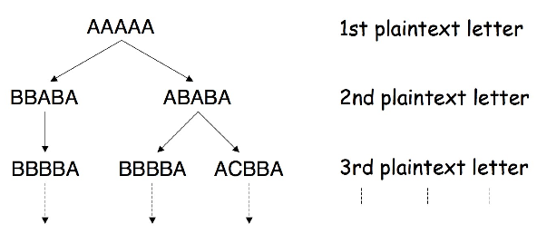
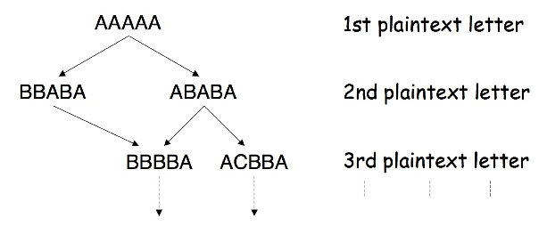
Primary Phase: Merging Paths
Suppose first 3 plaintext match
With initial settings AAAAA
Consistent paths
Merged consistent paths
Can merge paths since only the rotor settings (not path) needed for next step
From Stamp

Slide 102
Secondary Phase
Discussion here applies to each primary phase survivor
Each primary survivor gives putative cipher rotors and settings
Obvious secondary test is to…
Try all control and index settings: 10!/32 ⋅ 5! ⋅ 2⁵ ⋅ 26⁵ = 2^{52.2} of these
Work of more than 2⁵² per primary survivor
Primary work is about 2⁴³
With about 2²⁰ survivors
Obvious secondary has total work about 2⁷²
Since 2⁵² work for each of 2²⁰ survivors
Can we improve secondary phase?
Cipher rotor motion is not uniform
Recall that from 1 to 4 steps for each letter
Also, index permutation is fixed for a message
From Stamp

Slide 103
Example
Consider index perm 0123456789 → 5479381026
C₄ connected to 10 control letters
C₂ connected to 1 control letter
C₄ will step much more frequently than C₂
From Stamp

Slide 104
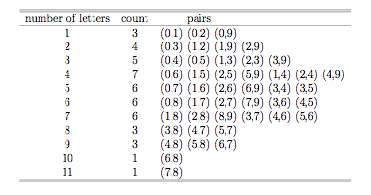
Index Perm Inputs
Can use this table to determine input pairs
Count number of times each cipher rotor steps (using the known plaintext)
From Stamp

Slide 105
Improved Secondary
About 100 to 200 known plaintexts
Reduces number of index perms to……about 2⁷
This reduces secondary work from 10!/32 ⋅ 5! ⋅ 2⁵ ⋅ 26⁵ = 2^{52.2} to about 2⁷ ⋅ 5! ⋅ 2⁵ ⋅ 26⁵ = 2^{42.4}
Note: this work is per primary survivor
WWII Sigaba had a readily available keyspace of 95.6 bits
Our attack has work factor of about 2⁶⁰ under reasonable assumptions
Sigaba as generally used in WWII had exhaustive key search work of 2^{47.6}
From Stamp

