Slide 1

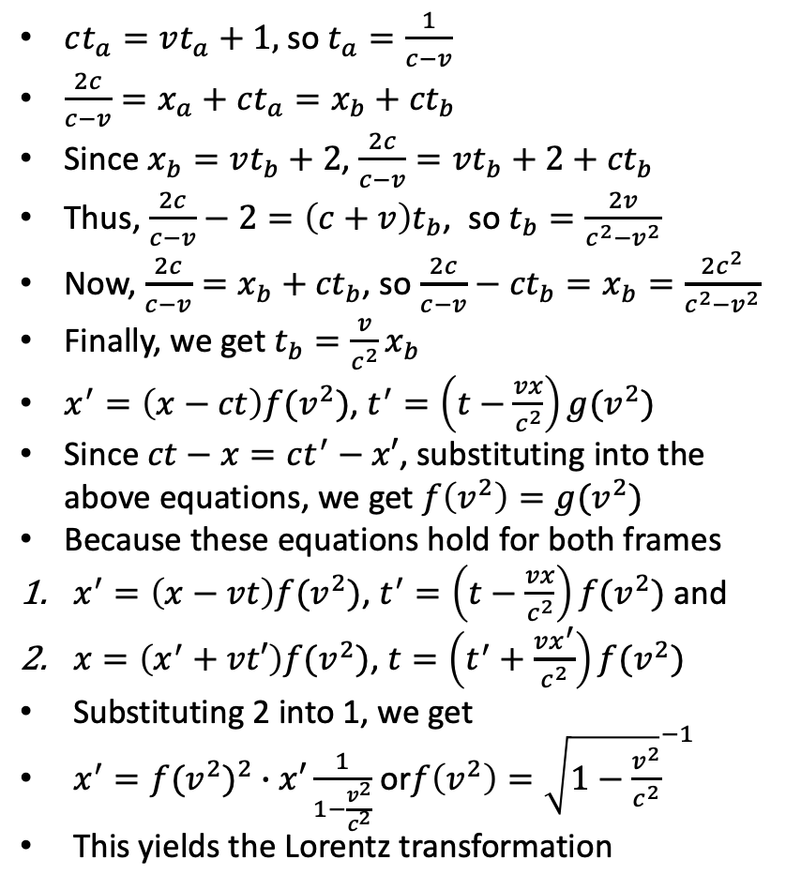









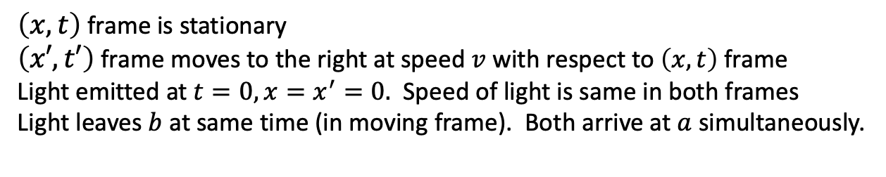
Proof of Lorentz Transformation
$ct_{a}=vt_{a}+1,$so $t_{a}=\frac{1}{c−v}$
$\frac{2c}{c−v}=x_{a}+ct_{a}=x_{b}+{ct}_{b}$
Since $x_{b}=vt_{b}+2$, $\frac{2c}{c−v}=vt_{b}+2+{ct}_{b}$
Thus, $\frac{2c}{c−v}−2=\left(c+v\right)t_{b}$, so $t_{b}=\frac{2v}{c^{2}−v^{2}}$
Now, $\frac{2c}{c−v}=x_{b}+{ct}_{b}$, so $\frac{2c}{c−v}−{ct}_{b}=x_{b}=\frac{2c^{2}}{c^{2}−v^{2}}$
Finally, we get $t_{b}=\frac{v}{c^{2}}x_{b}$
$x^{′}=\left(x−ct\right)f(v^{2})$, $t^{′}=\left(t−\frac{vx}{c^{2}}\right)g(v^{2})$
Since $ct−x=ct^{′}−x′$, substituting into the above equations, we get $f\left(v^{2}\right)=g(v^{2})$
Because these equations hold for both frames
$x^{′}=\left(x−vt\right)f(v^{2})$, $t^{′}=\left(t−\frac{vx}{c^{2}}\right)f(v^{2})$ and
$x=\left(x^{′}+vt′\right)f(v^{2})$, $t=\left(t^{′}+\frac{vx^{′}}{c^{2}}\right)f(v^{2})$
Substituting 2 into 1, we get
$x^{′}={f(v^{2})}^{2}∙x′\frac{1}{1−\frac{v^{2}}{c^{2}}}$ or$f\left(v^{2}\right)={\sqrt{1−\frac{v^{2}}{c^{2}}}}^{−1}$
This yields the Lorentz transformation
$$x=vt$$
$$x=vt+1$$
$$x=vt+2$$
$$t$$
$$x=ct$$
$$a$$
$$b$$
$$x^{′},$$
$$t^{′}=0$$
$$x=−ct$$
$$x$$
$\left(x, t\right)$ frame is stationary
$\left(x′, t′\right)$ frame moves to the right at speed $v$ with respect to $\left(x, t\right)$ frame
Light emitted at $t=0, x=x^{′}=0.$ Speed of light is same in both frames
Light leaves $b$ at same time (in moving frame). Both arrive at $a$ simultaneously.

