Slide 1

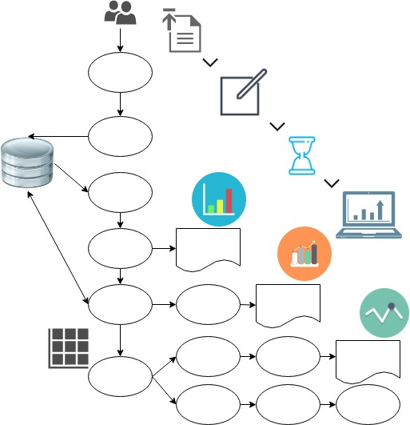
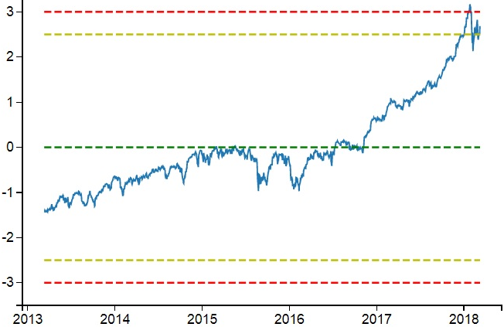
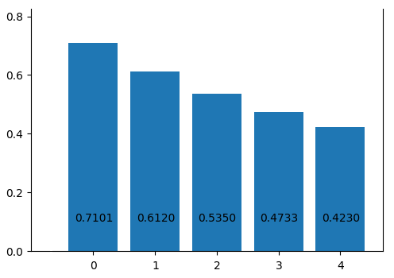
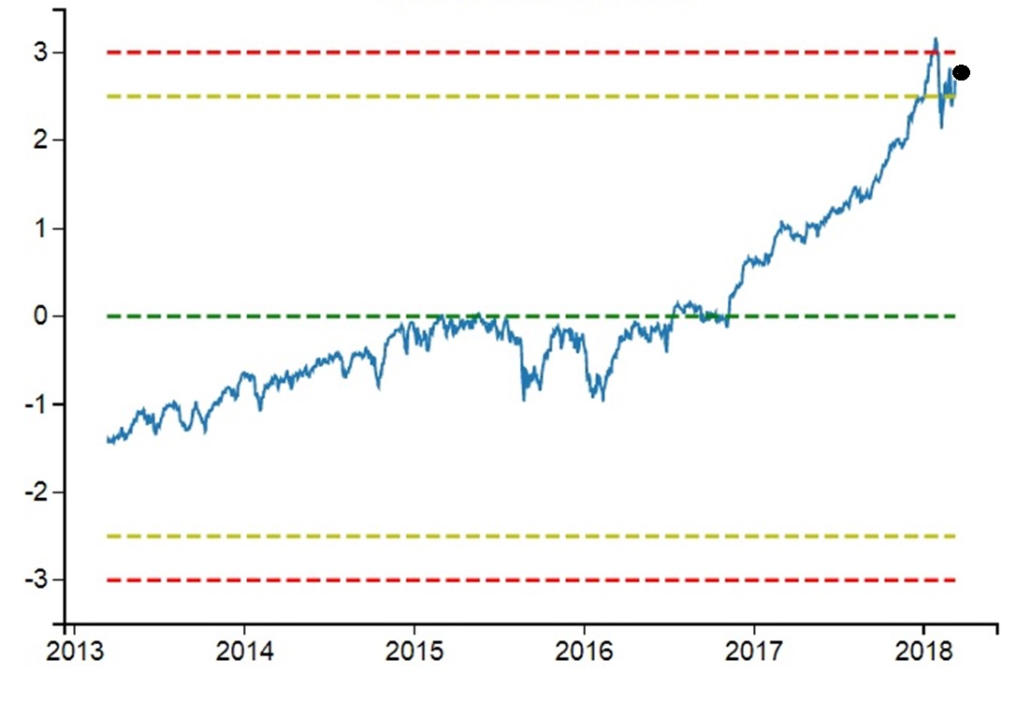
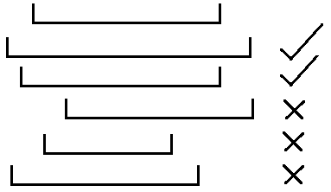
RepoMining – Repository and Mining of Temporal Data
Siomara Nieves, Jessica Nguy
Faculty Advisor/s: Dr. Philip Chan, Dept of Computer Science, Florida Institute of Technology
Objective
System Architecture
Results
Create a web application that allows and simplifies the visualization and analysis of data by answering the following questions:
Q1: Time vs data
Time vs z-score
Time vs Δdata
Time vs Δ z-score
Q2: Data vs top-k var.
Data vs Corr. top-k
Top-1 corr. top-k
Upload
Description(name, info, IDnum)
Granularity(start, end, type, IDnum)
Tags(tag1, tag2, tag3, IDnum)
.csv file
Q3: Forecast
Q1: Is there a significant change on my data?
Q2: What are the top-k variables affecting it?
Q3: What is the next possible value?
Metadata
File, target, tags
Read data
Fig 1: Q1 time vs data
Q1
Q1 graphs
Fig 2: Q2 Target vs top-k variables
Motivation
Narrow
Data
Q2
Q2 graphs
To simplify the appearance of data mining, collection, and analysis as well as to be able to predict future trends based on different types of information.
80% of info
Matrix top-k & target
Linear Regression
Q3 graphs
20% of info
Percent Error
Error^2
Mean Abs Value
Accuracy
Tools
Algorithms
Django – Web Application Framework
Q1: time vs data, z-score, Δx, Δz-score
Q2: NarrowData, Pearson Correlation
Q3: Linear Regression
NarrowData: Compares the timestamps of all data in storage and returns the ones whose starting timestamp falls before the target’s and whose end timestamp falls after the target’s. Uses lag of n-times to determine if past data affected present data. Calculates the correlation value of the matching data and returns the top-k variables affecting the target.
Linear Regression: Used along with top-k values from to predict the target’s future timestamp.
Python – Programming Language
Fig3: Q3 value forecast
JSON – Handling data objects
HTML/Bootstrap/CSS/JS – Front-end
Notes:
1

