Slide 1
Statistical inference: CLT, confidence intervals, p-values

Slide 2
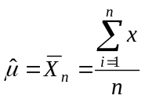
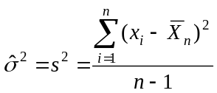
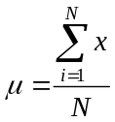
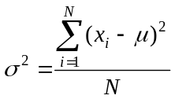
Statistical Inference
The process of making guesses about the truth from a sample.
Sample statistics
Truth (not observable)
Sample (observation)
*hat notation ^ is often used to indicate “estitmate”
Population parameters
Make guesses about the whole population

Slide 3
Statistics vs. Parameters
Sample Statistic – any summary measure calculated from data; e.g., could be a mean, a difference in means or proportions, an odds ratio, or a correlation coefficient
  E.g., the mean vitamin D level in a sample of 100 men is 63 nmol/L
  E.g., the correlation coefficient between vitamin D and cognitive function in the sample of 100 men is 0.15
Population parameter – the true value/true effect in the entire population of interest
  E.g., the true mean vitamin D in all middle-aged and older European men is 62 nmol/L
  E.g., the true correlation between vitamin D and cognitive function in all middle-aged and older European men is 0.15

Slide 4
Examples of Sample Statistics:
Single population mean
Single population proportion
Difference in means (ttest)
Difference in proportions (Z-test)
Odds ratio/risk ratio
Correlation coefficient
Regression coefficient
…
Notes:
It turns out that if you were to go out and sample many, many times, most sample statistics that you could calculate would follow a normal distribution.
What are the 2 parameters (from last time) that define any normal distribution?
Remember that a normal curve is characterized by two parameters, a mean and a variability (SD)
What do you think the mean value of a sample statistic would be? The standard deviation?
Remember standard deviation is natural variability of the population
Standard error can be standard error of the mean or standard error of the odds ratio or standard error of the difference of 2 means, etc. The standard error of any sample statistic.

Slide 5
Example 1: cognitive function and vitamin D
Hypothetical data loosely based on [1]; cross-sectional study of 100 middle-aged and older European men.
Estimation: What is the average serum vitamin D in middle-aged and older European men?
  Sample statistic: mean vitamin D levels
Hypothesis testing: Are vitamin D levels and cognitive function correlated?
  Sample statistic: correlation coefficient between vitamin D and cognitive function, measured by the Digit Symbol Substitution Test (DSST).
1. Lee DM, Tajar A, Ulubaev A, et al. Association between 25-hydroxyvitamin D levels and cognitive performance in middle-aged and older European men. J Neurol Neurosurg Psychiatry. 2009 Jul;80(7):722-9.

Slide 6
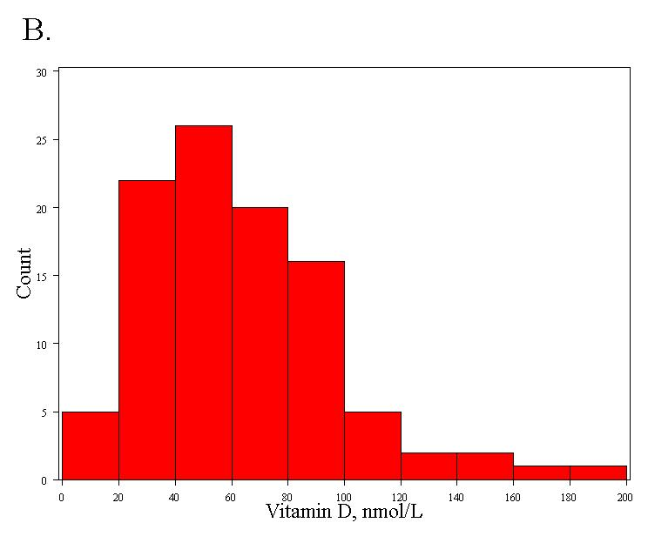
Distribution of a trait: vitamin D
Right-skewed!
Mean= 63 nmol/L
Standard deviation = 33 nmol/L
Notes:
IF the true mean was 128 with an average variability of 15 lbs….

Slide 7
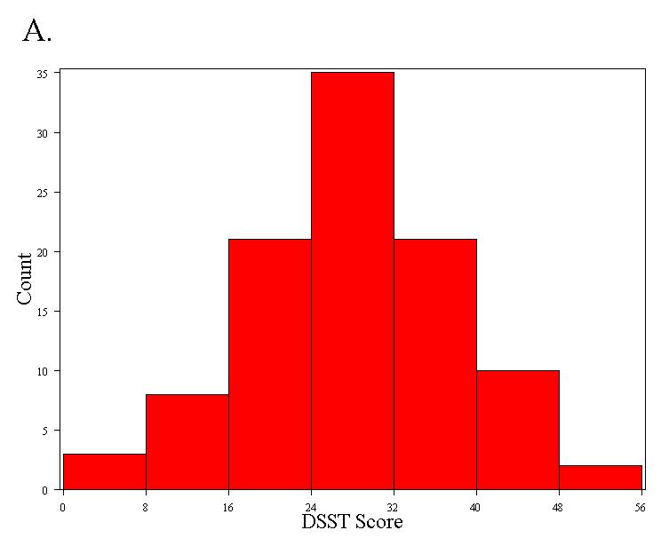
Distribution of a trait: DSST
Normally distributed
Mean = 28 points
Standard deviation = 10 points
Notes:
By chance, you would sometimes get values for your sample mean as high as 157 pounds. Very rarely would you see anything higher, though.

Slide 8
Distribution of a statistic…
Statistics follow distributions too…
But the distribution of a statistic is a theoretical construct.
Statisticians ask a thought experiment: how much would the value of the statistic fluctuate if one could repeat a particular study over and over again with different samples of the same size?
By answering this question, statisticians are able to pinpoint exactly how much uncertainty is associated with a given statistic.

Slide 9
Distribution of a statistic
Two approaches to determine the distribution of a statistic:
  1. Computer simulation
    Repeat the experiment over and over again virtually!
    More intuitive; can directly observe the behavior of statistics.
  2. Mathematical theory
    Proofs and formulas!
    More practical; use formulas to solve problems.

Slide 10
Example of computer simulation…
How many heads come up in 100 coin tosses?
Flip coins virtually
  Flip a coin 100 times; count the number of heads.
  Repeat this over and over again a large number of times (we’ll try 30,000 repeats!)
  Plot the 30,000 results.

Slide 11
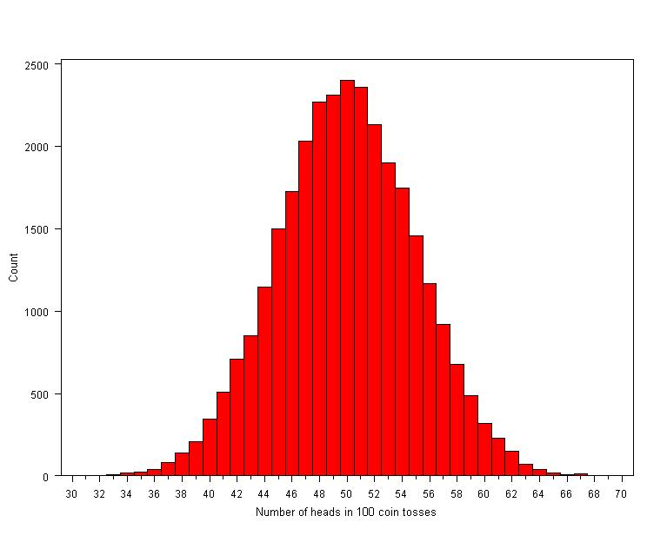
Coin tosses…
Conclusions:
We usually get between 40 and 60 heads when we flip a coin 100 times.
It’s extremely unlikely that we will get 30 heads or 70 heads (didn’t happen in 30,000 experiments!).

Slide 12
Distribution of the sample mean, computer simulation…
1. Specify the underlying distribution of vitamin D in all European men aged 40 to 79.
  Right-skewed
  Standard deviation = 33 nmol/L
  True mean = 62 nmol/L (this is arbitrary; does not affect the distribution)
2. Select a random sample of 100 virtual men from the population.
3. Calculate the mean vitamin D for the sample.
4. Repeat steps (2) and (3) a large number of times (say 1000 times).
5. Explore the distribution of the 1000 means.

Slide 13
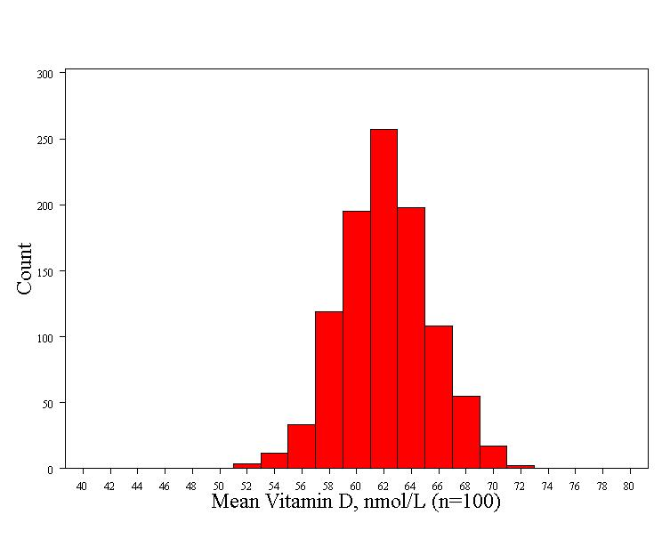
Distribution of mean vitamin D (a sample statistic)
Normally distributed! Surprise!
Mean= 62 nmol/L (the true mean)
Standard deviation = 3.3 nmol/L

Slide 14
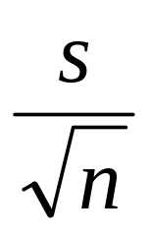
Distribution of mean vitamin D (a sample statistic)
Normally distributed (even though the trait is right-skewed!)
Mean = true mean
Standard deviation = 3.3 nmol/L
  The standard deviation of a statistic is called a standard error
  The standard error of a mean =

Slide 15
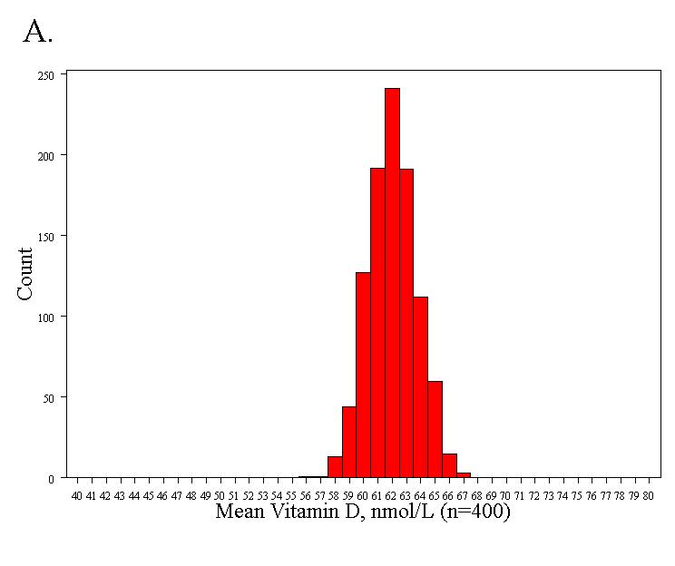
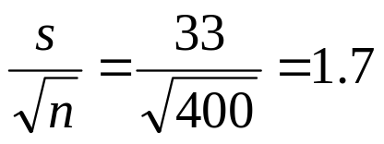
If I increase the sample size to n=400…
Standard error = 1.7 nmol/L

Slide 16
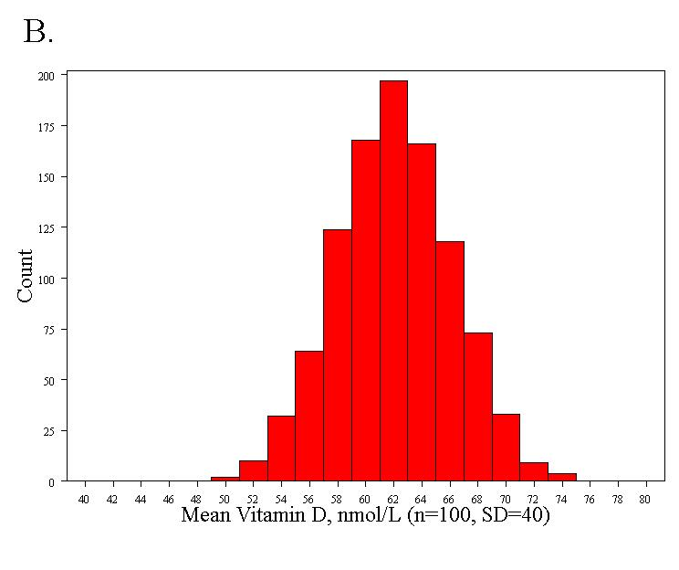
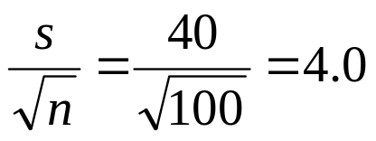
If I increase the variability of vitamin D (the trait) to SD=40…
Standard error = 4.0 nmol/L

Slide 17
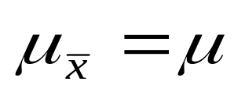
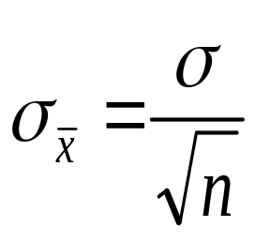
Mathematical Theory…
The Central Limit Theorem!
If all possible random samples, each of size n, are taken from any population with a mean μ and a standard deviation σ, the sampling distribution of the sample means (averages) will:
1. have mean:
2. have standard deviation:
3. be approximately normally distributed regardless of the shape of the parent population (normality improves with larger n). It all comes back to Z!
Notes:
It turns out that if you were to go out and sample many, many times, most sample statistics that you could calculate would follow a normal distribution.
What are the 2 parameters (from last time) that define any normal distribution?
Remember that a normal curve is characterized by two parameters, a mean and a variability (SD)
What do you think the mean value of a sample statistic would be? The standard deviation?
Remember standard deviation is natural variability of the population
Standard error can be standard error of the mean or standard error of the odds ratio or standard error of the difference of 2 means, etc. The standard error of any sample statistic.

Slide 18
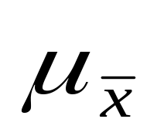
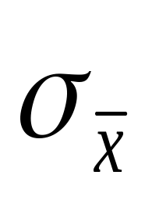
Symbol Check
The mean of the sample means.
The standard deviation of the sample means. Also called “the standard error of the mean.”
Notes:
It turns out that if you were to go out and sample many, many times, most sample statistics that you could calculate would follow a normal distribution.
What are the 2 parameters (from last time) that define any normal distribution?
Remember that a normal curve is characterized by two parameters, a mean and a variability (SD)
What do you think the mean value of a sample statistic would be? The standard deviation?
Remember standard deviation is natural variability of the population
Standard error can be standard error of the mean or standard error of the odds ratio or standard error of the difference of 2 means, etc. The standard error of any sample statistic.

Slide 19
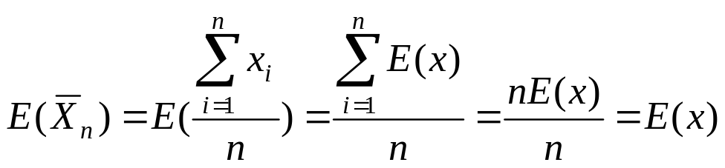
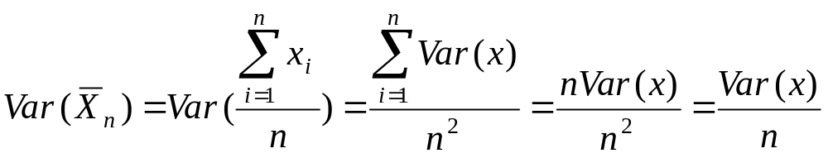
Mathematical Proof (optional!)
If X is a random variable from any distribution with known mean, E(x), and variance, Var(x), then the expected value and variance of the average of n observations of X is:

Slide 20
Computer simulation of the CLT:
(this is what we will do in lab next Wednesday!)
1. Pick any probability distribution and specify a mean and standard deviation.
2. Tell the computer to randomly generate 1000 observations from that probability distributions
  E.g., the computer is more likely to spit out values with high probabilities
3. Plot the “observed” values in a histogram.
4. Next, tell the computer to randomly generate 1000 averages-of-2 (randomly pick 2 and take their average) from that probability distribution. Plot “observed” averages in histograms.
5. Repeat for averages-of-10, and averages-of-100.
Notes:
IF the true mean was 128 with an average variability of 15 lbs….

Slide 21
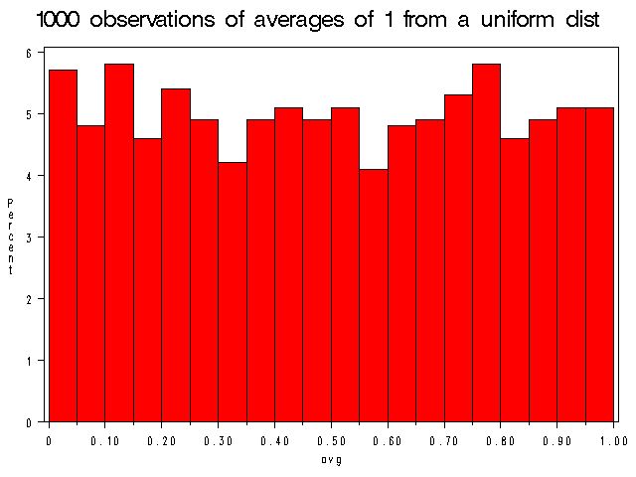
Uniform on [0,1]: average of 1
(original distribution)
Notes:
It turns out that if you were to go out and sample many, many times, most sample statistics that you could calculate would follow a normal distribution.
What are the 2 parameters (from last time) that define any normal distribution?
Remember that a normal curve is characterized by two parameters, a mean and a variability (SD)
What do you think the mean value of a sample statistic would be? The standard deviation?
Remember standard deviation is natural variability of the population
Standard error can be standard error of the mean or standard error of the odds ratio or standard error of the difference of 2 means, etc. The standard error of any sample statistic.

Slide 22
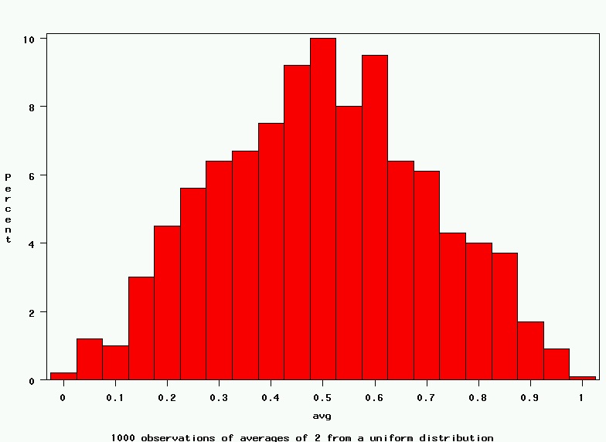
Uniform: 1000 averages of 2
Notes:
It turns out that if you were to go out and sample many, many times, most sample statistics that you could calculate would follow a normal distribution.
What are the 2 parameters (from last time) that define any normal distribution?
Remember that a normal curve is characterized by two parameters, a mean and a variability (SD)
What do you think the mean value of a sample statistic would be? The standard deviation?
Remember standard deviation is natural variability of the population
Standard error can be standard error of the mean or standard error of the odds ratio or standard error of the difference of 2 means, etc. The standard error of any sample statistic.

Slide 23
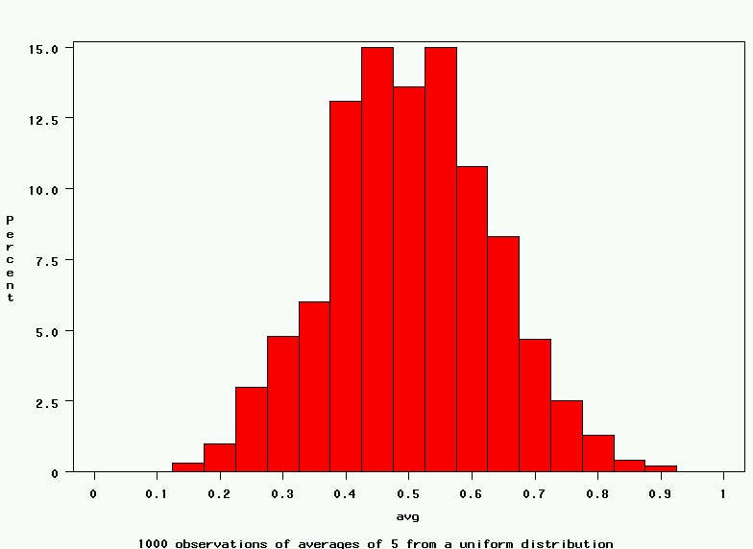
Uniform: 1000 averages of 5
Notes:
It turns out that if you were to go out and sample many, many times, most sample statistics that you could calculate would follow a normal distribution.
What are the 2 parameters (from last time) that define any normal distribution?
Remember that a normal curve is characterized by two parameters, a mean and a variability (SD)
What do you think the mean value of a sample statistic would be? The standard deviation?
Remember standard deviation is natural variability of the population
Standard error can be standard error of the mean or standard error of the odds ratio or standard error of the difference of 2 means, etc. The standard error of any sample statistic.

Slide 24
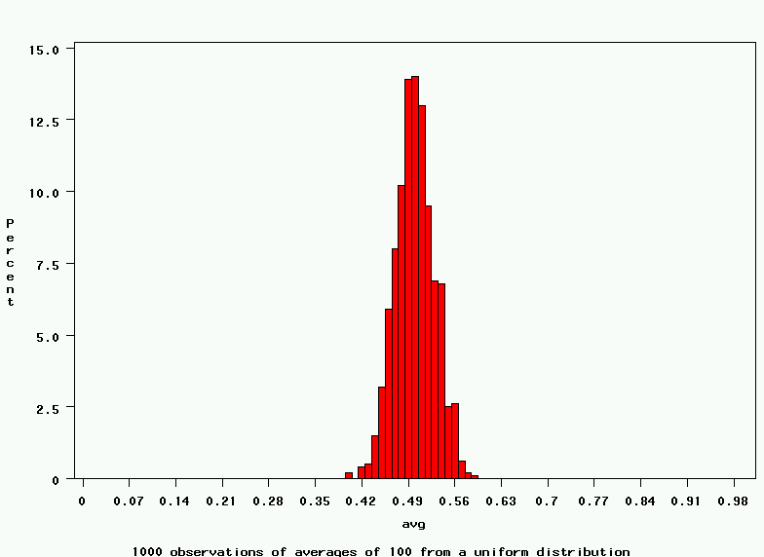
Uniform: 1000 averages of 100
Notes:
It turns out that if you were to go out and sample many, many times, most sample statistics that you could calculate would follow a normal distribution.
What are the 2 parameters (from last time) that define any normal distribution?
Remember that a normal curve is characterized by two parameters, a mean and a variability (SD)
What do you think the mean value of a sample statistic would be? The standard deviation?
Remember standard deviation is natural variability of the population
Standard error can be standard error of the mean or standard error of the odds ratio or standard error of the difference of 2 means, etc. The standard error of any sample statistic.

Slide 25
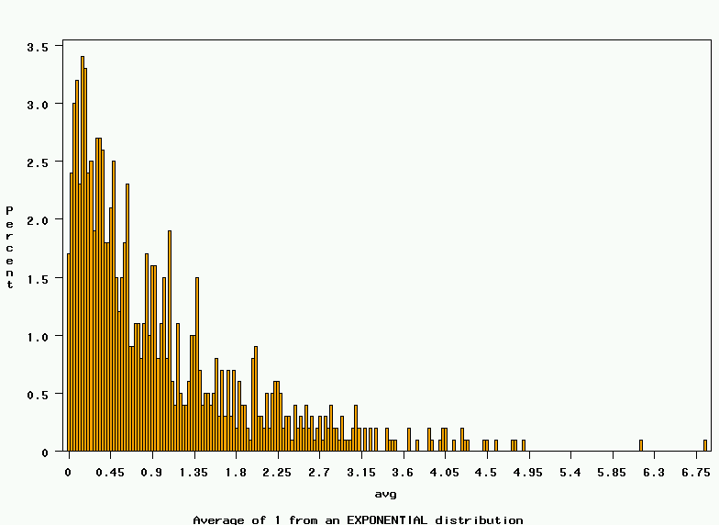
~Exp(1): average of 1
(original distribution)
Notes:
It turns out that if you were to go out and sample many, many times, most sample statistics that you could calculate would follow a normal distribution.
What are the 2 parameters (from last time) that define any normal distribution?
Remember that a normal curve is characterized by two parameters, a mean and a variability (SD)
What do you think the mean value of a sample statistic would be? The standard deviation?
Remember standard deviation is natural variability of the population
Standard error can be standard error of the mean or standard error of the odds ratio or standard error of the difference of 2 means, etc. The standard error of any sample statistic.

Slide 26
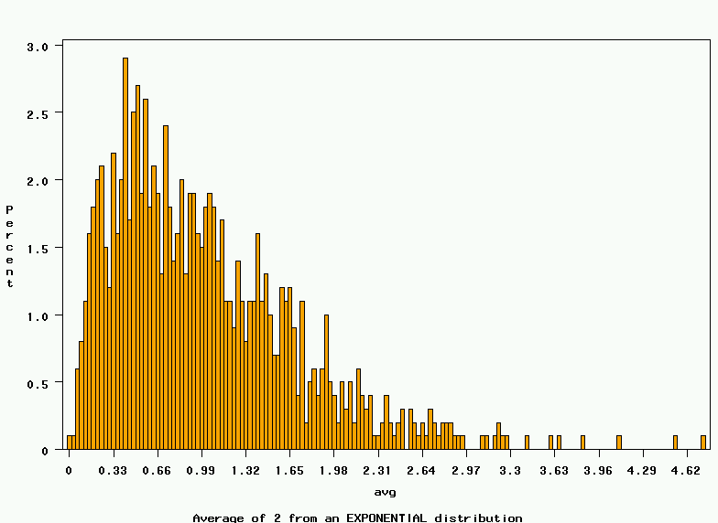
~Exp(1): 1000 averages of 2
Notes:
It turns out that if you were to go out and sample many, many times, most sample statistics that you could calculate would follow a normal distribution.
What are the 2 parameters (from last time) that define any normal distribution?
Remember that a normal curve is characterized by two parameters, a mean and a variability (SD)
What do you think the mean value of a sample statistic would be? The standard deviation?
Remember standard deviation is natural variability of the population
Standard error can be standard error of the mean or standard error of the odds ratio or standard error of the difference of 2 means, etc. The standard error of any sample statistic.

Slide 27
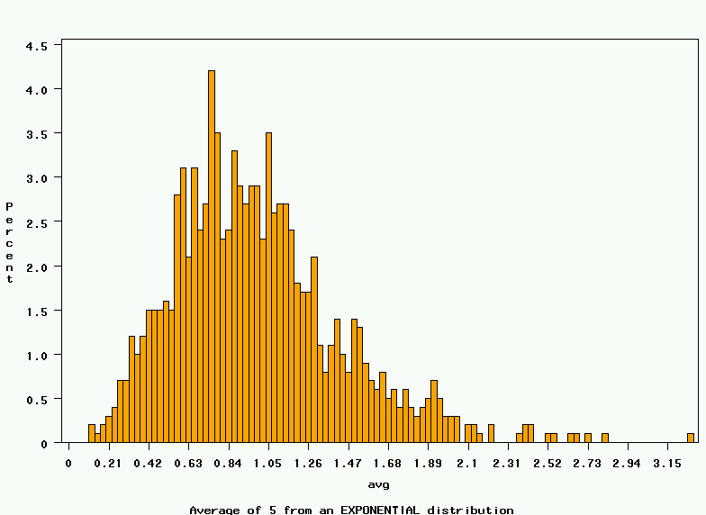
~Exp(1): 1000 averages of 5
Notes:
It turns out that if you were to go out and sample many, many times, most sample statistics that you could calculate would follow a normal distribution.
What are the 2 parameters (from last time) that define any normal distribution?
Remember that a normal curve is characterized by two parameters, a mean and a variability (SD)
What do you think the mean value of a sample statistic would be? The standard deviation?
Remember standard deviation is natural variability of the population
Standard error can be standard error of the mean or standard error of the odds ratio or standard error of the difference of 2 means, etc. The standard error of any sample statistic.

Slide 28
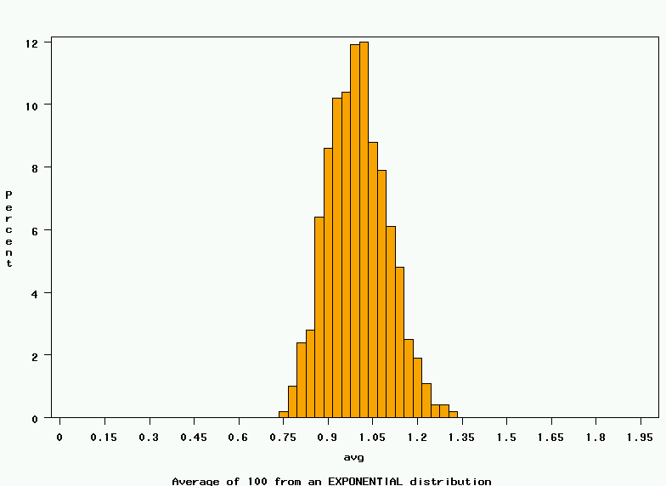
~Exp(1): 1000 averages of 100
Notes:
It turns out that if you were to go out and sample many, many times, most sample statistics that you could calculate would follow a normal distribution.
What are the 2 parameters (from last time) that define any normal distribution?
Remember that a normal curve is characterized by two parameters, a mean and a variability (SD)
What do you think the mean value of a sample statistic would be? The standard deviation?
Remember standard deviation is natural variability of the population
Standard error can be standard error of the mean or standard error of the odds ratio or standard error of the difference of 2 means, etc. The standard error of any sample statistic.

Slide 29
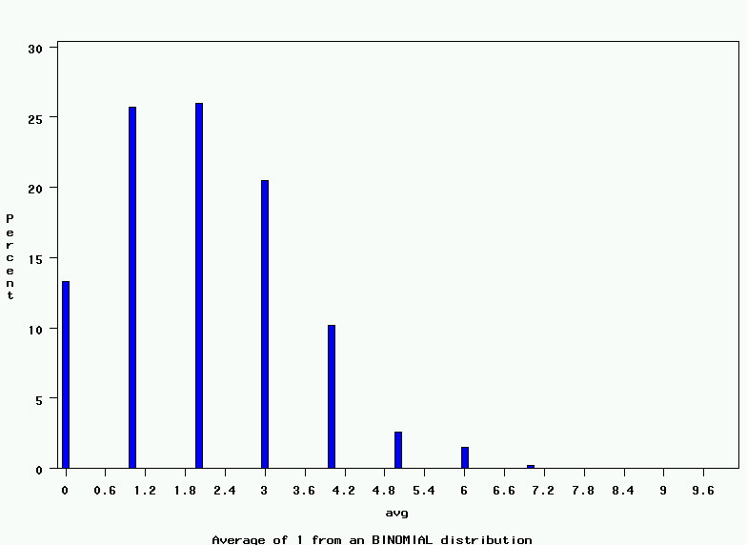
~Bin(40, .05): average of 1
(original distribution)
Notes:
It turns out that if you were to go out and sample many, many times, most sample statistics that you could calculate would follow a normal distribution.
What are the 2 parameters (from last time) that define any normal distribution?
Remember that a normal curve is characterized by two parameters, a mean and a variability (SD)
What do you think the mean value of a sample statistic would be? The standard deviation?
Remember standard deviation is natural variability of the population
Standard error can be standard error of the mean or standard error of the odds ratio or standard error of the difference of 2 means, etc. The standard error of any sample statistic.

Slide 30
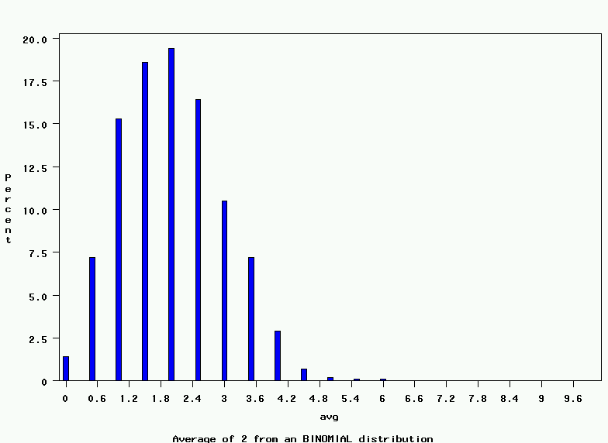
~Bin(40, .05): 1000 averages of 2
Notes:
It turns out that if you were to go out and sample many, many times, most sample statistics that you could calculate would follow a normal distribution.
What are the 2 parameters (from last time) that define any normal distribution?
Remember that a normal curve is characterized by two parameters, a mean and a variability (SD)
What do you think the mean value of a sample statistic would be? The standard deviation?
Remember standard deviation is natural variability of the population
Standard error can be standard error of the mean or standard error of the odds ratio or standard error of the difference of 2 means, etc. The standard error of any sample statistic.

Slide 31
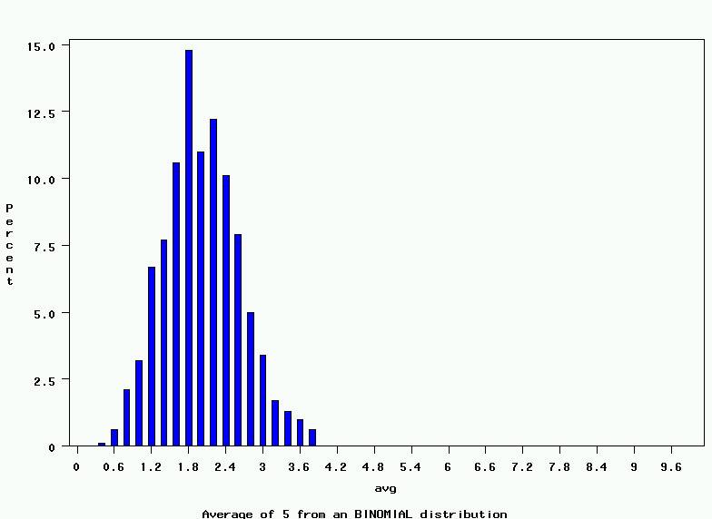
~Bin(40, .05): 1000 averages of 5
Notes:
It turns out that if you were to go out and sample many, many times, most sample statistics that you could calculate would follow a normal distribution.
What are the 2 parameters (from last time) that define any normal distribution?
Remember that a normal curve is characterized by two parameters, a mean and a variability (SD)
What do you think the mean value of a sample statistic would be? The standard deviation?
Remember standard deviation is natural variability of the population
Standard error can be standard error of the mean or standard error of the odds ratio or standard error of the difference of 2 means, etc. The standard error of any sample statistic.

Slide 32
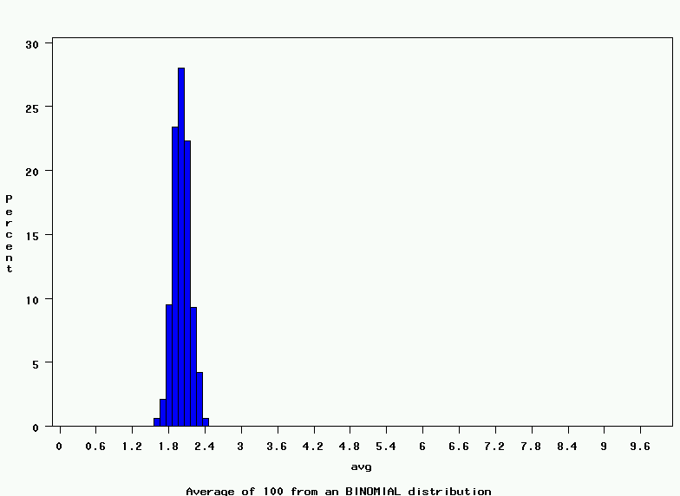
~Bin(40, .05): 1000 averages of 100
Notes:
It turns out that if you were to go out and sample many, many times, most sample statistics that you could calculate would follow a normal distribution.
What are the 2 parameters (from last time) that define any normal distribution?
Remember that a normal curve is characterized by two parameters, a mean and a variability (SD)
What do you think the mean value of a sample statistic would be? The standard deviation?
Remember standard deviation is natural variability of the population
Standard error can be standard error of the mean or standard error of the odds ratio or standard error of the difference of 2 means, etc. The standard error of any sample statistic.

Slide 33
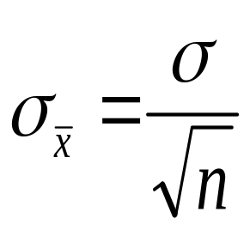
The Central Limit Theorem:
If all possible random samples, each of size n, are taken from any population with a mean μ and a standard deviation σ, the sampling distribution of the sample means (averages) will:
1. have mean:
2. have standard deviation:
3. be approximately normally distributed regardless of the shape of the parent population (normality improves with larger n)
Notes:
It turns out that if you were to go out and sample many, many times, most sample statistics that you could calculate would follow a normal distribution.
What are the 2 parameters (from last time) that define any normal distribution?
Remember that a normal curve is characterized by two parameters, a mean and a variability (SD)
What do you think the mean value of a sample statistic would be? The standard deviation?
Remember standard deviation is natural variability of the population
Standard error can be standard error of the mean or standard error of the odds ratio or standard error of the difference of 2 means, etc. The standard error of any sample statistic.

Slide 34
Central Limit Theorem caveats for small samples:
For small samples:
  The sample standard deviation is an imprecise estimate of the true standard deviation (σ); this imprecision changes the distribution to a T-distribution.
    A t-distribution approaches a normal distribution for large n (≥100), but has fatter tails for small n (<100)
  If the underlying distribution is non-normal, the distribution of the means may be non-normal.
More on T-distributions next week!!

Slide 35
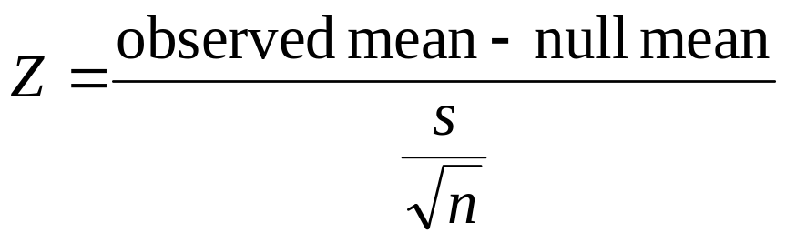
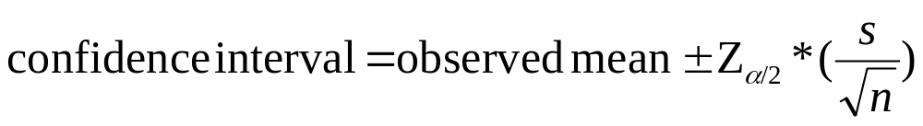
Summary: Single population mean (large n)
Hypothesis test:
Confidence Interval

Slide 36
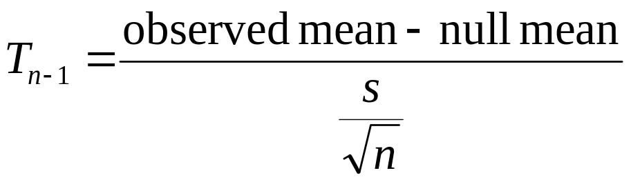
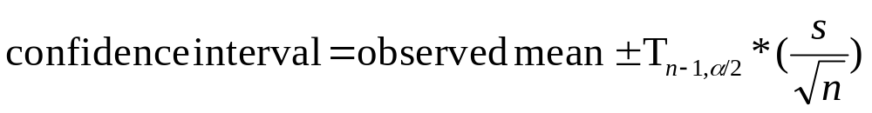
Single population mean (small n, normally distributed trait)
Hypothesis test:
Confidence Interval

Slide 37
Examples of Sample Statistics:
Single population mean
Single population proportion
Difference in means (ttest)
Difference in proportions (Z-test)
Odds ratio/risk ratio
Correlation coefficient
Regression coefficient
…
Notes:
It turns out that if you were to go out and sample many, many times, most sample statistics that you could calculate would follow a normal distribution.
What are the 2 parameters (from last time) that define any normal distribution?
Remember that a normal curve is characterized by two parameters, a mean and a variability (SD)
What do you think the mean value of a sample statistic would be? The standard deviation?
Remember standard deviation is natural variability of the population
Standard error can be standard error of the mean or standard error of the odds ratio or standard error of the difference of 2 means, etc. The standard error of any sample statistic.

Slide 38
Distribution of a correlation coefficient?? Computer simulation…
1. Specify the true correlation coefficient
  Correlation coefficient = 0.15
2. Select a random sample of 100 virtual men from the population.
3. Calculate the correlation coefficient for the sample.
4. Repeat steps (2) and (3) 15,000 times
5. Explore the distribution of the 15,000 correlation coefficients.

Slide 39
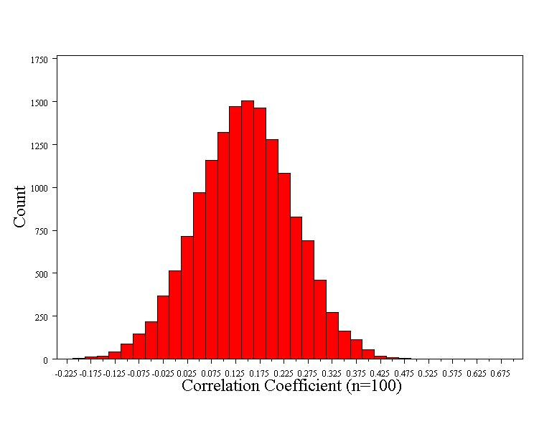
Distribution of a correlation coefficient…
Normally distributed!
Mean = 0.15 (true correlation)
Standard error = 0.10

Slide 40
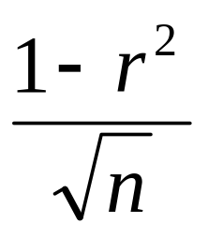
Distribution of a correlation coefficient in general…
1. Shape of the distribution
    Normally distributed for large samples
    T-distribution for small samples (n<100)
2. Mean = true correlation coefficient (r)
3. Standard error ≈

Slide 41
Many statistics follow normal (or t-distributions)…
Means/difference in means
  T-distribution for small samples
Proportions/difference in proportions
Regression coefficients
  T-distribution for small samples
Natural log of the odds ratio

Slide 42
Estimation (confidence intervals)…
What is a good estimate for the true mean vitamin D in the population (the population parameter)?
  63 nmol/L +/- margin of error

Slide 43
95% confidence interval
Goal: capture the true effect (e.g., the true mean) most of the time.
A 95% confidence interval should include the true effect about 95% of the time.
A 99% confidence interval should include the true effect about 99% of the time.

Slide 44
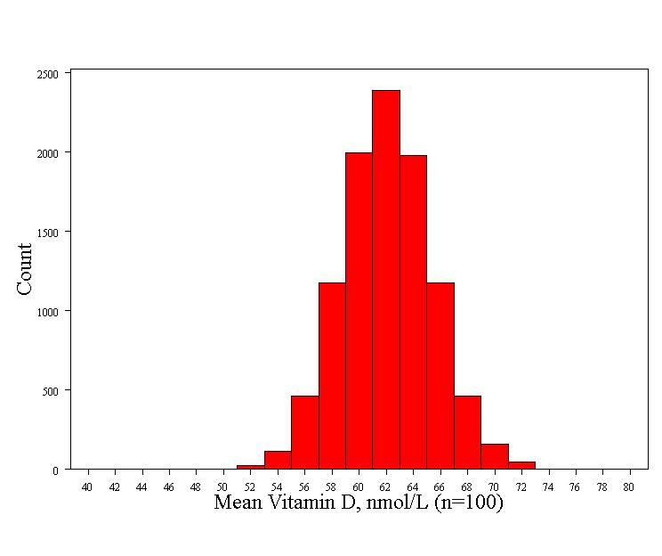
Recall: 68-95-99.7 rule for normal distributions! These is a 95% chance that the sample mean will fall within two standard errors of the true mean= 62 +/- 2*3.3 = 55.4 nmol/L to 68.6 nmol/L
Mean - 2 Std error=55.4
Mean
Mean + 2 Std error =68.6
To be precise, 95% of observations fall between Z=-1.96 and Z= +1.96 (so the “2” is a rounded number)…

Slide 45
95% confidence interval
There is a 95% chance that the sample mean is between 55.4 nmol/L and 68.6 nmol/L
For every sample mean in this range, sample mean +/- 2 standard errors will include the true mean:
  For example, if the sample mean is 68.6 nmol/L:
    95% CI = 68.6 +/- 6.6 = 62.0 to 75.2
    This interval just hits the true mean, 62.0.

Slide 46
95% confidence interval
Thus, for normally distributed statistics, the formula for the 95% confidence interval is:
sample statistic ± 2 x (standard error)
Examples:
  95% CI for mean vitamin D:
    63 nmol/L ± 2 x (3.3) = 56.4 – 69.6 nmol/L
  95% CI for the correlation coefficient:
    0.15 ± 2 x (0.1) = -.05 – .35

Slide 47
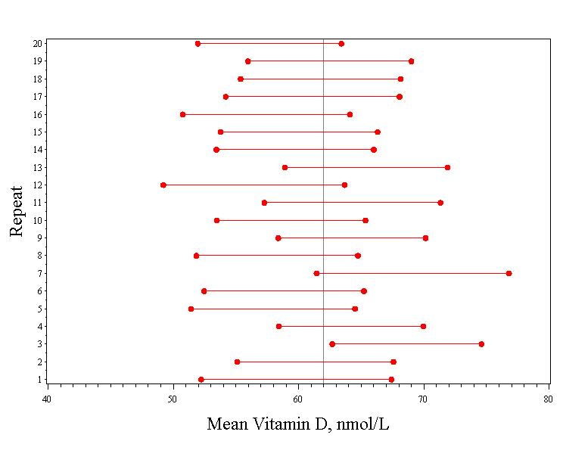
Simulation of 20 studies of 100 men…
Vertical line indicates the true mean (62)
95% confidence intervals for the mean vitamin D for each of the simulated studies.
Only 1 confidence interval missed the true mean.

Slide 48
Confidence Intervals give:
*A plausible range of values for a population parameter.
*The precision of an estimate.(When sampling variability is high, the confidence interval will be wide to reflect the uncertainty of the observation.)
*Statistical significance (if the 95% CI does not cross the null value, it is significant at .05)
Notes:
It turns out that if you were to go out and sample many, many times, most sample statistics that you could calculate would follow a normal distribution.
What are the 2 parameters (from last time) that define any normal distribution?
Remember that a normal curve is characterized by two parameters, a mean and a variability (SD)
What do you think the mean value of a sample statistic would be? The standard deviation?
Remember standard deviation is natural variability of the population
Standard error can be standard error of the mean or standard error of the odds ratio or standard error of the difference of 2 means, etc. The standard error of any sample statistic.

Slide 49
Confidence Intervals
The value of the statistic in my sample (eg., mean, odds ratio, etc.)
point estimate ± (measure of how confident we want to be) × (standard error)
From a Z table or a T table, depending on the sampling distribution of the statistic.
Standard error of the statistic.

Slide 50
Common “Z” levels of confidence
Commonly used confidence levels are 90%, 95%, and 99%
Confidence Level
Z value
80%
90%
95%
98%
99%
99.8%
99.9%
1.28
1.645
1.96
2.33
2.58
3.08
3.27

Slide 51
99% confidence intervals…
  99% CI for mean vitamin D:
    63 nmol/L ± 2.6 x (3.3) = 54.4 – 71.6 nmol/L
  99% CI for the correlation coefficient:
    0.15 ± 2.6 x (0.1) = -.11 – .41

Slide 52
Testing Hypotheses
1. Is the mean vitamin D in middle-aged and older European men lower than 100 nmol/L (the “desirable” level)?
2. Is cognitive function correlated with vitamin D?

Slide 53
Is the mean vitamin D different than 100?
Start by assuming that the mean = 100
This is the “null hypothesis”
This is usually the “straw man” that we want to shoot down
Determine the distribution of statistics assuming that the null is true…

Slide 54
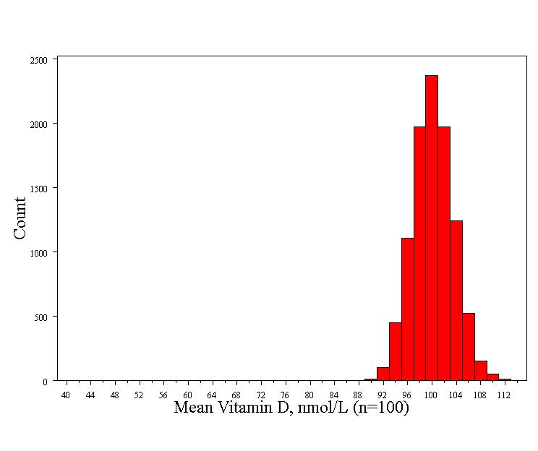
Computer simulation (10,000 repeats)…
This is called the null distribution!
Normally distributed
Std error = 3.3
Mean = 100

Slide 55
Compare the null distribution to the observed value…
What’s the probability of seeing a sample mean of 63 nmol/L if the true mean is 100 nmol/L?
It didn’t happen in 10,000 simulated studies. So the probability is less than 1/10,000

Slide 56
Compare the null distribution to the observed value…
This is the p-value!
P-value < 1/10,000

Slide 57
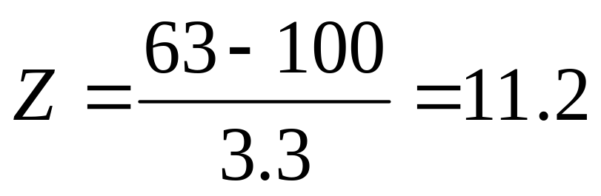
Calculating the p-value with a formula…
Because we know how normal curves work, we can exactly calculate the probability of seeing an average of 63 nmol/L if the true average weight is 100 (i.e., if our null hypothesis is true):
Z= 11.2, P-value << .0001

Slide 58
The P-value
    P-value is the probability that we would have seen our data (or something more unexpected) just by chance if the null hypothesis (null value) is true.
    Small p-values mean the null value is unlikely given our data.
    Our data are so unlikely given the null hypothesis (<<1/10,000) that I’m going to reject the null hypothesis! (Don’t want to reject our data!)

Slide 59
P-value<.0001 means:
The probability of seeing what you saw or something more extreme if the null hypothesis is true (due to chance)<.0001
P(empirical data/null hypothesis) <.0001

Slide 60
The P-value
By convention, p-values of <.05 are often accepted as “statistically significant” in the medical literature; but this is an arbitrary cut-off.
A cut-off of p<.05 means that in about 5 of 100 experiments, a result would appear significant just by chance (“Type I error”).

Slide 61
Summary: Hypothesis Testing
The Steps:
1. Define your hypotheses (null, alternative)
2. Specify your null distribution
3. Do an experiment
4. Calculate the p-value of what you observed
5. Reject or fail to reject (~accept) the null hypothesis

Slide 62

Hypothesis Testing
The Steps:
Define your hypotheses (null, alternative)
  The null hypothesis is the “straw man” that we are trying to shoot down.
  Null here: “mean vitamin D level = 100 nmol/L”
  Alternative here: “mean vit D < 100 nmol/L” (one-sided)
Specify your sampling distribution (under the null)
  If we repeated this experiment many, many times, the mean vitamin D would be normally distributed around 100 nmol/L with a standard error of 3.3
3. Do a single experiment (observed sample mean = 63 nmol/L)
4. Calculate the p-value of what you observed (p<.0001)
5. Reject or fail to reject the null hypothesis (reject)

Slide 63
Confidence intervals give the same information (and more) than hypothesis tests…

Slide 64
Duality with hypothesis tests.
95% confidence interval
Null value
50 60 70 80 90 100
Null hypothesis: Average vitamin D is 100 nmol/L
Alternative hypothesis: Average vitamin D is not 100 nmol/L (two-sided)
P-value < .05

Slide 65
Duality with hypothesis tests.
99% confidence interval
Null value
50 60 70 80 90 100
Null hypothesis: Average vitamin D is 100 nmol/L
Alternative hypothesis: Average vitamin D is not 100 nmol/L (two-sided)
P-value < .01

Slide 66
2. Is cognitive function correlated with vitamin D?
Null hypothesis: r = 0
Alternative hypothesis: r ≠ 0
  Two-sided hypothesis
  Doesn’t assume that the correlation will be positive or negative.

Slide 67
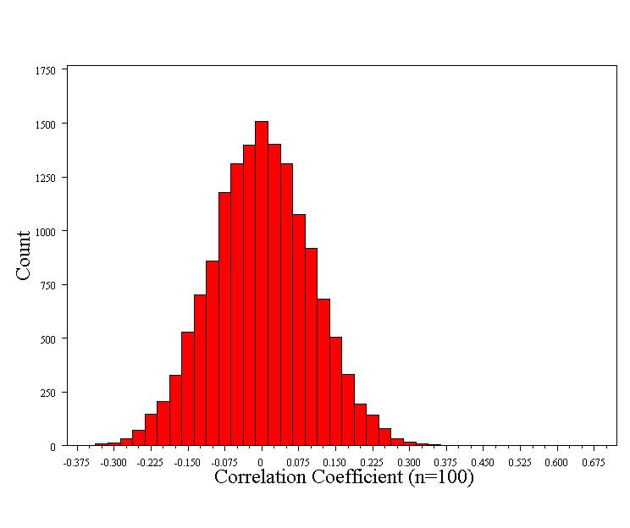
Computer simulation (15,000 repeats)…
Null distribution:
Normally distributed
Std error = 0.1
Mean = 0

Slide 68
What’s the probability of our data?
Even when the true correlation is 0, we get correlations as big as 0.15 or bigger 7% of the time.

Slide 69
What’s the probability of our data?
This is a two-sided hypothesis test, so “more extreme” includes as big or bigger negative correlations (<-0.15).
P-value = 7% + 7% = 14%

Slide 70
What’s the probability of our data?
Our results could have happened purely due to a fluke of chance!

Slide 71
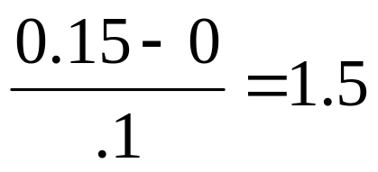
Formal hypothesis test
1. Null hypothesis: r=0
  Alternative: r ≠ 0 (two-sided)
2. Determine the null distribution
    Normally distributed
    Standard error = 0.1
3. Collect Data, r=0.15
4. Calculate the p-value for the data:
  Z =
5. Reject or fail to reject the null (fail to reject)
Z of 1.5 corresponds to a two-sided p-value of 14%

Slide 72
Or use confidence interval to gauge statistical significance…
95% CI = -0.05 to 0.35
Thus, 0 (the null value) is a plausible value!
P>.05

Slide 73
Examples of Sample Statistics:
Single population mean
Single population proportion
Difference in means (ttest)
Difference in proportions (Z-test)
Odds ratio/risk ratio
Correlation coefficient
Regression coefficient
…
Notes:
It turns out that if you were to go out and sample many, many times, most sample statistics that you could calculate would follow a normal distribution.
What are the 2 parameters (from last time) that define any normal distribution?
Remember that a normal curve is characterized by two parameters, a mean and a variability (SD)
What do you think the mean value of a sample statistic would be? The standard deviation?
Remember standard deviation is natural variability of the population
Standard error can be standard error of the mean or standard error of the odds ratio or standard error of the difference of 2 means, etc. The standard error of any sample statistic.

Slide 74
Example 2: HIV vaccine trial
Thai HIV vaccine trial (2009)
  8197 randomized to vaccine
  8198 randomized to placebo
Generated a lot of public discussion about p-values!

Slide 75
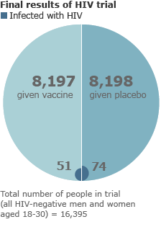
51/8197 vs. 75/8198
=23 excess infections in the placebo group.
=2.8 fewer infections per 1000 people vaccinated
Source: BBC news, http://news.bbc.co.uk/go/pr/fr/-/2/hi/health/8272113.stm

Slide 76
Null hypothesis
Null hypothesis: infection rate is the same in the two groups
Alternative hypothesis: infection rates differ

Slide 77
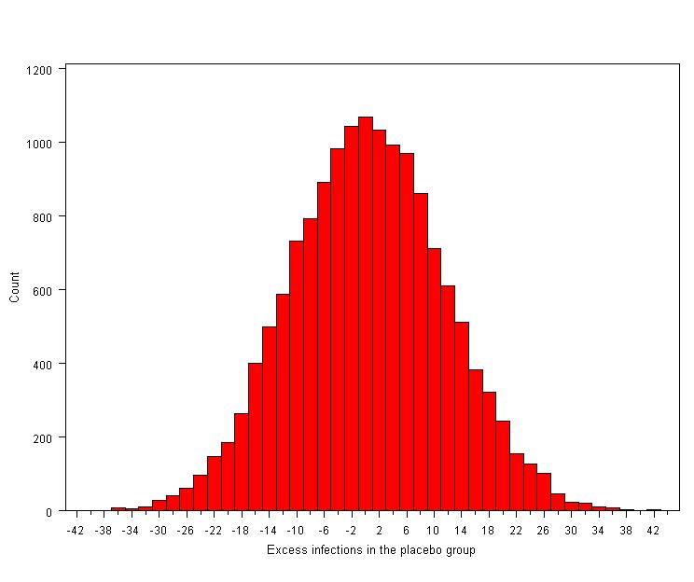
Computer simulation assuming the null (15,000 repeats)…
Normally distributed, standard error = 11.1

Slide 78
Computer simulation assuming the null (15,000 repeats)…
If the vaccine is completely ineffective, we could still get 23 excess infections just by chance.
Probability of 23 or more excess infections = 0.04

Slide 79
How to interpret p=.04…
P(data/null) = .04
P(null/data) ≠.04
P(null/data) ≥ 22%
*estimated using Bayes’ Rule (and prior data on the vaccine)
*Gilbert PB, Berger JO, Stablein D, Becker S, Essex M, Hammer SM, Kim JH, DeGruttola VG. Statistical interpretation of the RV144 HIV vaccine efficacy trial in Thailand: a case study for statistical issues in efficacy trials. J Infect Dis 2011; 203: 969-975.

Slide 80
Alternative analysis of the data (“intention to treat”)…
56/8202 (6.8 per 1000) infections in the vaccine group versus 76/8200 (9.3 per 1000)

Slide 81
Computer simulation assuming the null (15,000 repeats)…
Probability of 20 or more excess infections = 0.08
P=.08 is only slightly different than p=.04!

Slide 82
Confidence intervals…
95% CI (analysis 1): .0014 to .0055
95% CI (analysis 2): -.0003 to .0051
The plausible ranges are nearly identical!

