Slide 1
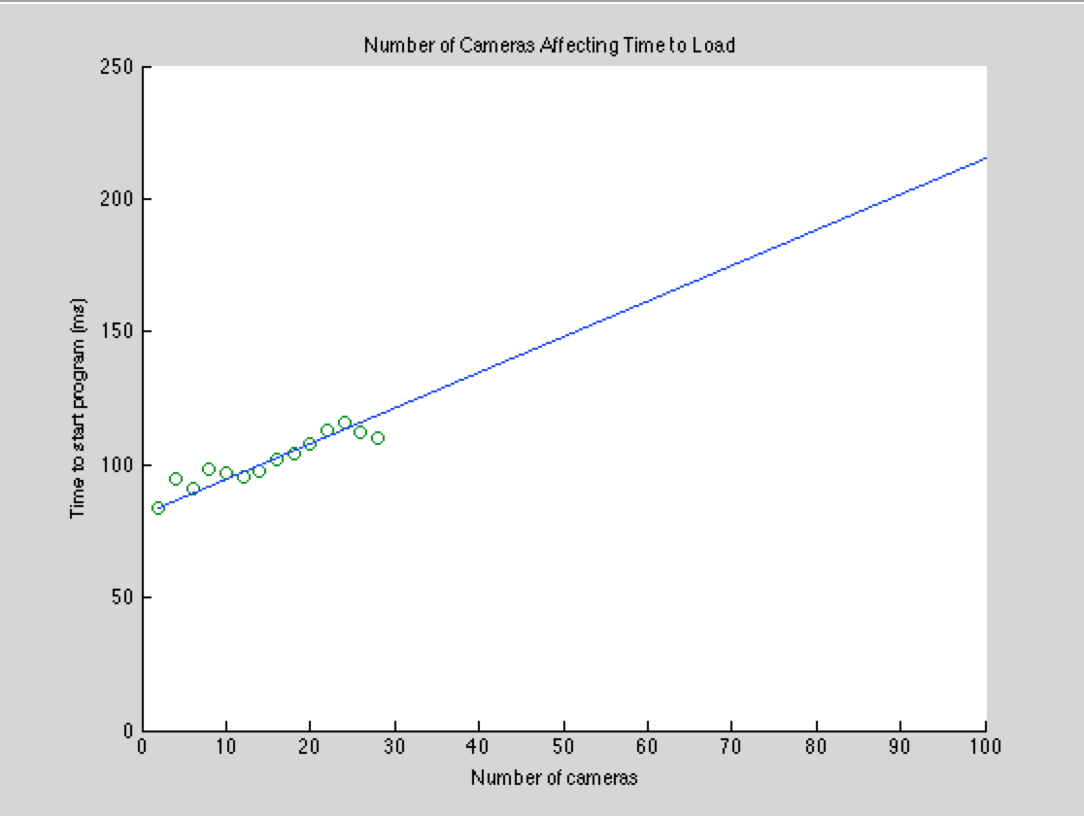
Runtime vs. Number of Cameras
Measuring loading page runtime vs. Number of cameras processed
Runtime for 28 cameras: 110ms
Extrapolated runtime for 100 cameras: 215.6ms
Backend processing time
Difference in runtime isn’t noticeable
Majority of runtime dedicated to markers and route line drawings on Google Maps

Slide 2
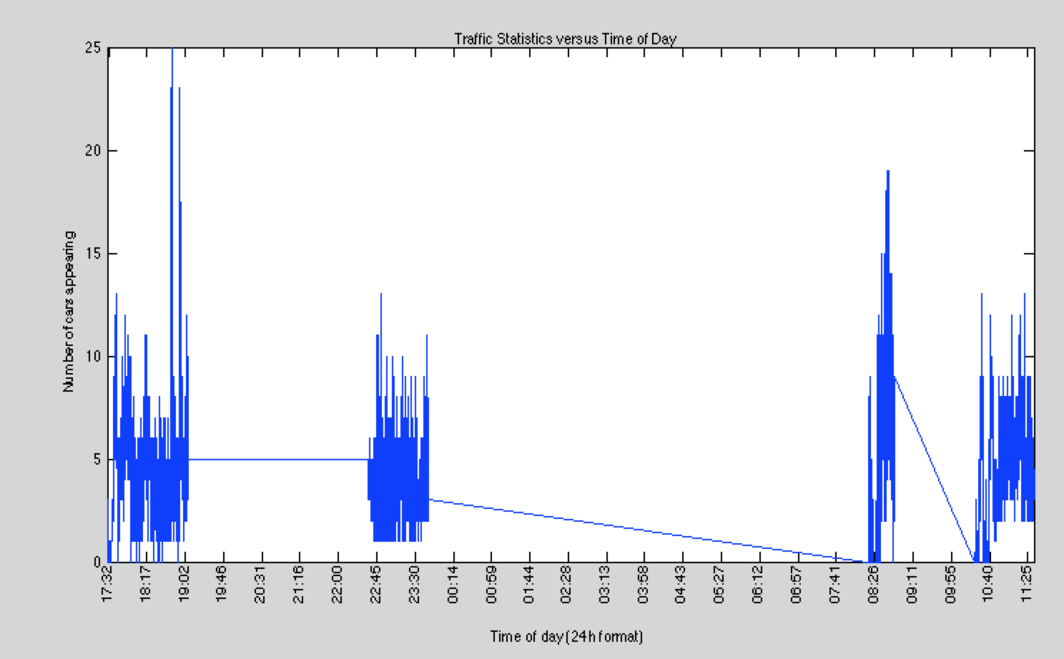
Time of Day Traffic Analysis

