Slide 1
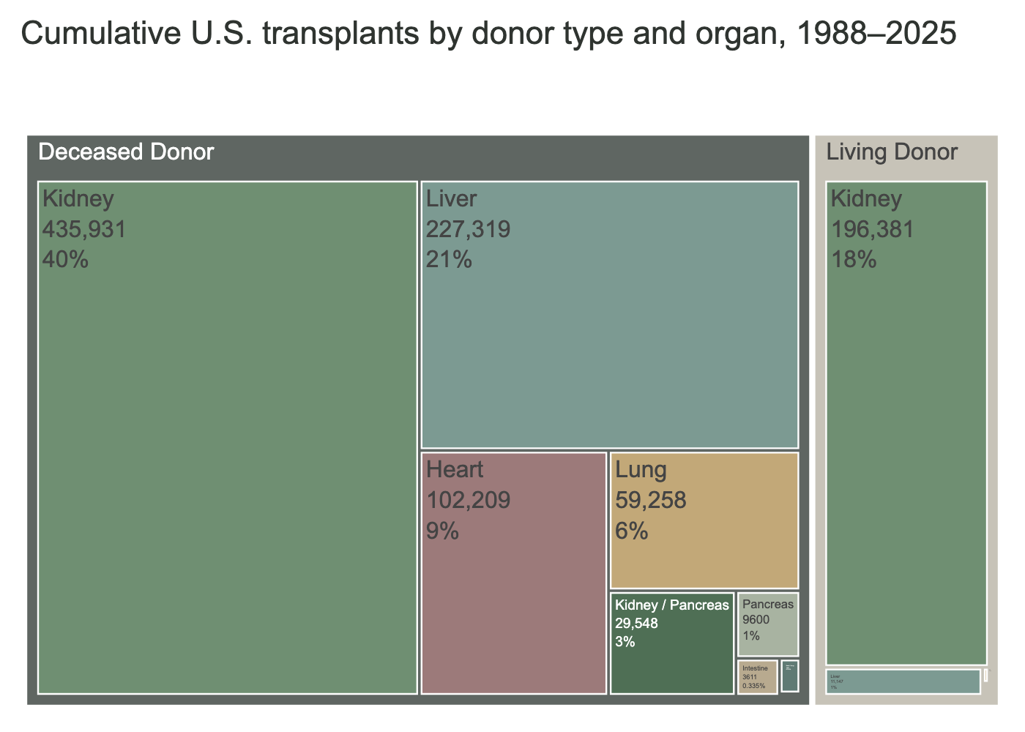
Key Insights
The transplant system is heavily concentrated in kidney procedures.
Living donation contributes meaningfully Kidney transplants.
The second most frequent living organ is the liver
Most other organ transplants depend entirely on deceased donors.
Source: Organ Procurement and Transplantation Network (OPTN), 2026.

