Slide 1
Identifying Profitable Rental Properties 12/5/2020
James Logan, Kevin Lane, Teck Lim

Slide 2





Outlines
USE AS NEEDED
Project Objective
Data Sources and Diagram
Extract, Transform, Load (ETL)
Rental Properties
Real Estate Properties Places of interest
Knowledge Graph Schema
Example Queries
Challenges and Limitations
Future Enhancements
Q / A
Notes:
Done!

Slide 3
Project Objective
Associate places of interest with short-term rental properties to identify profitable real estate investments in San Diego County
Construct knowledge graph connecting real estate listings with similar short-term rental properties and nearby places of interest
Connect places and reviews to neighborhoods
Process review text to find themes associated with neighborhoods

Slide 4
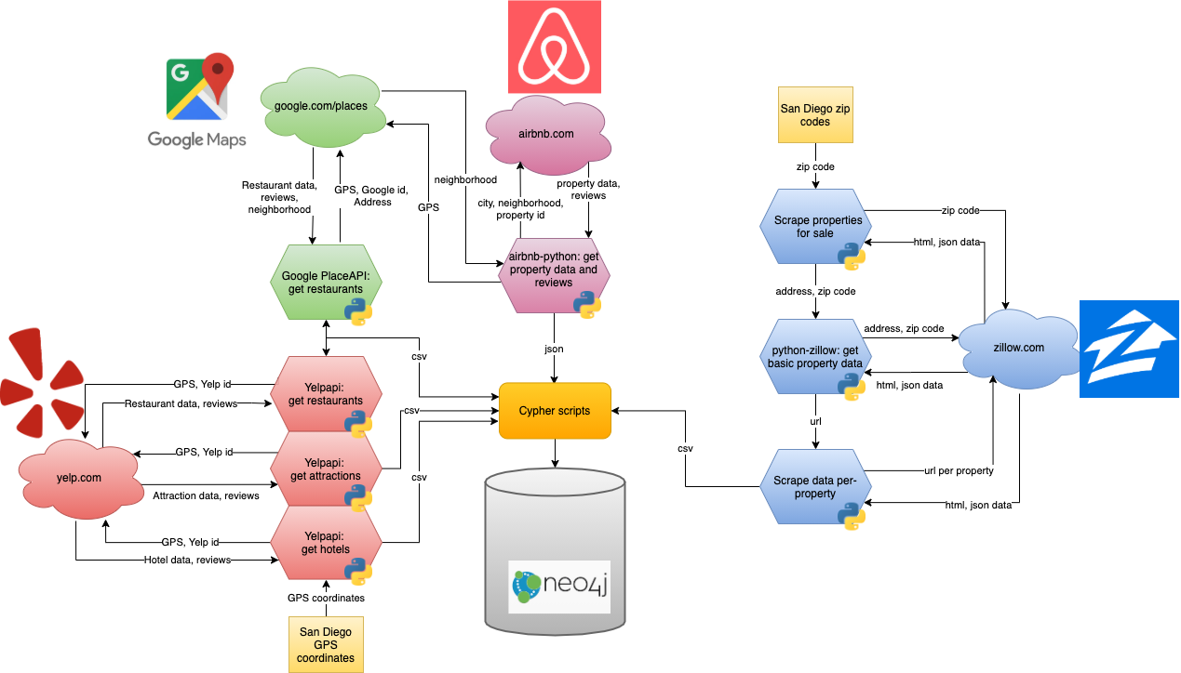
Data Sources and Diagram
Notes:
Kevin - present this as well TODO: Draw box around each data source and gray out the rest. Copy to the beginning of each section

Slide 5
ETL Process

Slide 6
ETL - Rental Properties & Reviews (Airbnb)
Notes:
Kevin - present this as well TODO: Draw box around each data source and gray out the rest. Copy to the beginning of each section

Slide 7
ETL - Rental Properties & Reviews (Airbnb)
Airbnb is a popular vacation rental marketplace for both vacationers and property owners alike to host and find places to stay from a single room to an entire house
Since its inception in 2008, Airbnb has grown to 5.6 million* active listings
Airbnb has listings in 100,000* cities and 220* countries
Airbnb hosts earn an average of $7,900* annually
IPO scheduled for Dec 10, 2020
Unofficial API hosted on GitHub
* numbers as of Sept 30, 2020
Notes:
Kevin

Slide 8
ETL - Rental Properties & Reviews (Airbnb)
Listings
Queries return a maximum of 300 listings
Expand results by searching by neighborhood
Identified 7,320 unique listings
Fields include:
location (city, neighborhood, GPS coordinate)
number of bedrooms and bathrooms
property type (ID)
space type (private room, entire house, etc.)
price
amenity IDs
About 30 per listing
amenity names (Wi-Fi, kitchen, air conditioning, etc.)
Only up to 4 per listing
Only import listings for the entire property
Notes:
Kevin

Slide 9
ETL - Rental Properties & Reviews (Airbnb)
Reviews
Obtain reviews by listing ID
Identified over 425,000 unique reviews
Fields include:
IDs: review, listing, guest, host
review text
rating
host response (no response for 90% of reviews)
time created
language
Notes:
Kevin

Slide 10
ETL - Rental Properties & Reviews (Airbnb)
Neighborhoods
Airbnb provides neighborhoods for most listings
Zillow neighborhood data is sparse
Yelp provides none
Google Maps Geocoding API enables reverse geocoding lookups on GPS coordinates
Provides details of nearby places, including neighborhoods
Google provides a convenient Python wrapper to format the JSON as dictionaries
Merge Airbnb and Google neighborhoods
Find relative complement of Google neighborhoods in Airbnb (A \ G)
Score remaining neighborhoods with py_stringmatching
Identifies abbreviated neighborhoods (e.g. Gaslamp, Gaslamp Quarter)
Identifies differing symbols (e.g. Roseville/Fleet Ridge, Roseville - Fleet Ridge)

Slide 11
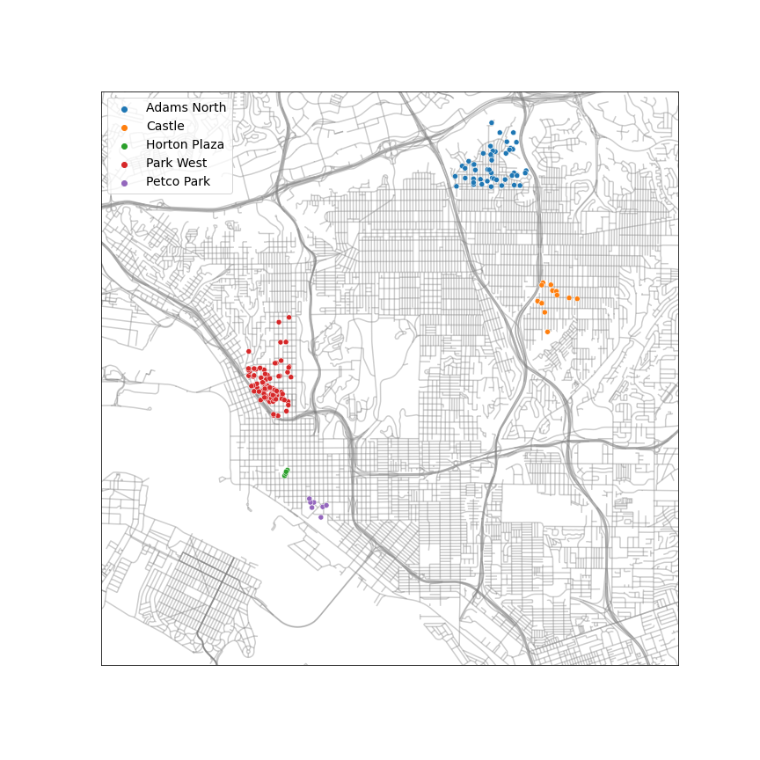
ETL - Rental Properties & Reviews (Airbnb)
Neighborhoods
Compare unmatched neighborhoods with their Google counterparts
Unmatched Neighborhood | Google Counterpart
Adams North | Normal Heights, Mid-City
Castle | City Heights, Mid-City
Horton Plaza | Gaslamp Quarter
Park West | Bankers Hill, Cortez Hill, Hillcrest, Little Italy, Middletown
Petco Park | East Village

Slide 12
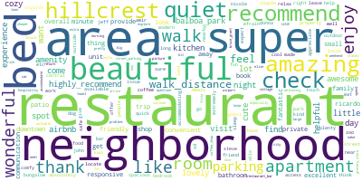
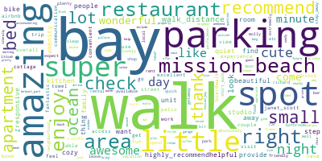
ETL - Rental Properties & Reviews (Airbnb)
Review Text Processing
Merge listings with non-automated English reviews
Automated reviews for trip cancellations
Filter out reviews from neighborhoods with less than 5000 reviews
Spacy
Text processing (tokenization, stop word removal, lemmatization, etc.)
Gensim
Bi-grams and tri-grams
Hillcrest
Mission Beach

Slide 13
ETL - Rental Properties & Reviews (Airbnb)
Review Topic Modeling
Perform LDA with Gensim and MALLET
Associate topics with neighborhoods
Calculate P(T|N) and P(T)
Review/topic pairs weighted by LDA score
Associate neighborhoods with topics that appear more often relative to all neighborhoods
Topic Words | Neighborhoods
beach, restaurant, walk, ocean, walk_distance, shop, dog, perfect, bike, short_walk, bay, coffee_shop | La Jolla, Mission Beach, Ocean Beach, Pacific Beach, Point Loma
san_diego, apartment, downtown, walk, little_italy, airport, balboa_park, sd, restaurant, convenient | Bankers Hill, Core-Columbia, East Village, Golden Hill, Hillcrest, Little Italy, Middletown, Park West, Sherman Heights
night, issue, sleep, noise, work, problem, leave, loud, neighbor, bad | Bankers Hill, East Village, Little Italy, Logan Heights, Mission Beach, Park West

Slide 14
ETL - Real Estate Properties (Zillow)
Notes:
Kevin - present this as well TODO: Draw box around each data source and gray out the rest. Copy to the beginning of each section

Slide 15
ETL - Real Estate Properties (Zillow)
"Zillow is the leading real estate and rental marketplace dedicated to empowering consumers with data, inspiration and knowledge around the place they call home, and connecting them with the best local professionals who can help."
Zillow's real estate property database has many features
address, bedrooms, bathrooms, square footage
heating/cooling, parking, nearby schools
Estimated mortgage, taxes, HOA
LGBT legal protections
Why Zillow?
redfin.com: no API
realtor.com: no accessible API
trulia.com: no API
Notes:
James - switch order with Airbnb

Slide 16
ETL - Real Estate Properties (Zillow)
Official Zillow API (3rd-party wrapper)
Functional, fast, free
"GetSearchResults"
Given:
api key
address
zip code
Returns:
unique identifier
full address
urls
price "zestimate"
Drawbacks:
Returns limited feature set
Returned property is not necessarily for sale
Notes:
address + zip code are important to note for next slide

Slide 17
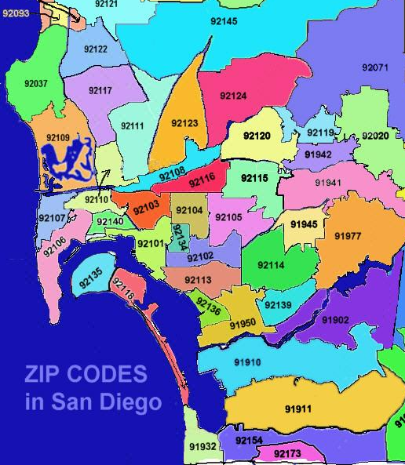
ETL - Real Estate Properties (Zillow)
Official API requires address + zip code inputs
Scrape Zillow for address + zip code pairs
www.zillow.com/homes/for_sale/92129_rb
First, assemble list of San Diego zip codes
Manual creation
Get properties by zip code
~40 properties returned per zip code
Retrieve data with "requests" module
Parse data with "BeautifulSoup" module
Returned properties are not necessarily located within
the given zip code

Slide 18
ETL - Real Estate Properties (Zillow)
Zillow “GetSearchResults” API
Receive basic property data, urls, etc.
python object
Use received Zillow url to scrape more data, per property
Retrieve data with "requests" module
Parse data with "BeautifulSoup" module
Extract:
price
location info
neighborhood
number of bedrooms
number of bathrooms
lot size
agent description

Slide 19
ETL - Real Estate Properties (Zillow)
Zillow’s “neighborhood” data is very sparse
95% null
Potential scraping oversight
Reverse geocode GPS to neighborhood
Export data as csv

Slide 20
Connecting Similar Zillow Properties
Relationships are unidirectional and added symmetrically
Attributes considered:
Price
Location
Cosine similarity of neighborhood sets
Street name
Size
Number of Bedrooms
Number of Bathrooms
Notes:
Move to in between zillow and yelp

Slide 21
Connecting Similar Airbnb Rentals
Attributes considered:
Location
Cosine similarity of neighborhood sets
City equality if one or both neighborhood sets are empty
Number of bedrooms
Number of bathrooms
Property type (id)
Cosine similarity of amenity IDs and amenity names

Slide 22
Connecting Similar Zillow Properties and Airbnb Rentals
Column name matching
Attributes considered:
Location
Cosine similarity of neighborhood sets
City equality if one or both neighborhood sets are empty
Number of bedrooms
Number of bathrooms
Notes:
overlap between the two isn’t extensive: zillow has price as primary weight, airbnb has amenties, plus airbnb doesn’t give us the address for security reasons.
Future enhancements section addresses the smaller number of features here

Slide 23
ETL - Places of interest (Yelp / Google)

Slide 24
ETL - Places of interest (Yelp / Google)
Yelp: “The Yelp API gives you access to search for over 50,000,000 businesses in 32 countries. We provide a search, phone search, and business API to help integrate Yelp into your app.”
Yelp API: Well established REST API and GraphQL. Daily limit on usage.
Google Place - “Google Places API Web Service allow the user to query for place information on a variety of categories, such as establishments, prominent points of interest, geographic locations, and more.” Google Place API: Well established & documented REST API. Costly.
Notes:
Teck

Slide 25
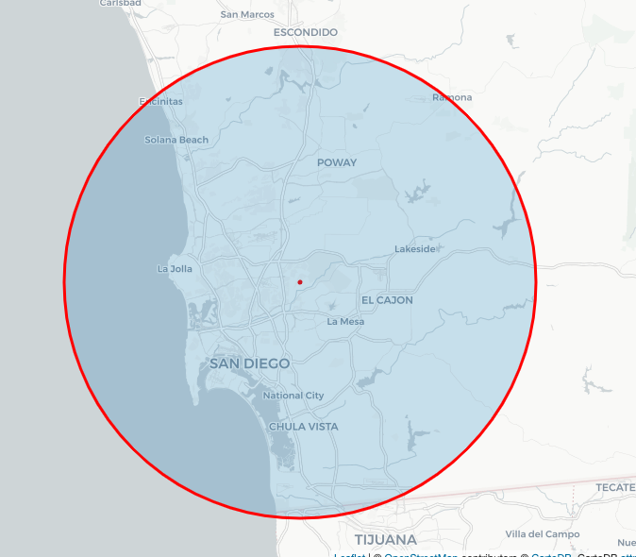
ETL - Places of interest (Yelp)
Ideal Scenario:
A coordinate with search radius to get all the restaurant, hotel, tourist attraction data.
Reality:
Each coordinate returns up to 50 results and 20 pages.
Density of places-of-interest varies between urban and suburban.

Slide 26
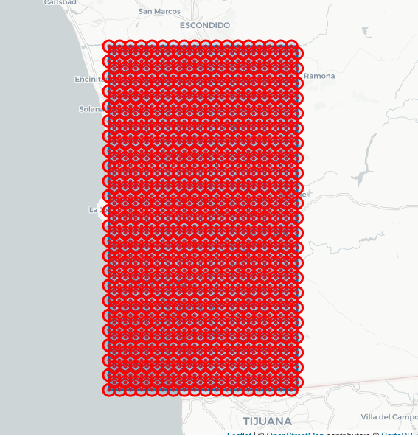

ETL - Places of interest (Yelp)
Map Sweep Technique:
Identify a rectangular box on the map
Create equally distributed coordinates with 1 km radius to get maximum coverage.
Daily limit on REST API calls.
Restaurant, Hotel, Tourist attraction & Reviews

Slide 27
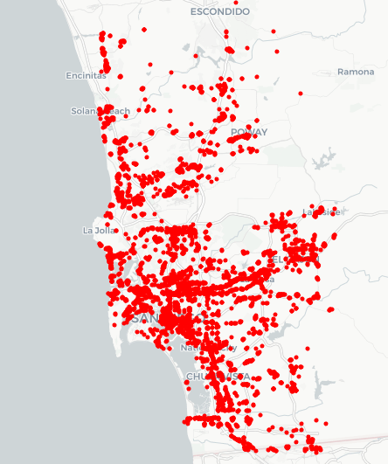
ETL - Places of interest (Google)
Ideal Scenario:
Same methodology as Yelp
Reality:
Each coordinate returns up to 20 results and 3 pages.
Coordinates with smaller radius.
Density map from Yelp.

Slide 28
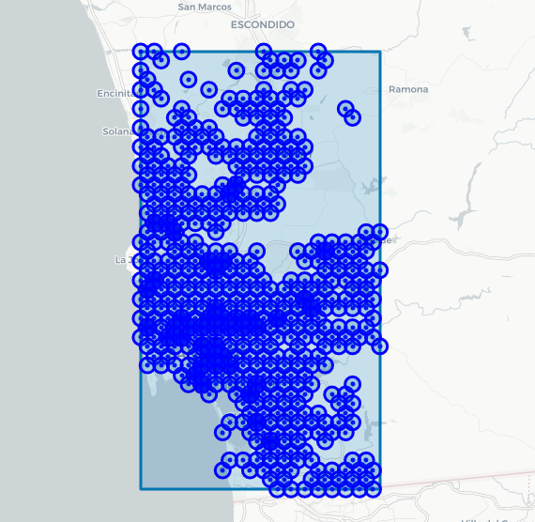
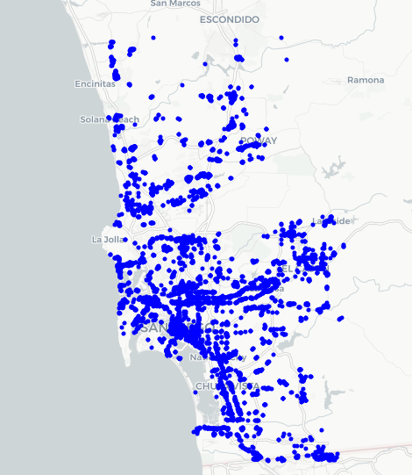
ETL - Places of interest (Google)
“Targeted” Map Sweep Technique:
Identify a rectangular box on the map
Create “non-equally” distributed coordinates with “variable” radius to save on API calls
Pay per 1000 REST API calls
Restaurant & Reviews

Slide 29
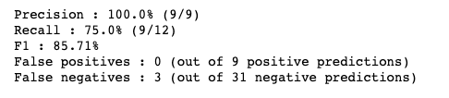
ETL - Places of interest (Yelp / Google)
Entity matching:
Restaurant data from both Google and Yelp
Blocking:
Phone number exact match, or
Name with Jaccard similarity, and
Places that are less than 5 km apart
Matching:
Naive Bayes model
4349 matches

Slide 30
ETL - Places of interest (Yelp / Google)
Topic modeling
Employ the same technique from Airbnb Review
Find 10 topics from entire review corpus
Get top 2 topics from each neighborhood
Topic Words | Neighborhoods
bad, people, customer, work, customer_service, give, employee, star, guy, leave | San Ysidro, Otay Ranch, Clairemont, Miramar, Mission Valley, University City, Barrio Logan
great, drink, nice, bar, spot, enjoy, beer, area, night, dinner | Little Italy, Gaslamp Quarter, East Village, Marina, Core-Columbia, Point Loma, Mission Beach, La Jolla, Pacific Beach
order, time, taco, pick, wait, burrito, drive, delivery, call, minute | Otay Ranch, San Ysidro, Mid-City, Grantville, Clairemont, Carmel Mountain Ranch, Mira Mesa, Rancho Bernardo, Carmel Valley

Slide 31
Knowledge Graph Schema

Slide 32
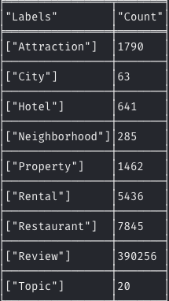
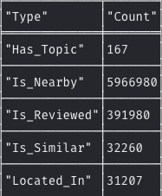
Knowledge Graph Schema
Node Labels
Attraction: Coordinate, Name, Rating, Price Range, ...
City: Name
Hotel: Coordinate, Name, Rating, Price Range, …
Neighborhood: Name
Property: Coordinate, Street, Bed, Bath, Price, Size, Year built, Description, ...
Rental: Coordinate, Bed, Bath, Price, …
Restaurant: Coordinate, Name, Rating, Price Range, ...
Review: Rating, Text, Time Created, Author Id, …
Topic: Words, Type
Relationship Types
Has_Topic: {null}
Is_Nearby: Distance
Is_Reviewed: {null}
Is_Similar: Score
Located_in: {null}

Slide 33
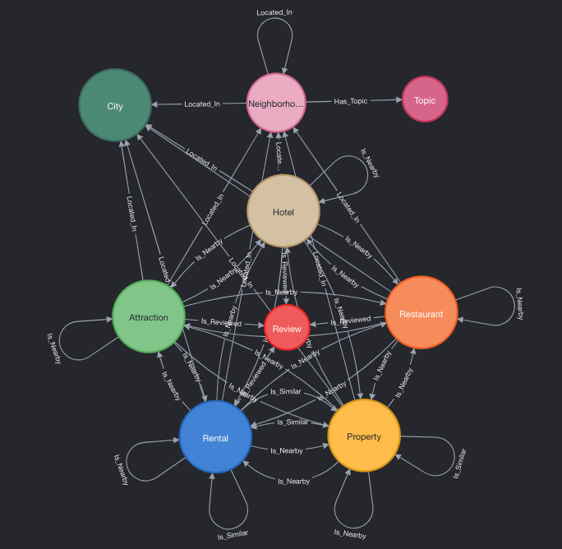
Knowledge Graph Schema

Slide 34
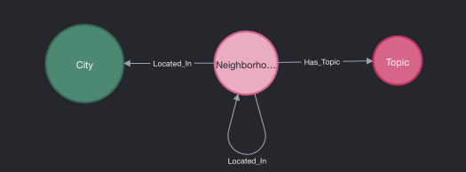
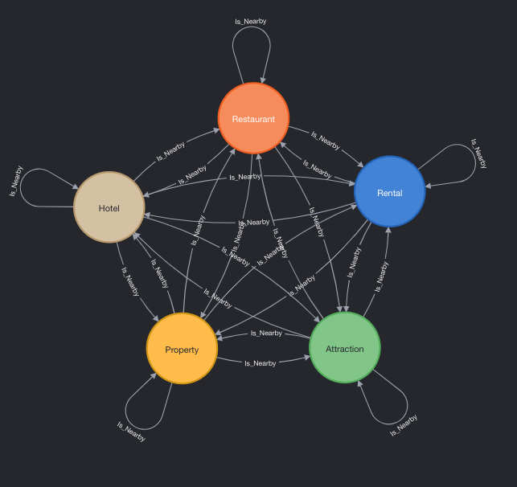
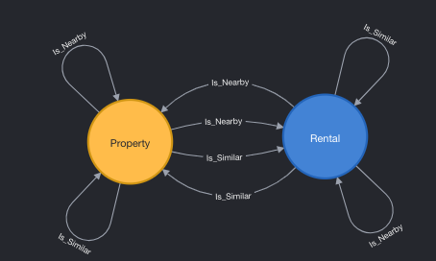
Knowledge Graph Schema
Location Subgraph
Nearby Subgraph
Similarity Subgraph

Slide 35
Example Queries

Slide 36
Example Queries
Find properties under $1M that are similar to rentals with an average price at least $500 and located in a neighborhood associated with a topic containing the word “walk”
MATCH (p:Property)-[:Is_Similar]->(r:Rental)-[:Located_In]->(n:Neighborhood)-[:Has_Topic]->(t:Topic)
WHERE 'walk' IN t.words AND p.price < 1000000
WITH p, n, r, t, avg(r.price) AS price
WHERE price >= 500
RETURN p, n, r, t;
Notes:
Teck

Slide 37
Example Queries
Find properties with at least 10 nearby restaurants that have both Yelp and Google ratings higher than 4, within 250 meters in a neighborhood associated with a topic containing the word “bar”
MATCH (p:Property)-[d:Is_Nearby]->(r:Restaurant)-[:Located_In]->(n:Neighborhood)-[:Has_Topic]->(t:Topic)
WHERE 'bar' IN t.words AND d.distance < 250 AND r.yelp_rating > 4 AND r.google_rating > 4
WITH p, COUNT(r) AS rc, n
WHERE rc >= 10
RETURN p, n.name AS neighborhood, rc AS restaurant_count;
Notes:
Teck

Slide 38
Example Queries
Find properties with at least 10 local attractions within 1000 meters, while without any hotel in nearby proximity, in San Diego City
MATCH (p1:Property)-[:Is_Nearby]->(:Hotel)
WITH COLLECT(DISTINCT p1) AS p1
MATCH (c:City)<-[:Located_In]-(p2:Property)-[d:Is_Nearby]->(a:Attraction)
WHERE NOT (p2 IN p1) AND d.distance < 1000
WITH p2, COUNT(a) AS ac, c
WHERE ac >= 10 AND c.name = 'San Diego'
RETURN p2 AS properties, ac AS attraction_count;
Notes:
Teck

Slide 39
Challenges and Limitations

Slide 40
Challenges and Limitations
API limitations and non-free APIs
Exhausted $320 credit on Google Place and Geocoding APIs
Constantly hit daily limit on Yelp API
Zillow does not appreciate scrapers and can refuse to serve results
The final data contains >12 million relationships. Connections are drawn between nodes using unique identifiers (id). Without indices on these ids, data ingest executes at an unbearably slow pace.
Google Place API returns 5 reviews per place. Yelp API returns 3 reviews, with 160 characters limit, per place. Review corpus size is not large enough for precise topic modeling.
Notes:
JAMES CAN TAKE THIS ONE

Slide 41
Future Enhancements

Slide 42
Future Enhancements
Fill in missing Zillow property attributes using agent description
Investigate historical Airbnb occupancy rates to estimate potential rental income
Incorporate property types in Airbnb/Zillow comparisons
Infer Airbnb property types from host description and/or reviews (map to type IDs)
Determine Zillow property types from agent descriptions
Fine tune entity matching between Yelp and Google data to achieve higher Recall
Approximate 4500+ out of 6000+ restaurants are matched currently
Retrieve Hotel and Attraction data from Google Places
Compare Zillow addresses using an edit distance-type metric
Notes:
Teck - Merge nodes from the same place (hotel/restaurant/attraction)
Kevin - improve similarity score
James - Prese

Slide 43
Q & A

Slide 45
Backup Slides

