Slide 1
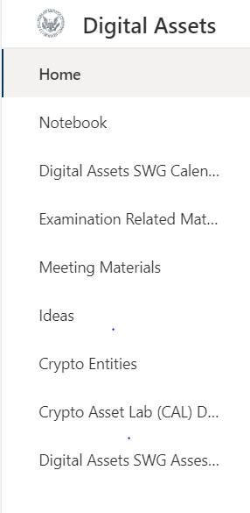
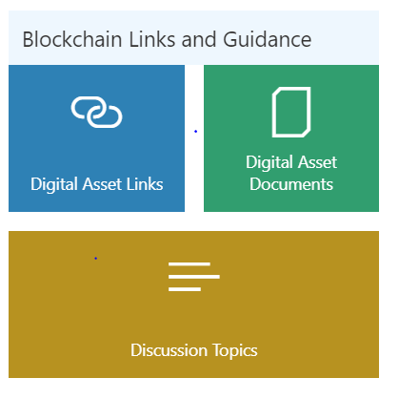
LINKS (need sublinks?)
Education Center page (3)
Resources link to site (4)
Restricted access site link to AI taskforce force only site (8)
Banner including SEC logo and name: Exams Artificial Intelligence “AI” Task Force.
Could we include the AI Task Force email address here that can link to open up an Outlook email to the team?
Box for mission statement (broader? About the team?))
AI Task Force Events. Upcoming 3 events here and a link to the Events page (7)
Q&A section with a submission box. Also, a link to the history of all Q&A on page (6)
News & Headlines: Show the 5 most recent links here along with a link to the New & Headlines page (5)
Click through link to find AI Task Force members and contact info on separate page (2)

Slide 2
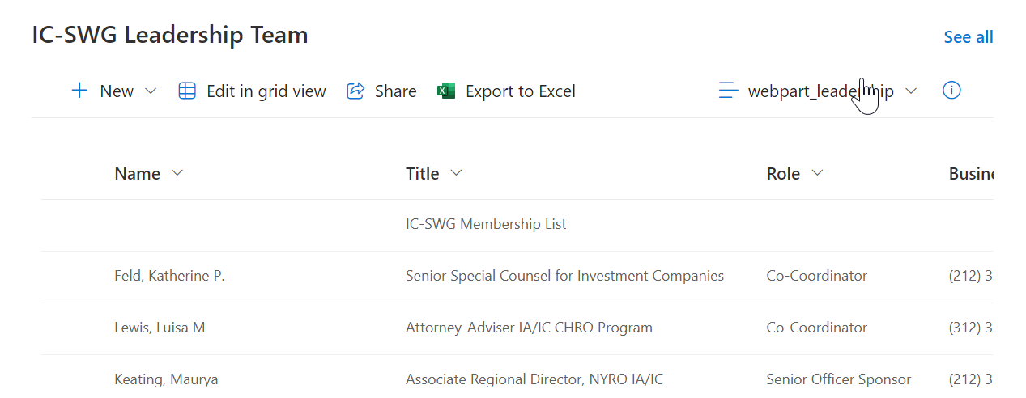
Task Force Contact Site
Names, office, email and phone numbers. Can we enable a hyperlink to the email to open a message box to the recipient?
Name | Division | Office | Email | Phone
See sample below

Slide 3
Education Center
Categories/TAGS:
AI topics? (either have tags or write in a custom tag)
Basic/Foundational
AI related data
Computing/hardware
AI methods
Internal Training sites (ie. Finhub AI Training and Education - All Items (sharepoint.com))
Video
Audio
Documents
Links

Slide 4
Resources Site
Categories/TAGS
SEC internal site links on AI (ie. FinHub)
Sharepoint?
Confluence?
Gitlab?
SEC external website links (ie. Proposed AI rulemaking on conflicts of interest)
Government agency website links (ie. AI.gov)
Section with AI Firms (Start with Rob Grasso’s Excel of AI firm’s inventory)
List in embedded ? with links (need sections to fill out, how to populate?)
Links
Documents
Audio
Videos

Slide 5
News & Headlines Site
Must be searchable (by keyword search or by tags?) (type in search or predefined search by view)
A list of all headline links chronologically ordered (view)
Documents section for articles and papers (Sharepoint List with link to file in document library)
Video section
Audio section
Major News site links for updates ( ie. Artificial Intelligence - Nextgov/FCW)

Slide 6
Questions & Answers Site
Record of all questions and responses chronologically ordered by date of submission. We want to have the submitter and responder both be anonymous. (would this be a text only or with voice/video?)
Would also like to have the questions tagged under the following sub-categories. Searchable (type in search or categoried search)
AI technical question
Tool, Product or Service
Exam related
General questions

Slide 7
Events Site
Tiles or other structure? (event calendar)
Any new submitted event can auto generate a calendar entry into Outlook to all AI Task Force members that can be accepted or rejected. (will need to check to see if we can accomplish this using Power Automate)

Slide 8
AI Task Force Site (members only)
Notes/comments section
Documents
Videos
Links to sites of interest
(Document Library - section only viewed by a small group of member)

Slide 9
Questions for Dev
Robust searching capabilities?
Multi-item tagging and search capabilities (Journal and topic)
Multiple key word searches
Look-throughs
Rankings
Filters based on doc type and topic

