Slide 1
U-NET BASED DEEP LEARNING MODEL FOR RETINAL VESSEL SEGMENTATION
Project Presentation
Jettigari Lokesh Goud (25911D5808)
M.Tech – Computer Science and Engineering
Vidya Jyothi Institute of Technology, Hyderabad
DRIVE Dataset | U-Net | PyTorch | Django

Slide 2
1. Problem Statement
Why retinal vessel segmentation is challenging
• Retinal vessels vary greatly in width, from major vessels to very thin branches.
• Low contrast between vessels and surrounding retinal tissue makes thin vessels difficult to detect.
• Complex branching and interconnected structures must be preserved during segmentation.
• Illumination variation in fundus images requires effective preprocessing.
• Patch-based inference reduces computation but requires careful reconstruction.
• A trained model alone is difficult to use; an accessible interface is needed for visualization and analysis.
Need: an integrated pipeline for preprocessing → segmentation → evaluation → visualization
Target Output Binary retinal vessel mask
2

Slide 3
2. Objectives
Automate
Preprocess
Segment
Develop a retinal vessel segmentation pipeline.
Use green-channel extraction, CLAHE, normalization and FOV processing.
Train a U-Net for binary vessel/background classification.
Optimize
Evaluate
Deploy
Select the segmentation threshold using validation performance.
Measure Dice, IoU, Precision, Recall and Accuracy.
Generate DRIVE test predictions and integrate inference into Django.
Analyze
Provide masks, overlays, vessel coverage and probability statistics.
3

Slide 4
3. Literature Survey
Traditional Methods
Machine Learning
Deep Learning
U-Net
Thresholding, morphology, matched filters, vessel tracking
Hand-crafted features + classifiers
CNNs learn hierarchical features automatically
Encoder–decoder + skip connections for segmentation
Key references from the project documentation
• Staal et al. (2004) – ridge-based retinal vessel segmentation.
• Hoover et al. (2000) – matched-filter response for blood-vessel localization.
• Soares et al. (2006) – Gabor wavelet + supervised classification.
• Liskowski & Krawiec (2016) – deep neural networks for retinal vessels.
• Ronneberger et al. (2015) – U-Net for biomedical image segmentation.
4

Slide 5
4. Research Gap & Proposed Approach
Existing Approaches
Proposed Integrated System
Outcome
• Traditional methods depend on manually designed image features.
• Low-contrast and thin vessels remain difficult.
• Deep-learning models need careful preprocessing and thresholding.
• A model alone does not provide an accessible analysis workflow.
• DRIVE-based preprocessing pipeline.
• 64×64 patch-based U-Net segmentation.
• Threshold optimization and quantitative evaluation.
• Complete test-set prediction.
• Django interface for visualization and downloadable masks.
Automated segmentation + quantitative analysis + accessible web interface
5

Slide 6
5. Methodology – Overall Pipeline
DRIVE Dataset
Preprocessing Green + CLAHE + Normalize
64×64 Patch Generation
U-Net Training
Validation + Threshold
Test-set Prediction
Django Inference
Mask + Overlay + Statistics
Training: 30 epochs | Best checkpoint: Epoch 24 | Inference threshold: 0.50
6

Slide 7
6. Dataset & Preprocessing
DRIVE Dataset
Preprocessing Pipeline
• Public retinal fundus-image benchmark.
• Provides vessel annotations and field-of-view information.
• Used for training, evaluation and test prediction.
1
2
3
4
5
Green Channel
CLAHE
Normalization [0,1]
FOV Processing
64×64 Patches
Patch-based processing reduces computational load while retaining local vessel structure.
7

Slide 8
7. U-Net Model & Training
Skip connections preserve spatial detail needed for thin vessels.
Encoder 64
Encoder 128
Decoder 128
Decoder 64
Output 1
Bottleneck 256
Input 64×64×1
• 30 training epochs
• Best checkpoint: Epoch 24
• Binary vessel/background segmentation
• Sigmoid output → probability map
Checkpoint best_unet.pth
Training
8

Slide 9
8. Testing & Evaluation
Evaluation metrics
Testing workflow
Dice
Overlap between prediction and ground truth
Load best checkpoint
IoU
Intersection relative to union
Process 20 DRIVE test images
Precision
Correctness of predicted vessel pixels
Patch inference + reconstruction
Recall
Vessel pixels correctly detected
Apply threshold 0.50
Accuracy
Overall pixel classification
Save prediction masks
9

Slide 10
9. Results
Dice
82.63%
IoU
70.46%
Precision
82.27%
Recall
83.26%
Accuracy
96.99%
Vessel coverage across test predictions: approximately 7.29% – 10.87%
Selected threshold: 0.50
Best checkpoint: Epoch 24
20 / 20 DRIVE test images processed
10

Slide 11
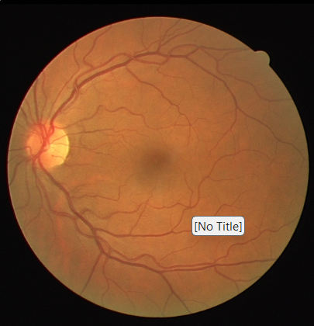
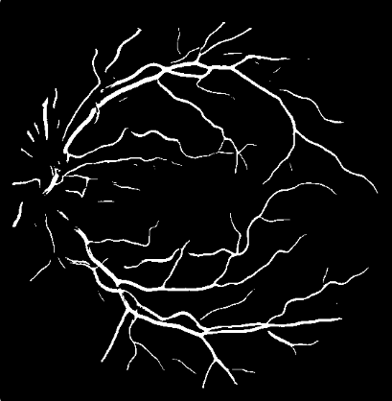
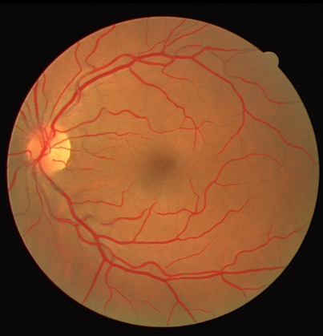
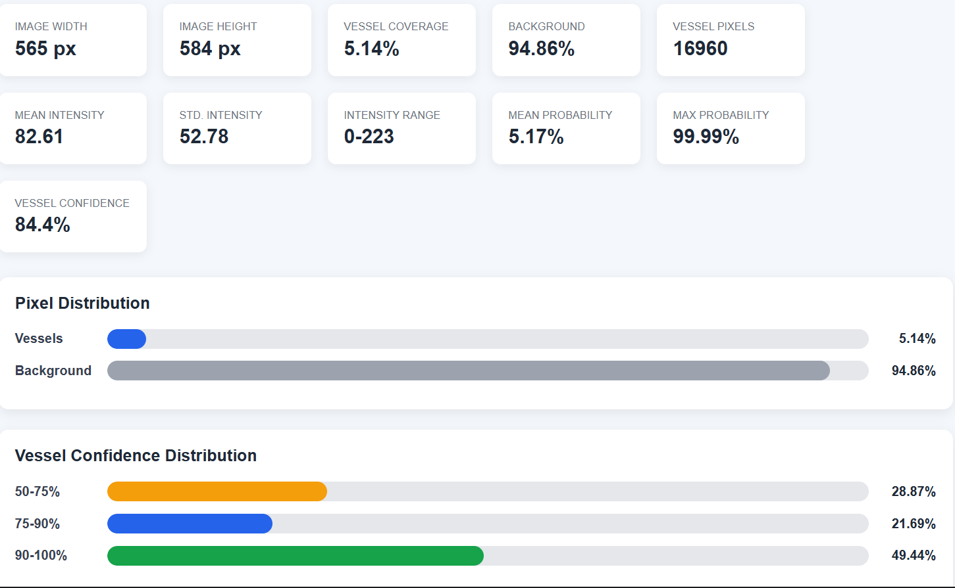
10. System Output & Web Interface
Original Image
Binary Segmentation
Vessel Overlay
Vessel Coverage | Pixel Statistics | Probability | Confidence Distribution
11

Slide 12
11. Limitations
• DRIVE is a relatively small dataset, which limits diversity and generalization.
• Thin and low-contrast vessels may still be missed or incorrectly classified.
• The current model is a baseline U-Net without an explicit attention mechanism.
• Patch-based inference requires reconstruction and may introduce boundary-related errors.
• Performance can vary for retinal images that differ substantially from the DRIVE distribution.
• The system is intended for research/educational visualization, not independent clinical diagnosis.
Key limitation: generalization beyond the training distribution
12

Slide 13
12. Future Scope
• Advanced architectures: Attention U-Net, U-Net++ and residual/dense designs.
• Multi-level and multi-scale feature extraction for thin vessels.
• Stronger data augmentation and larger retinal datasets.
• Evaluate generalization using STARE and CHASE_DB1.
• Improve thin-vessel segmentation using specialized losses and boundary-aware learning.
• Optimize inference using pruning, quantization or knowledge distillation.
• Enhance Django application with authentication, history, comparison and richer analytics.
Goal: higher accuracy + stronger generalization + faster inference + richer analysis
13

Slide 14
13. Conclusion
• A complete U-Net-based retinal vessel segmentation pipeline was successfully developed.
• The system combines preprocessing, 64×64 patch generation, model training, threshold optimization and test prediction.
• The best checkpoint was obtained at Epoch 24 and threshold 0.50 produced the reported final performance.
• The model achieved Dice 82.63%, IoU 70.46%, Precision 82.27%, Recall 83.26% and Accuracy 96.99%.
• All 20 DRIVE test images were successfully processed.
• Django integration makes the trained model accessible through image upload, visualization, statistics and mask download.
• The project provides a practical foundation for future research in automated retinal image analysis.
14

Slide 15
THANK YOU

