Slide 1

Brackets
Adam Lehman Sr. Product Manager adrock@adobe.com
An Introduction
www.digitalblasphemy.com

Slide 2
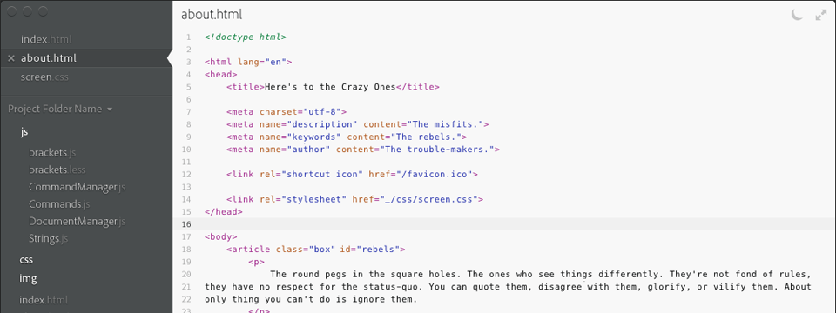
Brackets is an open source code editor for the web.

Slide 3

By The People, For The People!
Built with JavaScript, HTML & CSS. You have the skills and expertise to extend and customize.
Fully extensible. A comprehensive plugin system and API.
An open source project on GitHub MIT-licensed. No restrictions. Fork us!

Slide 4
An Open Source Project
Open source today!
MIT licensed. No restrictions.
Public repository on GitHub.
Public backlog. Public planning.
Community driven.

Slide 5
Code Editor For The Web
Brackets is a code editor. Not a text editor. Not an IDE.
Brackets is optimized for web development. JavaScript, HTML and CSS are the stars of the show.

Slide 6

A Different Editor
Tools that don’t get in your way. Quickly edit external files and tools inline with Quick Edit.
Brackets ‘s your browser. Make a live connection to your browser for dynamic design and debugging.

Slide 7
Brackets [ IN ACTION ]

Slide 8
Open Source
# GitHub Watchers / Forks
Pull Requests

Slide 9
Sprint 8
External contributions
Extensibility
Performance

Slide 10
Sprint 9
The Future

Slide 11
Project Vision
Core
Foundation
General code editor
Search & Replace
HTML / JavaScript / CSS support
Quick navigate
Innovation
Inline Editor
Live Browser Connection
JavaScript Breakpoint Debugging
GitHub / Dropbox Integration
Plugin / Bundle System
Foundation
Preferences
Keyboard shortcuts
Silent update mechanism
Original font optimized for code
General Code Editor
Configurable keyboard shortcuts
Word wrap
Undo / Redo
Code collapse / folding
Drag & drop
Command-line integration

Slide 12
Where To Find Brackets
Desktop Traditional desktop install focused on speed and performance.

Slide 13
Beyond The Desktop
Continue feature development Maintain open source project Extend the reach of Brackets
Cloud Hosted development environment on brackets.adobe.com.
Embedded Built-in to browser applications (e.g. WordPress) and desktop products.
Device PhoneGap powered tablet application for iOS and Android.
Browser Deployed as a browser extension or run on a local server.

Slide 14
Info
GitHub
IRC
Mailing List

