Slide 1

What makes a great workshop?
A Cloud Advocate round table

Slide 2
Our panelists
Jen Looper – Cloud Advocate Lead, Academic Team (@jenlooper and @FrontEndFoxes on Twitter)
Nitya Narasimhan – Senior Cloud Advocate, Mobile & Fusion Dev Team (@nitya on Twitter)
Brandon Minnick – Cloud Advocate, Xamarin, .NET (@TheCodeTraveler on Twitter)
Brian Clark – Cloud Advocate, Academic Team (@_clarkio on Twitter)

Slide 3
Attendee Spectrum
Expert with workshop’s technology
Novice Developer
Experienced Developer
Novice with workshop’s technology

Slide 4
How do we ensure every attendee is successful?

Slide 5
Oversimplify Each Step

Slide 6
Oversimplify Each Step Recommendations
Include the location of the action
“On the Azure Portal, on the left-hand menu, select Create New Resource”
One action per step
Bad
1. In the Solution Explorer, right-click MyBackend.Functions and select Publish
Better
1. In the Solution Explorer, right-click MyBackend.Functions
2. On the right-click menu, select Publish

Slide 7
Include Screenshots

Slide 8
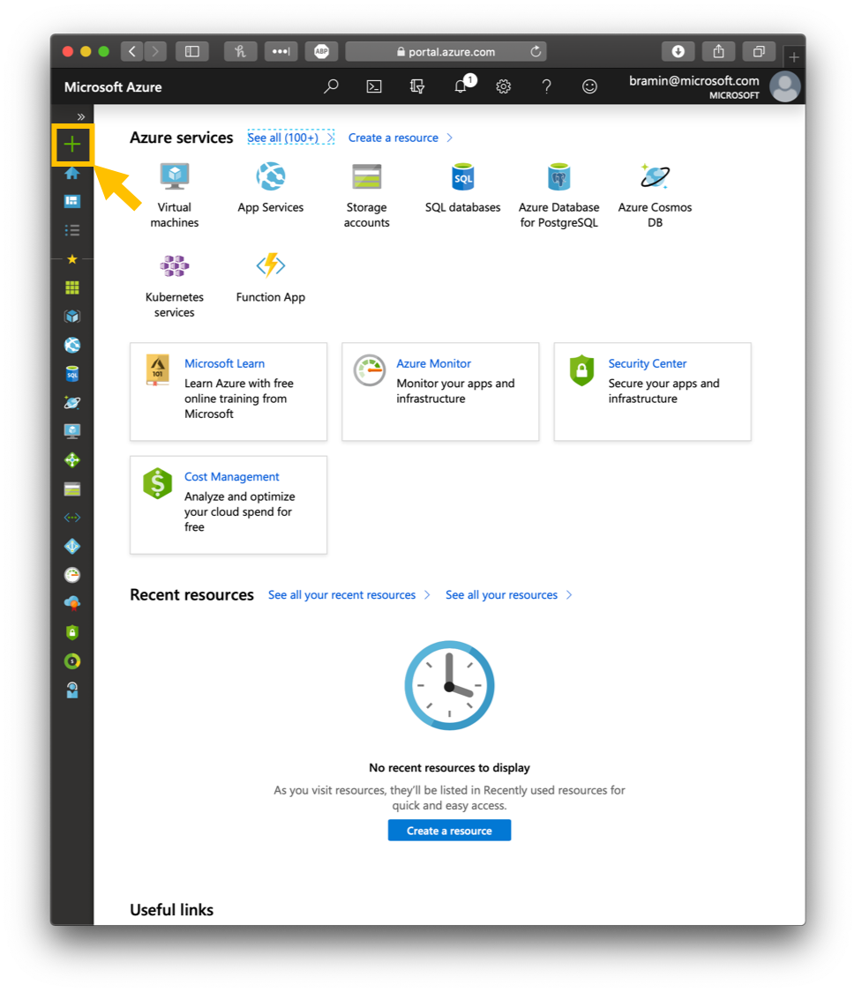
Include Screenshots
When
Every time the user is navigating a GUI
How
Boxes & Arrows

Slide 9
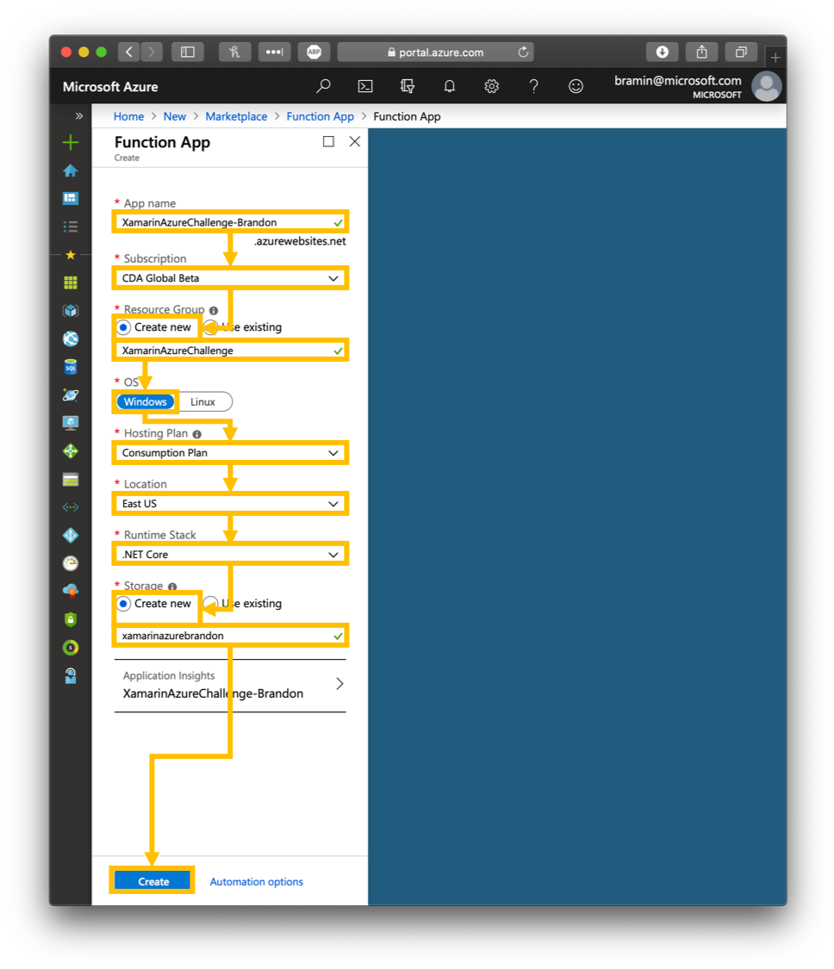
Include Screenshots
When
Every time the user is navigating a GUI
How
Boxes & Arrows

Slide 10
Avoid Jargon

Slide 11
Avoid Jargon Example
1. In the AppDelegate, create an int property called ScreenWidth, then add this in the `FinishedLaunching` method:
ScreenWidth = (int)UIScreen.MainScreen.Bounds.Width;

Slide 12
Lead the Workshop

Slide 13
Lead the Workshop Recommendations
Walkthrough the workshop step-by-step
Go slowly
Explain each step
Ensure each developer completes each step
Pause periodically and offer assistance
Allow experienced devs to work at a faster pace

Slide 14
Include a Completed Solution

Slide 15
Include a Completed Solution Recommendations
Allows devs to check their work
Helps avoid blockers due to typos/grammatical errors

Slide 16
Resources
https://github.com/jlooper/league-workshop-template
https://github.com/jlooper/green
https://workshops.frontendfoxes.org
https://howdoieven.dev
https://github.com/microsoft/AcademicContent
http://2020.makethetalkhappen.dev/
https://codetraveler.io/SuccessfulWorkshops

