Slide 1

Becoming a green developer
Jen Looper
Cloud Developer Advocate
Microsoft

Slide 2
Agenda - learn about sustainable software development - code together!

Slide 3
What is sustainable software development?
An emerging discipline at the intersection of:
🌱 climate science
💻 software practices and architecture
💡electricity markets
🔌 hardware and data center design
https://principles.green/

Slide 4

Goals
By following certain recommendations, a Sustainable Software Engineer
can make decisions
that have a meaningful impact
on the carbon impact of their applications.
Let’s look at these 8 recommendations

Slide 5
8 principles
1. Build applications that are carbon efficient
2. Build applications that are energy efficient
3. Consume electricity with the lowest carbon intensity
4. Build applications that run on older hardware
5. Run servers at a high rate of utilization
6. Reduce the amount of data and the distance it must travel across the network
7. Instead of shaping supply to meet demand, try shaping demand to match supply
8. Focus on end-to-end optimizations that increase overall carbon efficiency

Slide 6
Can we build a carbon-friendly app?
Should we build a web site?
Mobile app?
Desktop app?
Problem: building fresh web assets that are always online consume unnecessary energy to keep them live
Solution: cloud hosting can help spin up assets when requested/needed, or an offline-first strategy can keep energy requests low

Slide 7
A better solution
1. Build applications that are carbon efficient
2. Build applications that are energy efficient
6. Reduce the amount of data and the distance it must travel across the network
7. Instead of shaping supply to meet demand, try shaping demand to match supply
Let’s build something that is hosted locally
It can answer several ‘principles’
A browser extension!

Slide 8
A green browser extension
Help you make educated decisions to manage your personal energy usage choices
Hosted locally
Called ad hoc
Built with vanilla JavaScript, very little overhead

Slide 9
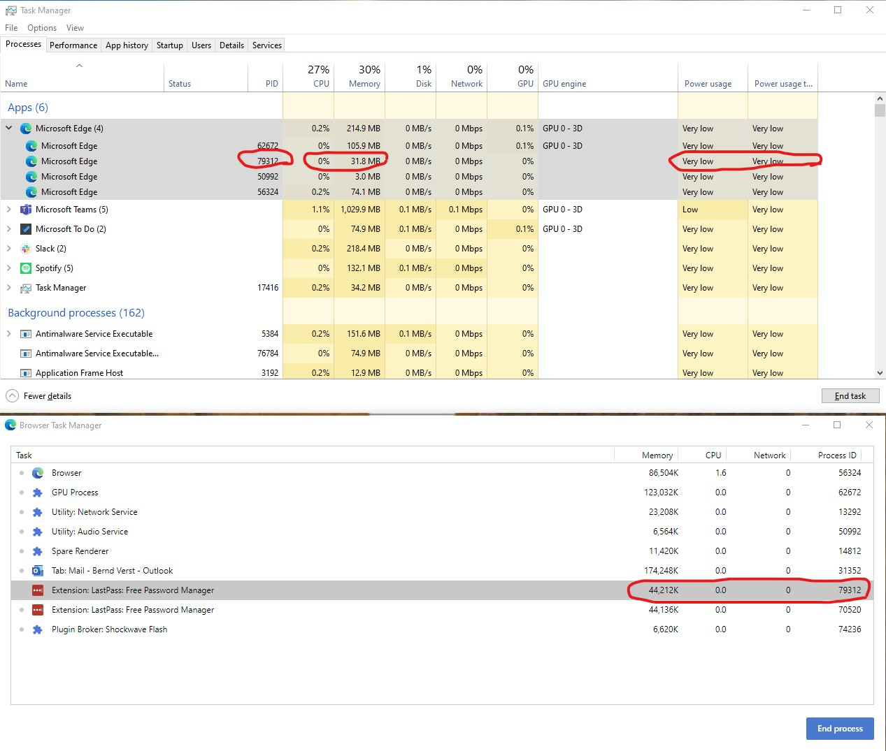
Careful now!

Slide 10
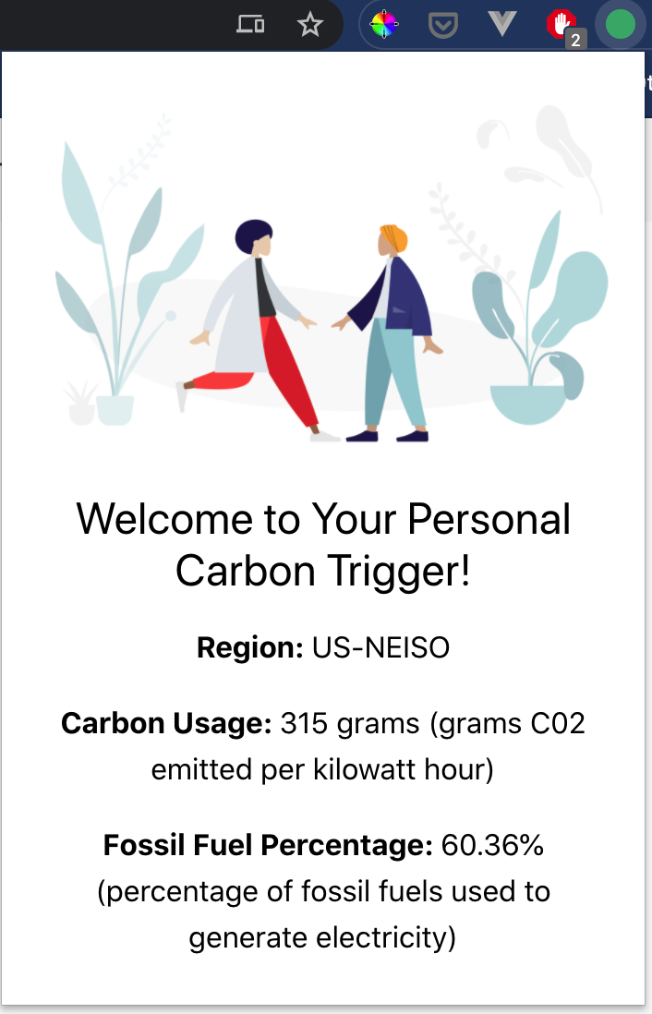
The Greenest App = the one you don’t build!

Slide 11
Let’s build a browser extension
Use the C02Signal API
Change color of icon based on carbon intensity in your region
Get a quick readout of your region’s carbon status
Knowledge = power! ⚡️
💡Save power by boosting knowledge!

Slide 12
Demo on Edge browser (also works on Chrome)

Slide 13
Let’s build together
Clone the repo: https://github.com/jlooper/carbon-trigger-extension/tree/start
** use the start branch **
2. Navigate to the root and `npm install` dependencies
3. Explore the files:
dist/manifest.json (defaults set here)
src/index.js (your JS code goes here)
dist/index.html (frontend HTML markup here)
dist/background.js (background JS here)
dist/index.js (built JS)

Slide 14
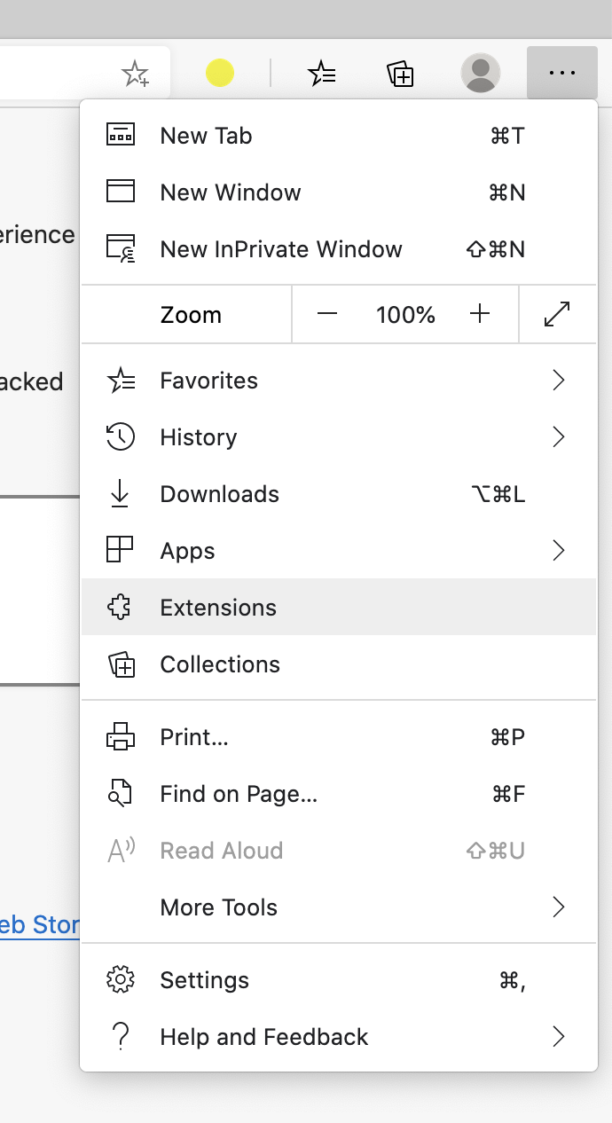
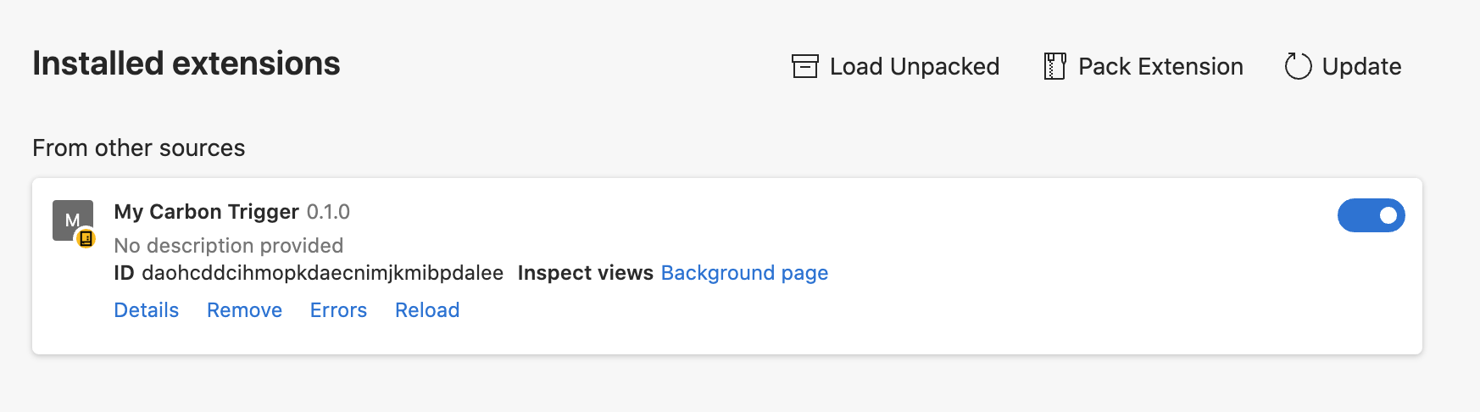
Development process
Build a copy of your extension: `npm run build`
Add extension to Edge
1
2
3

Slide 15
Complete the code: follow the 🌱
Pre-development tasks
Take a look at the energy map here: https://www.electricitymap.org/map
Get an API key here: https://www.co2signal.com/ (the key will be emailed to you quickly)
Find your zone here: http://api.electricitymap.org/v3/zones

Slide 16
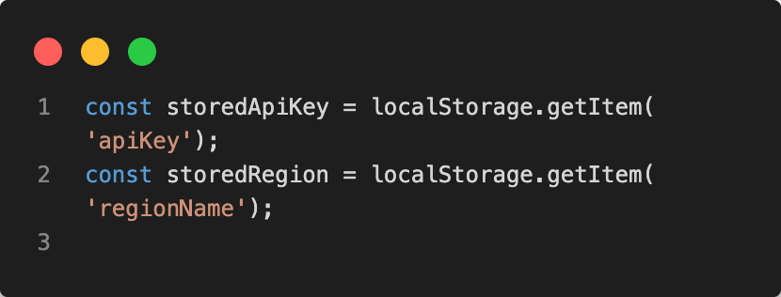
🌱 1: if anything is in localStorage, pick it up🌱
/src/index.js
Add a check to the init() function to see if any API key or Region is set in local storage:

Slide 17
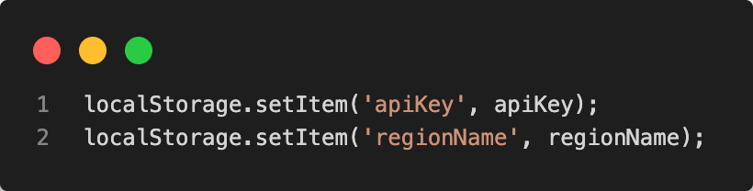
🌱 2. manage local storage inputs 🌱
/src/index.js
In the setUpUser method, set user-entered API key and region

Slide 18
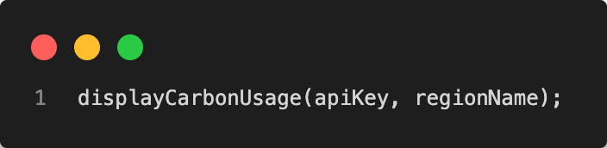
🌱 3. make initial call 🌱
/src/index.js
Once user inputs are set up in setUpUser, make an API call to get the region’s carbon intensity

Slide 19
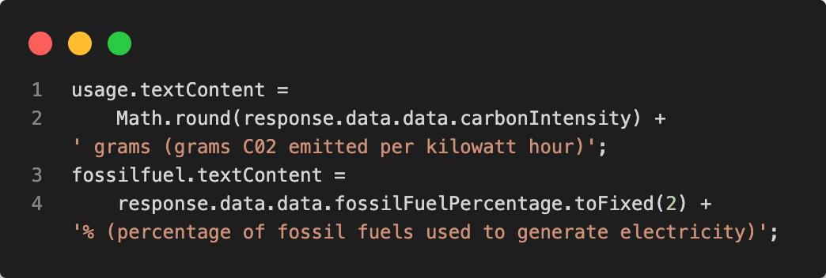
🌱4. display usage and carbon source🌱
/src/index.js
Make the API call to get your region’s usage, and display it

Slide 20
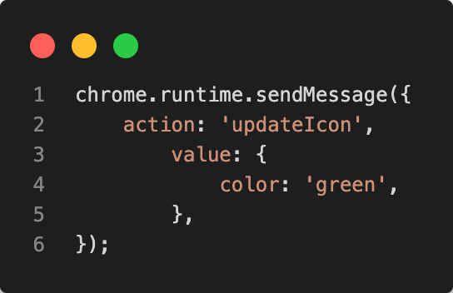
🌱 5. set icon to be generic green🌱
/src/index.js
Set the icon to a default; it will change when the API is called. This function uses the chrome runtime built-in management methods

Slide 21
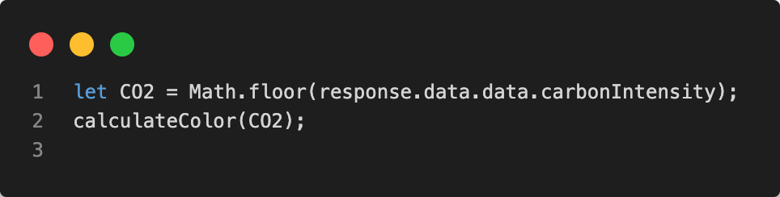
🌱6. calculate color of icon, based on carbon intensity🌱
/src/index.js
Calculate the appropriate color of the icon, which changes based on an active API call

Slide 22
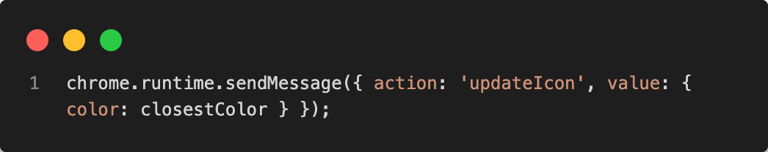
🌱 7. update icon 🌱
/src/index.js
In calculateColor(), update the icon, again calling the chrome.runtime to invoke a background process

Slide 23
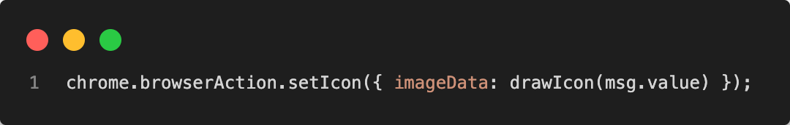
🌱 7. update icon 🌱
/dist/background.js
In the listener for ‘updateIcon’, create a browser action to redraw the icon using the Canvas HTML API

Slide 24
Build and Load Extension
Navigate to root and type `npm run build` to build a new bundle via webpack
In the Extensions panel, refresh your extension. Add your API key and region and check your region’s carbon intensity.
Congratulations, now you know when to run an errand or run the dryer! Just consult your ad hoc browser extension!

Slide 25
Remember…the greenest web asset is the slimmest, the one with the least overhead, and the one that is only called ad hoc.
Plus, you built something slim that helps you make greener decisions!
To: An Awesome Web Developer
123 Maple Lane
Greentown, CO
00000

Slide 26
Thank you!
@jenlooper
Jenlooper.com

