Slide 1
Houston’s Housing Market
Jocely Lopez Luna

Slide 2
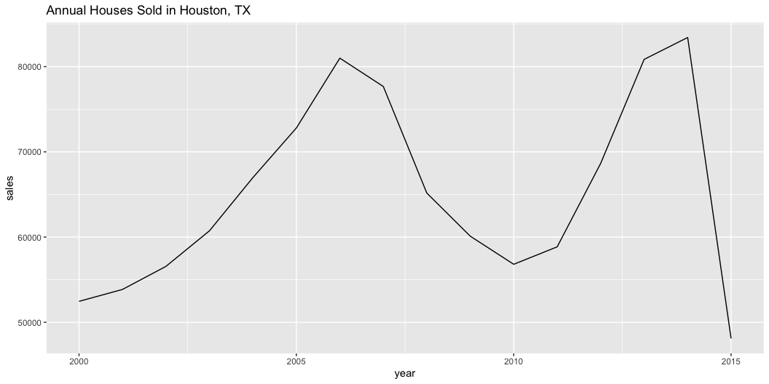
History of House Sales

Slide 3
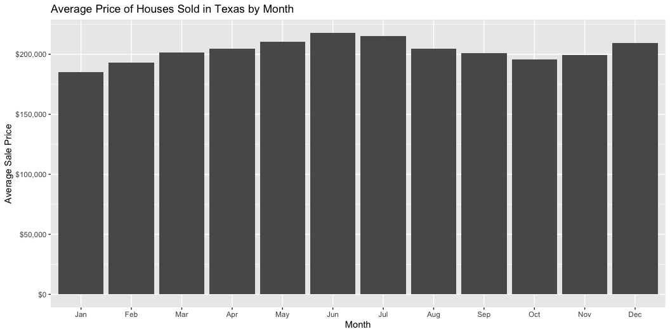
Average Sale Price

Slide 4
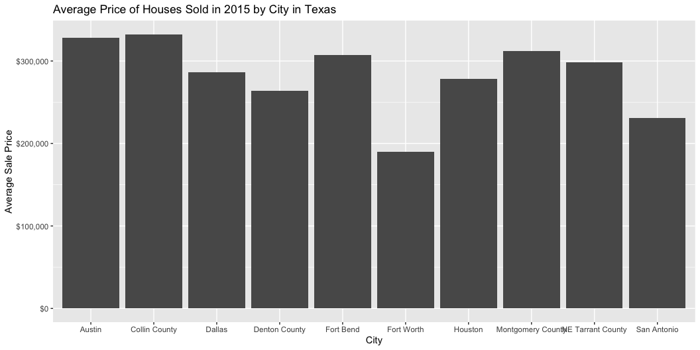
How does Houston rank?

