Slide 1
GTR2: Group 1
By: David Grimm, Lynn Tran, Natasha Nakhasi, and Joshua Lopez

Slide 2
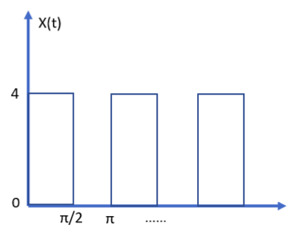
Part 1: Analysis of given square wave signal

Slide 3
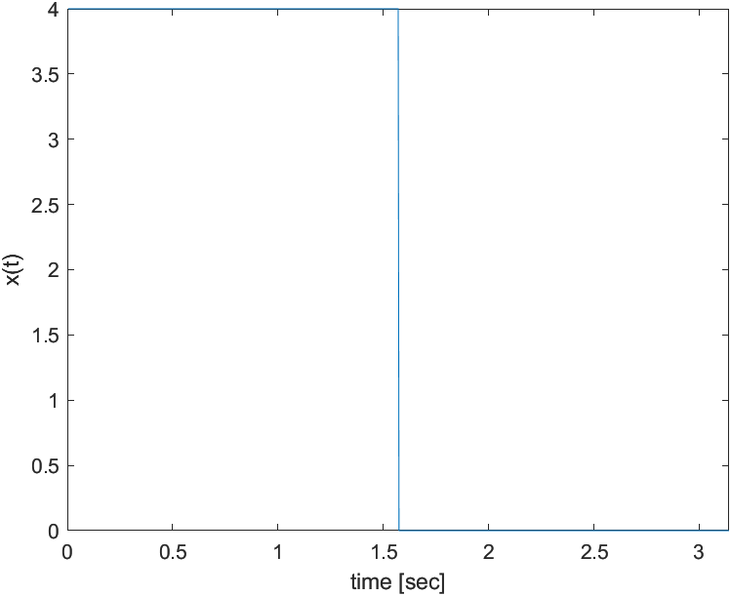
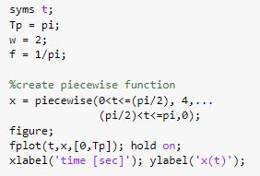
MATLAB Plot & Code for Square Wave
Square Wave Plot

Slide 4
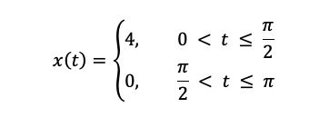
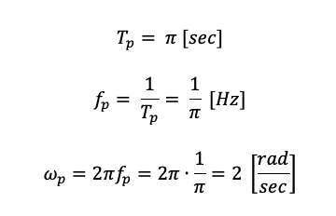
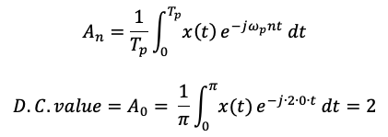
Mathematical Analysis
Analytical Formula
D.C. Calculation

Slide 5
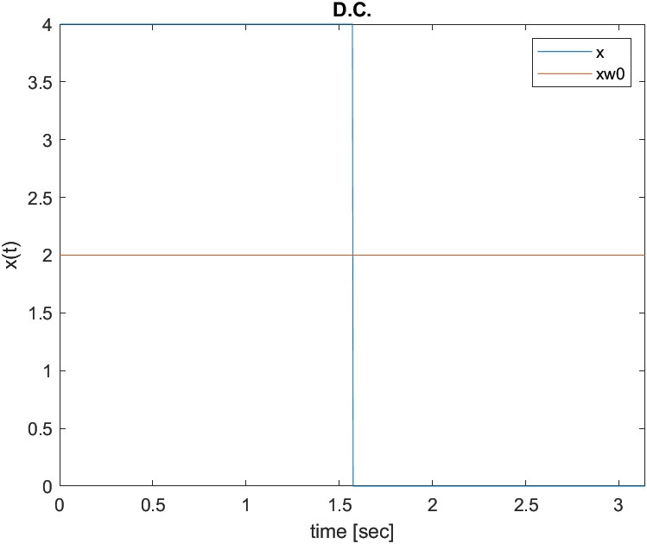

D.C. Calculation
MATLAB Plot & Code

Slide 6

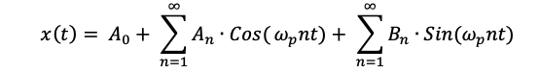
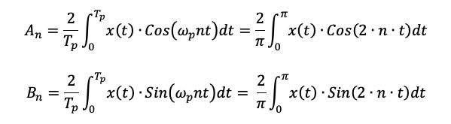


Generalized Analytical Fourier Transform

Slide 7
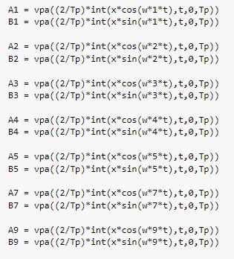
Fourier Transform Approximation Using Generalized Analytical Formulas
MATLAB Code

Slide 8
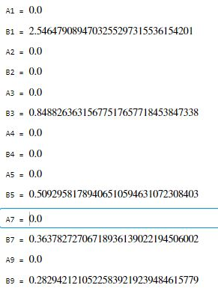

Fourier Transform Approximation Results
MATLAB Results

Slide 9
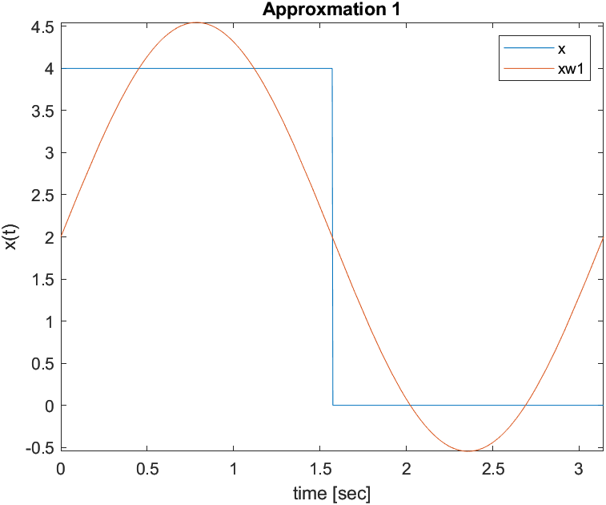
Fourier Transform Using One Term
Time History Plot #1

Slide 10
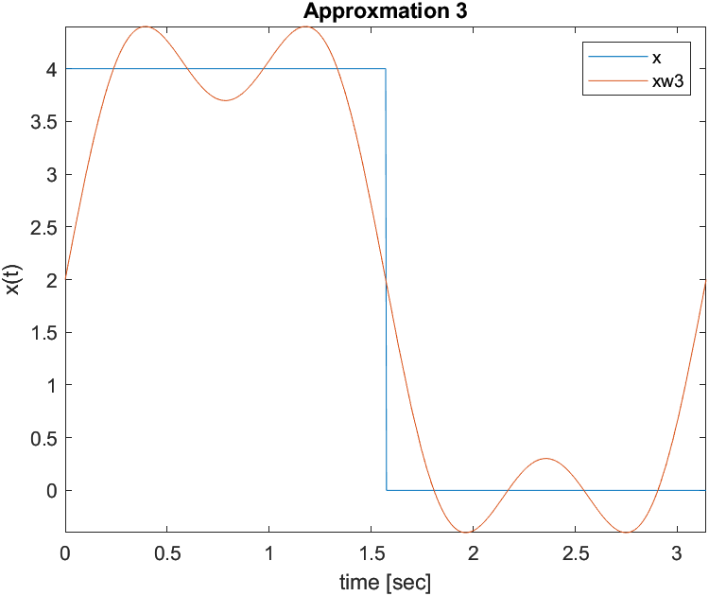

Fourier Transform Using Summation of the First Two Terms
Time History Plot #2

Slide 11
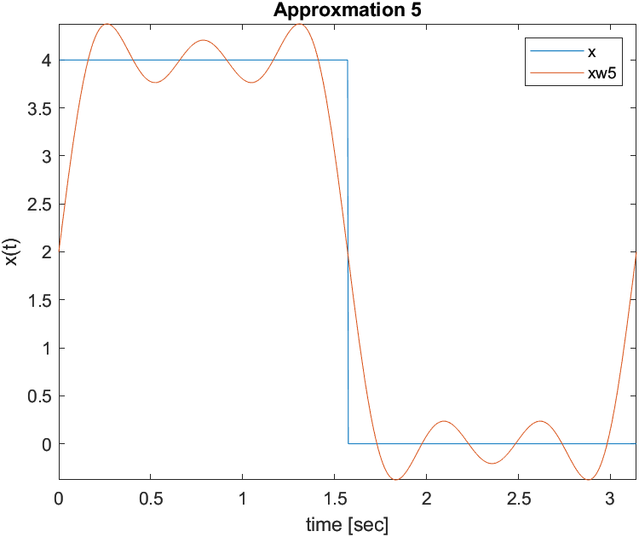

Fourier Transform Using Summation of the First Three Terms
Time History Plot #3

Slide 12
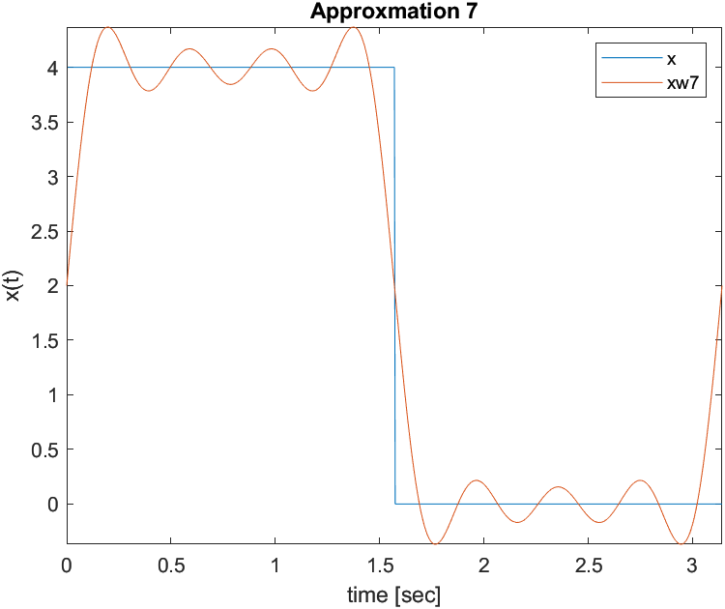
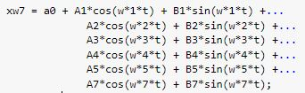
Fourier Transform Using Summation of the First Four Terms
Time History Plot #4

Slide 13

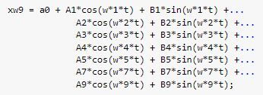
Fourier Transform Using Summation of the First Five Terms
Time History Plot #5

Slide 14
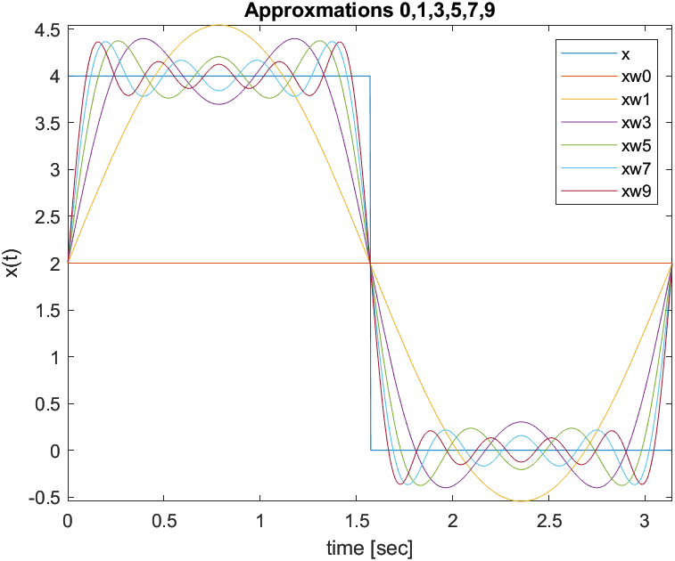
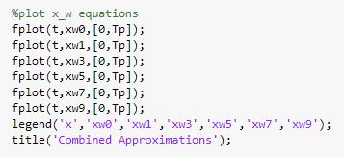
How many harmonics are enough to capture the square wave signal?
Time History Plot #6
Approximately 20 harmonics
But in order to capture the exact square wave signal, an infinite amount of harmonics is necessary.

Slide 15
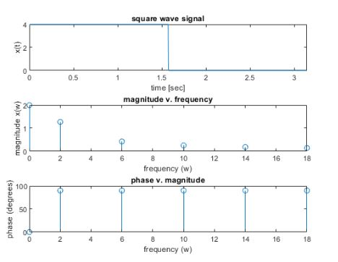
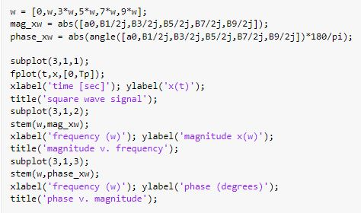
Frequency Response Plot & Code

Slide 16
Does the signal have harmonics?
Yes, the signal does have harmonics. This is because harmonics are defined as an ordered series of standing waves that follow a pattern of repeated frequencies.
A square wave has harmonics at odd multiples of the fundamental frequency. As higher harmonics are added, the result gets closer to an ideal square wave, which contains infinite harmonics.
Notes:
Yes, the signal does have harmonics. This is because harmonics are defined as a series and/or pattern of repeated frequencies.

Slide 17
Part 2: Assume signal is not periodic and has only a unit pulse from t = 0 sec to t = π/2 sec with an amplitude of 4 and zero otherwise

Slide 18
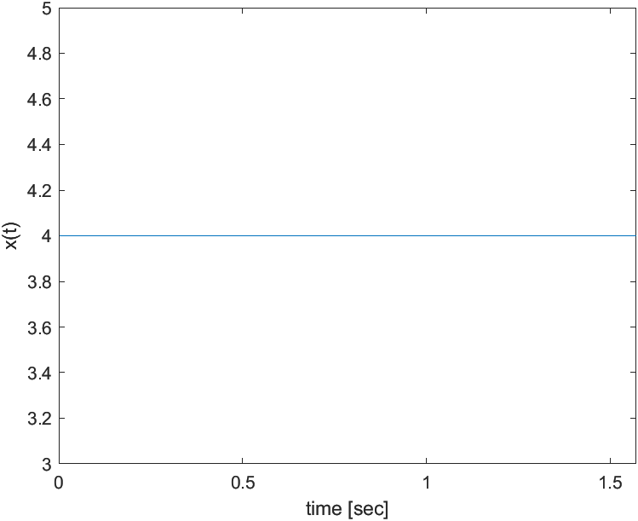
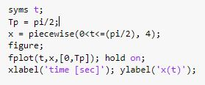
MATLAB Code & Plot

Slide 19


Mathematical Analysis
Analytical Formula
Generalized Analytical Fourier Transform

Slide 20
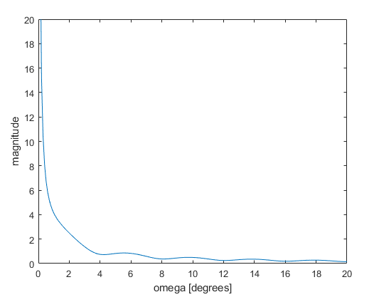
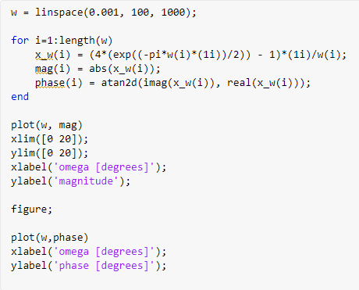
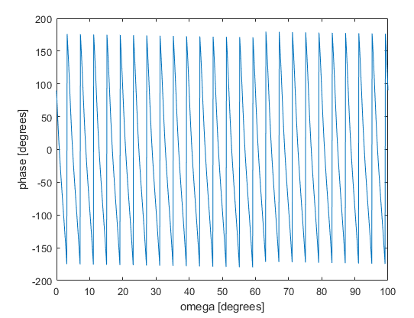
Frequency Response Plot & Code
Magnitude Frequency Response Plot
Phase Frequency Response Plot​

Slide 21
Does the non-periodic signal have harmonics?
No, non-periodic signals do not have harmonics.
A signal that does not repeats its pattern over a period is called aperiodic signal or non periodic

Slide 22
Thank You !

