Slide 1
Getting Started with OpenCV
Yue Gao
CS 4758/6758 Robot Learning
http://vast.uccs.edu/~tboult/CS330/NOTES/OpenCV_2005Q4_tutorial.ppt

Slide 2
Agenda
OpenCV facts and overall structure
Install OpenCV
OpenCV functions and examples
Some useful OpenCV tips & tricks

Slide 3
What is OpenCV?
OpenCV stands for Open Source Computer Vision Library
Being developed at Intel since 1999
Written in C/C++; Contains over 500 functions.
Available on Windows, Linux and MacOSX.
So far is extensively used in many companies and research centers
Home page: www.intel.com/technology/computing/opencv/

Slide 4
OpenCV structure
CV
Image processing
and vision algorithms
HighGUI
GUI, Image and Video I/O
CXCORE
basic structures and algoritms,
XML support, drawing functions

Slide 5
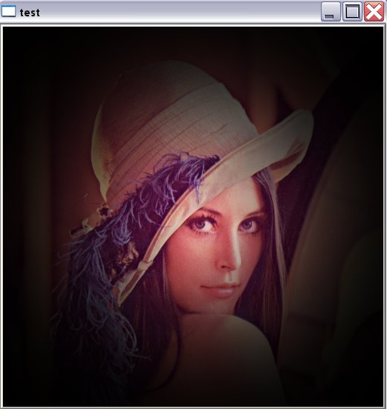
First OpenCV Program
1. #include <cxcore.h>
2. #include <highgui.h>
3. #include <math.h>
4. int main( int argc, char** argv ) {
5. CvPoint center;
6. double scale=-3;
7. IplImage* image = argc==2 ? cvLoadImage(argv[1]) : 0;
8. if(!image) return -1;
9. center = cvPoint(image->width/2,image->height/2);
10. for(int i=0;i<image->height;i++)
11. for(int j=0;j<image->width;j++) {
12. double dx=(double)(j-center.x)/center.x;
13. double dy=(double)(i-center.y)/center.y;
14. double weight=exp((dx*dx+dy*dy)*scale);
15. uchar* ptr = &CV_IMAGE_ELEM(image,uchar,i,j*3);
16. ptr[0] = cvRound(ptr[0]*weight);
17. ptr[1] = cvRound(ptr[1]*weight);
18. ptr[2] = cvRound(ptr[2]*weight); }
19. cvSaveImage( “copy.png”, image );
20. cvNamedWindow( "test", 1 );
21. cvShowImage( "test", image );
22. cvWaitKey();
23. return 0; }
Radial gradient

Slide 6
How to build and run the program?
Obtain the latest version of OpenCV:
  Get the official release (currently, OpenCV b5 for Windows = OpenCV 0.9.7 for Linux) at http://www.sourceforge.net/projects/opencvlibrary
  Get the latest snapshot from CVS:
:pserver:anonymous@cvs.sourceforge.net:/cvsroot/opencvlibrary
Install it:
  On Windows run installer, on Linux use “./configure + make + make install” (see INSTALL document)
  On Windows: open opencv.dsw, do “build all”, add opencv/bin to the system path; on Linux - see a)
Build the sample:
  Windows:
    cl /I<opencv_inc> test.cpp /link /libpath:<opencv_lib_path> cxcore.lib cv.lib highgui.lib
    Create project for VS (see opencv/docs/faq.htm)
or use opencv/samples/c/cvsample.dsp as starting point
  Linux:
g++ -o test `pkg-config –cflags` test.cpp `pkg-config –libs opencv`
Run it:
test lena.jpg or
./test lena.jpg

Slide 7
The Program Quick Review
1. #include <cxcore.h>
2. #include <highgui.h>
3. #include <math.h>
4. int main( int argc, char** argv ) {
5. CvPoint center;
6. double scale=-3;
7. IplImage* image = argc==2 ? cvLoadImage(argv[1]) : 0;
8. if(!image) return -1;
9. center = cvPoint(image->width/2,image->height/2);
10. for(int i=0;i<image->height;i++)
11. for(int j=0;j<image->width;j++) {
12. double dx=(double)(j-center.x)/center.x;
13. double dy=(double)(i-center.y)/center.y;
14. double weight=exp((dx*dx+dy*dy)*scale);
15. uchar* ptr = &CV_IMAGE_ELEM(image,uchar,i,j*3);
16. ptr[0] = cvRound(ptr[0]*weight);
17. ptr[1] = cvRound(ptr[1]*weight);
18. ptr[2] = cvRound(ptr[2]*weight); }
19. cvSaveImage( “copy.png”, image );
20. cvNamedWindow( "test", 1 );
21. cvShowImage( "test", image );
22. cvWaitKey();
23. return 0; }
short and clear program, no need to mess with MFC/GTK/QT/…, cross-platform
cvLoadImage() and cvSaveImage() provide the easiest way to save/load images of various formats.
cvPoint and other “constructor” functions make the code shorter and allow 1-line functions call.
CV_IMAGE_ELEM() – pretty fast way to access image pixels
cvRound() is very fast and convenient way to cast float/double to int
cvNamedWindow() creates “smart” window for viewing an image
cvShowImage() shows image in the window
cvWaitKey() delays the execution until key pressed or until the specified timeout is over

Slide 8
What else HighGUI can do?
“Smart” windows
Image I/O, rendering
Processing keyboard and other events, timeouts
Trackbars
Mouse callbacks
Video I/O

Slide 9
Windows
cvNamedWindow(window_name, fixed_size_flag);
creates window accessed by its name. Window handles repaint, resize events. Its position is remembered in registry:
cvNamedWindow(“ViewA”,1);
cvMoveWindow(“ViewA”,300,100);
cvDestroyWindow(“ViewA”);
…
cvShowImage(window_name, image);
copies the image to window buffer, then repaints it when necessary. {8u|16s|32s|32f}{C1|3|4} are supported.
only the whole window contents can be modified. Dynamic updates of parts of the window are done using operations on images, drawing functions etc.
On Windows native Win32 UI API is used
Linux – GTK+ 2
MacOSX – X11 & GTK+ 2; Native Aqua support is planned.

Slide 10
Image I/O
IplImage* cvLoadImage(image_path, colorness_flag);
loads image from file, converts to color or grayscle, if need, and returns it (or returns NULL).
image format is determined by the file contents.
cvSaveImage(image_path, image);
saves image to file, image format is determined from extension.
BMP, JPEG (via libjpeg), PNG (via libpng), TIFF (via libtiff), PPM/PGM formats are supported.
IplImage* img = cvLoadImage(“picture.jpeg”,-1);
if( img ) cvSaveImage( “picture.png”, img );

Slide 11
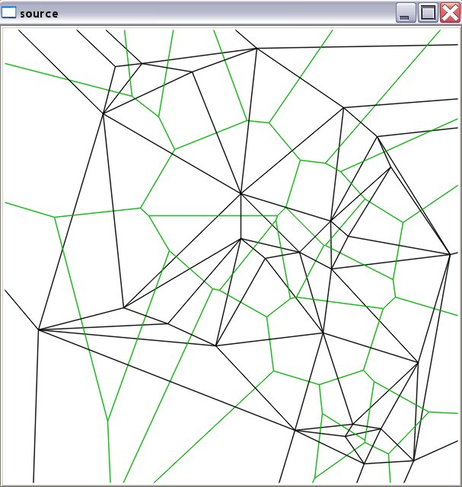
Waiting for keys…
cvWaitKey(delay=0);
waits for key press event for <delay> ms or infinitely, if delay=0.
The only function in highgui that process message queue => should be called periodically.
Thanks to the function many highgui programs have clear sequential structure, rather than event-oriented structure, which is typical for others toolkits
To make program continue execution if no user actions is taken, use cvWaitKey(<delay_ms!=0>); and check the return value
// opencv/samples/c/delaunay.c
…
for(…) {
…
int c = cvWaitKey(100);
if( c >= 0 )
// key_pressed
break;
}
delaunay.c, 240 lines

Slide 12
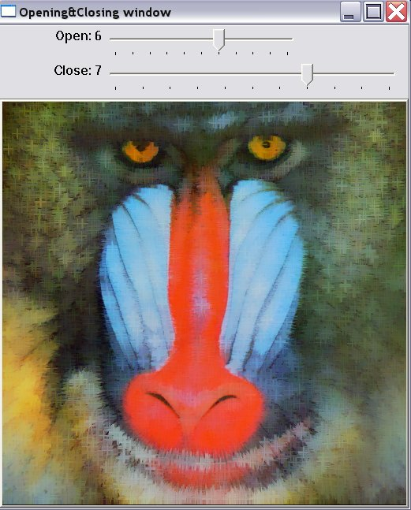
Trackbars
cvCreateTrackbar(trackbar_name,window_name,
position_ptr,max_value,callback=0);
creates trackbar and attaches it to the window.
Value range 0..max_value. When the position is changed, the global variable updated and callback is called, if specified.
// opencv/samples/c/morphology.c
int dilate_pos=0; // initial position value
void Dilate(int pos) {
… cvShowImage( “E&D”, erode_result );
}
int main(…){
…
cvCreateTrackbar(“Dilate”,”E&D”,
&dilate_pos,10,Dilate);
…
cvWaitKey(0); // check for events & process them
...}
morphology.c, 126 lines

Slide 13
Mouse Events
cvSetMouseCallback(window_name, callback, userdata=0);
sets callback on mouse events (button clicks, cursor moves) for the specified window
// opencv/samples/c/lkdemo.c
void on_mouse(int event,int x,int y,int flags,
void* param) { … }
int main(…){
…
cvSetMouseCallback(“LkDemo”,on_mouse,0);
…
cvWaitKey(0); // check for events & process them
…
}
Scroll forward
for example ☺

Slide 14
Video I/O API
CvCapture* cvCaptureFromCAM(camera_id=0);
initializes capturing from the specified camera
CvCapture* cvCaptureFromFile(videofile_path);
initializes capturing from the video file.
IplImage* cvQueryFrame(capture);
retrieves the next video frame (do not alter the result!), or NULL if there is no more frames or an error occured.
cvGetCaptureProperty(capture, property_id);
cvSetCaptureProperty(capture, property_id, value);
retrieves/sets some capturing properties (camera resolution, position within video file etc.)
cvReleaseCapture(&capture);
do not forget to release the resouces at the end!
Used interfaces:
  Windows: VFW, IEEE1394, MIL, DShow (in progress), Quicktime (in progress)
  Linux: V4L2, IEEE1394, FFMPEG
  MacOSX: FFMPEG, Quicktime (in progress)

Slide 15
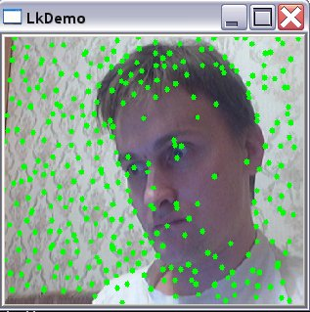
Video I/O Example
// opencv/samples/c/lkdemo.c
int main(…){
…
CvCapture* capture = <…> ? cvCaptureFromCAM(camera_id) : cvCaptureFromFile(path);
if( !capture ) return -1;
for(;;) {
IplImage* frame=cvQueryFrame(capture);
if(!frame) break;
// … copy and process image
cvShowImage( “LkDemo”, result );
c=cvWaitKey(30); // run at ~20-30fps speed
if(c >= 0) {
// process key
}}
cvReleaseCapture(&capture);}
lkdemo.c, 190 lines
(needs camera to run)

Slide 16
Using OpenCV in User Apps
Least squares (real example from OpenCV itself).
// was (A – NxN matrix, b – Nx1 right-side vector, x – solution):
some_old_least_sq_func_32f( /* float* */ A, /* int */ N, /* int */ N, /* float* */ b, /* float* */ x);
// has been converted to:
{ CvMat _A=cvMat(N,N,CV_32F,A), _b=cvMat(N,1,CV_32F,b), _x=cvMat(N,1,CV_32F,x);
cvSolve( &_A, &_b, &_x, CV_SVD );
}
Advantages:
  error handling
  size and type checking
  easier 32f<->64f conversion

Slide 17
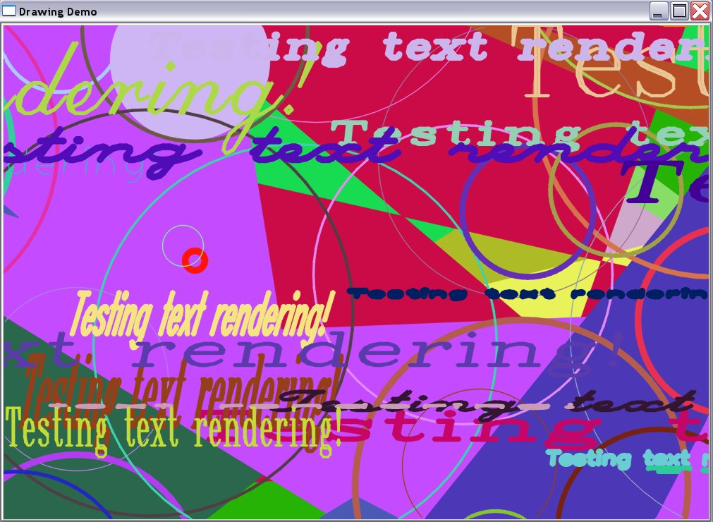
What can be drawn in image
(besides circles)?
cxcore provides numerous drawing functions:
  Lines, Circles, Ellipses, Elliptic Arcs
  Filled polygons or polygonal contours
  Text (using one of embedded fonts)
  Everything can be drawn with different colors, different line width,
antialiasing on/off
  Arbitrary images types are supported (for depth!=8u antializing is off)

Slide 18
Save your data (to load it then)
Need a config file?
Want to save results of your program to pass it to another one, or look at it another day?
It all can be easily done with OpenCV
persistence-related functions.
my_matrix.xml
// somewhere deep in your code… you get 5x5
// matrix that you’d want to save
{ CvMat A = cvMat( 5, 5, CV_32F, the_matrix_data );
cvSave( “my_matrix.xml”, &A );
}
// to load it then in some other program use …
CvMat* A1 = (CvMat*)cvLoad( “my_matrix.xml” );
<?xml version="1.0"?>
<opencv_storage>
<my_matrix type_id="opencv-matrix">
<rows>5</rows>
<cols>5</cols>
<dt>f</dt>
<data>
1. 0. 0. 0. 0. 0. 1. 0. 0. 0. 0.
0. 1. 0. 0. 0. 0. 0. 1. 0. 0. 0. 0.
0. 1.</data></my_matrix>
</opencv_storage>

Slide 19
Some OpenCV Tips and Tricks
Use short inline “constructor” functions: cvScalar, cvPoint, cvSize, cvMat etc.
Use cvStackAlloc for small buffers
Consider CV_IMPLEMENT_QSORT_EX() as possible alternative to qsort() & STL sort().
To debug OpenCV program when runtime error dialog error pops up, press “Retry” (works with debug version of libraries)
…

Slide 20
Where to get more information?
OpenCV Wiki-pages: http://opencvlibrary.sourceforge.net
Supplied documentation: OpenCV/docs/index.htm, faq.htm

Slide 21
Take away points
-Google is your best friend
- Learn OpenCV coding style

Slide 22
Thank you!

