Slide 1
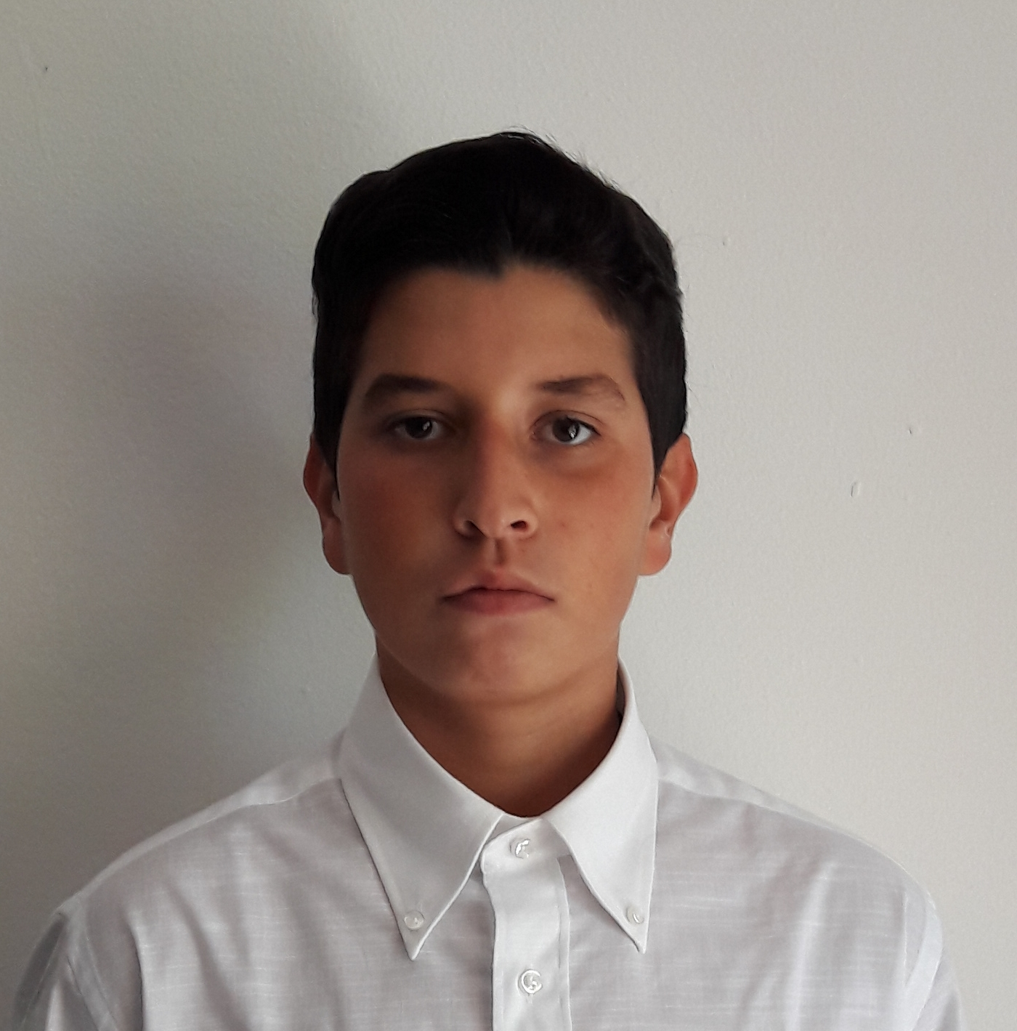
Gamma Undergraduate Software Support Analyst Placement
Anas Zouhir 17.02.2020

Slide 2






Who am I?
Brunel university student
Computer science
Second year

Slide 3
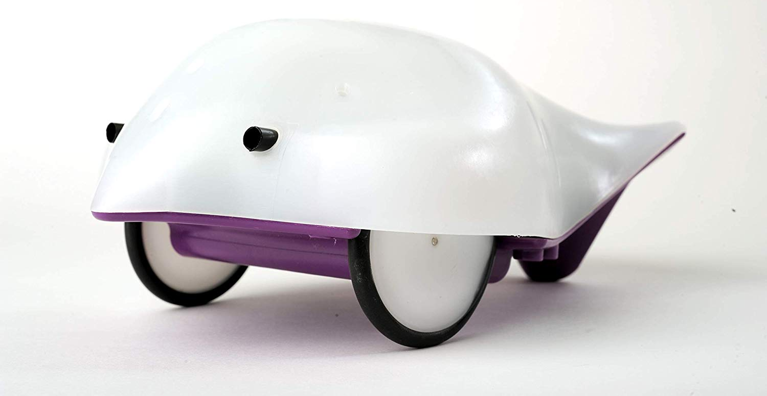
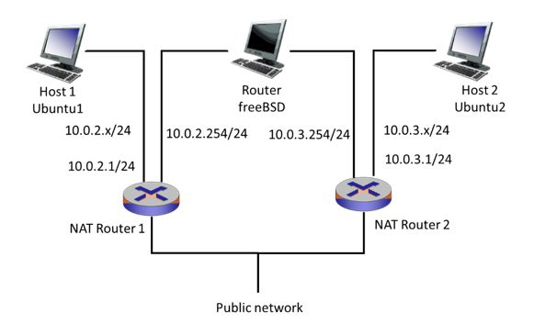
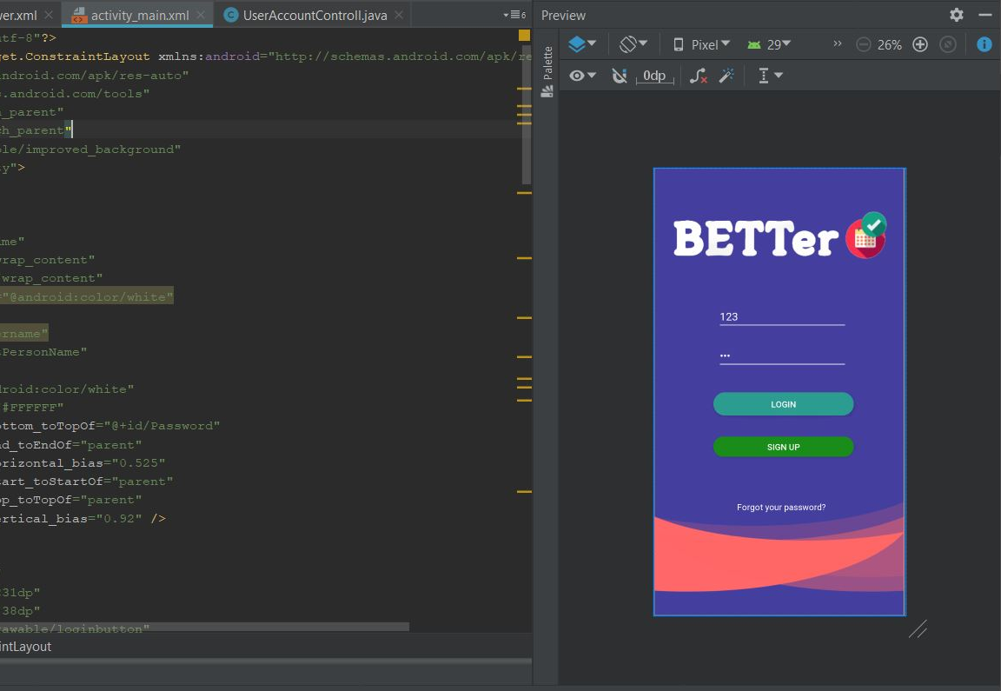


PROJECTS
FINCH ROBOT
NETWORKING
ANDROID APPLICATION

Slide 4
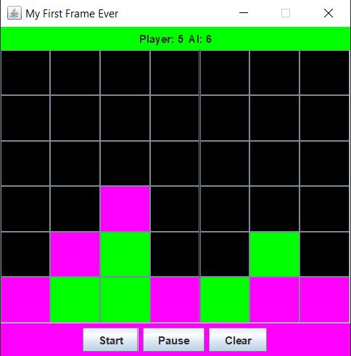

Connect 4 JAVA
My very first project
Hard but satisfactory
Achieved a high grade
MADE ME APPRECIATE THE ART OF PROGRAMMING

Slide 5
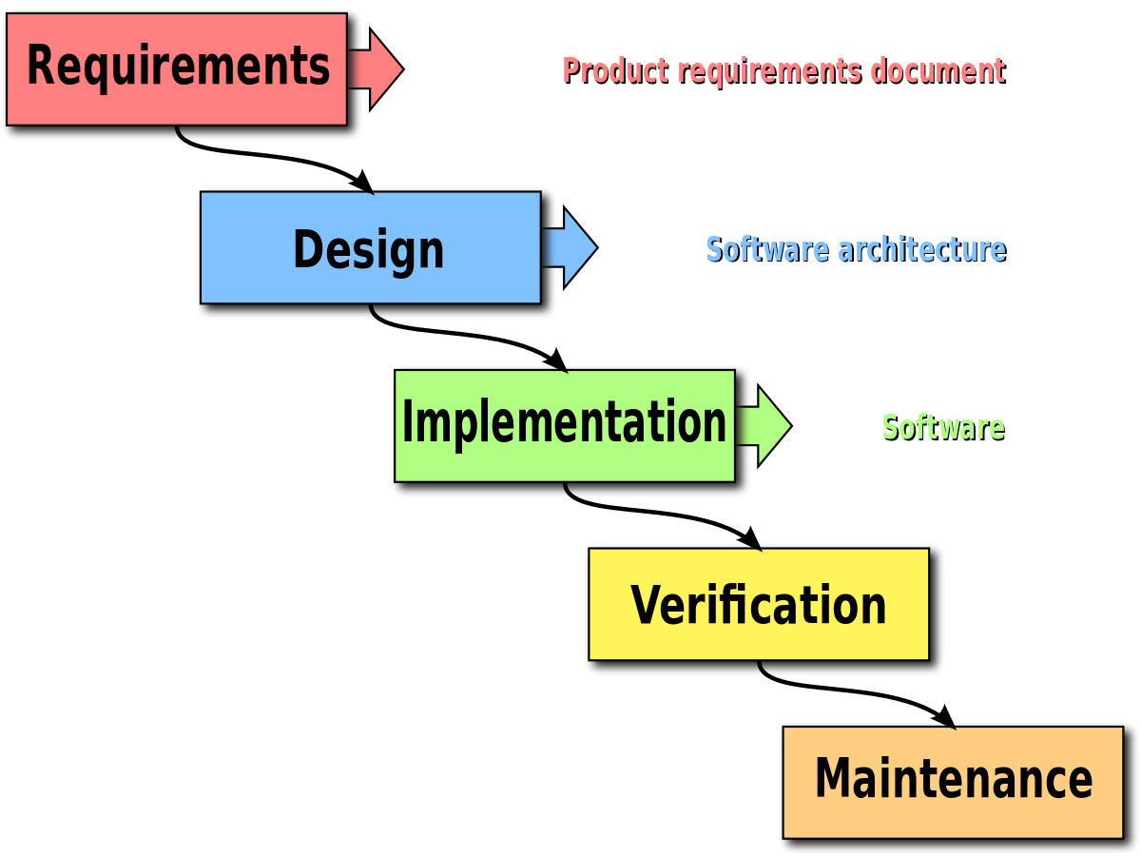
WATERFALL METHODOLOGY
Fixed requirements
Fixed time
NO second thoughts
Same method for study
Fast, efficient and reliable

Slide 6
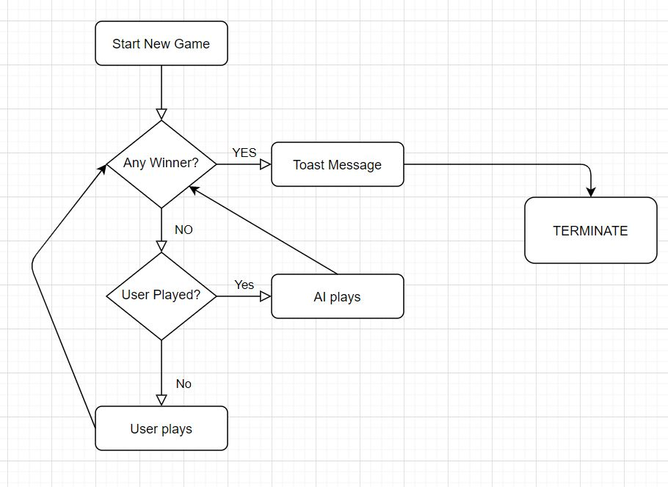
DESIGN PHASE logical

Slide 7

CODING PHASE
Avoid GOD Class
Object Oriented Programming:
-Inheritance
-Polymorphism
-Encapsulation

Slide 8
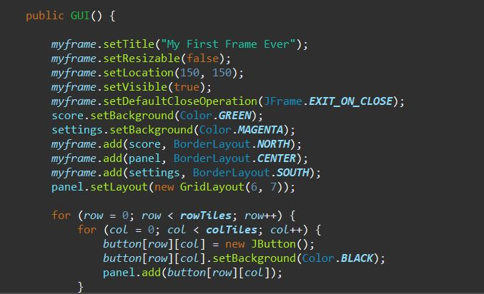
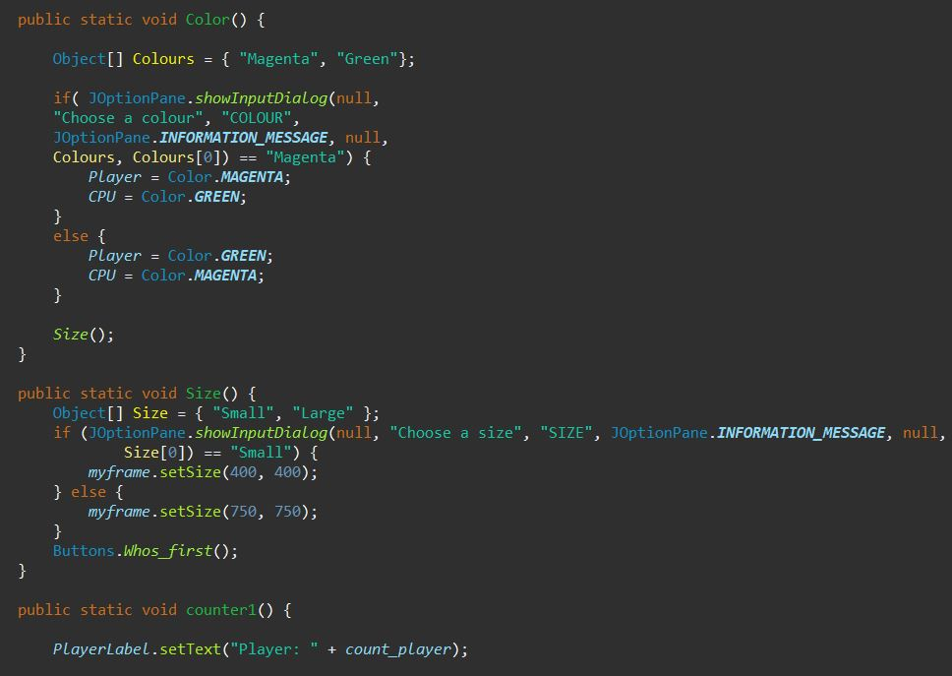
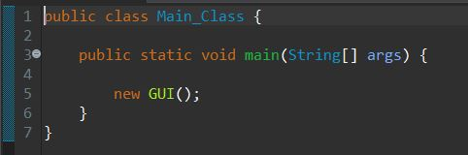
FRAME BUILDER & MAIN CLASS

Slide 9
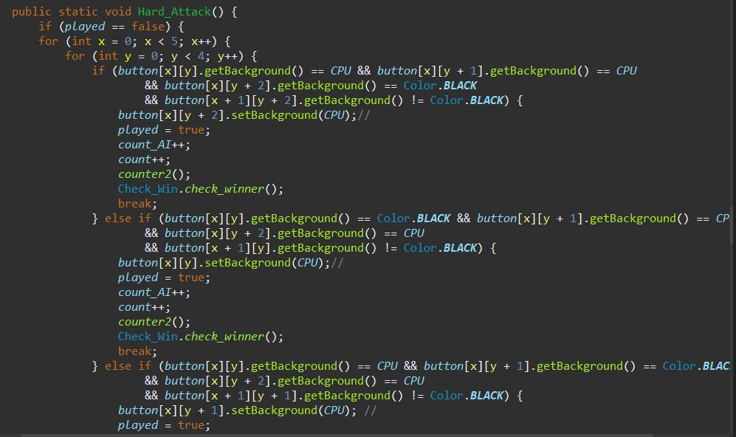
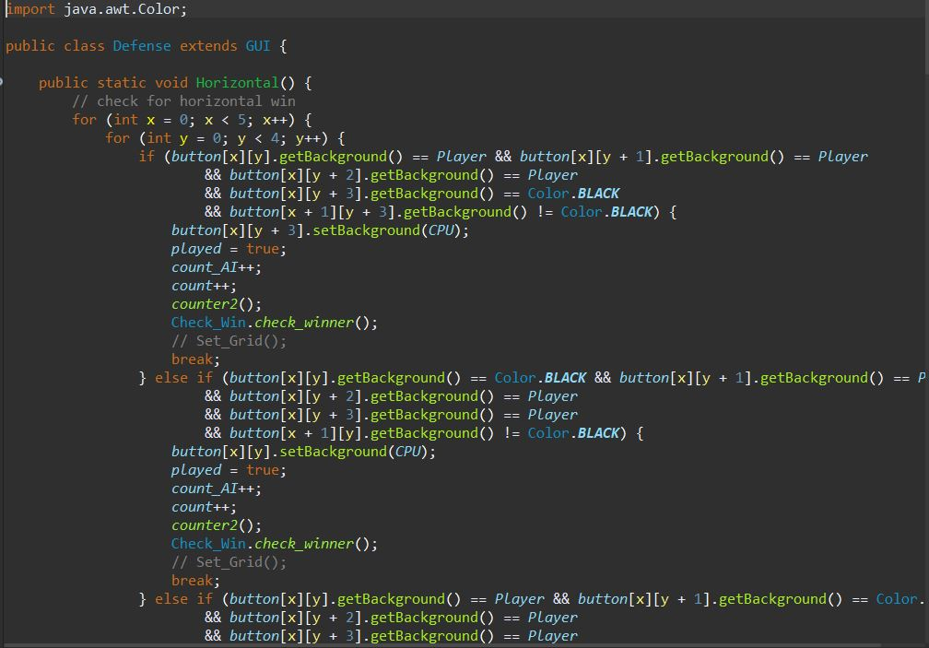
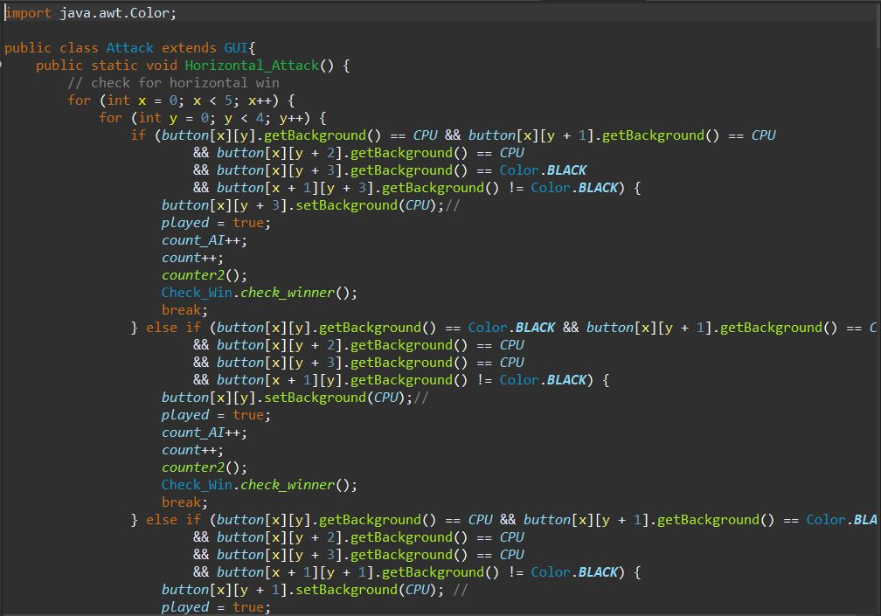
AI Strategy

Slide 10
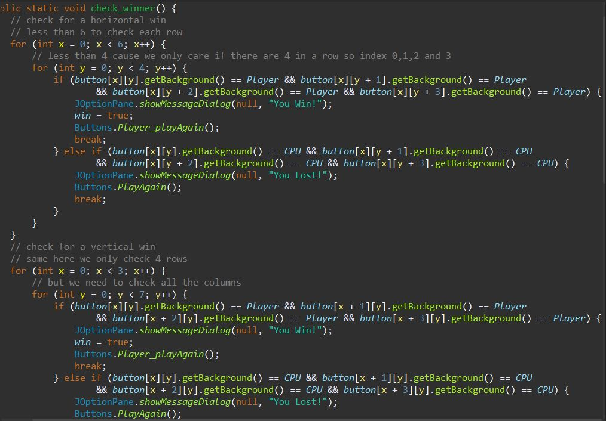
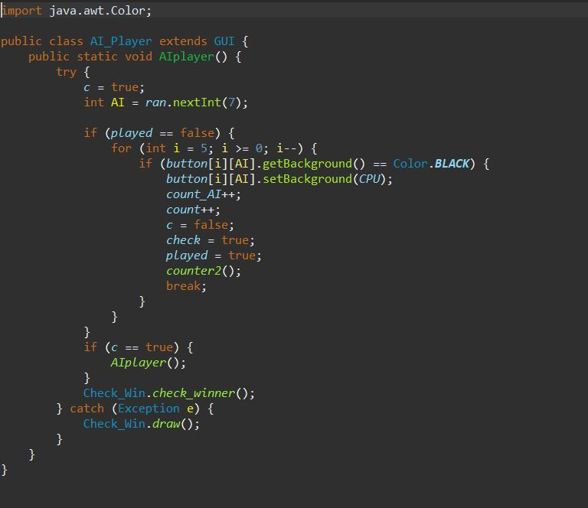
Winner Validation & Random AI

Slide 11
DIFFICULTIES
-Matrices
-Troubleshooting & Debugging
-Testing Phase
-Frame building

Slide 12
ACHIEVEMENTS
Learning OOP
Avoiding Bad smell coding
Working with design
Back end & Front end combined
Better understanding of debugging tools
High Cohesion (Every class specific task)
Low Coupling

Slide 13
THANK YOU VERY MUCH FOR YOUR ATTENTION
ANY QUESTIONS?

