Slide 1
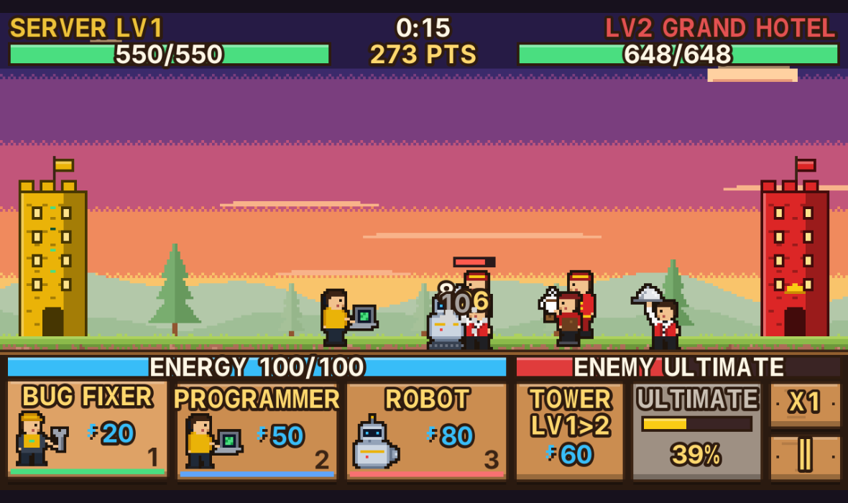
Department Tower Clash
· BS COMPUTER SCIENCE
A Java tower-vs-tower battle game with player accounts, a MySQL leaderboard and LAN 1v1
Hospitality
Education
Computer Science
Notes:
Introduce the project: a tower battle game built in pure Java with NetBeans, themed around three school departments.

Slide 2
What is Tower Clash?
Two towers face each other on one lane. Each player spends energy to send units, upgrades their tower, and fires an Ultimate skill. The first tower to fall loses.
3
15
departments
units, each with an ability
Each department is a tower with its own units and Ultimate
Every player has an account; progress is saved per person
Scores go to a shared leaderboard in MySQL
Two players can battle each other over LAN
7
5
modes: 5 stages, Endless, LAN
database tables

Slide 3




Project objectives
Fun, strategic gameplay
Personal accounts
Saved in a database
Play together
Three departments with different play styles, unit abilities and counters
Register and log in so every player keeps their own progress
Accounts, progress, matches and the leaderboard live in MySQL
A shared class leaderboard and 1v1 battles over the local network

Slide 4



Three departments, three towers
Hospitality Management
Education
Computer Science
Grand Hotel Tower
Academy Tower
Server Tower
TOWER
TOWER
TOWER
Hot plates that BURN; slowly heals itself
Longest range; books SLOW enemies by 40%
Very fast bolts that CHAIN to nearby enemies
ULTIMATE
ULTIMATE
ULTIMATE
Kitchen Inferno
Burns every enemy and heals your tower
Final Exam
Freezes all enemies and their tower for 5 s
System Overload
Lasers the tower and blocks enemy spawns 5 s

Slide 5












15 units, each with an ability
HM
Waiter
Chef
Bellboy
Barista
Manager
Tip Jar
Kitchen Fire
Luggage Shield
Coffee Break
Five-Star Service
EDUC
Student
Teacher
Principal
Librarian
Coach
Graduation
Chalk Toss
Detention
Quiet Please
Pep Talk
CS
Bug Fixer
Programmer
Robot
Hacker
Drone
Patch
Overclock
Self-Destruct
Data Theft
Air Strike
Counters: FAST beats RANGED · RANGED beats TANK · TANK beats FAST. Players pick 3 of their 5 units as a lineup before each battle.

Slide 6
How a match is played
1
Log in
2
Pick a department
3
Choose 3 units
4
Pick a stage
5
Battle!
In battle
Energy fills up over time
Spawn units with keys 1, 2, 3
Upgrade the tower for more HP and damage
Ultimate charges as you fight
Win for coins and up to 3 stars

Slide 7



Game modes
Story stages
Endless Siege
LAN 1v1
Five stages against the AI, each harder than the last:
Waves keep coming. Survive as long as you can and beat your best time.
Battle a classmate on another computer on the same Wi-Fi.
1 Freshman Rush
2 Sophomore Siege
3 Junior Clash
4 Senior Showdown
5 Dean's Gauntlet
Unlocks after Stage 3
Own leaderboard tab
Host or join by IP
Wins and losses saved

Slide 8
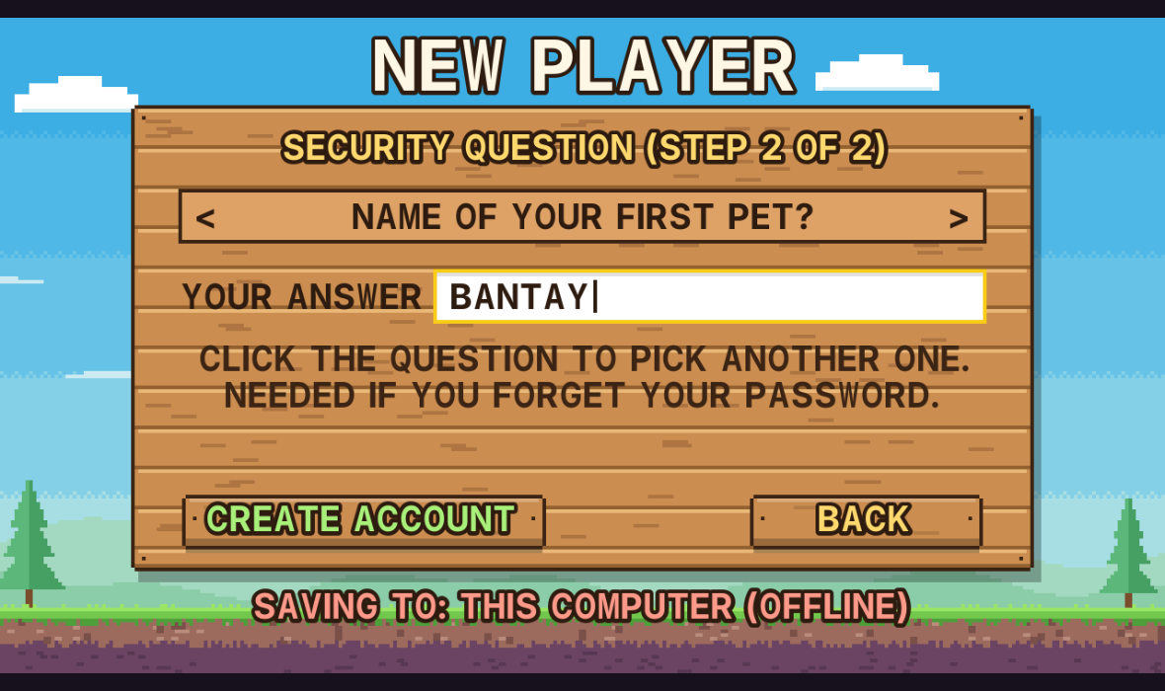



Accounts and security
Register in two steps
Account details first, then a security question for a forgotten password
Hashed passwords and answers
Only SHA-256 hashes with a random salt are stored, never the real text
Safe queries
Every SQL query uses PreparedStatement against SQL injection
Works offline too
Register step 2: the player picks a question and types the answer
If MySQL is off, the game saves on the computer instead

Slide 9
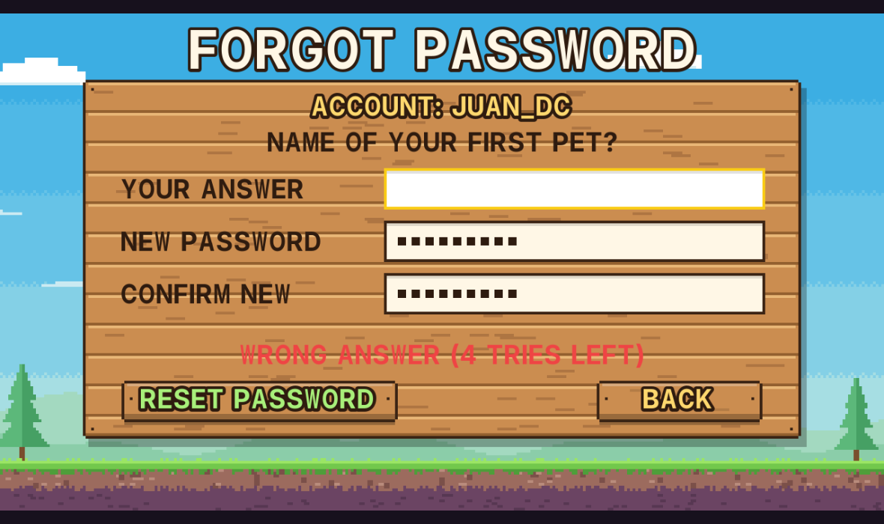
Forgot password
1
FORGOT PASSWORD?
on the Login screen
2
Username or email
the game shows that account's question
3
Answer + new password
the new password is typed twice
4
Log in again
only the new password works now
No email or internet: works offline and on LAN
Not case-sensitive: “Bantay” = “bantay”
5 wrong answers: reset is locked for 15 minutes
A wrong answer shows how many tries are left

Slide 10
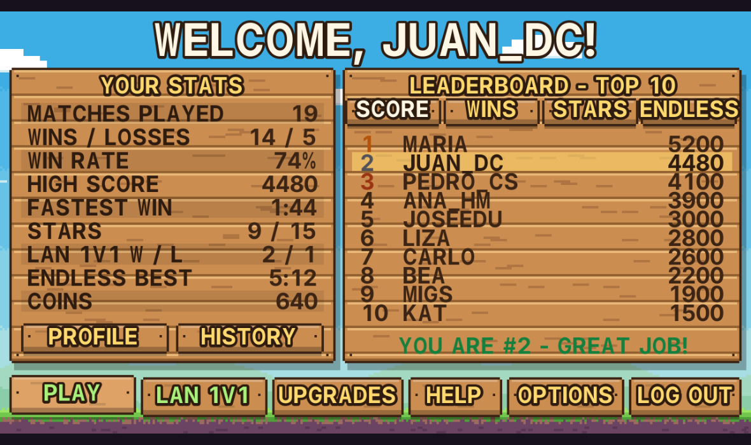
Dashboard and leaderboard
1
Your stats
Matches, win rate, high score, stars, LAN record
2
Top 10 leaderboard
Four tabs: score, wins, stars and Endless time
3
Your rank
Shown even when you are not in the top 10
4
Shared on LAN
Point every PC to one MySQL server for one class board

Slide 11
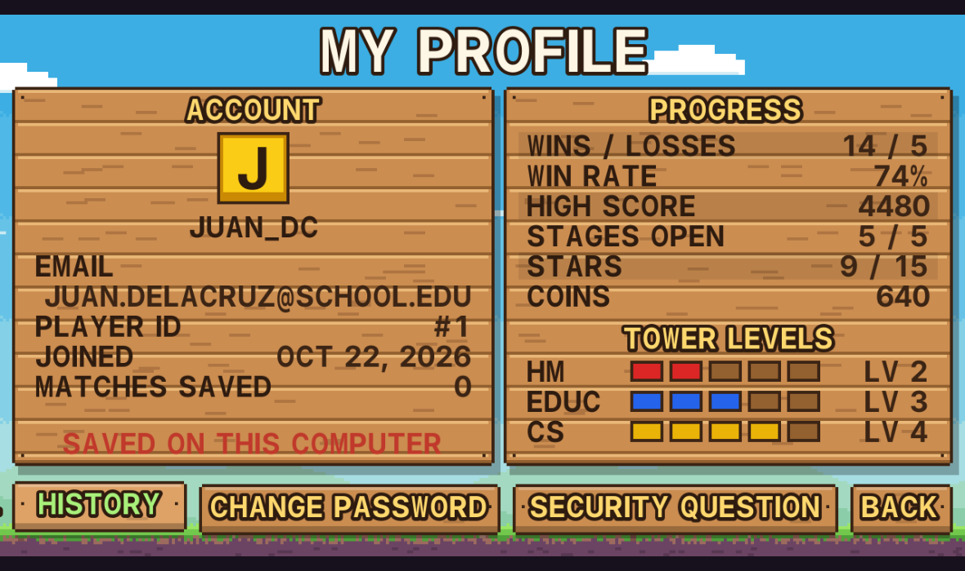
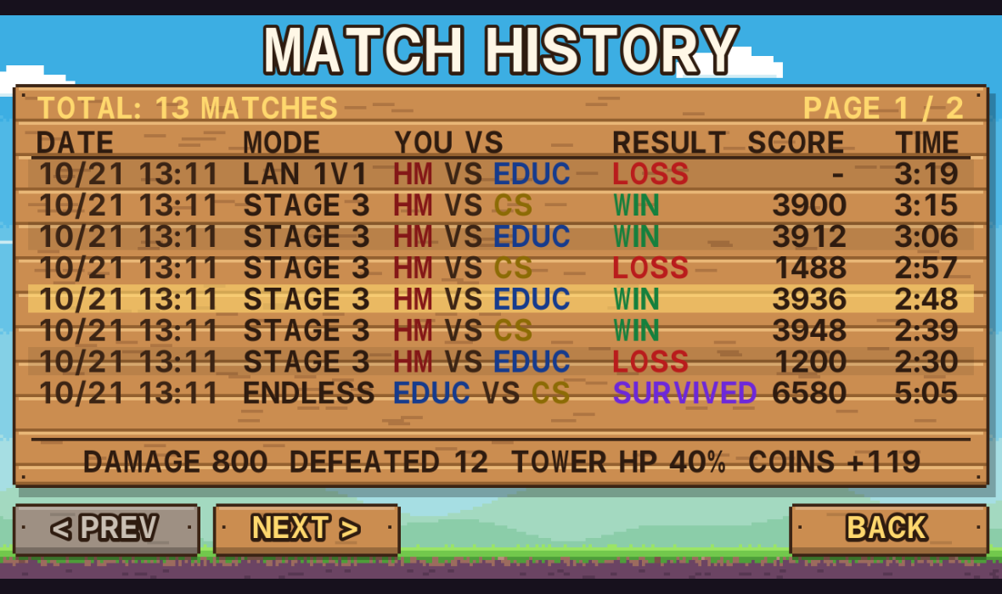
Profile and match history
My Profile Email, player ID, join date, progress and tower levels, plus Change Password and Security Question
Match History Every match, newest first, 8 per page. Point at a row to see damage, units defeated and coins.

Slide 12
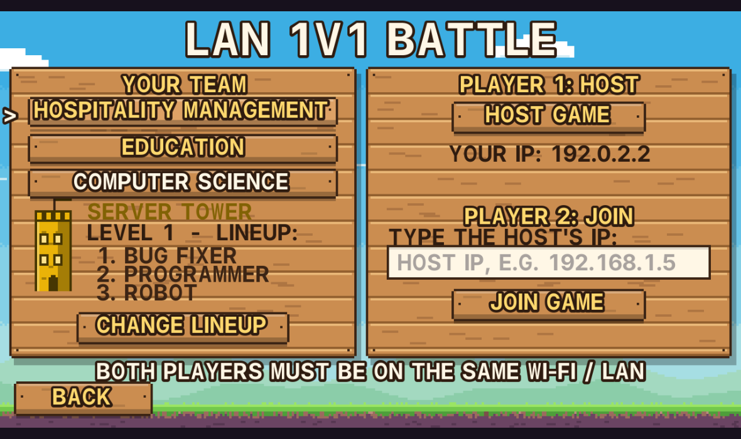

LAN 1v1 multiplayer
TCP 5555
Player 1: Host
Player 2: Join
Left tower
Right tower
Same Wi-Fi: no internet or server needed
Lockstep: both PCs run the same battle; only button presses are sent
Checked: a fingerprint every second proves both screens match
Fair: no pause or speed-up; P or Esc to surrender
The host shares their IP; the other player types it and joins

Slide 13
Database design: tower_battle_db
player_progress
users
match_history
PK FK user_id
coins, wins, losses
high_score
total_stars
best_endless_seconds
save_data
PK user_id
username (unique)
email (unique)
password_hash, salt
security_question
security_answer_hash
reset_attempts
created_at, last_login
PK match_id
FK user_id
FK stage_number
FK player/enemy_tower
result, score
duration_seconds
played_at
How they connect
One player has one progress row and many matches. Each match points to a stage and two towers.
towers
stages
PK tower_code
tower_name
color_hex
PK stage_number
stage_name
difficulty

Slide 14


Technology stack
Java SE + NetBeans
Made entirely in code
MySQL via XAMPP
Swing window and screens, Java2D drawing, Ant build
Pixel sprites written as text; sounds synthesized at runtime; no image or audio files
phpMyAdmin to view tables; tables are created by the game itself
JDBC + Connector/J
Java Sockets
java.security
The only outside library: the MySQL driver JAR
TCP connection for LAN 1v1 on port 5555
SHA-256 with SecureRandom salt for passwords and security answers

Slide 15
Code structure and OOP
Packages
Inheritance
Polymorphism
app
starts the game
Student, Chef, Robot… extend Unit; every screen extends PixelScene
AccountStore is MySQL or local files; the game never needs to know which
ui
window, screens, pixel font, HUD
game
battle rules, AI, effects
model
towers, units, stages, progress
Abstraction
Encapsulation
db
accounts, MySQL and local saves
Screens only say what to draw; PixelScene handles scaling and input
PlayerProgress keeps its fields private behind getters and rules
net
LAN 1v1 connection
audio
synthesized music and effects

Slide 16




What makes it different
Campus theme
Every unit has an ability
Towers and units come from real school departments
Burn, slow, freeze, heal, steal energy, self-destruct
Lineup choice
Online or offline
Pick 3 of 5 units before battle to plan counters
Uses MySQL when available and falls back to local saves
Real 1v1 on LAN
No asset files
Classmates battle each other with no internet needed
All art and sound are generated from code

Slide 17




Thank you!
NEXT STEPS
Admin panel
Manage players: reset, ban, promote
Department Tower Clash · Group 8
Campus events
Lorica, Johanssen
Castillo, Lexus
Labenia, Lorenzo Mico
Gazzingan, Rainmer
Trinidad, Asher
Brownout, Exam Week, Foundation Day
Boss stage
“The Dean” with special attacks
Achievements
Badges saved to each account

