Slide 1
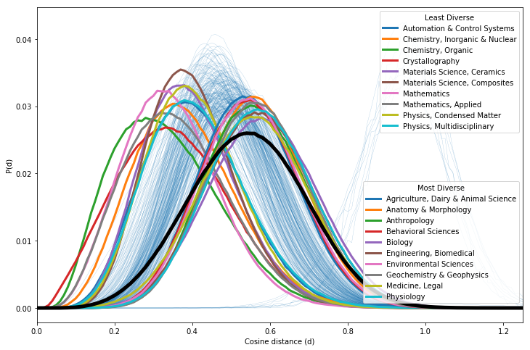
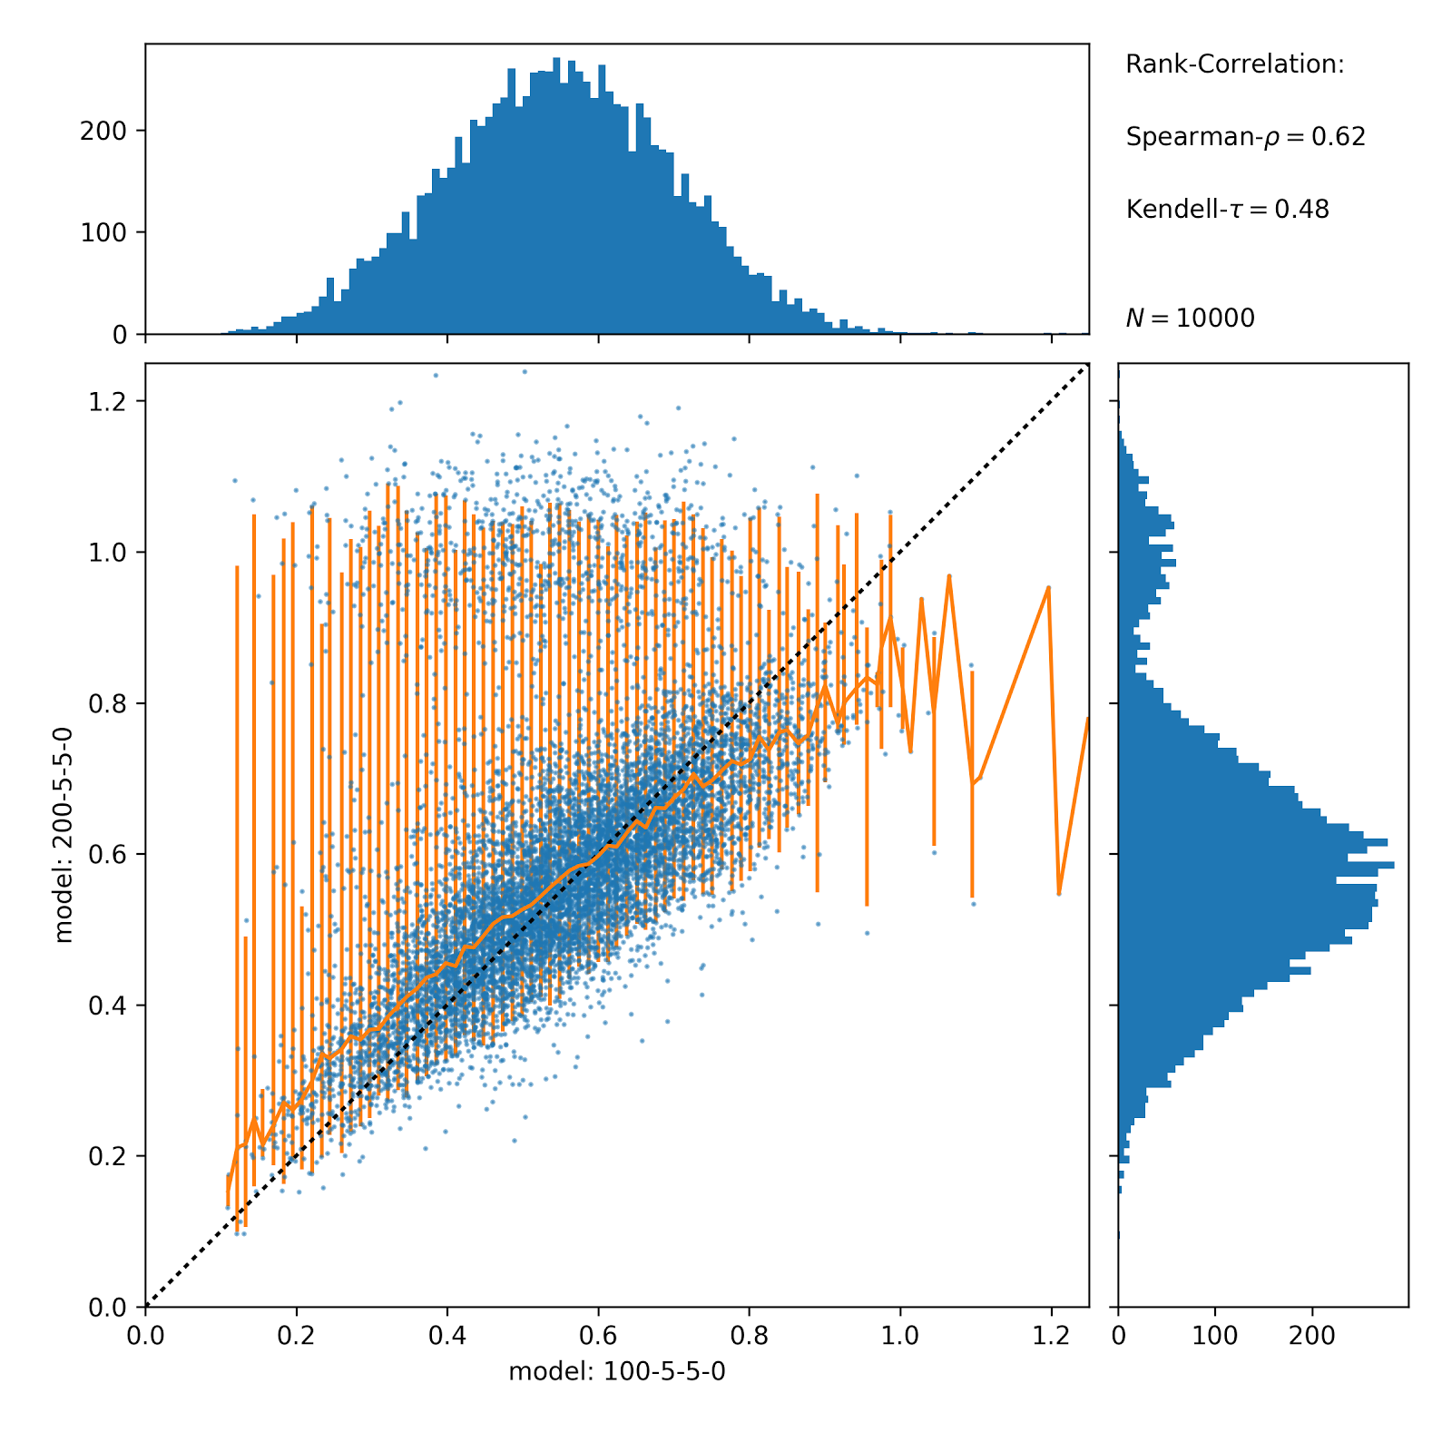
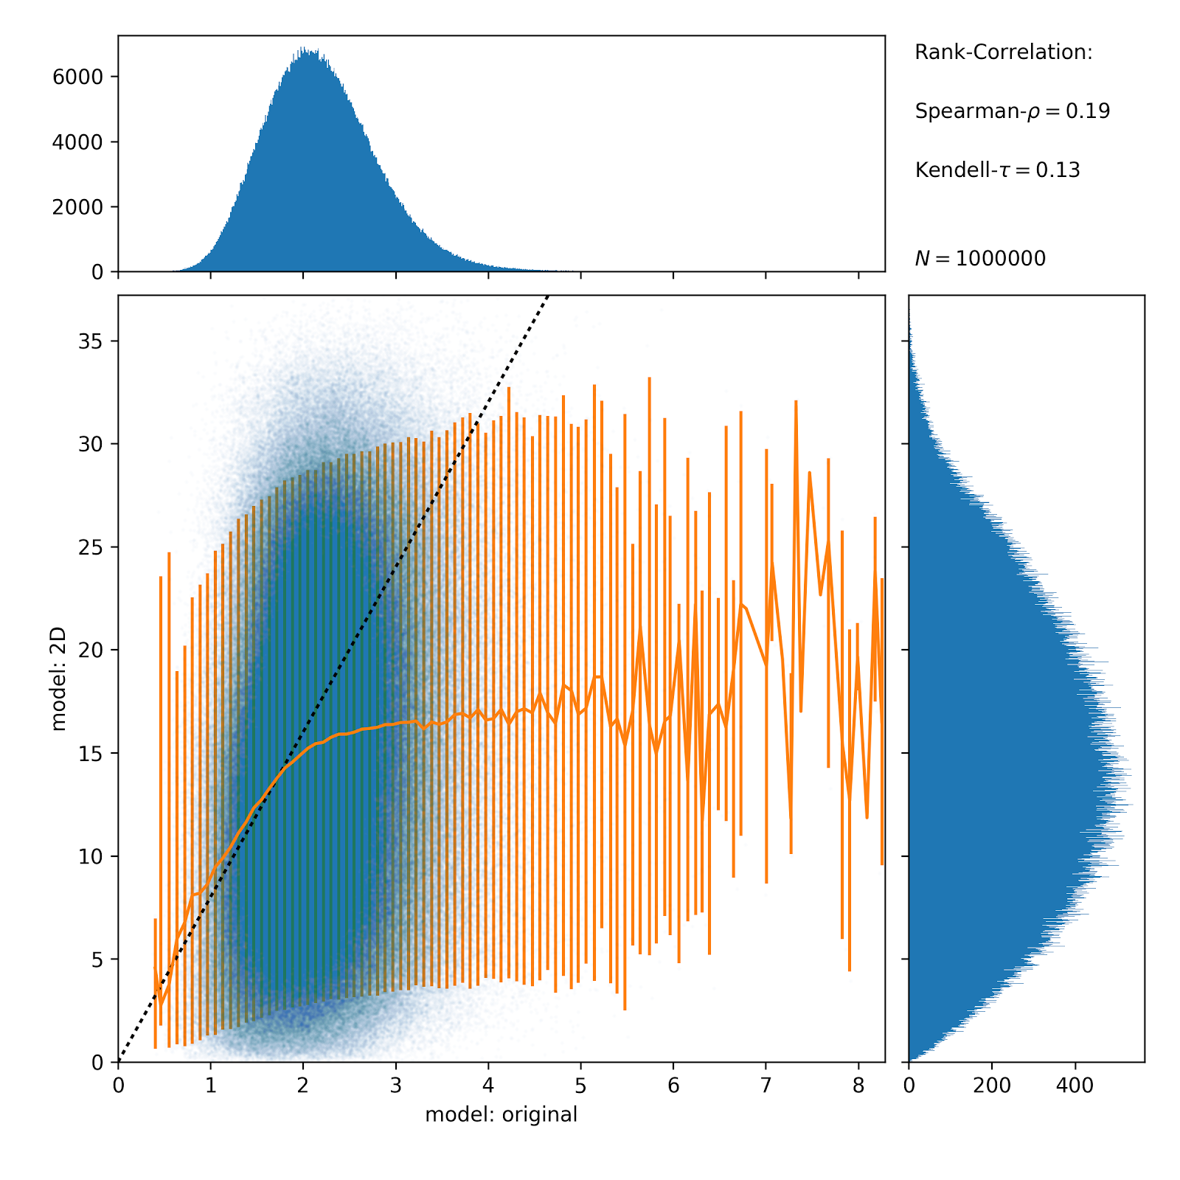
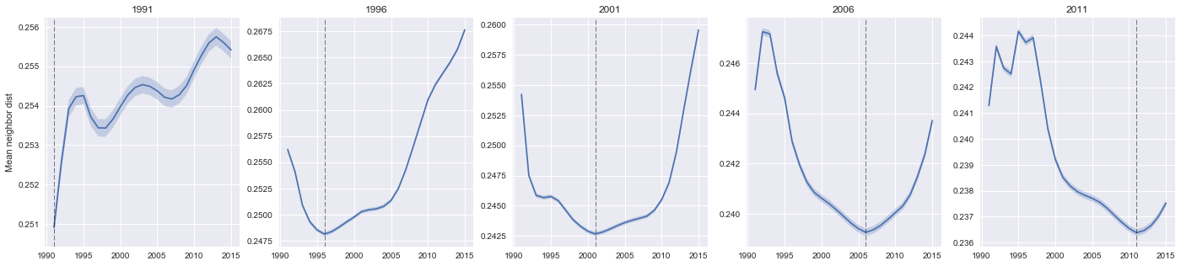
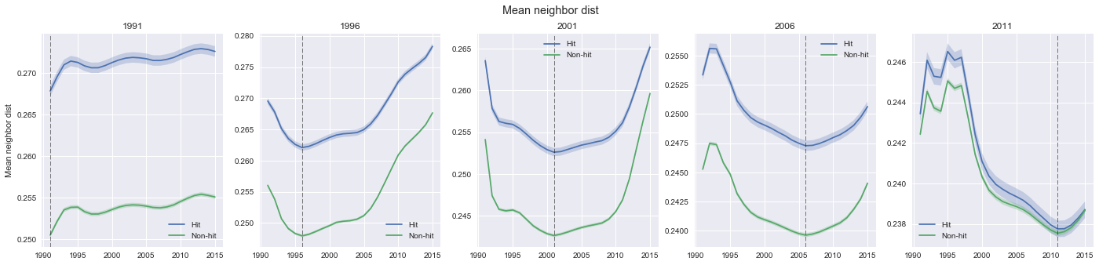
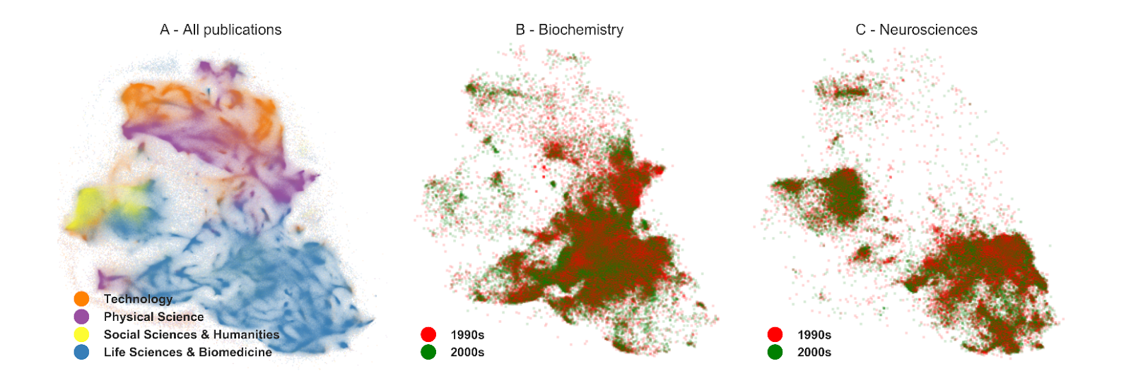
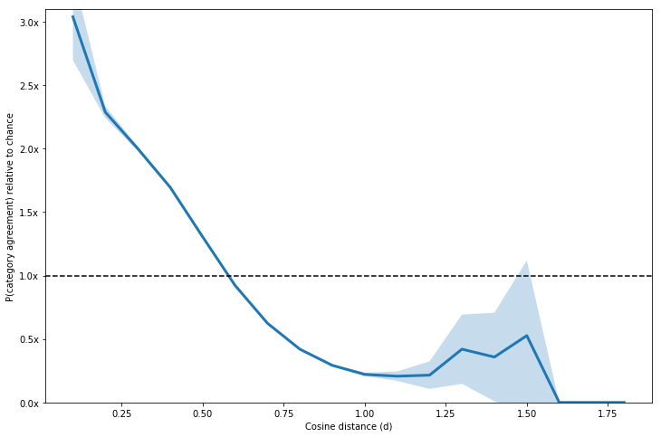
Measuring Textual Similarity of Scientific Papers to Predict Growth and Decline of Disciplines
Jared Lorince¹, Martin Gerlach², Diego F. M. Oliveira^{1,2}, Brian Uzzi¹
¹Northwestern Institute of Complex Systems, Northwestern University, Evanston Illinois 60208, USA, ²Department of Chemical and Biological Engineering, Northwestern University, Evanston Illinois 60208, USA
Introduction
How meaningful is the embedding?
Comparison of intra and inter category distances - Distribution of distances for two randomly sampled articles and compare with distribution of two articles sampled from the same category. We observe that (for most) categories, the distribution of distances is systematically shifted to lower values of distances. This indicates that two articles from the same category are systematically closer in the embedding space than two randomly selected articles.
With increasing number of articles published every year, comes the need for an automatic organization based on their semantic content aiming at obtaining the so called maps of science [?]. While most approaches are based on the analysis of citations. In recent years, the availability of the actual content of the articles sparked an interest in the large-scale analysis of texts revealing the organization and evolution of scientific fields [?]. However, most of the works approach the problem on an aggregate level of, e.g., journals or (pre-defined) fields. Here, our goal is to quantify the semantic relationship between individual articles. The questions we are trying to answer are: Where are new articles added in the semantic space? How are new topics or regions in space populated? Refer to the dense region of the research frontier? How do people choose their research, e.g. experiments (Rzhetsky, PNAS 2015).
Robustness with respect to parameters in doc2vec - The embedding doc2vec-model has a bunch of free parameters, e.g. number of dimensions or size of the context-window. Here, we compare the embeddings obtained with different parameter-settings. While the absolute values of distances change, the relative order of distances among articles is largely conserved. We sample N pairs of articles and calculate the distance in each space. We can then calculate the rank-correlation for both sets of distances. Observe that in the 200-dimensionsal space papers get separated into two big chunks (bi-modal marginal distribution). This might be an indication that it resolves additional structure that the 100-dimensional model is not able to resolve.
Local Density with respect to articles from a given year - We select a set of articles published in a given year and measure their local density (in fact it is the inverse of the density) or the mean distance to a papers over time (i.e. with respect to reference paper from different periods of time). The results show that density is highest at the time the original articles were published. This is insofar remarkable as the model does not know anything about the ordering of these papers in time.
Embedding of Documents
This space is constructed via so-called doc2vec based on the abstracts of the papers. Our hypothesis is that the resulting space captures some notion of semantic content of papers.
(a) Embeddings with different number of dimensions yield similar results. For 10,000 randomly sampled pairs of papers we calculate i) the distance in the 100-dimensional space (x-axis) and ii) the distance in the 200-dimensional space (y-axis). Orange line is median with 2.5 and 97.5-percentiles. (b) 2D-emebdding is only reliable for papers that are close. For 10,000 randomly sampled pairs of papers we calculate i) the distance in the original space (x-axis) and ii) the distance in the 2D-projected space (y-axis)
Correlation between diversity and impact - Density of a paper (published in a given year) over time. Here, we look at two groups individually, hit (top 10% in citations) and non-hit papers. We see that non-hit papers are systematically closer to other papers (appear in a more dense region). This can be interpreted as that hit-papers tend to be a bit more unconventional. While this difference is smaller, it is quite systematic. Interestingly, the difference disappears as we look at more recent papers.
Comparison to WoS categories
Does the distance in the embedding space correspond in any way to a semantic relation between two articles?
Sharing a category as a function of distance - Probability that two randomly selected articles share one of their WoS-Categories as a function of the measured semantic distance. We observe a monotonic decreasing trend, i.e. the closer two articles are in the embedding space the more likely they will come from the same category.
Conclusions or directions
Visualization of the semantic space of WoS-abstracts. Each point is a publication and proximity between points corresponds to textual similarity. (a) All WoS abstracts, colored by subject heading. (b) and (c) Subsets of (a) for two example disciplines, colored by publication decade (1990s vs. 2000s). Differences in density of red vs. green points across the network suggest semantic change in the papers published within a discipline over time. Note that this projection captures the full picture only to some degree, that is this embedding only tries to preserve the relation between papers that are close
Text here
Notes:
<number>

