Slide 1
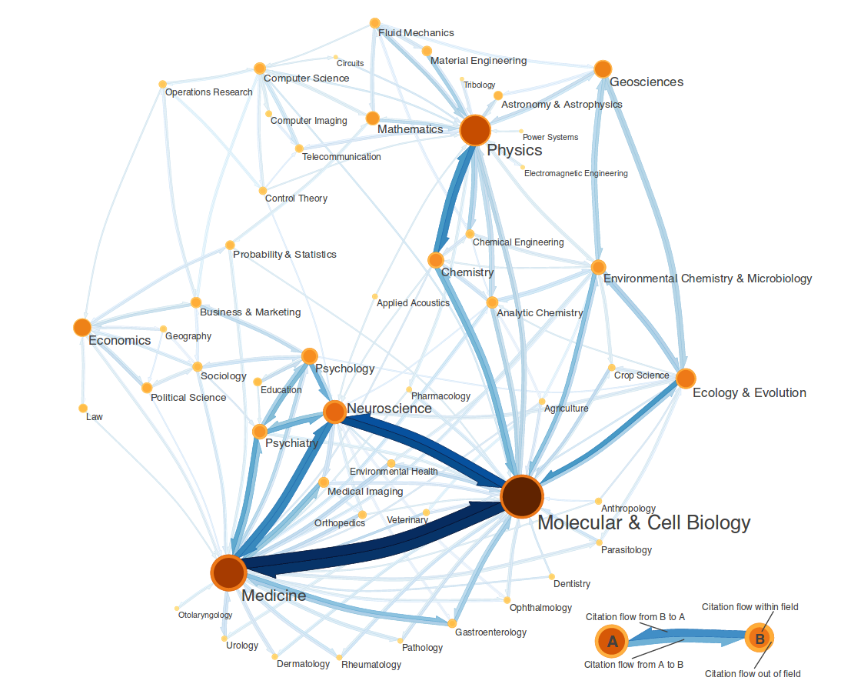
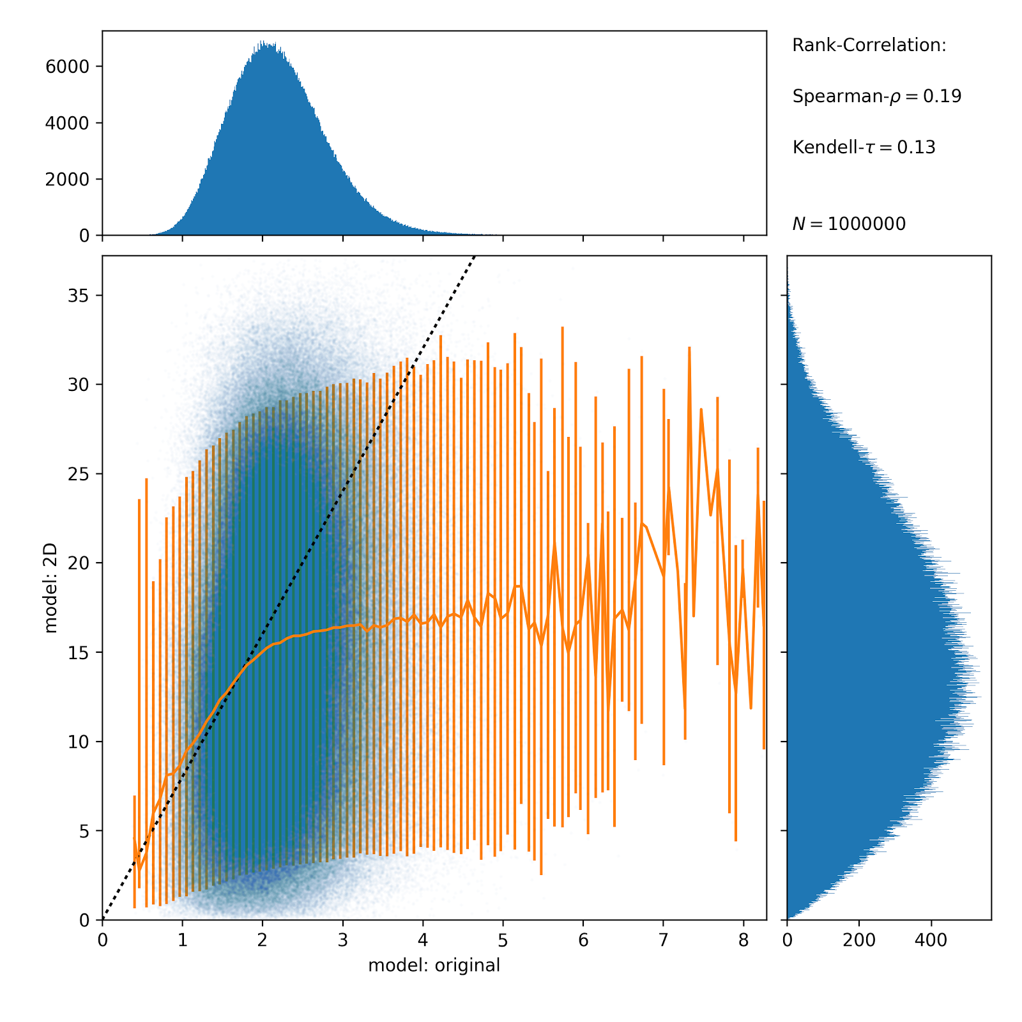
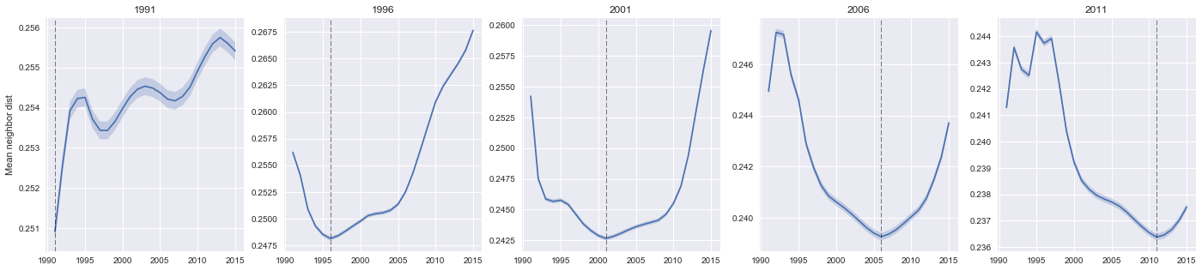
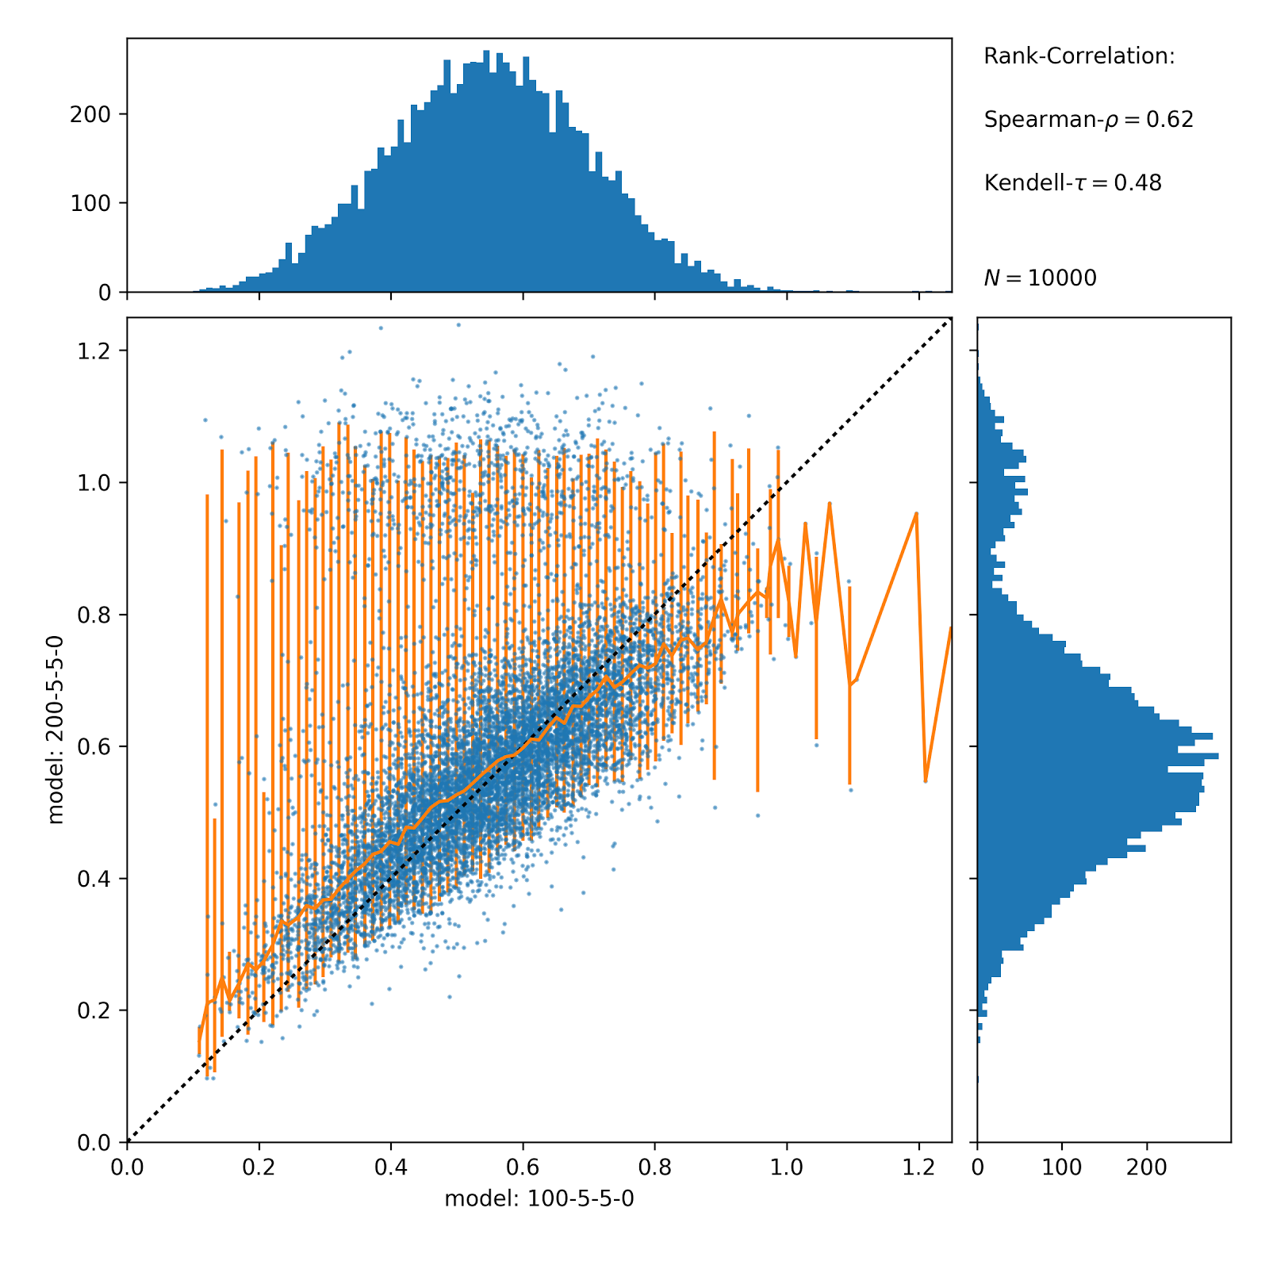
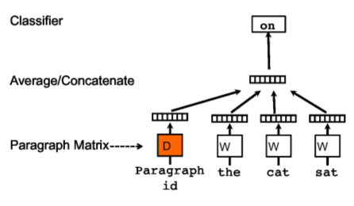
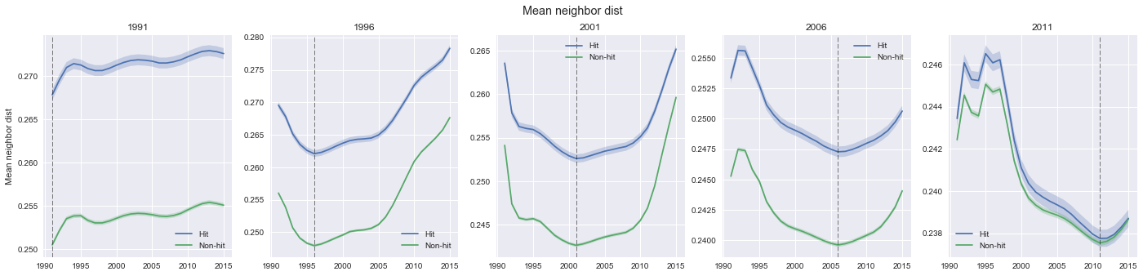
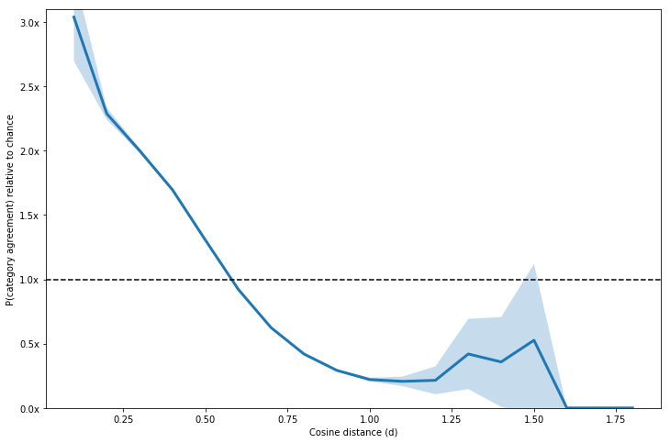
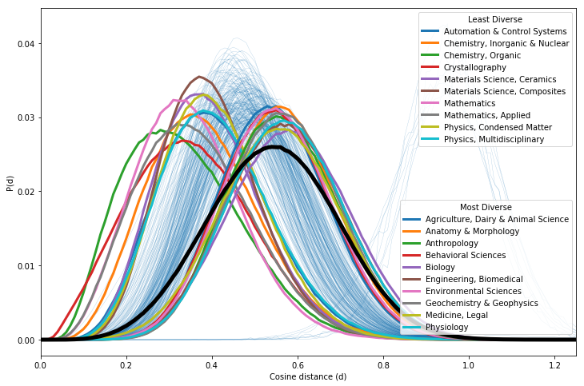
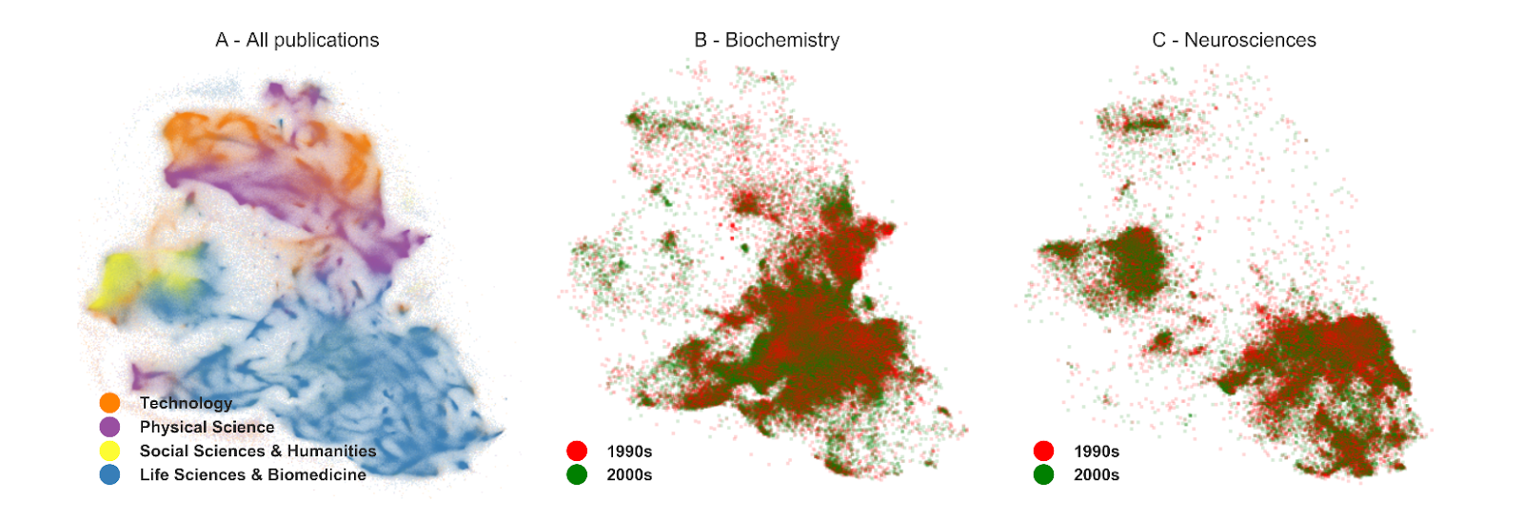
Quantifying the semantic relation between millions of scientific articles using document embeddings
Jared Lorince¹, Martin Gerlach², Diego F. M. Oliveira^{1,2}, Brian Uzzi¹
¹Northwestern Institute of Complex Systems, Northwestern University, Evanston Illinois 60208, USA, ²Department of Chemical and Biological Engineering, Northwestern University, Evanston Illinois 60208, USA
Introduction
How meaningful is the embedding?
Exploration of the semantic space over time
The increasing digitization of science allows for new quantitative approaches to understand organization of knowledge [1], e.g. mapping the structure of scientific fields (see figure adapted from [2]) or assessing the novelty of individual articles [3].
However, most-common approach is based on analysis of citations or operate on aggregate level of journals / fields.
Limitations of the 2D-projection
Compare distance between 2 articles in 100-D space and 2-D projected space
Only small distances are preserved in projection
→ projetion only provides qualitative picture
Quantifying novelty by finding dense regions
Technical challenge:
- 100-dimenional space (binning is sparse)
- 20M x 20M pairs of distances
Solution:
- local density estimation
- approximate nearest neighbors
For articles published in a given year, estimate density w.r.t. articles from past/present/future
Aim: Quantify the semantic similarity between more than 20M articles from the Web of Science based on their written texts (abtracts)
→ short text lengths (<100 words/document) constitutes a main challenge
We show that approaches based on embedding techniques lead to a meaningful semantic representation on the level of individual articles
This allows us to measure how the semantic space is explored over time
Robustness w.r.t. parameter-choices
Compare distance between 2 articles in 100-D and 200-D model
Distances are highly correlated
Larger nubmer of dimensions resolve additional structure.
[Formulate Better] Articles from same year are closest to each other (highest density)
Embedding of Documents (doc2vec)
Learn (low-dimensional) representation of words and documents → “semantic space”
High-impact articles originate in less-explored regions
Consider separately hit-papers (top-10% of citations among articles from same year)
Basic idea: Predict each word from word- and document-vectors in context-window using neural networks [4]
Advantage: Take into account ordering of words
Topic models such as Latent Dirichlet Allocation
use bag-of-word assumption [5]
→ especially promising for large collections of short texts (abstracts)
Distances capture organization into scientific disciplines (WoS-categories)
100-dimensional embedding of 20M abstracts from Web of Science (1991-2015)
Hit-papers are located in regions with systematically lower density
This effect disappears when considering recently published articles (<5 years ago)
2D-Visualization of the embedding (each dot is one article)
References
[1] R.M. Shiffrin & K. Boerner, Mapping Knowledge Domains, PNAS (2004)
[2] M. Rosvall & C.T. Bergstrom, Maps of random walks on complex networks reveal community structure, PNAS (2004)
[3] B. Uzzi et al., Atypical Combinations and Scientific Impact, Science (2013)
[4] Q.V. Le & T. Mikolov, Distributed Representations of Sentences and Documents, PMLR (2014)
[5] A.M. Dai, Document Embedding with Paragraph Vectors, arXiv:1507.07998
Articles that are close are more likely to belong to the same category
(and vice versa!)
Distance within categories systematically smaller than across categories
Articles from the same category (same color) cluster in different regions
Articles from Neuroscience start to appear in regions associated to “Social Science & Humanities” after 2000
→ Embedding captures the aspects of the semantic structure of scientific disciplines
While most approaches are based on the analysis of citations. In recent years, the availability of the actual content of the articles sparked an interest in the large-scale analysis of texts revealing the organization and evolution of scientific fields [?]. However, most of the works approach the problem on an aggregate level of, e.g., journals or (pre-defined) fields. Here, our goal is to quantify the semantic relationship between individual articles. The questions we are trying to answer are: Where are new articles added in the semantic space? How are new topics or regions in space populated? Refer to the dense region of the research frontier? How do people choose their research, e.g. experiments (Rzhetsky, PNAS 2015).
Notes:
<number>

