Slide 1

Candidate-Set Restriction for Computationally
Efficient Decentralized Multi-Robot Task Allocation
Presenter: James Lott
Advisor: Dr. Vahraz Honary
MIT IEEE URTC 2026
Notes:
Good morning, I’m James Lott from the University of San Diego. Most multi-robot task-allocation research asks how to make the allocator itself better. We asked a simpler deployment question: does the allocator actually need to see every available task every time it runs? In this work, we put a very simple Top-K filter in front of six existing decentralized allocators and measured what happened to mission performance and compute cost.

Slide 2
Do robots need to consider every task?
50 valid targets
1
2
3
4
Local valid
task set
Rank
candidates
Top-K
filter
Existing
allocator
50 tasks
distance
K = 5
unchanged
Same allocator logic. Smaller problem.
Rank locally (distance here) → keep only the best K
4
50
6
8
4,800
robots
targets
allocators
K levels
paired trials
Notes:
The mechanism is intentionally simple. At every allocation event, each robot forms its locally valid task set, ranks those candidates — in this Collaborative Visit experiment, primarily by Manhattan distance — and only passes the first K into the allocator. We never modify the internals of the allocator. We tested four robots visiting fifty known targets on a 19-by-19 grid, across six very different decentralized allocation methods and eight candidate limits. Reusing the same one hundred scenarios across conditions gave 4,800 paired trials.

Slide 3
At 10% retention, compute fell faster than performance
K = 5 of the initial 50 targets — paired change relative to unrestricted execution.
Compute saved per allocator call (%) ↑
100
high savings / low penalty
HIPC
62.2%
DMCHBA
80
DGA
mean compute reduction
filtering overhead included
60
ACBBA
3.9%
40
PI
CBAA
mean max-step degradation
20
response is allocator-specific
0
0
2
4
6
8
10
Example: DGA saved 79.7% compute with +2.1% steps.
Mission penalty (% increase in max-robot steps)
Notes:
This is the key result. At ten percent retention — just five of the original fifty targets — the average computation per allocator call fell by 62.2 percent, while the maximum-robot-step metric increased by only 3.9 percent. The scatter shows why a single number does not tell the whole story: the response depends strongly on the allocator. CBAA gives up essentially no mean mission performance but has less compute to save. DGA is especially interesting here: about an eighty percent compute reduction for only about a two percent step penalty. HIPC and DMCHBA save even more compute, but pay around an eight percent mission penalty. So Top-K is best viewed as a tunable operating point, not a universal constant.

Slide 4
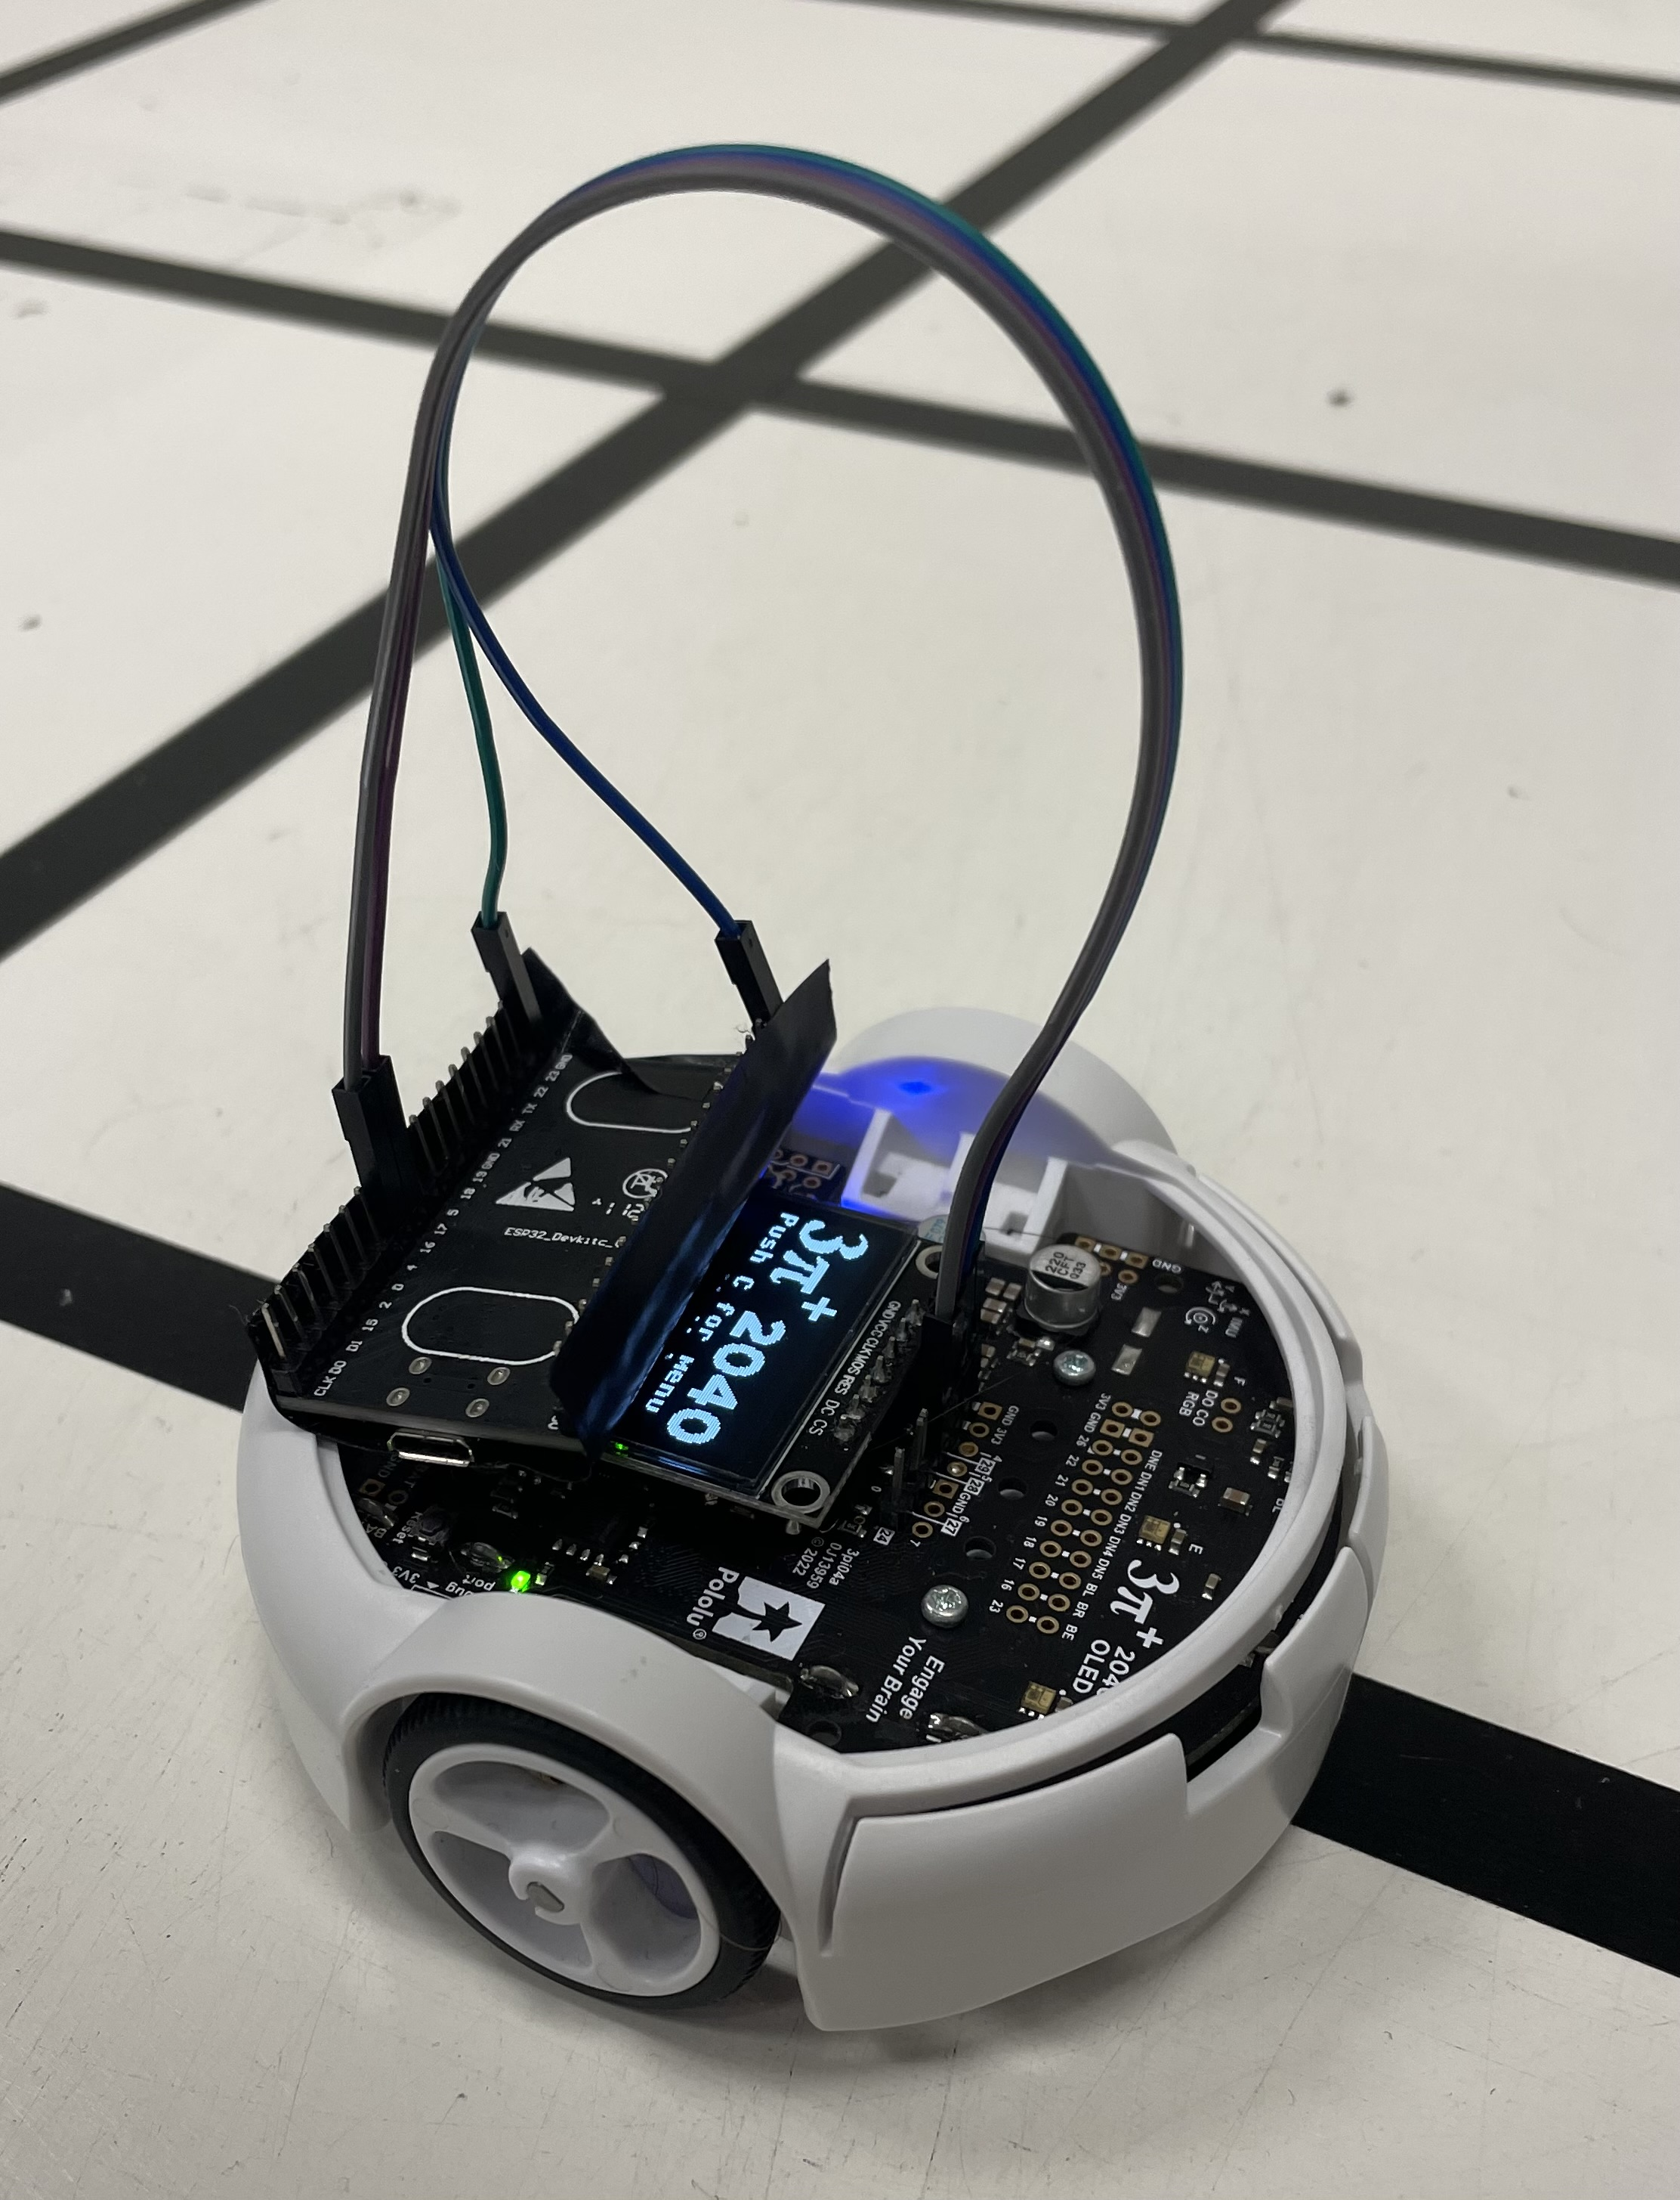
On the RP2040, restriction changed what was runnable
For DMCHBA, candidate restriction crossed an embedded execution-feasibility boundary.
DMCHBA on RP2040
100%
K = 50
> 30 s guard
×
75%
K = 38
> 30 s guard
×
50%
K = 25
feasible
✓
10%
K = 5
≈ 96 ms / call
✓
Candidate-set size is a deployment parameter.
Pololu 3pi+ 2040 • RP2040 microcontroller
Notes:
The embedded result is where this stops being just an optimization story. On the RP2040, DMCHBA exceeded our thirty-second per-call guard at the large candidate sets. At fifty percent retention it became feasible, and at ten percent retention it reached roughly ninety-six milliseconds per call. In other words, candidate restriction can move an allocator between hardware execution regimes, not just make it incrementally faster. The takeaway is that candidate-set size should be treated as a deployment parameter. The natural next step is to let the robot adapt K online based on measured computation and the deadline it has available. Thank you.

