Slide 1
AIDE Platform
What features does it have and
how are they built?
Pablo Campillo Sánchez

Slide 2
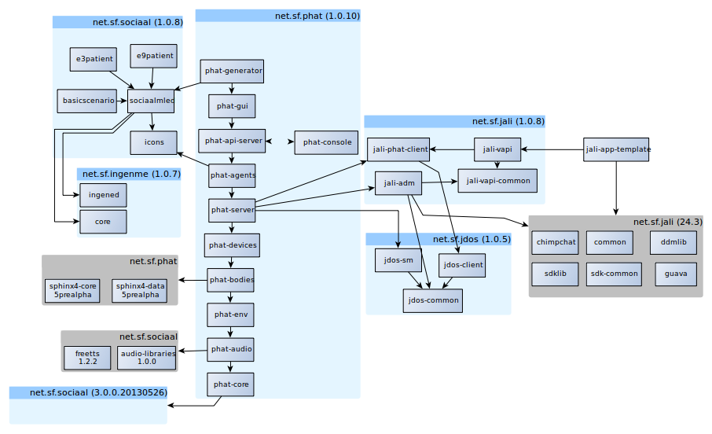
AIDE Platform Artifacts

Slide 3
Repositories of AIDE Platform Artifacts
Phatsim: https://github.com/Grasia/phatsim
SociAALML: https://github.com/Grasia/sociaalml
jALI: https://sourceforge.net/projects/jali/
jDOS: https://sourceforge.net/projects/jdos/

Slide 4
jDOS - java Directory Of Services
ServiceSet
  public String getId();
  public List<Service> getServices();
  public void add(Service service);
  public void remove(Service service);
  public Service get(String serviceTypeName);
ServiceSets (devices) contains Services (Sensors and Actuators).
Every Service has an id, a port, an IP and a type.
Types: MICROPHONE, CAMERA, ACCELEROMETER, PRESENCE, VIBRATOR, SPEAKER, ...
Service
  public String getType();
  public String getIp();
  public int getPort();
  public String getID();

Slide 5
jALI - java Android Layer for Interaction
Two main functions:
  jali-adm: offers adb admin tools, such as launch Android Virtual Devices (AVD), install apps, get screen snapshots, send key events and tap screen, between othres.
  jali-vapi: library that allows Android Apps to interact with the virtual world. It overrides sensors and actuators behaviors.

Slide 6
PHAT Atifacts
Phat-core: basic functionalities.
Phat-audio:
Phat-env: Manages the environment and houses.
Phat-bodies: Manages character's bodies using commands.
Phat-devices: Manages devices (sensors, actuators).
Phat-server: Allow real devices to be connected to virtual ones.
Phat-agents: Behavior both characters and devices.
Phat-api-server: RPC-JSON API to control simulation.
Phat-gui: graphical components and tools for simulation analysis.
Phat-generator: translates SociAALML models to PHAT code.

Slide 7
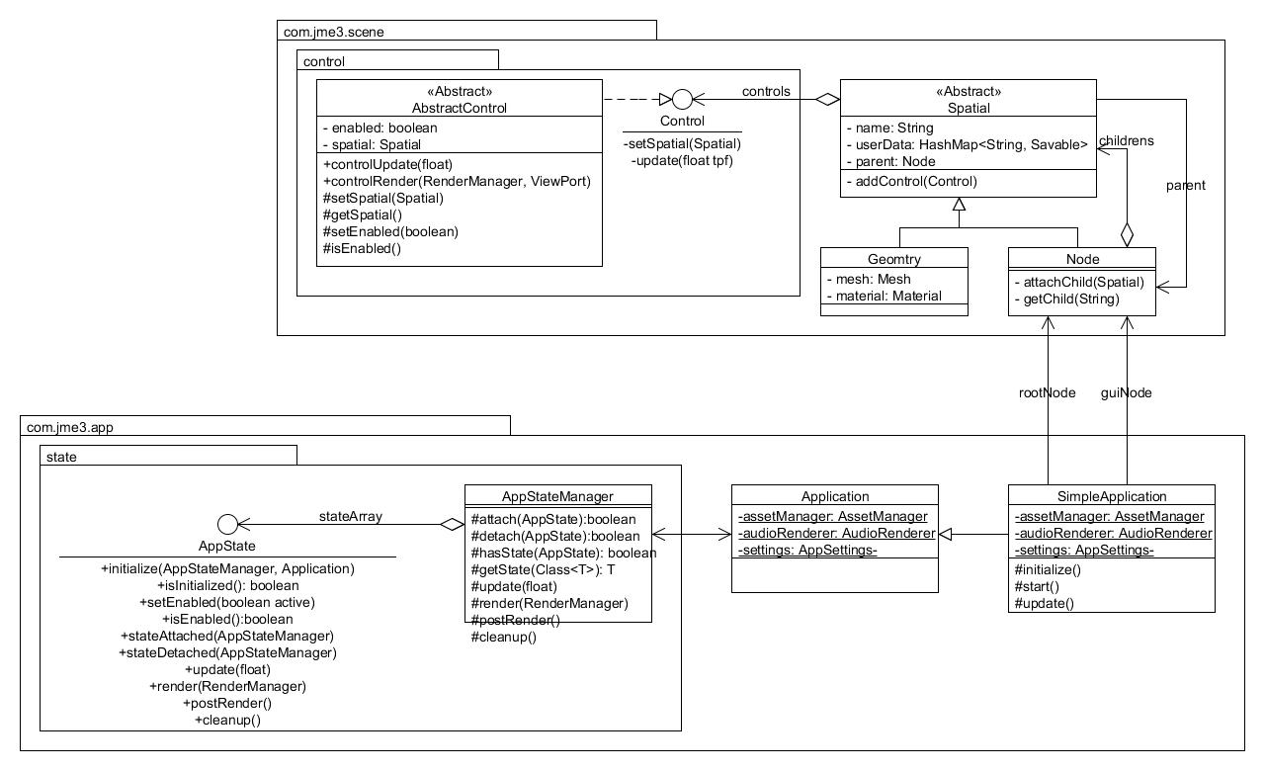
JME3 Control classes

Slide 8
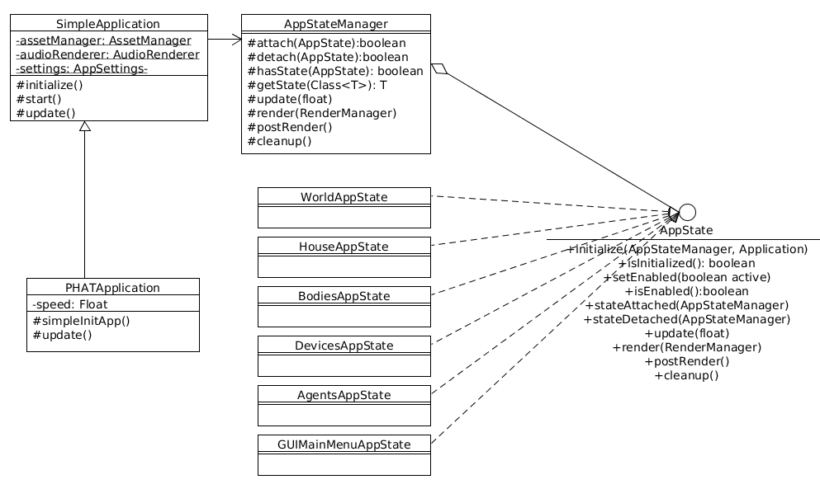
Main PHAT Control classes

Slide 9
Main Loop
Initialization – Execute simpleInitApp() method once.
Main Update Loop
  Input listeners respond to mouse clicks and keyboard presses – Input handling
  Update game state:
    Update overall simulation state – Execute Application States (WorldAppState, HouseAppState, BodiesAppState, etc.)
    PHATApplication code update – Execute update() method.
    Logical update of entities – Execute Custom Controls (Most of them are in bodies)
  Render audio and video
    Application States rendering.
    Scene rendering.
    User code rendering – Execute simpleRender() method.
  Repeat loop.
Quit – If user requests exit(), execute cleanup() and destroy().

Slide 10

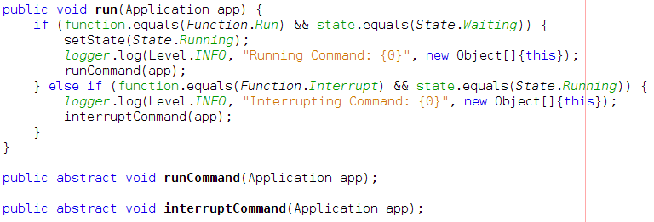
PHATCommands
Functions: Run, Interrupt
States: Waiting, Running, Interrupted, Success, Fail
Notifies changes on its states to the Listener (PHATCommandListener)
Asynchronous behaviour
PHATCommand functions:

Slide 11
phat-env (1/6)
WorldAppState:
  Updates PHATCalendar (time and date)
  Sky
  Land and places where houses can be added
  Init lights and simulates the sun
  Weather no implemented

Slide 12
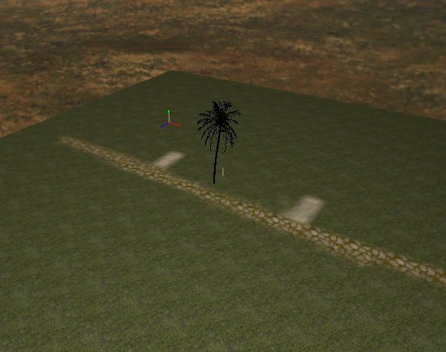
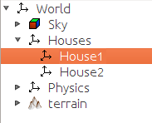
phat-env (2/6)

Slide 13
phat-env (3/6)
HouseAppState:
  NavMesh
  Coordenates of areas and rooms. Perimeter of the rooms.
  Objects with meta information
  Commands:
    CreateHouseCommand(String id, HouseFactory.HouseType houseType)
    DebugShowHouseNavMeshCommand(boolean enable)

Slide 14
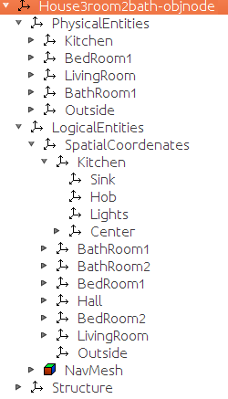
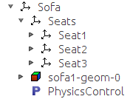
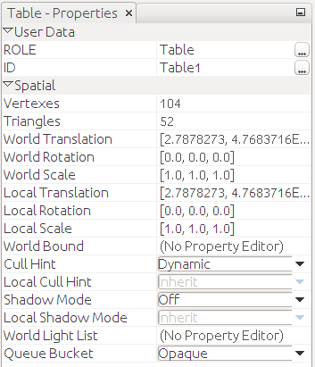

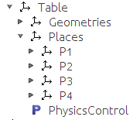
phat-env (4/6)

Slide 15
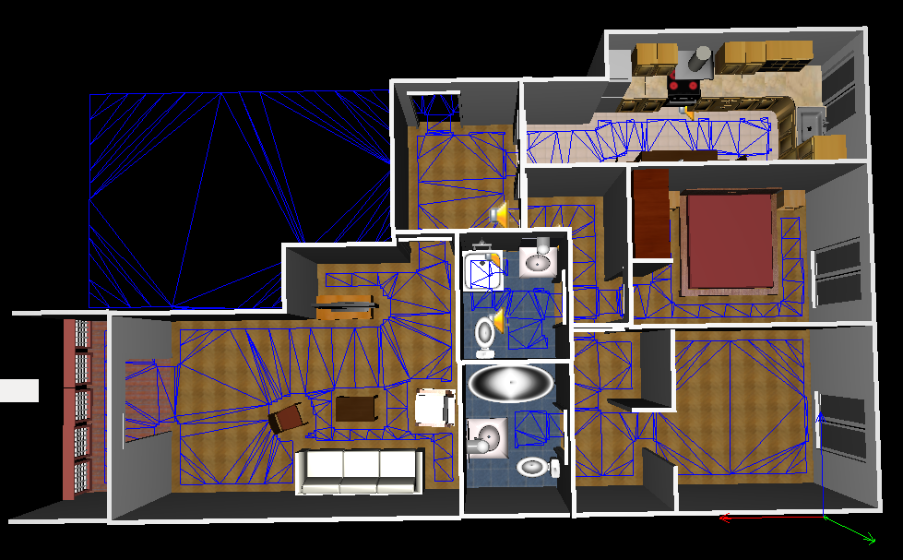
phat-env (5/6)

Slide 16
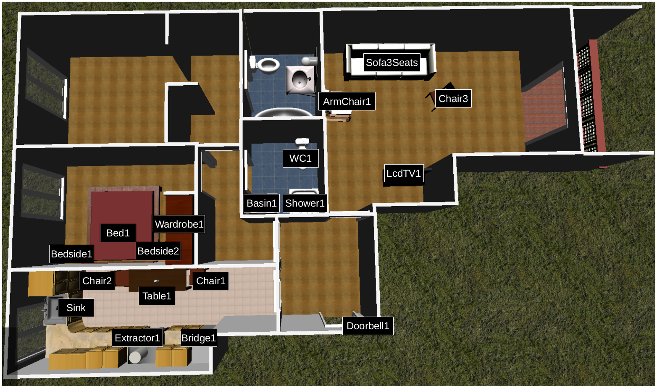
phat-env (6/6)

Slide 17
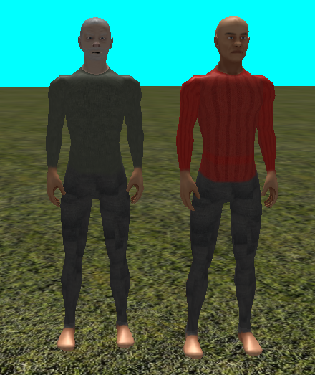
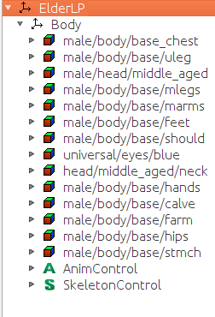
phat-bodies (1/6)

Slide 18

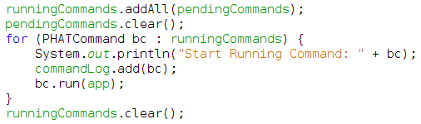
phat-bodies (2/6)
BodiesAppState
  Pending commands list both to be run and interrupted.
  RunningCommands list that have started but don't ends.
  A log of commands that has being runned → it is poor, it doesn't keep timestamp with state changes

Slide 19
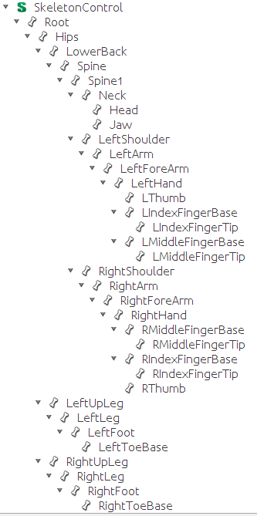
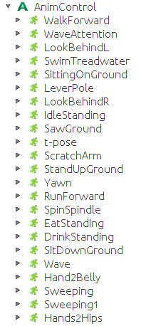
Phat-bodies (3/6)

Slide 20
phat-bodies (4/6)
Commands
  Displacements:
    GoCloseToBodyCommand(String bodyId, String targetBodyId)
    GoCloseToObjectCommand(String bodyId, String targetObjectId)
    GoIntoBedCommand(String bodyId, String placeId)
    GoToCommand(String bodyId, Lazy<Vector3f> destiny)
    GoToSpaceCommand(String bodyId, String spaceId)
    RemoveBodyFromSpaceCommand(String bodyId)
    RotateTowardCommand(String bodyId, String entityId)
    AlignWithCommand(String bodyId, String entityId)
    SetBodyInCoordenatesCommand(String bodyId, Vector3f location)
    SetBodyInHouseSpaceCommand(String bodyId, String houseId, String spaceId)
    SetSpeedDisplacemenetCommand(String bodyId, float speed)
    FallDownCommand(String bodyId)
    TripOverCommand(String bodyId) → need to be reviewed

Slide 21
phat-bodies (5/6)
Commands
  Interactions:
    OpenObjectCommand(String bodyId, String objectId)
    CloseObjectCommand(String bodyId, String entityId)
    PickUpCommand(String bodyId, String entityId, Hand hand)
    SayASentenceBodyCommand(String bodyId, String message)
    SitDownCommand(String bodyId, String placeId)
    StandUpCommand(String bodyId)
  Appearance:
    SetBodyColorCommand(String bodyId, ColorRGBA color)
    SetBodyHeightCommand(String bodyId, float height)
  Debbuging:
    AttachIconCommand(String bodyId, String imagePath, Boolean show)
    BodyLabelCommand(String bodyId, Boolean show)
    ShowLabelsOfVisibleObjectsCommand(String bodyId, boolean on)
    SetCameraToBodyCommand(String bodyId)

Slide 22
phat-bodies (6/6)
Commands
  Gestures:
    PlayBodyAnimationCommand(String bodyId, String animationName)
    LookAtCommand(String bodyId, String targetId)
    SetShortStepsCommand(String bodyId, Boolean on)
    SetStoopedBodyCommand(String bodyId, Boolean on)
    SetRigidArmCommand(String bodyId, Boolean on, Boolean left)
    TremblingHandCommand(String bodyId, Boolean on, Boolean left)
    TremblingHeadCommand(String bodyId, Boolean on)
  Others:
    SetPCListenerToBodyCommand(String bodyId)
    WaitForCloseToBodyCommand(String bodyId, String targetBodyId)
    CreateBodyTypeCommand(String bodyId, String urlResource)
    RandomWalkingCommand(String bodyId, boolean enabled)

Slide 23
phat-devices
There are not models of Android devices. They are created with a cube shape.
DevicesAppState
Commands:
  CreateSmartphoneCommand(String smartphoneId)
  DisplayAVDScreenCommand(String smartphoneId, String avdId)
  InstallApkCommand(String smartphoneId, String apkFile)
  PressOnScreen(String smartphoneId, int x, int y)
  SetAndroidEmulatorCommand(String smartphoneId, String avdId, String serialEmulator)
  SetDeviceInCoordenatesCommand(String deviceId, Vector3f location)
  SetDeviceOnFurnitureCommand(String smartphoneId, String houseId, String furnitureId)
  SetDeviceOnPartOfBodyCommand(String bodyId, String deviceId, PartOfBody partOfBody)
  SetImageOnScreenCommand(String deviceId, String imagePath)
  StartActivityCommand(String smartphoneId, String packageName, String activityName)
  SwitchTVCommand(String tvId, boolean on) → deprecated

Slide 24
phat-interface
Several responsibilities:
  AgentsAppState: manage agents
  Agents:
    Automaton (HFSM)
    PHATEventManager
    DiseaseManager and Filters
  GUIMainMenuAppState: graphical components to show FPS, take snapshot, pause and forward simulation.
  PHATInitializer: facility to create and initializate the simulation.
    Set a seed for repeteable experiments

Slide 25
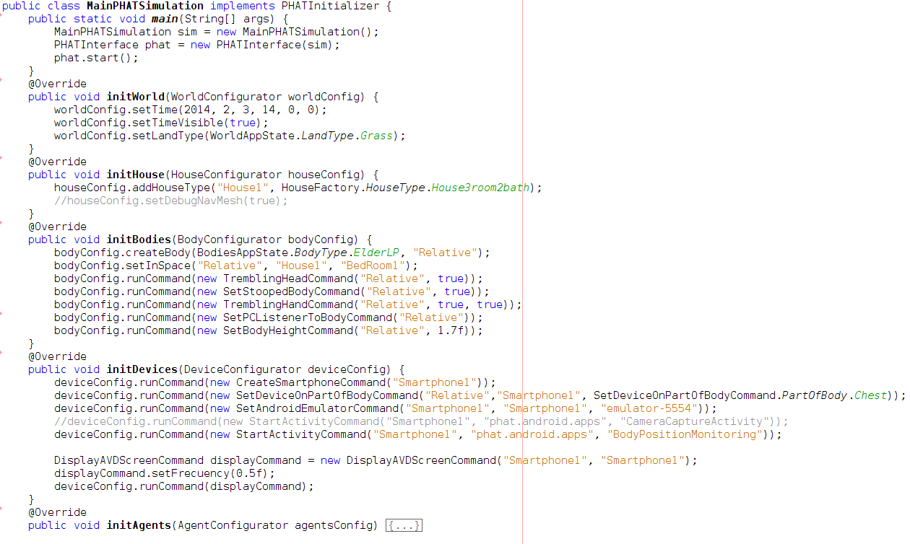
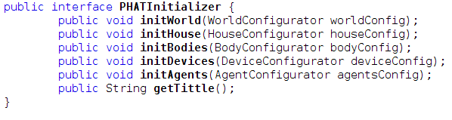
Phat-interface - PHATInitializer

Slide 26
SociAALML Behaviors
ADLs are manage hierarchically:
  Periods of time of the day
  Activities
  Tasks/Actions
The purpose of these elements is to model the ADLs of a human in his/her house.
They assume that all activities and task will be carry out without problems.
These elements do not model human-human interaction, just human-environment (devices also).

Slide 27
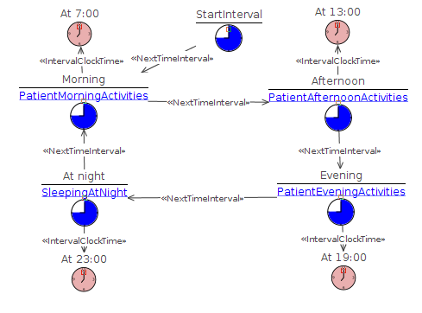
SociAALML – Periods of time of the day
ADLSpecDiagram: specifies a set of period of time that references to an AcivityDiagram.
The clock indicates when the period starts.
When it's time to start a new period it starts immediately and any task or activity in previous period is interrupted.
What happen if all activities in the period have finished and It's no time to the next period? 2 options:
  Define activity diagram such as it never ends.
  Define an a default activity.

Slide 28
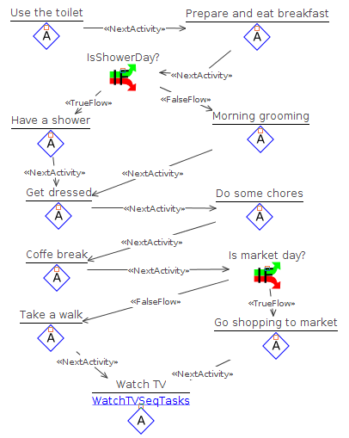
SociAALML – Activities
ActivityDiagram: specifies a set of activities for a period of time.
The activities can vary depending on conditions. They should be improved:
  Probability
  Level of a symptom (TODO)
  Day of the week (TODO)
  …
When all task of an activity are finished then the next task starts.
The last task has to be long time enough for the next period. Or modify the diagram to be able to add a default activity. Or it is possible to make a loop with two or more activities.

Slide 29
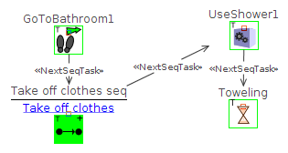


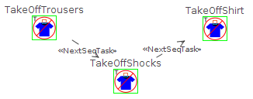
SociAALML – Tasks
Tasks can be defined using:
  SequentialTaskDiagram: Task are performed in order.
  RandomTaskDiagram: All tasks are performed in random order. (TODO)
Both diagrams can contains tasks and elements that referenciate to a sequential or random task diagram.
Activities just only be defined using SequentialTaskDiagram.
Activities should start with a task to go to the place where it will be performed.

Slide 30





SociAALML – Filters
Filters process tasks and modify them.
They are activated depending on symptoms levels (NONE, LOW, MEDIUM, HIGH).
Type of filters:
  Selector: select what tasks will be sent to the next filter.
  Delay: Changes the duration of a task or the speed.
  Unable: The task is skipped, i.e., it is not performed and go on the next.
  Replace: Remove the current task and add a new sequence of task.
  ChangeTarget: Modifies a parameter of the task, e.g., change the chair where the patient will be seated. (TODO)
    Ambiguous: Which parameter? They are not typified.

Slide 31

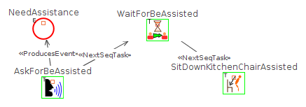

SociAALML – Filters
Look out with Unable, Replace and ChangeTarget filters: A filter should be consistent with the task replaced to go on with the next task.
For example, for the task sit down in a chair:
  If a patient cannot perform the task the filter Replace can contain tasks to ask for help and so he/she is assisted and the task is performed.
  Don't skip a task if it is important for the next task. Patient will eat standing!
  Don't change the seat where he/she will be seated if it doesn't make sense, e.g. in the toilet.

Slide 32
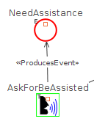

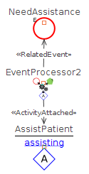
SociAALML – Events
Events can be attached to tasks in Sequential and Random Task Diagrams.
Humans have a InteractionProfile that refers to an InteractionDiagram where mappings between events and activities are defined.
  Needed condition to perform the activity can be added, but they are very limited yet.
When a human is going to perform the activity of the event:
  He/she suspends his/her current activity or task (or wait to be finished if it cannot be interrupted).
  He resumes the interrupted activity (Resume an activity is complex, depending on what he/she were doing some task should be done before. For instance, to resume a sleeping task, the patient should go into bed first). It should be improved!
It's supposed that there are several types of events depending on the medium they are perceived.
  AudioEvent → has a volume and distance and it can be perceived just in the moment it was created. They are launched when the task is finished.
  VisualEvent → It is not defined yet. The idea is that it was perceived only by direct vision. The event is launched at beginning of the task and it remains while the task is happening.
  TouchEvent → It is not defined yet.

