Slide 1
Section 2.2.1 (ii)
ENSO - Theory
How does the phase of ENSO reverse?
What triggers an El Nino event?

Slide 2
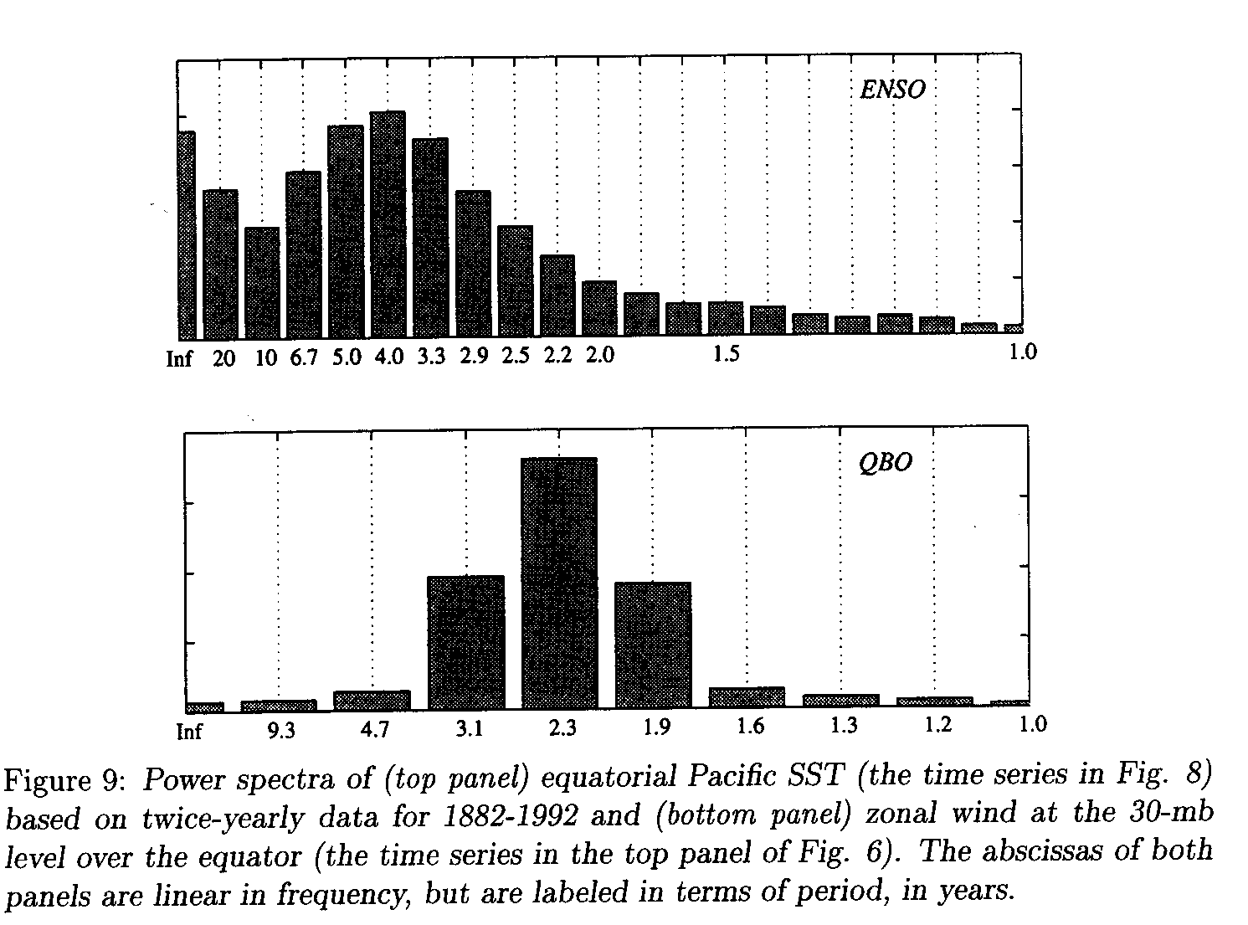
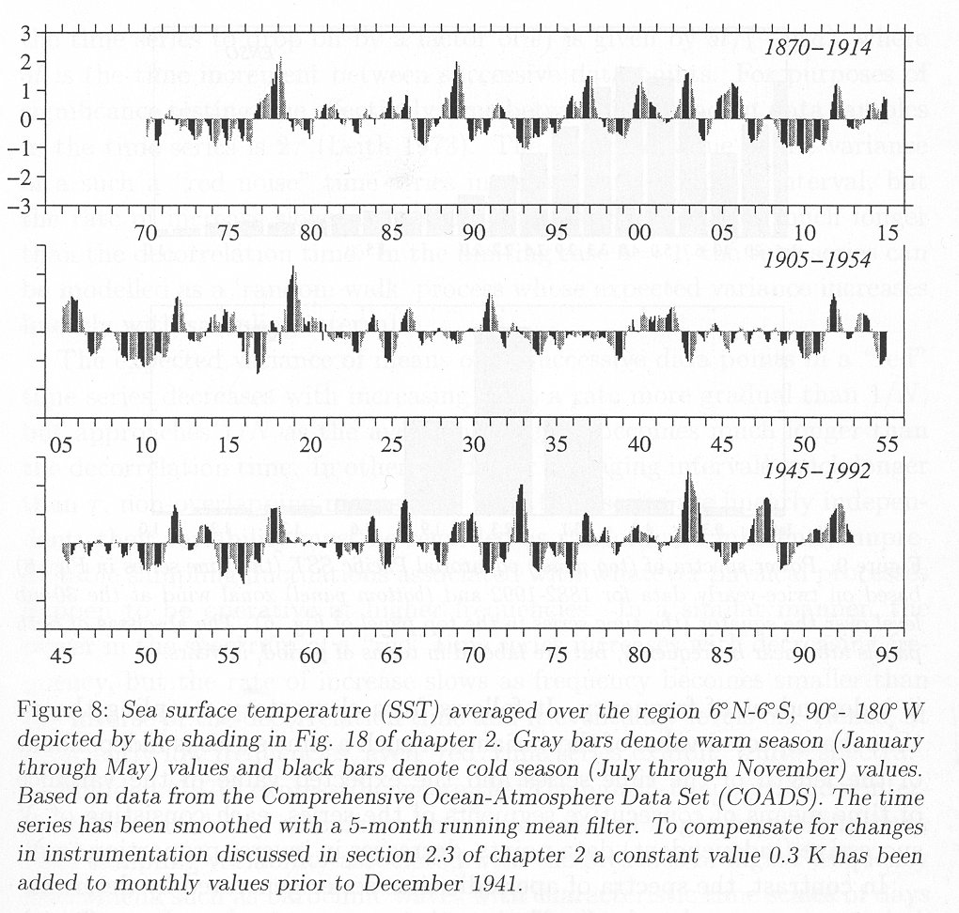
Power Spectrum
What determines the 4-year periodicity?

Slide 3
Equatorial Waves
Equatorial waves in the ocean are believed to play an important role in the onset and variability of ENSO
Two types:
  Kelvin waves (propagate eastward along the equator and also along coasts)
  Rossby waves (long waves propagate westward)
The relevant waves are baroclinic: internal to the ocean, propagating along the density contrast of the thermocline
Equatorial Kelvin waves travel 3 times faster than the fastest equatorial Rossby waves

Slide 4
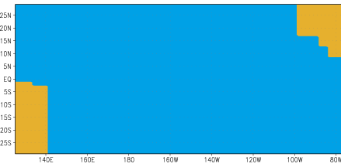
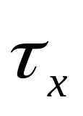
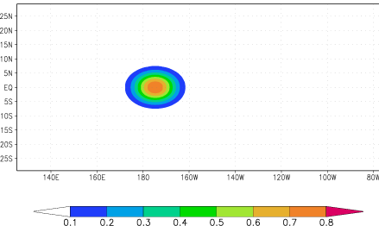
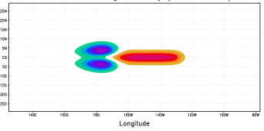
How does the phase of ENSO reverse?
Delayed Oscillator Theory
Battisti and Hirst, 1989; Suarez and Schopf, 1988
Westerly winds force downwelling on Equator and upwelling to North and South
=> Excites Kelvin and Rossby waves
Thermocline depth
Figures from IRI: http://iri.columbia.edu/climate/ENSO/theory/

Slide 5
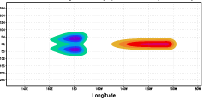
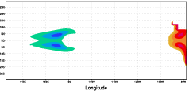
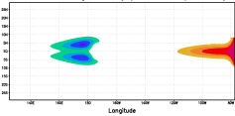
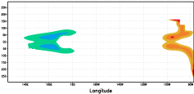
Delayed Oscillator Theory 2
Upwelling Rossby waves
Downwelling Kelvin wave
25 days
75 days
50 days
100 days

Slide 6
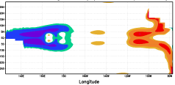
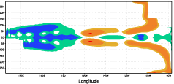
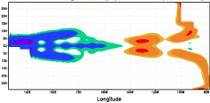
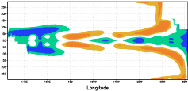
Delayed Oscillator Theory 3
125 days
225 days
175 days
275 days
Phase has reversed

Slide 7
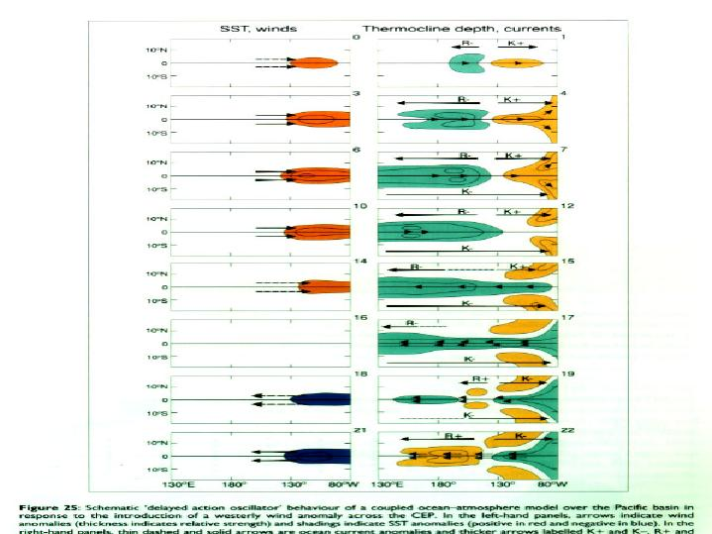

Slide 8
Delayed Oscillator Theory 4
Equatorial ocean waves offer a mechanism to reverse the phase of perturbations to the thermocline depth
Without further wind forcing waves eventually decay
Thermocline depth perturbations influence SST in the upwelling regions of central / eastern equatorial Pacific => coupling to atmosphere
Bjerknes feedback + equatorial waves can generate a self-sustaining oscillation

Slide 9
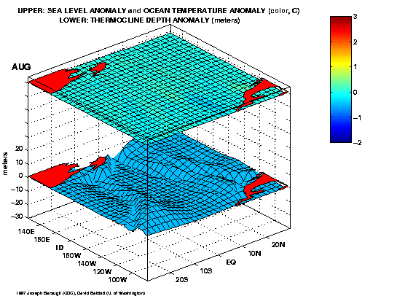

Slide 10
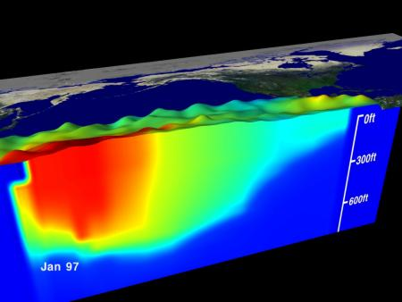
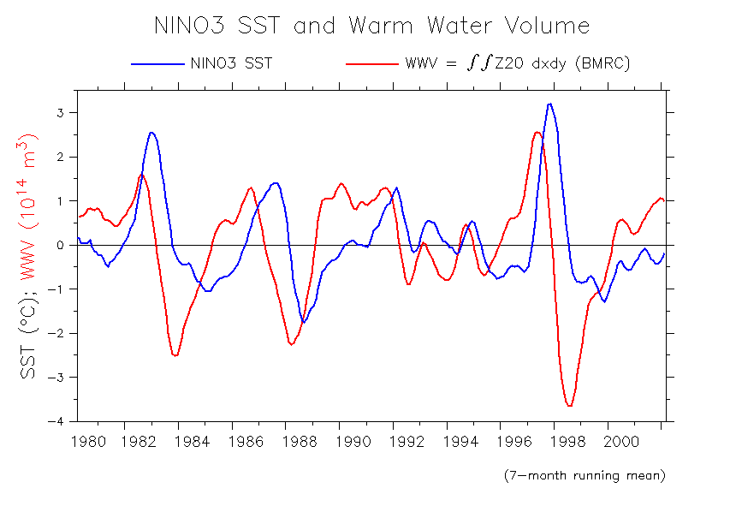
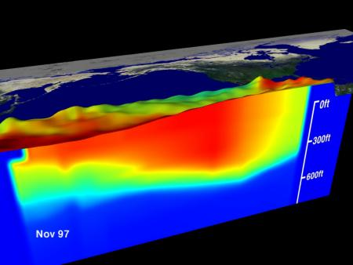
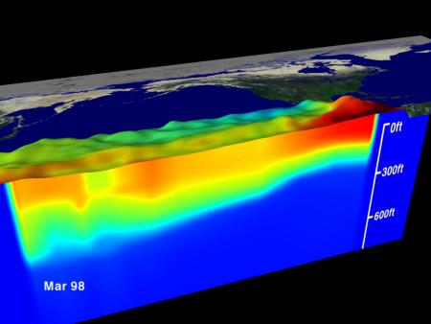
Recharge/Discharge theory (Jin, 1997)
recharged
discharging
Source: A. Timmermann
Prior to El Nino heat content in equatorial region builds up
During El Nino heat is “discharged” eastward and polewards
discharged
Notes:
Sverdrup transport below Ekman layer is key to recharge and discharge

Slide 11
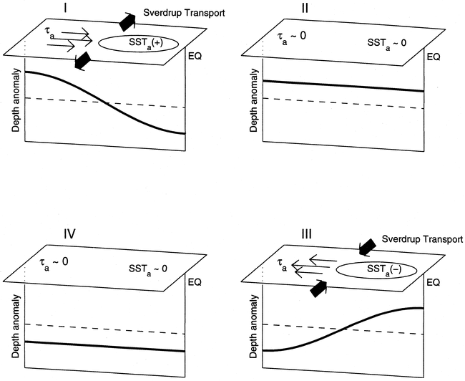

Slide 12
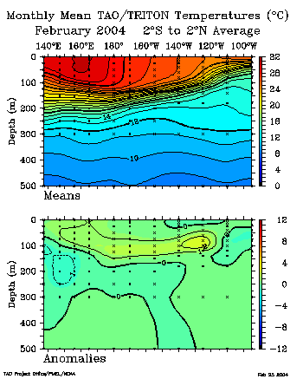
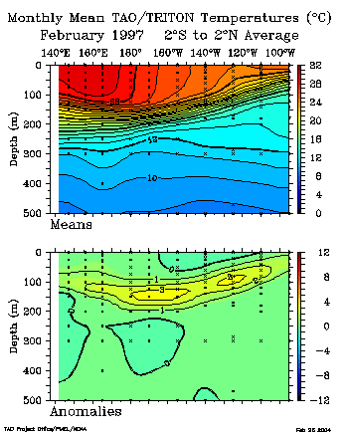
Equatorial temperature sections

Slide 13
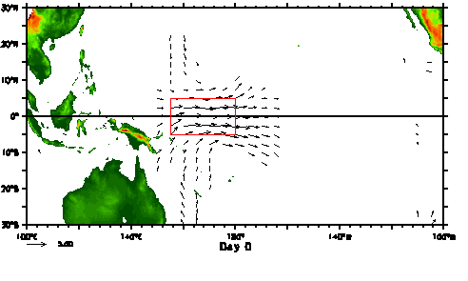
What triggers El Nino?
Still not fully understood
High heat content (deep thermocline) in the equatorial region necessary but not sufficient condition
“Westerly wind bursts” (few days duration) associated with the Madden Julian Oscillation may act as one trigger.
G. Vecchi

Slide 14
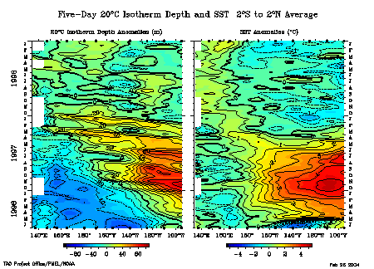
Onset of the 1997/98 El Nino
Downwelling equatorial Kelvin waves triggered by westerly wind bursts

Slide 15
Summary of El Nino onset
Need high heat content in equatorial Pacific
Triggering by wind fluctuations (e.g. WWBs) over central/western Pacific
Growth through Bjerknes positive feedback mechanism

Slide 16
Theories for ENSO Oscillations
Delayed Oscillator (e.g. Battisti and Hirst, 1989; Suarez and Schopf, 1988
Recharge/discharge theory (Jin, 1997)
Western Pacific Oscillator (e.g. Weisberg, R. H., and C. Wang, 1997)
Advective-Reflective Oscillator (e.g. Picaut et al, 1997)
Unified Oscillator (Wang, 2001 J Clim)

