Slide 1
ENSO variability Connecting observations with theoretical models
Oliver Elison Timm ATM 306 Fall 2016
Lecture 5
Notes:
Presentation slide for courses, classes, lectures et al.
1

Slide 2
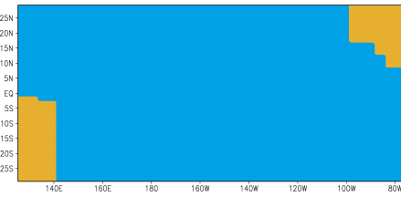
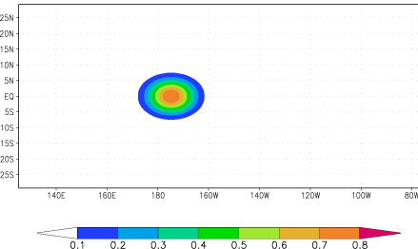
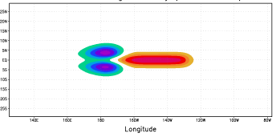
How does the phase of ENSO reverse?
Delayed Oscillator Theory
Battisti and Hirst, 1989; Suarez and Schopf, 1988
Westerly winds force downwelling on Equator and upwelling to North and South
=> Excites Kelvin and Rossby waves
Thermocline depth
Figures from IRI: http://iri.columbia.edu/climate/ENSO/theory/
Notes:
2

Slide 3
Equatorial Waves
The dynamics of oceanic and atmospheric waves can be described with prognostic* mathematical equations.
They are based on some fundamental laws:
Conservation of mass
Conservation of energy
Conservation of momentum
Conservation of angular momentum
Notes:
Prognostic equation:
A time derivative on the left hand side of the equation (change in wind, currents, or any other variable) is related to an instantaneous state of the system(e.g. pressure gradient)

Slide 4
Equatorial Waves
Momentum (Navier-Stokes) equation:
These equations describe how forces of gravity, buoyancy, pressure, friction and Coriolis effect act to change the momentum of a fluid (i.e. accelerate a fluid parcel) at a given location at a given point in time.
Notes:
Prognostic equation:
A time derivative on the left hand side of the equation (change in wind, currents, or any other variable) is related to an instantaneous state of the system(e.g. pressure gradient)

Slide 5
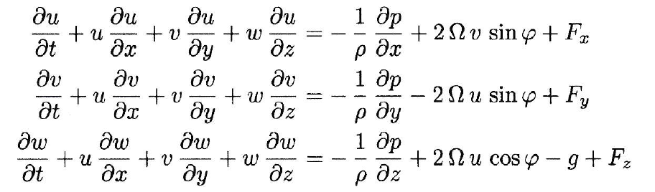
Equatorial Waves
Navier-Stokes equations on a rotating sphere:
Please refer to textbooks on atmospheric dynamics or fluid dynamics for a detailed derivation and discussion of the terms.
Notes:
Prognostic equation:
A time derivative on the left hand side of the equation (change in wind, currents, or any other variable) is related to an instantaneous state of the system(e.g. pressure gradient)

Slide 6
Equatorial Waves
The full momentum equations are difficult to solve and to find all types of solution. Therefore, approximate, simplified sets of equations are derived from the full equation:
Scale analysis of the magnitude of the individual terms:
keep only the dominant forces in the equations
Simplified ocean stratification: 2 layer models: One active upper ocean mixed layer and a lower water layer.
This is an approximation to the continuously stratified ocean with a vertical density (temperature, salinity) profile showing a sharp increase of density with depth (pycnocline).
Notes:
Prognostic equation:
A time derivative on the left hand side of the equation (change in wind, currents, or any other variable) is related to an instantaneous state of the system(e.g. pressure gradient)

Slide 7
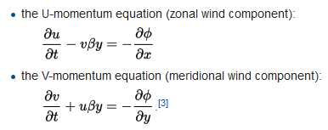
Equatorial Waves
Approximate solutions use simplified sets of equations: Scale analysis of the magnitude of the individual terms:
Governing equations: 2 layers*: one active upper ocean mixed layer and lower water layer
* Sometimes you will find the expression 1 ½ layer model, because the deeper ocean layer is only a passive layer and the wave motions are studied in the upper layer.
Notes:
Further note for students interested in theoretical dynamical concepts: In these equations we simplified the Coriolis force. The term ‘v beta y’ shows represents a linear increase in the Coriolis force with latitude for a given velocity (e.g consider v=1m/s). This is an equatorial beta-plane approximation.

Slide 8
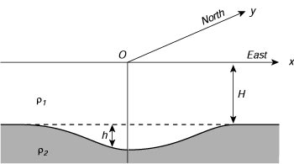
Equatorial Waves
Note that in the interior ocean
'reduced gravity' acts as a restoring force when the thermocline is perturbed.
Sketch of the two-layer model of the equatorial ocean used
to calculate planetary waves in those regions. From Philander (1990)
Reduced gravity: is related to the density difference between the two layers
(ρ₂ – ρ₁)/ ρ₂
Notes:
Write down equations on the board: highlight the connections.
Add the continuity equation
Make the point: that Coriolis force links both momentum equations:
Now this type of equations allow for wave-type solutions.

Slide 9
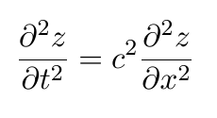
What is a wave?
Imagine in this figure the line
represents the pycnocline.
Mathematical equation for wave solutions in one spatial dimension:
Variable z can have different meanings. In our ocean case z is the depth anomaly of the pycnocline.
Notes:
Animated GIF from https://en.wikipedia.org/wiki/Wave

Slide 10
Wave Characteristics:
Wavelength (wavenumber), for spatial domain
Period (frequency) for time domain
Waveform (usually constructed with sine and cosine-functions)
Amplitude (in linear wave theory small deviations from the equilibrium state, e.g. small pressure anomalies compared with the total average pressure force)
Notes:
Linear waves:
Two waves can superpose each other without interacting: two waves traveling against each other will continue undisturbed their path when they meet and continue with the same characteristics afterwards.

Slide 11
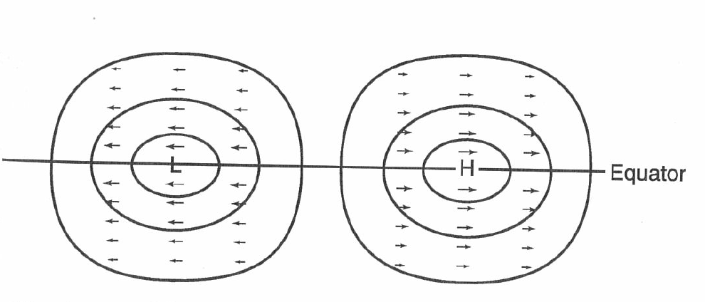
Equatorial Kelvin Wave
Phase Speed ~ 2.8 m/s eastward propagation
Maximum
Amplitude on Equator
Rapid decay in amplitude
within 5 degree N
and 5 degree S
Zonal current anomalies
(No meridional flow!)
(here positive anomaly)
Contours of equal thermocline anomaly
(here negative)

Slide 12
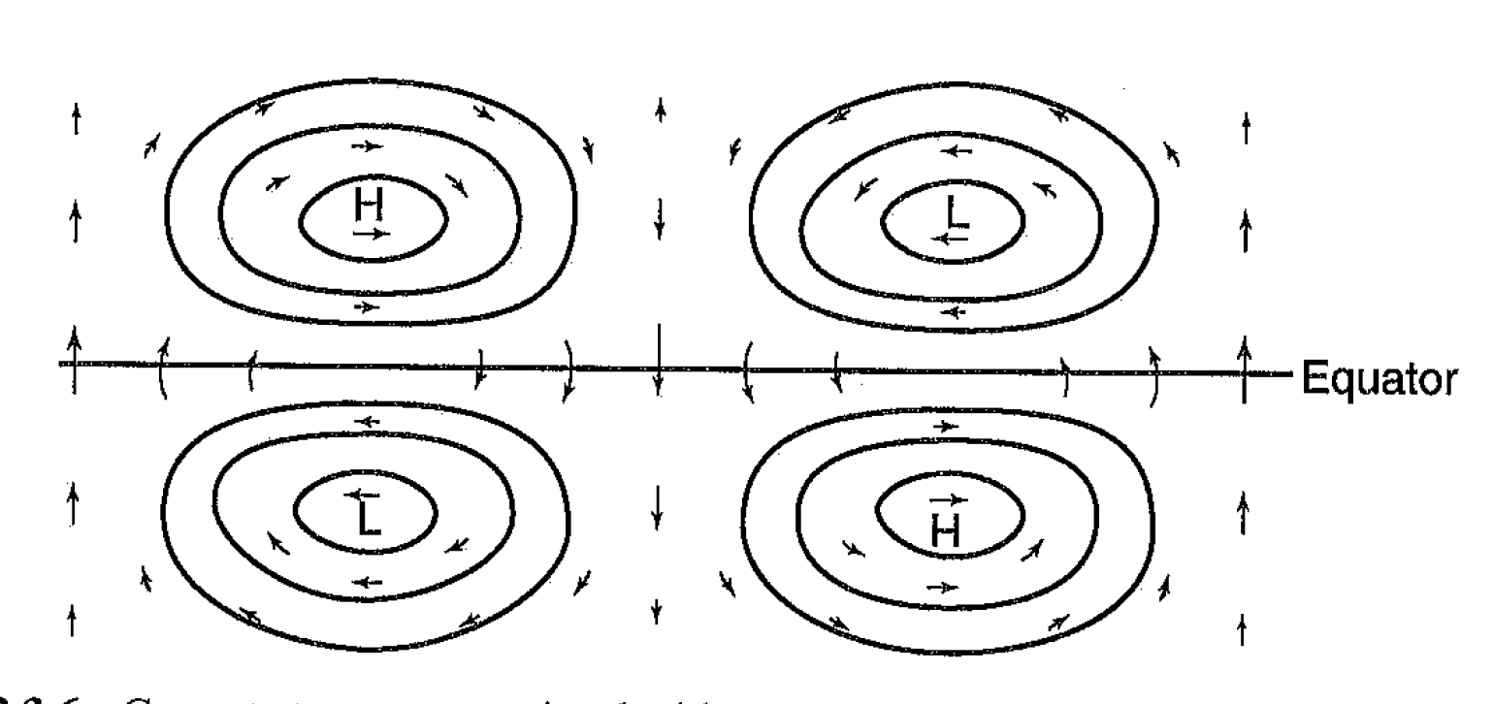
Equatorial Rossby Waves
Phase speed: westward propagation
1/3 or less of Kelvin phase speed
Maximum pressure amplitudes
(height anomalies)
off the equator
(with strongest zonal wind
anomalies)
Strongest meridional wind
amplitudes on equator
Equatorial Rossby can be symmetric or
asymmetric with respect to the equator
(Example of an asymmetric Rossby wave)

Slide 13
Delayed Oscillator Theory 2 Response to initial perturbation
Downwelling Kelvin wave:
Thermocline depth deeper than normal h>0 (red)
Equatorial Kelvin waves are centered on the equator
Sea surface height anomalies are small compared with the internal thermocline displacements.
Notes:
13

Slide 14
Delayed Oscillator Theory 2 Response to intial perturbation
Downwelling Kelvin wave:
Thermocline depth deeper than normal h>0 (red)
On the Equator
Notes:
14

Slide 15
How does the phase of ENSO reverse?
Delayed Oscillator Theory
Battisti and Hirst, 1989; Suarez and Schopf, 1988
Westerly winds force downwelling on Equator and upwelling to North and South
=> Excites Kelvin and Rossby waves
Thermocline depth
Figures from IRI: http://iri.columbia.edu/climate/ENSO/theory/
Notes:
15

Slide 16
Back of the Envelope Calculation:
Example calculate how fast long it takes a Kelvin wave to
cross from the date line to the South American coast.
Notes:
(*note there are more intricate details to the theory, in particular
Distinction between barotropic and baroclinic modes are important)
Basin: center of Kelvin wave at 180W to coastline at 80W
=>100deg wide basin to cross.
Phase speed 2.8m/s
111km/1deg on Equator
2.8m/s = 241km/day

Slide 17
Delayed Oscillator Theory: Response to initial perturbation
Upwelling Rossby waves
(symmetric mode)
Downwelling Kelvin wave
EQ
Notes:
17

Slide 18
Delayed Oscillator Theory: Response to initial perturbation
Upwelling Rossby waves
(symmetric mode)
t+25d
Downwelling Kelvin wave
EQ
Notes:
18

Slide 19
Delayed Oscillator Theory: Response to initial perturbation
Upwelling Rossby waves
(symmetric mode)
t+50d
Downwelling Kelvin wave
EQ
Notes:
19

Slide 20
Delayed Oscillator Theory: Response to intial perturbation
Upwelling Rossby waves
(symmetric mode)
t+75d
Coastal Kelvin waves and reflection
EQ
Notes:
20

Slide 21
Delayed Oscillator Theory: Response to initial perturbation
Upwelling Rossby waves
(symmetric mode)
Off-equatorial downwelling Rossby waves
t+100d
EQ
Notes:
21

Slide 22
Delayed Oscillator Theory: Response to initial perturbation
Upwelling Rossby waves
(symmetric mode)
t+125d
Downwelling Rossby waves
EQ
Notes:
22

Slide 23
Delayed Oscillator Theory: Response to initial perturbation
t+175d
Downwelling Rossby waves
EQ
Reflection and start of upwelling equatorial Kelvin wave
Notes:
23

Slide 24
Delayed Oscillator Theory: Response to initial perturbation
t+225d
Downwelling Rossby waves
EQ
Reflected Rossby waves: upwelling Kelvin wave
Notes:
24

Slide 25
Delayed Oscillator Theory: Response to initial perturbation
t+275d
Downwelling Rossby waves
EQ
Reflected Rossby waves and upwelling Kelvin wave
Notes:
25

Slide 26
Satellite Altimeter data animation
https://www.youtube.com/watch?v=F8zYKb2GoR4
Created by the NASA/Jet Propulsion Laboratory

Slide 27
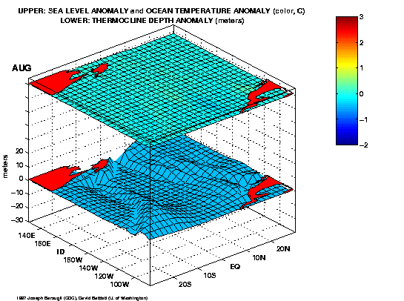
Notes:
27

Slide 28
Further information on ENSO theory: Delayed Oscillator Theory
This material is provided as additional information. It goes more into the theoretical aspects how we can explain the behavior that ENSO
Variability is concentrated on 2-7yr time scales.
Notes:
28
Not covered in class

Slide 29
Delayed Oscillator Theory
Equatorial ocean waves offer a mechanism to reverse the phase of perturbations to the thermocline depth
Without further wind forcing waves eventually decay
Thermocline depth perturbations influence SST in the upwelling regions of central / eastern equatorial Pacific => coupling to atmosphere
Bjerknes feedback + equatorial waves can generate a self-sustaining oscillation
Notes:
29

Slide 30
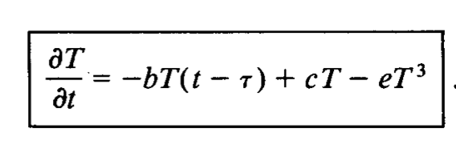
The delayed oscillator equation:
A prognostic model for eastern tropical Pacific SST anomalies:
(Non-linear damping)
Net local heating rate
In eastern trop Pac.
(upwelling, advection,
Bjerknes-type feedback)
Rate of change in
eastern tropical SST
Delayed negative
Feedback
(Kelvin-Rossby wave
Processes)
(τ is the delay time)
Battisti and Hurst 1989

Slide 31
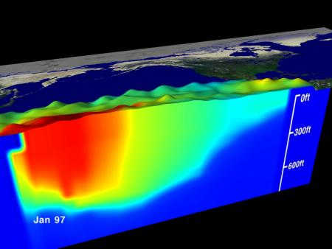
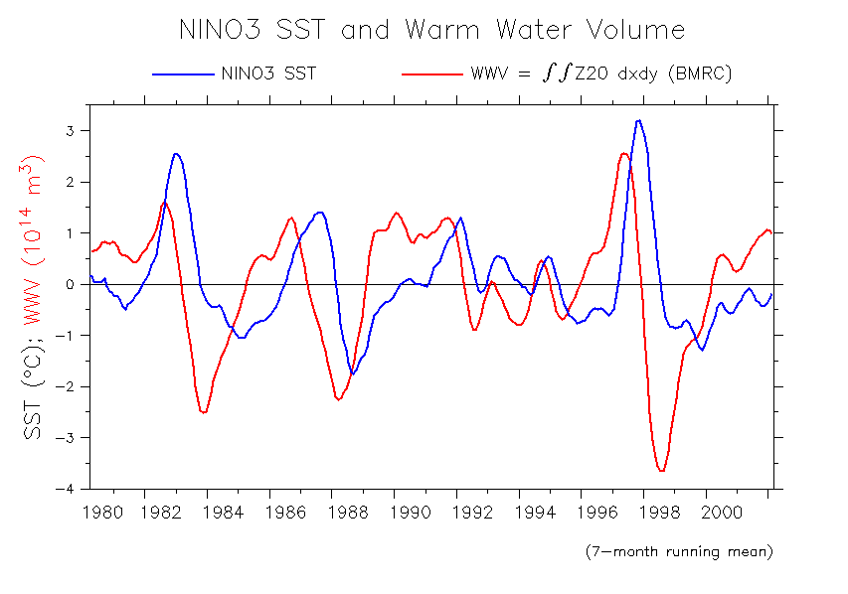
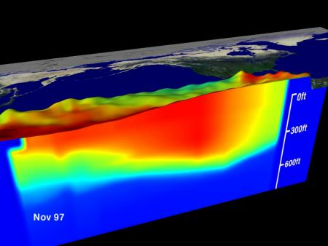
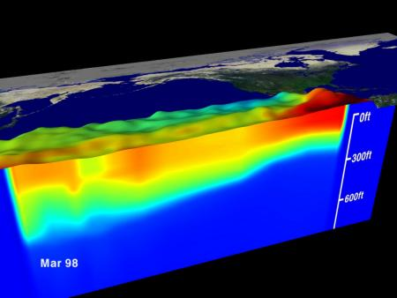
Recharge/Discharge theory (Jin, 1997)
recharged
discharging
Source: A. Timmermann
Prior to El Nino heat content in equatorial region builds up
During El Nino heat is “discharged” eastward and polewards
discharged
Notes:
31
Sverdrup transport below Ekman layer is key to recharge and discharge

Slide 32
Theories for ENSO Oscillations
Delayed Oscillator (e.g. Battisti and Hirst, 1989; Suarez and Schopf, 1988
Recharge/discharge theory (Jin, 1997)
Western Pacific Oscillator (e.g. Weisberg, R. H., and C. Wang, 1997)
Advective-Reflective Oscillator (e.g. Picaut et al, 1997)
Unified Oscillator (Wang, 2001 J Clim)
Notes:
32

Slide 33
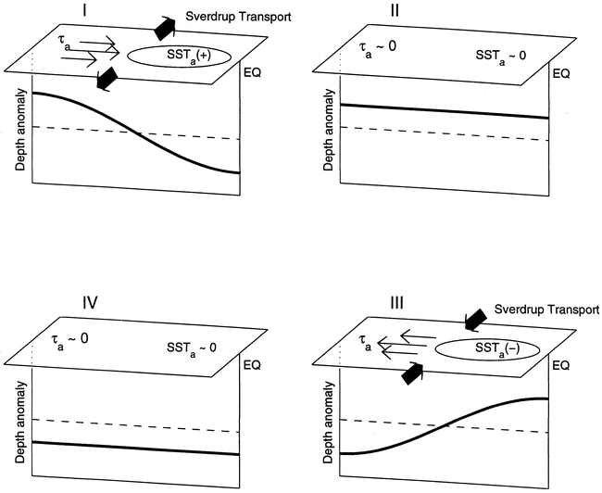
Notes:
33

Slide 34
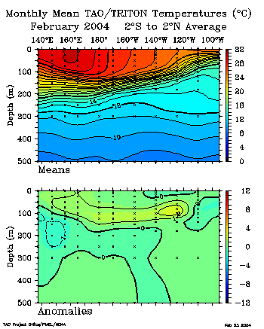
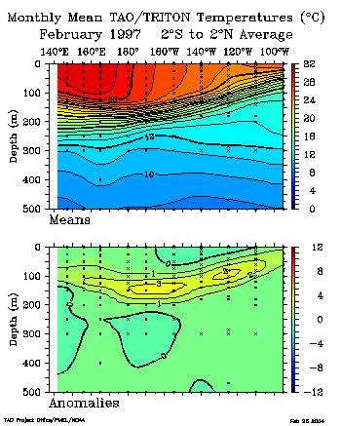
Equatorial temperature sections
Notes:
34

Slide 35
What triggers El Nino?
Illustration of westerly wind bursts
Notes:
35

Slide 36
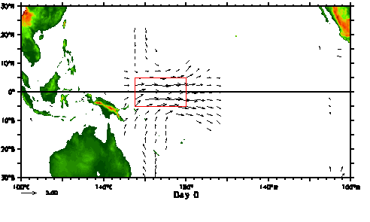
What triggers El Nino?
Still not fully understood
High heat content (deep thermocline) in the equatorial region necessary but not sufficient condition
“Westerly wind bursts” (few days duration) associated with the Madden Julian Oscillation may act as one trigger.
Notes:
36

Slide 37
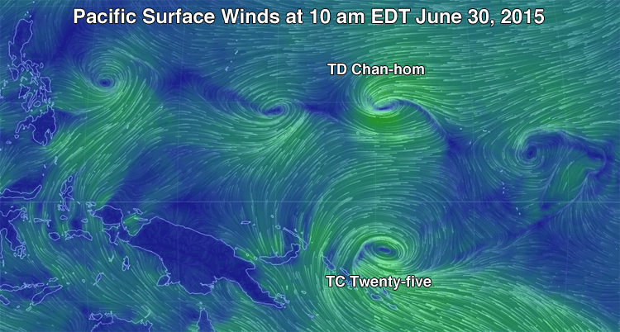

Slide 38
Summary of El Nino event:
onset, growth and decay
Need high heat content in equatorial Pacific
Trigger mechanism: wind fluctuations (e.g. westerly wind bursts over central/western tropical Pacific)
Growth through positive (Bjerknes) feedback mechanism
Eastward propagation of subsurface heat anomalies through Kelvin waves
Decay or reversal through a combination of wave processes: westward propagating Rossby waves off the equator (discharge of warm water away from equator)
Notes:
38

