Slide 1
Caesura
CIS 598 Final Presentation
Jacob Peterson

Slide 2
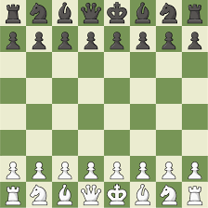
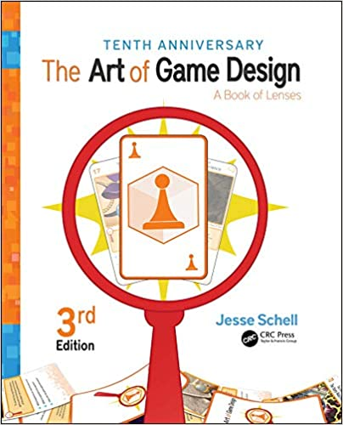
Inspiration & Background[1]
Love for strategy games/problem solving/quick thinking
Intro to Game Design course last semester
The Art of Game Design: A Book of Lenses – Jesse Schell
Approach from direction of a creative director
Colorful, tile-based board (Tetris, Blokus)

Slide 3
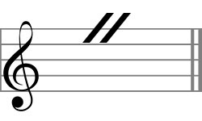
Inspiration & background[2]
de-emphasized graphics
Love for music
Combine music and gameplay
Caesura: a break, pause, or interruption in the normal tempo of a composition

Slide 4
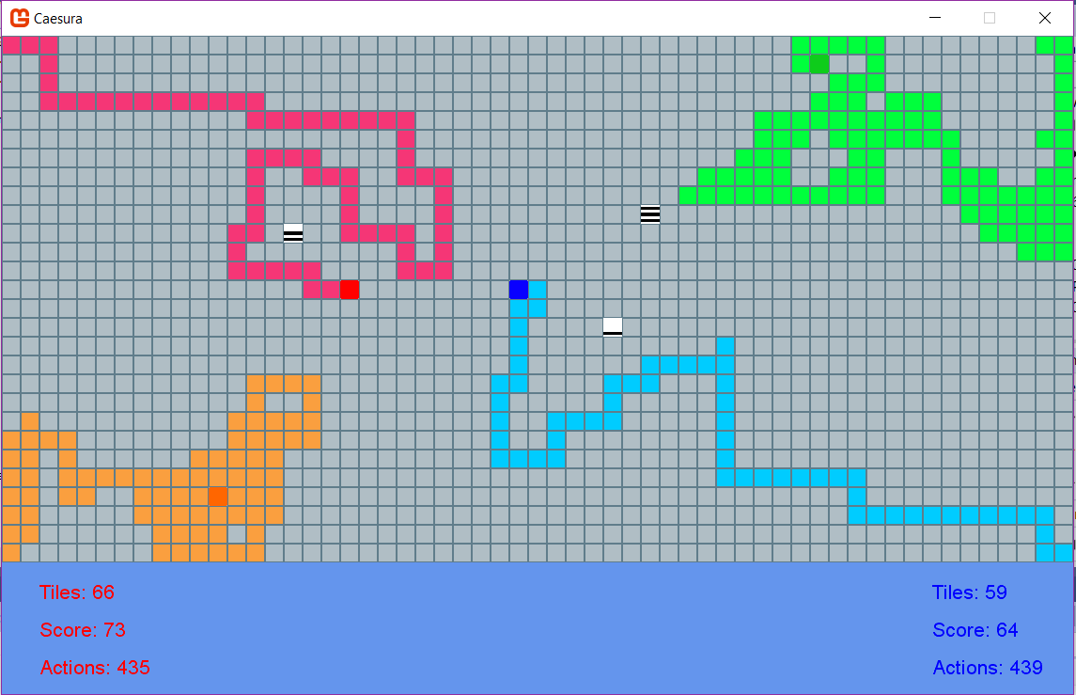

What is it?
Tile based strategy game utilizing C# scripts, Monogame, XNA framework
Capture tiles on a board and monitor movement costs
AI controlled “entities” act as obstacles and also drop items

Slide 5
Goals
Approach from the perspective of a game designer
Appeal to a wide audience
Board game/video game
Compose entire soundtrack to suit game
De-emphasized art, focus on creative and engaging gameplay

Slide 6





Tools list

Slide 7
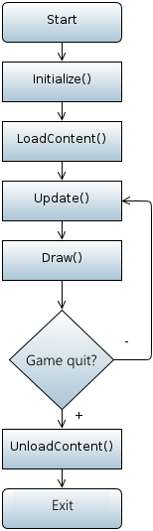
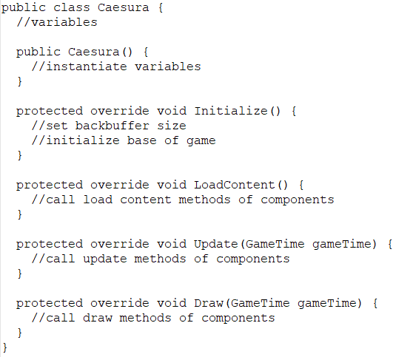
Game Structure

Slide 8
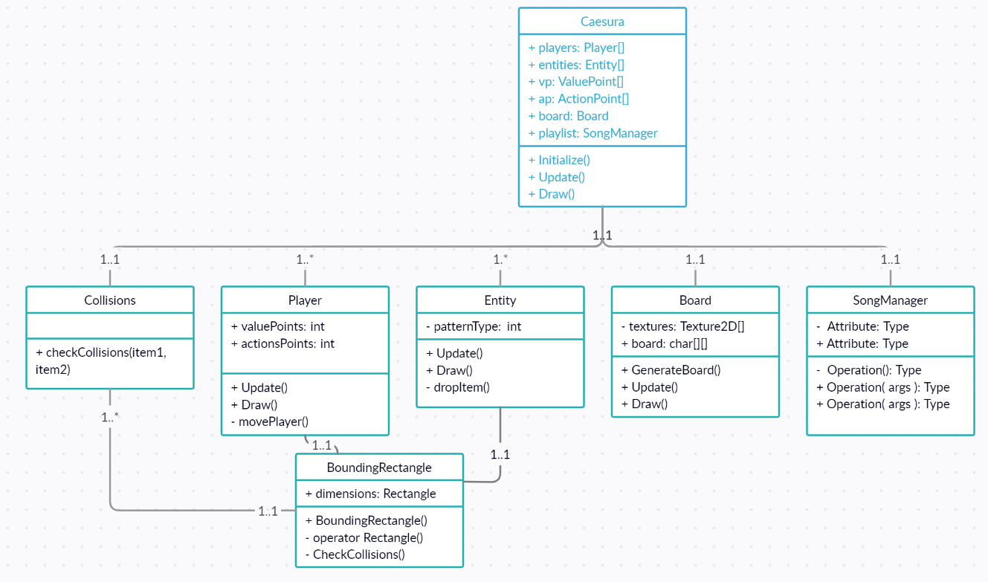
Class Diagram

Slide 9
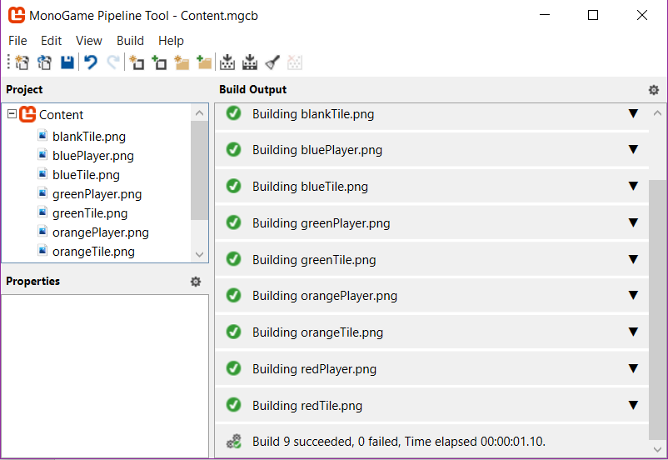
Content Pipeline
Used for organizing and building external content for Monogame use
Importing graphic elements and audio elements
Content.Load<ContentType>(“name”)

Slide 10
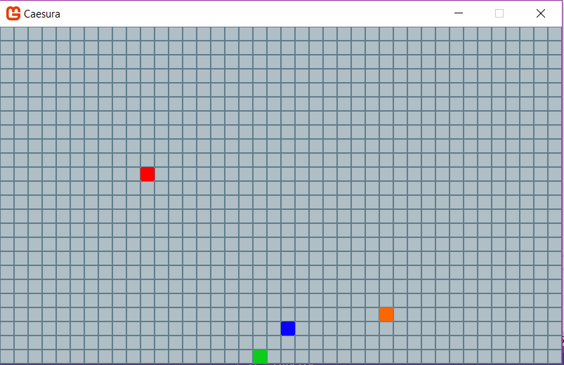
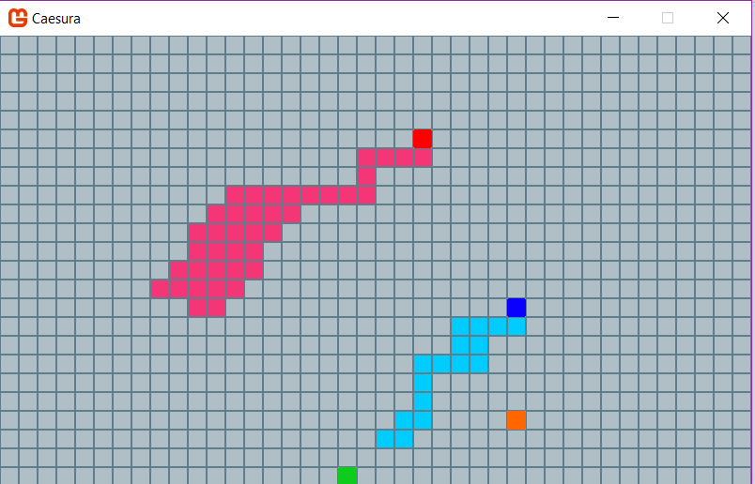
Tile System

Slide 11
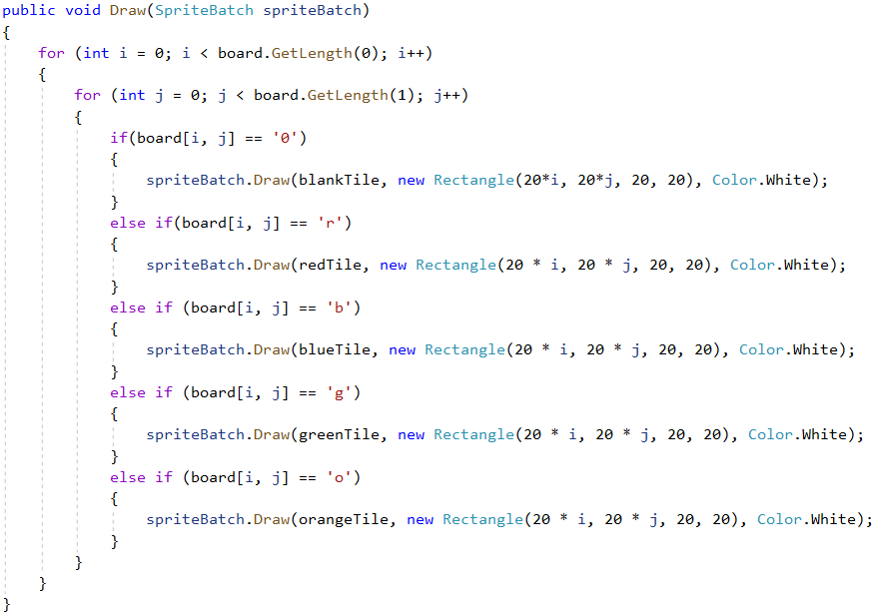
Tile System
Char grid size randomly generated
Player movements snap to tiles
Players exist and are drawn independently from grid (BoundingRectangle)
Speed mode changes how player move method is called

Slide 12
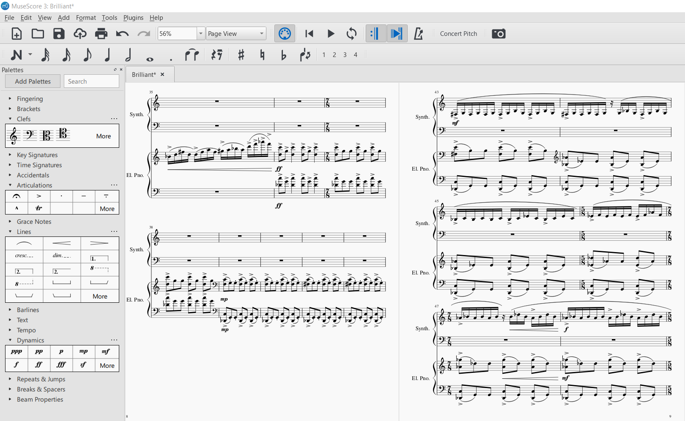
Musical element - Musescore

Slide 13
Musescore demo

Slide 14
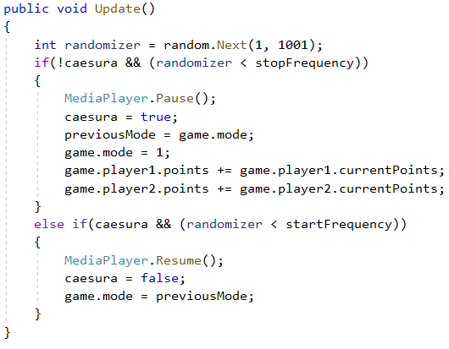
Musical element – SongManager
Class that manages playlist of songs
Monogame Song class
Mode changes
Caesura effect

Slide 15
Gameplay[1]
Two players
Grid-like ‘board’, point system
Limited number of actions, capable of being replenished
Players leave behind a trail of their color
Moving entities eliminate players, create neutral squares, and drop value points and action points
Objective: First player to reach 500 points OR last player standing
Three songs that designate speed/mode of gameplay (switches on board)
Fast: constant required movement in a direction and forced use of action points
Medium: selective movement (tile by tile)
Slow: selective movement with higher costs, entities drop points less frequently
Different speeds reward different strategies and can be altered mid game to aid in strategy

Slide 16
Gameplay[2]
Caesura
Music stops at random
Adds tile count to players score
No action points used, players can only travel on their color of tile or entity tiles
Allows players to reposition, escape, rewards mobile players with more squares
Elements of chance
Randomly generated components (placement of objectives, board size)
Surprise, variety, reaction
Strategies
Goal oriented (chase value points and action points, attempt to end game)
Aggressive (go after players with lower point values and force them out of movement points)
Survival (outlast opponents, survive till end of game, hoard action points)
Strategies can vary based on board size, placement of switches

Slide 17
Game demo

Slide 18
For the future
4 player functionality
Smarter entity movements
More advanced menu with rule page, 4 player selection, etc.
More obstacles on board
Improved graphics?

Slide 19
Thank you!
Questions?

