Slide 1
Caesura
CIS 598 Design Presentation
Jacob Peterson

Slide 2
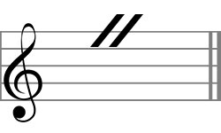
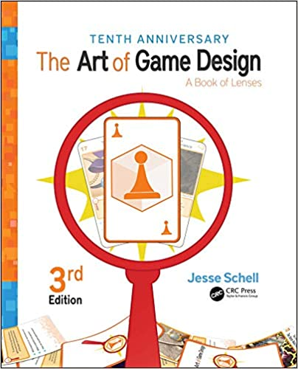
A Quick Reminder!
Tile based strategy game utilizing C# scripts, Monogame, XNA framework
Capture tiles on a board and monitor movement costs
Combine music and gameplay, de-emphasized graphics
Caesura: a break, pause, or interruption in the normal tempo of a composition
The Art of Game Design: A Book of Lenses – Jesse Schell

Slide 3





Tools list

Slide 4
Progress SO Far
Randomized grid board elements
Multiple players with movement and tile capture
BoundingRectangle class and collision detection
Entire soundtrack composed
SongManager class implemented (Caesura and song switching)

Slide 5
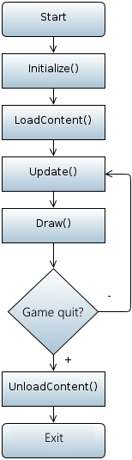
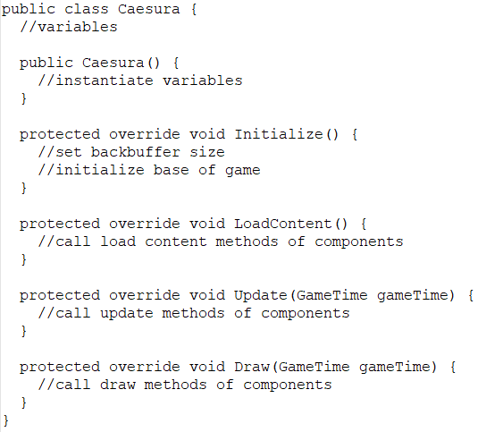
Game Structure

Slide 6
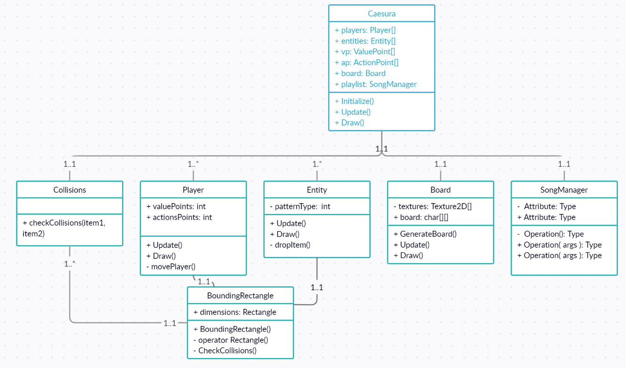
Class Diagram

Slide 7
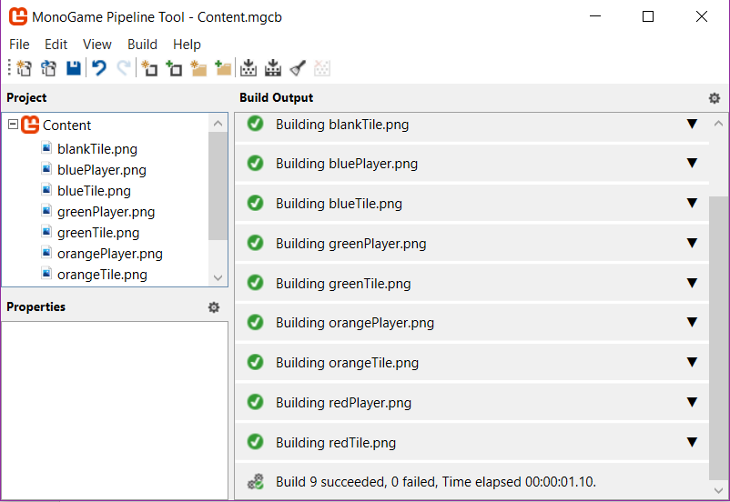
Content Pipeline
Used for organizing and building external content for Monogame use
Importing graphic elements and audio elements
Content.Load<ContentType>(“name”)

Slide 8
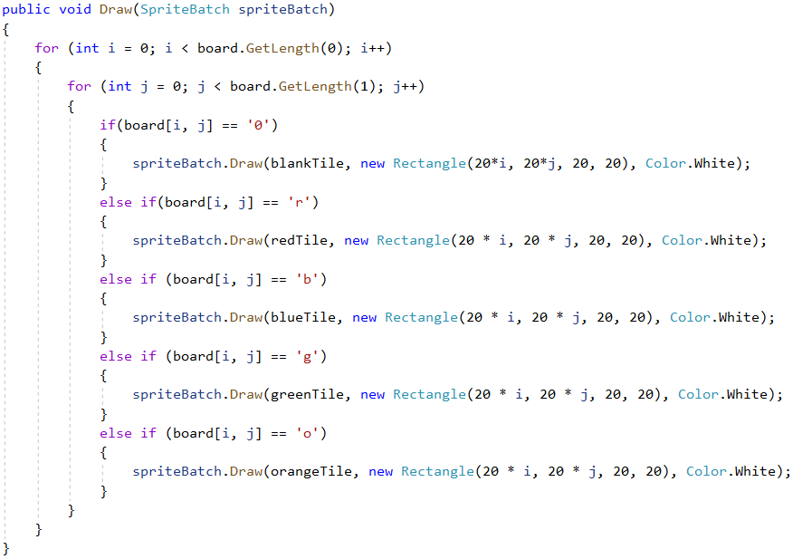
Tile System
Char grid size randomly generated
Player movements snap to tiles
Players exist and are drawn independently from grid (BoundingRectangle)
Speed mode changes how player move method is called

Slide 9
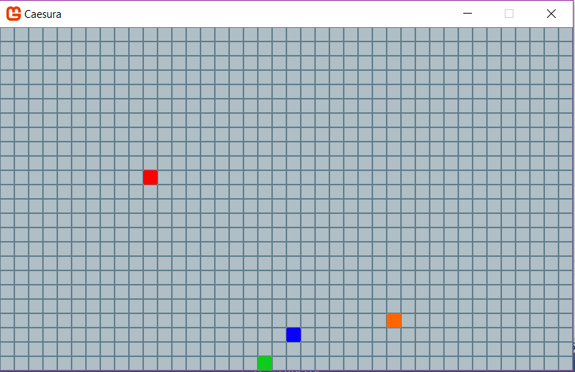
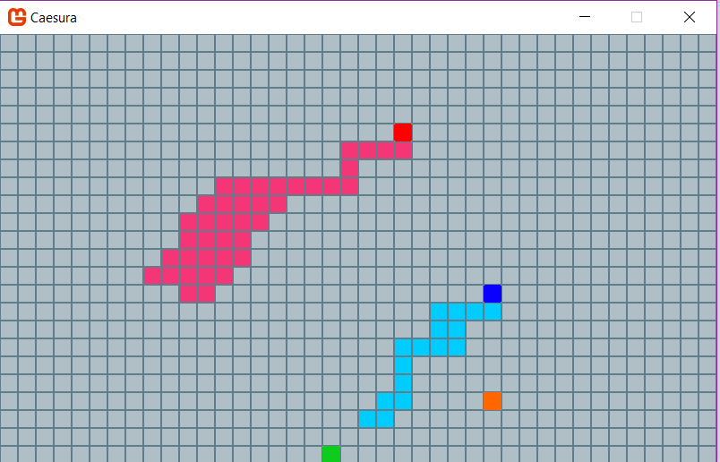
Tile System

Slide 10
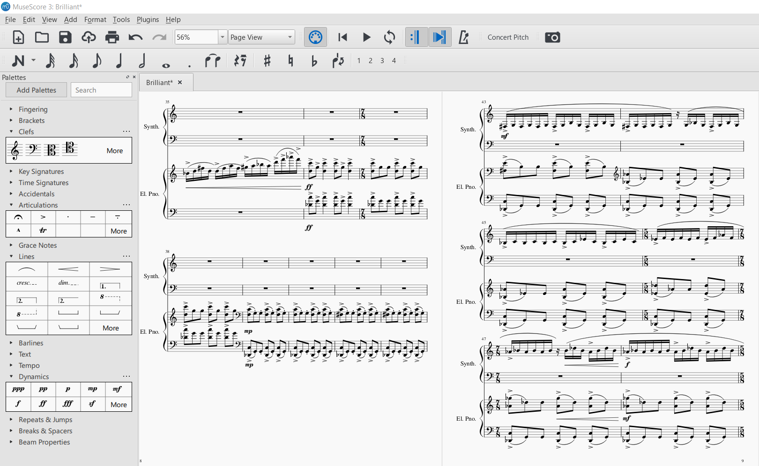
Musical element - Musescore

Slide 11
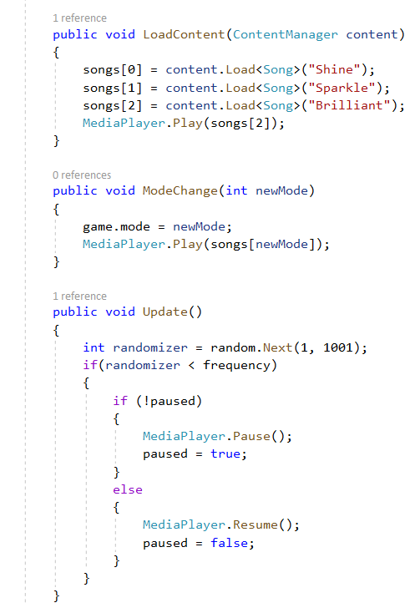
Musical element – SongManager
Class that manages playlist of songs
Monogame Song class
Mode changes
Caesura effect

Slide 12
To Do
Point system and scoring implementations
Entity movements
Menu functionality (character selection, custom board elements)
Cleaning up of visual elements (smooth tile movement, graphics, etc.)
Testing and refactoring using Schell AOGD

Slide 13
Thank you!
Questions?

