Slide 1
Caesura
CIS 598 Project Overview and Requirements Presentation
Jacob Peterson

Slide 2
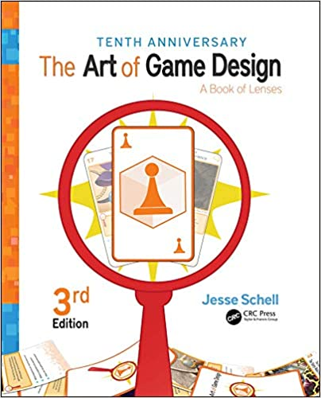
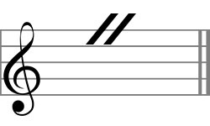
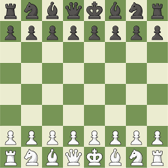
Inspiration
The Art of Game Design: A Book of Lenses – Jesse Schell
Music + gameplay
Caesura: a break, pause, or interruption in the normal tempo of a composition
Love for strategy games/problem solving/quick thinking

Slide 3
Goals
Approach from the perspective of a game designer
Appeal to a wide audience
Board game/video game
Compose entire soundtrack to suit game
De-emphasized art, focus on creative and engaging gameplay

Slide 4
Gameplay[1]
Two to four players
Grid-like ‘board’, point system
Limited number of actions, capable of being replenished
Players leave behind a trail of their color
Moving entities eliminate players, create neutral squares, and drop value points and action points
Objective: last player standing OR highest value points when board is clear of points
Three songs that designate speed/mode of gameplay (switches on board)
Fast: constant movement in a direction and forced use of action points
Medium: selective movement (tile by tile)
Slow: selective movement, entities move slower and drop points less frequently
Different speeds reward different strategies and can be altered mid game to aid in strategy

Slide 5
Gameplay[2]
Caesura
Music stops at random
No action points used, players can only travel on their color of tile
Allows players to reposition, escape, rewards mobile players
Elements of chance
Randomly generated components (placement of objectives, board layout)
Surprise, variety, reaction
Strategies
Goal oriented (chase value points and action points, attempt to end game)
Aggressive (go after players with lower point values)
Survival (outlast opponents, survive till end of game, hoard action points)

Slide 6
Requirements
Solid principles of game design (Schell)
User friendly, engaging gameplay
Bug free system
Main menu, game board
Randomly generated board elements and music elements
Self composed soundtrack

Slide 7





Tools list

Slide 8
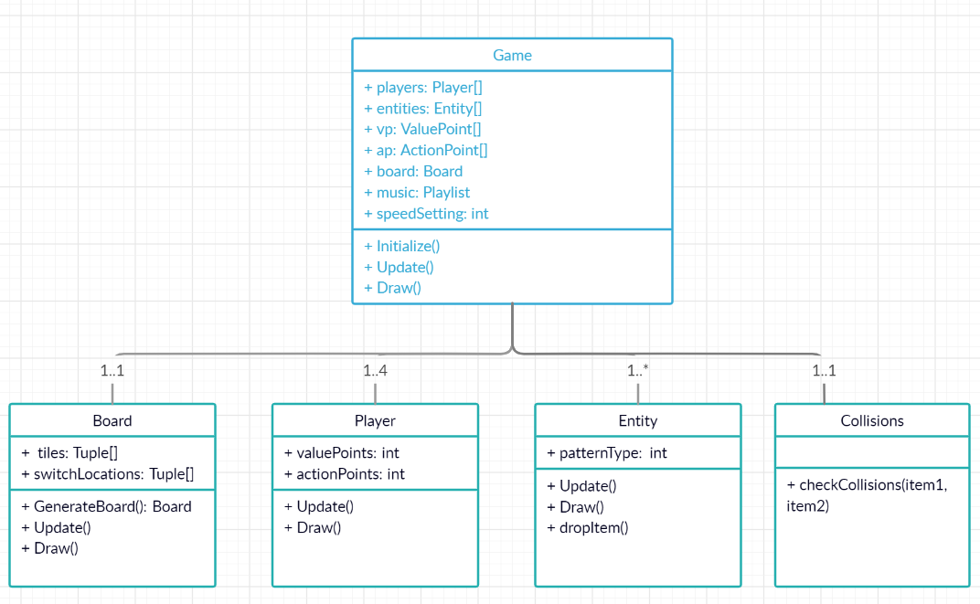
Structure

Slide 9
Development
Minimum viable product approach
Create music along with gameplay so that the aesthetic is tailored entirely to the experience
Follow Schell lenses
Bi-weekly, scrum/agile styled sprints to keep advisor in loop and re-evaluate goals and features

Slide 10
Timeline
OCTOBER:
Random board generation
Sketches of soundtrack
Main menu functionality
Agents moving within board
NOVEMBER:
Value and action points generated on board
3 movement speeds implemented
Soundtrack completion
Caesura functionality
Bug fixing
DECEMBER:
Win conditions fully implemented
Playtesting/balance
Final presentation

Slide 11
Questions?

