Slide 1
Summer Final
Check-In
By Jason Lee

Slide 2
Purpose
Create an MVP for a datapipeline for my mom's restaurant
  At best, the product can go in to production
  At worst, I'll brainstorm my next project
Acquire skills to build a neural network from scratch
  Finish chapter 4 of the textbook
  Relearn Linear Algebra
Follow curiosity – how Normal Equations work to find optimal parameters

Slide 3
Table of Contents
MVP Development
  OCR
  Google API Authentication
  Google Drive + Google Sheets Services
  ML unfinished
Chapter 4: How Models Learn
  Linear Regression
  Logistic Regression
  Batch Gradient Descent
  Regularization
  Results w/ Early Stopping

Slide 4





Café Bich Nga Data Pipeline MVP
Scanner
(CamScanner App)
Database
(Google Drive)
Handwritten Text Recognition (HTR)
(EasyOCR)
CSV
(Google Sheets)
ML
(Scikit-learn)
The goal of this data pipeline is to
  - Train a machine learning (ML) model to predict future customer orders and turn out
  - Have a POS system that would do all the accounting for my mother.

Slide 5
Scanner: Upload to Google Drive
I would teach mom how to
- Scan all of the bills
- Share them to Google Drive in the bichngaocr@gmail.com account
She would scan the bills at the end of the day
Scanner
(CamScanner App)
Database
(Google Drive)

Slide 6
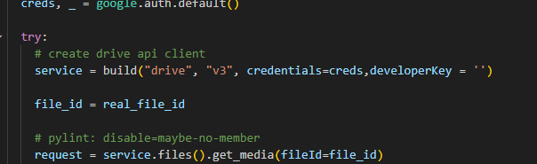
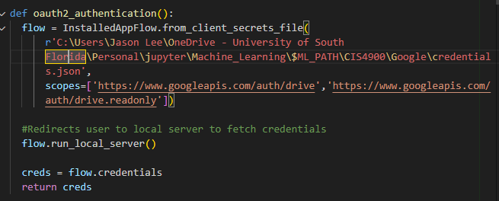
Google API Services - Authentication
Before using the Google APIs, Oauth2.0, a standard protocol to obtain an access token, is required.
But Google’s API authentication code is outdated, and the only solution to this problem was found in the Google API Python client documentation.
Enable the API in your Google Cloud console
Allow OAuth usage in “Branding”
Download credentials from “Clients”
Extract credentials with a configured scope to authenticate your program

Slide 7
Google Drive: Download the Bills
Download PDF of bills
(Embed wouldn't work)

Slide 8
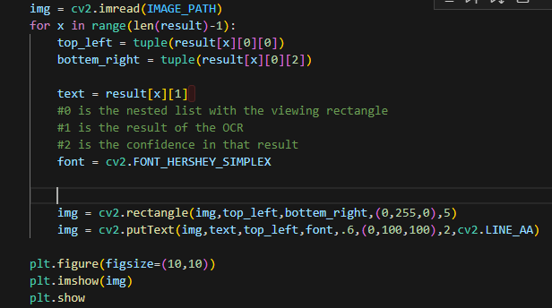
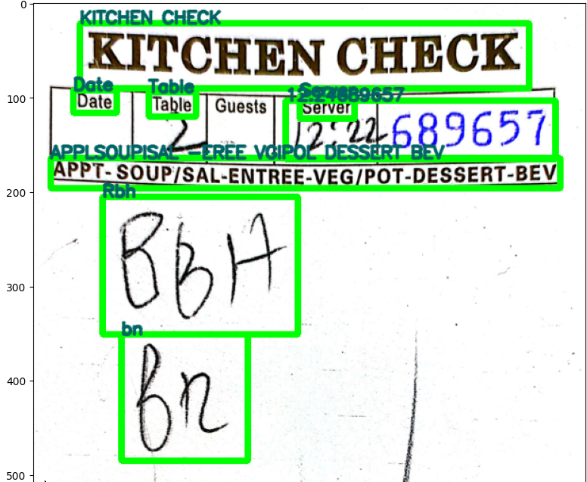
OCR – EasyOCR
Sections of the image are read with “viewing rectangles” (visualized by the green rectangles around text)
Text is displayed on the upper left of the rectangle
No amount of fine-tuning will make EasyOCR accurate enough for production
  “Rbh” is supposed to be “BBH” which stands for “Bun Bo Hue”
  “bn” is supposed to be “BR” which stands for Bun Rieu
Even if EasyOCR were reliable, one wrong order or miscalculation could ruin the accounting
Results are exported via a JSON file to the Google Sheets POS System

Slide 9
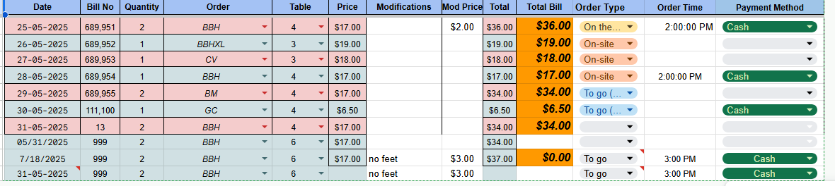
Google Sheets Template
s
After a bill is scanned with the OCR, the results are input into a point-of-sale (POS) database
Such a database could show which order is correlated with order type, the time, payment methods, etc.
  For example, Bun Bo Hue might be preferred for lunch rather than dinner!
Template is taken and edited from: myeasytool

Slide 10
Google Sheets: Append a JSON file as a Row
Append a JSON file to a Google Sheet's row
(Embed wouldn't work)

Slide 11
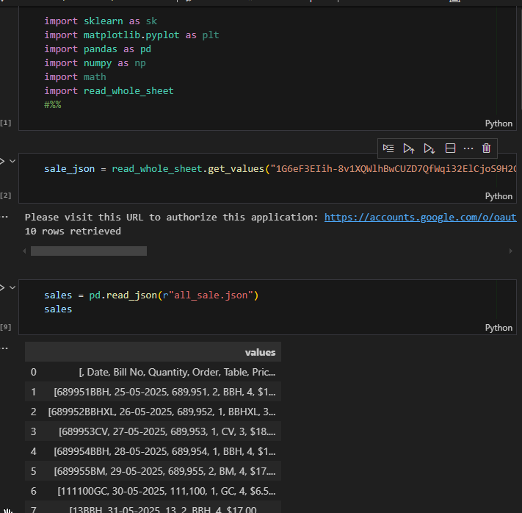
The ML Code
The Google Sheets .csv file is imported as a JSON file into a
Jupyter notebook.
At this point, I would be
  Cleaning up the data.
    Making categorical items like Orders into integers
    Excluding the price and total columns
    Scraping the internet for features
      Weather conditions
      Nearby events
Train a logistic regression model (more on this later) with multiple categories
Test the model on an unseen part of the dataset

Slide 12
Issues with the MVP
It wasn’t until I got to this part that I realized
There is little to no recorded features to base order predictions on
  Whether someone orders a menu item is dependent on personal, hard-to-track variables.
  Did they work out and need a meaty soup? What did their friend recommend they try? Have they eaten Vietnamese food before? Etc.
Even if the MVP’s purpose pivots to profit forecasting, more data is needed, which means hours 10s of hours of manual data input.
The boss and the family don’t need a ML model to know what customers order because we’re collecting and interpreting the data itself

Slide 13

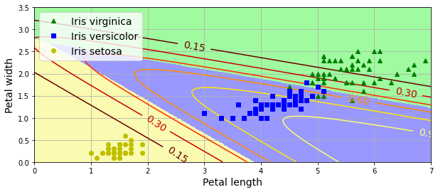
Chapter 4: Softmax Regression Project
Using the Iris dataset provided in the book, I must create a regularized logistic regression (softmax regression) model to distinguish between the 3 different types of irises.
I have created my functions and only consulted the solution if I was stuck.
Textbook Solution
My Solution

Slide 14
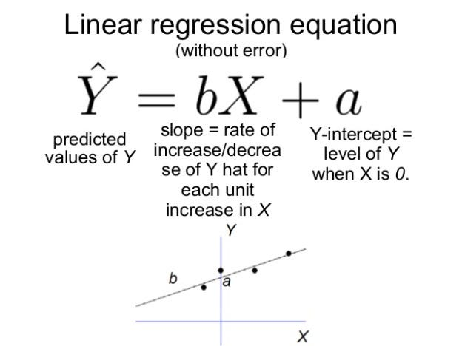
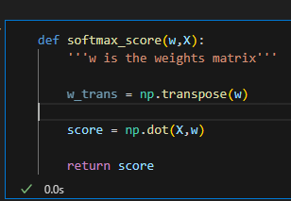
Linear Regression
ML models are trained when they find parameters that can yield satisfactory predictions for real-world data.
The parameters in this case are a matrix of weights (b) and a single value bias (a).
To evaluate the parameters of our model, there is an error function that tracks the difference between the prediction and the actual value.
The output is often referred to as the “score” of a logistic regressor.
X is the matrix of the dataset.

Slide 15
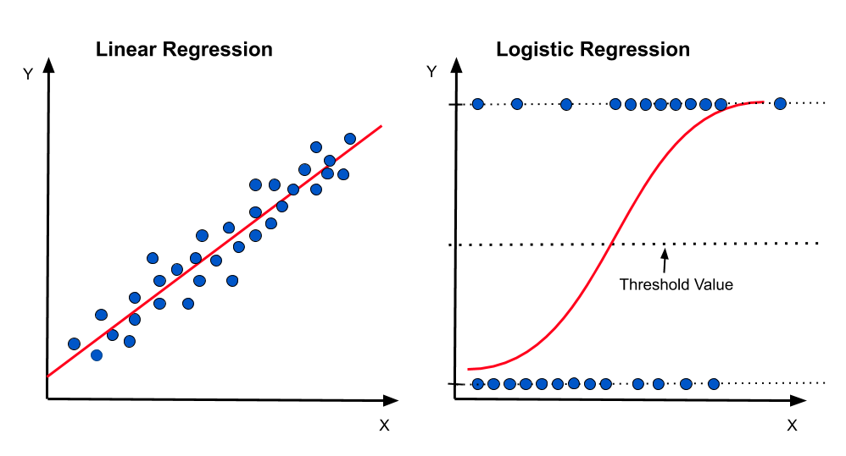
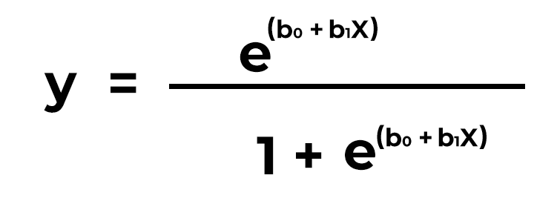

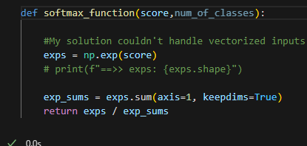
Logistic Regression
Takes the output of a linear regression and inputs it into a sigmoid function to determine which category the datapoint belongs to.
If the output of the sigmoid function is beyond a threshold point, then the datapoint will be a positive reading. If the output is below the threshold, there will be a negative reading.
Softmax Regression is logistic regression, but for 3 or more classes. For the project, we’re performing Softmax regression on only 3 classes.

Slide 16
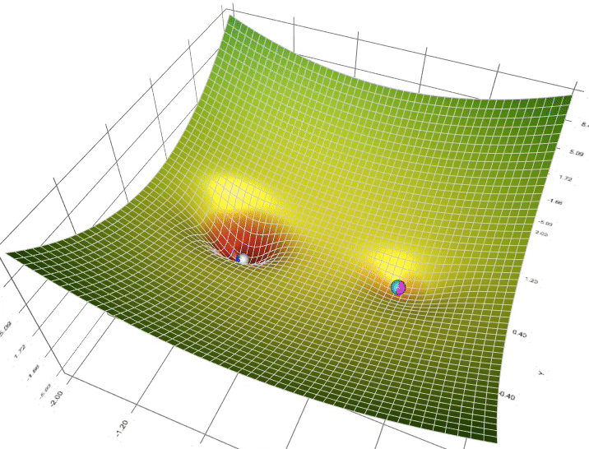
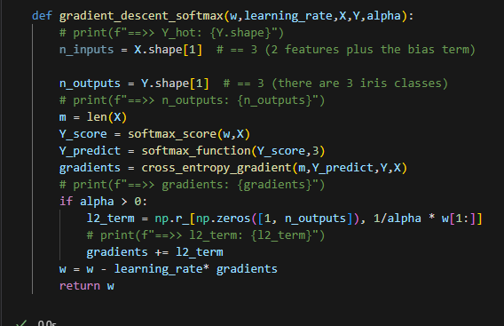
Batch Gradient Descent
An iterative process where the parameters are decreased to find the minima of an error function (the lower the error, the better fit the parameters are!)
  Analogy: Think of a marble rolling down a hill into a hole. The marble’s position is decided by the combination of parameters and the holes are the minima.
  Batch gradient descent calculates the descending gradients based on the entire dataset.
Can be used for BOTH linear regression and logistic regression. For this project, gradient descent is applied to softmax regression
Returns a 3 x 3 matrix of weights to apply onto our validation set and test set

Slide 17
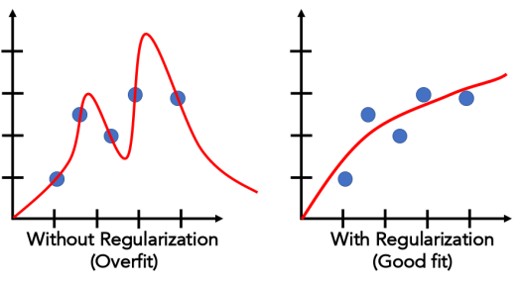


Regularization
- Prevents “overfitting” a dataset by inflating the error value.
-It’s standard to regularize all models to generalize predictions for unseen data.
- In this project, we’re using ridge regularization, which inflates the error values based on the sum of the squared weights and the hyperparameter lambda.
- The effect of this regularization is that it makes the weights (regression slope) approach 0, which yields a smaller, and simpler prediction
The error function is MSE (or Mean Squared Error), a common error metric for logistic regression

Slide 18
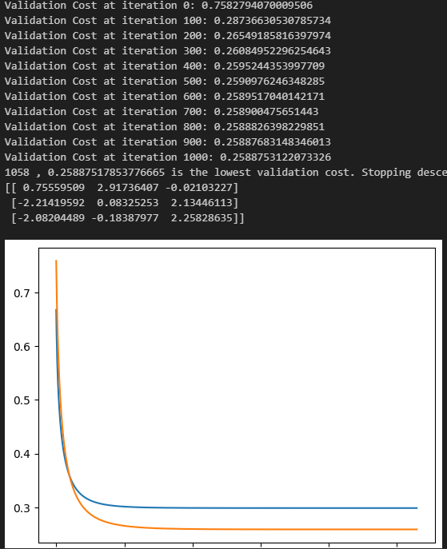
Results w/ Early Stopping
Early Stopping: After each iteration, the same weights used for the training set are used for the validation set. The goal is to stop the gradient descent function when the validation error is at its lowest. If the validation error remained low for a while and then starts rising again, stop the descent function, and you’re left with the best weights.
The orange line is the validation error, while the blue line is the training error.
Normally, the validation error is supposed to be slightly above the training error. In this instance, it’s below the training error. According to pyimagesearch, this event may have occurred due to the validation set being easier than the training set.

Slide 19
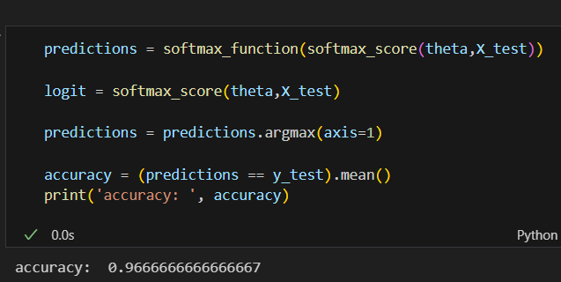
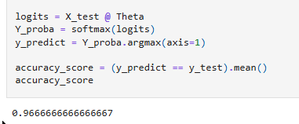
Results w/ Early Stopping (cont.)
Are the weights we found a proper fit for our testing dataset?
Yes! with the intended 96% accuracy for random seed 43. And a 86 -100% range accuracy for various other seeds
(102, 100%) , (200, 86%) , (9001,96%)
The bottom image is from the Jupyter notebook with the solution code. As you see, for random seed 43, the model scored 96% accuracy.

Slide 20
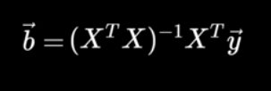
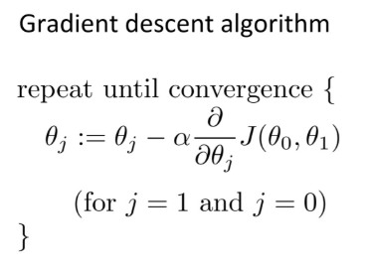
How Normal Equations Work
Closed-Form
Iterative
B (vector) = parameters
X = training set
X^T = transpose of dataset
Takes way less time
Requires more memory to fit entire training set
Uses matrix multiplication
My questions:
How can a simple linear algebra equation find the optimal parameters in less time than an iterative solution?
How is the equation derived?
Takes more time
Requires less memory

Slide 21
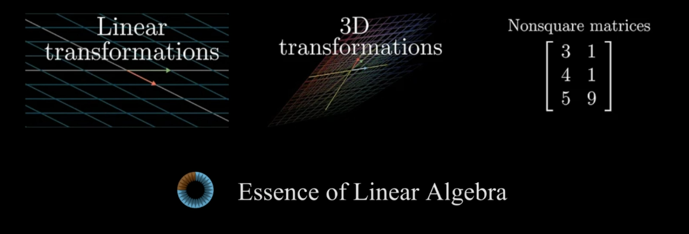
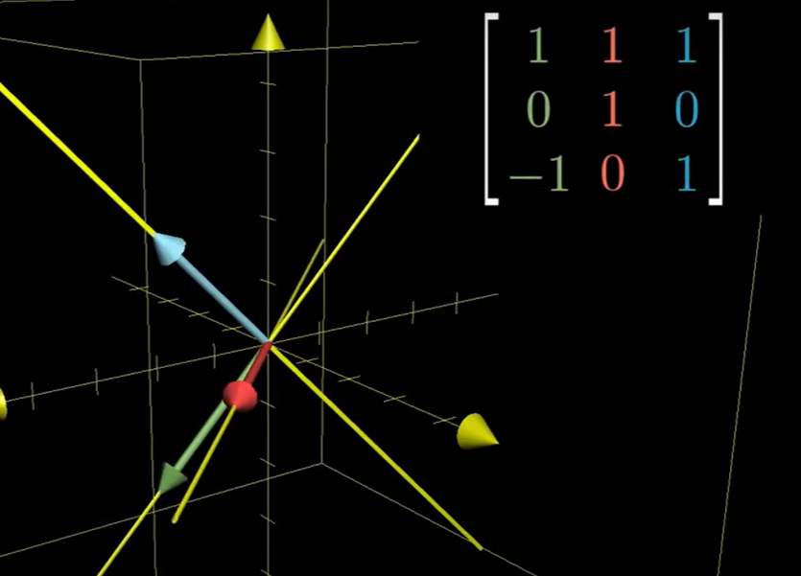
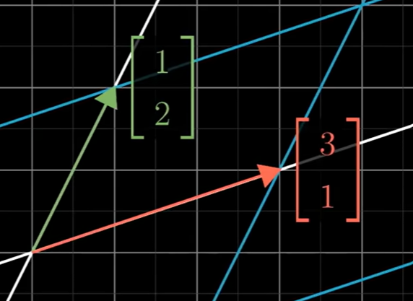
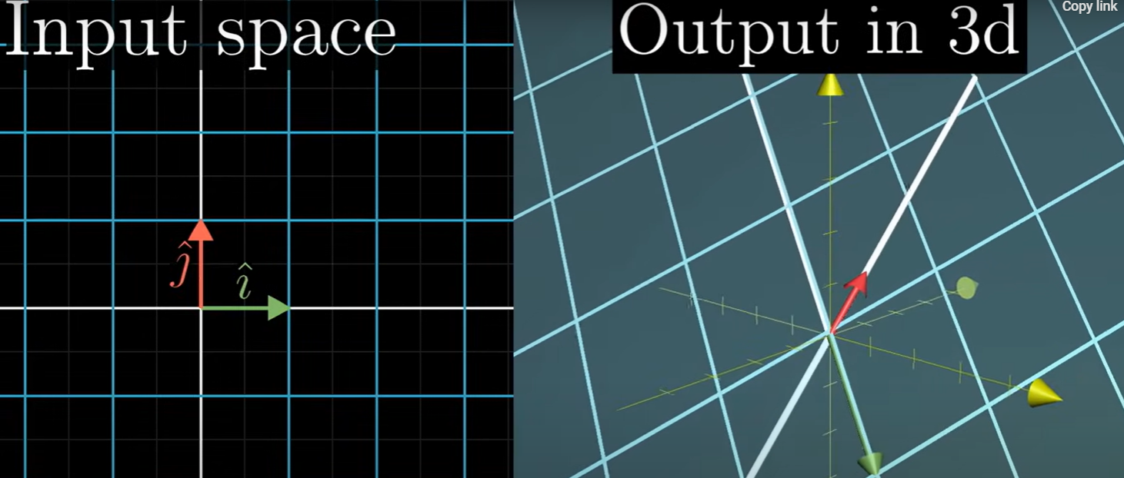
How Normal Equations Work (cont.)
Key point: Don't think about transformation as transforming vectors, but the SPACE these vectors occupy (which is expressed through unit vectors)
Red = i unit vector , Green = j unit vector
A 3D matrix (3x3) can undergo a transformation that will flatten the vectors onto the 2D (3x2) plane.
Think of a 3D vector as a 3x3 matrix with each column corresponding to a vector

Slide 22
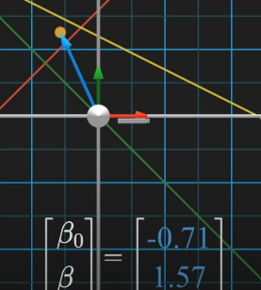
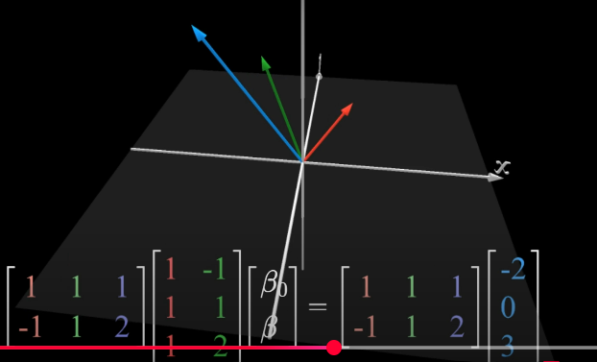
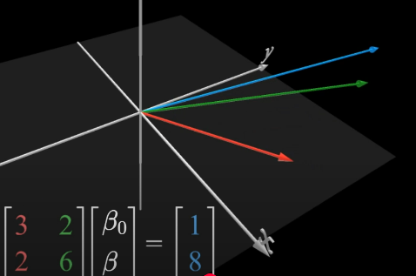
How Normal Equations Work (cont.)
The vectors (2x3) start off in the 3D plane and the following transformations are applied. The vectors are
These transformations smush the 3D vectors into the 2D plane
The inverse of the 2D vectors are applied and the resulting beta vectors point to the solution with the smallest error in our system of equations

Slide 23
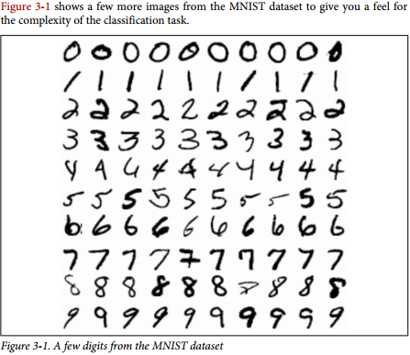
Chapter 3: Classification (INCOMPLETE)
As I go through the textbook, I am learning more about performance measures and why accuracy alone can’t be the sole evaluation for a model. The textbook references the MNIST dataset and builds a classifier for identifying 5s.

Slide 24
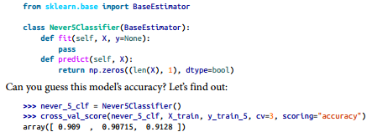
Why Accuracy can be Misleading
If your goal is to create a classifier for a minority group in a dataset, accuracy can be high if you were guessing the majority all the time.
For example, if you’re making an ML model to identify spam emails and only 10% of your inbox is spam, then guessing all of the emails as “NOT SPAM” will yield a 90% accuracy. All while missing the spam emails.
If you’re working with a dataset, it’s highly advisable that you don’t look at the original dataset before preprocessing. So, you won’t know which classes are the majority and minority.
90% accuracy is only possible due to 5s making up
only 10% of the dataset

Slide 25
What’s Next?
Turns out, I have all the skills to finally make a Neural Network (NN) from scratch!
I have learned a lot of linear algebra that I hope to apply onto NN.
I realize I don’t need to learn the other chapters (for now) because all the skills for NN are found in chapter 4.
- I want to apply my Softmax regression algorithm onto another dataset to truly make the practice solution mine.

Slide 26
Citations
3Blue1Brown. (n.d.). https://www.3blue1brown.com/topics/linear-algebra
Ageron. (n.d.). Handson-ML3/04_training_linear_models.ipynb at Main · Ageron/Handson-ML3. GitHub. https://github.com/ageron/handson-ml3/blob/main/04_training_linear_models.ipynb
Jiao, J. (n.d.). YouTube. https://www.youtube.com/watch?v=HY_VtvUKock

