Slide 1
Atlas Executive
Board pack · Atlascorp · data as of 30 Sep 2026

Slide 2
Headline
ID | Indicator | Value | Rating
EX-01 | Portfolio delivery health | 18% | Amber
EX-02 | Direction of travel | — | —
EX-03 | Schedule slippage | 11.5 | Amber
EX-04 | Milestone hit rate | 33% | Red
EX-05 | Cost variance | +3.9% | Green
EX-06 | Spend to date versus plan | 102% | Green
EX-07 | Value at risk | £5.5m | —
EX-08 | Benefits confidence | 76% | Amber
EX-09 | Benefits realised to date | 75% | Amber
EX-10 | Decisions overdue | 2 | Amber
EX-11 | Escalated risks and issues | 5 | —
EX-12 | Data quality score | 99% | Green
3 of 16 active projects are Red, holding 18% of budget. Forecast cost is +3.9% against budget. Overdue decisions: 2.

Slide 3
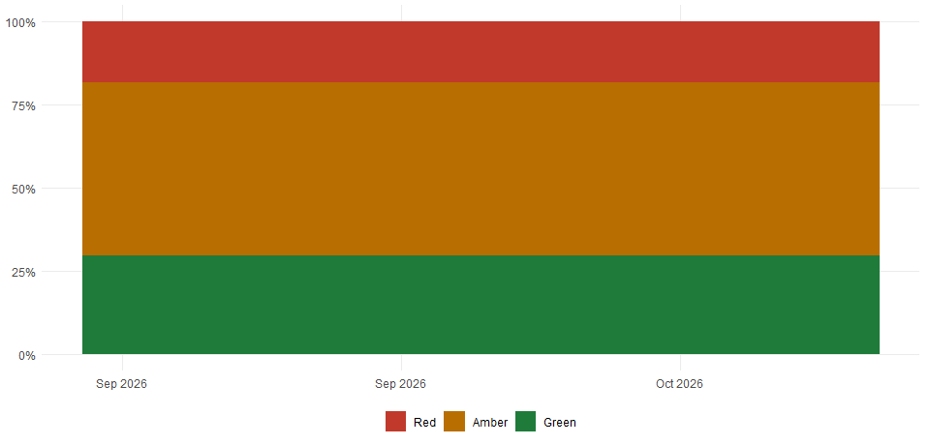
Health and direction of travel
Notes:
Share of active budget by Atlas status, month end.

Slide 4
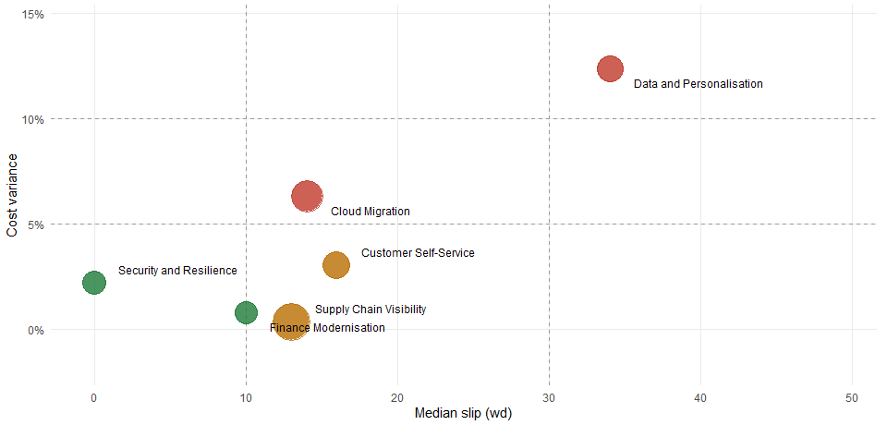
Schedule and cost by programme
Notes:
Median slip against cost variance; circle size is budget. Dashed lines are the Amber and Red limits.

Slide 5
Needs your decision
Type | Item | Where | Owner | When
Decision overdue | Confirm Wave 2 scope after hosting contract renewal | Cloud Migration | Ravi Patel | 29 days overdue
Decision overdue | Approve additional £600k and revised go-live | Marketing Analytics | Elena Rossi | 15 days overdue
High risk | Key warehouse system supplier in financial difficulty | Warehouse Management System | Kiran Shah | exposure £900k
High issue | Analytics vendor unable to staff integration team until December | Marketing Analytics | Elena Rossi | exposure £650k
High risk | Supplier data-sharing agreement not yet signed | Supplier Portal | Laura Nunes | exposure £300k
High risk | Two critical applications failed migration rehearsal | Data Centre Exit Wave 1 | Nina Petrova | exposure £250k

Slide 6
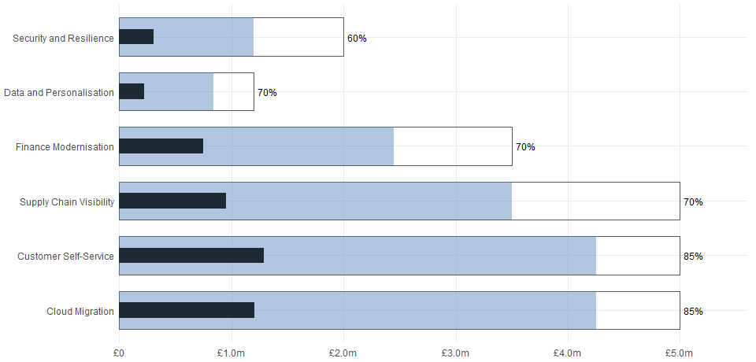
Benefits by programme
Notes:
Cash benefits. Outline: planned. Fill: forecast. Dark bar: realised to date.

Slide 7
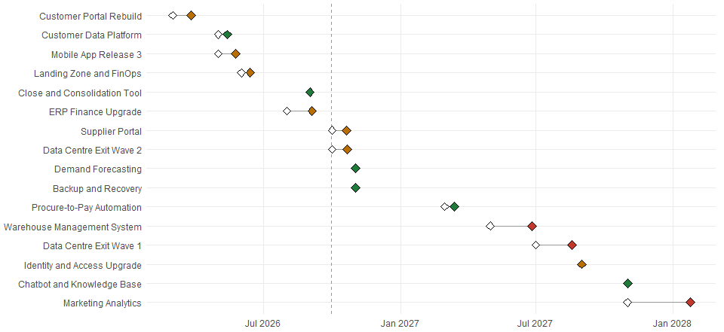
Executive milestones
Notes:
Hollow: baseline. Filled: forecast or actual. Quarter hit rate: 33%.

Slide 8
Projects needing attention
Project | Status | Reported | Budget | Cost variance | Slip (wd)
Marketing Analytics | Red | Red | £3.2m | +15.5% | 60
Warehouse Management System | Red | Red | £450k | +9.8% | 40
Data Centre Exit Wave 1 | Red | Green | £1.6m | +5.0% | 35
Notes:
Marketing Analytics: Analytics vendor cannot staff until December. Go-live moves by about three months unless additional funding is approved.
Warehouse Management System: Supplier financial difficulty threatens the WMS contract. Fallback options are being costed for the October board.
Data Centre Exit Wave 1: Two critical applications failed the migration rehearsal; a second rehearsal is booked for November.

Slide 9
Data quality findings
Entity | Field or check | Requirement | Affected | Out of
Delivery objects | sponsor_name | Recommended | 3 | 27
Active projects | planned_cost_to_date | Recommended | 2 | 16
Active projects | source_rag | Recommended | 1 | 16
Active projects | executive_summary | Recommended | 1 | 16

