Slide 1

POST MORTEM
513 STUDIOS
D.R.E.A.D.

Slide 2
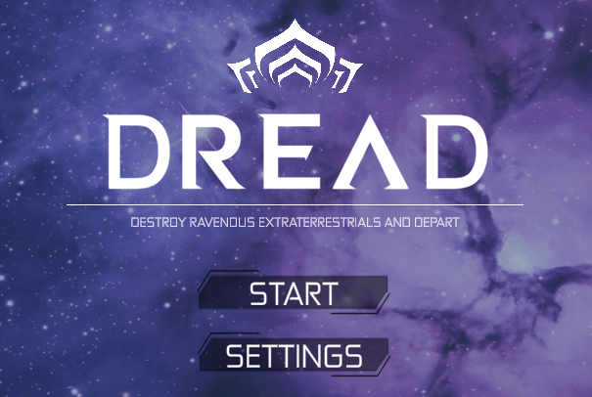
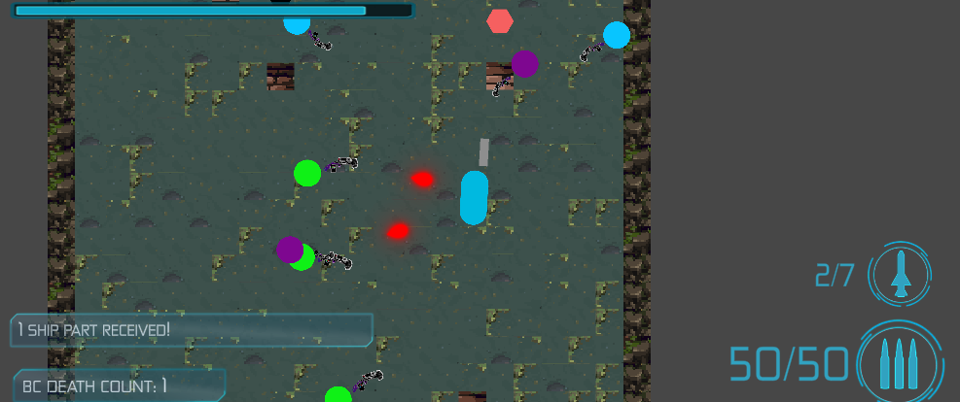
Snapshot: 4pm 12/5/22

Slide 3
Project Breakdown
Level Generation
Items
Player & enemies - Taylor
Level generation & sound - Dan
Weapons & items & screens - Jordan
Enemies
Player
Weapons

Slide 4
Hindsight is 20/20
Breakdown seemed logical for 3 people
Changing level generation plan
Planning design patterns first
Scope!
Initial plan was for a much larger project

Slide 5
Course Improvements
Current Course Timeline
Pong 1 week
Platformer 3 weeks
MVP 1 week
Proposed Course Timeline
Pong 1 week
Platformer 2 weeks
1 easy bounds test?
Game planning 1 week
talk about design patterns here
MVP 1 week
Notes:
We felt rushed between platformer and MVP. So we suggest a different timeline in the course to help students do better. We did better on the platformer because we split it up based on how we were splitting up the big game. It might be a good idea to suggest the same.

