Slide 1

Songly (Socialized Music Social Media Platform)
Team - Okan ÇİFTÇİ
Supervisor - Fatih SOYGAZİ
University - Aydın Adnan Menderes Üniversitesi

Slide 2
Project Goal
To develop Music, Music News and User discovery platform

Slide 3
Why we are here
We are here to create more personalized platform
We are here to create increase communication between listeners

Slide 4
Content
Access Dbpedia to find artists and bands and related artists and bands.
Give rating to posts and take post recommendations.
Use Songly with Spotify to take music recommendations.
Find currently listening song lyrics and look listening activity on platform.
Find users according to their listening activity and access their information.

Slide 5
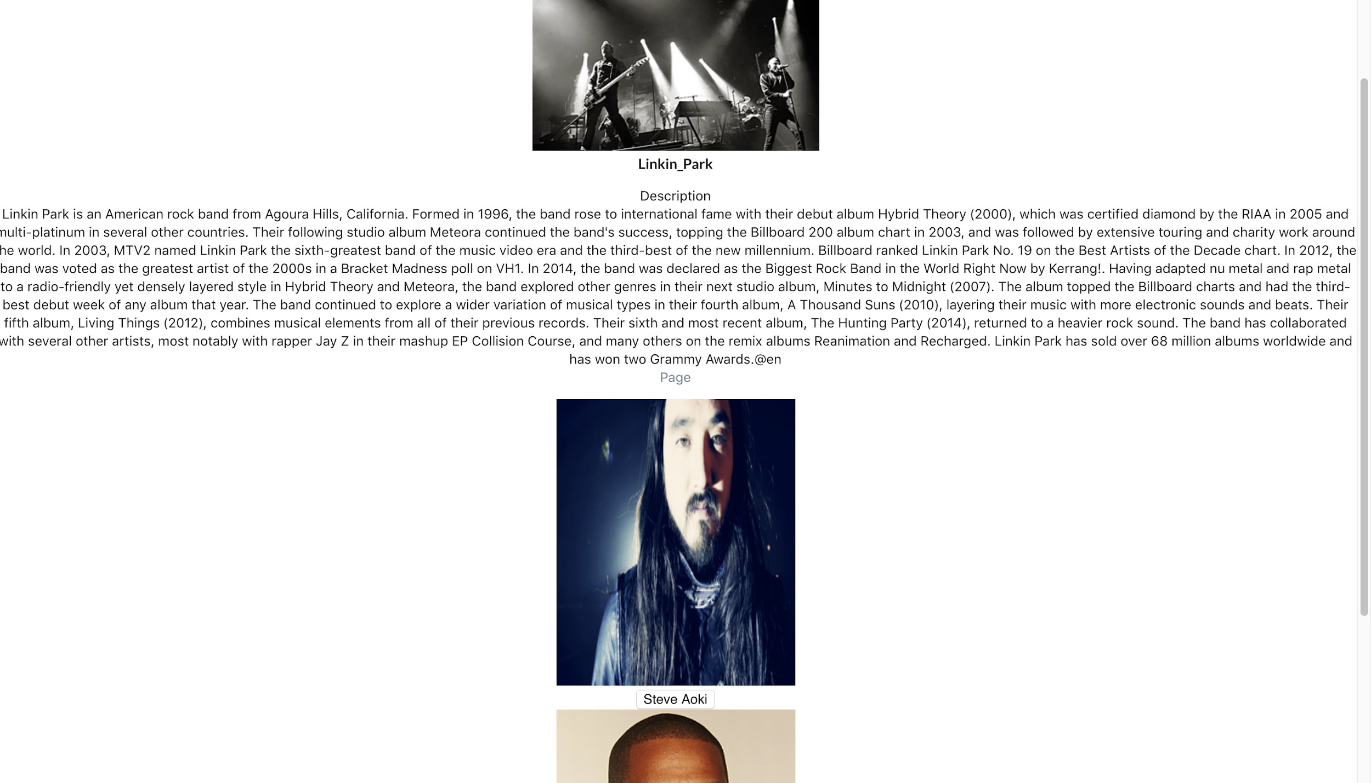
Songly Access Dbpedia

Slide 6
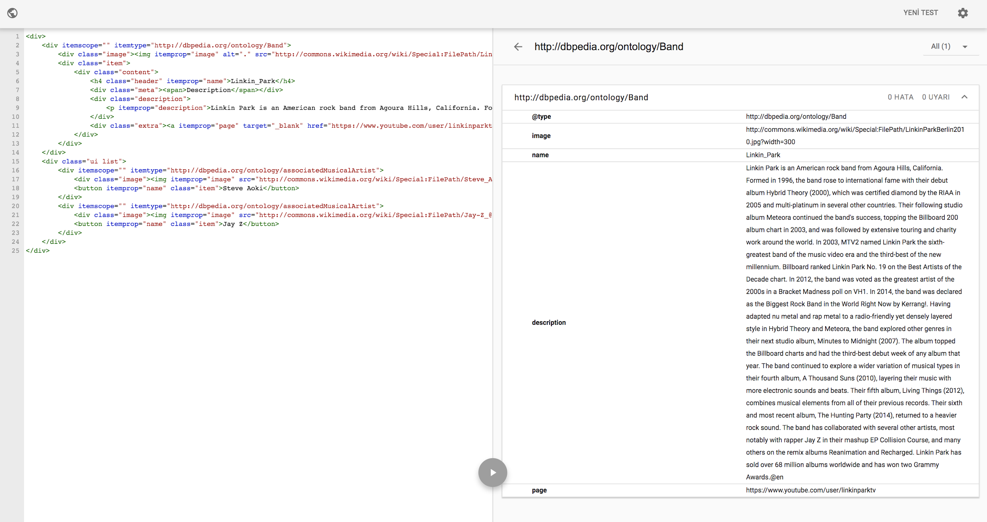
Semantic Annotations - 1

Slide 7
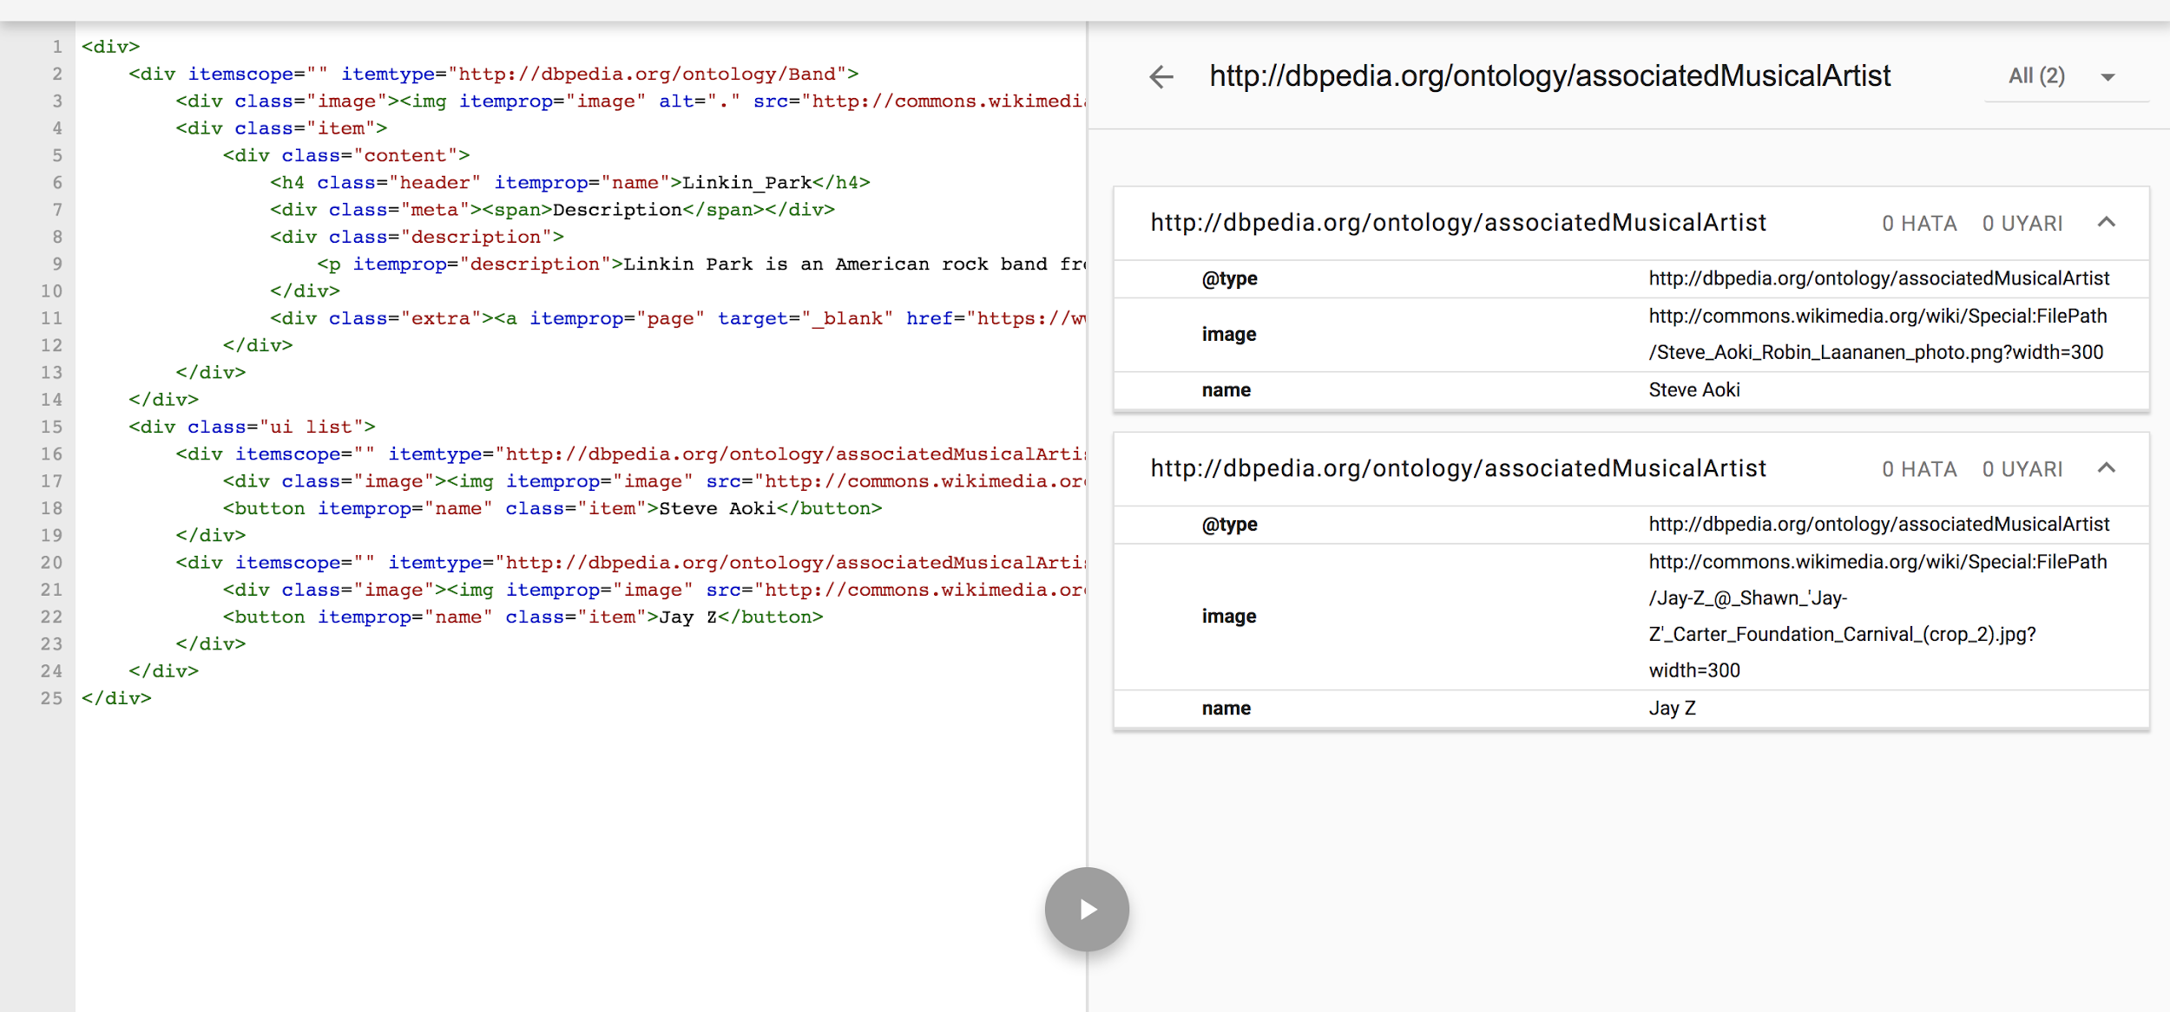
Semantic Annotations - 2

Slide 8
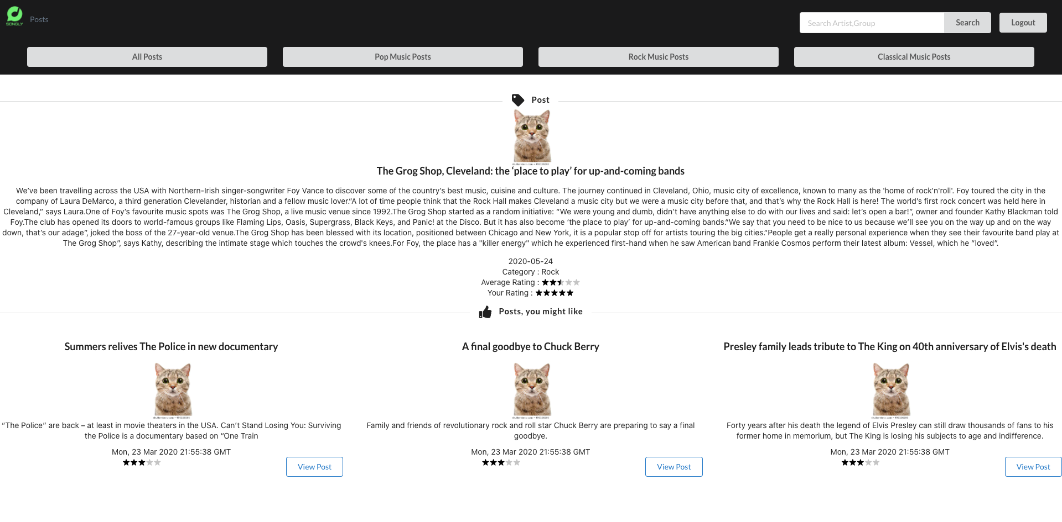
Post Recommendation - 1

Slide 9
Post Recommendation - 2
Posts scraped from web using beautifulsoup
50000 Ratings generated for 214 posts according to 300 users (heuristic : genre)
Autoencoder architecture for recommendation
Mean Square Error for loss function (1.267)

Slide 10
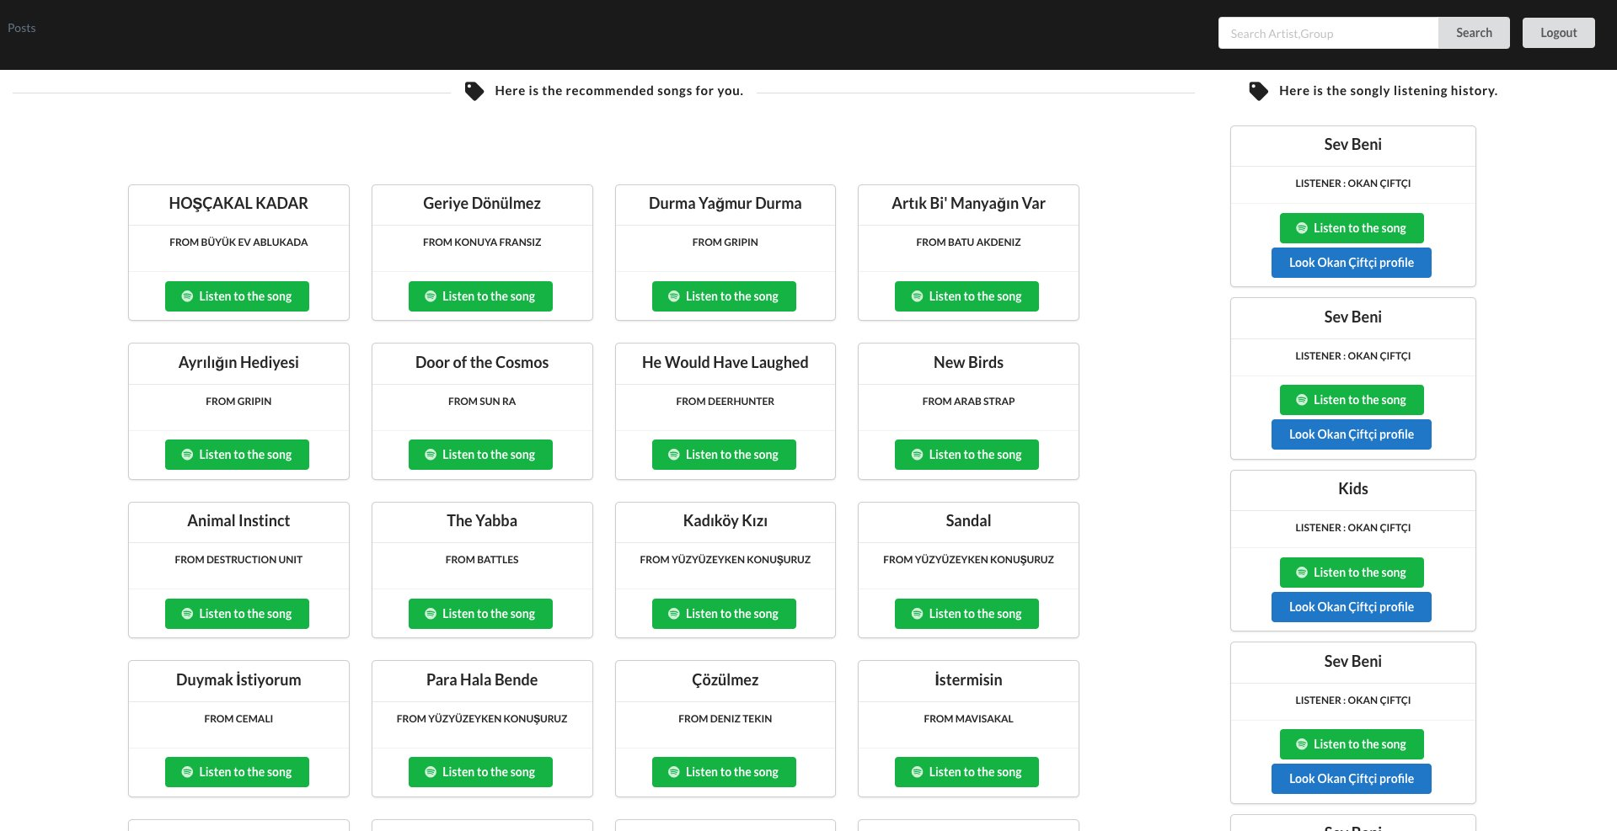
Spotify Song Recommendation - 1

Slide 11
Spotify Song Recommendation - 2
Find related songs for every user according to their listening history and create playlist on spotify.
Find platform listening activity and check other users profile.
Find currently listening song lyrics.
k-means, word2Vec, cosine similarity used for recommendations
160.000 Songs
3038 Genres
26.037 Artists/Bands

Slide 12

Technologies / Tools

Slide 13
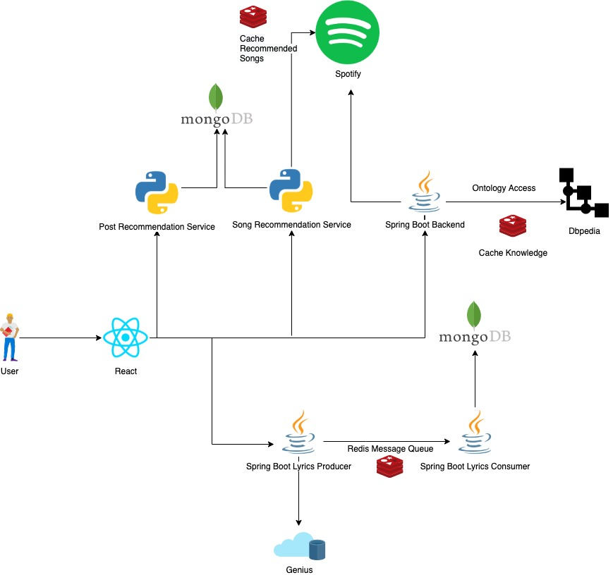
Architecture

Slide 14
References
https://jena.apache.org/
https://www.archunit.org/
http://eecs.qmul.ac.uk/research/eecs-research-impact/semantic-web-for-music/
https://plantuml.com/
https://towardsdatascience.com/applied-deep-learning-part-3-autoencoders-1c083af4d798
mongodb.com
https://trello.com/
https://tr.reactjs.org/
https://towardsdatascience.com/introduction-to-recommender-systems-6c66cf15ada
https://oauth.net/2/
https://www.baeldung.com/
https://wiki.dbpedia.org/
https://redis.io/
https://spring.io/
https://tr.reactjs.org/
https://open.hpi.de/courses/semanticweb
https://www.palermo.edu/ingenieria/Pdf2010/CyT9/15.pdf
https://www.mongodb.com/
https://junit.org/junit5/
https://developer.spotify.com/

