Slide 1

POWER ON
MODO
LOCAL
REMOTO
COMPARTIMENTO
SUPERIOR
INFERIOR
DESINFECTAR
ON
OFF

Slide 2
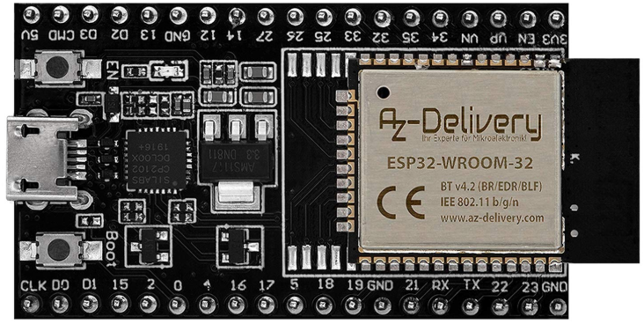
POWER ON
MODO
LOCAL
REMOTO
COMPARTIMENTO
SUPERIOR
INFERIOR
DESINFECTAR
ON
OFF

Slide 3
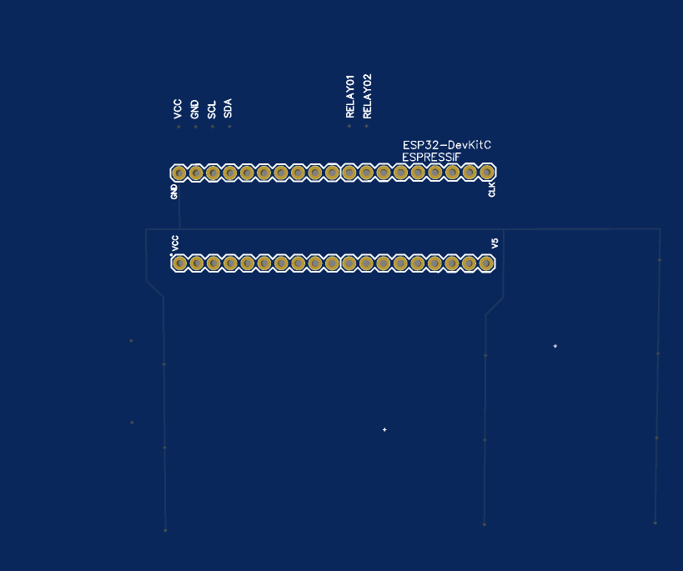
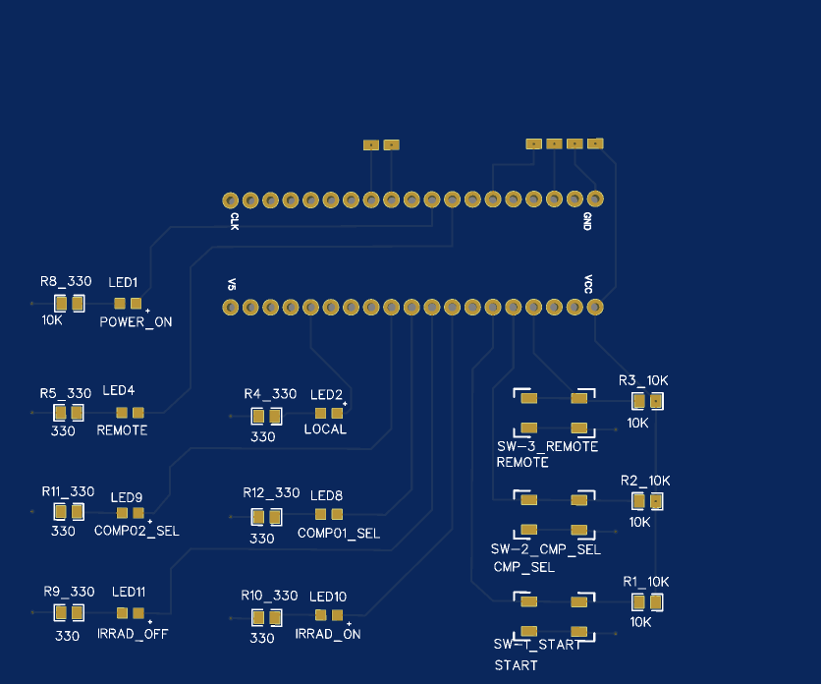
DELANTERO
TRASERO

Slide 4
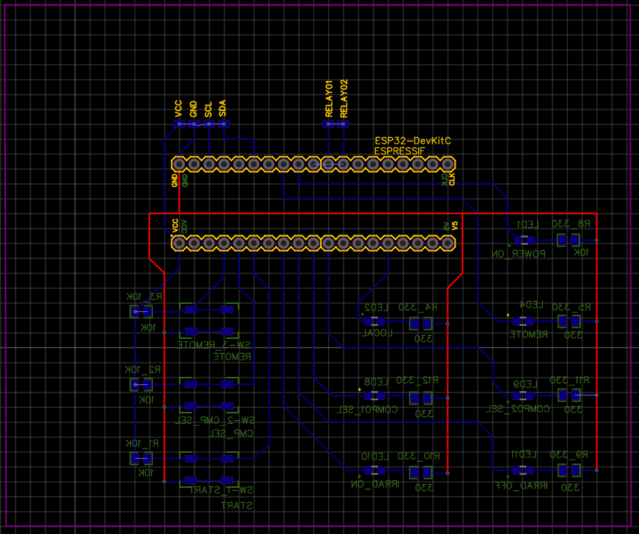
DELANTERO
TRASERO

Slide 5
DELANTERO
TRASERO

