Slide 1
Refactoring to Eclipse Collections
Making Your Java Streams Leaner, Meaner, and Cleaner

Slide 2
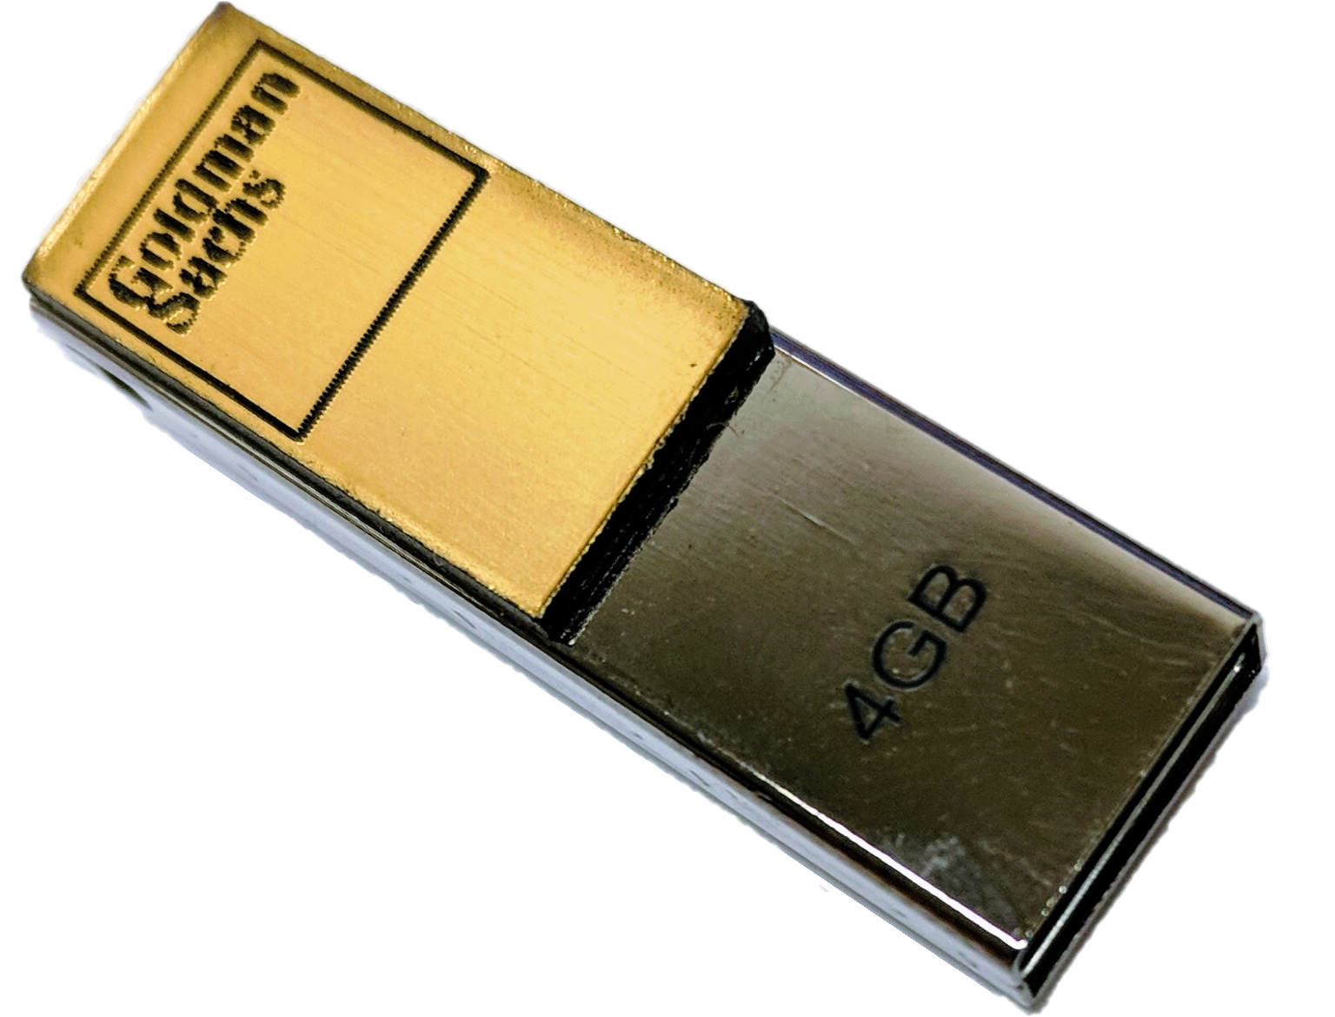
Introduction
What is Eclipse Collections?
Feature rich, memory efficient Java Collections framework
History
Eclipse Collections started off as an internal collections framework named Caramel at Goldman Sachs in 2004
In 2012, it was open sourced to GitHub as a project called GS Collections
GS Collections was migrated to the Eclipse Foundation, re-branded as Eclipse Collections in 2015
Learn Eclipse Collections with Kata
Eclipse Collections is open for contributions!

Slide 3
Why Refactor to EC?
Lazy or Eager
TestUtils
No “Bun” methods
Testability/Debuggability
Drop-in replacement for JDK types
Concise Code
Benefits
It’s Easy!
Intuitive humane APIs
Rich[er] APIs
Memory Savings
Better Performance ^{[citation needed ]}
Comprehensive Support for Primitive Types
Efficient Maps and Sets

Slide 4
Any Types You Need
Boolean
Byte
Char
Double
Float
Int
Long
Object
Short
Bag
BiMap
Interval
List
Map
Set
Stack
Immutable
Mutable
Sorted
Multimap
MutableIntList
LongStack
SortedBagMultimap
ImmutableObjectLongMap
MutableSortedSetMultimap
*.asLazy()
*.asParallel()

Slide 5

Instantiate Them Using Factories
Primitive Type | Container Type | Mutability | Multimap | Initialized | Lazy
Boolean Byte Char Double Float Int Long Object Short | Bags BiMaps Lists Maps Multimaps Sets SortedBags SortedMaps SortedSets Stacks | .mutable .immutable .fixedSize | .bag .list .set .sortedSet | .empty()|.of()|.with() .of(one)|.with(one) ... .of(one,…,ten) .with(one,…,ten) .of(... elements) .with(... elements) .ofAll(Iterable) .withAll(Iterable) | .asLazy()
ImmutableLongStack
LongStacks.immutable.with(1, 2, 3).asLazy()
LazyLongIterable

Slide 6
Methods by Category - Highlights
transform
convert
filter
collect[With]
collect[Boolean,Byte,Char,Double,Float,Int,Long,Short]
collectIf
collectKeysAndValues
collectValues
collectWithIndex
collectWithOccurrences
flatCollect
toArray
toBag
toImmutable
toList
toMap
toReversed
toSet
toSortedBag[By]
toSortedList[By]
toSortedMap
toSortedSet
toSortedSet[By]
toStack
toString
select[With]
selectByOccurrences
selectInstancesOf
reject[With]
partition[With]
partitionWhile
group
groupBy
groupByEach
groupByUniqueKey
sumBy[Double,Float,Int,Long]
sumOf[Double,Float,Int,Long]
aggregateBy
aggregateInPlaceBy
wrap
test
find
asLazy
asParallel
asReversed
asSynchronized
asUnmodifiable
allSatisfy[With]
anySatisfy[With]
noneSatisfy[With]
notEmpty
isEmpty
detect[With]
detect[With]IfNone
detect[With]Optional
max[By]
min[By]

Slide 7
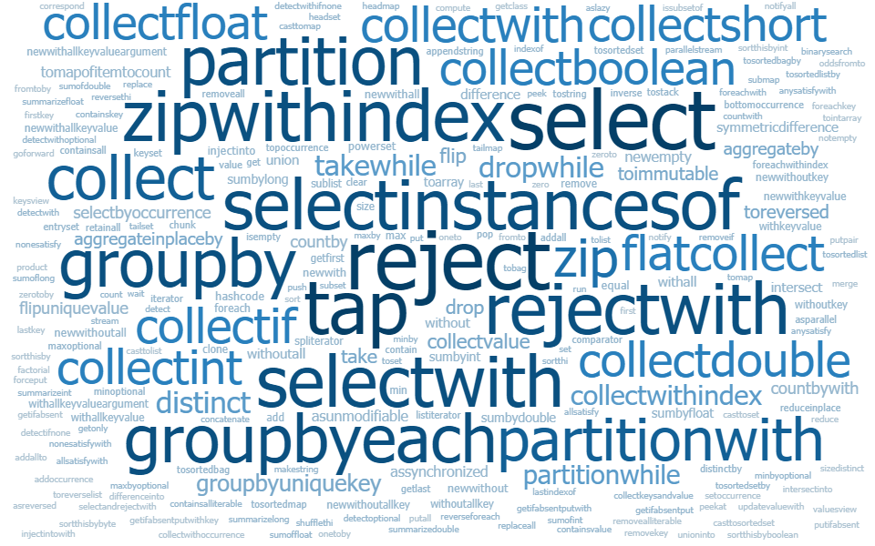
Methods – Lots More…

Slide 8
Let’s Do It!

Slide 9
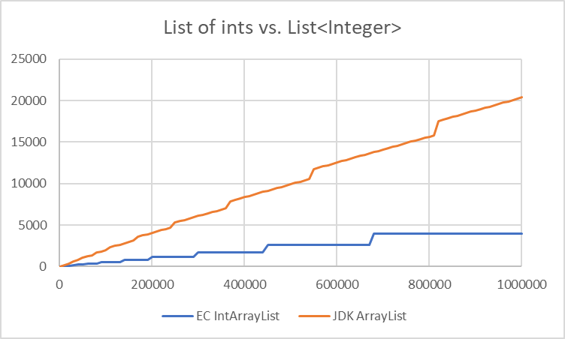
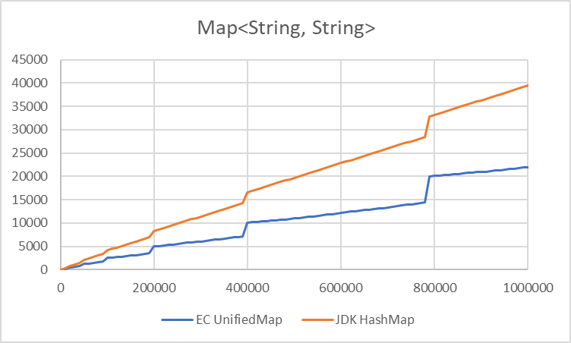
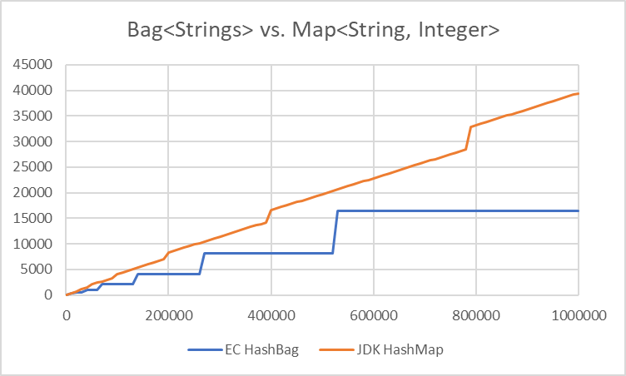
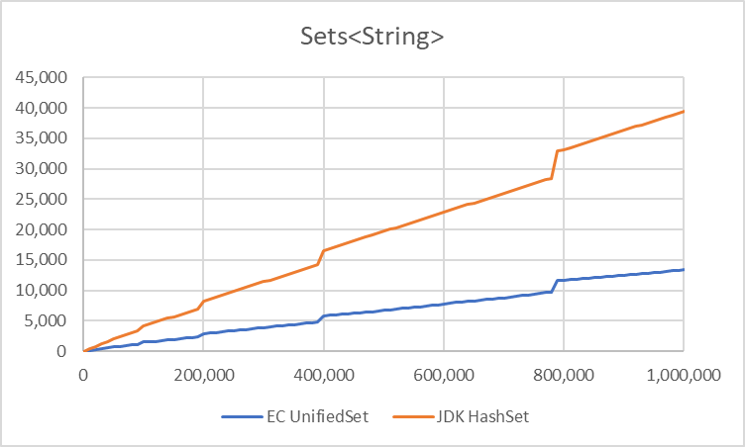
Memory Usage (Overhead in KB, Count)

Slide 10
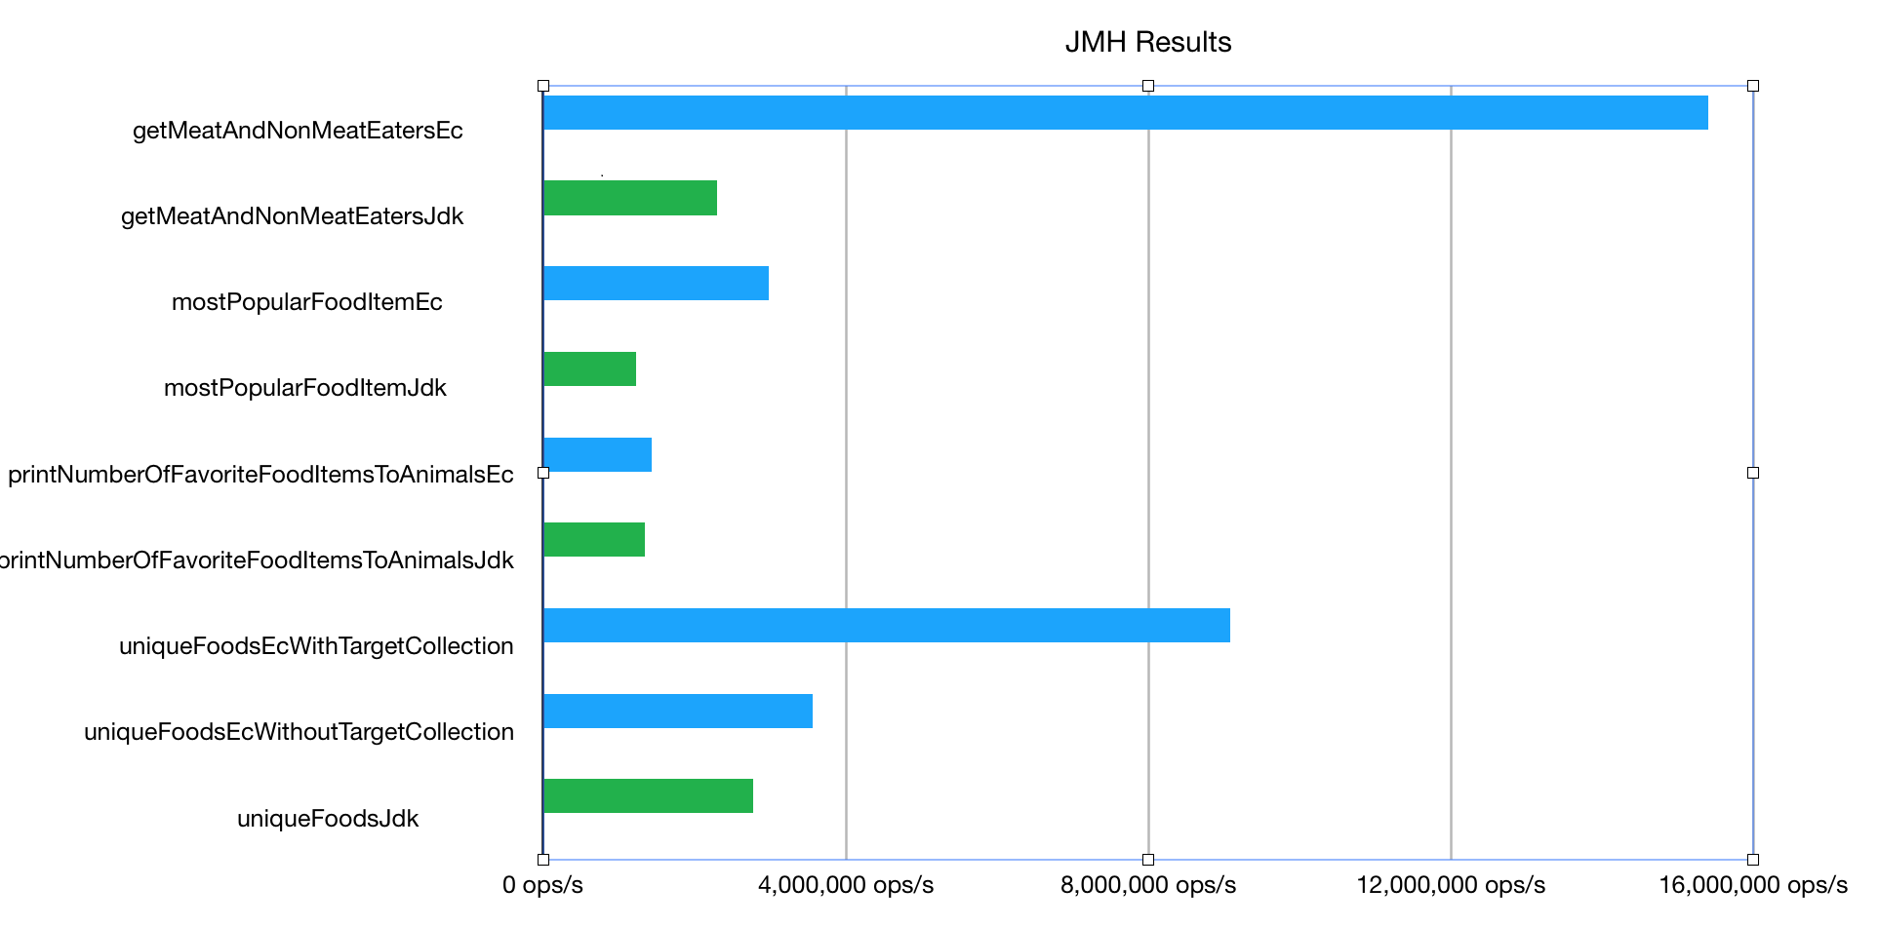
JMH Benchmark Results

