Slide 1
Refactoring to Eclipse Collections
Making Your Java Streams Leaner, Meaner, and Cleaner

Slide 2
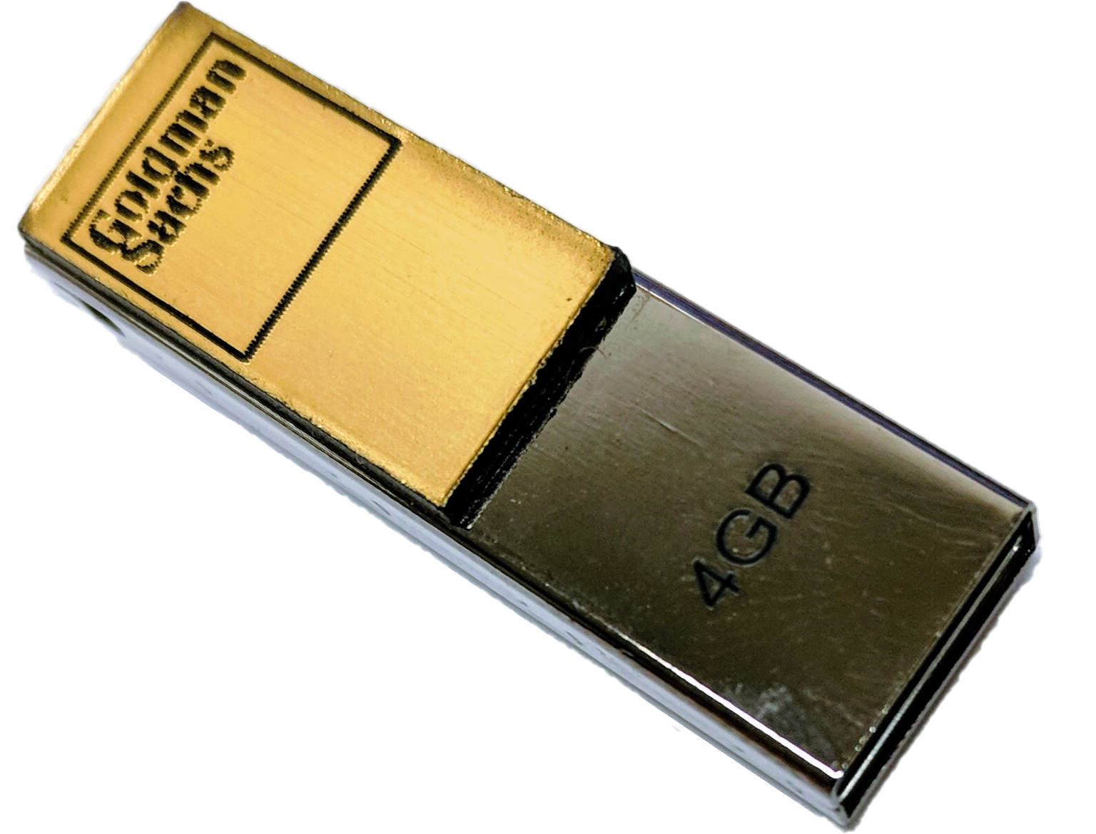
Introduction
What is Eclipse Collections?
Feature rich, memory efficient Java Collections framework
History
Eclipse Collections started off as an internal collections framework named Caramel at Goldman Sachs in 2004
In 2012, it was open sourced to GitHub as a project called GS Collections
GS Collections was migrated to the Eclipse Foundation, re-branded as Eclipse Collections in 2015
Eclipse Collections open for contributions!

Slide 3
Build Any Types You Need
Boolean
Byte
Char
Double
Float
Int
Long
Object
Short
Bag
BiMap
Interval
List
Map
Set
Stack
Immutable
Mutable
Sorted
Multimap
MutableIntList
LongStack
SortedBagMultimap
ImmutableObjectLongMap
MutableSortedSetMultimap
*.asLazy()
*.asParallel()

Slide 4
Methods [some of] by Category
wrap
convert
transform
filter
asLazy
asParallel
asReversed
asSynchronized
asUnmodifiable
toArray
toBag
toImmutable
toIntArray
toList
toMap
toMapOfItemToCount
toReverseArray
toReverseList
toReversed
toSet
toSortedBag[By]
toSortedList[By]
toSortedMap
toSortedSet
toSortedSet[By]
toStack
toString
toStringOfItemToCount
collect
collectBoolean
collectByte
collectChar
collectDouble
collectFloat
collectIf
collectInt
collectKeysAndValues
collectLong
collectShort
collectValues
collectWith
collectWithIndex
collectWithOccurrences
flatCollect
select[With]
selectByOccurrences
selectInstancesOf
reject[With]
partition[With]
partitionWhile
group
groupBy
groupByEach
groupByUniqueKey
sumByDouble
sumByFloat
sumByInt
sumByLong
aggregateBy
aggregateInPlaceBy
test
allSatisfy[With]
anySatisfy[With]
noneSatisfy[With]
notEmpty
isEmpty

Slide 5
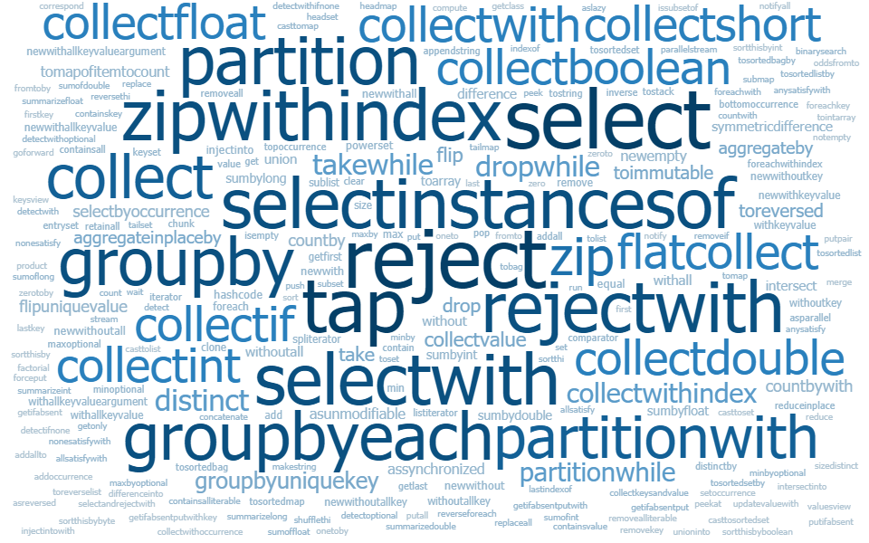
Methods – lots more…
Word sizes are
proportional
to the number of
implementations of the method

Slide 6
Why Refactor to EC?
Lazy or Eager
TestUtils
No “Bun” methods
Testability/Debuggability
Drop-in replacement for JDK types
Concise Code
Benefits
It’s Easy!
Intuitive humane APIs
Rich[er] APIs
Memory Savings
Better Performance ^{[citation needed ]}
Comprehensive Support for Primitive Types
Primitive Types
Efficient Maps and Sets

Slide 7
Let’s Do It!

Slide 8
JMH Benchmark Results

Slide 9
Memory Usage Comparison

