Slide 1
Refactoring to Eclipse Collections
Making Your Java Streams Leaner, Meaner, and Cleaner

Slide 2
Introduction

Slide 3
History

Slide 4
Build Any Types You Need from Blocks
Boolean
Byte
Char
Double
Float
Int
Long
Object
Short
Bag
BiMap
Interval
List
Map
Set
Stack
Immutable
Mutable
Sorted
Multimap
Start
*.asLazy()
*.asParallel()

Slide 5
Methods [some of] by Category
wrap
convert
transform
filter
asLazy
asParallel
asReversed
asSynchronized
asUnmodifiable
toArray
toBag
toImmutable
toIntArray
toList
toMap
toMapOfItemToCount
toReverseArray
toReverseList
toReversed
toSet
toSortedBag[By]
toSortedList[By]
toSortedMap
toSortedSet
toSortedSet[By]
toStack
toString
toStringOfItemToCount
collect
collectBoolean
collectByte
collectChar
collectDouble
collectFloat
collectIf
collectInt
collectKeysAndValues
collectLong
collectShort
collectValues
collectWith
collectWithIndex
collectWithOccurrences
flatCollect
select[With]
selectByOccurrences
selectInstancesOf
reject[With]
partition[With]
partitionWhile
group
groupBy
groupByEach
groupByUniqueKey
sumByDouble
sumByFloat
sumByInt
sumByLong
aggregateBy
aggregateInPlaceBy
test
allSatisfy[With]
anySatisfy[With]
noneSatisfy[With]
notEmpty
isEmpty

Slide 6
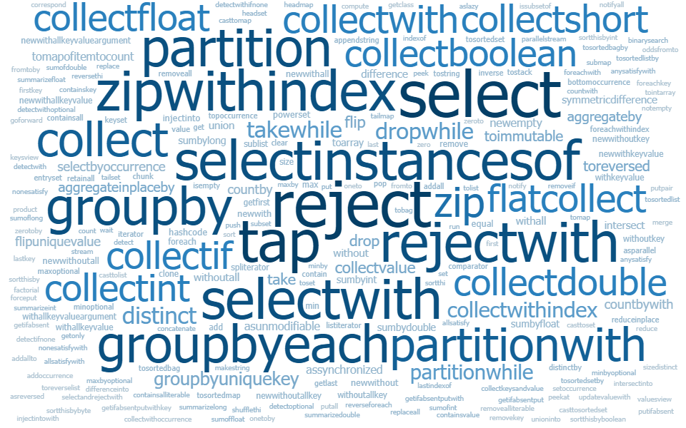
Methods – lots more…
Word sizes are
proportional
to the number of
implementations of the method

Slide 7
Why Refactor to EC?
No “Bun” methods
Testability/Debuggability
Concise Code
Refactoring
Rich[er] APIs
Memory Savings
Better Performance ^{[citation needed]}
Comprehensive Support for Primitive Types

Slide 8
Let’s Do It!

Slide 9
Appendix

Slide 10
Example: Find Corners

