Slide 1
SPAN 301 – SecCiÓn 2
Terminos españoles de ingeneria de computacion.
Notes:
Hello class welcome to your first quiz section for 333...

Slide 2
Nuestros Objetivos
Traer galletas para los estudiantes
Enseñar los estudiantes español
Confundir los estudiantes profundante y hacerles pensar que estamos en una clase de español
Y realmente ninguno de estos objetivos se van a lograr ☹
Notes:
ADDITIONAL: Just a reminder there is an exercise due tomorrow and HW0 is due Tuesday.
OVERVIEW:
- C workflow review
-

Slide 3
CSE 333 – SECTION 2
Pointers, Arrays, and Memory Management

Slide 4
Questions, Comments, Concerns
Do you have any?
Exercises going ok?
Lectures make sense?
Looked at the homework?

Slide 5
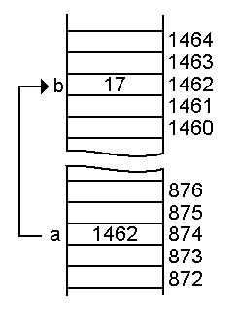
Pointers - Review
A data type that stores an address
Used to indirectly refer to values
Can add/subtract to the address
It’s just another number
Address
Value
Address
a
p

Slide 6
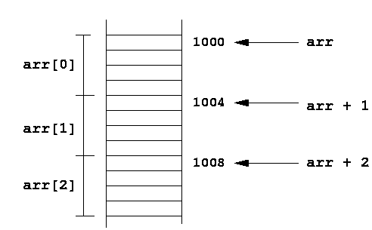
Arrays and pointers
a[0] <==> *a
a[3] <==> *(a + 3)
How about a, a+3,
*a+3 or *a++?

Slide 7
Example
[basic_pointer.c]
#include <stdio.h>
void f(int *j) {
(*j)++;
}
int main() {
int i = 20;
int *p = &i;
f(p);
printf("i = %d\n", i);
return 0;
}

Slide 8

Pointers to pointers
char *c = “hello”;
char **cp = &c;
char ***cpp = &cp;
Why could this be useful?

Slide 9
Function pointers
We can have pointers to functions as well
Syntax is a little awkward
Example: int (*ptr_to_int_fn)(int, int)
Makes sense if you think about it hard
We will be using these in the homework assignments!
Demo: [function_pointer.c]

Slide 10
Using the Heap
Why is this necessary?
Lifetime on the stack
Lifetime on the heap

Slide 11
Memory Management
C gives you the power to manage your own memory
C does very little for you
Benefits? Disadvantages?
When would you want this vs. automatic memory management?

Slide 12
Memory Management Done Right
Need to let the system know when we are done with a chunk of memory
In general, every malloc() must (eventually) be matched by a free()
Example:
[arraycopy.c]

Slide 13
Memory Management Details
When are we done with a piece of data?
Depends on where we got it from, how we are using it, etc.
Some functions expect allocated space, others allocate for you
sprintf() vs asprintf()
Some APIs expect you to free structures, others free for you
Compare / contrast?

Slide 14
Memory Management Gone Horribly Wrong
Many (many!) ways to mess up
Dangling pointers
Double frees
Incorrect frees
Never frees
That’s just a few
Small example: [badlylinkedlist.c]

Slide 15
Valgrind Is Your Friend
Use of uninitialized memory
Use of memory you shouldn’t be using
Memory leaks
Definitely Lost
Indirectly Lost
Possibly Lost
Still Reachable*
Simply run: valgrind <program>
Small example: [imsobuggy.c]
*This is generally ok

Slide 16
Exercise 1
Assume that a character takes 1 byte. Output of following program?
#include <stdio.h>
int main() {
char str1[20] = "GeeksQuiz";
char *str2 = "GeeksQuiz";
char str3[] = "GeeksQuiz";
char str4[] = {'G', 'e', 'e', 'k', 's', 'Q', 'u', 'i', 'z'};
printf("%zu\n", sizeof(str1));
printf("%zu\n", sizeof(str2));
printf("%zu\n", sizeof(str3));
printf("%zu\n", sizeof(str4));
return 0;
}
Notes:
Answer:
20
4 or 8 depending on whether you’re on a 32 or 64 bit machine
10
9

Slide 17
Exercise 2 – What happens here?
#include <stdio.h>
#include <stdlib.h>
int *a;
void add1(int * arr); // Adds 1 to each element of array a
int main() {
int *a = malloc(4 * sizeof(int));
for (int i = 0; i < 4; i++) {
a[i] = i;
printf("a[%d] = %d\n", i, i);
}
add1(a);
free(a);
return 0;
}
void add1(int *arr) {
for (int i = 0; i < 4; i++) {
a[i] = a[i + 1];
printf("a[%d] = %d\n", i, i);
}
free(arr);
}
Notes:
This code WILL compile. However it causes a segmentation fault and valgrind produces some helpful errors. Have the class help you get rid of those valgrind errors, then run it again (Hopefully it’ll seg fault again) and rerun valgrind and have the class help you fix the messages it complains about again. Point is, this is mostly a debugging exercise using valgrind although many of the kids will be able to notice errors within a minute if you give them time.

Slide 18
Homework Tips
Start Them Early
Spend 1 week implementing, the following debugging
Seg Faults? You have friends to help
Valgrind, GDB, Discussion Board, TA Office Hours
What are we looking for?
Correct, well documented code that passes our unit tests (hint: test_suite), has no memory leaks (hint: valgrind), and is stylistically pleasing (hint: clint)
Watch out for
Segmentation Faults, Valgrind Errors/Leaks, Compiler Errors/Warnings
Dangling pointers, double frees, null pointers
Violation of the DRY principle (Don’t repeat yourself, refactor!)

